Slide 1
CHAPTER 2 DIVIDE-AND-CONQUER ALGORITHMS
2.1 Multiplication
2.2 Recurrence relations
2.3 Mergesort
2.4 Medians
2.5 Matrix multiplication
2.6 The fast Fourier transform

Slide 2
CHAPTER 2 DIVIDE-AND-CONQUER ALGORITHMS
Divide-and-conquer strategy:
  Break a problem into subproblems;
  Recursively solve subproblems;
  Appropriately combine their answers.

Slide 3
2.1 MULTIPLICATION
The product of two complex numbers:
  Basically, need four real-number multiplications
  (a+bi)(c+di)=ac-bd+(bc+ad)i
  Improvement: three real-number multiplications
  bc+ad=(a+b)(c+d)-ac-bd
Reduce the number of multiplications from four to three
  Significant when applied recursively.

Slide 4
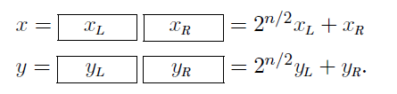
2.1 MULTIPLICATION
Suppose x and y are n-bit integers and n is a power of 2:
Recurrence relation:

Slide 5
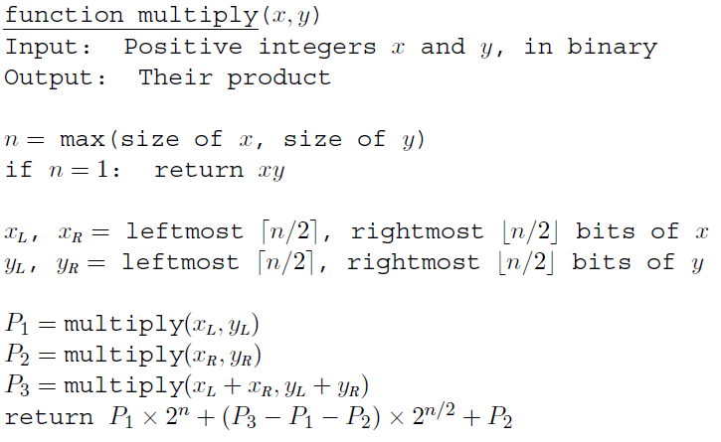
2.1 MULTIPLICATION
Gauss’trick:

Slide 6
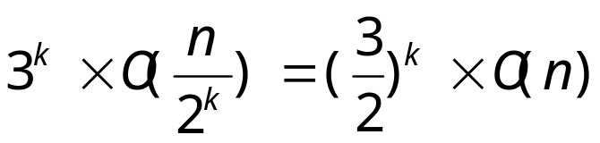

2.1 MULTIPLICATION
Constant factor improvement, from 4 to 3, occurs at every level of recursion:
The total time spent at depth 0≤k≤logn in the tree is:

Slide 7
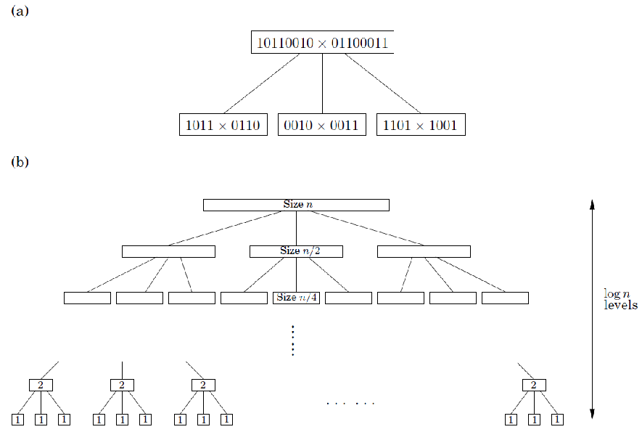
2.1 MULTIPLICATION
Logn+1

Slide 8

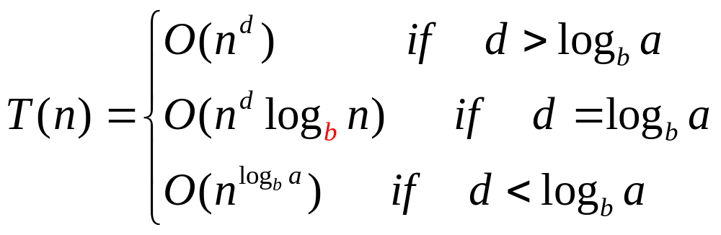
2.2 RECURRENCE RELATIONS
Divide-and-conquer algorithms tackle a problem of size n by recursively solving a subproblems of size n/b and then combine these answers in O(n^{d}) time.
Master theorem If for some constants a>0, b>1, and d≥0, then

Slide 9
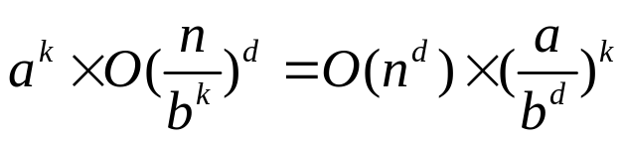
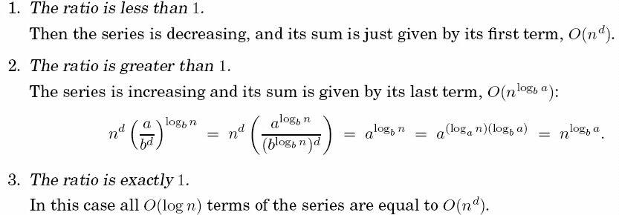
2.2 RECURRENCE RELATIONS
Proof.
  Assume n is a power of b
  The total work done at the kth level
  As k goes from 0 to log_{b}n, these numbers form a geometric series with ratio a/b^{d}.
O(log_{b}n)

Slide 10
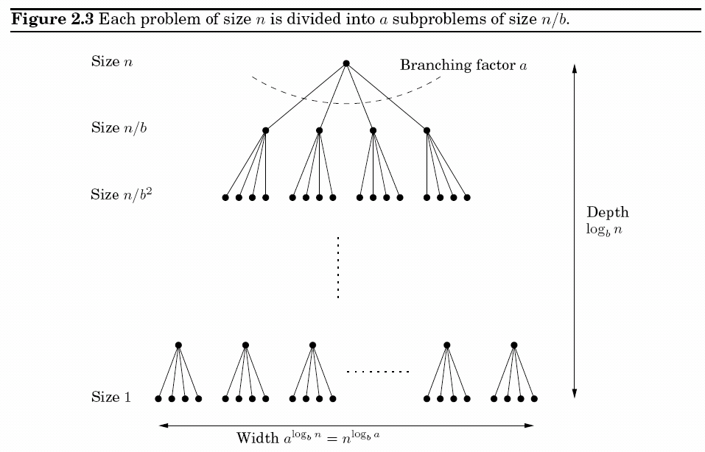
2.2 RECURRENCE RELATIONS
Log_{b}n+1

Slide 11
SOLVING RECURRENCES
Master theorem (Ex. 2.3, 2.4, 2.5)
Recursion-tree method (optional)
Substitution method (optional)

Slide 12
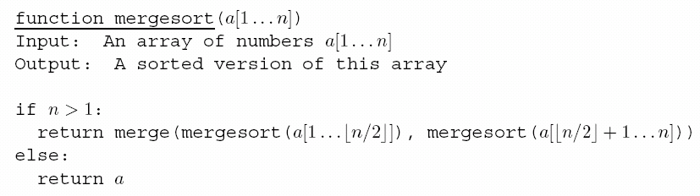
2.3 MERGESORT
Divide-and-conquer strategy:
  Split the list into two halves
  Recursively sort each half
  Merge the two sorted sublists

Slide 13
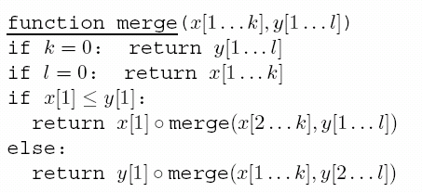
2.3 MERGESORT
All the real work is done in merging, which doesn’t start until the recursion gets down to singleton arrays.
Merging is linear. (Inputs must be ordered lists)
The total complexity of mergesort:

Slide 14
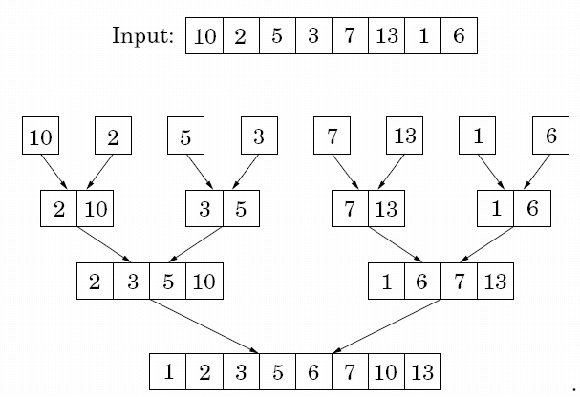
2.3 MERGESORT

Slide 15
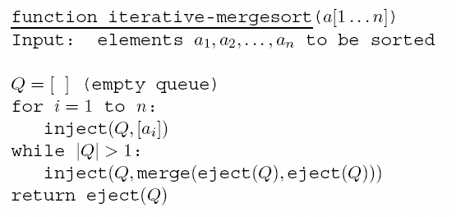
2.3 MERGESORT
An iterative mergesort algorithm:
  inject: add an element to the end of the queue
  eject: remove and return the element at the front of the queue

Slide 16
2.4 MEDIANS
Median of a list of numbers:
  The 50th percentile;
  Half of the numbers are bigger than it, and half are smaller;
  The middle number in an ordered list;
  If the list has even length, median is the smaller of the two middle numbers.
The purpose of the median: summarize a set of numbers by a single, typical value.
Sorting the list to get the median is wasteful for it takes O(nlogn), and we would like something linear!

Slide 17
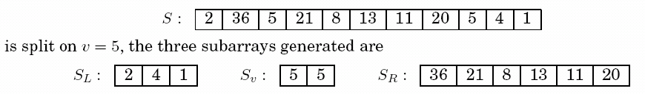
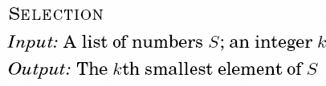

2.4 MEDIANS
For any number v, the list S is split into three categories: S_{L}, S_{V}, and S_{R} .

Slide 18
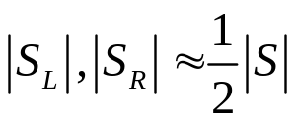

2.4 MEDIANS
Efficiency analysis:
  Ideal situation: if , then
  Worst-case: keep picking v to be the largest (or smallest) element, and shrink the array by only one element each time
  Best-case: v is good if it lies within the 25th to 75th percentile, and S_{L}, S_{V}, have size at most three-fourths that of S

Slide 19
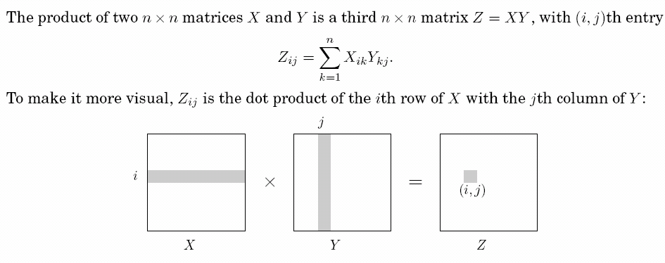
2.5 MATRIX MULTIPLICATION
The default O(n³) algorithm:

Slide 20


2.5 MATRIX MULTIPLICATION
The divide-and-conquer algorithm of O(n³) :

Slide 21
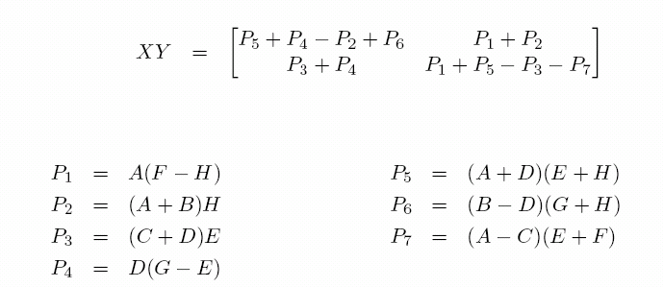
2.5 MATRIX MULTIPLICATION
The divide-and-conquer algorithm of O(n^{2.81}) :

Slide 22
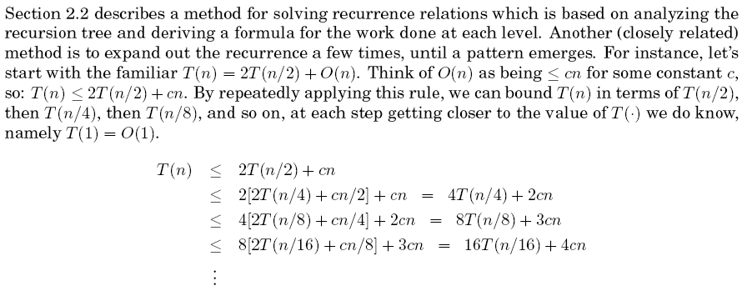
Exercise 2.3

Slide 23
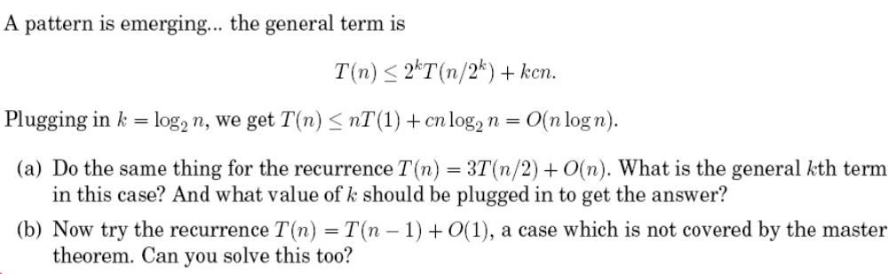
Exercise 2.3

Slide 24
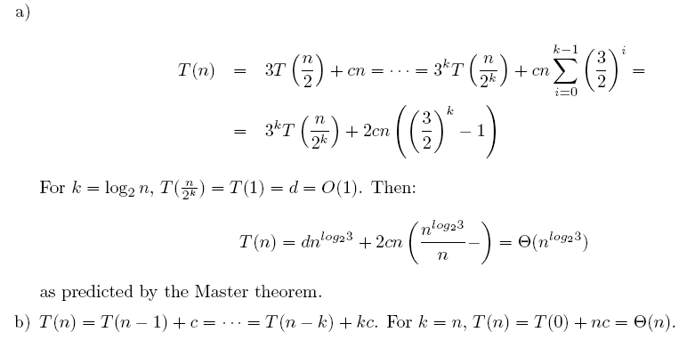
Exercise 2.3

Slide 25
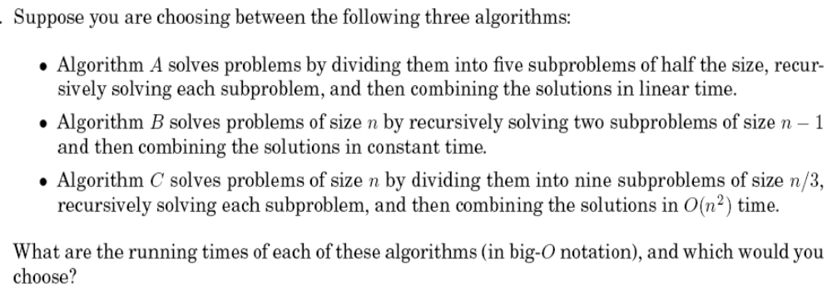
Exercise 2.4

Slide 26
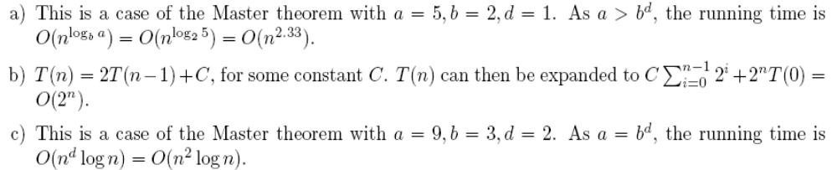
Exercise 2.4
O(n^{d}log₃n)=O(n²log₃n)

Slide 27
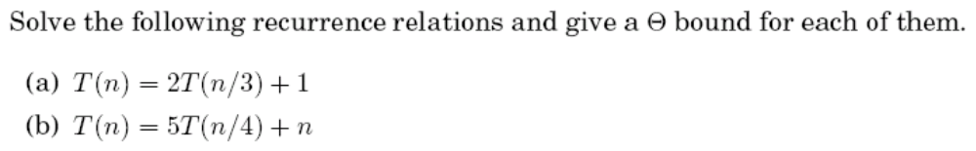
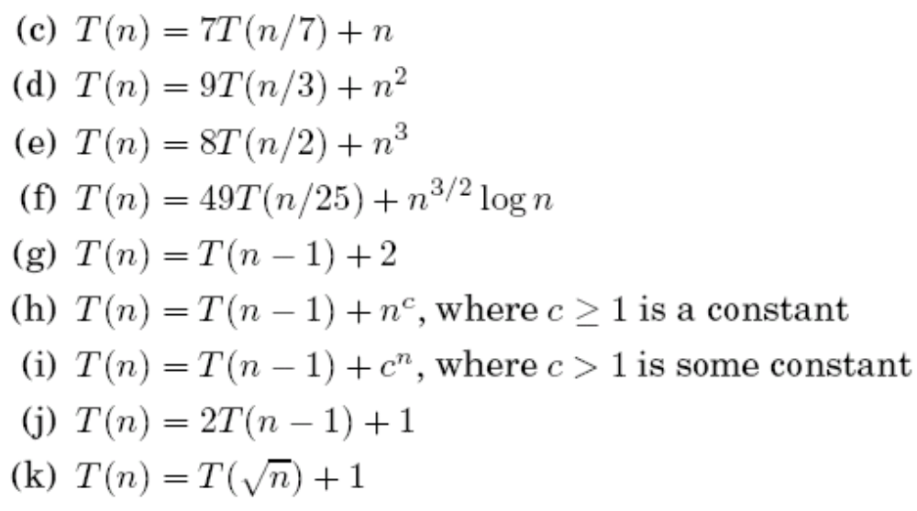
Exercise 2.5

Slide 28
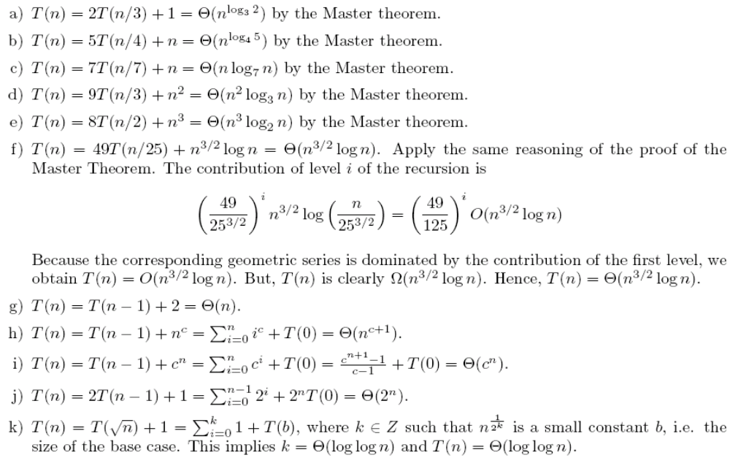
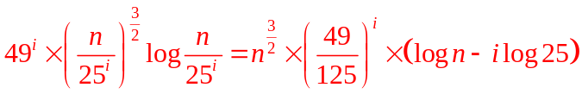
Exercise 2.5
1
1
1
log_{b}n
log_{b}n

Slide 29
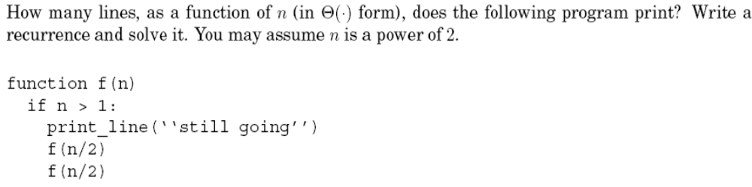
Exercise 2.12

Slide 30
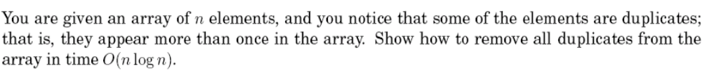
Exercise 2.14

Slide 31
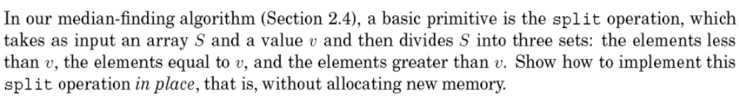
Exercise 2.15

Slide 32
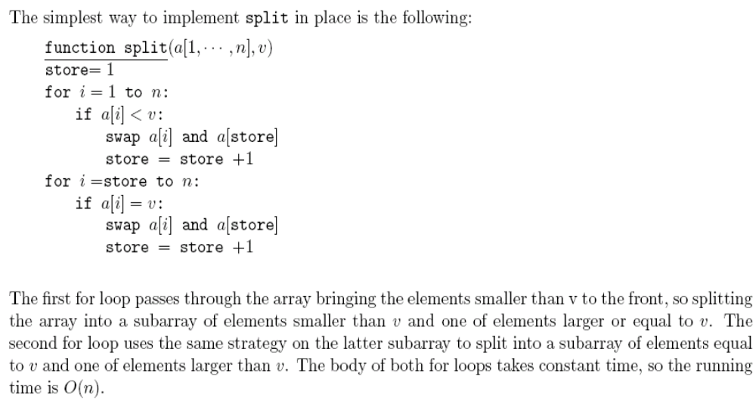
Exercise 2.15

Slide 33
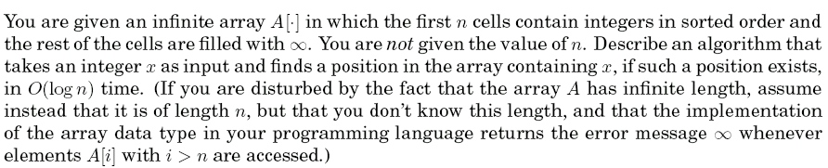
Exercise 2.16

Slide 34
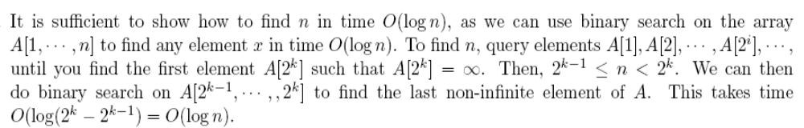
Exercise 2.16

Slide 35
Homework:
Ex 2.17, 2.19
Your homework should be submitted in the next class.

Slide 36
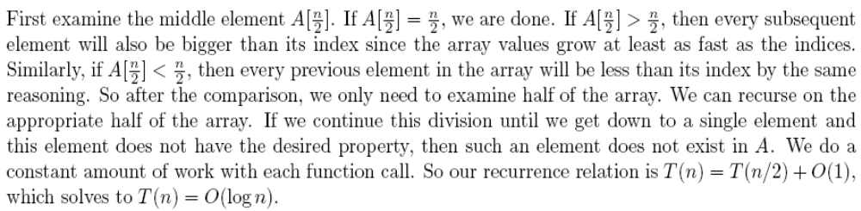
Exercise 2.17

Slide 37
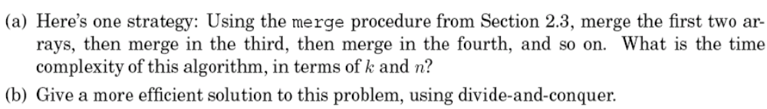
Exercise 2.19

Slide 38
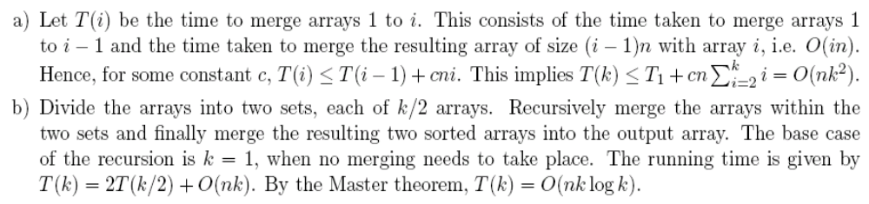
Exercise 2.19

