Slide 1
CHAPTER 3 Decompositions of graphs
3.1 Why graphs?
3.2 Depth-first search in undirected graphs
3.3 Depth-first search in directed graphs
3.4 Strongly connected components

Slide 2
PREPARATION
How to express (or store) a graph? What is the advantage and disadvantage of each expression?
Give the pseudocode of the depth-first searching (DFS) algorithm and the breath-first searching (BFS) algorithm. What is the time complexity of the DFS or the BFS?

Slide 3
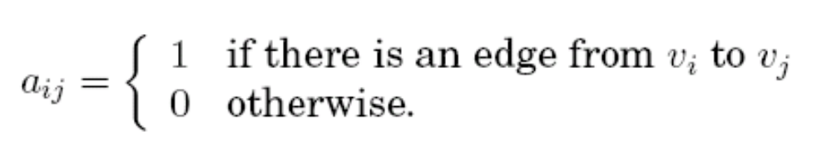
3.1 Why graphs?
Graph: G=<V,E>, V is a set of vertices, and E is a set of edges.
  Undirected edge e between x and y: e={x,y}
  Directed edge e from x to y: e=(x,y)
How is a graph represented?
  I. Adjacency matrix: n×n array
  Check the presence of a particular edge in constant time
  Take up O(n²) space
  Waste space if the graph is sparse
  Symmetric for undirected graphs: a_{ij}=a_{ji}

Slide 4
3.1 Why graphs?
How is a graph represented?(cont.)
  II. Adjacency list:
  |V| linked lists, one per vertex
  The linked list for u holds v if (u,v)∈E
  Take up O(|V|+|E|) space
  Checking edges requires sifting through adjacency list, no longer constant time
  Symmetry for undirected graphs: v is in u’s adjacency list if and only if u is in v’s adjacency list.

Slide 5
3.2 Depth-first search in undirected graphs
What parts of the graph are reachable from a given vertex?
  Explore a labyrinth with a ball of string and a piece of chalk
  Boolean variable (analog of chalk) for each vertex: indicate whether it has been visited already
  Stack (analog of string) : push a new vertex or pop the topmost vertex

Slide 6
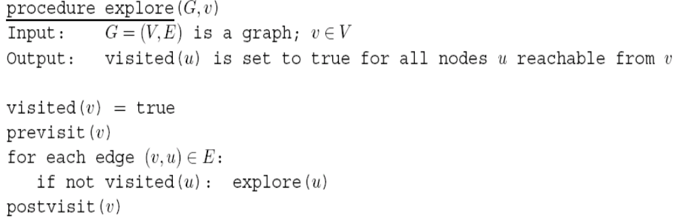
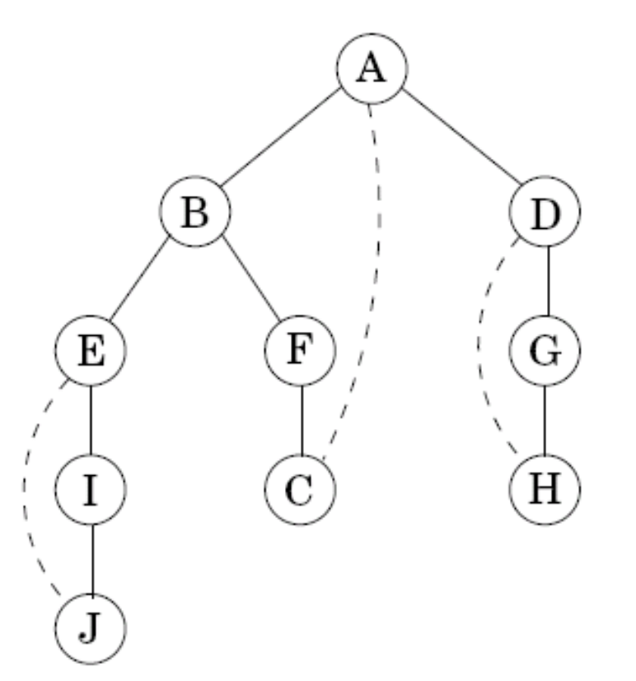
3.2.1 Exploring mazes
Solid edge: tree edge
Dotted edge: back edge

Slide 7
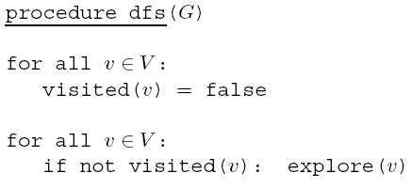
3.2.2 Depth-first search
Make the entire graph traversed

Slide 8
3.2.2 Depth-first search
Analyzing the running time of DFS
  Each vertex is explored just once
  During the exploration of a vertex
    1. some fixed amount of work - - making the spot as visited, and the pre/postvisit
    2. a loop in which adjacent edges are scanned, to see if they lead something new.
  The overall time in step 1 is O(|V|)
  In step 2, each edge {x,y} is examined exactly twice: explore(x) and explore(y).
  The overall time in step 2 is O(|E|)
  The running time of DFS is O(|V|+|E|)

Slide 9
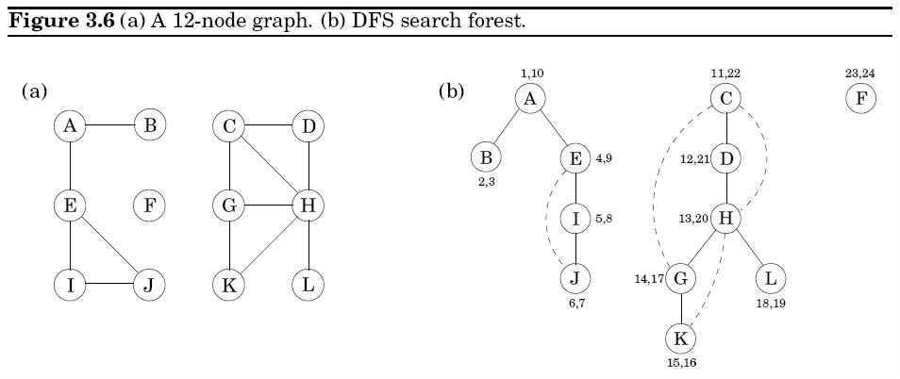
3.2.2 Depth-first search

Slide 10

3.2.3 Connectivity in undirected graphs
Undirected graph is connected if there is a path between any pair of vertices.
Connected component: a subgraph that is internally connected but has no edges to the remaining vertices.
ccnum[v]: identify the connected component to which v belongs.
cc: -- the identification of connected components
initialized to zero;
incremented each time the DFS procedure calls explore.

Slide 11
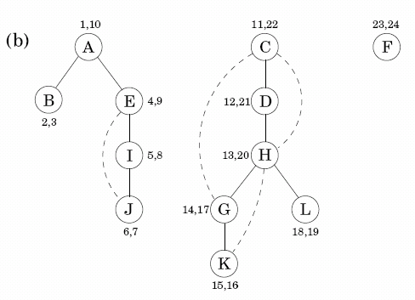
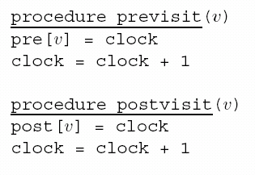
3.2.4 Previsit and postvisit orderings
Previsit: the moment of first discovery
Postvisit: the moment of final departure
Property For any nodes u and v, the two intervals [pre(u), post(u)] and [pre(v), post(v)] are either disjoint or one is contained within the other.

Slide 12
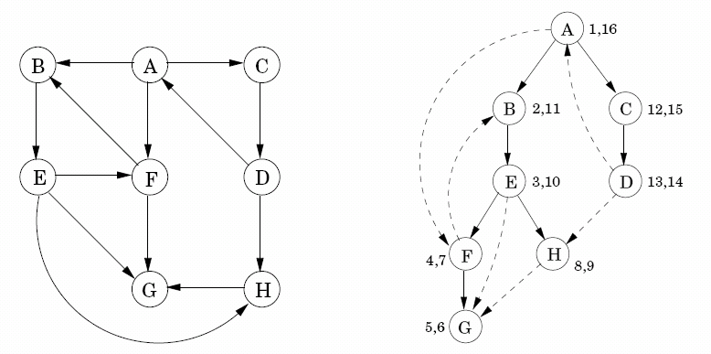
3.3 Depth-first search in directed graphs
DFS can be run on directed graphs: traverse edges only in their prescribed directions

Slide 13
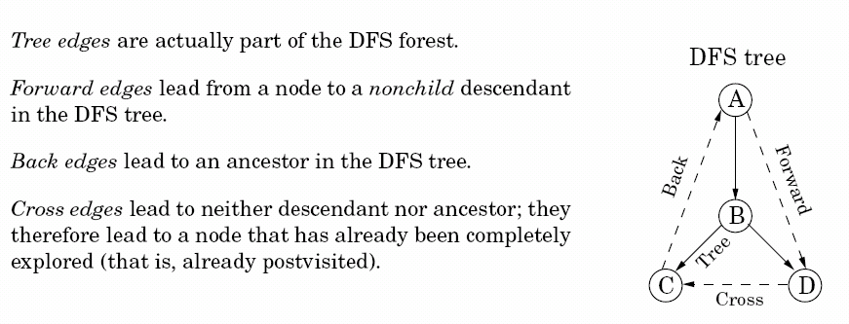
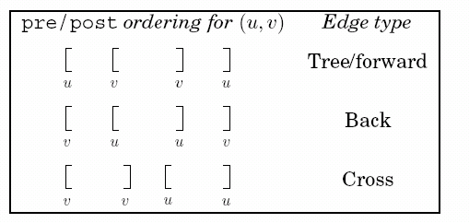
3.3.1 Types of edges

Slide 14
3.3.2 Directed acyclic graphs
Cycle in a directed graph: a circular path v₀→ v₁→ v₂→… v_{k}→ v₀
A graph without cycle is acyclic
Test for acyclicity in linear time with DFS
  Property A directed graph has a cycle if and only if its depth-first search reveals a back edge.

Slide 15
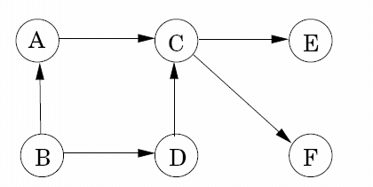
3.3.2 Directed acyclic graphs
Source: a node with no incoming edges
Sink: a node with no outgoing edges
Linearization: topologically sort; the vertices one after the other in such a way that each edge goes from an earlier vertex to a later vertex, so that all precedence constraints are satisfied.
Example of DAG
One source
Two sinks
Four linearization

Slide 16
3.3.2 Directed acyclic graphs
Property In a dag, every edge leads to a vertex with a lower post number.
  Source: the node with the biggest post number
  Sink: the node with the smallest post number
Property Every dag has at least one source and at least one sink.
How to linearize?
  Find a source, output it, and delete it from the graph
  Repeat until the graph is empty
Dag: acyclicity=linearizability=absence of back edges

Slide 17
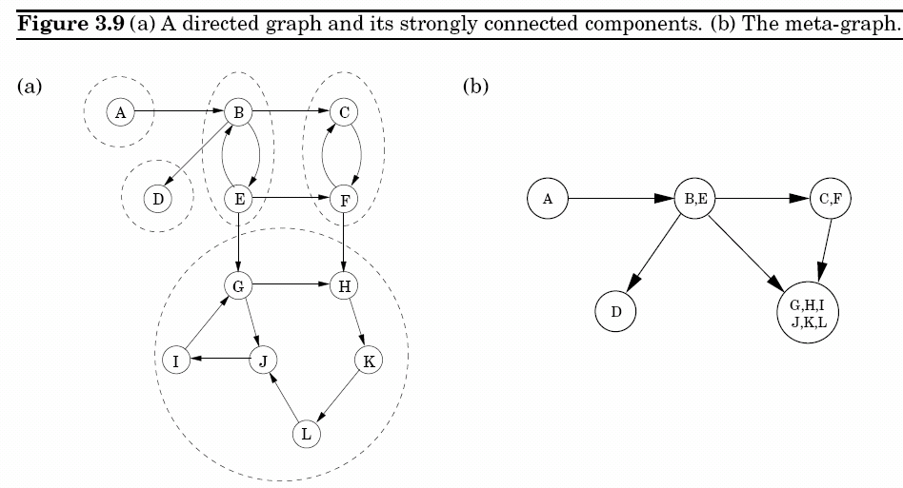
3.4 Strongly connected components
Define connectivity for directed graphs: two nodes u and v are connected if there is a path from u to v and a path from v to u

Slide 18
3.4.1 Defining connectivity for directed graph
Meta-graph: shrink each strongly connected component into a single meta-node, and draw an edge from one meta-node to another if there is an edge (in the same direction) between their respective components.
Property Every directed graph is a dag of its strongly connected components.
Two tiered connectivity structure of a directed graph:
  Top level: a dag which can be linearized
  Each node in this dag: a strongly connected component

Slide 19
3.4.2 An efficient algorithm
Decompose a directed graph into strongly connected components: O(V+E), using DFS
  Property 1 If the explore subroutine is started at node u, then it will terminate precisely when all nodes reachable from u have been visited.
  Property 2 The node that receives the highest post number in a depth-first search must lie in a source strongly connected component.
  Property 3 If C and C’ are strongly connected components, and there is an edge from a node in C to a node in C’, then the highest post number in C is bigger than the highest post number in C’.
    SCC can be linearized in decreasing order of the highest post numbers.

Slide 20
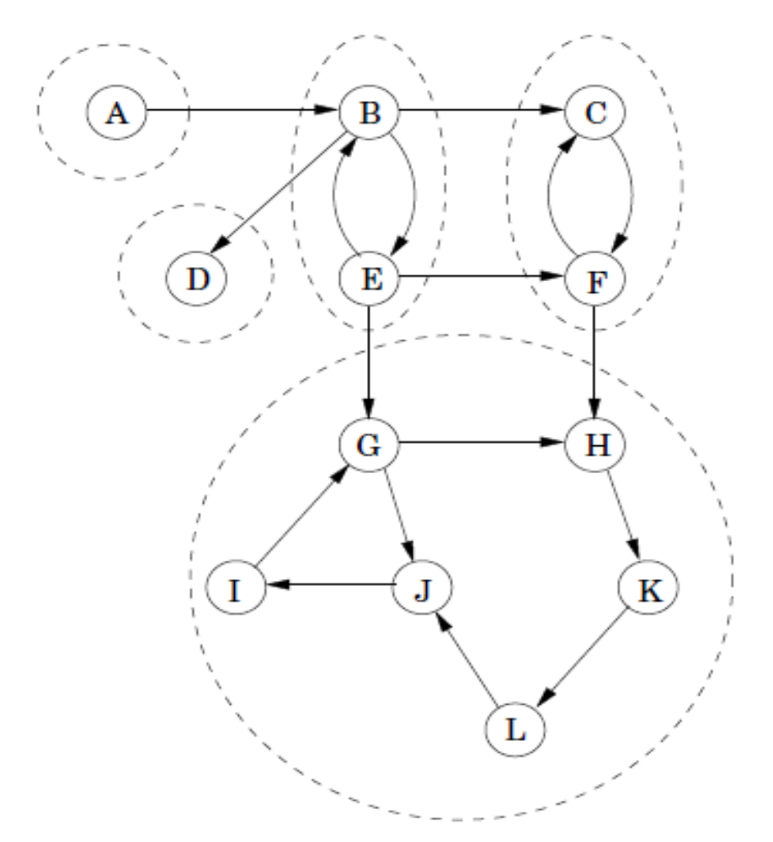
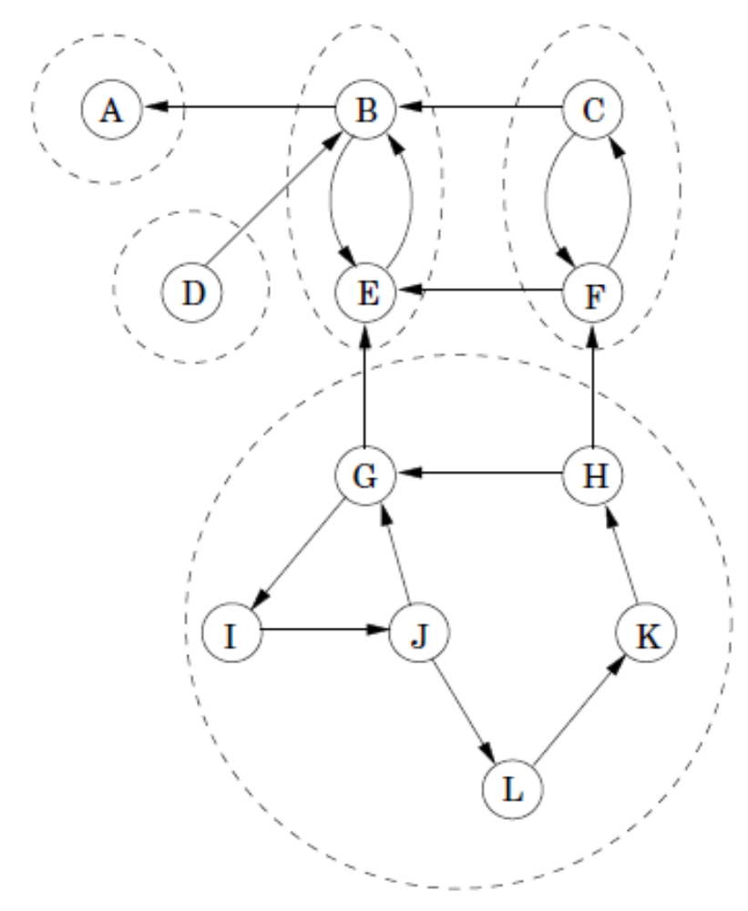
3.4.2 An efficient algorithm
Algorithm:
  1. Run DFS on G^{R}
    Reverse graph G^{R}: all edges reversed.
    G^{R} has the same SCCs as G, but source in G^{R} = sink in G

Slide 21
(1) RUN DFS IN G^{R}
(1,2)
(3,6)
(7,10)
(8,9)
(4,5)
(11,12)
(13,24)
(18,19)
(14,23)
(17,20)
(15,22)
(16,21)

Slide 22
(2) RUN DFS IN G ACCORDING TO THE EXISTING POST-NUMBERS
(1,2)
(3,6)
(7,10)
(8,9)
(4,5)
(11,12)
(13,24)
(18,19)
(14,23)
(17,20)
(15,22)
(16,21)

Slide 23
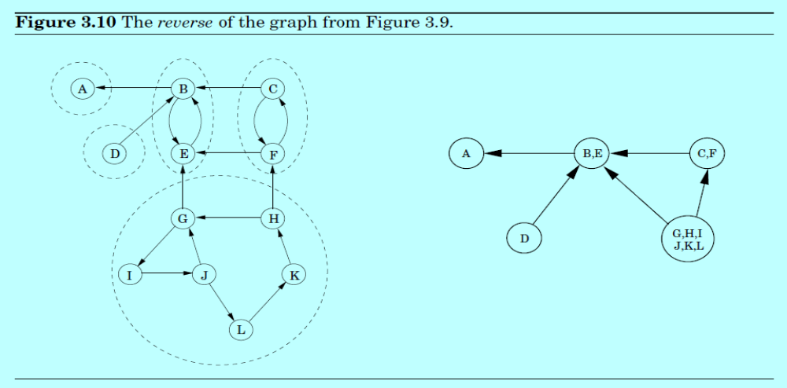
3.4.2 An efficient algorithm
Algorithm:
  1. Run DFS on G^{R}
  2. Run the undirected connected algorithm (from Section 3.2.3) on G, and during the DFS, process the vertices in decreasing order of their post numbers from step 1.
⑤
④
③
②
①

Slide 24
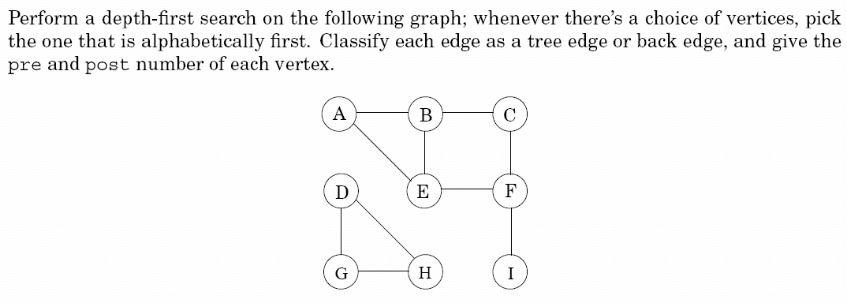
EXERCISE 3.1

Slide 25
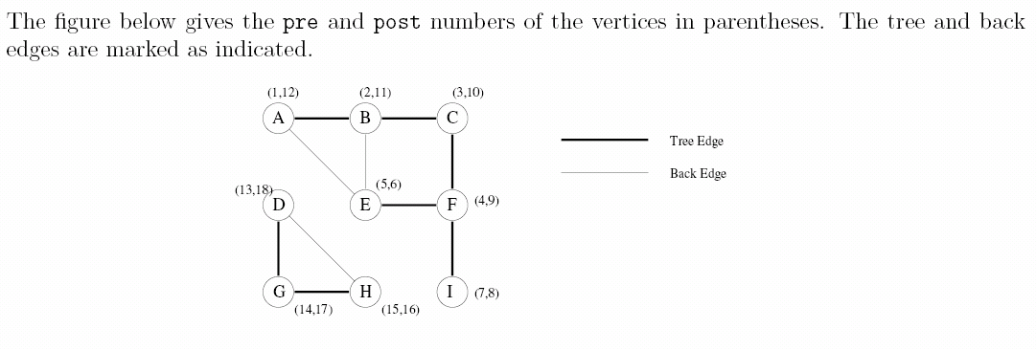
EXERCISE 3.1

Slide 26
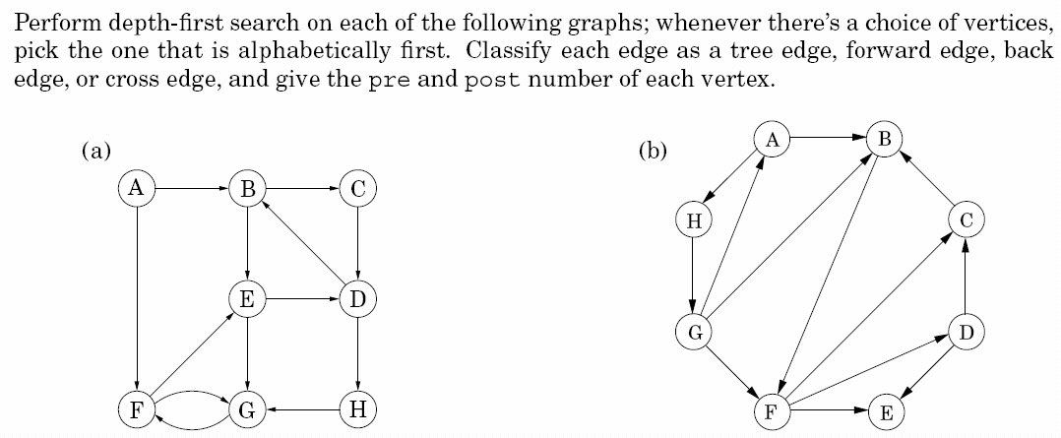
EXERCISE 3.2

Slide 27
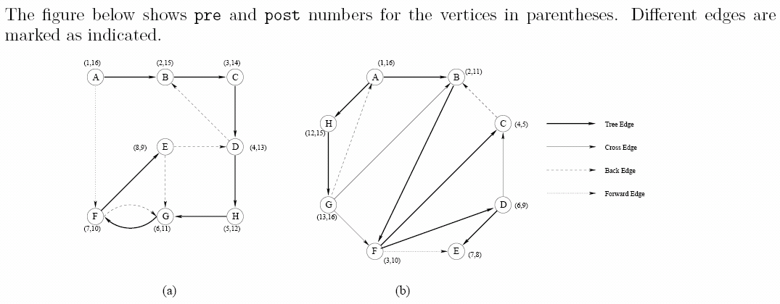
EXERCISE 3.2

Slide 28
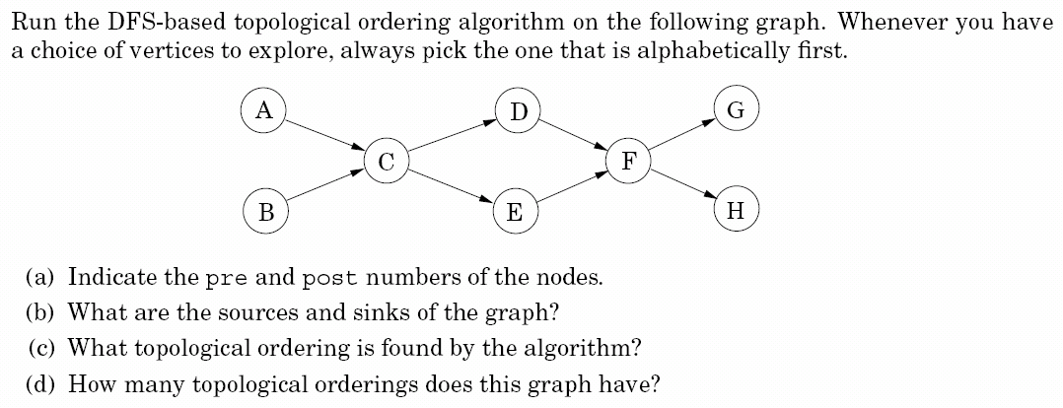
EXERCISE 3.3

Slide 29
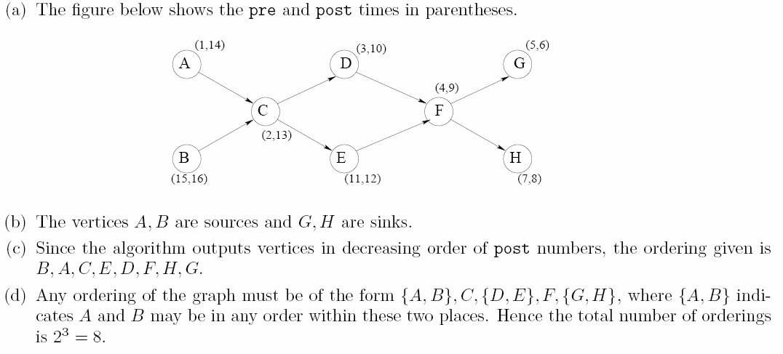
EXERCISE 3.3

Slide 30
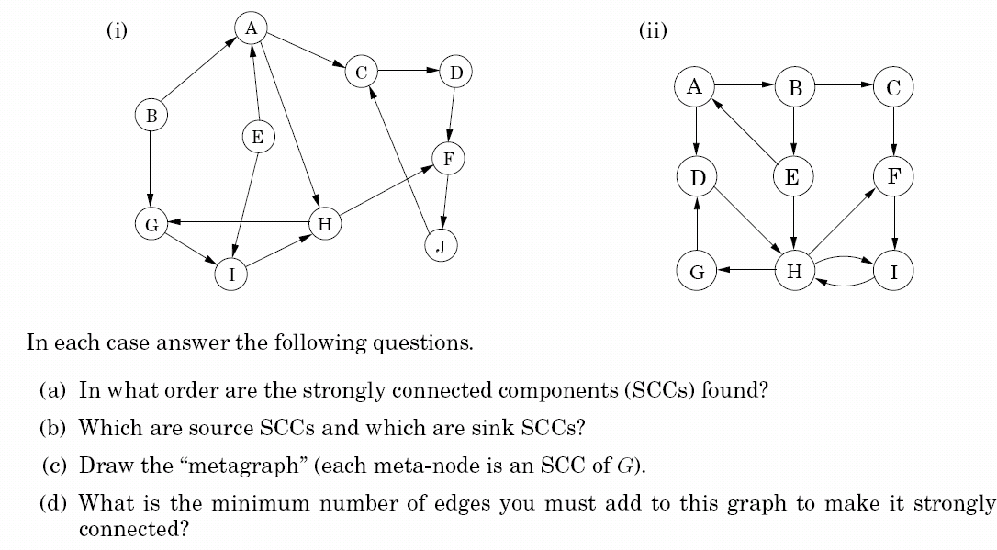
EXERCISE 3.4

Slide 31
(a.1) Run DFS in G^{R}
(1,6)
A
(7,20)
(10,11)
C
D
(2,3)
B
(4,5)
E
F
(9,18)
G
H
(14,15)
(12,17)
J
(8,19)
I
(13,16)

Slide 32
(a.2) Run DFS in G
(1,6)
A
(7,20)
(10,11)
C
D
(2,3)
B
(4,5)
E
F
(9,18)
G
H
(14,15)
(12,17)
J
(8,19)
I
(13,16)

Slide 33
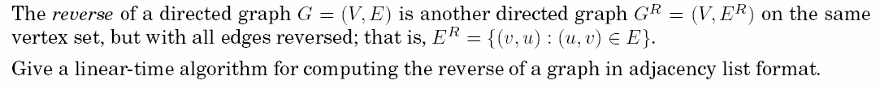
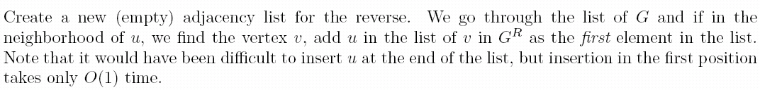
EXERCISE 3.5

Slide 34

EXERCISE 3.8

Slide 35
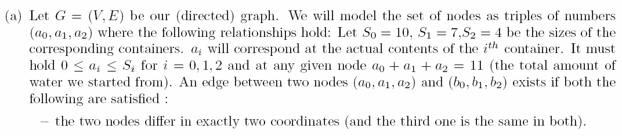
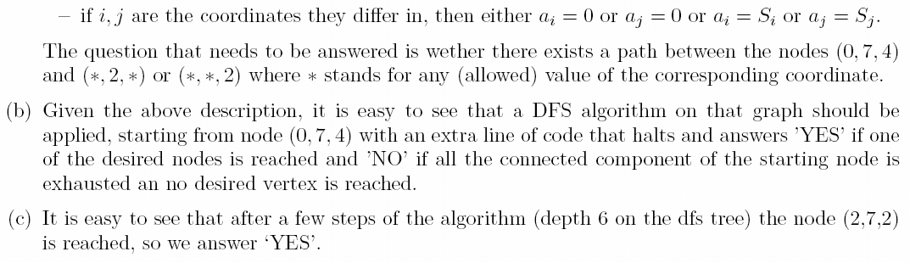
EXERCISE 3.8

Slide 36
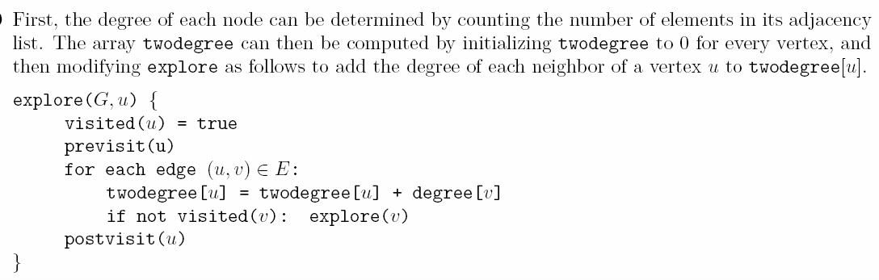
EXERCISE 3.9

Slide 37
EXERCISE 3.11

Slide 38
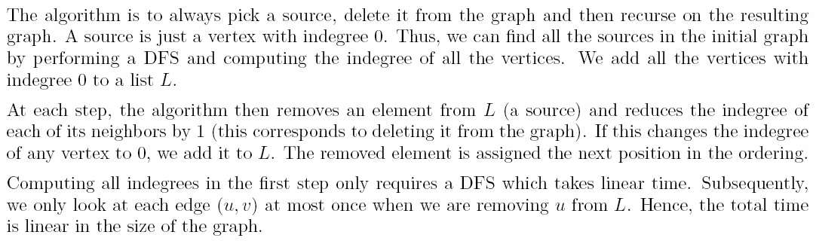
EXERCISE 3.14

Slide 39
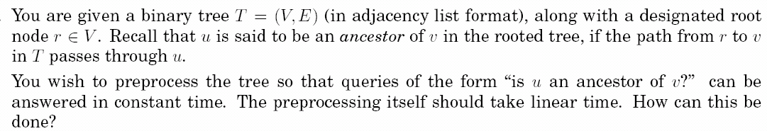
EXERCISE 3.18

Slide 40
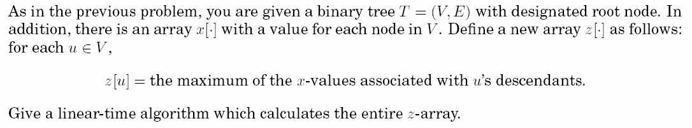
EXERCISE 3.19

Slide 41
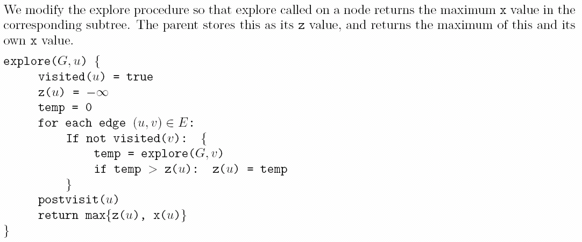
EXERCISE 3.19

Slide 42
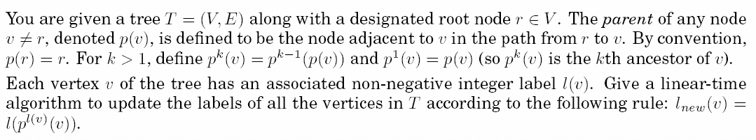
EXERCISE 3.20

Slide 43
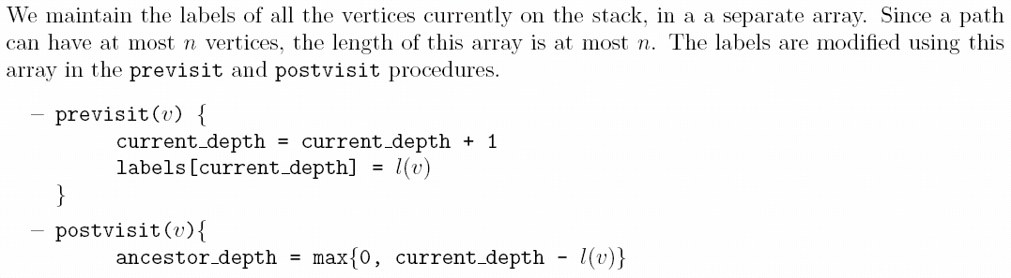
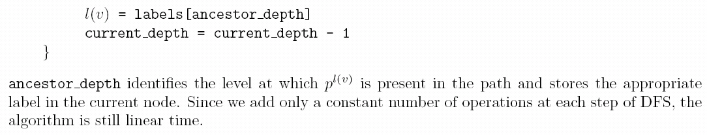
EXERCISE 3.20

Slide 44
HOMEWORK
P96: 3.4(ii)
P99: 3.8
Write programs which implement the suggested algorithm.
Output the whole directed graph (in adjacency list format) and all paths from the node (0,7,4) to the nodes (*,*,2) or (*,2,*).

