Slide 1
DESIGN AND ANALYSIS OF ALGORITHMS
Lecturer: Zhi-hua Jiang
Dep. Of Computer Science and Technology
Email: tjiangzhh@jnu.edu.cn

Slide 2
CHAPTER 4 Paths in graphs
4.1 Distances
4.2 Breadth-first search
4.3 Lengths on edges
4.4 Dijkstra’s algorithm
4.5 Priority queue implementations
4.6 Shortest paths in the presence of negative edges
4.7 Shortest paths in dags

Slide 3
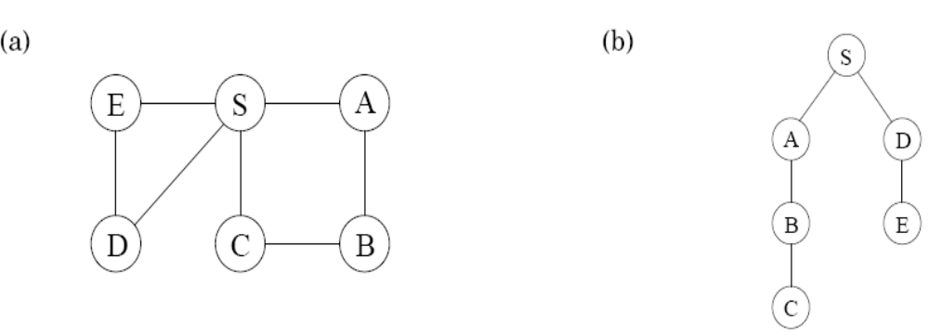
4.1 Distances
Distance between two nodes: the length of the shortest path between them.
DFS identifies all the vertices which can be reached from a starting point, but cannot find shortest paths in graphs.

Slide 4
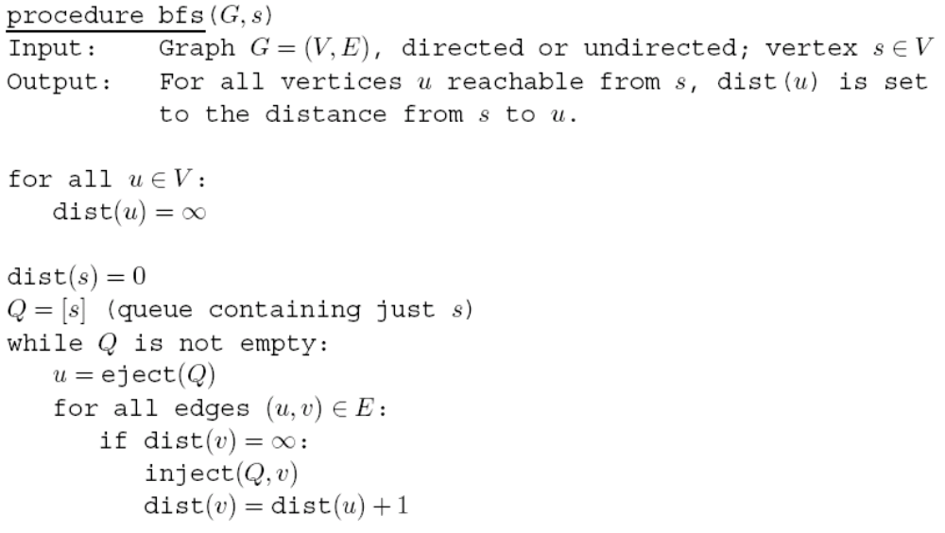
4.2 Breadth-first search

Slide 5
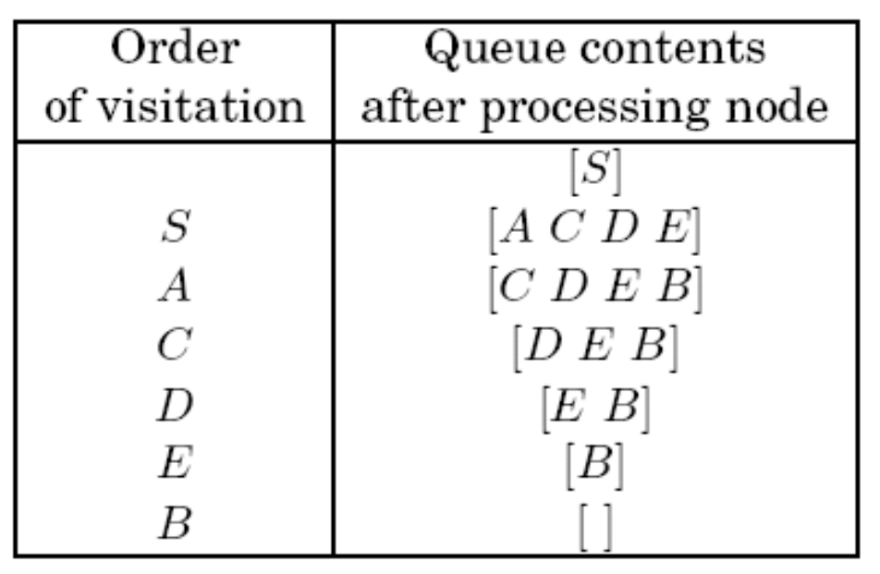
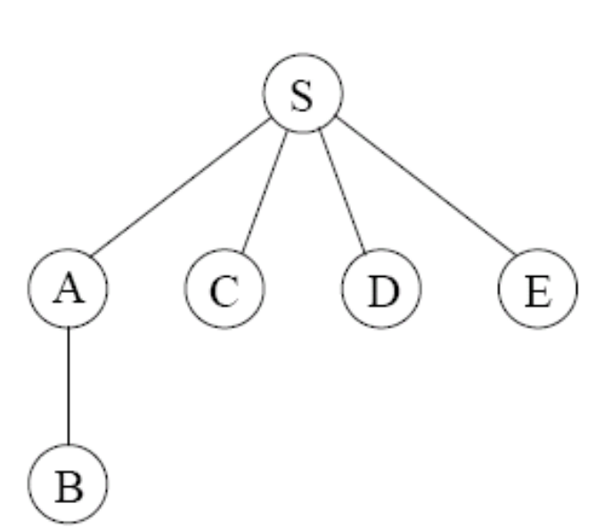
4.2 Breadth-first search

Slide 6
4.2 Breadth-first search
Correctness
For each d=0,1,2,…, there is a moment at which
  All nodes at distance ≤ d from s have their distances correctly set
  All other nodes have their distances set to ∞
  The queue contains exactly the nodes at distance d
Efficiency
  Each vertex is put on the queue exactly once, so there are 2|V| queue operations
  The innermost loop looks at each edge once (in directed graphs) or twice (in undirected graphs), so takes O(|E|) time
  The overall running time: O(|V| + |E|)

Slide 7
4.2 Breadth-first search
DFS vs. BFS
  DFS makes deep incursions into graphs; BFS visits vertices in increasing order of their distance from the starting point
  DFS finds reachable vertices; BFS finds shortest paths
  DFS uses a stack; BFS uses a queue

Slide 8
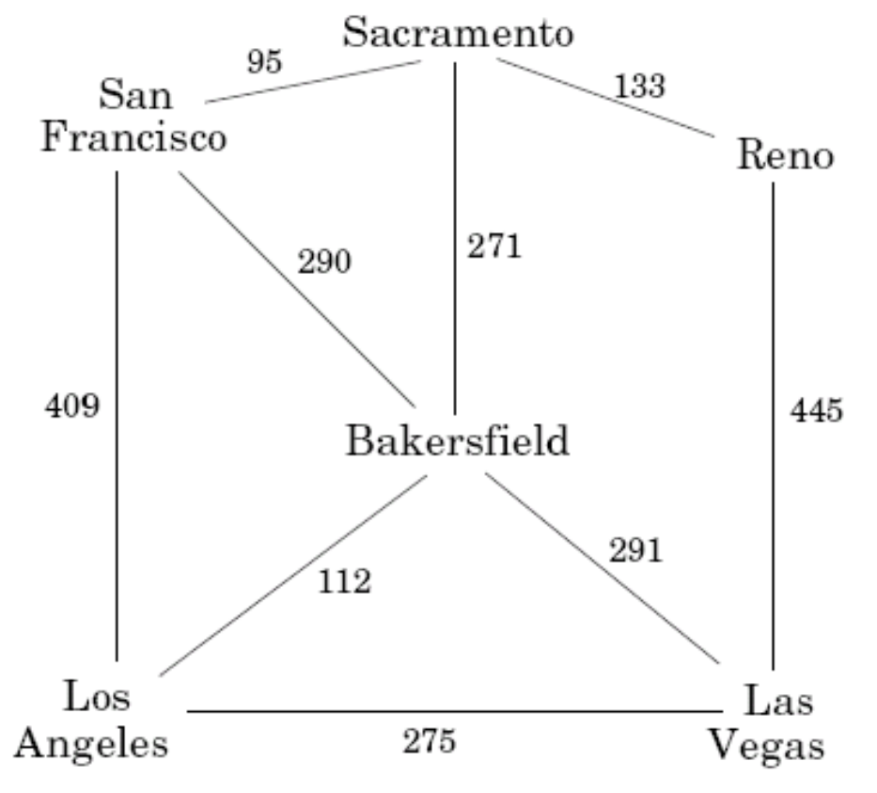
4.3 Lengths on edges
Weighted edges: every edge e∈E with a length l_{e}

Slide 9
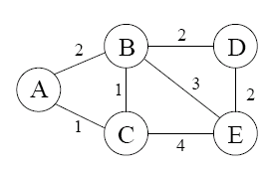
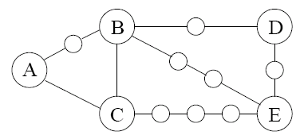
4.4 Dijkstra’s algorithm
BFS finds shortest paths in any graph whose edges have unit length
A more general graph: edge lengths l_{e} are positive integers
Construct new graph G’, then run BFS on G’
  For any edge e=(u,v), replace it by l_{e} edges of length 1, by adding l_{e} -1 dummy nodes between u and v

Slide 10
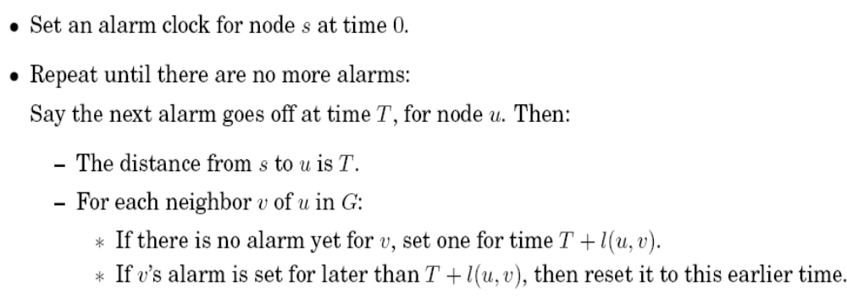
4.4.1 An adaptation of breadth-first search
When edge weights are large numbers, running BFS on G’ is impractical
Set alarms: estimated time of arrival
Alarm clock algorithm

Slide 11
4.4.1 An adaptation of breadth-first search
Implement alarms using a priority queue (or heap):
  Elements: graph nodes
  Key values: alarm times
  Operations:
    Insert. Add a new element to the set.
    Decrease-key. Accommodate the decrease in key value of a particular element.
    Delete-min. Return the element with the smallest key, and remove it from the set.
    Make-queue. Build a priority queue out of the given elements with the given key values.

Slide 12
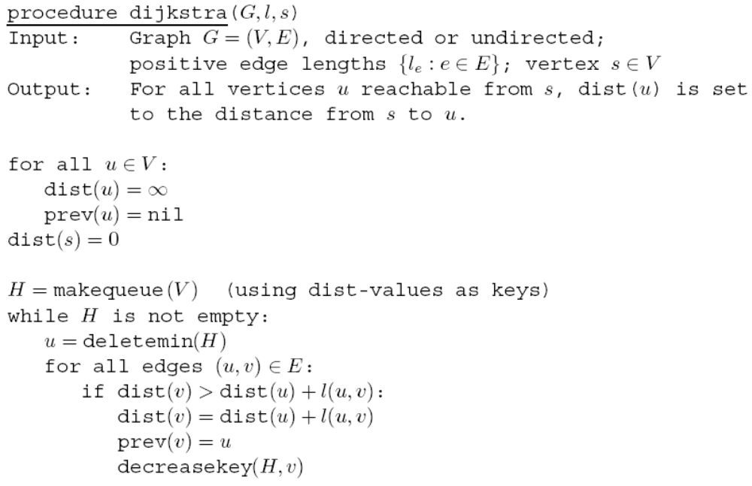
4.4.1 An adaptation of breadth-first search
dist(u): the current distance from s to u;
prev(u): the node immediately before u on the shortest path from s to u.
Dijkstra’s algorithm=BFS + priority queue

Slide 13
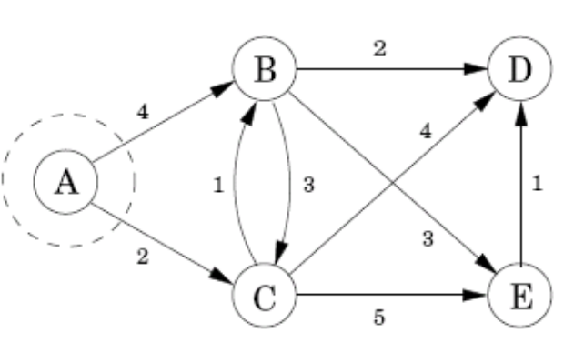
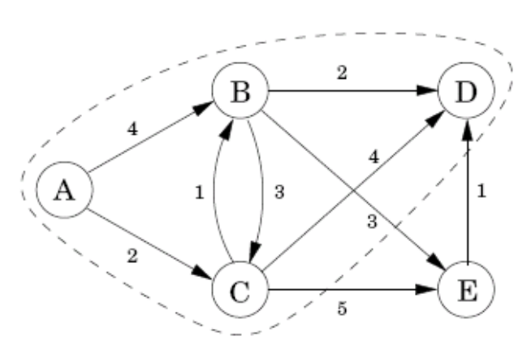
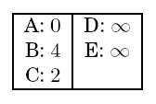
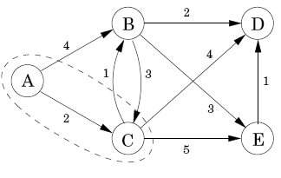
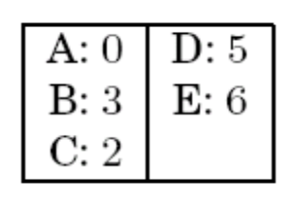
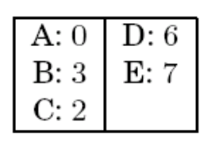
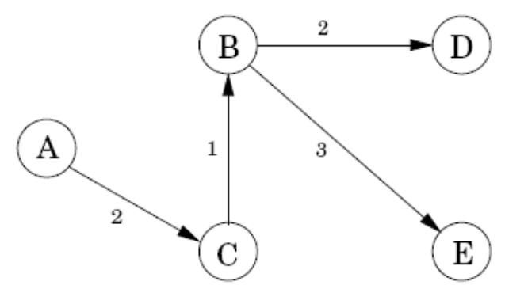
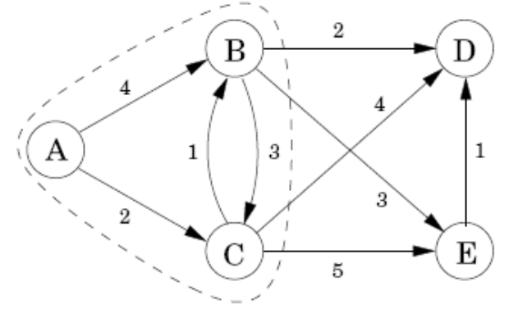
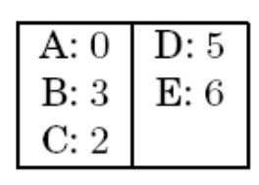
Exercise 4.1, 4.5, 4.15, 4.18

Slide 14
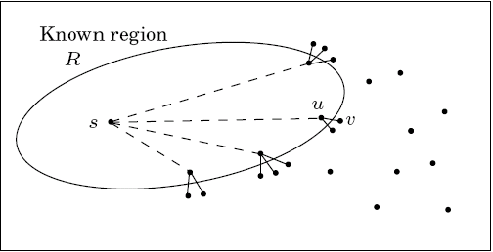
4.4.2 An alternative derivation
Known region: subset of vertices R that includes s
Extension of R: add the node v outside R that is closest to s
How to find v?
  outside R and with the smallest value of distance(s,u)+l(u,v)
  dist(v): the length of the currently shortest single-edge-extended path leading to v

Slide 15
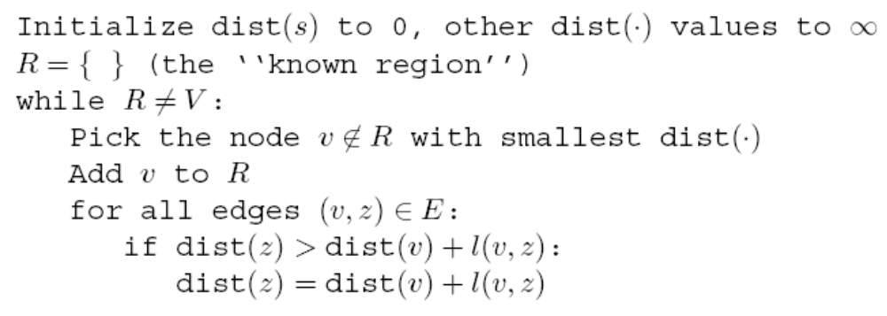
4.4.2 An alternative derivation
Inductive hypothesis:
  There is a value d such that all nodes in R are at distance ≤ d from s and all nodes outside R are at distance ≥ d from s
  dist(u) is the length of the shortest path from s to u whose intermediate nodes are constrained to be in R

Slide 16
4.4.3 Running time
Dijkstra’s algorithm is slower than BFS for the priority queue primitives
  makequeue: |V| insert operations
  deletemin: run |V| times
  decreasekey: run O(|E|) times
  Insert/deletemin/decreasekey: O(log|V|)
  Implemented with a binary heap: the overall running time is O((|V| + |E|)log|V|)

Slide 17
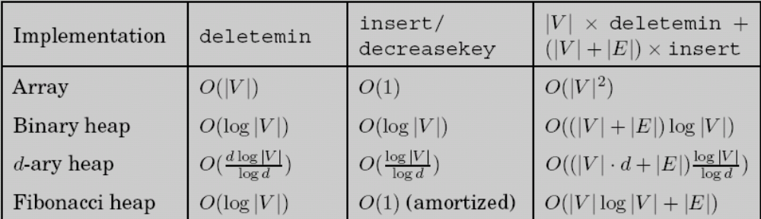
4.5 Priority queue implementations
The running time of Dijkstra’s algorithm depends heavily on the priority queue implementation.

Slide 18
4.5.1 Array
The simplest implementation of a priority array: an unordered array of key values
  Insert or decreasekey is fast: O(1)
  Deletemin: O(V)
  Total: |V|deletemin+|V|insert+|E|decreasekey=O(V²)
Alternative: an ordered array
  Insert is slow: O(V)
  Deletemin or decreasekey : O(1)
  Total: |V|deletemin+|V|insert+|E|decreasekey=O(V²)

Slide 19
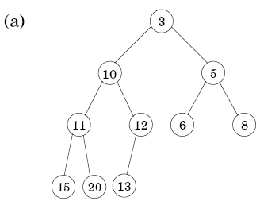
4.5.2 Binary heap
Elements are stored in a complete binary tree:
  Each level is filled in from left to right, and must be full before the next level is started.
  The key value of any node is less than or equal to that of its children.
  The tree root always contains the smallest element.

Slide 20
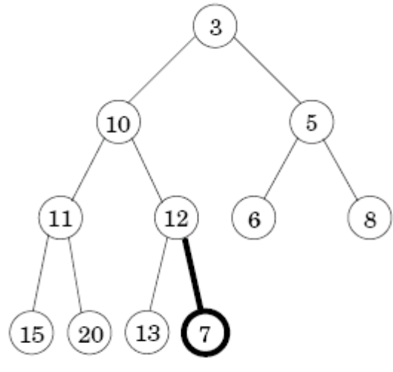
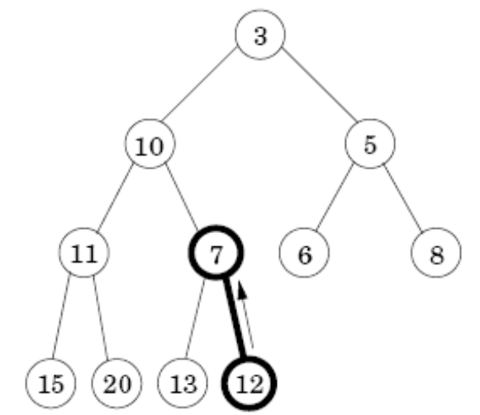
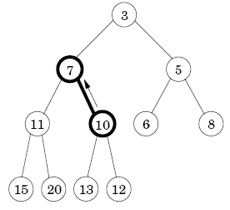
4.5.2 Binary heap
insert/decreaskey operation:
  Bubble up: place at the bottom of the tree; if smaller than its parent, swap the two and repeat.
  Take O(log|V|) time when the height of the tree is O(log|V|)

Slide 21
4.5.2 Binary heap
deletemin operation:
  Return the root value and place the last node at the root.
  Sift down: if bigger than either child, swap it with the smaller child and repeat.
  Take O(log|V|) time

Slide 22
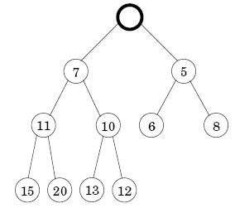
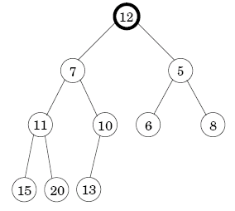
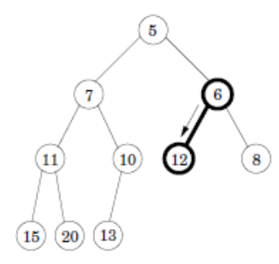
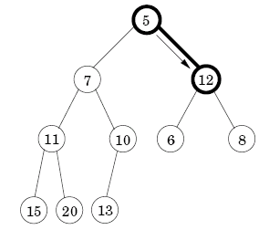

Slide 23
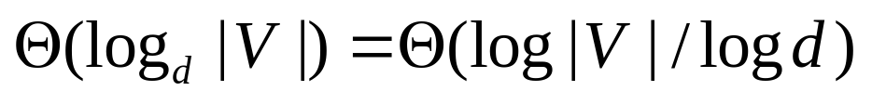
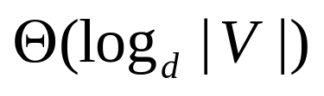
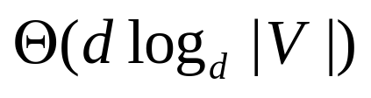
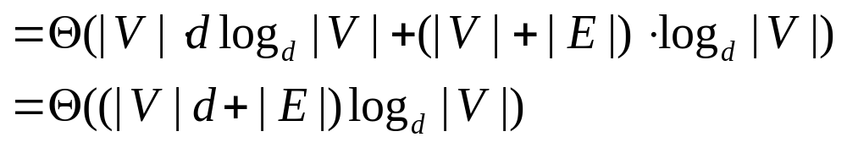
4.5.3 d-ary heap
Identical to a binary heap, except that nodes have d children.
The height of the tree:
Insert: speeded up,
Deletemin: take a longer time,
  Total: |V|deletemin+|V|insert+|E|decreasekey

Slide 24
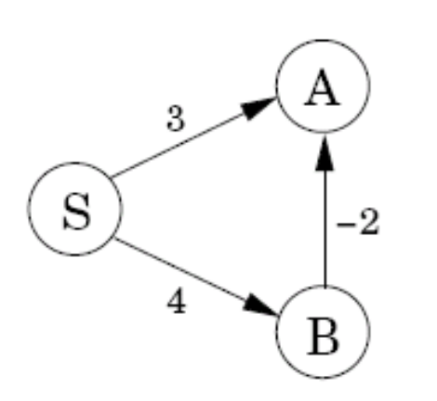
4.6 Shortest paths in the presence of negative edges
Dijkstra’s algorithm will not work if there are negative edges, e.g. dist(A)
Why?
  The dist values are overestimate or exactly correct
  Update: dist(v)=min{dist(v), dist(u)+l(u,v)}
  Property:
    Dist(v) is correctly set, when u is the second-last node in the shortest path to v, and dist(u) is correctly set.
    Never make dist(v) too small so that it is safe.

Slide 25
4.6.1 Negative edges
Bellman-Ford algorithm for single-source shortest paths in general graphs
  Observation: a shortest path can have at most |V| - 1 edges (cycles can be removed)
  Solution: update all the edges for |V| - 1 times
  Complexity: O(|V|⋅|E|)

Slide 26
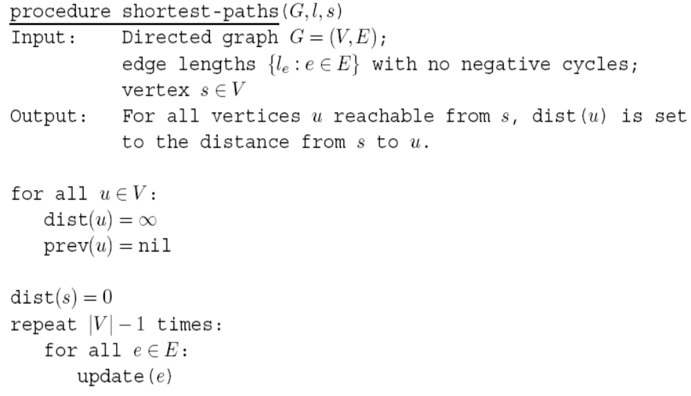
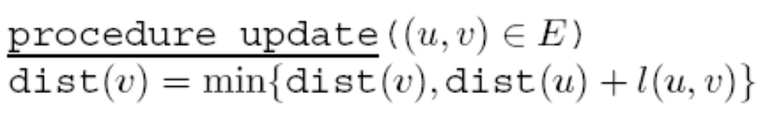
4.6.1 Negative edges
In fact, terminate when no update occurs

Slide 27
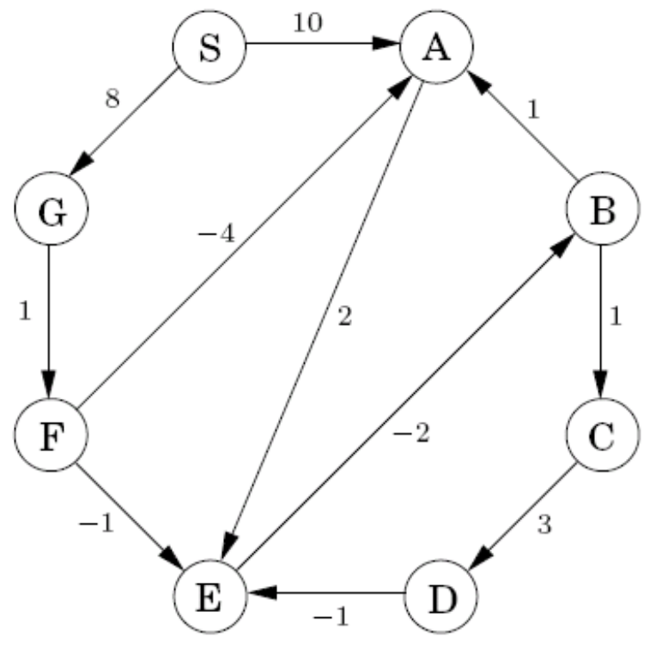
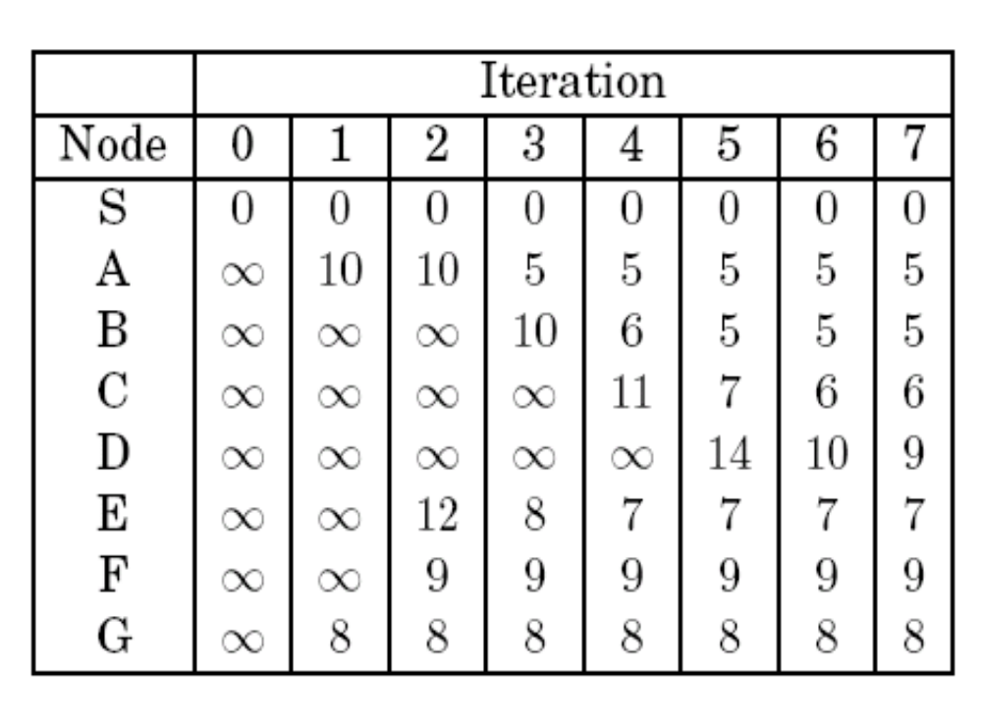
4.6.1 Negative edges

Slide 28
4.6.2 Negative cycles
Negative cycle: the length of cycle is negative
The shortest-path problem is ill-posed in graphs with negative cycles.
Use the Bellman-Ford algorithm to detect negative cycles
  After |V|-1 iterations, perform one extra round
  Negative cycle exists = some dist value is reduced during the extra round
-4

Slide 29
4.7 Shortest paths in dags
In any path of a dag, the vertices appear in increasing linearized order.
Linearize the dag by DFS, and visit the vertices in sorted order, updating the edges out of each.
Find longest paths in a dag: negate all edge lengths.

Slide 30
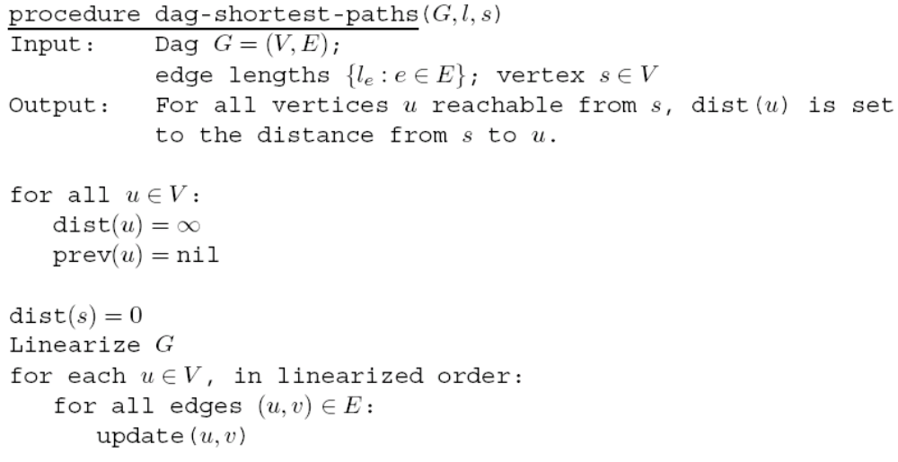
4.7 Shortest paths in dags
O(|V|+|E|)

Slide 31
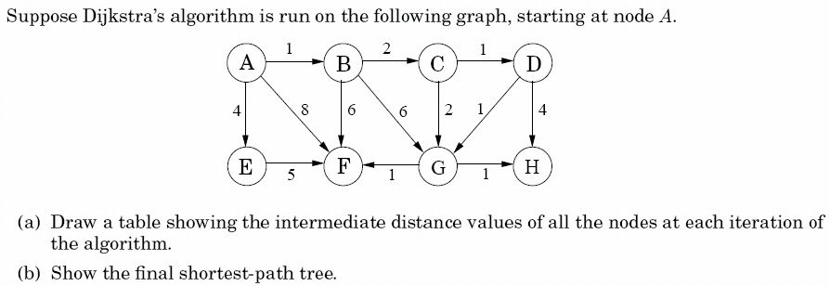
Exercise 4.1

Slide 32
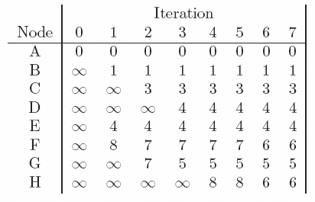
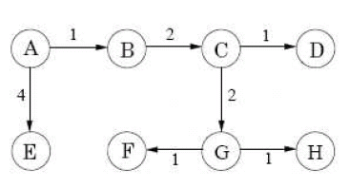
Exercise 4.1

Slide 33
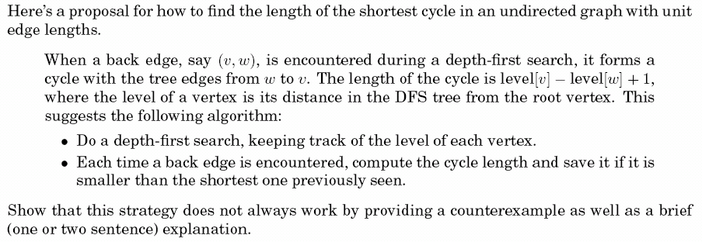
Exercise 4.4

Slide 34
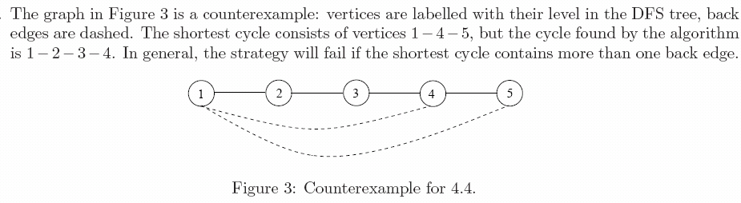
Exercise 4.4

Slide 35
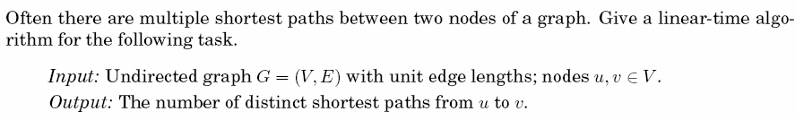
Exercise 4.5

Slide 36
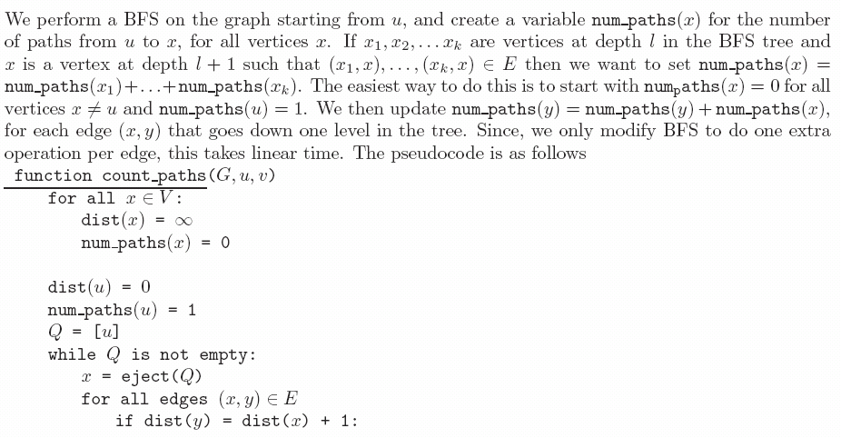
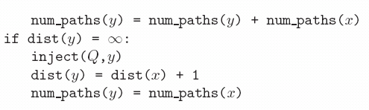
Exercise 4.5

Slide 37
Exercise 4.10

Slide 38

Exercise 4.15

Slide 39
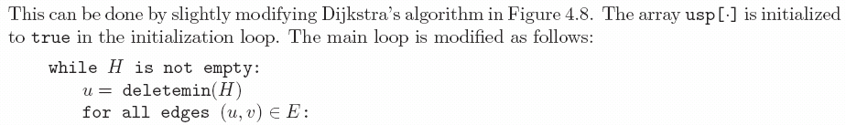
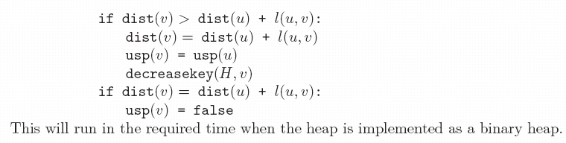
Exercise 4.15

Slide 40
HOMEWORK
Textbook:
Ex. 4.2,4.18

