Slide 1
CHAPTER 5 Greedy algorithms
5.1 Minimum spanning trees
5.2 Huffman encoding
5.3 Horn formulas
5.4 Set cover

Slide 2
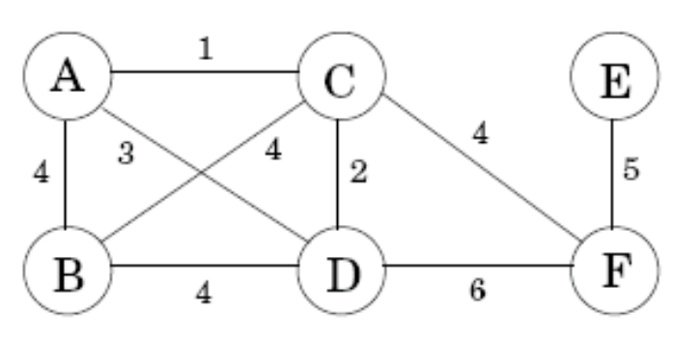
5.1 Minimum spanning trees
Introductory example:
  how to find the cheapest network?
Property 1 Removing a cycle edge cannot disconnect a graph.
The solution:
  A tree (connected and acyclic)
  The minimum spanning tree (with minimum total weight)

Slide 3
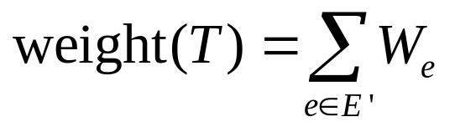
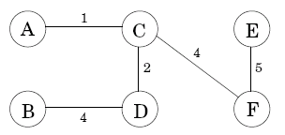
5.1 Minimum spanning trees
Minimum spanning tree (MST)
Input: An undirected graph G=(V,E); edge weights W_{e}.
Output: A tree T=(V,E’), with E’⊆E, that minimizes
The MST is not unique!

Slide 4
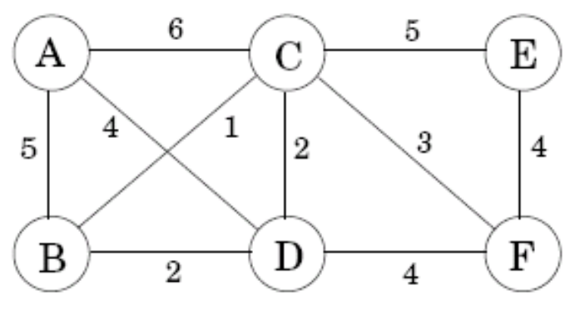
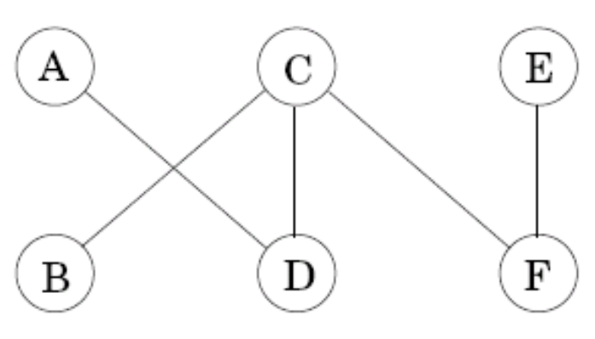
5.1.1 A greedy approach
Kruskal’s MST algorithm:
  Start with the empty graph
  Repeatedly add the next lightest edge that doesn’t produce a cycle
Example: Add edges in increasing order of weight

Slide 5
5.1.1 A greedy approach
Trees
  Property 1 A tree on n nodes has n-1 edges.
  Property 2 Any connected, undirected graph G=(V,E) with |E|=|V|-1 is a tree.
  Property 3 An undirected graph is a tree if and only if there is a unique path between any pair of nodes

Slide 6
5.1.2 The cut property
The correctness of Kruskal’s method follows from a cut property.
Cut: any partition of the vertices into two groups: S and V-S.
Cut property: Suppose edges X are part of a minimum spanning tree of G=(V,E). Pick any subset of nodes S for which X does not cross between S and V-S, and let e be the lightest edge across this partition. Then X ∪ {e} is a part of some MST.
The significance of the cut property: it is always safe to add the lightest edge across any cut, provided X has no edges across the cut.

Slide 7
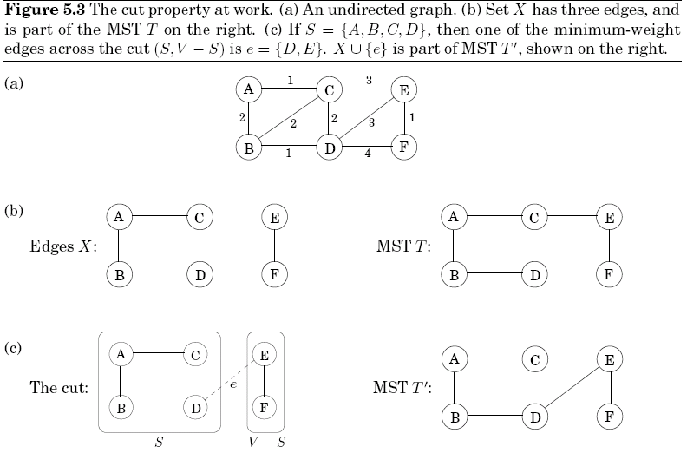
5.1.2 The cut property

Slide 8
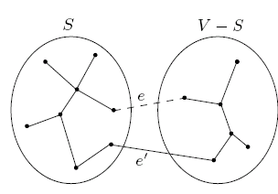
5.1.2 The cut property
Proof of the cut property
  Assume X are part of some MST T, and e is not in T
  Construct a different MST T’ containing X ∪ {e}
    Adding e to T will create a cycle
    T’=T∪{e}-{e’}
    T’ has the same number of edges as T, so T’ is a tree
    weight(T’)=weight(T)+w(e)-w(e’), since w(e)≤w(e’), weight(T’) ≤ weight(T). T’ is also a MST.

Slide 9
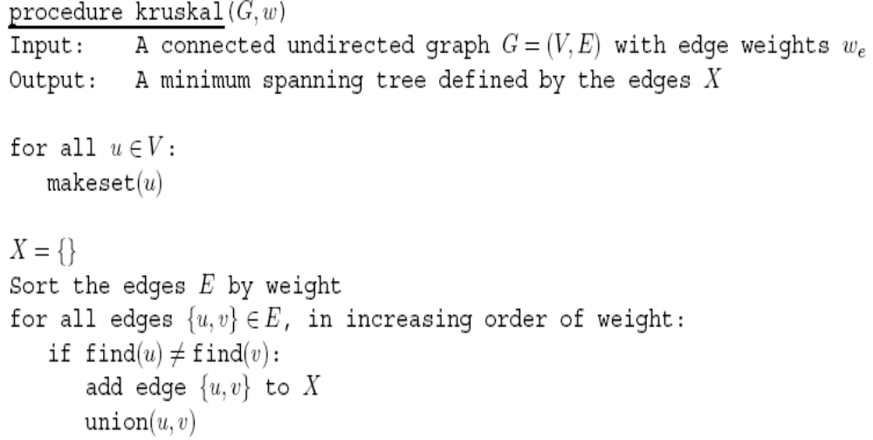

5.1.3 Kruskal’s algorithm
Makeset(x): create a singleton set containing just x
Find(x): to which set does x belong?
Union(x,y): merge the sets containing x and y
Set: connected component
Total work:
|V| makeset, 2|E| find, |V|-1 union
The total time:
O((|V|+|E|)log|V|),
if implement with disjoint sets

Slide 10
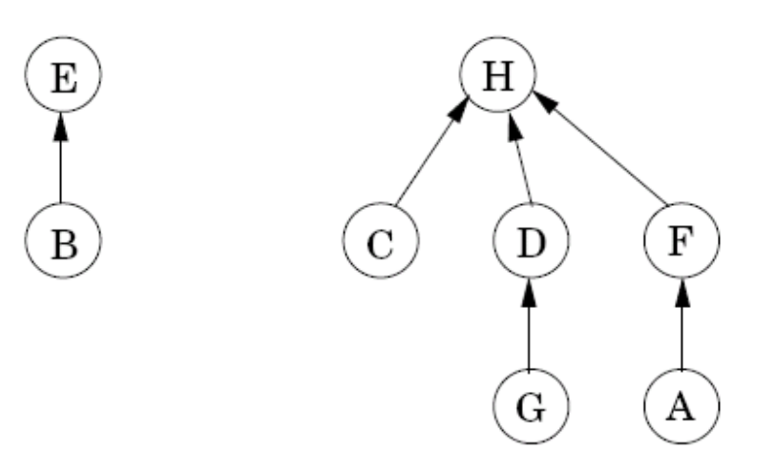
5.1.4 A data structure for disjoint sets
Why use disjoint sets?
  Contain the nodes of a particular component
How to store disjoint sets?
  A directed tree
  Nodes of the tree are elements of the set
  Each has a parent pointer that eventually leads up to the root of the tree

Slide 11
5.1.4 A data structure for disjoint sets
Each node has a parent pointer π and a rank (the height of the subtree rooted at that node)
Three operations on disjoint sets:
  Makeset(x)
    Make a singleton tree
    O(1)
  Find(x)
    Follow parent pointer to the root of the tree
    O(logn)
  Union(x,y)
    Make the root of the shorter tree point to the root of the taller tree
    The overall height increases only if equally tall
    O(logn)

Slide 12
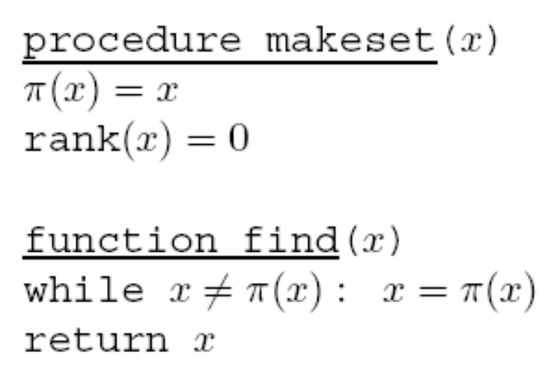
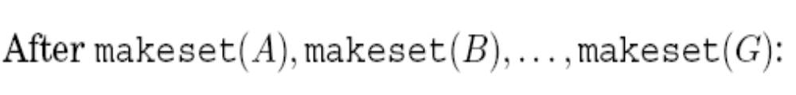
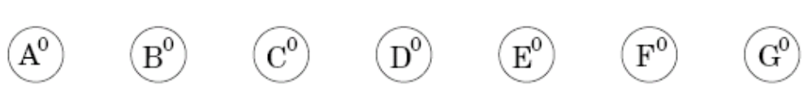
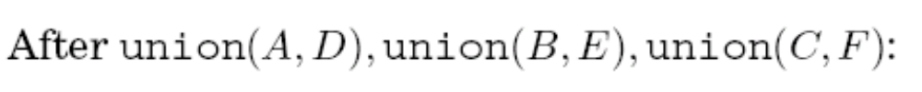
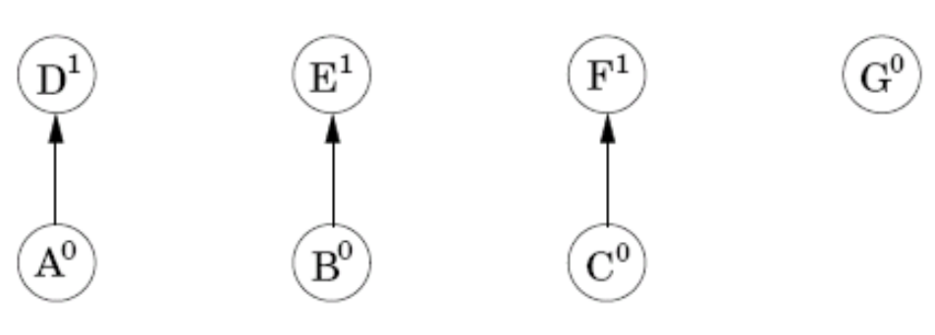
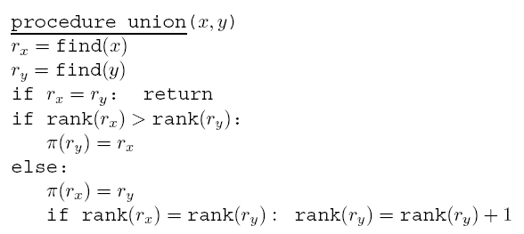
5.1.4 A data structure for disjoint sets

Slide 13

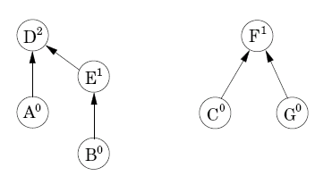

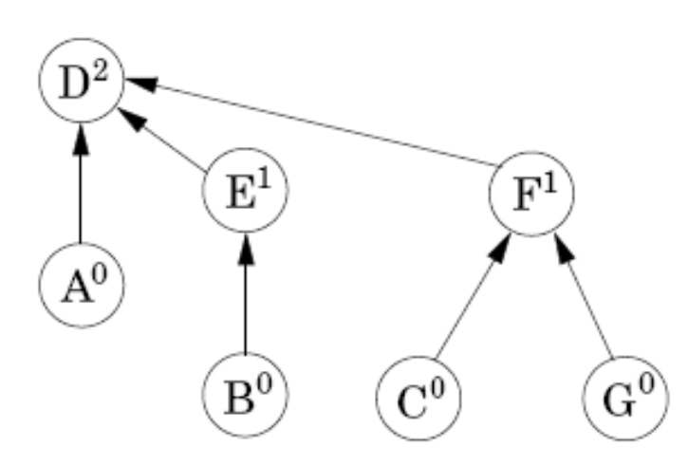
5.1.4 A data structure for disjoint sets
Property 1 For any x≠π(x), rank(x)<rank(π(x)).
Property 2 Any root node of rank k has at least 2^{k} nodes in its tree.
Property 3 If there are n elements overall, there can be at most n/2^{k} nodes of rank k. (All the trees have height ≤ logn)

Slide 14
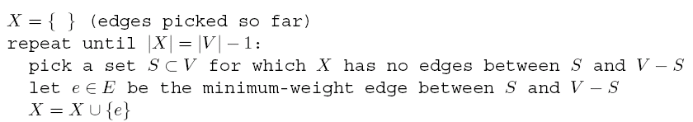
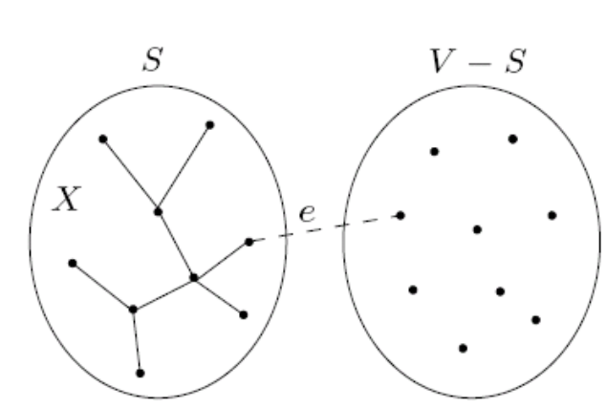
5.1.5 Prim’s algorithm
The following greedy schema always works for finding MST:
Prim’s algorithm: X always forms a subtree, and S is the set of this tree’s vertices

Slide 15
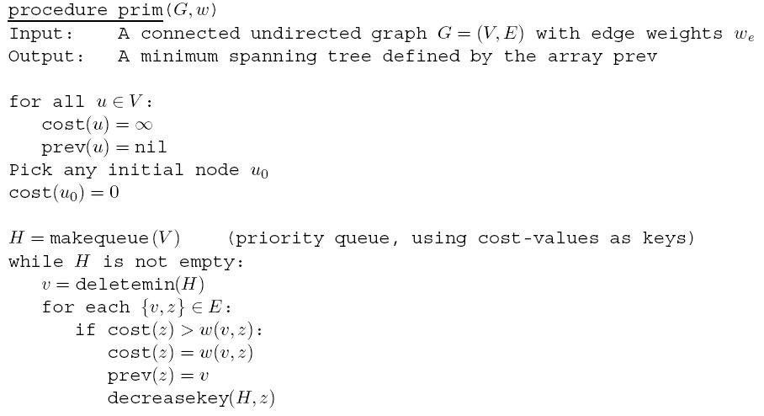

5.1.5 Prim’s algorithm
Similar to Dijkstra’s algorithm, except that the key value is the weight of the lightest incoming edge from set S, while in Dijkstra’s it is the length of an entire path to the node
The time complexity: O((|V|+|E|)log|V|)

Slide 16
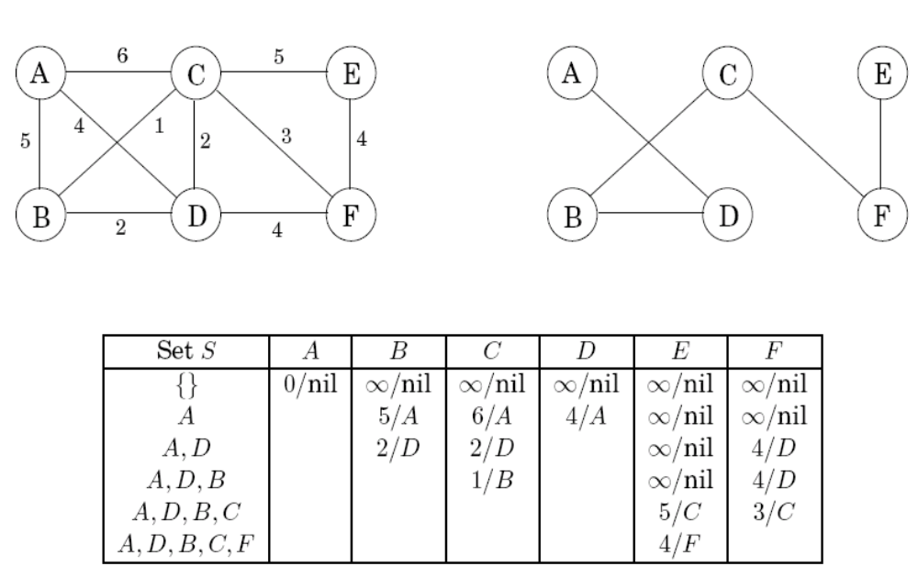
5.1.5 Prim’s algorithm

Slide 17
5.2 Huffman encoding
The introductory example:
A long string of length T = 130 million, an alphabet Γ consists of just four symbols A, B, C, D, how to encode in the most economical way?
  Uniform-length encoding
    00 for A, 01 for B, 10 for C, 11 for D
    260 megabits are needed in total
  Variable-length encoding
    One bit for the frequently occurring symbol, while three or more bits for less common symbols
    Cause ambiguity
    Prefix-free property: no codeword can be a prefix of another codeword

Slide 18
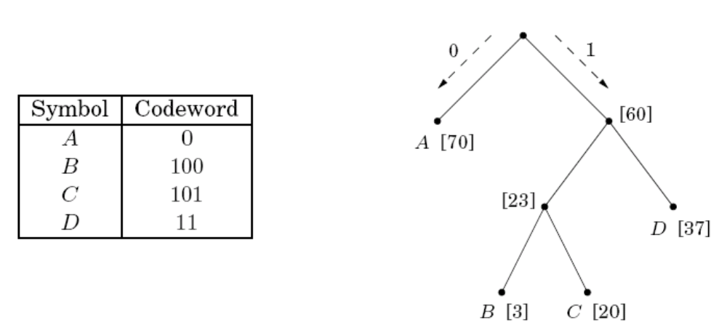
5.2 Huffman encoding
Prefix-free encoding:
  Represented by a full binary tree
  Symbols are at the leaves
  Codeword: a path from root to leaf, interpreting left as 0 and right as 1
  For the introductory example, drop to 213 megabits, a 18% improvement

Slide 19
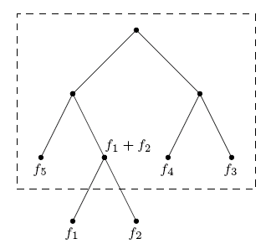
5.2 Huffman encoding
How to find the optimal coding tree, given the frequencies f₁,f₂,…,f_{n} of n symbols?
  Define the frequency of any internal node to be the sum of the frequencies of its descendant leaves
  The cost of tree is the sum of the frequencies of all leaves and internal nodes, except the root
  Construct the tree greedily:
    Find the two symbols with the smallest frequencies f₁ and f₂
    Pull f₁ and f₂ off the list of frequencies, insert (f₁ ＋ f₂), and loop

Slide 20
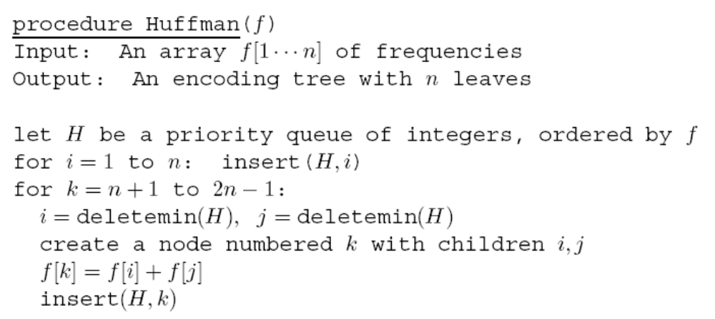
5.2 Huffman encoding
Use priority queue
Take O(nlogn) time if a binary heap is used

Slide 21
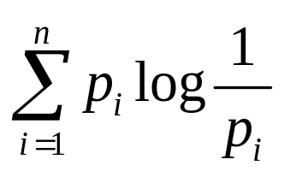
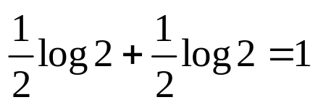
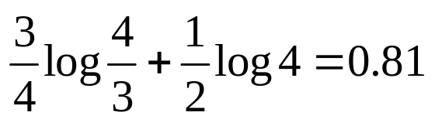
5.2 Huffman encoding
The entropy of a probability distribution: a measure of how much randomness it contains
The average number of bits needed to encode:
Examples:
  A fair coin has two outcomes, each with probability ½
  The coin flip contains one bit of randomness
  A biased coin has a ¾ chance of turning up heads
  The lower entropy, the less randomness

Slide 22

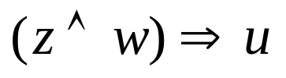
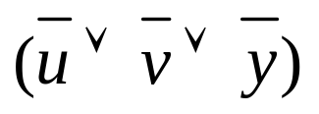
5.3 Horn formulas
Horn formulas: express logical facts and deriving conclusions
Boolean variable: take value true or false
Literal: a variable x or its negation
Two kinds of Horn clauses:
  Implications: left-hand side is an AND of any number of positive literals and right-hand side is a single positive literal
  Pure negative clauses: an OR of any number of negative literals
  Satisfying assignment: an assignment of true/false values to the variables that satisfies all the clauses.

Slide 23
5.3 Horn formulas
The implications → set variables to true
The negative clauses → set variables to false
How to solve a Horn formula
  Start with all variables false
  Set some variables to true, one by one, only if have to (greedy scheme)
  Once all implications are satisfied, back to check whether all negative clauses are satisfied
  Correctness guarantee: if return an assignment, then it is a valid solution; if find no satisfying assignment, then there really is none.
  The invariant: if a certain set of variables is set to true, then they must be true in any satisfying assignment

Slide 24
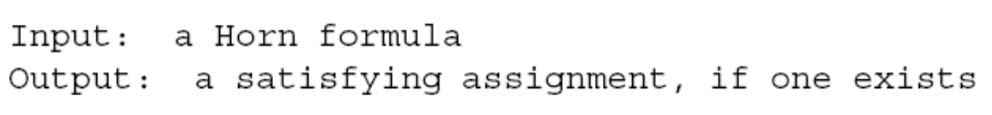
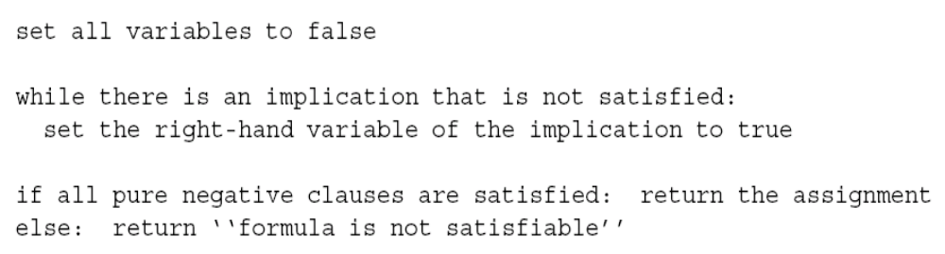
5.3 Horn formulas

Slide 25
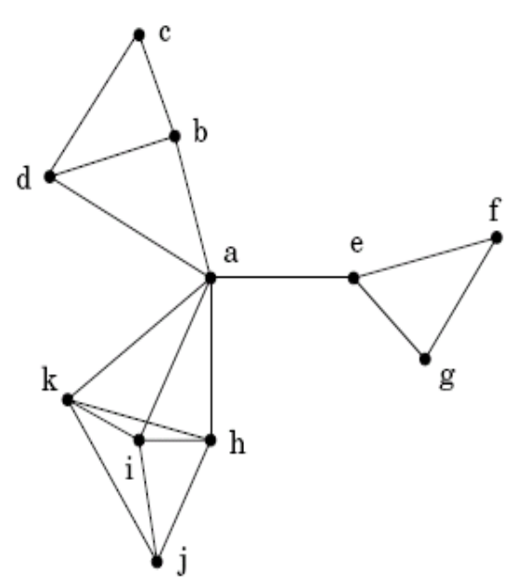
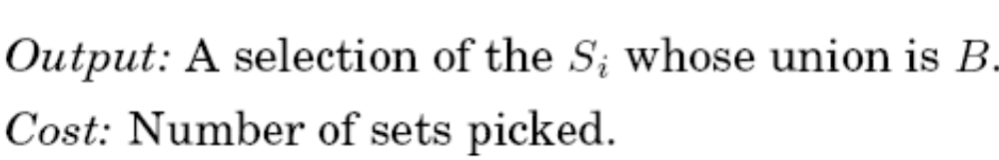
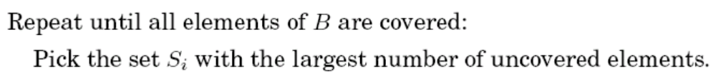
5.4 Set cover
The set cover problem:
A greedy algorithm:
A greedy solution{a, c, j, f } vs. an optimal solution{b, e, i}
O(mn*n) = O(mn²)

Slide 26
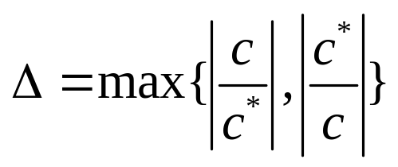
5.4 Set cover
Claim: Suppose B contains n elements and that the optimal cover consists of k sets. Then the greedy algorithm will use at most klnn sets.
Approximation factor: the ratio between the optimal value of the approximation solution and that of the optimal solution.
The closer the approximation factor is to one, the better the greedy algorithm performs.

Slide 27
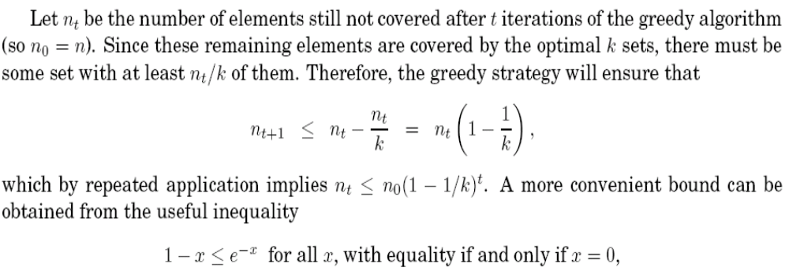
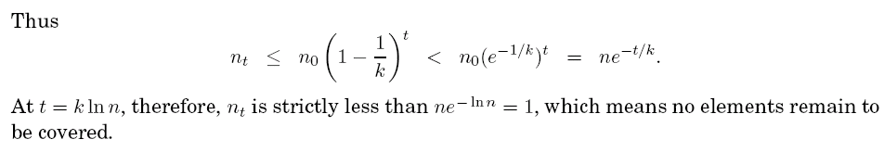
5.4 Set cover
Proof

Slide 28
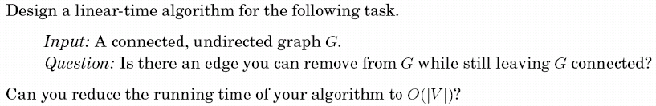
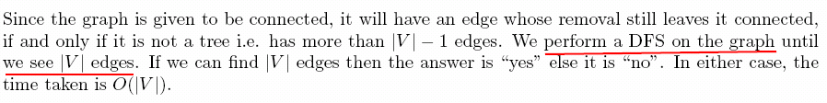
Exercise 5.3

Slide 29
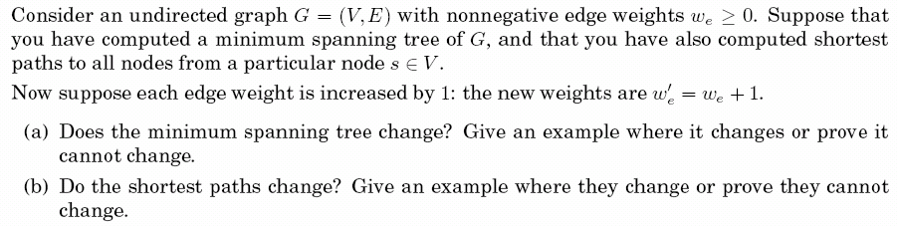
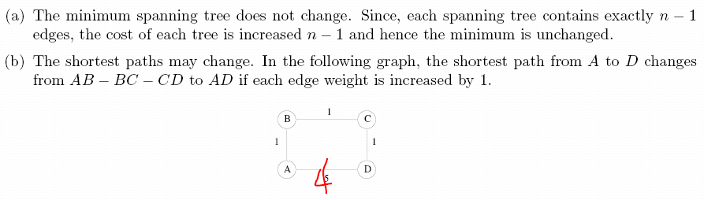
Exercise 5.5
4

Slide 30
Exercise 5.7

Slide 31
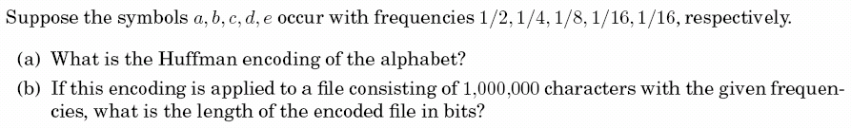

Exercise 5.14

Slide 32
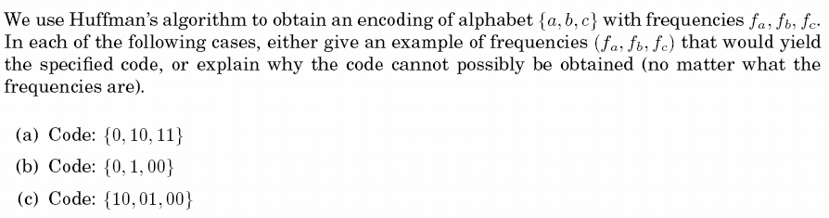
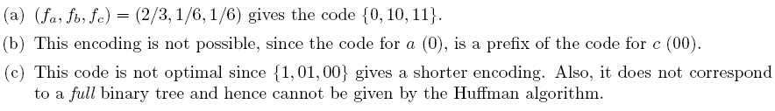
Exercise 5.15

Slide 33
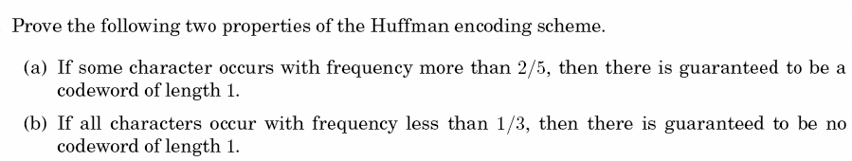
Exercise 5.16

Slide 34
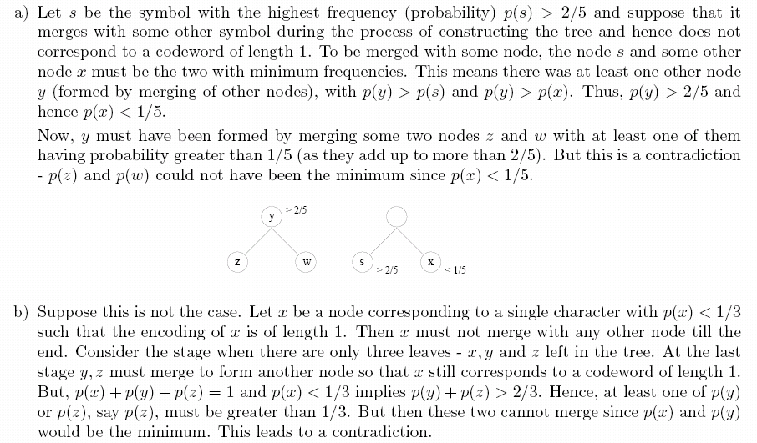
Exercise 5.16
Earlier merge!
nodes

Slide 35
Exercise 5.17

Slide 36
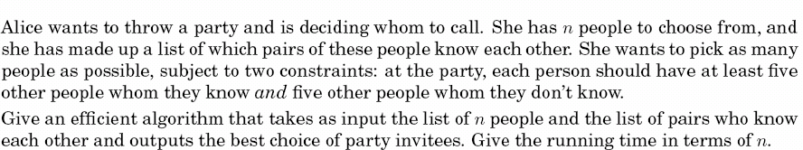
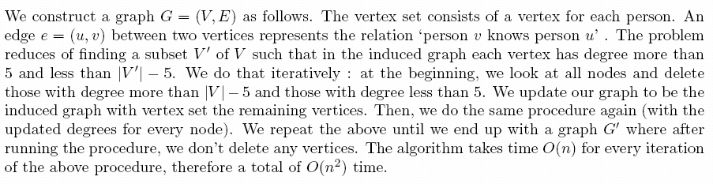
Exercise 5.28
O(V+O(E))
O(V²+E)=O(V²)

Slide 37
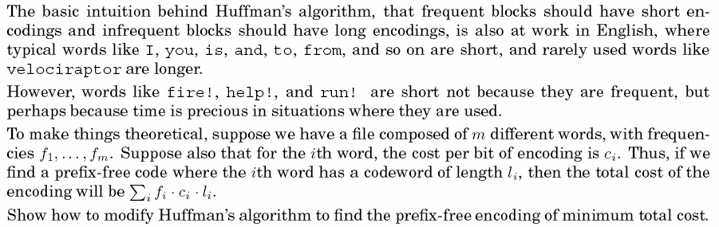
Exercise 5.31

Slide 38
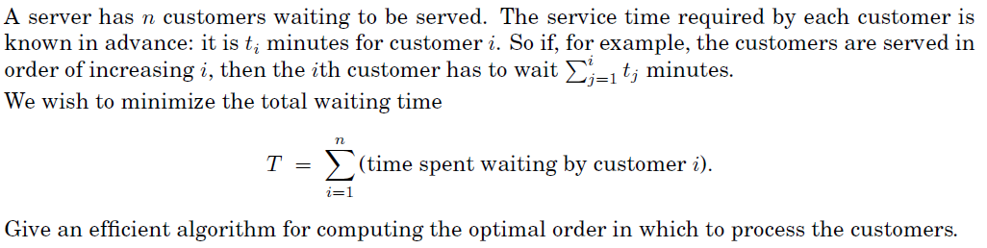
EXERCISE 5.32
i-1

Slide 39
Homework:
Ex 5.17, 5.32 submit in the next lesson, please.

Slide 40
Exercise 5.17

Slide 41

EXERCISE 5.32

Slide 42


EXERCISE 5.32

