Slide 1
第 8 章
16位流水线CPU设计

Slide 2
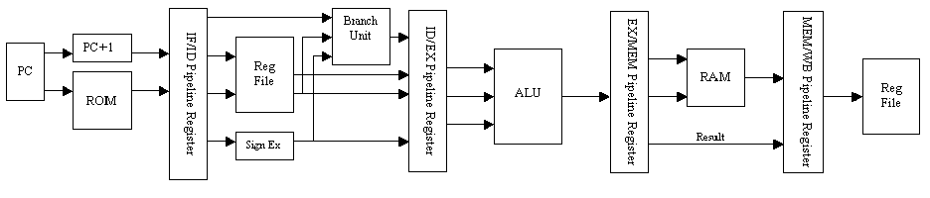
8.1 流水线CPU的结构
图8-1 流水线CPU的结构

Slide 3
8.2 指令系统设计
指令系统的完备性
指令系统的高效性
指令系统的规整性
指令系统的兼容性

Slide 4
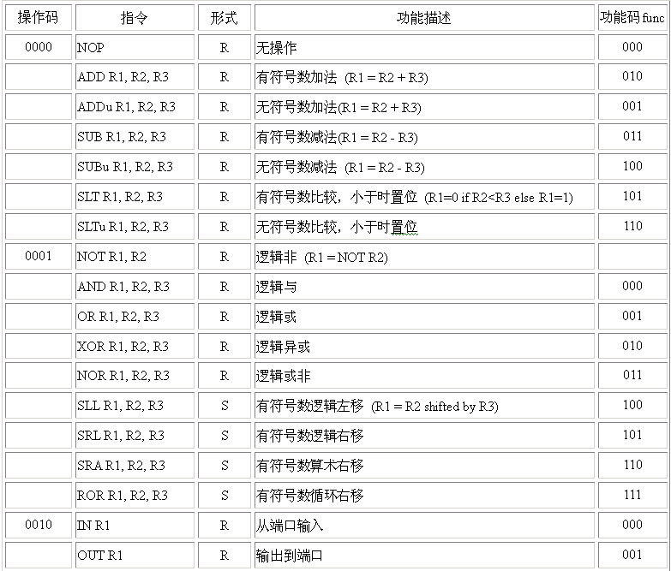
图8-1 流水线CPU的结构
8.2 指令系统设计

Slide 5
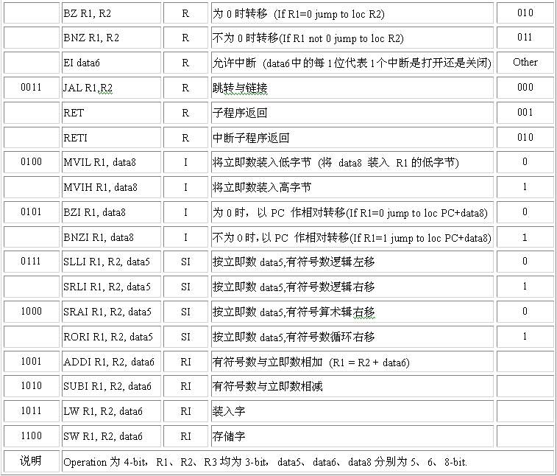
图8-1 流水线CPU的结构
8.2 指令系统设计

Slide 6

8.2 指令系统设计
8.2.1寄存器型 (R-型)
图8-2 R-型指令 ADD R1,R2,R3

Slide 7

8.2 指令系统设计
8.2.2 寄存器立即数型(RI-型)
图8-3 RI-型指令 ADDI R1,R2,0FH

Slide 8

8.2 指令系统设计
8.2.3 立即数型 (I-型)
图8-4 I-型指令 MVIL R1,FFH

Slide 9

8.2 指令系统设计
8.2.4 立即移位型 (SI-型)
图8-5 SI-型指令 RORI R1,R2,2H

Slide 10
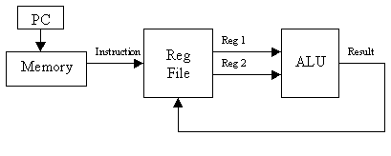
8.3 数据通路设计
8.3.1 R-型数据通路
图8-6 R-型 ALU 指令的数据通路

Slide 11
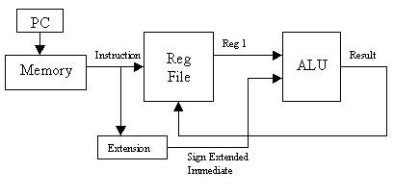
8.3 数据通路设计
8.3.2 RI-型数据通路
图 8-7 RI-型 ALU 指令的数据通路

Slide 12
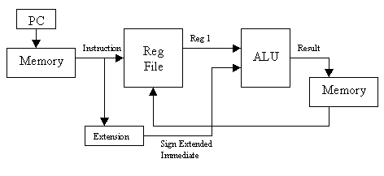
8.3 数据通路设计
8.3.3装入字数据通路
图8-8 装入字数据通路

Slide 13
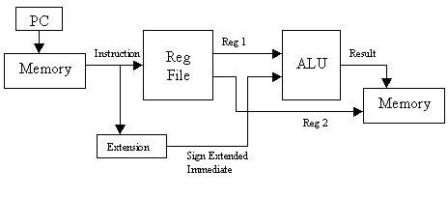
8.3 数据通路设计
8.3.4存储字数据通路
图8-9 存储指令的数据通路

Slide 14
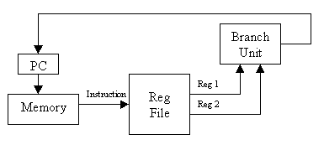
8.3 数据通路设计
8.3.5寄存器转移数据通路
图8-10 转移指令数据通路

Slide 15
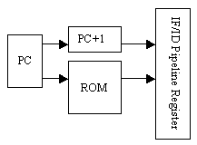
8.4流水线各段设计和功能描述
8.4.1 Stage 1取指令段
图 8-11 IF Stage 1的结构

Slide 16
8.4流水线各段设计和功能描述
8.4.1 Stage 1取指令段
1．功能描述
（1）取指令及锁存。
（2）地址计算。
（3）检验指令的合法性。
（4）同步控制。
2．模块划分和实现

Slide 17
【例8-1】
library ieee;
use ieee.std_logic_arith.all;
use ieee.std_logic_1164.all;
use ieee.std_logic_signed.all;
use ieee.std_logic_unsigned.all;
ENTITY pcselector IS
PORT(nextpc, branchpc, retpc, retipc : IN STD_LOGIC_VECTOR(15 DOWNTO 0);
sel : IN STD_LOGIC_VECTOR(3 DOWNTO 0);
newpc : OUT STD_LOGIC_VECTOR(15 DOWNTO 0));
END ENTITY pcselector;
ARCHITECTURE sel_behav OF pcselector IS
name : PROCESS(sel) IS
BEGIN
CASE sel IS
WHEN "0000" => newpc <= nextpc;
WHEN "0001" => newpc <= branchpc;
WHEN "0010" => newpc <= retpc;
WHEN "0011" => newpc <= retipc;
WHEN "0100" => newpc <= "1111111111111111";
WHEN "0101" => newpc <= "1111111111110000";
WHEN "0110" => newpc <= "0000000000001000";
WHEN "0111" => newpc <= "0000000000001100";
WHEN "1000" => newpc <= "0000000000001100";
WHEN "1001" => newpc <= "0000000000001110";
WHEN "1010" => newpc <= "0000000000010000";
WHEN OTHERS => newpc <= "0000000000010010";
END CASE;
END PROCESS name;
END ARCHITECTURE sel_behav;
8.4流水线各段设计和功能描述
8.4.1 Stage 1取指令段
BEGIN

Slide 18
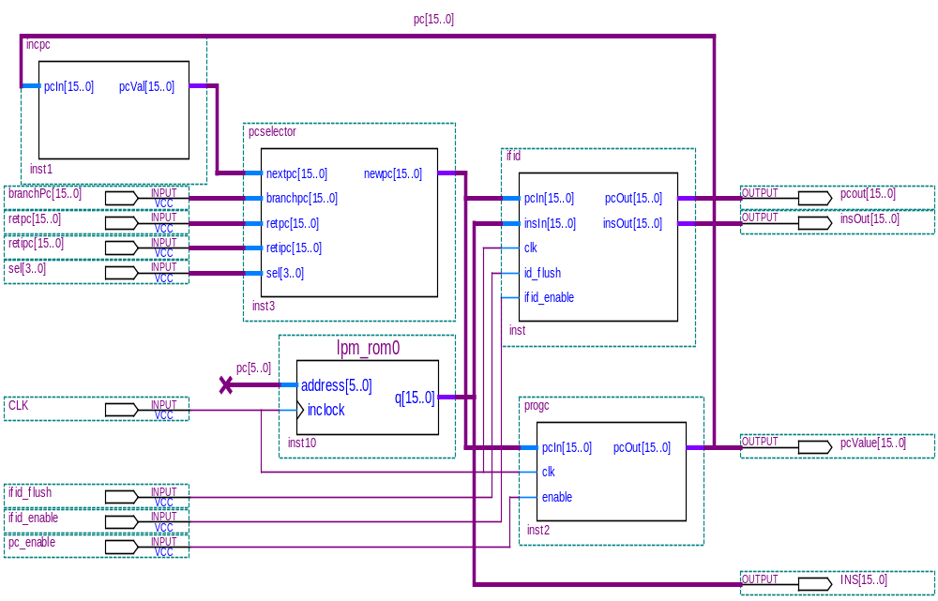
8.4流水线各段设计和功能描述
8.4.1 Stage 1取指令段
2．模块划分和实现
图8-12 Stage 1取指令段的各模块信号连接电路

Slide 19
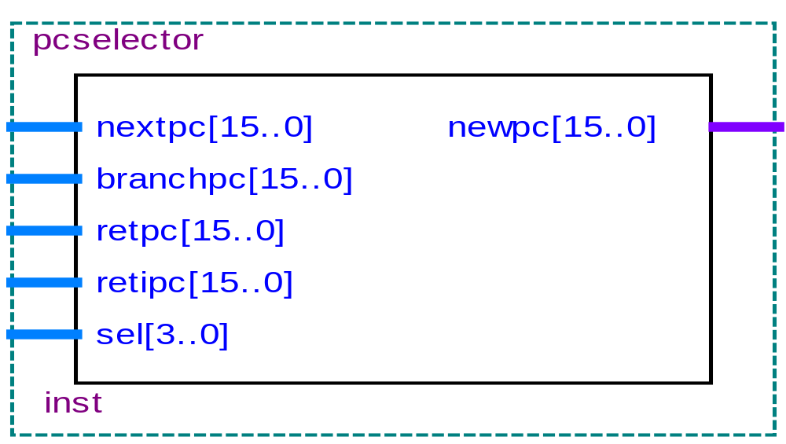
8.4流水线各段设计和功能描述
8.4.1 Stage 1取指令段
2．模块划分和实现
图8-13 pcselector的实体结构

Slide 20
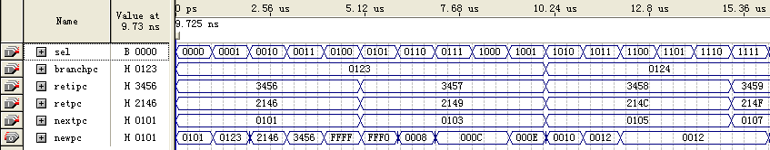
8.4流水线各段设计和功能描述
8.4.1 Stage 1取指令段
2．模块划分和实现
图8-14 pcselector的时序仿真波形图

Slide 21
【例8-2】
library ieee;
use ieee.std_logic_1164.all;
ENTITY progc IS
PORT(pcIn : IN STD_LOGIC_VECTOR(15 DOWNTO 0); clk,enable : IN STD_LOGIC;
pcOut : OUT STD_LOGIC_VECTOR(15 DOWNTO 0));
END ENTITY progc;
ARCHITECTURE progc_behav OF progc IS
BEGIN
name : PROCESS(clk) IS
VARIABLE regValue : STD_LOGIC_VECTOR(15 DOWNTO 0);
BEGIN
IF(clk='1') THEN
IF(enable='1') THEN regValue := pcin; END IF;
END IF;
pcOut <= regValue;
END PROCESS name;
END ARCHITECTURE progc_behav;
8.4流水线各段设计和功能描述

Slide 22
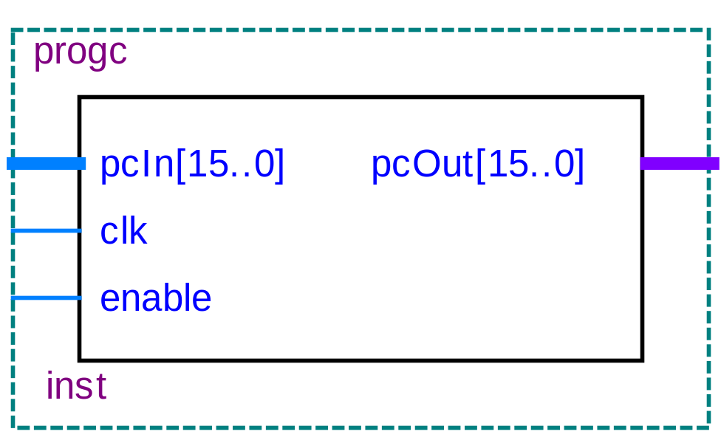
8.4流水线各段设计和功能描述
8.4.1 Stage 1取指令段
2．模块划分和实现
图8-15 progc的实体结构

Slide 23
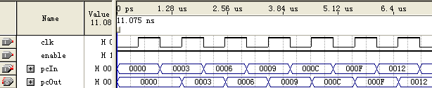
8.4流水线各段设计和功能描述
8.4.1 Stage 1取指令段
2．模块划分和实现
图8-16 progc的时序仿真图

Slide 24
8.4流水线各段设计和功能描述
8.4.1 Stage 1取指令段
2．模块划分和实现
【例8-3】
library ieee;
use ieee.std_logic_1164.all;
use ieee.std_logic_arith.all;
use ieee.std_logic_unsigned.all;
ENTITY incpc IS
PORT(pcIn : IN STD_LOGIC_VECTOR(15 DOWNTO 0);
pcVal : OUT STD_LOGIC_VECTOR(15 DOWNTO 0));
END ENTITY incpc;
ARCHITECTURE pc_behav OF incpc IS
BEGIN
name : PROCESS(pcIn) IS
BEGIN
pcVal <= pcIn +1;
END PROCESS name;
END ARCHITECTURE pc_behav;

Slide 25
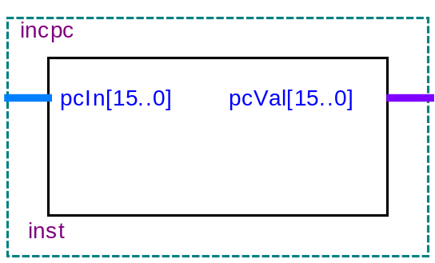

8.4流水线各段设计和功能描述
8.4.1 Stage 1取指令段
2．模块划分和实现
(a) incpc的实体结构 (b) incpc的RTL结构
图8-17 程序计数器加1模块

Slide 26

8.4流水线各段设计和功能描述
8.4.1 Stage 1取指令段
2．模块划分和实现
图8-18 程序计数器加1模块的仿真波形

Slide 27
【例8-4】
LIBRARY ieee;
USE ieee.std_logic_1164.all;
LIBRARY altera_mf;
USE altera_mf.altera_mf_components.all;
ENTITY lpm_rom0 IS
PORT (address : IN STD_LOGIC_VECTOR (5 DOWNTO 0);
Inclock : IN STD_LOGIC ; q : OUT STD_LOGIC_VECTOR (15 DOWNTO 0) );
END lpm_rom0;
ARCHITECTURE SYN OF lpm_rom0 IS
SIGNAL sub_wire0 : STD_LOGIC_VECTOR (15 DOWNTO 0);
COMPONENT altsyncram
GENERIC ( address_aclr_a : STRING;
init_file : STRING;
intended_device_family : STRING;
lpm_hint : STRING;
lpm_type : STRING;
numwords_a : NATURAL;
operation_mode : STRING;
outdata_aclr_a : STRING;
outdata_reg_a : STRING;
widthad_a : NATURAL;
width_a : NATURAL;
width_byteena_a : NATURAL );
8.4流水线各段设计和功能描述
8.4.1 Stage 1取指令段
2．模块划分和实现
接下页

Slide 28
8.4流水线各段设计和功能描述
PORT ( clock0 : IN STD_LOGIC ;
address_a : IN STD_LOGIC_VECTOR (5 DOWNTO 0);
q_a : OUT STD_LOGIC_VECTOR (15 DOWNTO 0) );
END COMPONENT;
BEGIN
q <= sub_wire0(15 DOWNTO 0);
altsyncram_component : altsyncram
GENERIC MAP ( address_aclr_a => "NONE", init_file => "rom_2.mif",
intended_device_family => "Cyclone",
lpm_hint => "ENABLE_RUNTIME_MOD=YES, INSTANCE_NAME=rom3",
lpm_type => "altsyncram", numwords_a => 64,
operation_mode => "ROM", outdata_aclr_a => "NONE",
outdata_reg_a => "UNREGISTERED", widthad_a => 6,
width_a => 16, width_byteena_a => 1 )
PORT MAP ( clock0 => inclock,address_a => address,q_a => sub_wire0 );
END SYN;
8.4.1 Stage 1取指令段
2．模块划分和实现

Slide 29
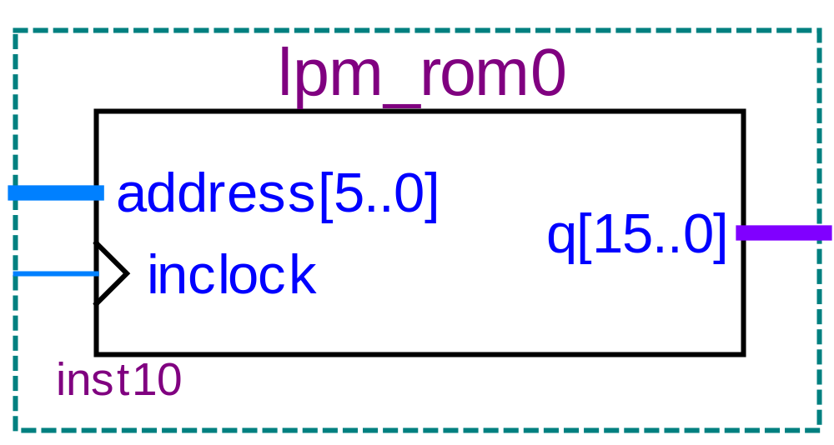
8.4流水线各段设计和功能描述
8.4.1 Stage 1取指令段
2．模块划分和实现
图8-19 lpm_rom的实体结构图

Slide 30
【例8-5】
library ieee;
use ieee.std_logic_1164.all;
ENTITY ifid IS
PORT(pcIn, insIn : IN STD_LOGIC_VECTOR(15 DOWNTO 0);
clk,id_flush,ifid_enable : IN STD_LOGIC;
pcOut, insOut : OUT STD_LOGIC_VECTOR(15 DOWNTO 0));
END ENTITY ifid;
ARCHITECTURE ifid_behav OF ifid IS
BEGIN
name : PROCESS(clk) IS
VARIABLE regValue : STD_LOGIC_VECTOR(31 DOWNTO 0);
BEGIN
IF(clk='1') THEN
IF(ifid_enable='1') THEN
IF(id_flush='1') THEN
regValue(31 DOWNTO 0) := regValue(31 DOWNTO 16) & "0000000000000000";
ELSE regValue(31 DOWNTO 0) := pcIn(15 DOWNTO 0) & insIn(15 DOWNTO 0);
END IF;
END IF;
END IF;
pcOut <= regValue(31 DOWNTO 16); insOut <= regValue(15 DOWNTO 0);
END PROCESS name;
END ARCHITECTURE ifid_behav;
8.4流水线各段设计和功能描述
8.4.1 Stage 1取指令段
2．模块划分和实现

Slide 31
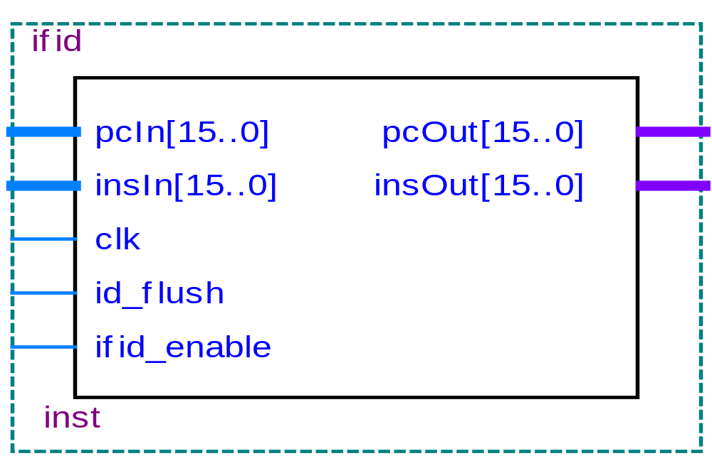
8.4流水线各段设计和功能描述
8.4.1 Stage 1取指令段
2．模块划分和实现
图8-20 ifid的实体结构图

Slide 32
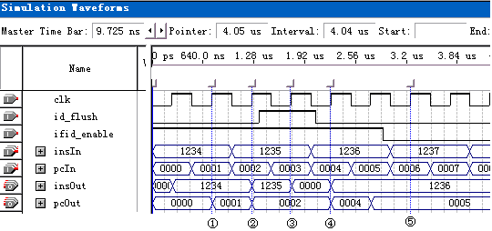
8.4流水线各段设计和功能描述
8.4.1 Stage 1取指令段
2．模块划分和实现
图8-21 ifid流水线寄存器的时序仿真波形图

Slide 33
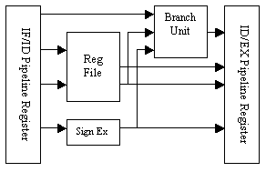
8.4流水线各段设计和功能描述
8.4.2 Stage 2译码段ID
2．模块划分和实现
图 8-22 stage 2指令译码段ID的基本结构

Slide 34
8.4流水线各段设计和功能描述
8.4.2 Stage 2译码段ID
1. stage2的功能描述
本段的主要功能如下：
访问寄存器文件。从寄存器文件中读取寄存器操作数并送往id latch段;
向寄存器文件回写数据。把流水线中已经执行完毕的指令所需要回写寄存器文件的执行结果，写入到寄存器文件当中;
符号位扩展。对指令中的8位或6位立即数操作数进行零扩展或者符号位扩展，把扩展后得到的16位操作数送往id latch段;
相关性检测。对正在ID段进行处理的指令和流水线中EXE, MEM, WB段中的指令进行数据相关检测和控制相关检测。如果检测到数据相关性，就对流水线各段发出pipeline flush信号; 如果检测到分支指令，就对流水线各段发出control flush信号。

Slide 35
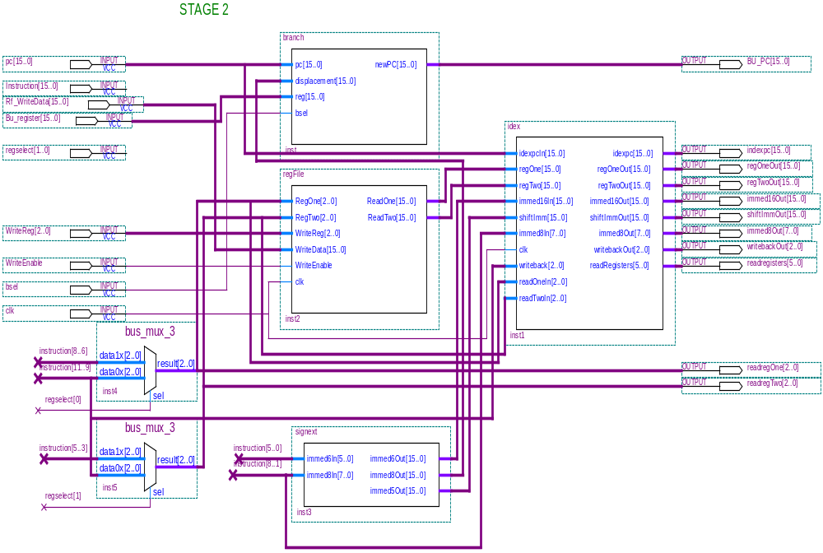
8.4流水线各段设计和功能描述
2．模块划分和实现
图 8-23 Stage 2 译码段ID的各模块信号连接电路

Slide 36
【例8-6】
library ieee;
use ieee.std_logic_1164.all;
use ieee.std_logic_arith.all;
use ieee.std_logic_signed.all;
ENTITY signext IS
PORT(immed6In : IN STD_LOGIC_VECTOR(5 DOWNTO 0);
immed8In : IN STD_LOGIC_VECTOR(7 DOWNTO 0);
immed6Out, immed8Out,immed5Out : OUT STD_LOGIC_VECTOR(15 DOWNTO 0));
END ENTITY signext;
ARCHITECTURE sign_behav OF signext IS
BEGIN
name: PROCESS(immed6In, immed8In) IS
VARIABLE tempInt : INTEGER;
BEGIN
IF(immed6In(5)='0') THEN immed6Out<="0000000000" & immed6In(5 DOWNTO 0);
ELSE immed6Out <= "1111111111" & immed6In(5 DOWNTO 0); END IF;
IF(immed8In(7)='0') THEN immed8Out<="00000000" & immed8In(7 DOWNTO 0);
ELSE immed8Out <= "11111111" & immed8In(7 DOWNTO 0); END IF;
IF(immed8In(4)='0') THEN immed5Out<="00000000000" & immed8In(5 DOWNTO 1);
ELSE immed5Out <= "11111111111" & immed8In(5 DOWNTO 1); END IF;
END PROCESS name;
END ARCHITECTURE sign_behav;
8.4流水线各段设计和功能描述

Slide 37
【例8-7】
library ieee;
use ieee.std_logic_1164.all;
use ieee.std_logic_arith.all;
use ieee.std_logic_unsigned.all;
ENTITY regFile IS
port(RegOne, RegTwo, WriteReg : IN STD_LOGIC_VECTOR(2 DOWNTO 0);
WriteData : IN STD_LOGIC_VECTOR(15 DOWNTO 0);
WriteEnable : IN STD_LOGIC;
clk : IN STD_LOGIC;
ReadOne, ReadTwo : OUT STD_LOGIC_VECTOR(15 DOWNTO 0));
END ENTITY regFile;
ARCHITECTURE behav OF regFile IS
BEGIN
reg : PROCESS (clk) IS
TYPE regArray IS ARRAY (INTEGER RANGE 0 TO 7) OF
STD_LOGIC_VECTOR(15 downto 0);
VARIABLE register_file : regArray;
BEGIN
IF(clk='1') THEN
IF (WriteEnable = '1') THEN
register_file(CONV_INTEGER(UNSIGNED(WriteReg))) := WriteData;
register_file(0) := "0000000000000000"; END IF;
(接下页）
8.4流水线各段设计和功能描述

Slide 38
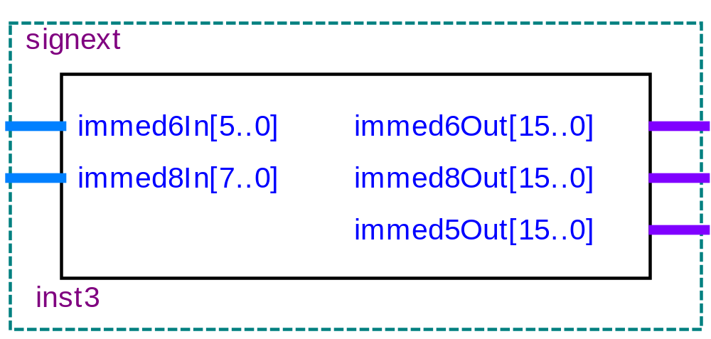
END IF;
IF(WriteEnable='1') THEN
IF(WriteReg = RegOne) THEN ReadOne <= WriteData;
ELSE ReadOne <= register_file(CONV_INTEGER(UNSIGNED(RegOne)));
END IF;
IF(WriteReg = RegTwo) THEN ReadTwo <= WriteData;
ELSE ReadTwo <= register_file(CONV_INTEGER(UNSIGNED(RegTwo)));
END IF;
ELSE ReadOne <= register_file(CONV_INTEGER(UNSIGNED(RegOne)));
ReadTwo <= register_file(CONV_INTEGER(UNSIGNED(RegTwo)));
END IF;
END PROCESS reg;
END ARCHITECTURE behav;
8.4流水线各段设计和功能描述
图8-24 符号扩展模块signext的结构图

Slide 39
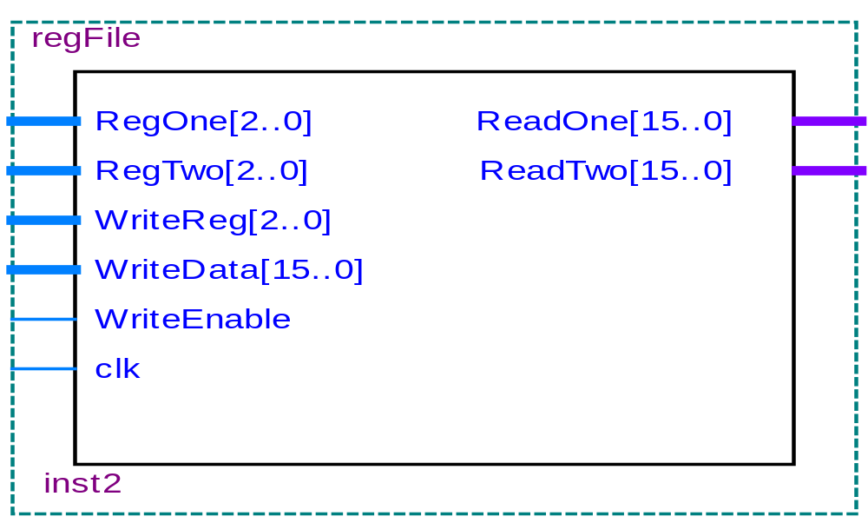
8.4流水线各段设计和功能描述
8.4.2 Stage 2译码段ID
2．模块划分和实现
图8-25 寄存器文件模块regFile的实体结构图

Slide 40
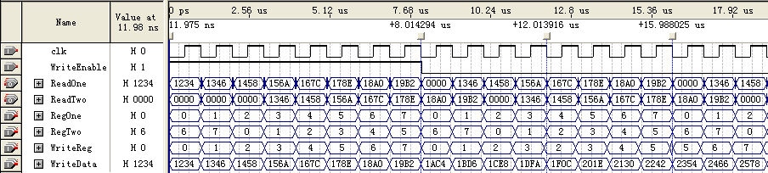
8.4流水线各段设计和功能描述
8.4.2 Stage 2译码段ID
2．模块划分和实现
图8-26 regFile的时序仿真图

Slide 41
8.4流水线各段设计和功能描述
【例8-8】
library ieee;
use ieee.std_logic_1164.all;
use ieee.std_logic_arith.all;
use ieee.std_logic_signed.all;
use ieee.std_logic_unsigned.all;
ENTITY branch IS
PORT(pc, displacement, reg : IN STD_LOGIC_VECTOR(15 DOWNTO 0);
bsel : IN STD_LOGIC;
newPC : OUT STD_LOGIC_VECTOR(15 DOWNTO 0));
END ENTITY branch;
ARCHITECTURE branch_behav OF branch IS
BEGIN
name : PROCESS(pc, displacement,reg,bsel) IS
BEGIN
IF(bsel='1') THEN newPC <= pc + displacement;
ELSE newPC <= reg; END IF;
END PROCESS name;
END ARCHITECTURE branch_behav;
8.4.2 Stage 2译码段ID
2．模块划分和实现

Slide 42
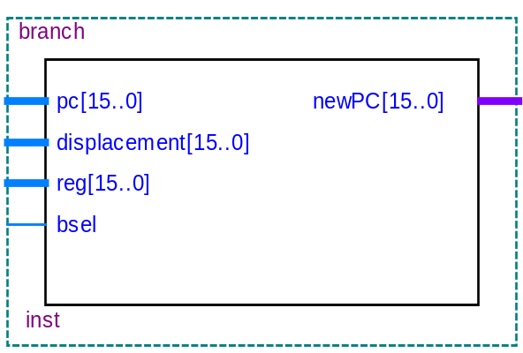
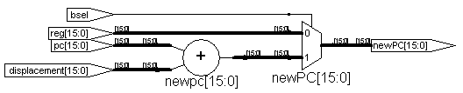
8.4流水线各段设计和功能描述
8.4.2 Stage 2译码段ID
2．模块划分和实现
(a) 实体结构图 (b) RTL结构图
图8-27 分支转移branch模块

Slide 43
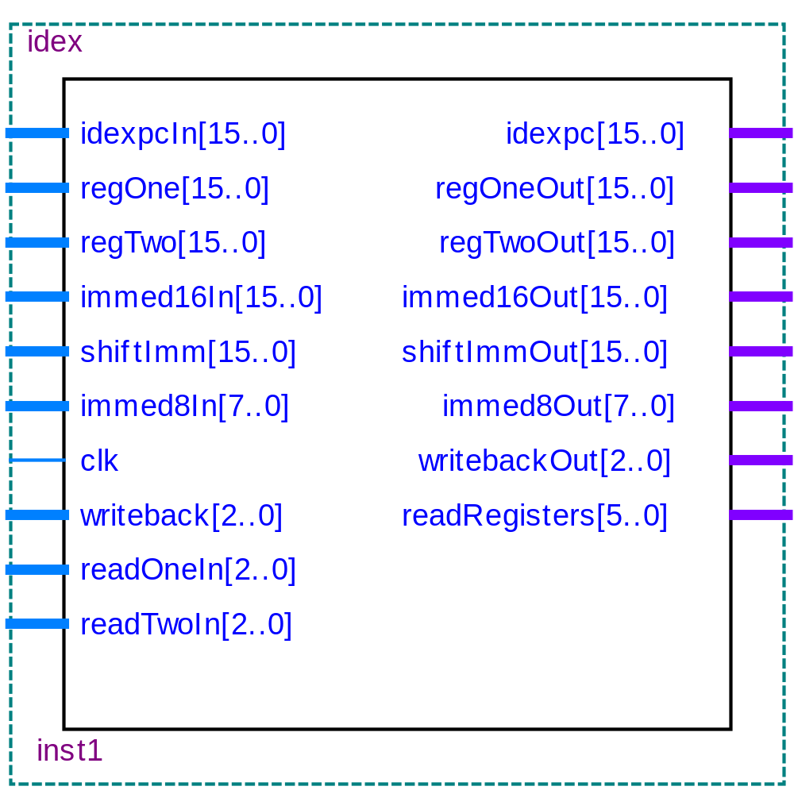
8.4流水线各段设计和功能描述
8.4.2 Stage 2译码段ID
2．模块划分和实现
图8-28 stage 2的idex结构图

Slide 44
8.4流水线各段设计和功能描述
8.4.2 Stage 2译码段ID
2．模块划分和实现
【例8-9】
library ieee;
use ieee.std_logic_1164.all;
ENTITY idex IS
PORT(idexpcIn,regOne, regTwo, immed16In : IN STD_LOGIC_VECTOR(15 DOWNTO 0);
shiftImm : IN STD_LOGIC_VECTOR(15 DOWNTO 0);
immed8In : IN STD_LOGIC_VECTOR(7 DOWNTO 0);
clk : IN STD_LOGIC;
writeback : IN STD_LOGIC_VECTOR(2 DOWNTO 0);
readOneIn, readTwoIn : IN STD_LOGIC_VECTOR(2 DOWNTO 0);
idexpc,regOneOut, regTwoOut : OUT STD_LOGIC_VECTOR(15 DOWNTO 0);
immed16Out, shiftImmOut : OUT STD_LOGIC_VECTOR(15 DOWNTO 0);
immed8Out : OUT STD_LOGIC_VECTOR(7 DOWNTO 0);
（接下页）

Slide 45
writebackOut : OUT STD_LOGIC_VECTOR(2 DOWNTO 0);
readRegisters : OUT STD_LOGIC_VECTOR(5 DOWNTO 0));
END ENTITY idex;
ARCHITECTURE idex_behav OF idex IS
BEGIN
name : PROCESS(clk) IS
VARIABLE regValue : STD_LOGIC_VECTOR(96 DOWNTO 0);
BEGIN
IF(clk='1') THEN regValue(96 DOWNTO 0) := idexpcIn(15 DOWNTO 0) &
readOneIn(2 DOWNTO 0) & readTwoIn(2 DOWNTO 0) &
shiftImm(15 DOWNTO 0) & regOne(15 DOWNTO 0) & regTwo(15 DOWNTO 0) &
immed16In(15 DOWNTO 0) & immed8In(7 DOWNTO 0) & writeback(2 DOWNTO 0);
END IF;
idexpc<=regValue(96 DOWNTO 81); readRegisters<=regValue(80 DOWNTO 75);
shiftImmOut <= regValue(74 DOWNTO 59);
regOneOut<=regValue(58 DOWNTO 43); regTwoOut<=regValue(42 DOWNTO 27);
immed16Out<=regValue(26 DOWNTO 11); immed8Out<=regValue(10 DOWNTO 3);
writebackOut <= regValue(2 DOWNTO 0);
END PROCESS name;
END ARCHITECTURE idex_behav;
8.4流水线各段设计和功能描述
8.4.2 Stage 2译码段ID
2．模块划分和实现

Slide 46
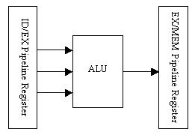
8.4流水线各段设计和功能描述
8.4.3 Stage 3执行有效地址计算段(EXE)
1．功能描述
图 8-29 stage 3执行EXE段的基本结构

Slide 47
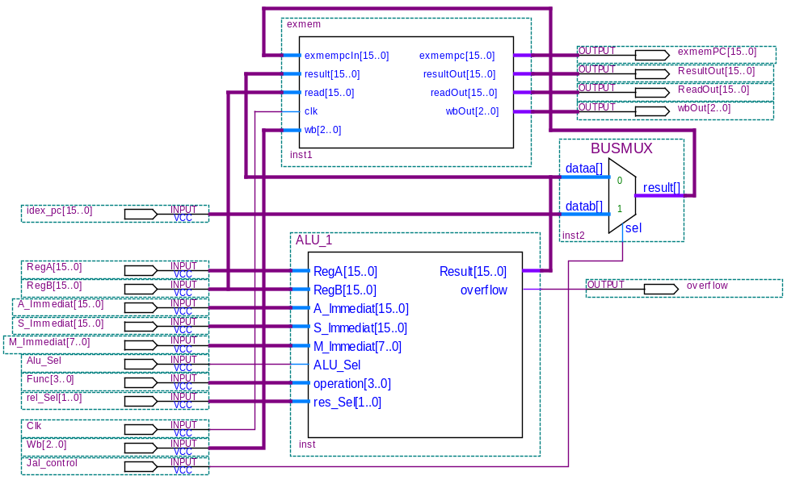
2. 模块划分和实现
8.4流水线各段设计和功能描述
8.4.3 Stage 3执行有效地址计算段(EXE )
图 8-30 Stage 3 EXE执行段的各模块信号连接电路

Slide 48
【例8-10】
library ieee;
use ieee.std_logic_1164.all;
ENTITY exmem IS
PORT(exmempcIn, result, read : STD_LOGIC_VECTOR(15 DOWNTO 0);
clk : IN STD_LOGIC;
wb : IN STD_LOGIC_VECTOR(2 DOWNTO 0);
exmempc, resultOut, readOut : OUT STD_LOGIC_VECTOR(15 DOWNTO 0);
wbOut : OUT STD_LOGIC_VECTOR(2 DOWNTO 0));
END ENTITY exmem;
ARCHITECTURE exmem_behav OF exmem IS
BEGIN
name : PROCESS(clk) IS
VARIABLE regValue : STD_LOGIC_VECTOR(50 DOWNTO 0);
BEGIN
IF(clk='1') THEN regValue(50 DOWNTO 0) := exmempcIn(15 DOWNTO 0) &
result(15 DOWNTO 0) & read(15 DOWNTO 0) & wb(2 DOWNTO 0); END IF;
exmempc <= regValue(50 DOWNTO 35); -- EX段的PC值
resultOut <= regValue(34 DOWNTO 19); --来自ALU的运算结果
readOut <= regValue(18 DOWNTO 3); --从ALU读出的数据
wbOut <= regValue(2 DOWNTO 0); --回写的寄存器
END PROCESS name;
END ARCHITECTURE exmem_behav;
2. 模块划分和实现
8.4流水线各段设计和功能描述
8.4.3 Stage 3执行有效地址计算段(EXE )
图 8-30 Stage 3 EXE执行段的各模块信号连接电路

Slide 49
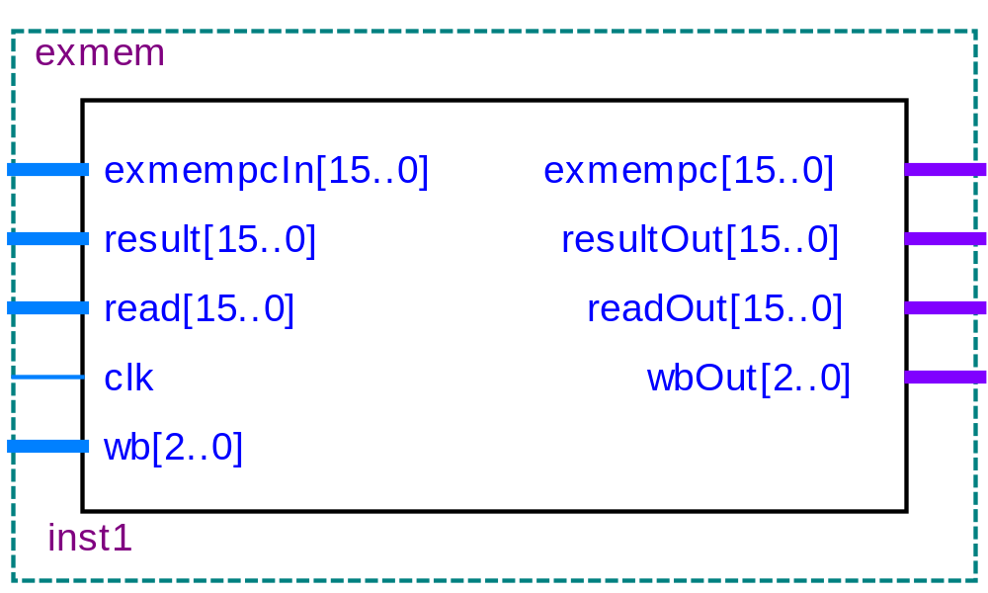
8.4流水线各段设计和功能描述
8.4.3 Stage 3执行有效地址计算段(EXE)
2. 模块划分和实现
图8-31 Stage 3 EXMEM流水线寄存器

Slide 50
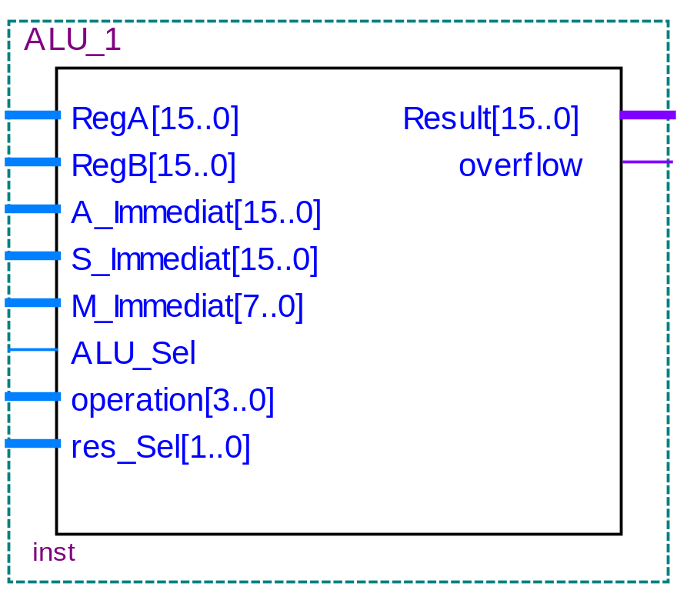
8.4流水线各段设计和功能描述
8.4.3 Stage 3执行有效地址计算段(EXE)
2. 模块划分和实现
图8-32 Stage 3的运算模块ALU_1

Slide 51
【例8-11】
library ieee;
use ieee.std_logic_1164.all;
use ieee.std_logic_arith.all;
use ieee.std_logic_signed.all;
use ieee.std_logic_unsigned.all;
ENTITY alu_16 IS
PORT(a, b : IN STD_LOGIC_VECTOR(15 DOWNTO 0);
func : IN STD_LOGIC_VECTOR(3 DOWNTO 0);
overflow : OUT STD_LOGIC;
c : OUT STD_LOGIC_VECTOR(15 DOWNTO 0));
END ENTITY alu_16;
ARCHITECTURE alu_behav OF alu_16 IS
BEGIN
name : PROCESS(a, b, func) IS
VARIABLE signedResult : SIGNED(15 DOWNTO 0);
VARIABLE unsignedResult : UNSIGNED(16 DOWNTO 0);
VARIABLE temp : STD_LOGIC_VECTOR(15 DOWNTO 0);
VARIABLE a1,b1 : STD_LOGIC_VECTOR(16 DOWNTO 0);
BEGIN
CASE func IS
WHEN "0000" => c <= a and b; overflow <= '0'; --AND_WORD
WHEN "0001" => c <= a or b; overflow <= '0'; --OR
WHEN "0010" => c <= a xor b; overflow <= '0'; --XOR
WHEN "0011" => c <= a nor b; overflow <= '0'; --NOR
WHEN "0100" => c <= not a; overflow <= '0'; --NOT
WHEN "0101" => signedResult := conv_signed(conv_integer(signed(a))
(接下页）
8.4流水线各段设计和功能描述
8.4.3 Stage 3执行有效地址计算段(EXE )
2. 模块划分和实现
图8-32 Stage 3的运算模块ALU_1

Slide 52
+conv_integer(signed(b)),16); --ADD
temp := conv_std_logic_vector(signed(a) + signed(b), 16);
c <= conv_std_logic_vector(signedResult,16); overflow <= '0';
WHEN "0110" => signedResult := signed(a) - signed(b); --SUB
c <= conv_std_logic_vector(signedResult,16); overflow <= '0';
WHEN "0111" => unsignedResult := unsigned(a) + unsigned(b);--ADD
a1 := "0" & a ; b1 :="0" & b;
unsignedResult := unsigned(a1) + unsigned(b1);
c <= conv_std_logic_vector(unsignedResult,16);
IF(conv_integer(unsignedResult) >= 65536) then overflow <= '1';
ELSE overflow <= '0'; END IF;
WHEN "1000" => a1 := "0" & a ; b1 :="0" & b; --SUBu
unsignedResult := unsigned(a1) - unsigned(b1);
c <=conv_std_logic_vector(unsignedResult,16); overflow <= '0';
WHEN "1001" => if(conv_integer(unsigned(a))<=conv_integer(unsigned(b)))
Then c <= "0000000000000000";
else c <= "0000000000000001"; end if;
overflow <= '0';
WHEN "1010" => if(conv_integer(signed(a))<=conv_integer(signed(b)))
Then c<="0000000000000000";
else c<="0000000000000001"; end if;
overflow <= '0';
WHEN others => c <= a; overflow <= '0';
END CASE;
END PROCESS name;
END ARCHITECTURE alu_behav;
8.4流水线各段设计和功能描述
8.4.3 Stage 3执行有效地址计算段(EXE )
2. 模块划分和实现
图8-32 Stage 3的运算模块ALU_1

Slide 53
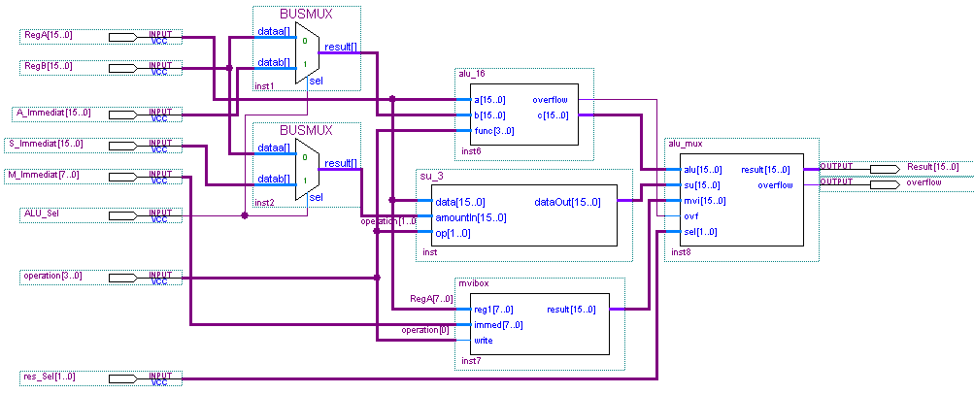
8.4流水线各段设计和功能描述
8.4.3 Stage 3执行有效地址计算段(EXE )
2. 模块划分和实现
图 8-33 运算模块ALU的内部结构图

Slide 54
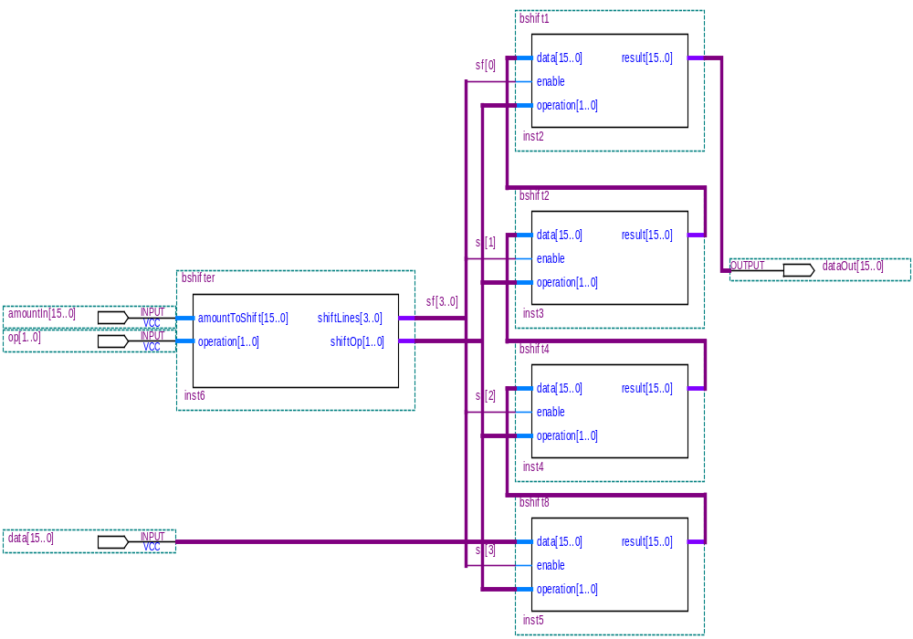
8.4流水线各段设计和功能描述
8.4.3 Stage 3执行有效地址计算段(EXE )
2. 模块划分和实现
图8-34 SU_3移位运算模块内部结构图

Slide 55
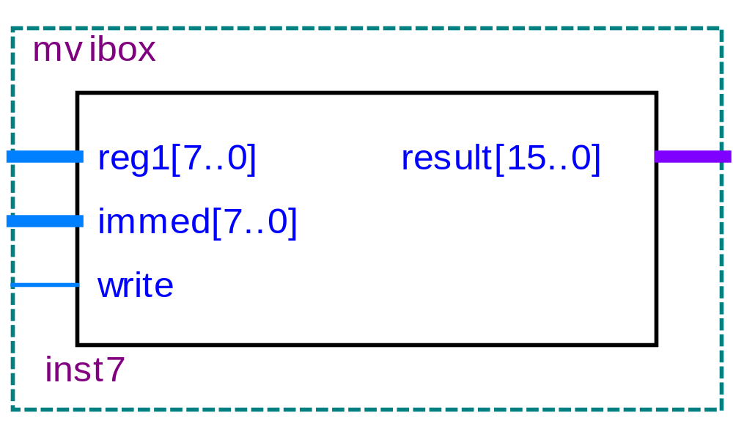
8.4流水线各段设计和功能描述
8.4.3 Stage 3执行有效地址计算段(EXE)
2. 模块划分和实现
图 8-35 movibox数据输入模块结构

Slide 56
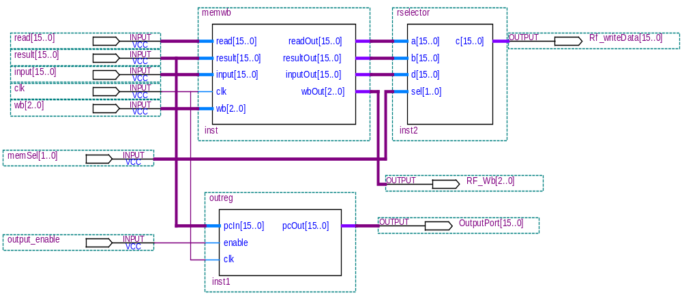
8.4流水线各段设计和功能描述
8.4.4 stage4访存段(MEM)
1.功能描述
图8-36 访存段Stage 4的内部结构

Slide 57
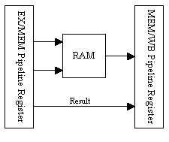
8.4流水线各段设计和功能描述
8.4.4 stage4访存段(MEM)
2．模块划分和实现
图8-37 Stage 4的基本结构

Slide 58
【例8-14】
library ieee;
use ieee.std_logic_1164.all;
ENTITY memwb IS
PORT(read, result, input : STD_LOGIC_VECTOR(15 DOWNTO 0);
clk : IN STD_LOGIC;
wb : IN STD_LOGIC_VECTOR(2 DOWNTO 0);
readOut, resultOut,inputOut : OUT STD_LOGIC_VECTOR(15 DOWNTO 0);
wbOut : OUT STD_LOGIC_VECTOR(2 DOWNTO 0));
END ENTITY memwb;
ARCHITECTURE memwb_behav OF memwb IS
BEGIN
name : PROCESS(clk) IS
VARIABLE regValue : STD_LOGIC_VECTOR(50 DOWNTO 0);
BEGIN
IF(clk='1') THEN
regValue(50 DOWNTO 0) := result(15 DOWNTO 0) & read(15 DOWNTO 0) &
input(15 DOWNTO 0) & wb(2 DOWNTO 0); END IF;
resultOut <= regValue(50 DOWNTO 35); readOut <= regValue(34 DOWNTO 19);
inputOut <= regValue(18 DOWNTO 3) ; wbOut <= regValue(2 DOWNTO 0);
END ARCHITECTURE memwb_behav;
8.4流水线各段设计和功能描述
8.4.4 stage4访存段(MEM)
END PROCESS name;
2．模块划分和实现
图8-37 Stage 4的基本结构

Slide 59
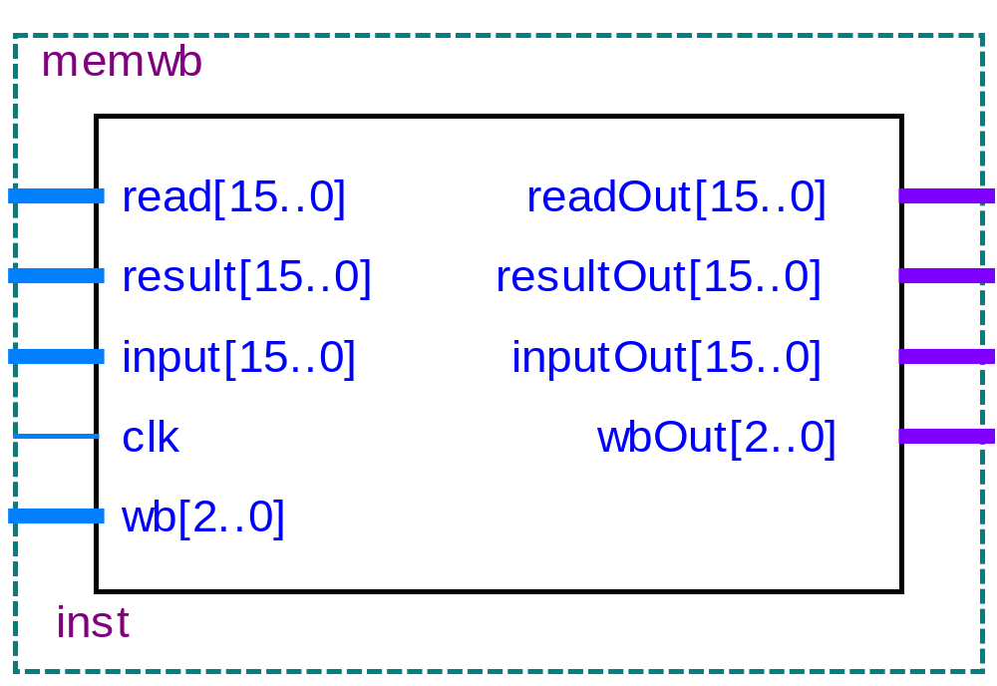
8.4流水线各段设计和功能描述
8.4.4 stage4访存段(MEM)
END PROCESS name;
2．模块划分和实现
图8-38 Stage 4的MEM/WB流水线寄存器

Slide 60
8.4流水线各段设计和功能描述
【例 8-15】
library ieee;
use ieee.std_logic_1164.all;
ENTITY outreg IS
PORT(pcIn : IN STD_LOGIC_VECTOR(15 DOWNTO 0);
enable,clk : IN STD_LOGIC;
pcOut : OUT STD_LOGIC_VECTOR(15 DOWNTO 0));
END ENTITY outreg;
ARCHITECTURE outreg_behav OF outreg IS
BEGIN
name : PROCESS(clk) IS
VARIABLE regValue : STD_LOGIC_VECTOR(15 DOWNTO 0);
IF(clk='1' AND CLK'EVENT) THEN
IF(enable='1') THEN regValue := pcIn;
END IF;
pcOut <= regValue;
END IF;
END PROCESS name;
END ARCHITECTURE outreg_behav;
8.4.4 stage4访存段(MEM)
BEGIN
2．模块划分和实现
图8-38 Stage 4的MEM/WB流水线寄存器

Slide 61
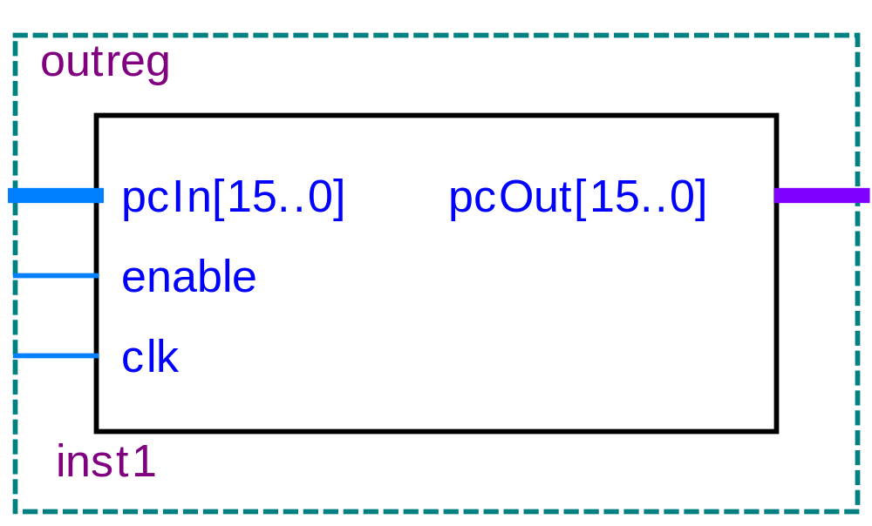
8.4流水线各段设计和功能描述
8.4.4 stage4访存段(MEM)
BEGIN
2．模块划分和实现
图8-39 Stage 4的输出寄存器

Slide 62
【例8-16】
library ieee;
use ieee.std_logic_1164.all;
use ieee.std_logic_arith.all;
ENTITY rselector IS
PORT(a,b,d : IN STD_LOGIC_VECTOR(15 DOWNTO 0);
sel : IN STD_LOGIC_VECTOR(1 DOWNTO 0);
c : OUT STD_LOGIC_VECTOR(15 DOWNTO 0));
END ENTITY rselector;
ARCHITECTURE rsel_behav OF rselector IS
BEGIN
name : PROCESS(a,b,sel) IS
CASE sel IS
WHEN "00" => c<=a;
WHEN "01" => c<=b;
WHEN OTHERS => c<=d;
END CASE;
END PROCESS name;
END ARCHITECTURE rsel_behav;
8.4流水线各段设计和功能描述
8.4.4 stage4访存段(MEM)
BEGIN
【例8-16】
BEGIN
2．模块划分和实现
图8-39 Stage 4的输出寄存器

Slide 63
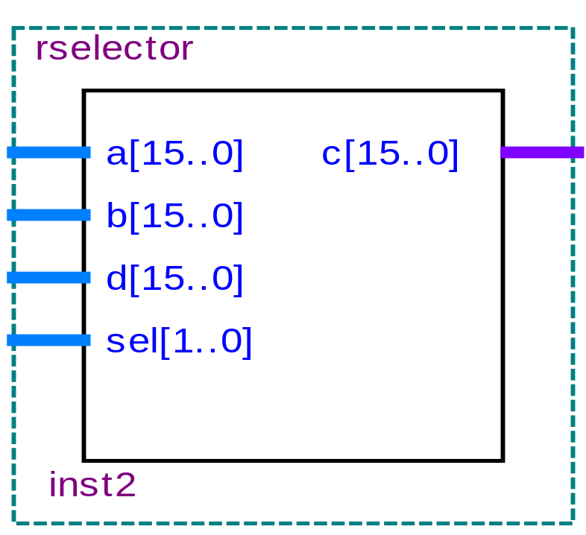
8.4流水线各段设计和功能描述
8.4.4 stage4访存段(MEM)
BEGIN
【例8-16】
BEGIN
2．模块划分和实现
图8-40 Stage 4的3选1数据多路器

Slide 64
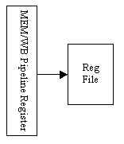
8.4流水线各段设计和功能描述
8.4.5 stage5回写段(WB)
BEGIN
【例8-16】
图8-41 Stage 5的基本结构

Slide 65

8.4流水线各段设计和功能描述
8.4.6 一些关键功能部件的设计
1．数据相关的检测及处理
① 数据相关的检测
图8-42 数据相关性检测原理图

Slide 66

8.4流水线各段设计和功能描述
8.4.6 一些关键功能部件的设计
1．数据相关的检测及处理
② 数据相关的发生
图8-43 数据相关实例

Slide 67
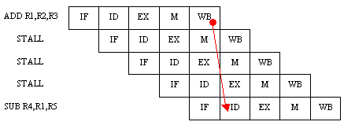
8.4流水线各段设计和功能描述
8.4.6 一些关键功能部件的设计
1．数据相关的检测及处理
③ 数据相关的处理
图8-44 阻塞流水线

Slide 68

8.4流水线各段设计和功能描述
8.4.6 一些关键功能部件的设计
1．数据相关的检测及处理
③ 数据相关的处理
图8-45 数据前推控制

Slide 69
【例8-17】
library ieee;
use ieee.std_logic_1164.all;
entity hazard is
port(opcode : in std_logic_vector(3 downto 0);
func, readone, readtwo, idexwrite : in std_logic_vector(2 downto 0);
idexMemWE, idexwe : in std_logic;
exmemwrite : in std_logic_vector(2 downto 0);
memstage : in std_logic;
pcenable, ifidenable,idexflush : out std_logic);
end entity hazard;
architecture hazard_behav of hazard is
begin
name : process(opcode, func, readone, readtwo, idexwrite, idexMemWE, memstage, exmemwrite) is
begin --若写允许(we=1)有效，MEM/IO段的数据处理如下.
if(idexMemWE='1') then
if(idexwrite=readone or idexwrite=readtwo) then
pcenable <= '0'; ifidenable <= '0'; idexflush <= '1';
else pcenable <= '1'; ifidenable <= '1'; idexflush <= '0';
end if;
--若写允许的同时遇到分支转移指令，并且要写入的寄存器就是转移指令要读出的寄存器， （接下页）
end if;
8.4流水线各段设计和功能描述
8.4.6 一些关键功能部件的设计
1．数据相关的检测及处理
③ 数据相关的处理
图8-45 数据前推控制

Slide 70
8.4流水线各段设计和功能描述
--则无论是MEM/IO段还是EX执行段都必须stall暂停执行
else if((opcode="0010" and func="010") or (opcode="0010" and
func="011") or opcode="0101") then --要写入的是EX执行段寄存器吗？
if(idexwe='1') then
if(idexwrite = readone or idexwrite=readtwo) then
pcenable <= '0'; ifidenable <= '0'; idexflush <= '1';
else pcenable <= '1'; ifidenable <= '1'; idexflush <= '0';
end if;
elsif (memstage='1') then --要写入的是MEM存储段寄存器吗?
if(exmemwrite = readone or exmemwrite = readtwo) then
pcenable <= '0'; ifidenable <= '0'; idexflush <= '1';
else pcenable <= '1'; ifidenable <= '1'; idexflush <= '0';
end if;
--若两者都不是，则按正常操作
Else pcEnable <='1'; ifidenable <= '1'; idexflush <= '0'; end if;
else pcenable <= '1'; ifidenable <= '1'; idexflush <= '0'; end if;
end process name;
end architecture hazard_behav;
8.4.6 一些关键功能部件的设计
1．数据相关的检测及处理
③ 数据相关的处理
图8-45 数据前推控制

Slide 71
【例8-18】
library ieee;
use ieee.std_logic_1164.all;
use ieee.std_logic_arith.all;
use ieee.std_logic_signed.all;
use ieee.std_logic_unsigned.all;
ENTITY forward IS
PORT(exmRegWrite,memwbRegWrite : in std_logic;
exmWriteReg, memwbWriteReg : in std_logic_vector(2 downto 0);
idexReadOne,idexReadTwo : in std_logic_vector(2 downto 0);
aluSelA, aluSelB : out std_logic_vector(1 downto 0));
END ENTITY forward;
ARCHITECTURE forward_behav OF forward IS
BEGIN
name : PROCESS(exmRegWrite, exmWriteReg, idexReadOne, idexReadTwo) IS
BEGIN
IF(exmRegWrite='1') THEN --若来自EX/MEM段的寄存器要被写入
IF(memwbRegWrite='0') THEN --若写寄存器=读寄存器one,则写入
IF(exmWriteReg=idexReadOne) THEN aluSelA <= "01";
ELSE aluSelA <= "00"; END IF;
IF(exmWriteReg=idexReadTwo) THEN aluSelB <= "01";
ELSE aluSelB <= "00"; END IF;
（接下页）
8.4流水线各段设计和功能描述
8.4.6 一些关键功能部件的设计
1．数据相关的检测及处理
③ 数据相关的处理
图8-45 数据前推控制

Slide 72
ELSE
IF(exmWriteReg=idexReadOne) THEN aluSelA <= "01";
ELSE IF(memwbWriteReg=idexReadOne) THEN aluSelA <= "10";
ELSE aluSelA <= "00"; END IF;
END IF;
IF(exmWriteReg=idexReadTwo) THEN aluSelB <= "01";
--若EX段写寄存器=ID段读寄存器two,则写入
ELSE IF(memwbWriteReg=idexReadTwo) THEN aluSelB <= "10";
ELSE aluSelB <= "00"; END IF;
END IF;
END IF;
ELSE IF(memwbRegWrite='1') THEN
IF(memwbWriteReg=idexReadTwo) THEN aluSelB <= "10";
ELSE aluSelB <= "00"; END IF;
IF(memwbWriteReg=idexReadOne) THEN aluSelA <= "10";
ELSE aluSelA <= "00"; END IF;
ELSE aluSelA <= "00"; aluSelB <= "00"; END IF;
END IF;
END PROCESS name;
END ARCHITECTURE forward_behav;
8.4流水线各段设计和功能描述
8.4.6 一些关键功能部件的设计
1．数据相关的检测及处理
③ 数据相关的处理
图8-45 数据前推控制

Slide 73
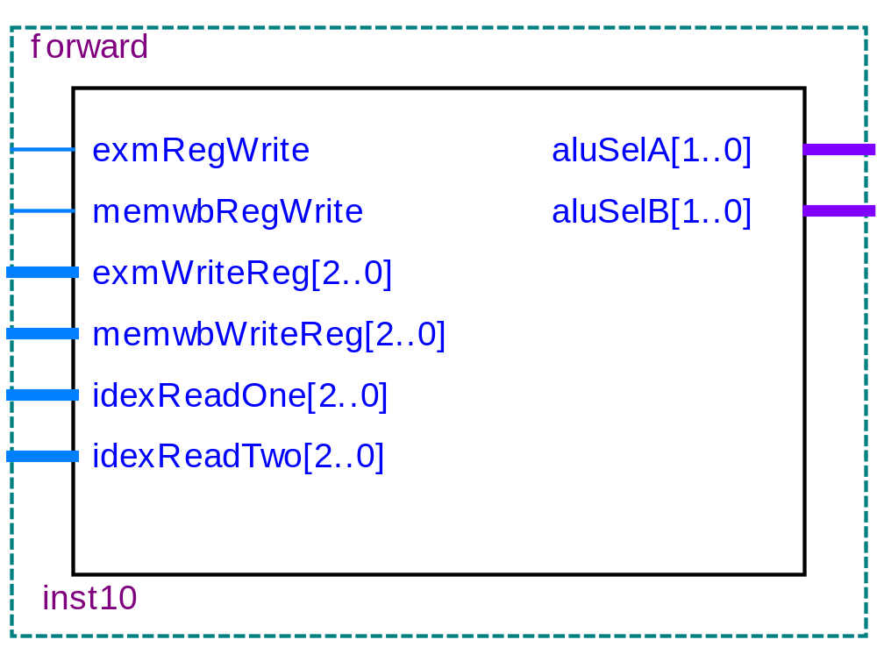
8.4流水线各段设计和功能描述
8.4.6 一些关键功能部件的设计
1．数据相关的检测及处理
图8-47 forward模块电路结构

Slide 74
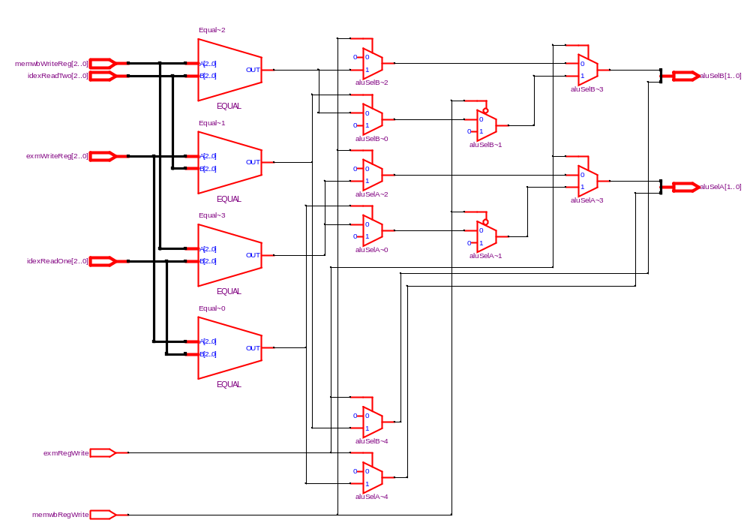
8.4流水线各段设计和功能描述
8.4.6 一些关键功能部件的设计
1．数据相关的检测及处理
图8-48 forward模块RTL电路结构

Slide 75
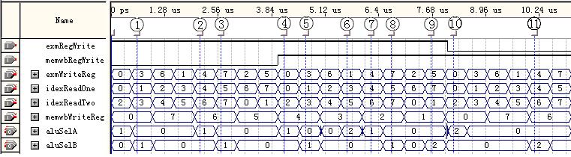
8.4流水线各段设计和功能描述
8.4.6 一些关键功能部件的设计
1．数据相关的检测及处理
图8-49 forward模块的时序仿真图

Slide 76
8.4流水线各段设计和功能描述
8.4.6 一些关键功能部件的设计
2．控制相关
3．结构相关
（1）结构相关检测
（2）阻塞
（3）预取
（4）资源重复

Slide 77
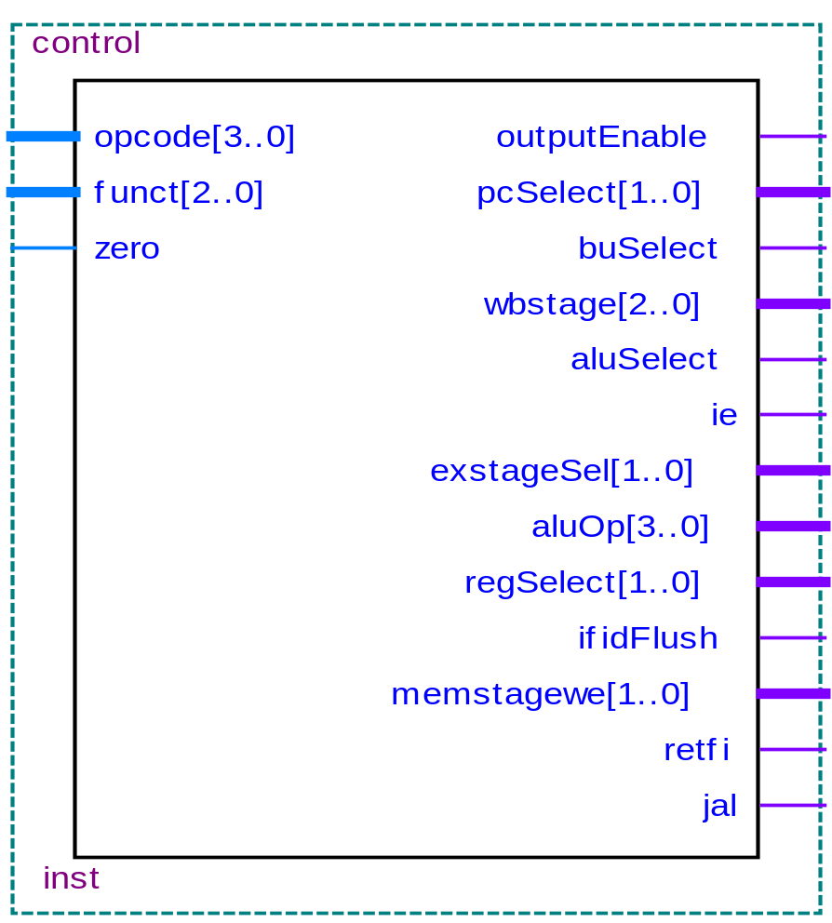
8.4流水线各段设计和功能描述
8.4.7 控制单元
图8-50 控制单元control的结构图

Slide 78
8.4流水线各段设计和功能描述
8.4.8 中断与异常
1.中断
中断是指外部事件向处理器发出的服务请求。
2.异常
本处理器能够处理的两种异常是算术溢出和未定义指令。算术溢出或未定义指令将导致异常信号线变为高电平，这一信号将导致当前指令及其后续指令都从流水线排出。
3.优先级
在本设计中，优先级的数值范围从0到5，其中，中断0具有最高优先级。优先级的顺序实际上是通过IF、ELSIF和ELSE语句实现的。

Slide 79
8.4流水线各段设计和功能描述
8.4.9 流水线CPU系统电路结构
这是一个具有五级流水线的RISC结构的CPU，基本操作有取指IF、译码ID、执行EXE、访存MEM、和回写WB。主要的组成部件有：取指、指令译码、执行、访存/回写、指令预取、前推控制、中断控制、分支转移、相关检测及核心控制器等功能模块。此外还有程序存储器和数据存储器。

Slide 80
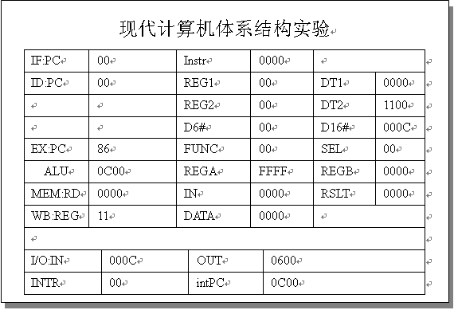
8.4流水线各段设计和功能描述
8.4.10 CPU与LCD显示模块的接口
图8-51 液晶LCD240×128显示流水线信息

Slide 81
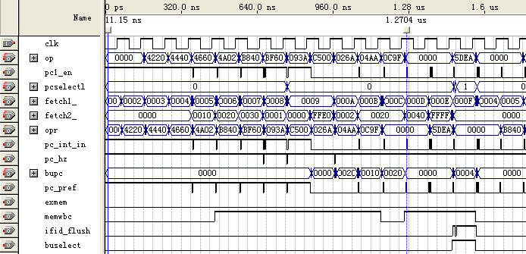
8.4流水线各段设计和功能描述
8.4.10 CPU与LCD显示模块的接口
图8-52 流水线CPU执行程序仿真波形

Slide 82
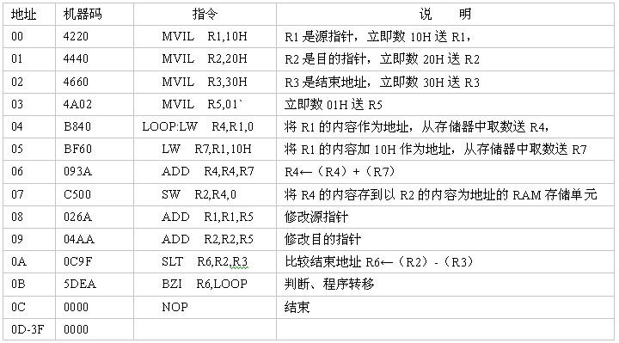
【例8-19】应用程序设计
8.4流水线各段设计和功能描述

Slide 83

习 题
8-1．基于本章介绍的流水线CPU，编写程序，在七段数码管上循环显示数字0~9。
8-2．基于本章介绍的流水线CPU，编写程序，先把字符‘A’~‘F’写到内存的040H~045H几个单元中，然后再读出来并送到输出端口。
8-3．基于本章介绍的流水线CPU，编写程序，完成从输入端口输入字符并送到输出端口。使用子程序调用指令和转移指令; 在子程序中，试完成将大写英文字母变为小写字母，并送到输出端口的功能。
8-4．基于本章介绍的流水线CPU，设计一个程序，在数码管LED上依次显示输出‘0’~‘9’这10个数字。
8-5．基于本章介绍的流水线CPU，计算1到N的累加和，将结果回写存储器并送到输出端口显示。
8-6．基于本章介绍的流水线CPU，设计一个有读写内存和子程序调用指令的程序，功能是读出指定内存中的大写字母字符，并将其送到输出端口; 转换为小写字母后再回写存储器原存储区域。
8-7．如果要为CPU设计一新的应用程序，如何将汇编程序代码转换为机器码，并将机器码配置到lpm_rom中？

Slide 84

实验与设计
实验8-1. Stage1取指令段实验
图8-53 Stage 1 取指段IF的结构

Slide 85
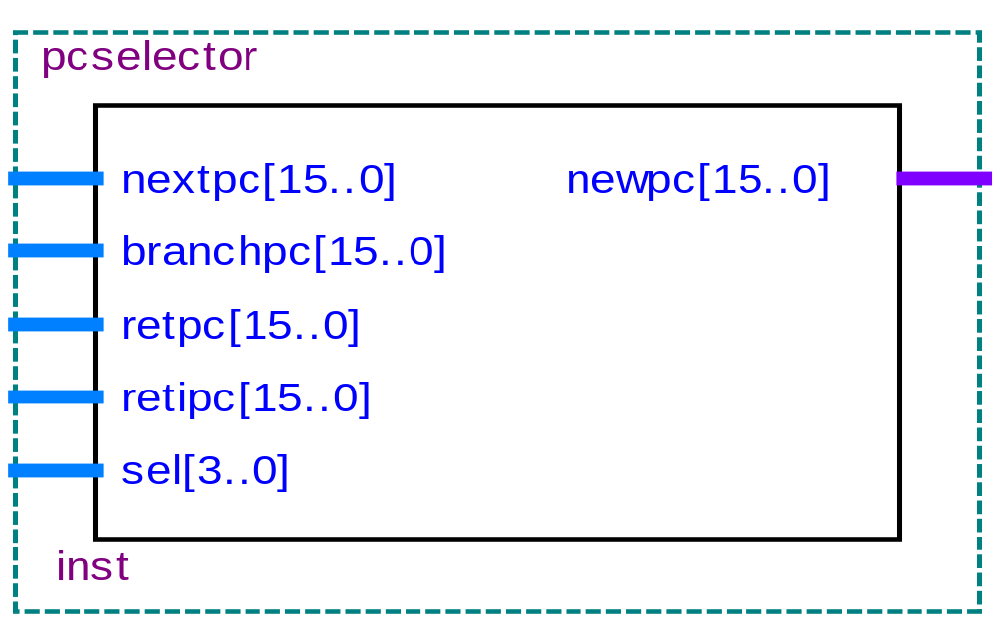
实验与设计
实验8-1. Stage1取指令段实验
图8-54 选择模块selector的结构

Slide 86
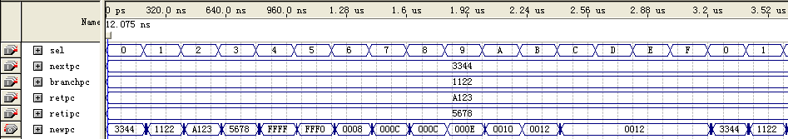
实验与设计
实验8-1. Stage1取指令段实验
图8-55 选择模块selector的仿真波形

Slide 87
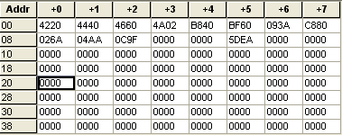
实验与设计
实验8-1. Stage1取指令段实验
图8-56 lpm_rom文件中的数据

Slide 88

实验与设计
实验8-1. Stage1取指令段实验
图8-57 Stage1 综合实验电路

Slide 89

实验与设计
实验8-1. Stage1取指令段实验
图8-58 Stage1 仿真波形

Slide 90
实验与设计
实验8-2. Stage2指令译码段实验
图8-59 Stage 2译码段结构

Slide 91
实验与设计
实验8-2. Stage2指令译码段实验
图8-60 Stage 2 译码段ID的各模块信号连接电路

Slide 92

实验与设计
实验8-2. Stage2指令译码段实验
图8-61 signext符号扩展模块仿真波形

Slide 93

实验与设计
实验8-2. Stage2指令译码段实验
图8-62 符号扩展模块结构

Slide 94

实验与设计
实验8-2. Stage2指令译码段实验
图8-63 寄存器文件模块结构

Slide 95

实验与设计
实验8-2. Stage2指令译码段实验
图8-64 regFile的时序仿真波形

Slide 96

实验与设计
实验8-2. Stage2指令译码段实验
图8-65 分支控制模块结构

Slide 97

实验与设计
实验8-2. Stage2指令译码段实验
图8-66 branch.vhd的仿真波形

Slide 98

实验与设计
实验8-2. Stage2指令译码段实验
图8-67 ID/EX段流水线寄存器的结构

Slide 99

实验与设计
实验8-2. Stage2指令译码段实验
图8-67 ID/EX段流水线寄存器的结构

Slide 100

实验与设计
实验8-2. Stage2指令译码段实验
图8-69 在Project中添加/删除程序

Slide 101
bus_mux_3.vhd的程序如下：
LIBRARY ieee;
USE ieee.std_logic_1164.all;
LIBRARY lpm;
USE lpm.lpm_components.all;
ENTITY bus_mux_3 IS
PORT( data0x,data1x : IN STD_LOGIC_VECTOR (2 DOWNTO 0);
sel : IN STD_LOGIC ; result : OUT STD_LOGIC_VECTOR (2 DOWNTO 0) );
END bus_mux_3;
ARCHITECTURE SYN OF bus_mux_3 IS
SIGNAL sub_wire0 : STD_LOGIC_VECTOR (2 DOWNTO 0);
SIGNAL sub_wire1 : STD_LOGIC ;
SIGNAL sub_wire2 : STD_LOGIC_VECTOR (0 DOWNTO 0);
SIGNAL sub_wire3 : STD_LOGIC_VECTOR (2 DOWNTO 0);
SIGNAL sub_wire4 : STD_LOGIC_2D (1 DOWNTO 0, 2 DOWNTO 0);
SIGNAL sub_wire5 : STD_LOGIC_VECTOR (2 DOWNTO 0);
COMPONENT lpm_mux
GENERIC (lpm_size : NATURAL;
lpm_type : STRING;
lpm_width : NATURAL;
lpm_widths : NATURAL );
PORT ( sel : IN STD_LOGIC_VECTOR (0 DOWNTO 0);
（接下页）
实验与设计
实验8-2. Stage2指令译码段实验

Slide 102
实验与设计
data : IN STD_LOGIC_2D (1 DOWNTO 0, 2 DOWNTO 0);
result : OUT STD_LOGIC_VECTOR (2 DOWNTO 0) );
END COMPONENT;
BEGIN
sub_wire5 <= data0x(2 DOWNTO 0); result <= sub_wire0(2 DOWNTO 0);
sub_wire1 <= sel; sub_wire2(0) <= sub_wire1;
sub_wire3 <= data1x(2 DOWNTO 0); sub_wire4(1, 0) <= sub_wire3(0);
sub_wire4(1, 1) <= sub_wire3(1); sub_wire4(1, 2) <= sub_wire3(2);
sub_wire4(0, 0) <= sub_wire5(0); sub_wire4(0, 1) <= sub_wire5(1);
sub_wire4(0, 2) <= sub_wire5(2);
lpm_mux_component : lpm_mux
GENERIC MAP ( lpm_size => 2, lpm_type => "LPM_MUX", lpm_width => 3,
lpm_widths => 1 )
PORT MAP ( sel => sub_wire2, data => sub_wire4,result=>sub_wire0 );
END SYN;
实验8-2. Stage2指令译码段实验

Slide 103

实验与设计
实验8-2. Stage2指令译码段实验
图8-70 编译后stage2的模块结构

Slide 104

图8-70 编译后stage2的模块结构
实验与设计
实验8-3. Stage3指令译码段实验

Slide 105

实验与设计
实验8-3. Stage3指令译码段实验
图8-71 stage 3执行EXE段的基本结构

Slide 106

实验与设计
实验8-3. Stage3指令译码段实验
图8-72 alu_16的仿真波形

Slide 107

实验与设计
实验8-3. Stage3指令译码段实验
表8-4 移位运算器的功能

Slide 108

实验与设计
实验8-3. Stage3指令译码段实验
图8-73 移位运算器SU_3的仿真波形

Slide 109

实验与设计
实验8-3. Stage3指令译码段实验
图8-74 数据输入模块movibox的仿真波形

Slide 110

实验与设计
实验8-3. Stage3指令译码段实验
图8-75 EX/MEM段流水线寄存器的仿真波形

Slide 111

实验与设计
实验8-4. Stage4/5存储与写回段实验
图8-76 Stage 4/5的主要部件

Slide 112
实验与设计
实验8-5. 数据相关性控制实验
图8-77 forward模块电路结构

Slide 113
实验与设计
实验8-6. 数据通路实验
（1） 存储器访问指令(load/store ) R1 ← (R2 + imm)
（2） R型ALU操作 R1 ← R2 op R3
（3）R-I型ALU操作 R1← R2 op imm
（4）分支操作 Branch condition ← R1 op 0
(5) 跳转操作 JAL指令 Branch condition← 0

Slide 114

实验与设计
实验8-7. 流水线CPU综合实验
图8-78 程序运行前ROM和RAM中的数据

Slide 115

实验与设计
实验8-7. 流水线CPU综合实验
图8-79 嵌入式逻辑分析仪设置情况图

Slide 116

实验与设计
实验8-7. 流水线CPU综合实验
图8-80 CPU运行时逻辑分析仪显示波形

Slide 117

实验与设计
实验8-7. 流水线CPU综合实验
图8-81 流水线CPU的时序仿真波形

Slide 118
参考程序如下：
地址
机器码
指令
说 明
实验与设计
00
4220
MVIL R1,10H
R1是源指针，立即数10H送R1，
01
4440
MVIL R2,20H
R2是目的指针，立即数20H送R2
02
4660
MVIL R3,25H
R3是结束地址，立即数25H送R3
实验8-7. 流水线CPU综合实验
03
4A02
MVIL R5,01`
常数01H送R5
04
4E0A
MVIL R7,05H
常数05H送R7
05
B840
LOOP:LW R4,R1,0
将R1的内容作为地址，从存储器中取数送R4，
06
093A
ADD R4,R4,R7
R4←（R4）+（R7）
07
C500
SW R2,R4,0
将R4的内容存到以R2的内容为地址的RAM存储单元
08
026A
ADD R1,R1,R5
修改源指针
09
04AA
ADD R2,R2,R5
修改目的指针
0A
0C9F
SLT R6,R2,R3
比较结束地址R6←（R2）-（R3）
0B
5DEA
BZI R6,LOOP
判断、程序转移，若R6< 0，则转到LOOP
0C
0000
NOP
结束
0D-3F
0000

