Slide 1

Milestone 7
CST-135
Gary Davis
Nathaniel Kumar
Jesse Gardner
Alondra Dominguez Ramirez

Slide 2
Deliverables
Customer Queue
-Create a CSV text file that contains a list of customers and their intended purchases
-Create a class ProcessCustomerQueue
-With methods First(), Length(), In(), Out() and isEmpty
-Processing Customer Queue
-Attempt to perform the requested purchase
-If the item is available, perform the transaction
-If the item is unavailable, automatically generated an alternative selection choosing an available item and perform the transaction
-Upon completing the transaction, remove the customer from the Queue
Customer Queue GUI
- Implement an animated visual display of customers in the Queue (e.g., a line of small icons depicting persons)
-Create an animated visual display of each customer interacting with the vending machine
-Display text messages that indicate the following
-Name, Item selection and transaction amount
-Alert if item is unavailable and the alternative selection made
-A message indicating when all customers have been served and display the current inventory
Integration of updated classes with existing project components
Create ReadMe file

Slide 3
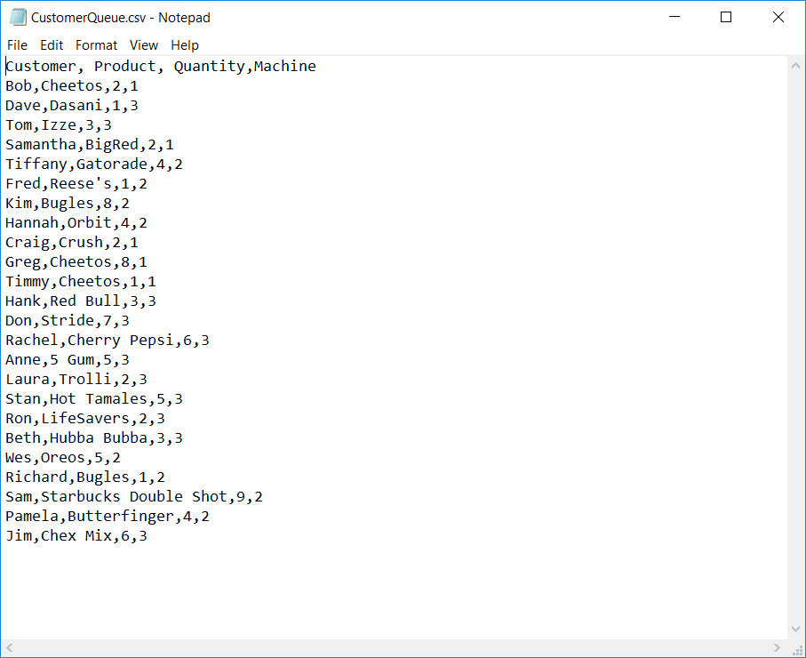
Create Customer Queue CSV File
Create csv files that will contain all the information needed to populate the customer queue.
1 customer queue CSV files was created
CSV contents
Customer (First Name)
Product (Name of Product)
Quantity (Customer requested quantity)
Machine (Vending Machine of the transaction)
CSV Contents

Slide 4
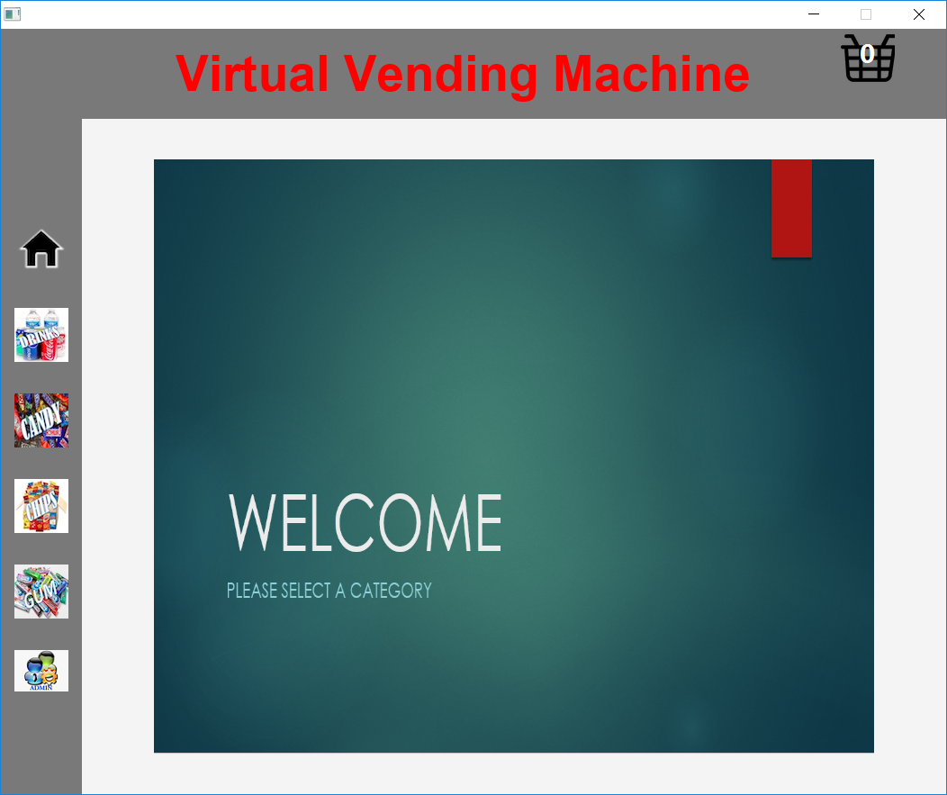
Welcome Screen with Category buttons
Home/ Welcome Screen
Shopping Cart
This Screen appears every time the application is launched, or the Home/ Welcome button is clicked.
Category Buttons
(Chips, Candy, Drink & Gum)
Admin/Service Button

Slide 5
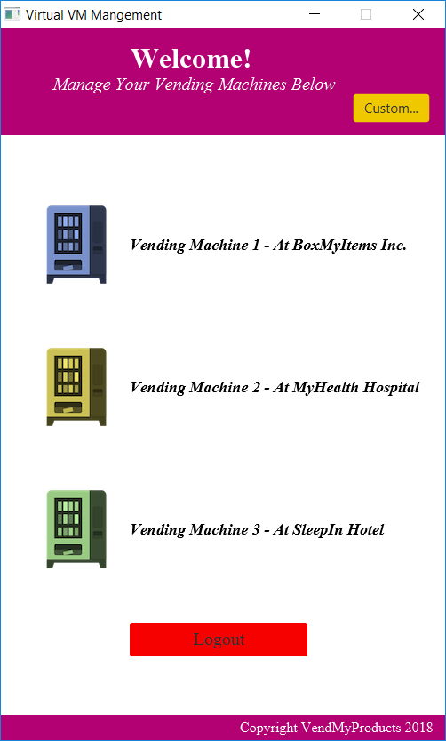
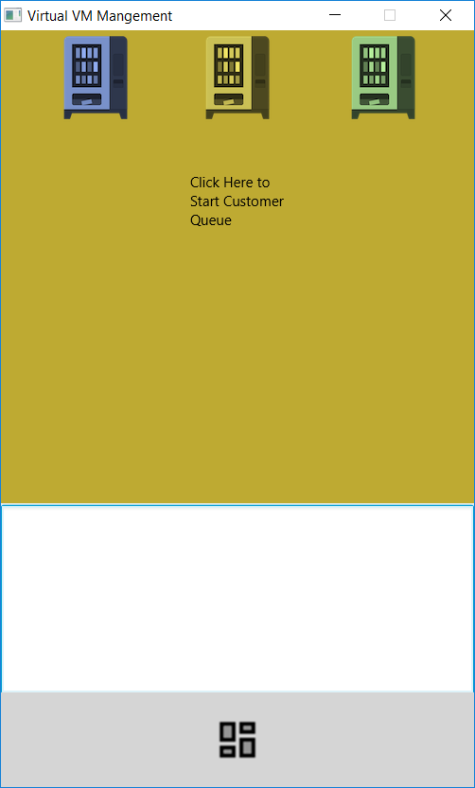
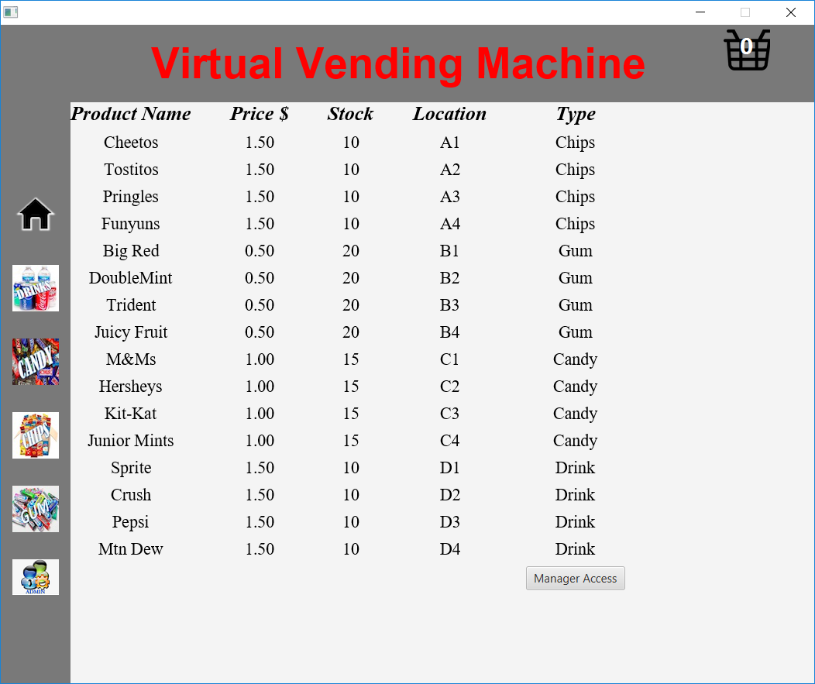
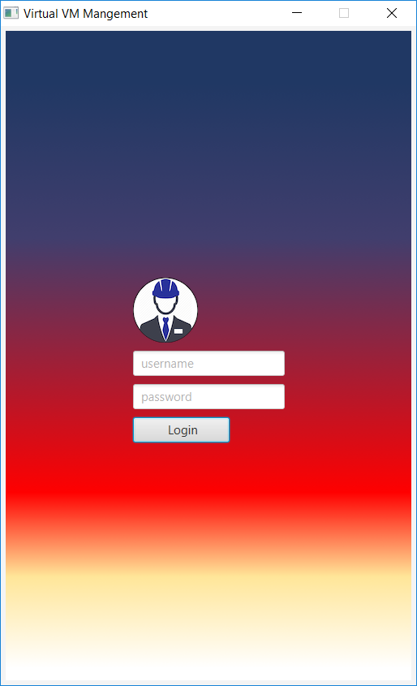
Customer Queue GUI
Button to Customer Queue GUI
The Customer Queue GUI can be access by going to Admin, clicking the “Manager Access” Button and clicking the “Custom…” Button.
Customer Queue GUI
Admin Window
Manager Login
Welcome Window

Slide 6
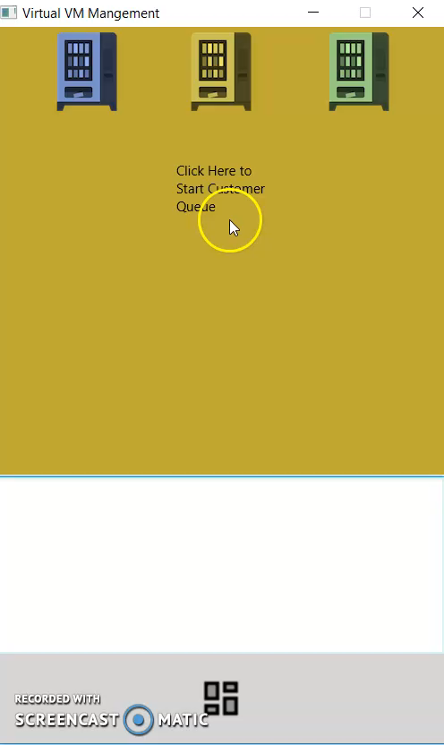
Customer Queue Animation Video

Slide 7
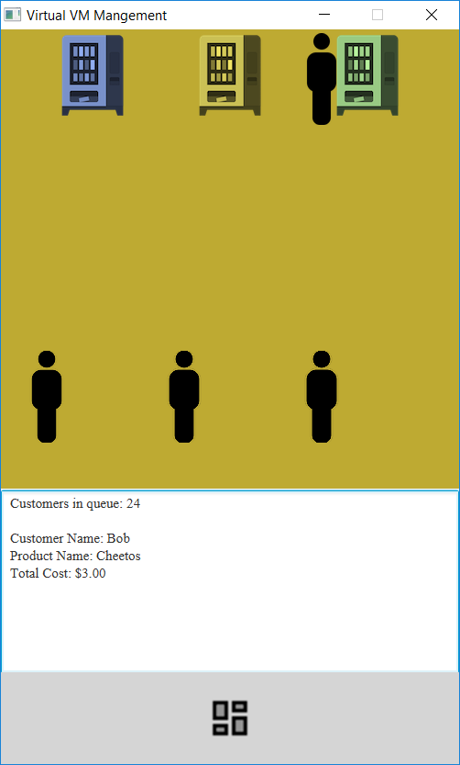
Customer Queue Transaction (In-Stock)
Customer Queue GUI
Animation / Customer Transaction
The customer image moves from the bottom of the GUI to the vending machine of transaction.
Message indicating the number of customers in Queue.
Message indicating the following customer information
Customer Name
Product Name
Total Cost of Transaction
Animated Customer
Customer Images / “Customers in Queue”
Message with Current Queue # and Customer Info

Slide 8
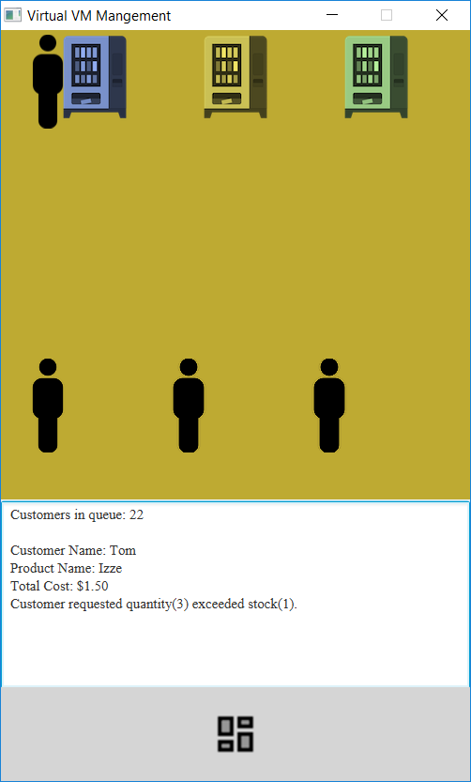
Customer Queue Transaction (Low Stock)
Customer Queue GUI
Animation / Customer Transaction
The customer image moves from the bottom of the GUI to the vending machine of transaction.
Message indicating the number of customers in Queue.
Message indicating the following customer information
Customer Name
Product Name
Total Cost of Transaction
Message indicating the customer quantity has exceeded the stock quantity. The customer will only be charged for in-Stock items.
Animated Customer
Customer Images / “Customers in Queue”
Message with Current Queue #, Customer Info and Stock Error

Slide 9
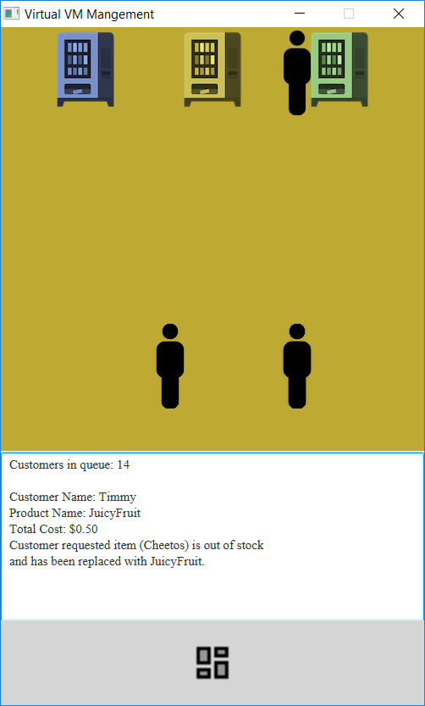
Customer Queue Transaction (No Stock)
Customer Queue GUI
Animation / Customer Transaction
The customer image moves from the bottom of the GUI to the vending machine of transaction.
Message indicating the number of customers in Queue.
Message indicating the following customer information
Customer Name
Product Name
Total Cost of Transaction
Message indicating that the customers requested item is out of stock and was replaced with a new in-stock item.
Animated Customer
Customer Images / “Customers in Queue”
Message with Current Queue #, Customer Info and Stock Error

Slide 10
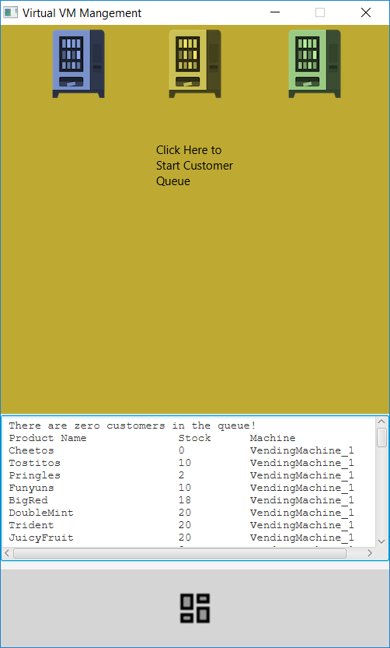
Customer Queue Completion
Customer Queue GUI
Animation / Customer Completion
All Customers have been removed from the Queue
Message indicating the number of customers in Queue
Text displaying the current inventory
All customer images have been removed from GUI
No Customer Images/ Queue = 0
Message Post Queue Completion

Slide 11
ReadMe
The purpose of this application is to be used as virtual vending machine. For this part of the project we had to make a customer queue. In order to do that we had created a ProcessCustomerQueue that had read the customers what their purchases were, including if the item is unavailable, then afterwards it removes the customer from the queue. Afterwards we had created a GUI which had animated the customers and their purchases – which can be seen in the admin screen.

Slide 12
Supplemental Slides Below

Slide 13
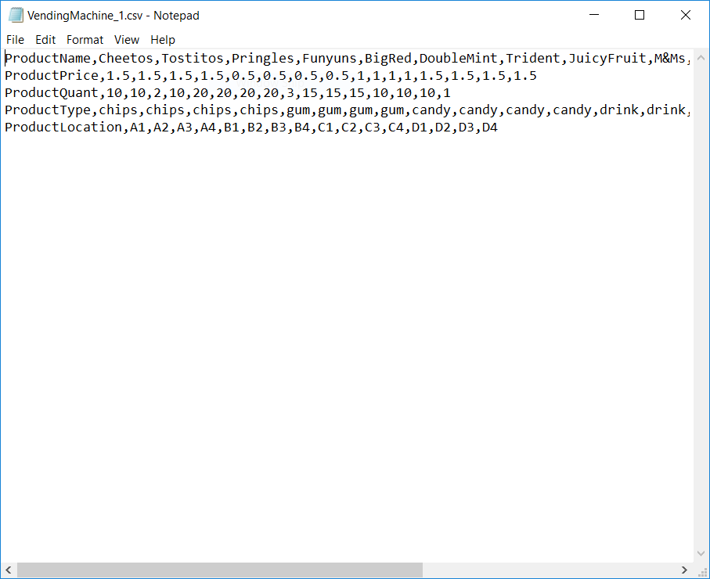
Create CSV Files
Create csv files that will contain all the information needed to populate multiple vending machines.
3 CSV files were created for 3 different vending machines
CSV contents
Product Name
Product Price
Product Quantity
Product Type
Product Location
CSV Contents

Slide 14
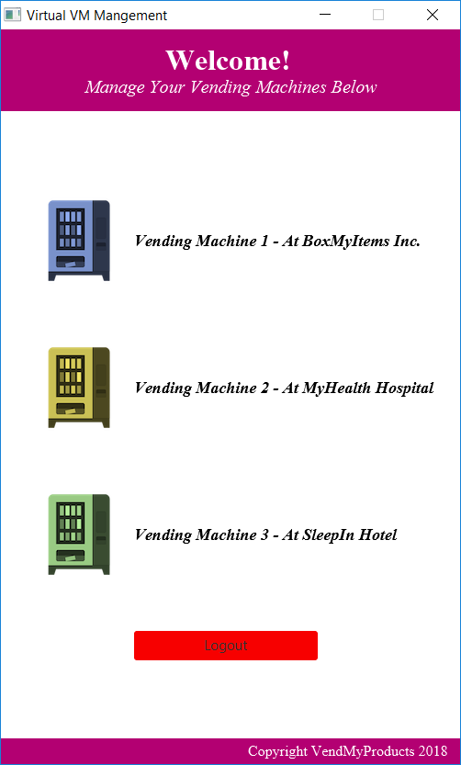
Manager GUI
The Manager GUI can be access by going to Admin and clicking the “Manager Access” Button.
Enter the username and password (not set), click “Login”.
Welcome window, select vending machine or Logout
Welcome Window
Manager Login
Admin Window

Slide 15
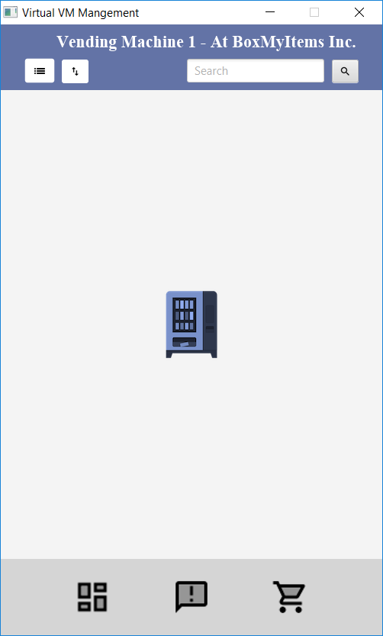
Manager GUI Continued
Vending Machine Options
Populate Item List Button
Adds the csv contents to the window
Sort List Button
Sorts the populated list alphabetically
Search textbox and button
Searches all the vending machines for product and displays the item details if found.
Back to Vending Machine Menu Button
Returns the users to the list of vending machines/ logoff
Low Inventory Button
Displays items with a quantity of less than or equal to 3
Auto generated Purchase Order Button
Populated list with items that need to be ordered (less than max quantity).
Item List
Sort List
Product Search
Low Inventory
Purchase Order
Vending Machine Menu

Slide 16
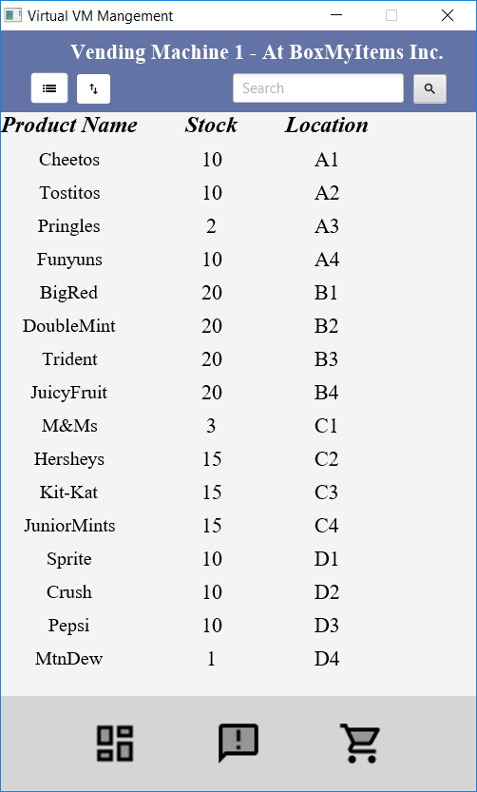
Manager GUI Item List
Item List Button
All the csv contents for the vending machine will be populated in the order it was added to the CSV file.
The list will display the “Product Name”, “Stock” and “Location”.
Vending Machine items created from the CSV file

Slide 17
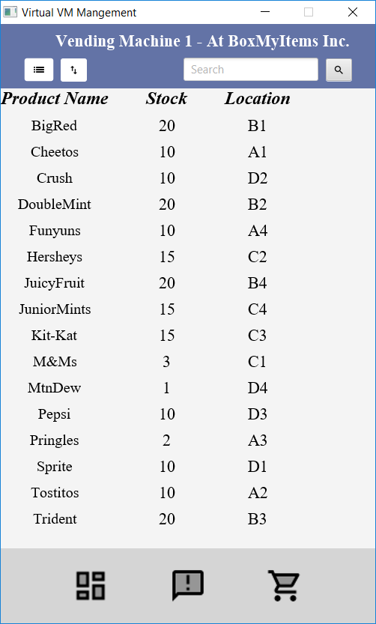
Manager GUI Item Sort
Item Sort Button
Sorts the items in alphabetical order
The list will display the “Product Name”, “Stock” and “Location”.
Vending Machine items sorted

Slide 18
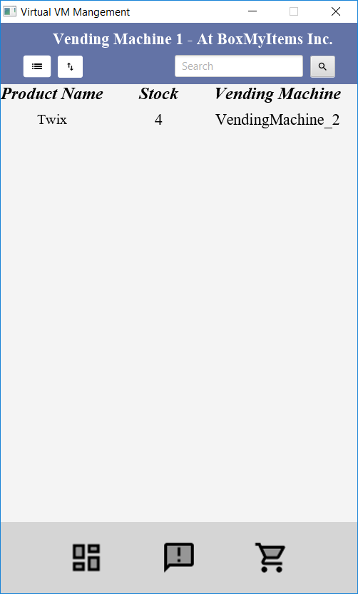
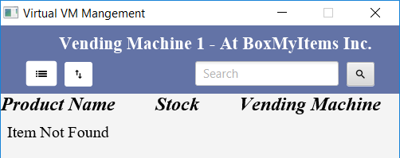
Manager GUI Item Search
Item Search Button
Searches all the vending machines for the user requested product name.
The list will display the “Product Name”, “Stock” and “Vending Machine”.
The results will be displayed in any vending machine window (Example: search completed in vending machine 1 but found in vending machine 2)
If the item is not found, the window will display “Item Not Found”
Item searched and found
Item searched and found
Item Not Found

Slide 19
Manager GUI Return VM Menu
Return to Vending Machine List
This will take you back to the list of vending machines where you can select a new vending machine or logoff

Slide 20
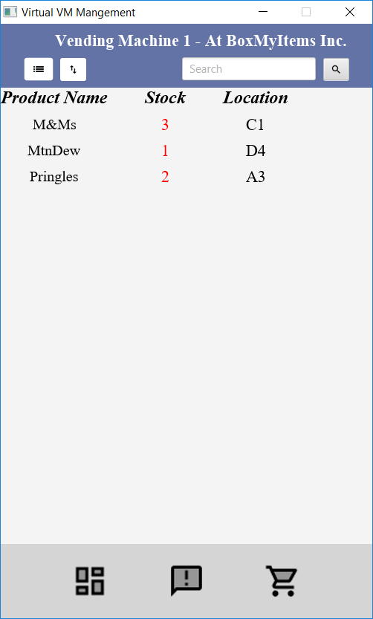
Manager GUI Low Inventory
Low Inventory Button
Displays the items that have a quantity equal to or less than 3.
The low quantity will be displayed in red font.
The list will display the “Product Name”, “Stock” and “Location”.
Item searched and found
Low Inventory

Slide 21
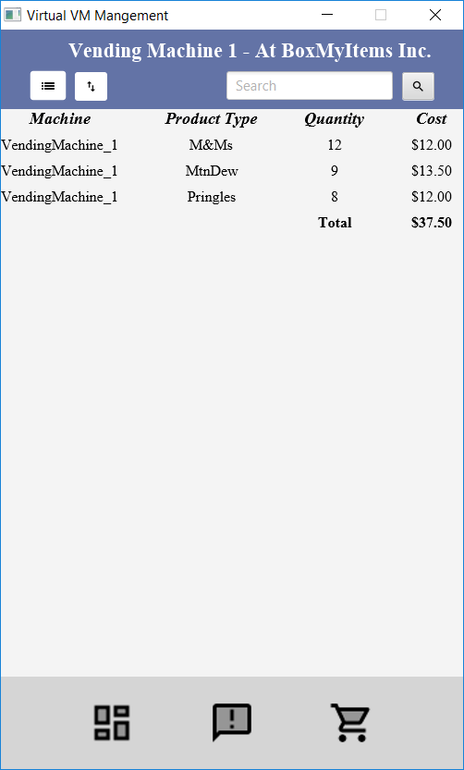
Manager GUI Purchase Order
Purchase Order Button
A list will be populated with items that have less than a maximum quantity.
The line item total will be displayed.
The subtotal will be displayed for the cost of all items in the PO.
The list will display the “Machine”, “Product”, “Quantity” and “Cost”.
PO Line Items

Slide 22
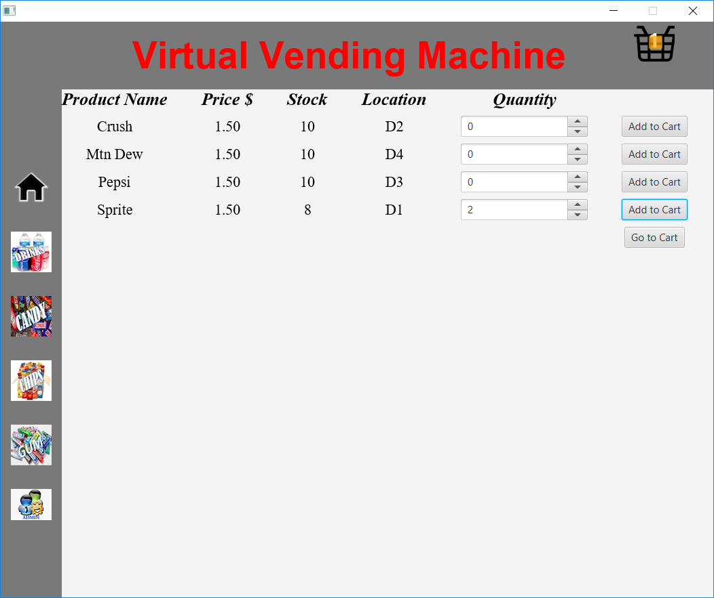
Item Selection with Animation
Line Item Count and Box Dropping Animation
The user will increase or decrease the quantity of the desired product.
They will click “Add to Cart” button to add the item to the cart. The cart icon will increase by one (line item) and an animated box will drop into the cart.
If they change their mind and change the quantity back to zero, the item will be removed from the cart.
Once the user is ready to review their order, they will click the “Go to Cart” button.
Items Added to Cart
Stock Increases or Decreases based on Quantity
Quantity can Increase or Decrease

Slide 23
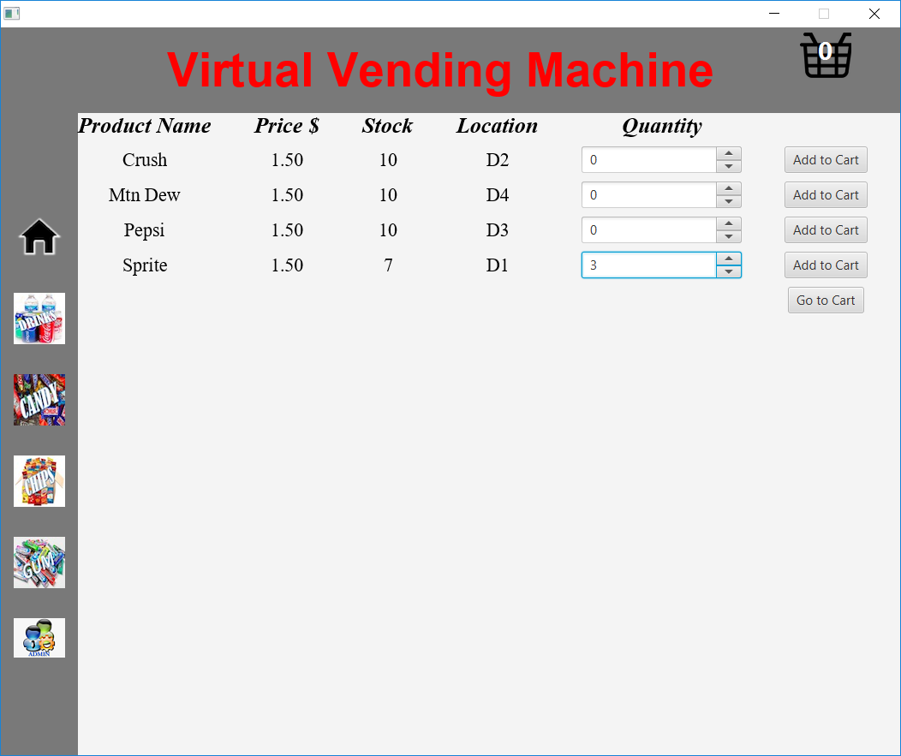

Inventory: Stock Decrease
Upon increasing the product quantity, the stock decreases.
Stock Decreased
Quantity Increased
Pre Selection
Stock = Max
Quantity = 0

Slide 24

Inventory: Stock Increase
Upon decreasing the product quantity, the stock increases.
Stock Increased
Quantity Decreased
Pre-Quantity Reduction
Stock = 7
Quantity = 3

Slide 25
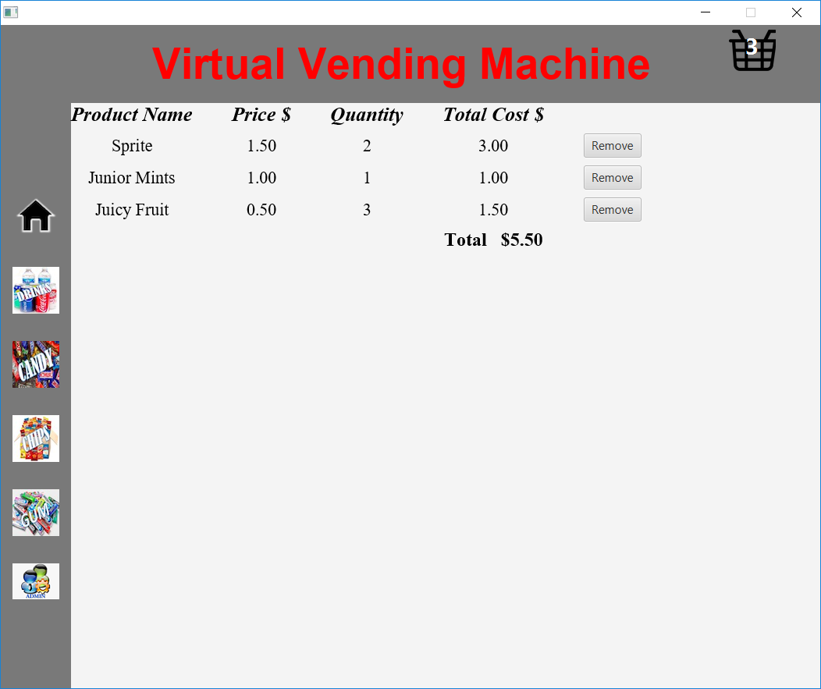
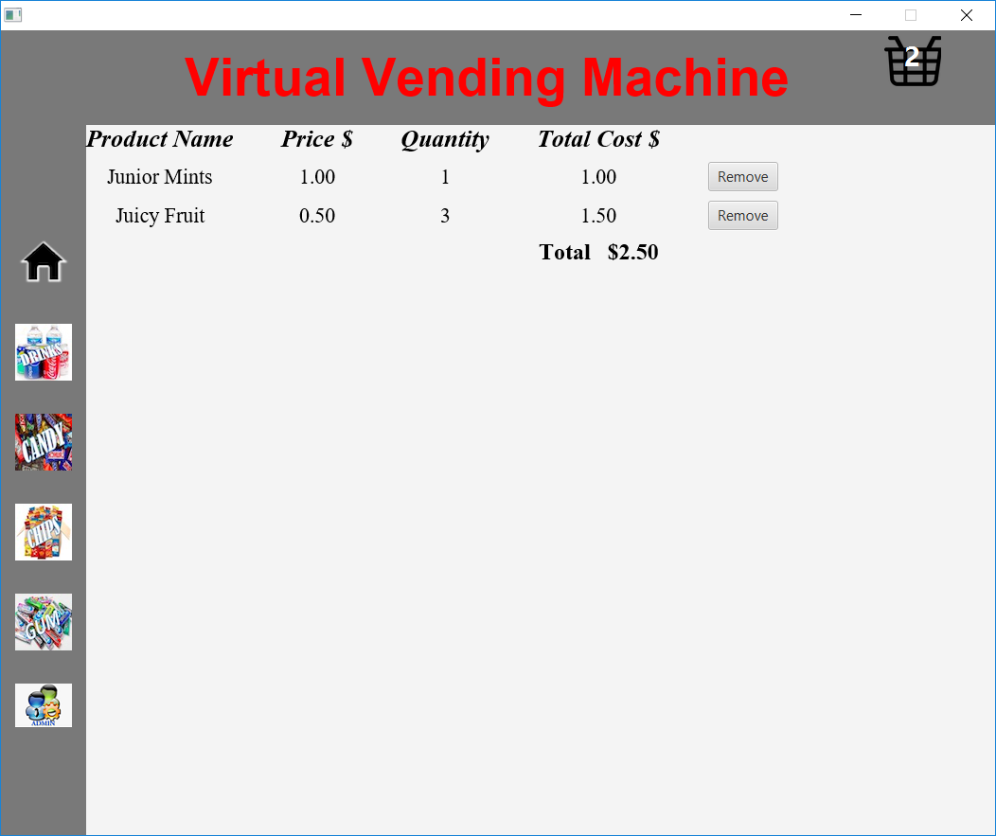
Additional Event (Remove from Cart)
Cart Line Items Change
Cart Line Items Change
Total Updated Post Removal
Remove from Cart Buttons
Clicking Remove
Line item is removed from the Cart.
Shopping Cart icon displays reduction.
Total cost is updated.

Slide 26
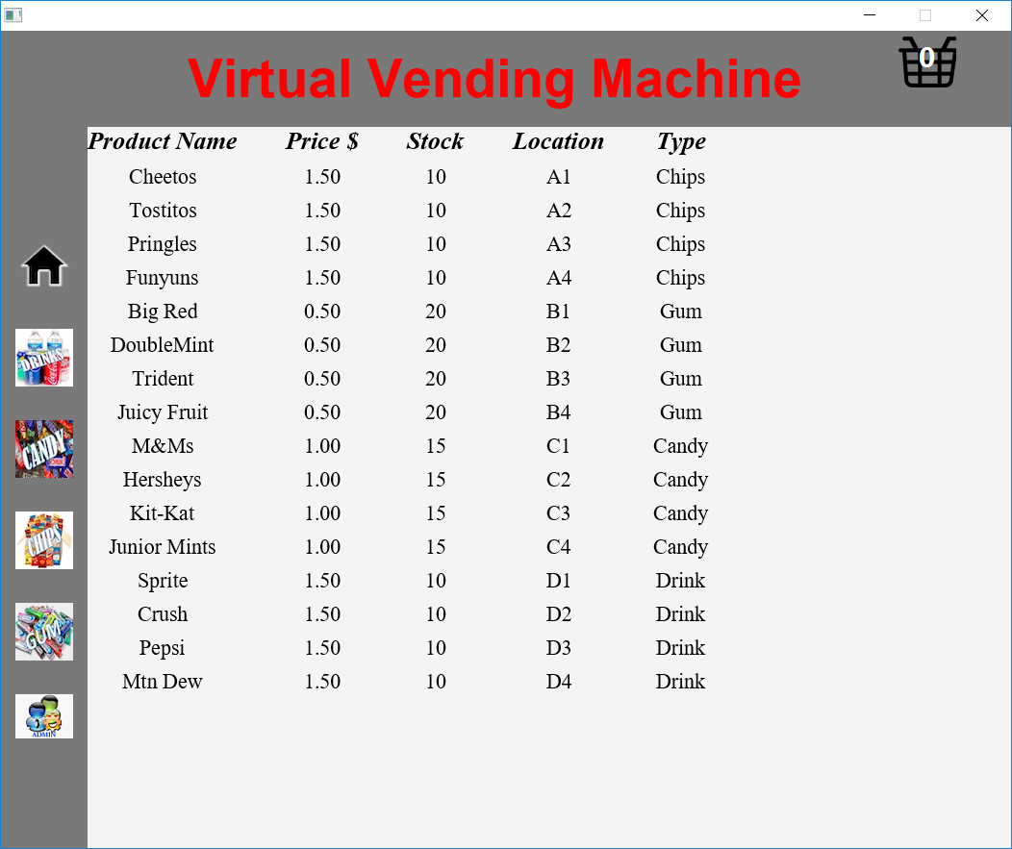
Admin / Service Display
Admin/Service Button
Upon clicking, the entire inventory will be will be displayed.
Admin/Service Button
All Products

Slide 27
Order Review
Remove Item Button
Each line item will have a total cost.
Item Price * Item Quantity = Item Total Cost
The total purchase cost will also be displayed.
Sum of all line items.
Items can be removed by going back to the category and setting the item to zero or clicking the remove button.
Total Cost of Line item.
Total Cost of all Line items.

