Slide 1

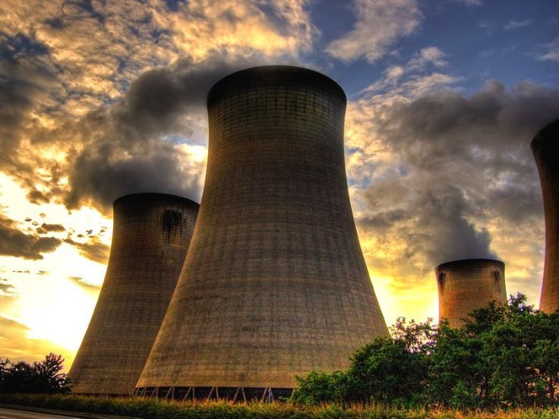
Title: Harnessing Machine Learning to Predict and Analyze CO2 Emissions Globally
MALLA REDDY ENGINEERING COLLEGE
Presented by :
G Deekshitha(22J41A6715)
G Anusha(22J41A6716)
A Poojitha(23J45A6701)
B Dhana Lakshmi(22J41A6710)

Slide 2
ABSTRACT
Climate change, driven by greenhouse gas emissions, poses a critical global threat, with carbon dioxide (CO2) as the primary contributor. This project develops a predictive model to estimate CO2 emissions from sources such as cement, coal, gas, oil, and flaring, using historical emissions and economic data. By analyzing interdependencies between economic activities and environmental outcomes, the model provides valuable insights for researchers, policymakers, and planners. The goal is to support data-driven strategies for mitigating emissions and enhancing sustainable policy decisions.

Slide 3
INTRODUCTION
Climate change, driven by rising CO2 emissions, poses a global threat. Major contributors include cement production, fossil fuel combustion, and flaring. Accurate prediction models are essential for analyzing trends and guiding climate policies.
This project develops a machine learning-based model to estimate CO₂ emissions using historical data and economic indicators. By identifying key emission drivers and forecasting future trends, it provides insights to support sustainable environmental planning and policy-making.

Slide 4
HARDWARE & SOFTWARE REQUIREMENTS
Hardware Requirements:
Processor: Intel Core i5/i7 or AMD equivalent
RAM: Minimum 8GB (Recommended: 16GB for faster processing)
Storage: At least 10GB free space for dataset storage and model training
GPU (Optional): NVIDIA GPU (for advanced model training, but not mandatory)

Slide 5
Software Requirements:
Operating System: Windows/Linux/MacOS
Programming Language: Python
Development Environment: Anaconda (Jupyter Notebook)
Libraries Used:
pandas – Data manipulation and analysis
matplotlib – Data visualization
numpy – Numerical computations
scikit-learn – Machine learning (train_test_split, LinearRegression,
mean_squared_error, mean_absolute_error, r2_score)
Dataset: CO2 emissions data

Slide 6
PROPOSED METHODOLOGY AND EXECUTION
Data Acquisition:
Collected historical CO2 emissions data, encompassing multiple sources such as cement, coal, gas, oil, and flaring.
Integrated relevant economic indicators to enhance predictive accuracy.
Utilized a structured dataset in CSV format for analysis.
2. Data Preprocessing:
Loaded the dataset using pandas for structured manipulation.
Handled missing values through imputation and conversion of non-numeric data using pd.to_numeric().

Slide 7
Removed irrelevant features such as 'Country.Name' and 'Country.Code' to optimize model efficiency.
Ensured data consistency and quality through normalization and transformation.
3. Exploratory Data Analysis (EDA):
Conducted a comprehensive statistical analysis to understand emission trends.
Visualized emission distributions and correlations using matplotlib to identify key patterns.
Assessed interdependencies between CO2 emissions and economic variables.

Slide 8
4. Feature Selection & Model Development:
Identified relevant predictive features through correlation analysis.
Partitioned the dataset into training (80%) and testing (20%) subsets using train_test_split().
Implemented Linear Regression as the primary predictive model to estimate CO2 emissions.
5. Model Training & Evaluation:
Trained the model using historical data to establish predictive relationships.
Generated emission forecasts and compared them against actual values.

Slide 9
Results :
Analyzed model outputs to identify significant emission drivers.
Presented findings through graphical representations, highlighting emission trends and model accuracy.
Evaluated model performance using key metrics:
  Mean Squared Error (MSE) – Measures the average squared difference between actual and predicted values.
  Root Mean Squared Error (RMSE) – Provides an interpretable error metric in the same units as the data.
  Mean Absolute Error (MAE) – Quantifies the average magnitude of errors.
  R² Score – Assesses the model’s explanatory power in predicting emissions.

Slide 10
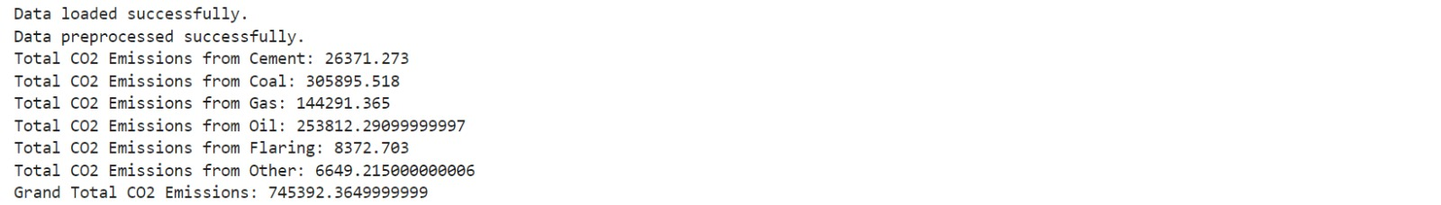
Output:

Slide 11
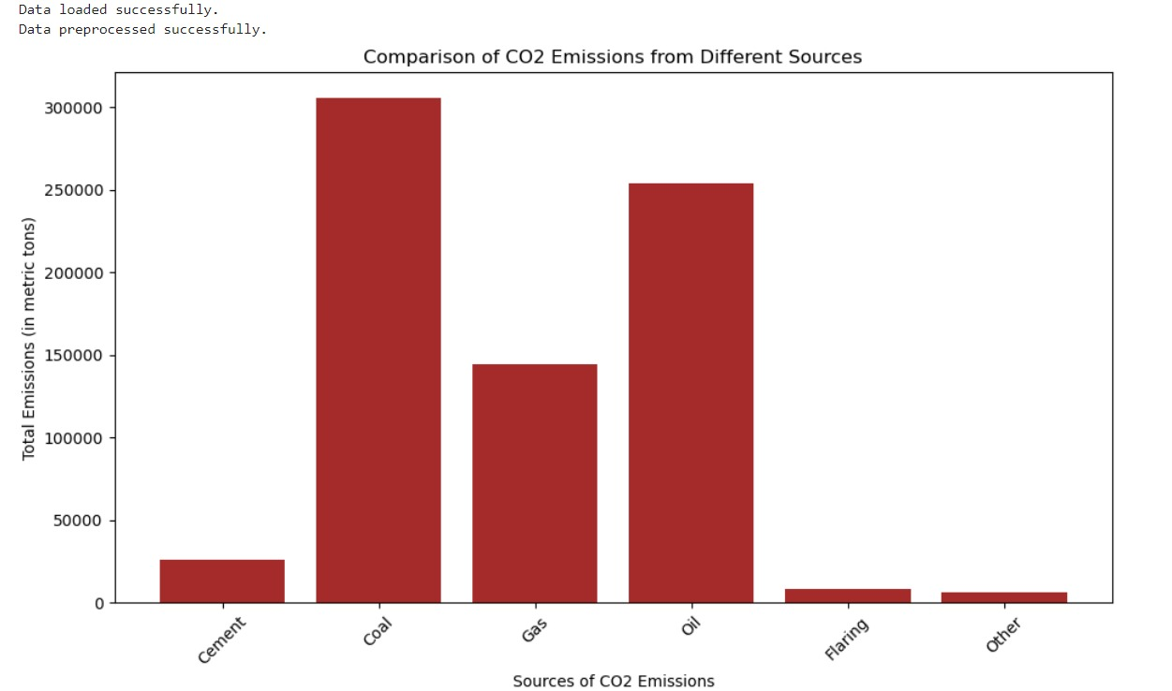

Slide 12
Conclusion:
Developed a machine learning model to predict CO₂ emissions using historical data and economic indicators.
Applied data preprocessing, exploratory analysis, and predictive modeling to extract meaningful insights.
Evaluated model performance using metrics like MSE, RMSE, MAE, and R² Score to ensure accuracy.
Findings support policymakers and environmental planners in making data-driven decisions for sustainability.
Future work can integrate advanced models and additional variables to improve prediction accuracy.
Contributes to global climate change mitigation efforts by enabling informed policy decisions.

Slide 13
REFERENCE:
•J. Brown et al., "Machine Learning Approaches for CO₂ Emission Prediction," IEEE EDS, 2020.
A. Smith, L. Zhang, "Data-Driven Climate Policy Using Predictive Models," J. Environ. Res., 2021.
P. Wilson, R. Kumar, "Economic Indicators in CO₂ Emission Forecasting," Int. J. Climate Sci. Tech., 2019.
C. Johnson et al., "Comparative Study of Regression Models for CO₂ Prediction," Global AI Sustain. Conf., 2022.
IPCC, "Climate Change 2021: The Physical Science Basis," Cambridge Univ. Press, 2021.

Slide 14
Thank you.

