Slide 1
COSE221, COMP211 Computer Logic Design
Introduction to the DE0 Board
Prof. Taeweon Suh
Computer Science & Engineering
Korea University

Slide 2
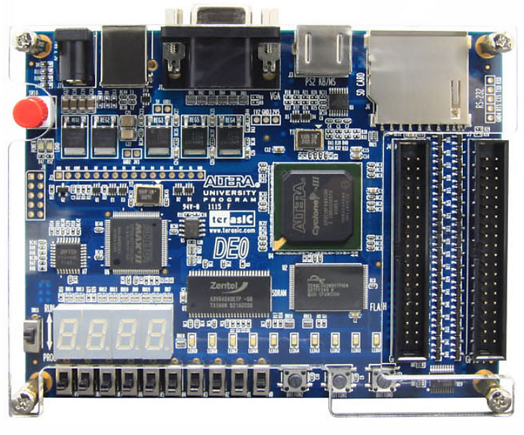
DE0 Board
Serial Port
FPGA
(Cyclone-III)
7 Segments
LEDs
Switches
Push Buttons

Slide 3
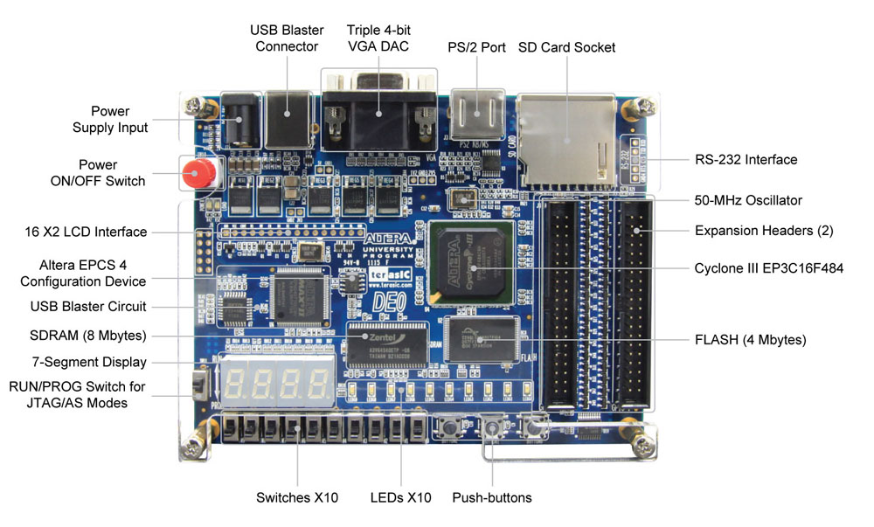
More Detailed Info

Slide 4
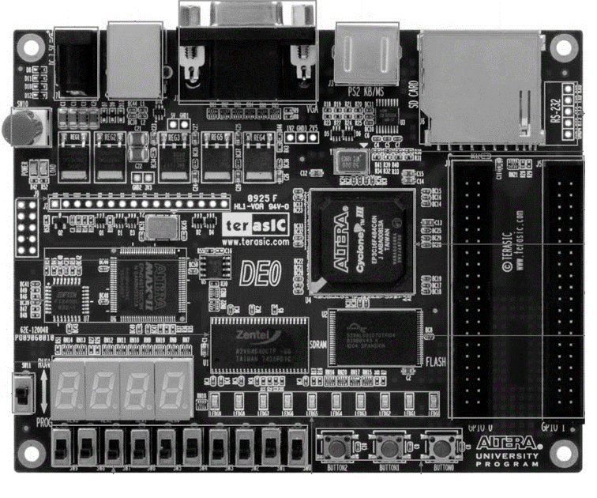
DE0 Board Connections

Slide 5

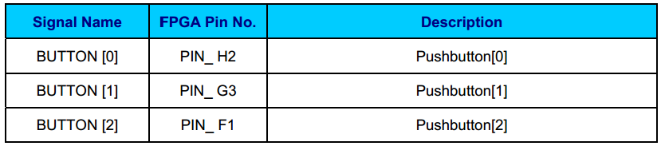
Push Buttons
Push button provides
Low (0 V) when pressed
High (3.3V) when NOT pressed

Slide 6

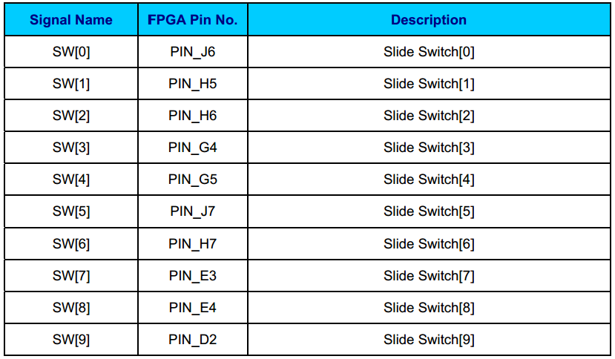
Switches
Switch provides
Low (0 V) when the switch is in the DOWN position (closest to the edge of the board)
High (3.3 V) when the switch is in the UP position

Slide 7
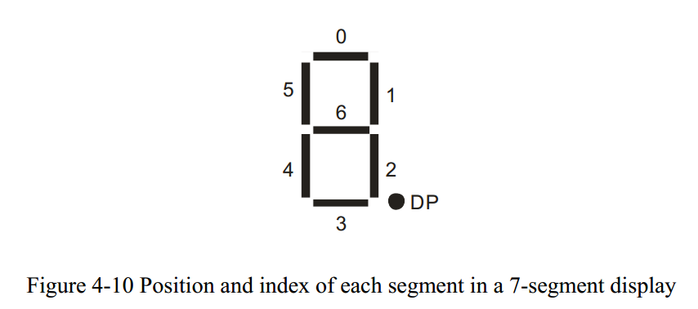

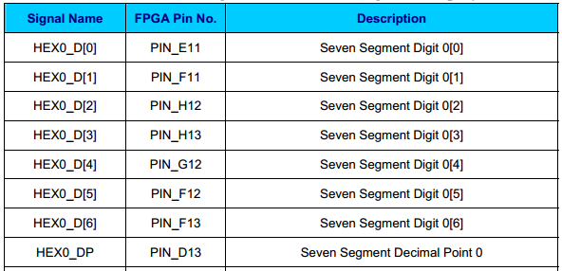
7 Segments
To light up a segment, provide a low level
To turn off a segment, provide a high level

Slide 8

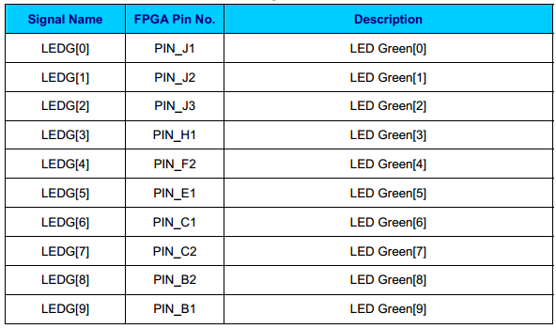
LEDs
10 green LEDs on the board
To turn on the LED, provide a high level
To turn off the LED, provide a low level

Slide 9
Pin Assignment
Let’s use the same names in our design as listed in the manual
Then, we don’t have to manually assign inputs and output in our design to the FPGA pins
Just import the pin assignment file (excel file) from Quartus-II, which is linked in the class web

Slide 10

Lab 1 Getting Started
BUTTON[0]
LEDG[9]
BUTTON[1]

