Slide 1
TRANSITS I
Legal Module
Presenter
Authors: Andrew Cormack, Nicole Harris and Silvio Oertli.
Version: 7.0.
This work is licensed under a Creative Commons Attribution-NonCommercial-ShareAlike 4.0 International License.

Slide 2
Learning Objectives
What CSIRT activities are covered by laws?
Why does this matter?
What are your responsibilities?
What do you need to find out?

Slide 3
Session Plan
Introduction
Which Issues arise when it comes to …
CSIRTs and the Law
Logging
Looking at Content
Scanning for Vulnerabilities
Takedown Requests
Working with Law Enforcement
Working with Others
Managing Vulnerabilities
Homework

Slide 4
Part One: Introduction

Slide 5
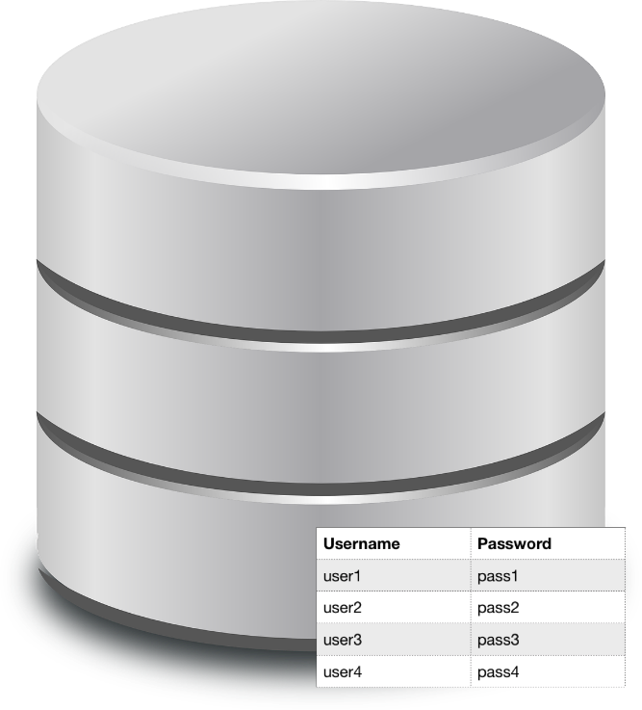
Discussion 1: CSIRTs and the Law
You receive a Dump with Username / Password.
It has been used to access a Site in the “Dark Web”.
Users are from your Organisation and others.
Police ask for a copy.
What can / should / must you do?
… your CSIRT?
… your Organisation?
Notes:
Example scenario – sent a dump of usernames/passwords (some, but not all, from your organisation) from a “dark web” site; now a policeman wants to see it too. What can/should/must I do? My CSIRT? My org?
Learning points:
legal issues are going to arise, whether you like it or not! Different sets of laws - public, limiting societally bad things such as drugs, firearms, hacking; private, on how one party can be required to repair damage it has caused to another (e.g. if you cause someone harm by falsely implying they have been involved in illegal acts); cooperation, requiring/allowing you to help state entities such as police.
Discussiontime: about 5 Minutes
Questions supporting the tutor:
How does the company react if the know that your credentials are on a website for buying drugs?
Should you inform other companies about their users?
Must you give the information to the police? What will be the human reaction?
And laws differ between countries - even in the fundamental bases for them: here's a map of those... (civil law, common law, sharia)
Usually decide applicable law by "location of crime" - Internet seriously messes that up!
No "law of IT" - "what's unlawful offline should be unlawful of online", plus laws addressing specific concerns (e.g. UK hacking law originates in a single access to the queen's husband's mailbox); and a single online action may include several things known to law

Slide 6
CSIRTs and Law
Learnings
Legal issues are going to arise, whether you like or not!
Old laws, new laws and ICT Laws.
Different sets of law:
Public -> limiting societally bad things such as drugs, firearms, hacking.
Private -> on how one party can be required to repair damage it has caused to another.
Cooperation -> requiring / allowing you to help state entities such as police.
Notes:
legal issues are going to arise, whether you like it or not! Different sets of laws - public, limiting societally bad things such as drugs, firearms, hacking; private, on how one party can be required to repair damage it has caused to another (e.g. if you cause someone harm by falsely implying they have been involved in illegal acts); cooperation, requiring/allowing you to help state entities such as police.

Slide 7
Public & private Law
Public Law
Cooperation
Private Law
Notes:
Public law, including criminal/penal law: between individuals and the state
Cooperation: Between persons and agents
Private law: between persons, both natural (people) and artificial (organisations) … confusingly also referred to as civil law

Slide 8
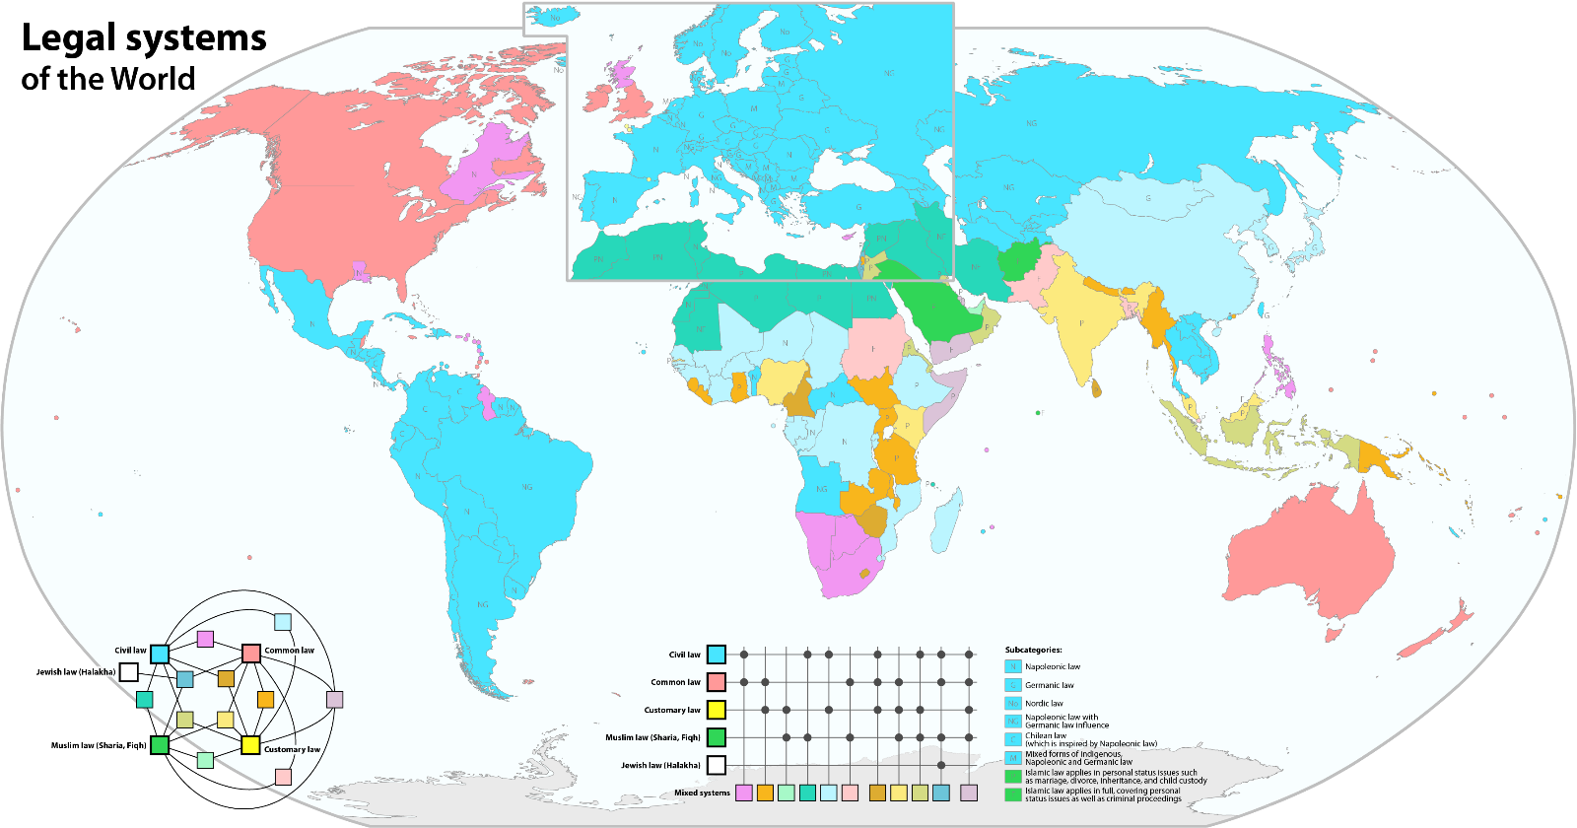
Law differ between countries
Maximilian Dörrbecker (Chumwa)
Notes:
Internet law happens …….

Slide 9
Part Two: Scenarios

Slide 10

Discussion 2: Logging
“Bad guys” have obtained username / password for some of your webmail users.
They are using credentials to send phishing e-mails to other local users.
You like to find out who’s compromised.
What logs do you need for investigation?
What legal issues arise?
Notes:
Logs – IP address is personal data, necessity, retention times,minimisation: all of these derive from "how would I use this?"
Scenario:
Badguys have obtained username/password combinations for some of your webmail users; they are now using the credentials to send phising e-mails to other local users. What logs do you need for the investigation? What legal issues arise?
Tutor Qs:
Which systems do you need logs from? How will you combine them? Do you have a documented process/tool for that?
What privacy issues might that raise?
Which data counts as "personal" in your legal system? (NB this will vary a lot - in Europe-influenced systems IP/email/MAC addresses are all likely to be classed as "personal")?
How far back into the past do you need to go? Will all the combining/etc. still work for old logs or has information changed/gone away?

Slide 11
Logging
Learnings
Logs contain personal data
Only use logs you need for this investigation
Process tell you which logs you need
How long to keep them?
Variability
EU + some states -> general personal data law (based on GDPR / Convention 108)
US + some states -> based on sector-specific law
Health
Teaching
Video rentals
Financial
Notes:
Learning points:
logs contain personal data (depending on country may just be names, or email addresses, or IP addresses); note that some data (e.g. email content) is treated differently (see next example); only use logs you need for this investigation; processes tell you which logs you need. And how long to keep them? Retention time related to how long you expect it to be before one of the phishing mails are reported : does the example make this last point?
Variability:
essentially two approaches: EU+, based on GDPR/Convention 108, general personal data law; US+, based on sector-specific law (e.g. health, teaching, video rentals, financial).
https://script-ed.org/article/incident-response-protecting-individual-rights-under-the-general-data-protection-regulation/

Slide 12
General Data Protection Act (GDPR)
European law (since 2018); influential elsewhere too.
Applies to all processing of personal data (including email/IP/MAC addresses).
Explicitly encourages incident response:
Implicitly requires it, via breach notification.
Legitimate interest tests:
Process minimum data required to achieve purpose.
Ensure benefit of processing justifies risk to individuals.
Key point: Incident Response improves protection of users’ personal data & privacy!

Slide 13
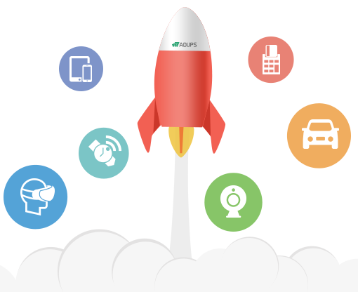
Discussion 3: Looking at Content
A chip vendor for Mobilephones implements FotA Updater.
The routine sends personal data to chip vendor’s IP.
Data transfer is unencrypted.
You intercept traffic to specific IP Addresses (to determine scenario and users affected).
What might you consider?
What legal issues arise?
Notes:
Monitoring/Wiretaps – interception law, plus privacy/DP covers stuff you acquire (TECH link)
Scenario:
There is a Chipvendor of Mobilephonechips who implemented a routine for Firmware over the Air Updater. It seems that these chips have implemented routines to send a lot of personal data unencrypted to the server of the chip vendor. You as a CSIRT like to intercept the traffic to distinct IPAddresses to determine the truth and to identify the users in your network with affected mobile phones.
Tutor Qs:
Which communications do you need to intercept?
What other things might those contain? (Hence law is likely to apply strongly to this activity)
How can you limit the impact of reading that? (e.g. by only looking at traffic to particular addresses; or by automating the inspection process)
Whose traffic are you likely to intercept? (law typically applies more restrictions if it's "the public")

Slide 14
Looking at Content
Learnings
Access to content more protected than access to metadata
Inspect content only for specific investigations
Need to implement safeguards
Specific legislation on telecommunication
European Convention on Human Rights (Art. 8)
Right to respect for private and family life, home and correspondence
Variability
High as well between countries as between types of network
Private / corporate vs. public / telecommunication
Notes:
Learning points:
access to content ("interception"/"wiretaps") is often more strongly protected by law than access to metadata/logs. Safer to inspect content only for specific investigations, rather than routine collection/logging of this information; need to implement safeguards (e.g. only intercept to certain IPs, or from my organisation); note that specific legislation on telcos may prohibit this or require e.g. court orders. Human Rights ….
Variability:
High, both between countries and between types of network (private/corporate vs public/telco)

Slide 15
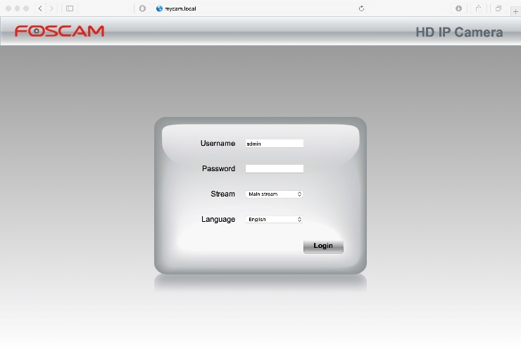
Discussion 4: Scanning for Vulnerabilities
A new DDoS amplification is discovered.
You as CSIRT like to determine vulnerable devices / services.
There is a login screen at Port 80.
You try to access with default password libraries.
Are your actions legal?
Notes:
Scanning/technical pentesting – computer misuse, what defenses (authorisation (UK), minimum difficulty (CH), good intentions (AT), no harm); DoS/DDoS: make sure you know the likely consequences of what you are going to do (TECH link)
Tutor Qs:
What kind of scanning do you need to do? (port e.g. SYN scan, application-layer e.g. banner grabs, authentication e.g. trying default passwords, exploits)
Whose devices will you be scanning? (probably easier in law to scan an organisation-owned device than a user-owned BYOD or an external IP address)
What are the potential consequences of the scanning? Might you cause a Denial of Service attack?
https://www.rechtsanwalt-louis.de/comparison-of-computer-misuse-acts-around-the-world/

Slide 16
Scanning for Vulnerabilities
Learnings
A lot of countries have “unauthorized access” laws
It might depend on Purpose / Protected / Authorised / Harm
Variability
High
Law often unclear even within countries
Notes:
Learning points:
Most countries have "unauthorised access" laws (often criminal). Tests for legality vary greatly: may include whether you are authorised (UK), whether the device is "protected" (e.g. CH), what your purpose is (e.g. AT), whether you cause harm (or, in some cases, know that you might cause harm).
Variability:
high, law often unclear even within countries (e.g. UK case on entering a URL including backquotes (command execution) and .. (directory traversal)).
Could also look at questions around testing common passwords...
https://www.terena.org/activities/tf-csirt/meeting43/Scanning%20for%20Vulnerabilities.pdf
https://script-ed.org/article/can-csirts-lawfully-scan-for-vulnerabilities/

Slide 17
Discussion 5: Takedown Request
You receive a complaint about illegal Material on a website
The website belongs to your constituency
You’ve been asked to remove the content and prevent it from being republished
What do you do?
What material is illegal in your country?
Notes:
Notice & Takedown – very different for different types of content (e.g. copyright, terrorism, indecent images, hate speech, “fake news”, cryptominers, malware); a few legal orders, some liability acquisition (unless you already have it as an act of an employee), soft law stuff – platform law. Any liability to content owner? Any material that I/we must report?
Scenario:
Your CSIRT has received a complaint that its website is hosting illegal material and insisting that you remove it and prevent it being republished. What do you do?
Tutor Qs:
What kinds of materials might be the subject of such a complaint?
What (if any) responsibilities might you have to the person who put it there? (e.g. contract or legal obligations to support free speech)?
What kind of evidence might you need?
Is the illegality dependent on context? (e.g. "fake news" may have serious intent or be indended as a joke) or just on the information itself (e.g. malware or indecent images of children)
What kind of law/policy declares this to be illegal? (e.g. public law (indecent images of children etc.), private law (defamation etc.), industry agreement (e.g. hate speech)

Slide 18
Takedown Request
Learnings
Variability
High
Depends on
Country
Type of material
Type of service
Different types are covered by different laws
Copyright, Software licensing. Terrorism. Hate speech. Cryptominers. Malware
Requirements to prevent re-publication are rare but not unknown
There may be types of material that you are required to report if discovered
It might be that you are on the other side and like to take down from somewhere else
Notes:
Learning points:
different types of material are covered by different laws (e.g. copyright, software licensing, terrorism, indecent images, hate speech, “fake news”, cryptominers, malware...). A few of these require you to remove down material immediately (e.g. EU proposal on terrorism), some require you to follow a specific process (e.g. DMCA notice & counter-notice), some say that if you do not remove the material you are taken to approve its content and accept any liability if it is found to be unlawful, some are "industry agreements" with no legal backing. Requirements to prevent re-publication are rare but not unknown, despite technical difficulties.If you do remove material, are you liable to the person who put it there? Also: there may be types of material that you are required to report (typically to law enforcement) if you discover them yourself.
Also it might be that you like to take down some material on sites somewhere. This might be difficult.
Variability:
very high, by country, type of material. Also an area where the law is changing rapidly.

Slide 19


Discussion 6: Working with Law Enforcement
Your Organisation runs its infrastructure in the cloud
A Server is compromised and distributes malware
The police ask for logs, billing information
The police ask for the malware
Are you allowed to give away the data?
What changes if the police is foreign?
Police
Notes:
LEO (etc.) information disclosure. Orders & permissions (under personal data law); MLAs, US-CLOUD, EU legal…
Scenario:
Your organisation runs its corporate infrastructure in the cloud; one of the servers has been compromised and used to distribute malware. The investing police have asked for logs (which will include bothe internal and external access), cloud billing information, and the malware. Step 2: what if the investigators are from another country?
Tutor Qs:
Does the law require you to disclose what they are asking for? Or allow you to? Or forbid you to?
Do you need any Papers from the police?
What change if the police is foreign?
Do you know any international processes / Conventions about cooperation?

Slide 20
Working with Law Enforcement
Learnings
National law may require / allow / prohibit disclosure to law enforcement
International disclosure may additionally require you to think about
Mutual Legal Assistance
Cybercrime Convention
Bilateral treaties
US Cloud ACT
EU E-Evidence proposal
Talk with the Police and your local lawyer
Variability
Very High
Based on
Countries
Types of investigations
Types of content
Notes:
Learning points:
National law covering disclosures to law enforcement may require disclosure, allow disclosure under certain circumstances, or prohibit disclosure, based on the type of material, severity of crime being investigated, etc. International disclosures may additionally require you to think about Mutual Legal Assistance (where a local Law Enforcement Agency helps and overseas one) or rules on international evidence gathering (e.g. US CLOUD Act, EU legal response, bilateral treaties, Budapest Convention): probably best to get the LEO to tell you what power they think authorises their action, then check with a local lawyer. Advanced topic: Wassennaar if disclosure involved dual-use hacking tools?
Variability:
Very high, based on countries, types of investigation, types of content!

Slide 21
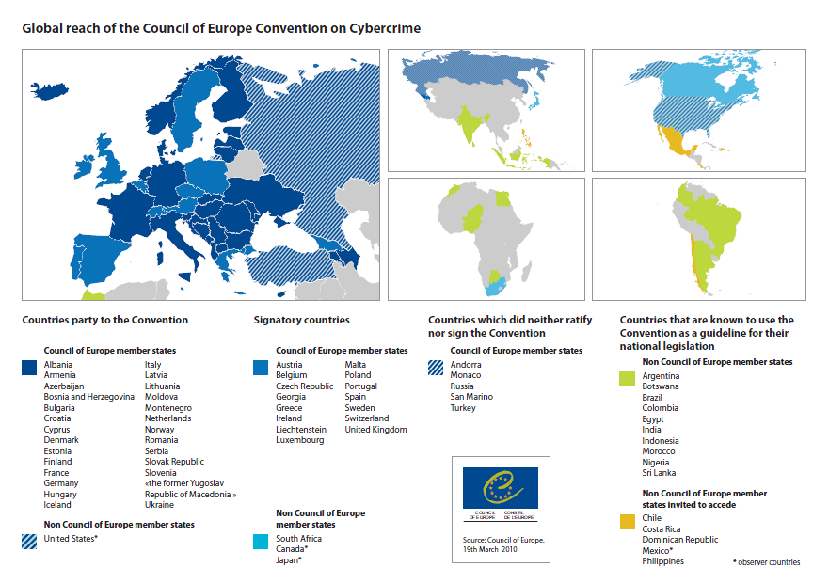
Cyber Crime Convention (Budapest Convention)

Slide 22
Discussion 7: Working with Others
You analyzed a new piece of malware
The malware was distributed through E-Mail
You would like to share:
Pattern / Indicators of Compromise with other CSIRTs
Malware and infected E-Mails through MISP
What could be the problem with sharing?
How could you avoid this?
Notes:
Info sharing – GDPR disclosure different from Law Enforcement Officer (know purpose and any safeguards - e.g. information use agreements); holding/developing attack tools/PoCs (TECH link)
Scenario:
Your CSIRT has analysed a new piece of email-delivered malware. You would like to share: (1) your pattern/IoC with other CSIRTs to help them protect their constituencies from the malware (2) the malware and infected email with other members of an threat analysis platform such as MISP.
Tutor Qs:
Does the sharing involve personal data? Is that allowed?
Does the sharing include content covered by law (e.g. malware, PoCs)?
How can you control the harm that might be caused by sharing? (e.g. agreements between CSIRTs on how information may be used, or with government/vendors that it will be used for defence rather than attack)
Learning points:
may be possible to construct a useful IoC with no personal data (e.g. malware hash) but more likely to need to include features such as sender address patterns. These are likely to be covered by privacy laws, so must ensure the risk of sharing is justified by the benefits, as well as protected by safeguards such as Traffic Light Protocol. Sharing the malware and email are definitely likely to raise these issues plus questions of whether it is lawful to distribute attack tools (e.g. UK Computer Misuse Act crime of "making available" tools likely to be used for hacking).
Variability:
data protection/privacy issues relatively standard (see above on GDPR/Convention 108); "hacking tools" laws aren't common, but need to be aware of their existence.

Slide 23
Working with Others
Learnings
Risk of sharing must be justified by benefits
Reduce risks by safeguards such as Traffic Light Protocol (TLP)
Sharing Malware may raise ”Hacking tools” issues
Variability
Data protection / privacy issues relatively standard
”Hacking tools” understanding might vary
Notes:
Learning points:
may be possible to construct a useful Indicator of Compromise with no personal data (e.g. malware hash) but more likely to need to include features such as sender address patterns. These are likely to be covered by privacy laws, so must ensure the risk of sharing is justified by the benefits, as well as protected by safeguards such as Traffic Light Protocol. Sharing the malware and email are definitely likely to raise these issues plus questions of whether it is lawful to distribute attack tools (e.g. UK Computer Misuse Act crime of "making available" tools likely to be used for hacking).
Variability:
data protection/privacy issues relatively standard (see above on GDPR/Convention 108); "hacking tools" laws aren't common, but need to be aware of their existence.

Slide 24
Discussion 8: Managing Vulnerabilities
Two weeks ago someone report a vulnerability in your web application
He used the main E-Mail Address of the organization
He accessed details of customers by careful choice of URL
Evidence was a screenshot
E-Mail routed to corporate lawyers, who threatening to report to the police
What legal issues arise?
How could they been avoided?
Notes:
Vulnerability disclosure – has the researcher committed crimes, do you promise not to sue, any laws on reverse engineering? Are you liable to users of the product, or to other vendors with same bug. How Managed Vulnerability Disclosure schemes help with these (TECH link)
Scenario: You discover that two weeks ago someone used your organisation's main e-mail account to report a vulnerability they had found in an application on your website. By careful choice of URL they were able to access details of all customers who have attended your corporate briefing events: as evidence they provided a sceenshot showing the first few lines of the database. However the e-mail was routed to your corporate lawyers, who have responded threatening to report the person to the police. What legal issues arise, and how could they have been avoided?
Question supporting Tutor:
What might the finder do next?
What legal obligations might the organisation have now it knows about the vulnerability? (may be required to report to privacy regulator and/or users whose data are exposed)
What might the next finder want to hear from us?

Slide 25
Managing Vulnerabilities
Learnings
Researcher appears to have been trying to help the organization
Legal Department’s response treats him as enemy
Better to have published vulnerability report policy
Liability might arise to individuals whose data are put at risk by the unfixed vulnerability
Advanced issues including laws against reverse engineering of software
Variability
Much of the work in Coordinated Vulnerability Disclosure done by organisations in the Netherlands
Same approach should be applicable elsewhere
Notes:
Learning points:
The researcher appears to have been trying to help the organisation by reporting this bug. The legal department's response might silence them - in which case you will have to spend a lot of time investigating and fixing the vulnerability without their help - or might cause them to report the problem either to a privacy regulator or publicly to shame the organisation. As discussed above, it will be a very case-specific (and country-specific) question whether a vulnerability researcher has actually broken either hacking or privacy laws. But it is much better to have a published vulnerability reporting policy to avoid this type of problem and encourage well-intentioned reporters to do the right thing. Advanced issues include laws against reverse engineering of software (e.g. copyright protection) and what liability might arise to individuals whose data are put at risk by the unfixed vulnerability.
Variability:
Much of the work in Coordinated Vulnerability Disclosure has been done by organisations in the Netherlands, however the same approach should be applicable elsewhere.
https://www.ncsc.nl/english/current-topics/responsible-disclosure-guideline.html
https://www.ceps.eu/content/software-vulnerability-disclosure-europe

Slide 26
Part Three: Homework

Slide 27
Where to start at home
Find out who is your legal adviser or who is in charge to support you
Find out and record the law for your CSIRT, e.g.
Privacy / Data Protection & Monitoring
Scanning / Pentesting
Notice and Takedown
Rules for working with law enforcement
Information Sharing
Vulnerability Management / Vulnerability Disclosure Policy

Slide 28
Where to start at home
Prepare to recognise and handle legal notices
Make sure policies & procedures support working lawfully

Slide 29
Authors: Andrew Cormack, Nicole Harris and Silvio Oertli.
Version: 7.0.
This work is licensed under a Creative Commons Attribution-NonCommercial-ShareAlike 4.0 International License.

