Slide 1
TRANSITS I
SCM – Secure Communication Module
Authors: Olivier Caleff, Jeffeny Hoogervorst, Don Stikvoort and Nicole Harris
Version: 7.2 release
This work is licensed under a Creative Commons Attribution-NonCommercial-ShareAlike 4.0 International License

Slide 2
Presenter Ideas- DELETE
Discussions
There are four group discussions in this material.
Group Discussion 1: how do we trust secure comms / do this as a group and have a matrix of technical, people, legal, other on a flipchart to note down ideas.
Group Discussion 2: standards for secure communication. have the group do this in small groups and feedback to the main group.
Group Discussion 3: What tools do we use and how do we secure? Group Discussion.
Group Discussion 4: Is PGP still relevant? You might want to move this / not do based on the experience of the group with PGP. See right.
PGP
There are three sections on PGP. An advanced group would probably only need section 5a. A less advanced group would need section 5b as well to go into further detail.
Section 5c is for a PGP keysigning party. Do not use if you are not going to do this with the group.

Slide 3
Learning Objectives
Gain an overview of elements to communicate securely
Discuss when and how a CSIRT needs to communicate securely
Know how to get started
Understand key reference documents to help you

Slide 4
Session Plan
How can communications be secured?
Tools and standards
Usage in the CSIRT communities
Wrap-up
PGP/GPG

Slide 5
Why Secure Communication ?
Introduction – Concepts, techniques and trust – What is “secure” ?
Notes:
Trainer: in the 4MAT system (as taught in trainer-training) this is the start of the Why section. It’s logically followed by What (content), How (process, practice) and What If (questions, variations, thinking out of the box, fostering curiosity for more learning).

Slide 6
When it comes to communication… (1/2)
Who?
Stakeholders, Level of trust
Constituents, Partners, Editors, Authorities …
Why?
Authoritative
Aim?
Awareness, Information
Request
Notification, Alert…
Direction
Incoming
Outgoing
Disseminating…
Supportive
Rationale …
Notes:
Trainers:
First items to define the context
Why / Why / Which way?
From trusted/closed communities to one-to-many & public communication
Remind about TLP
Remind that some CSIR Thave a official mandate

Slide 7
When it comes to communication… (2/2)
What?
Context,
How?
Processes
When?
Before
Practices
Tools…
During
After…
Content…
Sharing policy
What if?
Sample use cases
Scenario
Potential risks…
Notes:
Trainers:
Second set of items to define the context
What / How / When
Remind about TLP (again)
What if scenario: need to anticipate and pre-define processes, procedures & scripts, side effects, uncontrolled disclosure

Slide 8
Share Your Ideas
How do we trust / secure any communication?
(technical, human, policy / process, combined?)

Slide 9
Communication Standards and Processes

Slide 10




TLP Traffic Light Protocol
TLP CLEAR Unlimited – no restrictions
TLP GREEN Community-wide, not public
TLP AMBER In-house (organization + clients), need-to-know distribution
TLP AMBER+STRICT In-house (organization ONLY), need-to-know distribution
TLP RED Personal, for named! recipients! only!
More information: https://www.first.org/tlp
Notes:
This will come up in the other modules and in SIM3 discussion

Slide 11
NDAS and CSIRTS
NDA = Non Disclosure Agreement
Pre-agreed process for information sharing
Legal contract (must be able to sign)
Does not preclude use of TLP

Slide 12
Group Discussion
What problems might exist with using either of the standards for secure communication presented here (NDA / TLP)?
Notes:
Take 5 minutes to talk to the people next to you about what issues might arise
TLP – how do you know someone will keep to the community rules? Have they agreed to this declaration? See TI for example or do you declare this in your RFC2350.
NDAs – assumes you know what you want to share, not good for emergency collaboration, can you sign?

Slide 13
4 – Secure Information Handling Process
Information must be received securely
Information must be shared securely
Receiver must know the rules of sharing
Information must be stored securely
Does your team have a process on how to handle information securely?

Slide 14
Technical Tools
Context and technical aspects
Notes:
Trainers:
In the 4MAT system (as taught in trainer-training) this is the start of the Why section. It’s logically followed by What (content), How (process, practice) and What If (questions, variations, thinking out of the box, fostering curiosity for more learning).

Slide 15
Tools
Voice
Messaging
Web site or workspaces
Web portal with form(s)
Sharing resources
Phone/mobile with VoIP/Chat apps
Email, Instant Messaging
File repository, File shares
Peer Identification & Authentication
CSIRT or Third-Party Hosted & Managed
Confidentiality & Encryption Levels
Availability & Reliability
Notes:
Trainers:
4 means of communication
* Discussing about incoming information: spam via email & generic "security@" / "info@" mailboxes & Web form to submit incidents/requests
4 main criteria to take into account
Getting a good knowledge (or better, a proof) of who you’re communicating with
Whether or not your CSIRT is mastering the infrastructure
The required level of confidentiality, supported by encryption, based on the information to be shared
If used for crisis communication,

Slide 16
Share YourIdeas
What tools do you use, and how secure are they?

Slide 17
"Secure" tools, really?
Which ones are "secure"? What & who can you trust? Which criteria?
Can you ever trust a "free" product? Better with a "paid" product?
Can you trust XXX a very popular app/ecosystem?
What about reliability and sustainability?
What are the underlying infrastructure dependencies?
Notes:
Trainers:
Some key questions here, relaed to TRUST
What are your CSIRT’s criteria? Always the same or changing based on the context?
If it’ free, YOU ARE the product!
If it’s a company, source code can’t be audited (except in rare cases)
Can you trust pp XXX that has been acquired by YYY and is sharing information with ZZZ?
It has to work 24x7 unless you can’t rely on it… Crisis management apps (more expensive) or potentially less reliable freeware?
Many infra nowadays rely on the cloud. Don’t put all your eggs in the same basket and this is a criteria: AWS, Azure, GCP, OVH…

Slide 18
Secure e-mail and Cryptography

Slide 19
Group Discussion
Is PGP still a relevant and appropriate standard for CSIRTs today?
Do you have a PGP key?
Do you regularly use?
What other options are there?
How do you share?
How has this changed?
Keyservers? In email signature? On business cards?

Slide 20
Cryptography
Cryptography
Using algorithms to encrypt and decrypt data
Symmetric cryptography (Signal, file encryption, bitlocker)
Symmetric encryption uses a shared secret
Same key/password/code used to encrypt and decrypt data
Faster
Asymmetric cryptography (PGP, Adobe Sign, TLS)
Asymmetric encryption is based on secrets that are kept private and corresponding public keys
Different key used to encrypt and decrypt data
Easier to share

Slide 21
Security Requirements
Confidentiality
to keep communications secret
Integrity
to keep communications secured and complete
Authentication
to know who the sender and the recipient(s) are
Nonrepudiation
to seal sender/recipient(s)/content(s) against denial

Slide 22
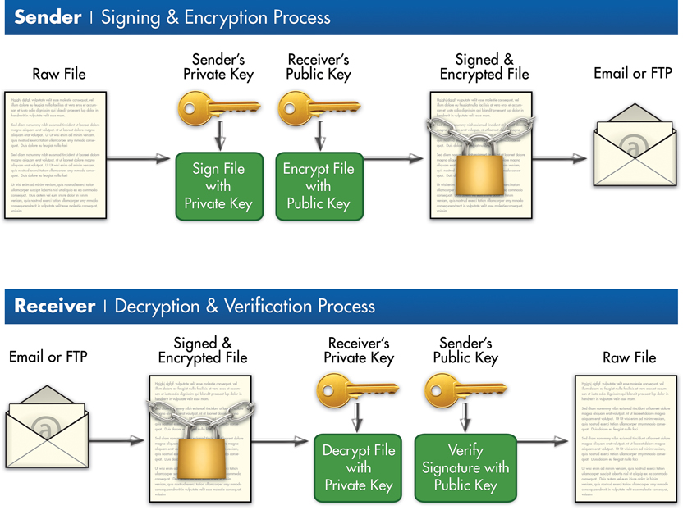
Asymmetric process
image source: https://www.andretimokhin.com/wp-content/uploads/2013/07/OpenPGP.jpg

Slide 23
Relationship between identity(ies) and key(s)
Identity = email address ≠ a real person
A direct association between an identity and a keypair
It’s not a one-to-one relationship
A keypair can be related to multiple email addresses
pub 4096R/40009346 2018-01-12 Olivier Caleff <security@caleff.com>
Olivier Caleff (OPS-T) <opst@caleff.com>
Olivier Caleff (CSIRT) <csirt@caleff.com>
Olivier Caleff (FIRST) <first@caleff.com>
Olivier Caleff (TF-CSIRT) <tfcsirt@caleff.com>
Olivier Caleff (TRANSITS) <transits@caleff.com>
Olivier Caleff (OpenCSIRT) <opencsirt@caleff.com>
Fingerprint=3D75 29D8 0593 8153 5FC6 55C9 6BFC B595 4000 9346
An email address can be related to multiple keypairs… but is it wise?
Example

Slide 24
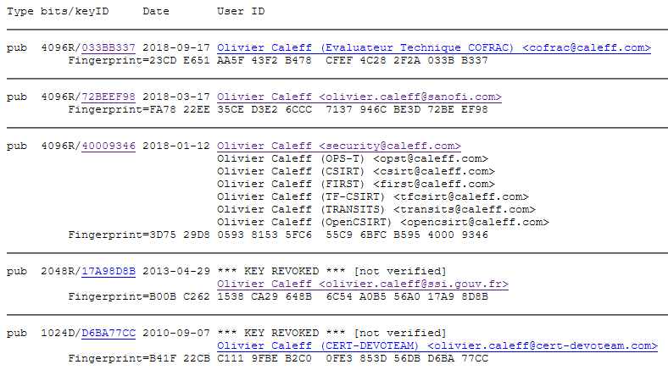
Relationship between identity(ies) and humans
A human can have multiple employers over his career, and different roles at any given time
A human can have multiple valid and obsolete email addresses
Example
Notes:
Drawing made by Olivier. NO copyright

Slide 25
How to Manage Keys?
Single Key, Single Person
Pros: easier to manage to easier find you
Cons: anyone can see your identities, your life can tracked via roles, might not meet company policy
Multiple Keys, Single Person
Pros: easier to split identities
Cons: people may use the wrong key
Shared Team Key
Pros: simple approach Cons: against authentication principle, issues when people leave
Main Key with Subkeys for Team
Pros: Easier to manage people joining and leaving
Cons: Needs active management, might not fit with other personal communication

Slide 26
History and Acronyms
PGP = Pretty Good Privacy
OpenPGP
GPG = GnuPG
S/MIME
1991 - Phil Zimmerman
Now commercial
RFC1991
1997, IETF WG
Non-proprietary
RFC2440 / 4880
1999, Werner Koch
Implementation of RFC4880
1995, RSA Data Security
RFC2045 (MIME)
RFC3850/1

Slide 27
External Communication

Slide 28
Build your Network

Slide 29
TF-CSIRT, Trusted Introducer and TRANSITS
TF-CSIRT
TRANSITS Training
TF-CSIRT
Steering Committee
Trusted Introducer
GÉANT Task Force but not typical.
Even mix of NREN, commercial, government / national CERTS.
Meets three times a year.
100 – 200 people per meeting.
Closed, only for teams in TI.
Provides both taught courses and licenses materials for general use.
Procured service.
Supports listing, accreditation and certification of teams.

Slide 30
What is Trusted Introducer?
A process for CSIRT teams to get to know each other and build trust.
A registry of CSIRT teams.
A set of tools that can be used by the teams for incident response.
An accreditation and certification process to help teams express their trustworthiness.
Traditionally Europe + surrounding regions but now accepts all teams.

Slide 31
Three Processes of TI
Listing
Free service
Must be supported by 2 existing teams
Accreditation
Cost of 1,200 euros per year, plus one time fee (800 euros)
Certification
Full audited certification
Simple team listing in registry
Can attend TF-CSIRT general sessions
Supported self-assessment against a set of criteria
Can attend closed meetings, be on closed lists, access closed area of website
Cost of 2,400 euros (in Europe, more outside)

Slide 32

Partners
APCERT,
AfricaCERT,
AMPARO,
FIRST,
ENISA,
RIPE.
We align with the Regional Internet Regions

Slide 33
Mission
The mission of TF-CSIRT is to facilitate and improve the collaboration within the European CSIRT community to make cyber space a better place

Slide 34
Why Us?
“TF-CSIRT operates with a European mindset, and strives to make it services and meetings inclusive, accessible, easy-to-reach, and affordable for all CSIRTS in Europe – regardless of sector. Through the Trusted Introducer service, TF-CSIRT can offer well-maintained and up-to-date information and provide teams with recognition status via its differentiated listing, accreditation and certification processes.”

Slide 35
Getting started with PGP / GPG

Slide 36
Key generation
Set up a secure environment – depending on your security requirements
Launch the key generation app
Select the appropriate parameters
On the key itself: key sizes much larger than 1024; At least 2048, best if > 4096
Set an expiration date for the key: it can be extended
Set a strong passphrase to protect the key: it can be changed
Generate a revocation certificate (more later)
Perform a backup (more later)
Public Key
Private Key
Passphrase
Revocation certificate

Slide 37
Key generation
Fingerprint - a recognisable 128-bit hash value, in hexadecimals like
3D75 29D8 0593 8153 5FC6 55C9 6BFC B595 4000 9346
KeyID is identical to last 8 or 16 hexadecimal positions → '0x40009346' or '0x6BFCB59540009346’
Check fingerprint and name/e-mail
The fingerprint is not guaranteed unique

Slide 38
Key storages and sharing
Key storage
Export the private key and keep it in a secured and controlled location
Export the revocation certificate
Keep the passphrase in a safe location
Key sharing
Public announcement
Upload on major publicly available servers
https://pgp.mit.edu/ – http://pgp.circl.lu/ – https://pgp.surfnet.nl/
http://pool.sks-keyservers.net/
Others: https://keys.openpgp.org/ – https://keyserver.pgp.com/
Sharing with a CSIRT community
Next step: Ensuring of authenticity of the shared key

Slide 39
Key updates and revocation
Key update
Adding an email address
Extending the duration of the validity
Key revocation
When the key becomes useless
When there are some risks that it has been compromised
Do not think about modifying or deleting
Revocation is the only way
What do you need to revocate a key?

Slide 40
Key Signing Party
Gathering to cross-sign the keys of participants
Participants print their key-data (email, fingerprint) and bring their ID ready
For each individual key presented, verify individual’s identity (against passport or national ID with photo)
Do this effectively by rotating like the track of a tank
Sign all the keys that you verified (this is best practice – but you decide based on your policy)
Need electronic copy of public key from keyservers
Add signed keys to keyservers in order to have your signature visible to the world

Slide 41
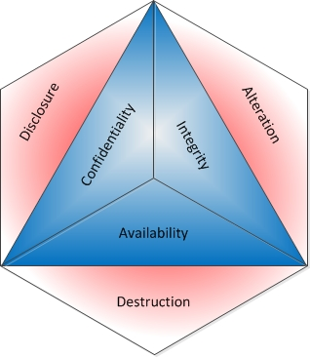
Wrap-up
Public key cryptography with a keypair
PUBLIC key to be shared over key servers
PRIVATE key to be protected and kept PRIVATE
Encryption/DEcyption
ENcrypted with the recipient’s public key
DEcrypted with the recipient’s private key
Encryption enforces Confidentiality and Integrity,
Availability is not covered
Encrypted information can be sent over insecure communication links
Signing with a PRIVATE key
Makes recipients know you are the author of a message

Slide 42
PGP Usage in CSIRT communities

Slide 43
Usage in the CSIRT Community
A team GPG key is a MUST-HAVE
The team managers (main + alternate) MUST HAVE their own GPG keypairs
The communication basis for tools such as MISP
Key Sharing parties are organized at most CSIRT conferences and at all on-site TRANSITS trainings

Slide 44
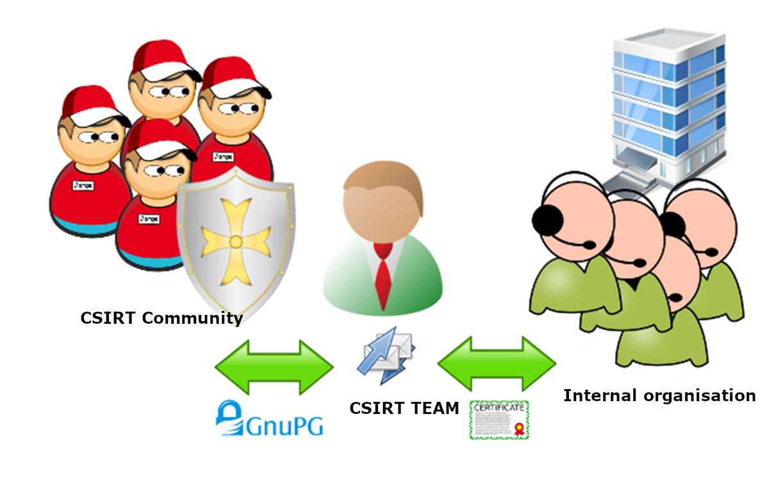
PGP/MIME versus S/MIME

Slide 45
Cryptographic basis of S/MIME and PGP/MIME
Symmetric encryption uses a shared secret
A password/code to encrypt/decrypt on both sides
Does not scale for bigger groups or communities
S/MIME and PGP/MIME both based on:
Asymmetric encryption is based on secrets that are kept private and corresponding public keys
Keypair: private/secret and public keys
Secret key unlocked by passphrase - remember that the chain is as strong as its weakest link ....
Items encrypted with your PUBLIC key can only be decrypted using your SECRET key
Items signed with your SECRET key can be recognized using your PUBLIC key
Additionally, the signing process is used to ensure integrity

Slide 46
PGP Keysigning Party

Slide 47
Key Signing Party
Gathering to cross-sign the keys of participants
We’ve printed participant key-data (email, fingerprint)
Bring your ID ready
For each individual key presented, verify individual’s identity (against passport or national ID with photo)
Do this effectively by rotating like the track of a tank
Sign all the keys that you verified (this is best practice – but you decide based on your policy)
Need electronic copy of public key from keyservers
Add signed keys to keyservers in order to have your signature visible to the world

Slide 48
TRANSITS I
SCM – Secure Communication Module
Authors: Olivier Caleff, Jeffeny Hoogervorst & Don Stikvoort
Version: experimental
This work is licensed under a Creative Commons Attribution-NonCommercial-ShareAlike 4.0 International License

