Slide 1
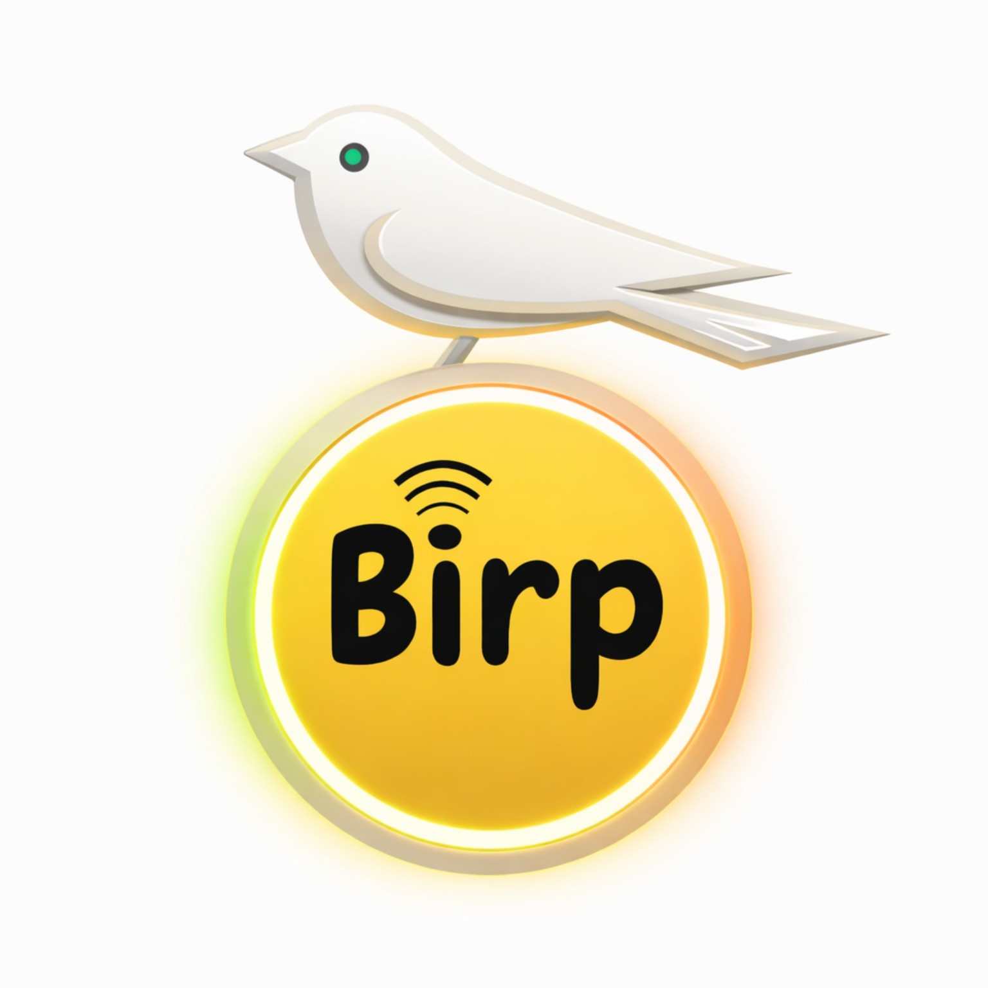
BIRP
The Home Canary
A physical bird that makes
room conditions visible.
Engineering partner discussion
Michael Gee • Founder
BIRP • Partner discussion • October 2026
01
Notes:
Concept-stage partner pitch. Original founder-supplied logo, preserved unchanged. Product requirements: https://github.com/GEEKProtocol0110/birp-home-canary/blob/main/docs/PRODUCT_VISION.md
No working physical device or customer validation is claimed.

Slide 2
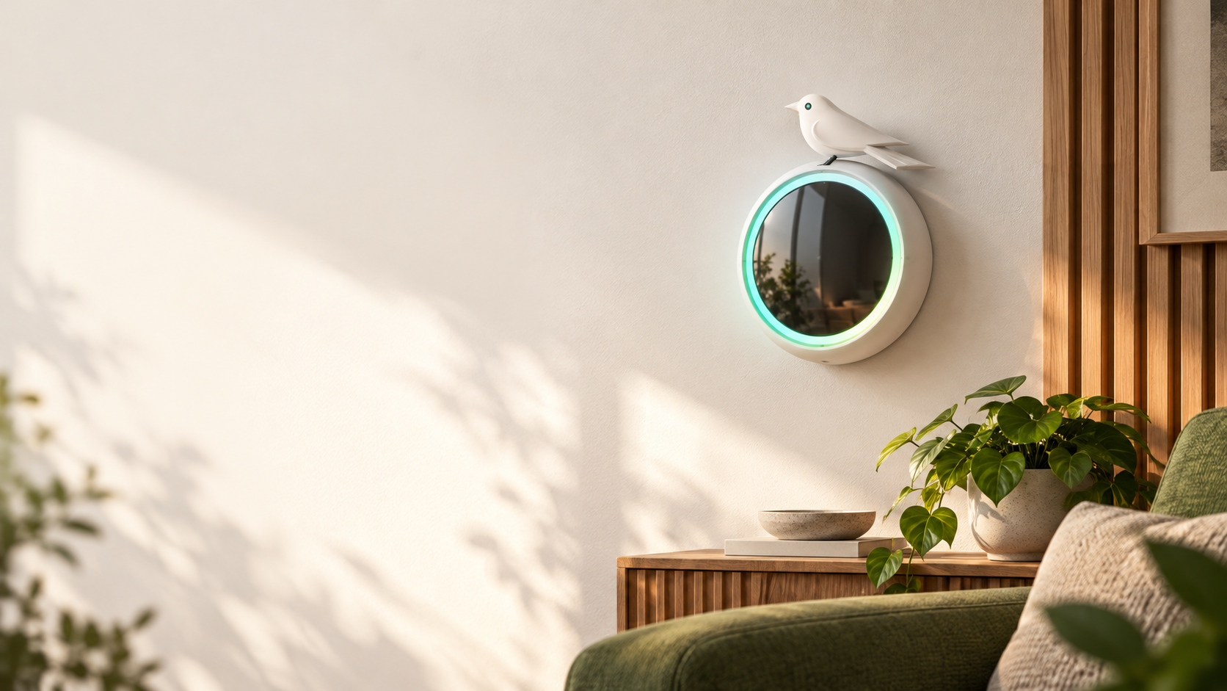
A clearer signal
in the room
Working hypothesis
A glanceable bird and halo could help
people notice a change and check
the reading that caused it.
First audience to test
People who want simple room-level
air awareness at home.
Concept illustration. Demand is unvalidated.
02
Notes:
Audience is a proposed discovery focus, not a validated customer segment. Generated lifestyle concept illustration created October 20, 2026 using founder artwork as reference. It does not depict existing hardware. Source: https://github.com/GEEKProtocol0110/birp-home-canary/blob/main/docs/PRODUCT_VISION.md

Slide 3
The bird moves around the perimeter
A physical bird outside a 5-inch round display
Condition | Bird position | Supporting signal
Better | Top | Teal halo and readings
Needs attention | Partway down | Amber halo and visible cause
Higher concern | Bottom | Red halo and visible cause
Proposed states. Thresholds and mechanism remain unvalidated.
Missing readings get an explicit status. Body tilt is a separate motion.
BIRP • Partner discussion • October 2026
03
Notes:
Founder requires top=better, bottom=worse. Intermediate preset, colors and fault behavior are proposed in control draft 0.2. Orbital position is not body tilt or a calibrated motor command. Unknown readings must not show a reassuring calm status. Sources: https://github.com/GEEKProtocol0110/birp-home-canary/blob/main/docs/PRODUCT_VISION.md and https://github.com/GEEKProtocol0110/birp-home-canary/blob/main/docs/control-spec-v0.2.md

Slide 4
Standalone core, optional connected services
Core experience
Broader product vision
Room readings on the display
Bird and halo in the room
Useful without an app
or subscription
Optional app and smart-home links
Camera and video intercom
Multiple room units
with a master unit
Product requirements and roadmap goals. Hardware and services are not implemented.
BIRP • Partner discussion • October 2026
04
Notes:
Standalone core and optional connected services are founder requirements. Same-hardware goal and multi-room topology remain unproven. Camera/intercom remain in broader vision. Sources: https://github.com/GEEKProtocol0110/birp-home-canary/blob/main/docs/PRODUCT_VISION.md and https://github.com/GEEKProtocol0110/birp-home-canary/blob/main/docs/SOURCE_RECONCILIATION.md

Slide 5
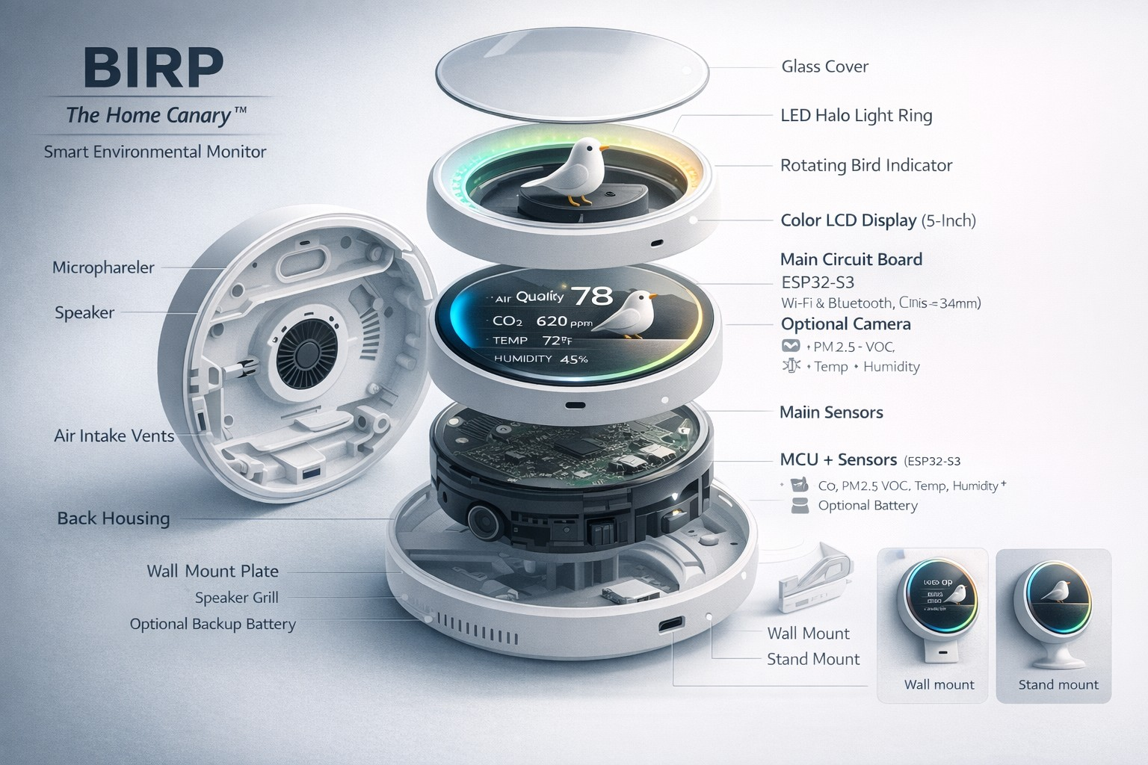
Original design direction
Round display
and light halo
Wall or stand
mounting concept
Baby, pet, plant
and greenhouse
use cases to explore
Original concept artwork. Labels and assembly are not a build specification.
BIRP • Partner discussion • October 2026
05
Notes:
Original founder-supplied exploded rendering preserved unchanged. The image is a historical concept illustration; components, dimensions and its text are not validated specifications. Earlier assistant drawing may place bird inside display, whereas authoritative founder requirement is physical perimeter movement. Sources: https://github.com/GEEKProtocol0110/birp-home-canary/blob/main/docs/ASSET_REGISTER.md and https://github.com/GEEKProtocol0110/birp-home-canary/blob/main/docs/SOURCE_RECONCILIATION.md

Slide 6
A documented concept, ready for review
Available today
Evidence still needed
Original product artwork
Four-page invention brief
Browser simulation of bird states
Draft control and fault behavior
Working physical mechanism
Integrated sensors and firmware
User understanding and demand
Cost and manufacturing feasibility
The browser demo uses simulated input. No physical prototype has been validated.
BIRP • Partner discussion • October 2026
06
Notes:
Project status as of October 20, 2026. No functioning firmware, physical prototype, buildable CAD, PCB, manufacturing quote, customer validation or test evidence. Sources: https://github.com/GEEKProtocol0110/birp-home-canary/blob/main/docs/STATUS.md and https://github.com/GEEKProtocol0110/birp-home-canary/blob/main/docs/brief/BIRP-Invention-Brief-v1.0.pdf

Slide 7
The first physical proof
01
User understanding
Test whether people understand the bird’s top-to-bottom meaning.
02
Mechanism feasibility
Select a reference method and prove bounded perimeter travel.
03
Sensor-to-indicator loop
Connect proposed CO₂, PM2.5, temperature and humidity inputs.
04
Recorded demonstration
Show visible causes, missing readings, recovery and fault handling.
Proposed bench experiment. Resources and engineering choices remain open.
BIRP • Partner discussion • October 2026
07
Notes:
Sequence is a proposed low-cost first experiment. It does not permanently exclude camera/intercom or other broader goals. Select sensor models, validate limits and review thresholds before physical operation. Sources: https://github.com/GEEKProtocol0110/birp-home-canary/blob/main/docs/FOUNDER_CHECKLIST.md and https://github.com/GEEKProtocol0110/birp-home-canary/blob/main/docs/control-spec-v0.2.md

Slide 8
Engineering partner sought
Help turn the perimeter-bird concept
into one reproducible bench demonstration.
Mechanical motion and enclosure feasibility
Sensor, display and embedded control integration
A scoped prototype plan with measured limits
Next discussion: feasibility, contribution and prototype scope.
birp-home-canary.oolongee.chatgpt.site
BIRP • Partner discussion • October 2026
08
Notes:
Ask is an engineering collaboration and feasibility discussion, not an investment or purchase offer. Terms, budget, ownership and licensing require separate discussion. Live concept site: https://birp-home-canary.oolongee.chatgpt.site
Repository: https://github.com/GEEKProtocol0110/birp-home-canary
Brief: https://github.com/GEEKProtocol0110/birp-home-canary/blob/main/docs/brief/BIRP-Invention-Brief-v1.0.pdf

