Slide 1
Data Structures and Algorithms (CS210A)
Lecture 11:
Arithmetic expression evaluation: Complete algorithm using stack
Two interesting problems

Slide 2
Quick Recap of last lecture

Slide 3



Stack: a new data structure
A special kind of list
where all operations (insertion, deletion, query) take place at one end only,
called the top.
top
$$a_{1}$$
$$a_{2}$$
$$a_{n}$$

Slide 4
Evaluation of an arithmetic expression
Question: How does a computer/calculator evaluate an arithmetic expression given in the form of a string of symbols ?
8 + 3 * 5 ^ 2 – 9

Slide 5
Evaluation of an arithmetic expression
Question: How does a computer/calculator evaluate an arithmetic expression given in the form of a string of symbols?
8 + 3 * 5 ^ 2 – 9
What about expressions involving parentheses: 3+4*(5-6/(8+9^2)+33) ?
What about associativity of the operators ?
operators
operands

Slide 6
Overview of our solution
Focusing on a simpler version of the problem:
Expressions without parentheses
Every operator is left associative
Solving the simpler version
Transforming the solution of simpler version to generic

Slide 7
Incorporating precedence of operators through priority number
Operator | Priority
+ , - | 1
* , / | 2
^ | 3

Slide 8
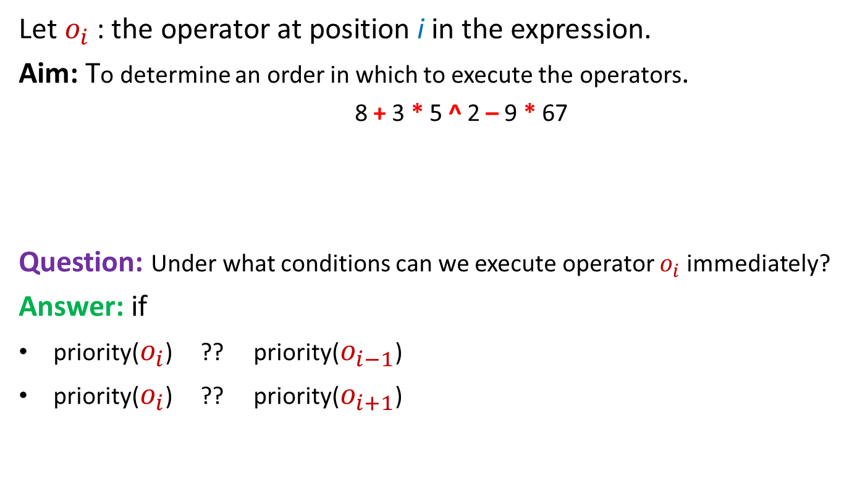
Insight into the problem
Let $o_{i}$ : the operator at position i in the expression.
Aim: To determine an order in which to execute the operators.
8 + 3 * 5 ^ 2 – 9 * 67
Question: Under what conditions can we execute operator $o_{i}$ immediately?
Answer: if
priority($o_{i}$) ?? priority($o_{i−1}$)
priority($o_{i}$) ?? priority($o_{i+1}$)
Position of an operator does matter
>
≥

Slide 9

Expression: $n_{1}{o_{1} n}_{2}o_{2}{ n}_{3}$ $o_{3} n_{4} o_{4}{ n}_{5 }o_{5}{ n}_{6 }o_{6}…$
We keep two stacks:
N-stack
for operands
O-stack
for operators

Slide 10











Expression: $n_{1}{o_{1} n}_{2}o_{2}{ n}_{3}$ $o_{3} n_{4} o_{4}{ n}_{5 }o_{5}{ n}_{6 }o_{6}…$
We keep two stacks:
$$o_{5}$$
$$n_{6}$$
$$n_{5}$$
$$o_{4}$$
$$n_{4}$$
$$o_{3}$$
$$n_{3}$$
$$n_{2}$$
$$o_{2}$$
$$n_{1}$$
$$o_{1}$$
N-stack
for operands
O-stack
for operators

Slide 11


Expression: $n_{1}{o_{1} n}_{2}o_{2}{ n}_{3}$ $o_{3} n_{4} o_{4} n\text{’} o_{6}…$
We keep two stacks:
$n$’
$$o_{4}$$
$$n_{4}$$
$$o_{3}$$
$$n_{3}$$
$$n_{2}$$
$$o_{2}$$
$$n_{1}$$
$$o_{1}$$
N-stack
for operands
O-stack
for operators

Slide 12



Expression: $n_{1}{o_{1} n}_{2}o_{2}{ n}_{3}$ $o_{3} n\text{" } o_{6}…$
We keep two stacks:
$$o_{6}$$
$$n"$$
$$o_{3}$$
$$n_{3}$$
$$n_{2}$$
$$o_{2}$$
$$n_{1}$$
$$o_{1}$$
N-stack
for operands
O-stack
for operators

Slide 13
A simple algorithm
Priority of $ :
Least
push($,O-stack);
While ( ? ) do
{ x ← next_token();
Two cases:
x is number :
x is operator :
while( ? >= ? )
{ o ← POP(O-stack);
Execute(o);
}
push(x,O-stack);
}
push(x,N-stack);
PRIORITY(TOP(O-stack)
PRIORITY(x)
POP two numbers from N-stack
apply operator x on them
place the result back into N-stack

Slide 14
Next step
Transforming the solution to Solve the most general case

Slide 15
How to handle parentheses ?
3+4*(5 - 6/2)
Answer:
Evaluate the expression enclosed by this parenthesis
before any other operator currently present in the O-stack.
So we must push ( into the O-stack.
Observation 1: While ( is the current operator encountered in the expression,
it must have higher priority than every other operator in the stack.
What should we do whenever
we encounter ( in the expression ?
*
+
(
O-stack

Slide 16

How to handle parentheses ?
3+4*(5 - 6/2)
Answer:
The ( should act as an artificial bottom of the O-stack .
every other operator that follows (
should be allowed to sit on the top of ( in the stack .
Observation 2 : while ( is inside the stack,
it must have less priority than every other operator that follows.
Observation 1: While ( is the current operator encountered in the expression,
it must have higher priority than every other operator in the stack
What needs to be done when
( is at the top of the O-stack ?
$$/$$
$$−$$
(
*
+
O-stack
A CONTRADICTION !!

Slide 17
Take a pause for a few minutes to realize surprisingly that
the contradicting requirements for the priority of (
in fact hints at a suitable solution for handling (.

Slide 18

How to handle parentheses ?
Using two types of priorities of each operator ●.
InsideStack priority
OutsideStack priority
The priority of an operator ●
when it is inside the stack.
The priority of an operator ●
when it is encountered in the expression.
$n_{1}{o_{1} n}_{2}o_{2}{ n}_{3}$ $o_{3} n_{4} { n}_{5 }o_{5}{ n}_{6 }o_{6}$
top
O-stack
O-stack

Slide 19






How to handle parentheses ?
Using two types of priorities of each operator ●.
Operator | InsideStackPriority | OutsideStackPriority
+ , -
* , /
^
(
$$1$$
$$1$$
$$2$$
$$2$$
$$3$$
$$3$$
0
4
Does it take care of nested parentheses ? Check it yourself.

Slide 20
How to handle parentheses ?
3+4*(5 - 6/2)
Question: What needs to be done whenever we encounter ) in the expression ?
Answer: Keep popping O-stack and evaluating the operators until we get its matching (.

Slide 21
The algorithm generalized to handle parentheses
push($,O-stack);
While ( ? ) do
x ← next_token();
Cases:
x is number : push(x,N-stack);
x is ) : while( TOP(O-stack) <> ( )
{ o ← Pop(O-stack);
Execute(o);
}
Pop(O-stack); //popping the matching (
otherwise : while( ? >= ? )
{ o ← Pop(O-stack);
Execute(o);
}
Push(x,O-stack);
InsideStackPriority(TOP(O-stack))
OutsideStackPriority(x)

Slide 22
Practice exercise
Execute the algorithm on 3+4*((5+6*(3+4)))^2 and convince yourself through proper reasoning that the algorithm handles parentheses suitably.

Slide 23
How to handle associativity of operators ?

Slide 24
Associativity of arithmetic operators
Left associative operators : +, - , * , /
a+b+c = (a+b)+c
a-b-c = (a-b)-c
a*b*c = (a*b)*c
a/b/c = (a/b)/c
Right associative operators: ^
2^3^2 = 2^(3^2) = 512.
What we need is the following:
If ^ is current operator of the expression, and ^ is on top of stack,
then ^ should be evaluated before ^.
How to incorporate it ?
We have already handled left associativity
in our algorithm.
How to handle right associativity ?
Play with the priorities ☺

Slide 25
How to handle associativity of operators ? Using two types of priorities of each right associative operator.
Operator | InsideStackPriority | Outside-stack priority
+ , - | 1 | 1
* , / | 2 | 2
^ | 3 | 3
( | 0 | 4
4
5

Slide 26
The general Algorithm It is the same as the algorithm to handle parentheses :-)
While ( ? ) do
x ← next_token();
Cases:
x is number : push(x,N-stack);
x is ) : while( TOP(O-stack) <> ( )
{ o ← Pop(O-stack);
Execute(o);
}
Pop(O-stack); //popping the matching (
otherwise : while(InsideStackPriority(TOP(O-stack)) >= OutsideStackPriority(x))
{ o ← Pop(O-stack);
Execute(o);
}
Push(x,O-stack);

Slide 27
Homeworks
Execute the general algorithm on 3+4*((4+6)^2)/2 and convince yourself through proper reasoning that the algorithm handles nested parentheses suitably.
Execute the general algorithm on 3+4^2^2*3 and convince yourself through proper reasoning that the algorithm takes into account the right associativity of operator ^.
What should be the priorities of $ ?
How to take care of the end of the expression ?
Hint: Introduce a new operator symbol #
at the end of the expression so that upon seeing #,
we do very much like what we do on seeing ). What should be the priorities of # ?

Slide 28
Homeworks
How is recursion implemented during program execution ?
int Recur(int i)
{
int j, k, val;
…
…
val = Recur(t);
…
…
}
Using stack
Learn about it from wikipedia …

Slide 29
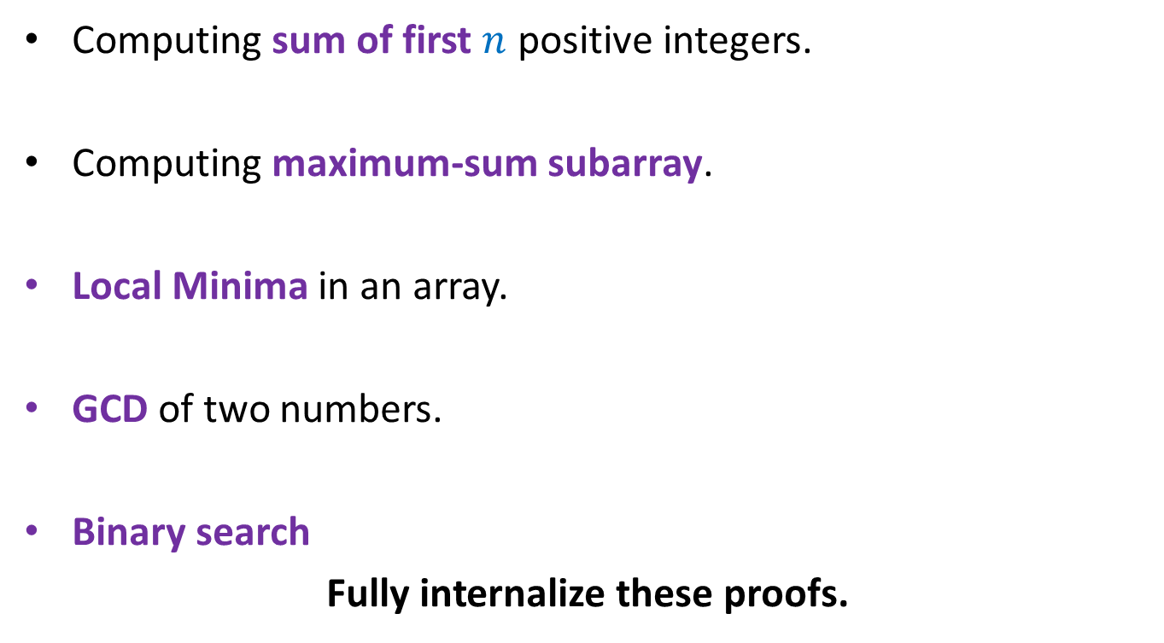
Proof of correctness of iterative algorithms
Computing sum of first $n$ positive integers.
Computing maximum-sum subarray.
Local Minima in an array.
GCD of two numbers.
Binary search
Fully internalize these proofs.

Slide 30
Two interesting problems
Applications of simple data structures

Slide 31
8 queen problem
Place 8 queens on a chess board so that no two of them attack each other.
Q
Q
With this sketch/hint,
try to design the complete algorithm using stack or otherwise.

Slide 32
Shortest route in a grid
From a cell in the grid, we can move to any of its neighboring cell in one step.
From top left corner, find shortest route to each green cell avoiding obstacles.
Ponder over this beautiful problem ☺

