Slide 1
Data Structures and Algorithms (CS210A)
Lecture 15:
Algorithm paradigm of Divide and Conquer :
Counting the number of Inversions
Another sorting algorithm based on Divide and Conquer :
Quick Sort

Slide 2
Divide and Conquer paradigm An Overview
Divide the problem instance
Solve each smaller instances
Combine the solutions of the smaller instances
to get the solution of the original instance.
into two or more instances of the same problem
recursively (base case suitably defined).
This is usually the main nontrivial step in the design of an algorithm using divide and conquer strategy

Slide 3
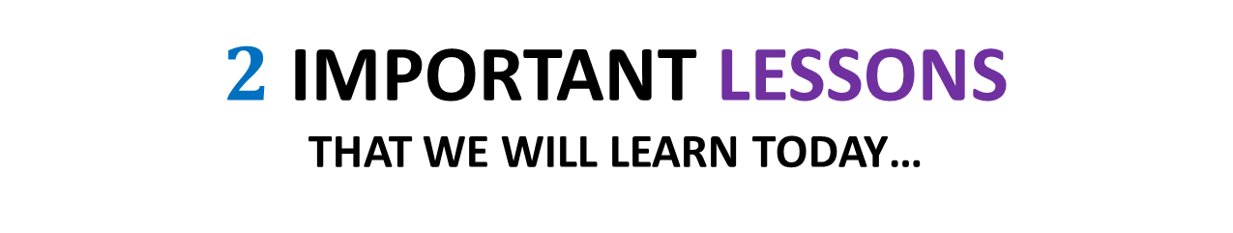
$2$ Important Lessons that we will learn today…
Role of Data structures
Learn from the past …
in algorithms

Slide 4
Role of Data Structures in designing efficient algorithms
Definition: A collection of data elements arranged and connected in a way
which can facilitate efficient executions of a
(possibly long) sequence of operations.
Parameters:
Query/Update time
Space
Preprocessing time

Slide 5

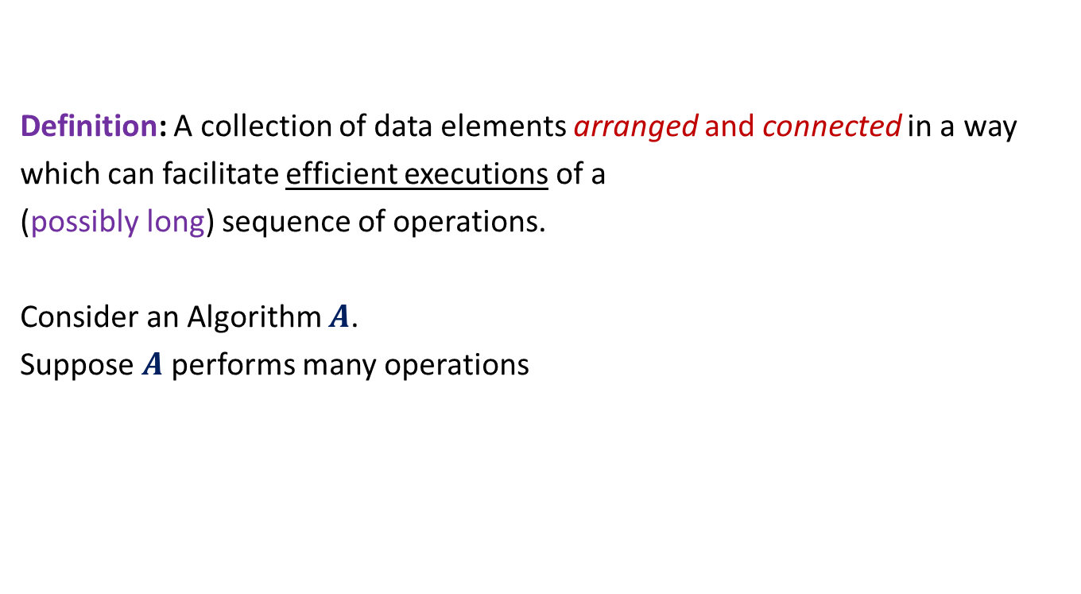
Role of Data Structures in designing efficient algorithms
Definition: A collection of data elements arranged and connected in a way
which can facilitate efficient executions of a
(possibly long) sequence of operations.
Consider an Algorithm $A$.
Suppose $A$performs many operations
of same type on some data.
Improving time complexity of these operations
Improving the time complexity of $A$.
So, it is worth designing
a suitable data structure.

Slide 6
Counting Inversions in an array Problem description
Definition (Inversion): Given an array A of size n,
a pair (i,j), 0≤i<j<n is called an inversion if
Example:
Inversions are :
(1,2), (1,4), (1,6),
(3,4),(3,6),
(5,6), (5,7)
AIM: An efficient algorithm to count the number of inversions in an array A.
A[i]>A[j].
0 1 2 3 4 5 6 7
A
3 15 8 19 9 67 11 27

Slide 7


Counting Inversions in an array Problem familiarization
Trivial-algo(A[$0..n−1$])
{ count ← 0;
For($j$=1 to $n−1$) do
{ For( $i$=0 to $j−1$ )
{ If ( ? ) count ← count + 1;
}
} return count;
}
Time complexity: O($n^{2}$)
A[$i$]>A[$j$]

Slide 8
Let us try to design a Divide and Conquer based algorithm

Slide 9



How do we approach using divide & conquer
$${count}_{I}$$
$${count}_{II}$$
0 1 2 3 4 5 6 7
A
3 15 8 19 9 67 11 27
$${count}_{III}$$

Slide 10
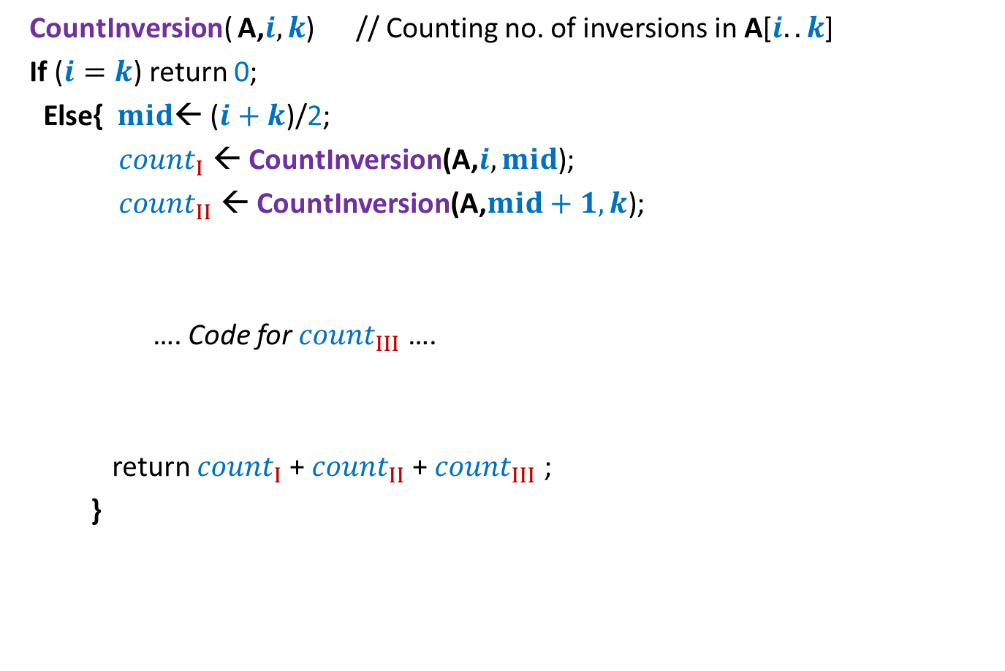
Counting Inversions Divide and Conquer based algorithm
CountInversion( A,$i,k$) // Counting no. of inversions in A[$i..k$]
If ($i=k$) return 0;
Else{ $mid$← ($i+k$)/2;
${count}_{I}$ ← CountInversion(A,$i,mid$);
${count}_{II}$ ← CountInversion(A,$mid+1,k$);
…. Code for ${count}_{III}$ ….
return ${count}_{I}$+ ${count}_{II}$+ ${count}_{III}$ ;
}

Slide 11

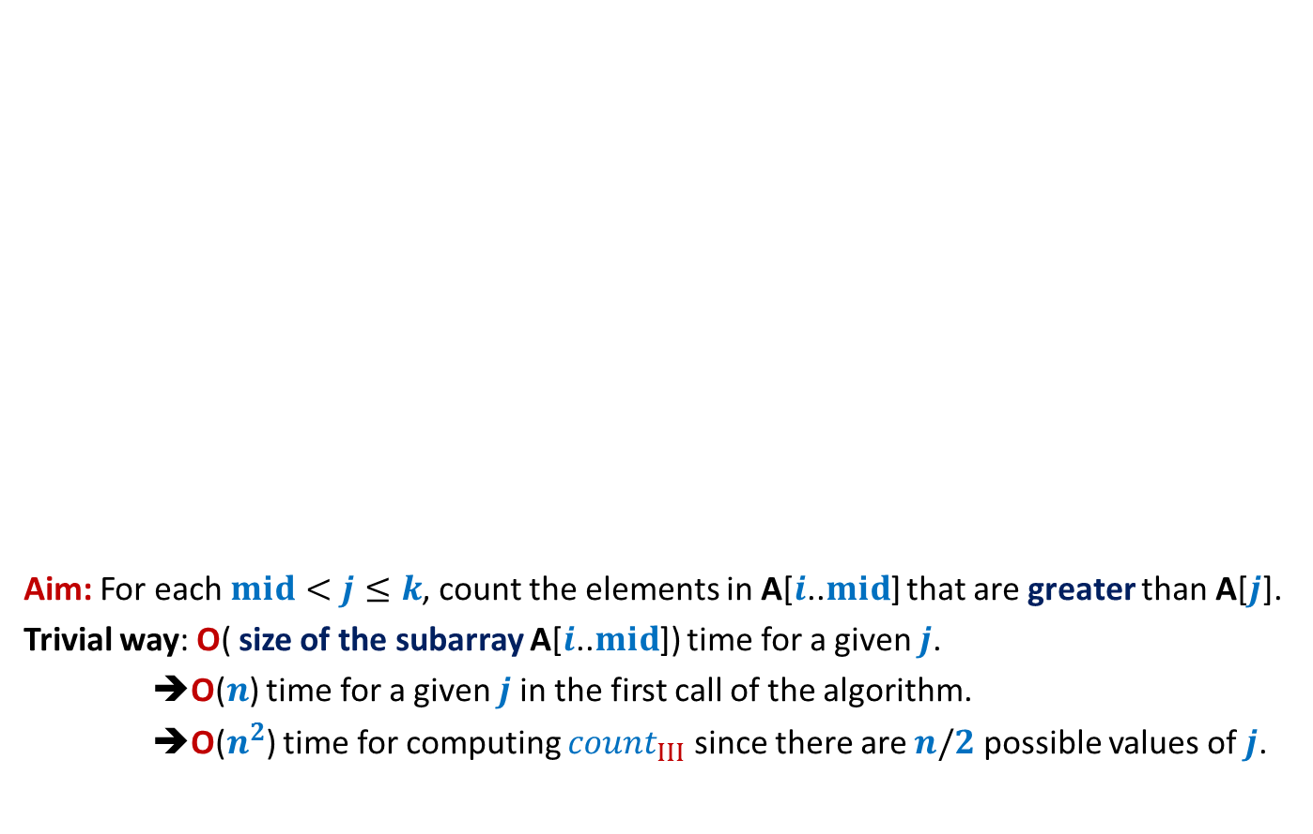

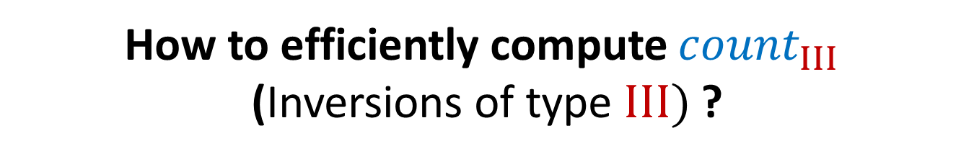


How to efficiently compute ${count}_{III}$ (Inversions of type $III)$ ?
Aim: For each $mid<j≤k$, count the elements in A[$i$..$mid$] that are greater than A[$j$].
Trivial way: O( size of the subarray A[$i$..$mid$]) time for a given $j$.
➔O($n$) time for a given $j$in the first call of the algorithm.
➔O($n^{2}$) time for computing ${count}_{III}$ since there are $n/2$ possible values of $j$.
$$i$$
$$j$$
$$k$$
A
3 15 8 19 9 67 11 27
O($n^{2}$) time algo
$${count}_{III}$$

Slide 12


How to efficiently compute ${count}_{III}$ (Inversions of type $III)$ ?
Let us state clearly what we want to achieve …
$$i$$
$$j$$
$$k$$
A
3 15 8 19 9 67 11 27
For each $j∈[mid+1,k]$
$${count}_{III}$$
count the elements in A[$i$..$mid$] that are greater than A[$j$].
What should be
the data structure ?
Time to apply Lesson 1
Sorted subarray A[$i$..$mid$].

Slide 13
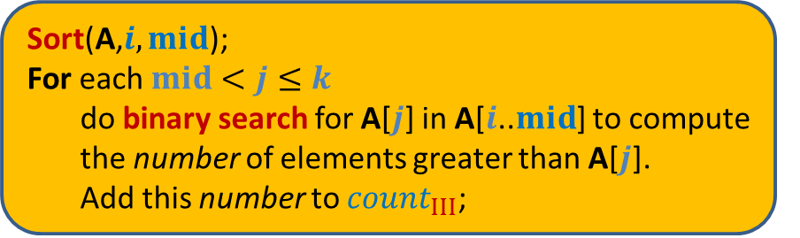
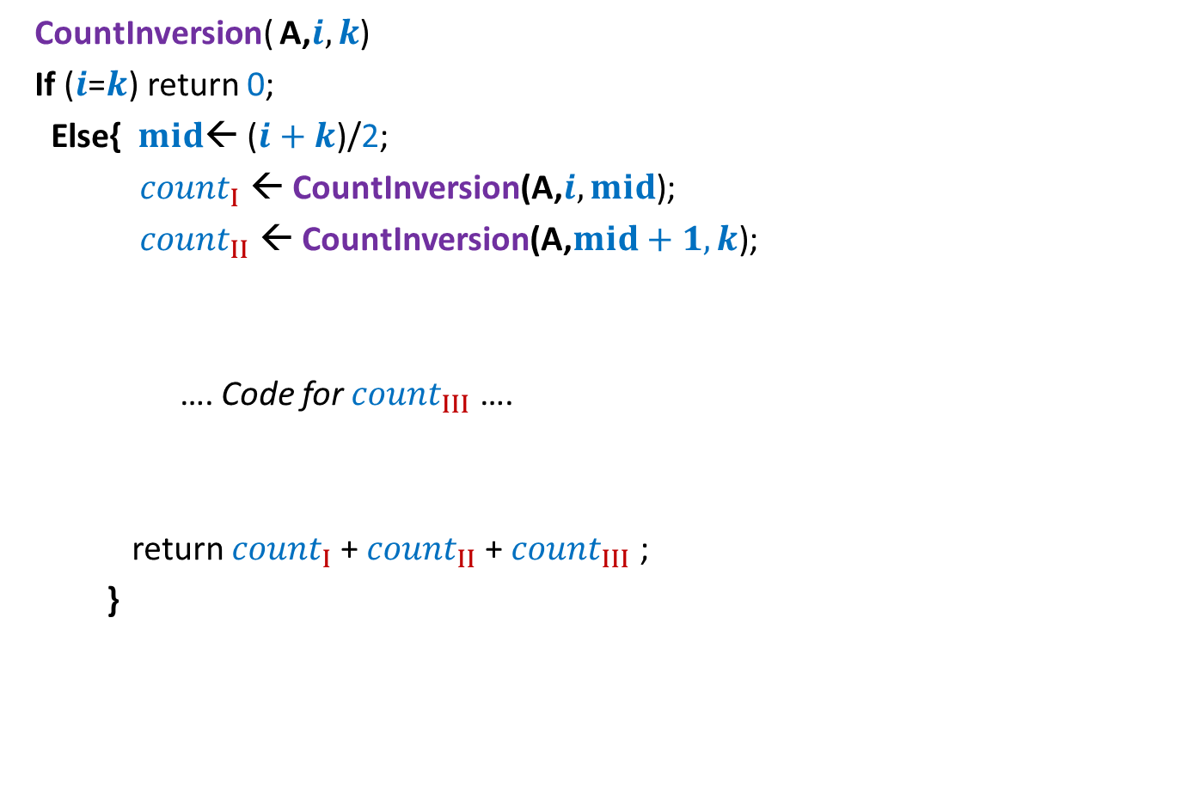


Counting Inversions First algorithm based on divide & conquer
CountInversion( A,$i,k$)
If ($i$=$k$) return 0;
Else{ $mid$← ($i+k$)/2;
${count}_{I}$ ← CountInversion(A,$i,mid$);
${count}_{II}$ ← CountInversion(A,$mid+1,k$);
…. Code for ${count}_{III}$ ….
return ${count}_{I}$+ ${count}_{II}$+ ${count}_{III}$ ;
}
2 T($n/2$)
Sort(A,$i,mid$);
For each $mid<j≤k$
do binary search for A[$j$] in A[$i$..$mid$] to compute
the number of elements greater than A[$j$].
Add this number to ${count}_{III}$;
c $n$ log $n$

Slide 14
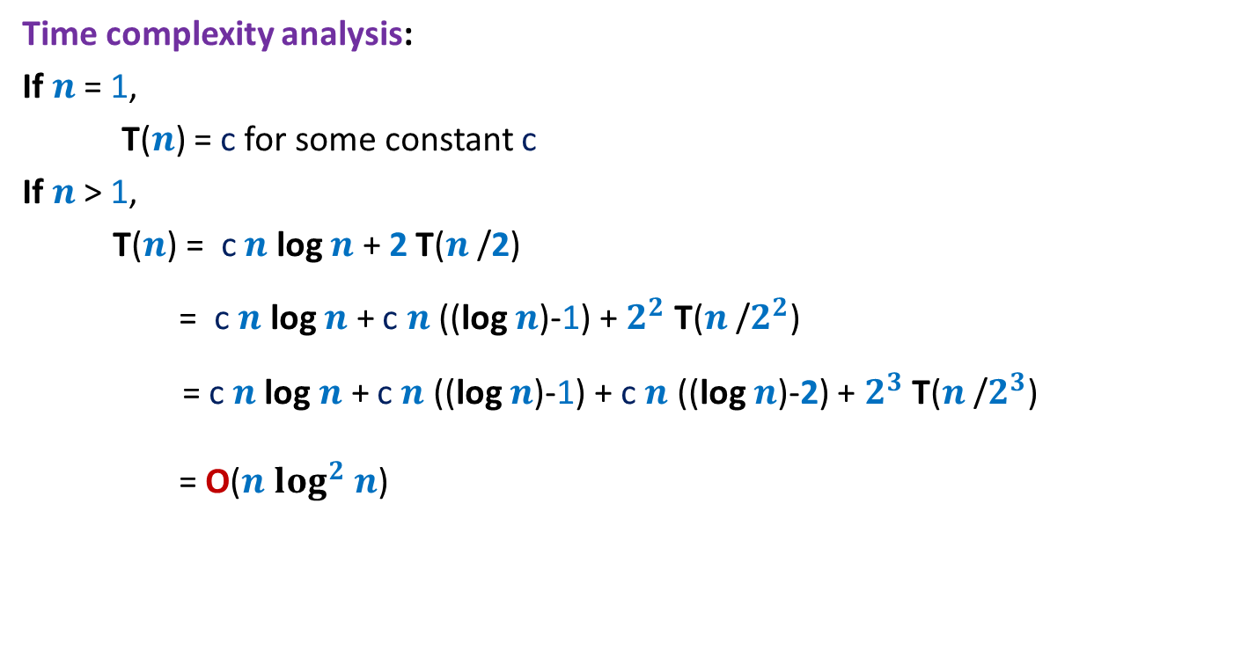
Counting Inversions First algorithm based on divide & conquer
Time complexity analysis:
If $n$ = 1,
T($n$) = c for some constant c
If $n$ > 1,
T($n$) = c $n$ log $n$ + 2 T($n$/2)
= c $n$ log $n$ + c $n$ ((log $n$)-1) + $2^{2}$ T($n$/$2^{2}$)
= c $n$log $n$ + c $n$ ((log $n$)-1) + c $n$ ((log $n$)-2) + $2^{3}$ T($n$/$2^{3}$)
= O($n$ $\log^{2}$ $n$)
Can we improve it further ?

Slide 15
Counting Inversions First algorithm based on divide & conquer
CountInversion( A,$i,k$)
If ($i$=$k$) return 0;
Else{ $mid$← ($i+k$)/2;
${count}_{I}$ ← CountInversion(A,$i,mid$);
${count}_{II}$ ← CountInversion(A,$mid+1,k$);
…. Code for ${count}_{III}$ ….
return ${count}_{I}$+ ${count}_{II}$+ ${count}_{III}$ ;
}
2 T($n/2$)
Sort(A,$i,mid$);
For each $mid<j≤k$
do binary search for A[$j$] in A[$i$..$mid$] to compute
the number of elements greater than A[$j$].
Add this number to ${count}_{III}$;
c $n$ log $n$

Slide 16
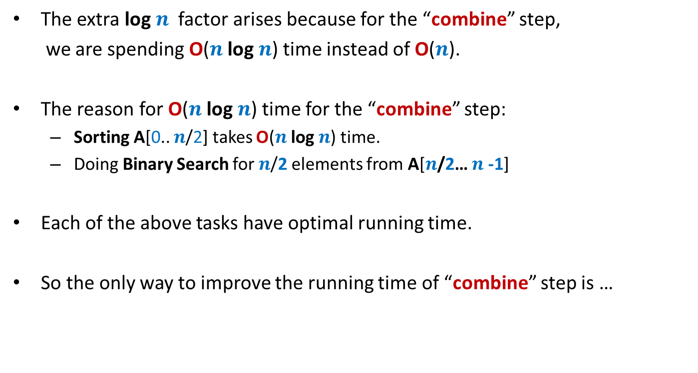
Sequence of observations To achieve better running time
The extra log $n$ factor arises because for the “combine” step,
we are spending O($n$ log $n$) time instead of O($n$).
The reason for O($n$ log $n$) time for the “combine” step:
Sorting A[0.. $n$/2] takes O($n$ log $n$) time.
Doing Binary Search for $n$/2 elements from A[$n$/2… $n$-1]
Each of the above tasks have optimal running time.
So the only way to improve the running time of “combine” step is …
some new idea

Slide 17
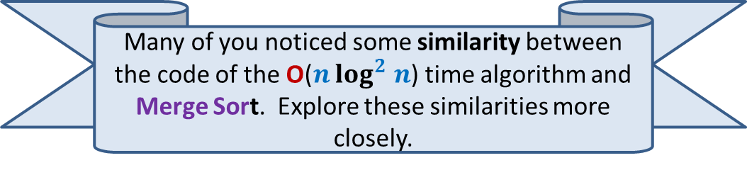
Learn from the past …
Many of you noticed some similarity between the code of the O($n$ $\log^{2}$ $n$) time algorithm and Merge Sort. Explore these similarities more closely.

Slide 18
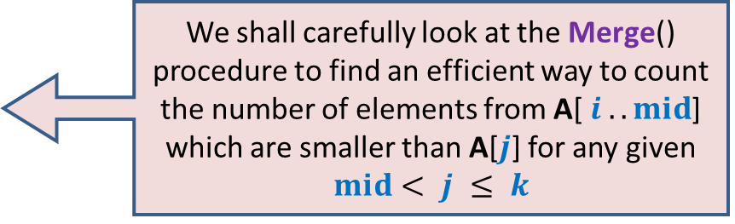
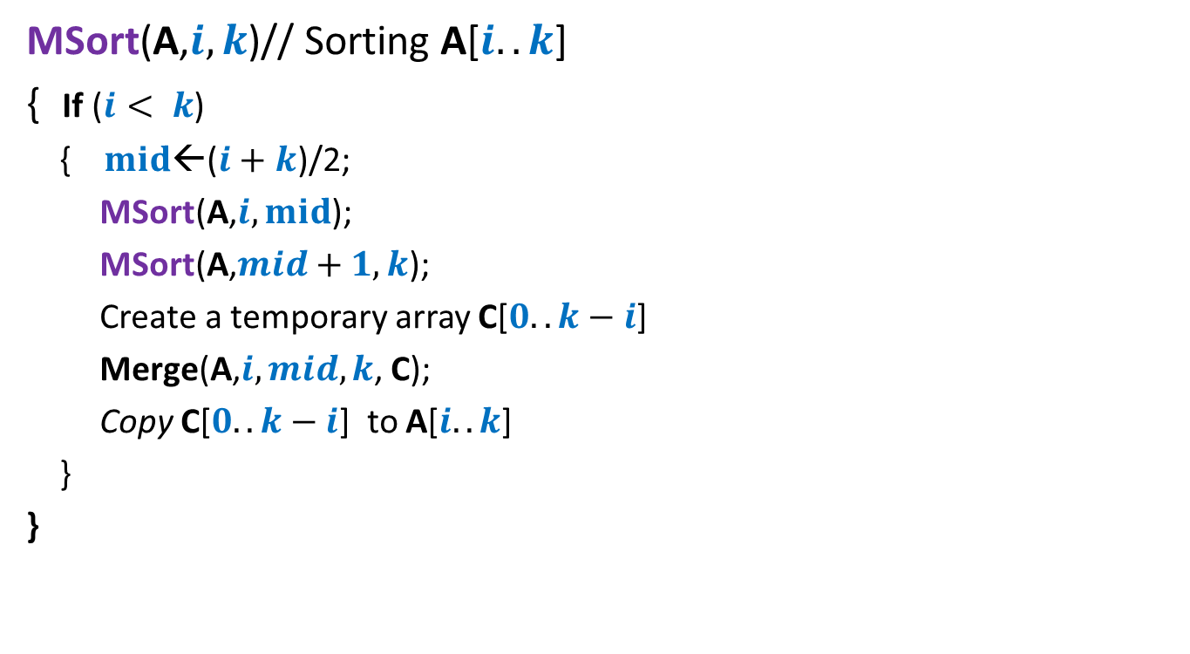
Revisiting MergeSort algorithm
MSort(A,$i,k$)// Sorting A[$i..k$]
{ If ($i< k$)
{ $mid$←($i+k$)/2;
MSort(A,$i,mid$);
MSort(A,$mid+1,k$);
Create a temporary array C[$0..k−i$]
Merge(A,$i,mid,k$, C);
Copy C[$0..k−i$] to A[$i..k$]
}
}
We shall carefully look at the Merge() procedure to find an efficient way to count the number of elements from A[ $i ..mid$] which are smaller than A[$j$] for any given $mid< j ≤ k$

Slide 19

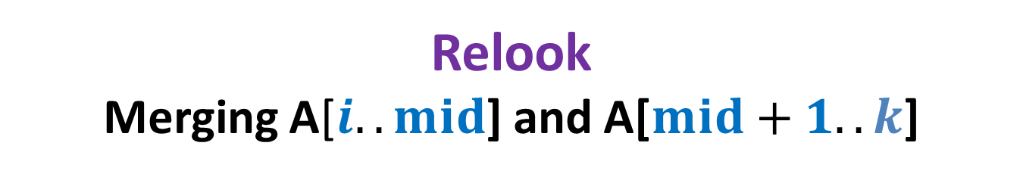
Relook Merging A[$i..mid$] and A[$mid+1..k$]
Sorted
Sorted
A
x
x
$$j$$
>x
C

Slide 20
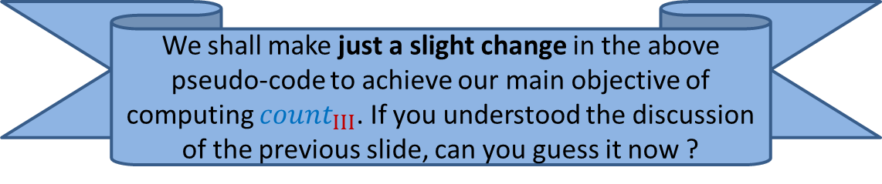
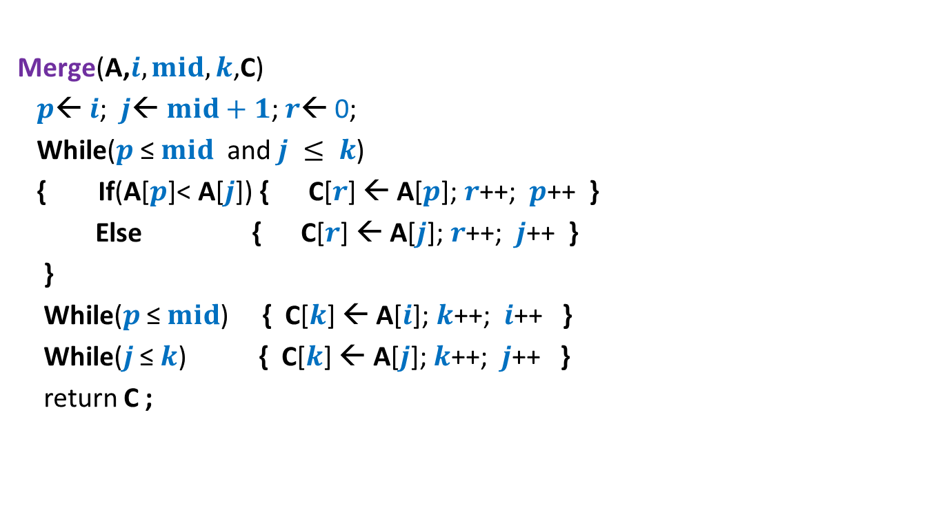
Pesudo-code for Merging two sorted arrays
Merge(A,$i,mid,k$,C)
$p$← $i$; $j$← $mid+1$; $r$← 0;
While($p$ ≤ $mid$ and $j ≤ k$)
{ If(A[$p$]< A[$j$]) { C[$r$] ← A[$p$]; $r$++; $p$++ }
Else { C[$r$] ← A[$j$];$r$++; $j$++ }
}
While($p$ ≤ $mid$) { C[$k$] ← A[$i$]; $k$++; $i$++ }
While($j$ ≤ $k$) { C[$k$] ← A[$j$]; $k$++; $j$++ }
return C ;
We shall make just a slight change in the above pseudo-code to achieve our main objective of computing ${count}_{III}$. If you understood the discussion of the previous slide, can you guess it now ?

Slide 21

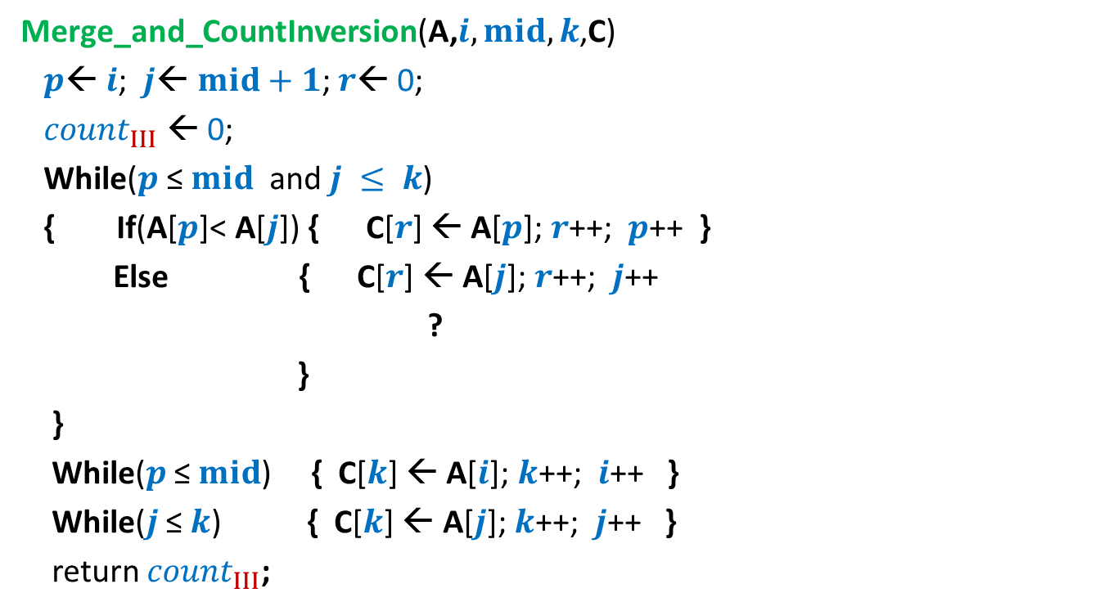

Pesudo-code for Merging and counting inversions
Merge_and_CountInversion(A,$i,mid,k$,C)
$p$← $i$; $j$← $mid+1$; $r$← 0;
${count}_{III}$ ← 0;
While($p$ ≤ $mid$ and $j ≤ k$)
{ If(A[$p$]< A[$j$]) { C[$r$] ← A[$p$]; $r$++; $p$++ }
Else { C[$r$] ← A[$j$];$r$++; $j$++
?
}
}
While($p$ ≤ $mid$) { C[$k$] ← A[$i$]; $k$++; $i$++ }
While($j$ ≤ $k$) { C[$k$] ← A[$j$]; $k$++; $j$++ }
return ${count}_{III}$;
${count}_{III}$ ← ${count}_{III}$ + ? ;
($mid−p+1$);
Nothing extra is needed here.

Slide 22

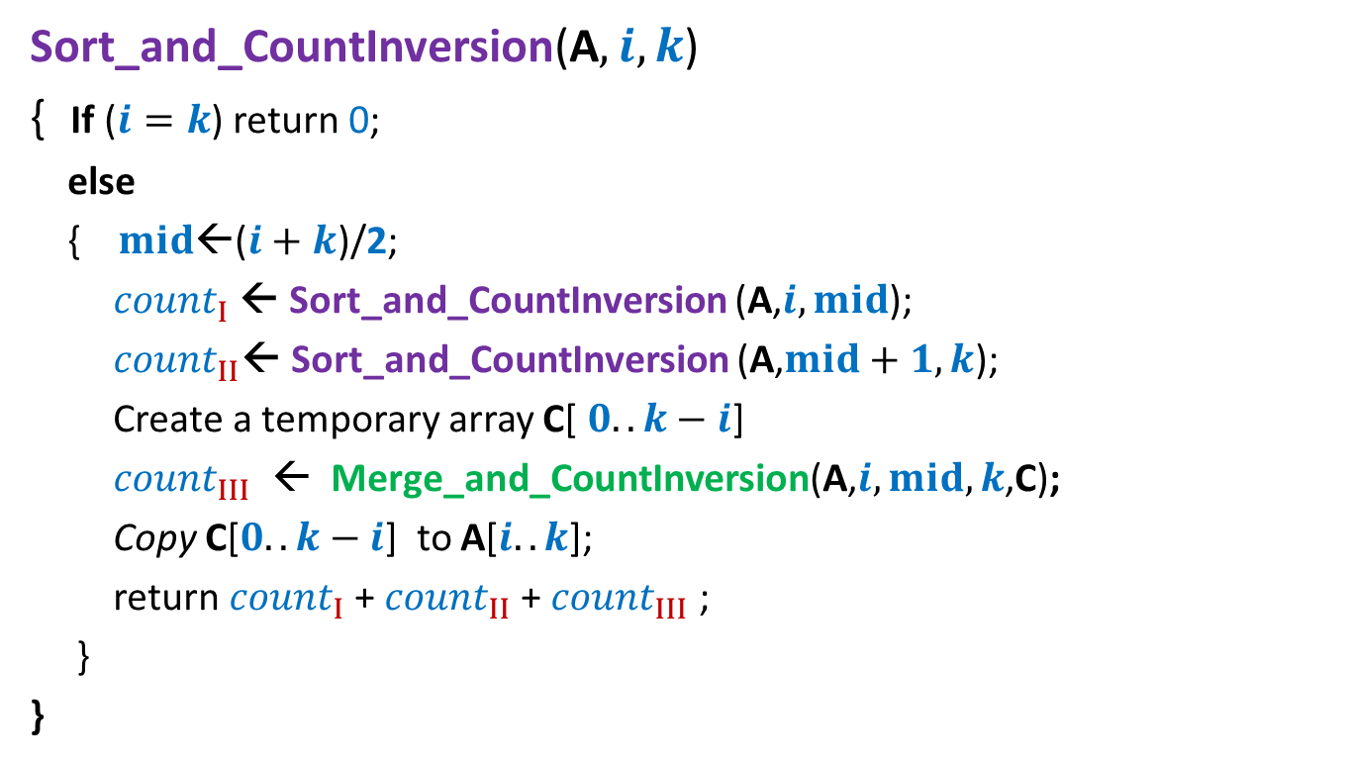

Counting Inversions Final algorithm based on divide & conquer
Sort_and_CountInversion(A$,i,k$)
{ If ($i=k$) return 0;
else
{ $mid$←($i+k$)/2;
${count}_{I}$← Sort_and_CountInversion (A,$i,mid$);
${count}_{II}$← Sort_and_CountInversion (A,$mid+1,k$);
Create a temporary array C[ $0..k−i$]
${count}_{III}$ ← Merge_and_CountInversion(A,$i,mid,k$,C);
Copy C[$0..k−i$] to A[$i..k$];
return ${count}_{I}$+ ${count}_{II}$+ ${count}_{III}$ ;
}
}
$2$ T($n/2$)
O($n$)

Slide 23
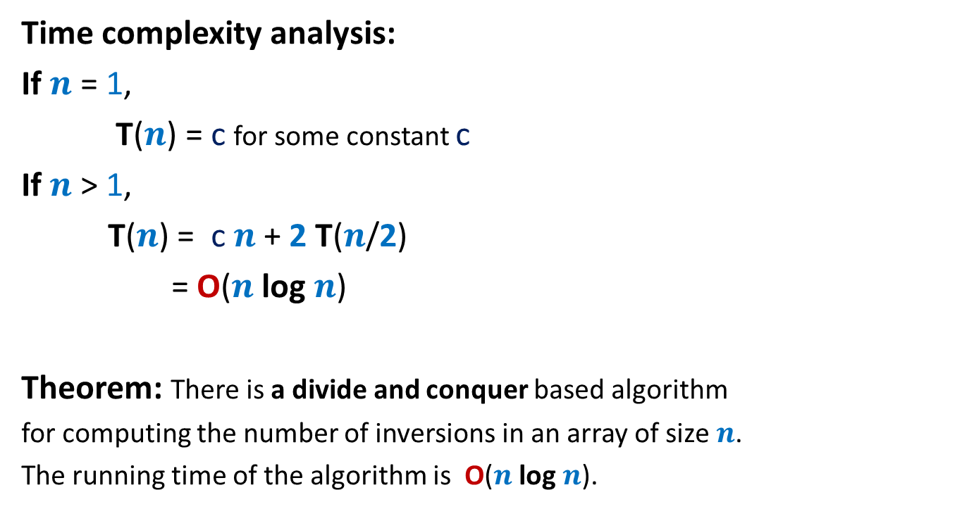
Counting Inversions Final algorithm based on divide & conquer
Time complexity analysis:
If $n$ = 1,
T($n$) = c for some constant c
If $n$ > 1,
T($n$) = c $n$ + 2 T($n$/2)
= O($n$ log $n$)
Theorem: There is a divide and conquer based algorithm
for computing the number of inversions in an array of size $n$.
The running time of the algorithm is O($n$ log $n$).

Slide 24
QuickSort
Another sorting algorithm based on divide and conquer

Slide 25
Is there any alternate way to divide ?
0 1 2 3 4 5 6 7 8
x
In MergeSort, we divide the input instance in an obvious manner.

Slide 26
0 1 2 3 4 5 6 7 8
>x
<x
x

Slide 27
This procedure is called Partition.
It rearranges the elements so that all elements less than x appear to the left of x and all elements greater than x appear to the right of x.
0 1 2 3 4 5 6 7 8
Can you now guess a divide and conquer algorithm for sorting based on Partition() ?
0 1 2 3 4 5 6 7 8
<x
>x

Slide 28
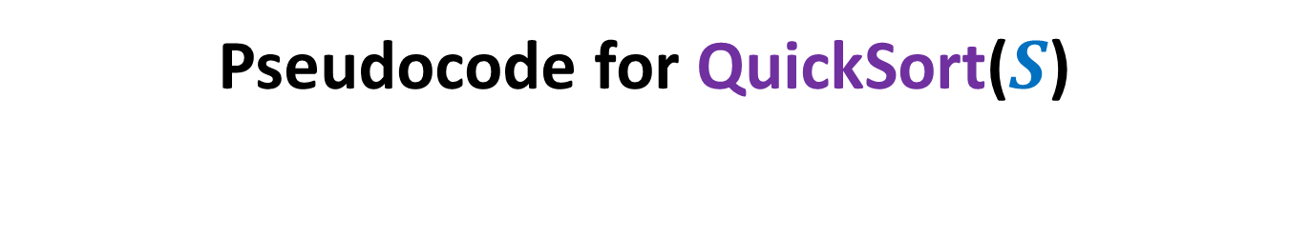
Pseudocode for QuickSort($S$)
QuickSort($S$)
{ If (|$S$|>1)
Pick and remove an element $x$from $S$;
($S_{<x}$, $S_{>x}$)← Partition($S$,$x$);
return( Concatenate(QuickSort($S_{<x}$), $x$, QuickSort($S_{>x}$))
}

Slide 29

Pseudocode for QuickSort($S$) When the input $S$is stored in an array
QuickSort($A$,$l$, $r$)
{ If ($l$ < $r$)
$i$← Partition($A$,$l$,$r$); // $i$ is index where element $A$[$l$] is finally placed
QuickSort($A$,$l$, $i−1$);
QuickSort($A$,$i+1$, $r$)
}
View this algorithm from various perspectives. For almost all practical purposes, this is the most efficient algorithm for sorting. It outperforms MergeSort by a significant factor.

Slide 30
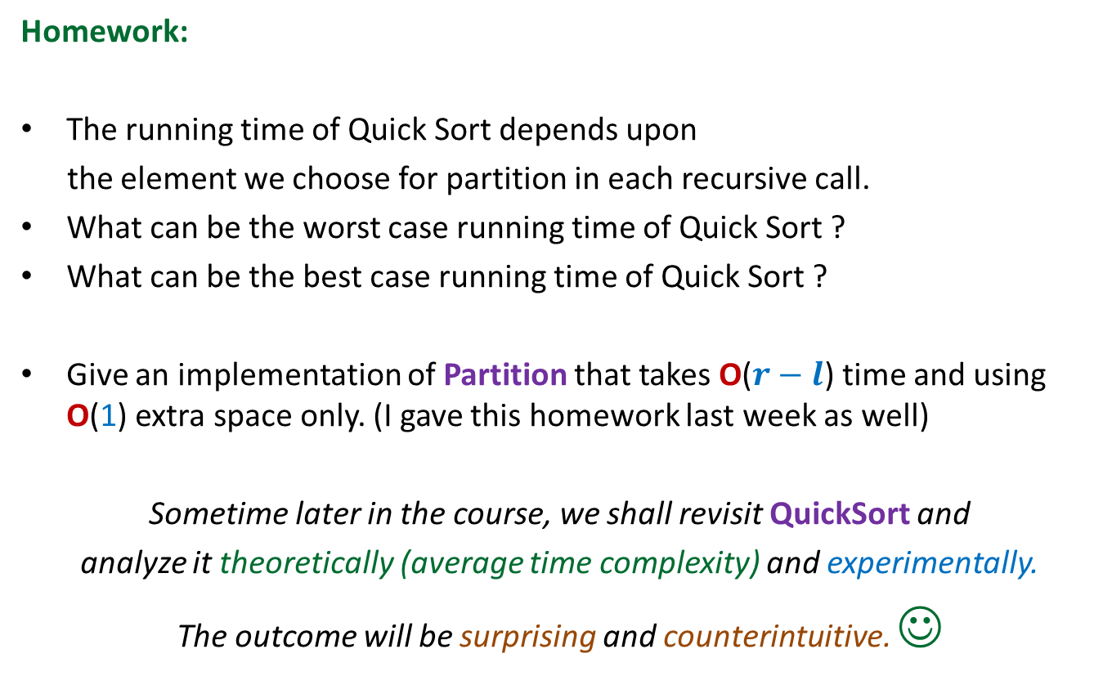
QuickSort
Homework:
The running time of Quick Sort depends upon
the element we choose for partition in each recursive call.
What can be the worst case running time of Quick Sort ?
What can be the best case running time of Quick Sort ?
Give an implementation of Partition that takes O($r−l$) time and using O(1) extra space only. (I gave this homework last week as well)
Sometime later in the course, we shall revisit QuickSort and
analyze it theoretically (average time complexity) and experimentally.
The outcome will be surprising and counterintuitive. ☺

