Slide 1
Data Structures and Algorithms (CS210A)
Lecture 17:
Height balanced BST
Red-black trees

Slide 2
Terminologies
Full binary tree:
A binary tree where
every internal node has exactly two children.
This node has exactly one child. So the current tree is not a full binary tree.

Slide 3
Terminologies
Complete binary tree:
A full binary tree where
every leaf node is at the same level.
We shall later extend this definition when we discuss “Binary heap”.

Slide 4
Binary Search Tree
root
Definition: A Binary Tree T storing values is said to be Binary Search Tree
if for each node v in T
If left(v) <> NULL, then
If right(v)<>NULL, then value(v) < value of every node in subtree(right(v)).
46
v
28
67
5
35
49
2
25
31
41
48
53
value(v) > value of every node in subtree(left(v)).

Slide 5
Binary Search Tree: a slight change
This transformation is merely to help us in the analysis of red-black trees. It does not cause any extra overhead of space. All NULL nodes correspond to a single node in memory.
root
Henceforth, for each NULL child link of a node in a BST, we create a NULL node.
➔ 1. Each leaf node in a BST will be a NULL node.
2. the BST will always be a full binary tree.
46
28
67
5
35
49
2
25
31
41
48
53

Slide 6
A fact we noticed in our previous discussion on BSTs (Lecture 9)
Time complexity of Search(T,x) and Insert(T,x) in a Binary Search Tree T = ??
Height(T):
The maximum number of nodes on any path from root to a leaf node.
O(Height(T))

Slide 7

Searching and inserting in a perfectly balanced BST
T
O( log $n$) time
46
28
67
5
35
49
83
2
25
31
41
48
53
73
96

Slide 8


Searching and inserting in a skewed BST on $n$ nodes
T2
48
39
23
19
11
O($n$) time !!
14
18

Slide 9
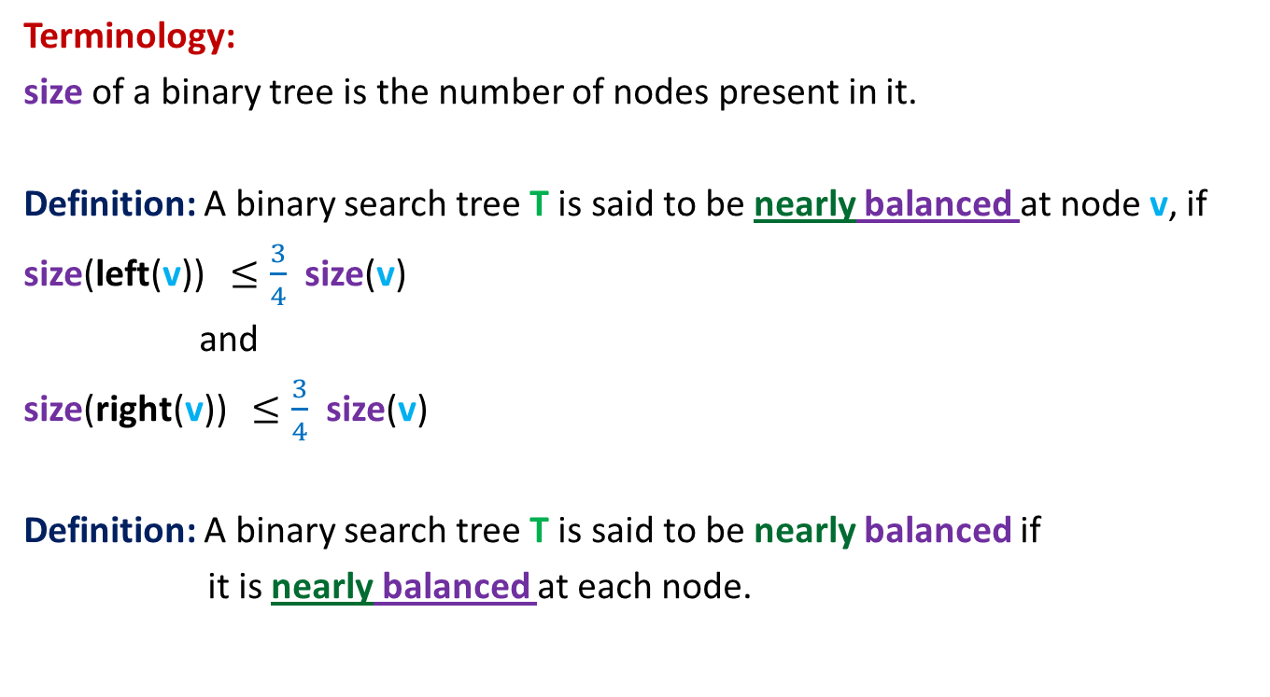
Nearly balanced Binary Search Tree
Terminology:
size of a binary tree is the number of nodes present in it.
Definition: A binary search tree T is said to be nearly balanced at node v, if
size(left(v)) $≤\frac{3}{4}$ size(v)
and
size(right(v)) $≤\frac{3}{4}$ size(v)
Definition: A binary search tree T is said to be nearly balanced if
it is nearly balanced at each node.

Slide 10

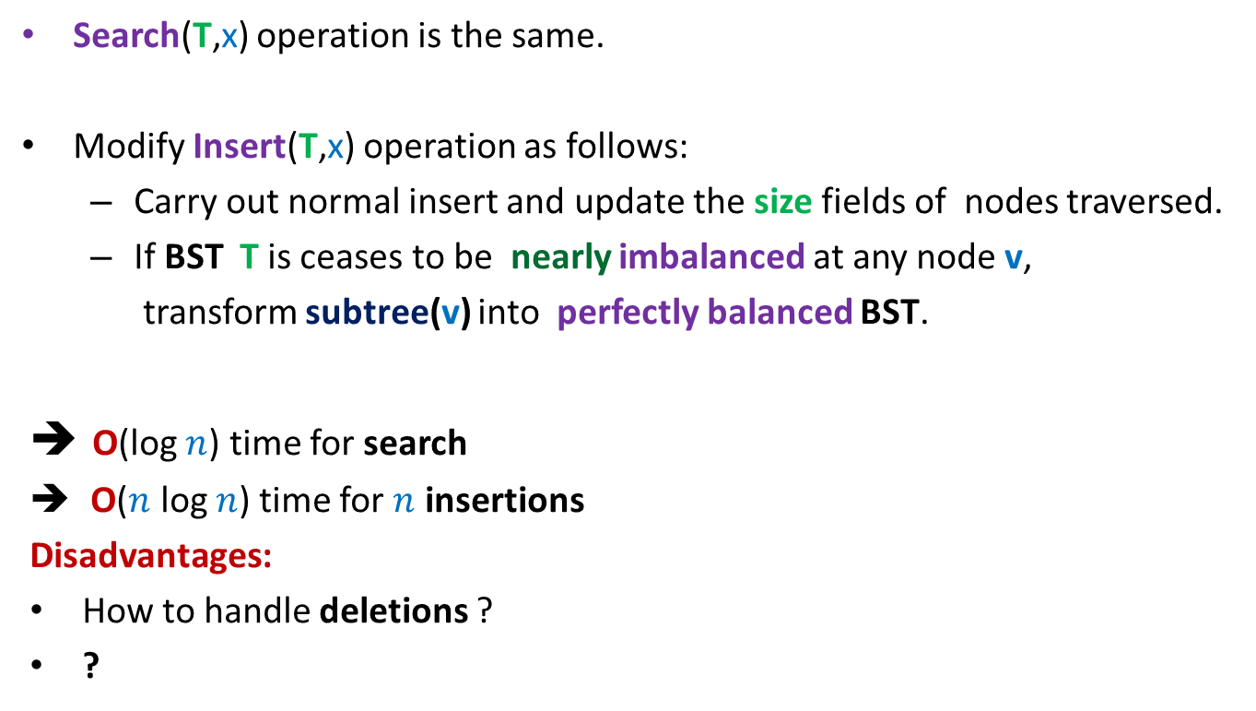
Nearly balanced Binary Search Tree
Search(T,x) operation is the same.
Modify Insert(T,x) operation as follows:
Carry out normal insert and update the size fields of nodes traversed.
If BST T is ceases to be nearly imbalanced at any node v,
transform subtree(v) into perfectly balanced BST.
O(log $n$) time for search
O($n$ log $n$) time for $n$ insertions
Disadvantages:
How to handle deletions ?
?
This fact will be proved soon in the next to the next class.
Some insertions may take O($n$) time ☹

Slide 11

Can we achieve O(log $n$) time for search/insert/delete ?
AVL Trees [1962]
Red Black Trees [1978]

Slide 12
Rotation around a node
An important tool for balancing trees
Each height balanced BST employs this tool which is derived from the flexibility which is hidden in the structure of a BST.
This flexibility (pointer manipulation) was inherited from linked list ☺.

Slide 13
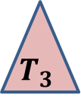





Rotation around a node
x
x
p
Right rotation
Left rotation
v
u
u
v
$$T_{3}$$
$$T_{1}$$
$$T_{2}$$
$$T_{3}$$
$$T_{1}$$
$$T_{2}$$
Note that the tree T continues to remain a BST even after rotation around any node.

Slide 14
Red Black Tree A height balanced BST

Slide 15
Red Black Tree
Red-Black tree is a binary search tree
satisfying the following properties:
Each node is colored red or black.
Each leaf is colored black
Every red node will have
No. of black nodes on a path from root to each leaf node is same.
and so is the root.
both its children black.
black height

Slide 16
A binary search tree
head
46
28
67
5
35
49
2
25
31
41
Can you color the nodes to make it a red-black tree ?

Slide 17
A binary search tree
head
46
28
67
5
35
49
2
25
31
41
A Red Black Tree

Slide 18

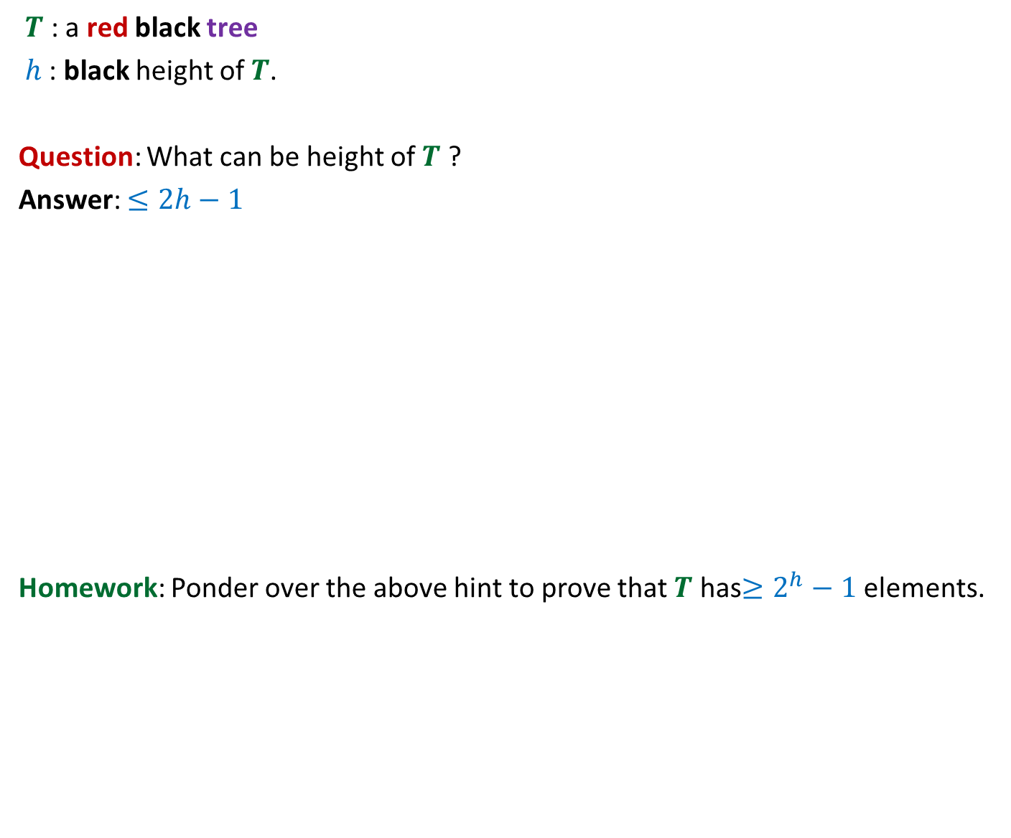


Why is a red black tree height balanced ?
$T$ : a red black tree
$h$: black height of $T$.
Question: What can be height of $T$ ?
Answer: $≤2h−1$
Homework: Ponder over the above hint to prove that $T$ has$≥2^{h}−1$elements.
What is this “green structure” ?
$$T$$
$$h$$
?
$$2h−1$$

Slide 19
Insertion in a Red Black tree
All it involves is
playing with colors ☺
and rotations ☺

Slide 20
Insertion in a red-black tree
Let us insert 83 into T.
T
46
28
67
5
35
49
83
2
25
31
41
What color should we assign to the new node ?
We shall assign every newly inserted node a red color. (give reason)

Slide 21
Insertion in a red-black tree
Let us insert 54 into T.
T
46
28
67
5
35
49
83
2
25
31
41
54
We have again a red black tree.
In order to remove the color imbalance try flipping the colors of parent (and uncle) of the new node with the grandparent
Color imbalance

Slide 22
Insertion in a red-black tree
T
46
28
67
5
35
49
83
2
25
31
41
54

Slide 23
Insertion in a red-black tree
Let us insert 44 into T.
T
46
28
67
5
35
49
83
2
25
31
41
54
44
In order to remove the color imbalance try flipping the colors of parent (and uncle) of the new node with the grandparent
Color imbalance

Slide 24
Insertion in a red-black tree
T
46
28
67
5
35
49
83
2
25
31
41
54
44
Do the same trick again.
Color imbalance

Slide 25
Insertion in a red-black tree
We can color it black.
T
Color imbalance is removed. But the root is red now.
46
28
67
5
35
49
83
2
25
31
41
54
44

Slide 26
Insertion in a red-black tree
T
46
28
67
5
35
49
83
2
25
31
41
54
44

Slide 27
Insertion in a red-black tree summary till now …
Let p be the newly inserted node. Assign red color to p.
Case 1: parent(p) is black
nothing needs to be done.
Case 2: parent(p) is red and uncle(p) is red,
Swap colors of parent (and uncle) with grandparent(p).
This balances the color at p but may lead to imbalance of color at
grandparent of p. So p← grandparent(p), and proceed upwards similarly.
If in this manner p becomes root, then we color it black.
Case 3: parent(p) is red and uncle(p) is black.
This is a nontrivial case. So we need some more tools ….

Slide 28
Handling case 3

Slide 29
Description of Case 3
p is a red colored node.
parent(p) is also red.
uncle(p) is black.
Without loss of generality assume: parent(p) is left child of grandparent(p).
(The case when parent(p) is right child of grandparent(p) is handled similarly.)

Slide 30
Handling the case 3 two cases arise depending upon whether p is left/right child of its parent
x
x
g
g
d
k
p
d
k
p
f
b
Can you transform Case 3.2 to
Case 3.1 ?
Case 3.1:
p is left child of its parent
Case 3.2:
p is right child of its parent

Slide 31
Handling the case 3 two cases arise depending upon whether p is left/right child of its parent
x
x
g
g
left rotation
f
k
d
k
d
3
1
f
1
2
2
3
Case 3.2:
p is right child of its parent
Vow!
This is exactly Case 3.1

Slide 32
We need to handle only case 3.1

Slide 33
Handling the case 3.1
x
g
p
d
k
Can we say anything about color of node f ?
3
black
b
f
1
2

Slide 34
Handling the case 3.1
x
g
p
d
k
3
b
f
1
2

Slide 35
Handling the case 3.1
x
x
Right rotation
g
p
d
p
d
k
b
g
3
1
b
f
f
k
1
2
2
3
Now every node in tree 1 has one less black node on the path to root ! We must restore it. Moreover, the color imbalance exists even now. What to do ?
Change color of node d to black

Slide 36
Handling the case 3.1
x
x
g
p
d
p
d
k
b
g
3
1
b
f
f
k
1
2
2
3
Color node g red
The number of black nodes on the path to root are restored for tree 1. Color imbalance is also removed.
But the number of black nodes on the path to root has increased by one for trees 2 and 3. What to do now ?

Slide 37
Handling the case 3.1
x
x
g
p
d
p
d
k
b
g
3
1
b
f
f
k
1
2
2
3
The black height is restored for all trees.
This completes Case 3.1

Slide 38
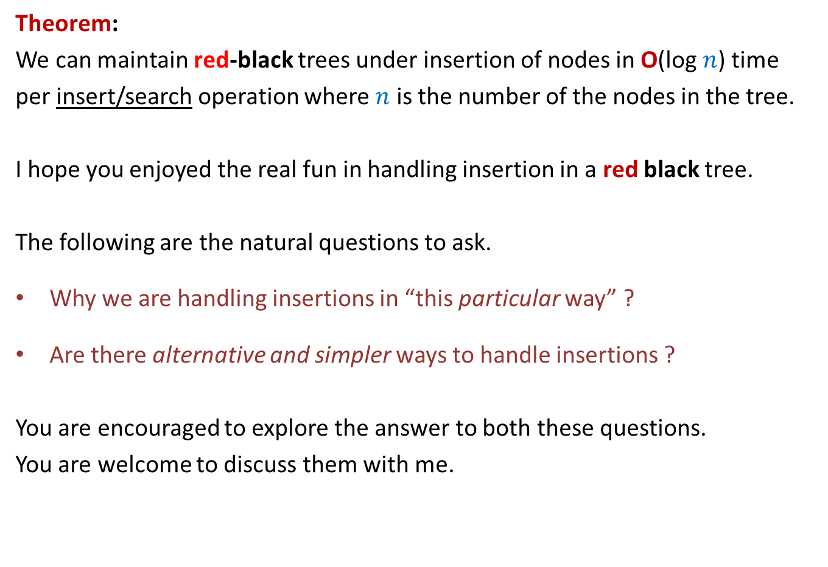
Theorem:
We can maintain red-black trees under insertion of nodes in O(log $n$) time
per insert/search operation where $n$ is the number of the nodes in the tree.
I hope you enjoyed the real fun in handling insertion in a red black tree.
The following are the natural questions to ask.
Why we are handling insertions in “this particular way” ?
Are there alternative and simpler ways to handle insertions ?
You are encouraged to explore the answer to both these questions.
You are welcome to discuss them with me.

Slide 39
Please solve the problem on the following slide.

Slide 40
How to insert 4 ?
11
2
14
1
7
15
5
8

Slide 41
How do will we handle deletion ?
This is going to be a bit more complex.
So please try on your own first before coming to the next class.
It will still involve playing with colors and rotations ☺
Do not miss the next class ☺

