Slide 1
Data Structures and Algorithms (CS210A)
Lecture 18:
Height balanced BST
Red-black trees - II

Slide 2
Red Black Tree
Red Black tree:
a full binary search tree
and satisfying the following properties.
Each node is colored red or black.
Each leaf is colored black and so is the root.
Every red node will have both its children black.
No. of black nodes on a path from root to each leaf node is same.
with each leaf as a null node
black height

Slide 3
A red-black tree
root
46
28
67
5
35
49
2
25
31
41

Slide 4
Handling Deletion in a Red Black Tree

Slide 5
Notations to be used
a black node
a red node
a node whose color is not specified
a BST
Could potentially be

Slide 6
Deletion in a BST is slightly harder than Insertion
(even if we ignore the height factor)
T
How to delete 28 ?
46
28
67
5
35
49
83
2
25
31
41
54
44

Slide 7
Is deletion of a node easier for some cases ?
T
Deletion of 31 is easy.
Can you see ?
46
28
67
5
35
49
83
2
25
31
41
54
44

Slide 8
Is deletion of a node easier for some cases ?
T
What about deletion of 49 ?
46
28
67
5
35
49
83
2
25
41
54
44

Slide 9
Is deletion of a node easier for some cases ?
T
46
28
67
5
35
83
2
25
41
54
44

Slide 10
An insight
It is easier to maintain a BST under deletion if
the node to be deleted
has at most one child which is non-leaf.
p
q

Slide 11
An insight
It is easier to maintain a BST under deletion if
the node to be deleted has at most one child which is non-leaf.
q

Slide 12
An important question
It is easier to maintain a BST under deletion if
the node to be deleted has at most one child which is non-leaf.
Question: Can we transform every other case to the above case ?
Answer: ??
p
non-leaf
non-leaf

Slide 13
How to delete a node whose both children are non-leaves?
T
How to delete 46 ?
How to delete 28 ?
46
28
67
5
35
49
83
2
25
31
41
54
Can you figure out the strategy now ?
44
Swap 28 and 25 and then delete 28
Swap 46 and 44 and then delete 46

Slide 14
An important observation
It is easier to maintain a BST under deletion if the node to be deleted has at most one child which is non-leaf.
Question: Can we transform every other case to the above case ?
Answer: by swapping value(p) with its predecessor,
and then deleting the predecessor node.
p
non-leaf
non-leaf

Slide 15
We need to handle deletion only for the following case
p
q

Slide 16
How to maintain a red-black tree under deletion ?
We shall first perform deletion like in an ordinary BST
and then restore all properties of red-black tree.

Slide 17
Easy cases and difficult case
p
p
p
q
q
q
Easy case
Easy case:
Change color of q to black
Difficult case

Slide 18
Handling the difficult case
p
s
q

Slide 19
Handling the difficult case
p
s
q

Slide 20
Handling the difficult case
s
q

Slide 21

Handling the difficult case
Notice that the number of black nodes to each leaf node in subtree(q) has become one less than leaf nodes in other trees. We need an algorithm to remove this black-height imbalance.
r
q
s
$$−$$
As some student had noticed during the class that the subtree(q) will actually be just a leaf node in the beginning. But we are not showing it explicitly here. This is because we are depicting the most general case. During the algorithm, we might shift the height imbalance upwards and in that case the subtree(q) might not be a leaf node.
Moreover, this generic procedure of restoring the of black height of one entire subtree will have many other applications. One such application will be discussed in the class on Friday.

Slide 22
Handling the difficult case: An overview
Color of s ?
s is red
reduction
s is black
Both children of s are black
At least one child of s is red
right(s) is red
reduction
left(s) is red and right(s) is black
Eventually we need to handle these two cases only

Slide 23
“s is red” “s is black”
reduction

Slide 24

“s is red” “s is black”
reduction
r
What can we say about parent and children of s ?
q
s
$$−$$
1
2

Slide 25
“s is red” “s is black”
reduction
s
r
Left rotation
swap colors
r
q
s
q
2
1
$$−$$
1
2
$$−$$
The new sibling of q is now a black node. But the number of black nodes to leaves of tree 2 have reduced by one. What to do ?

Slide 26
“s is red” “s is black”
reduction
s
r
Left rotation
r
q
s
q
s
2
1
1
2
$$−$$
Convince yourself that the number of black nodes to any leaf of subtree(q) or subtrees 1 and 2 is now the same as before the rotation. And now the sibling of q is black. So we are done.

Slide 27
We just need to handle the case
“s is black”

Slide 28
Handling the case: s is black
Case 1: both children of s are black
Case 2: at least one child of s is red
r
q
s
$$−$$

Slide 29
Handling the case: s is black and both children of s are black

Slide 30

Handling the case: s is black and both children of s are black
When r is red
When r is black
r
r
q
s
q
s
$$−$$
$$−$$
1
2
1
2
What if we swap colors of s and r
How to handle this case ?

Slide 31
Handling the case: s is black and both children of s are black
When r is red
When r is black
r
r
q
s
q
s
$$−$$
$$−$$
1
2
1
2
YES.
As a result of swapping the colors, the number of black nodes to the leaves of trees 1 and 2 unchanged. Interestingly, the deficiency of one black node on the path to the leaves of subtree(q) is also compensated. So we are done☺
What if we change color of s to red
How to handle this case ?
Are we done ?

Slide 32

Handling the case: s is black and both children of s are black
When r is red
When r is black
r
r
q
s
q
s
$$−$$
$$−$$
$$−$$
Changing color of s to red has reduced the number of black nodes on the path to the root of subtree(s) by one. As a result the imbalance of black height has propagated upward. So we process the new q.

Slide 33
Handling the case: s is black and one of its children is red

Slide 34


There are two cases
When right(s) is red
reduction
When left(s) is red and right(s) is black
r
r
q
s
q
s
$$−$$
$$−$$

Slide 35
Handling the case: right(s) is red

Slide 36
Handling the case: right(s) is red
r
q
s
$$−$$
1
2
Let color(r) be c

Slide 37

Handling the case: right(s) is red
s
r
Left rotation
r
swap colors
q
s
q
2
$$−$$
1
1
2
$$−$$
The number of black nodes on the path from root to any leaf node of subtree(q) has increased by one (this is good!), has remained unchanged for leaves of tree 1, and is uncertain for leaves of tree 2(depends upon c). How to get rid of this uncertainty ?

Slide 38
Handling the case: right(s) is red
s
r
Left rotation
r
q
s
q
2
$$−$$
1
2
1
Change color of root of tree 2 to black and we are done.
The number of black nodes on the path from root to any leaf node of tree 2 is now less by one node. What to do ? (Hint: root of tree 2 is red)

Slide 39
Handling the case: right(s) is red
s
r
Left rotation
r
q
s
q
2
$$−$$
1
2
1
Convince yourself that left rotation at r, followed by color swap of s and r, followed by change of color of root of tree 2 removes the imbalance of black height for all leaf nodes of the subtrees shown.

Slide 40
Handling the case “left(s) is red and right(s) is black”

Slide 41
Handling the case: left(s) is red and right(s) is black
r
q
s
$$−$$

Slide 42
Handling the case: left(s) is red and right(s) is black
r
q
s
$$−$$
3
1
2

Slide 43

Handling the case: left(s) is red and right(s) is black
r
r
q
q
s
Right rotation
swap colors
s
$$−$$
1
$$−$$
3
2
3
1
2
The number of black nodes on the path from root to any leaf node in tree 1 has now reduced by one although it is the same for trees 2 and 3. What should we do ?

Slide 44
Handling the case: left(s) is red and right(s) is black
r
r
q
s
q
s
Right rotation
s
$$−$$
1
$$−$$
3
2
3
1
2
Notice that now the new sibling of q has its right child red. So we have effectively reduced the current case to the case which we know how to handle.

Slide 45
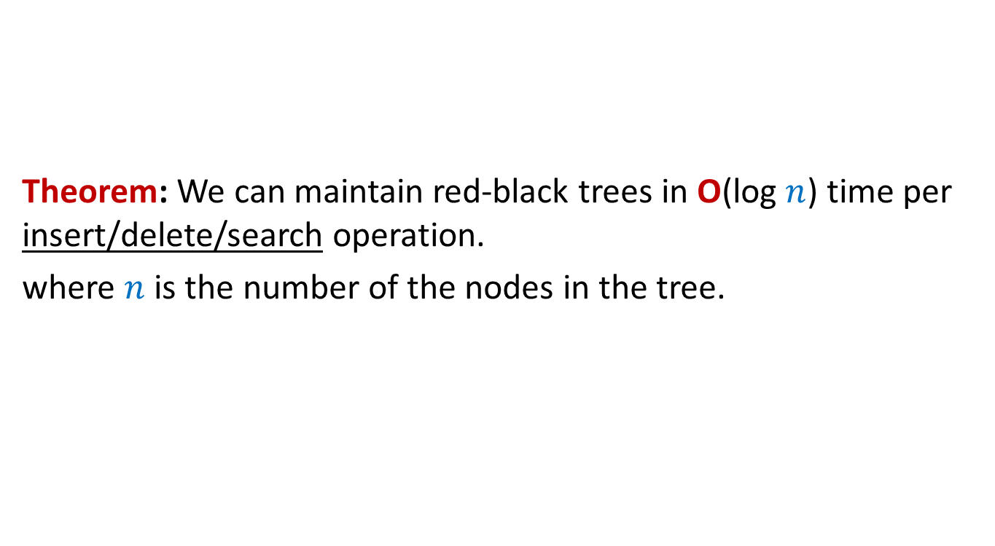
Theorem: We can maintain red-black trees in O(log $n$) time per insert/delete/search operation.
where $n$ is the number of the nodes in the tree.

Slide 46
A Red Black Tree is height balanced
A detailed proof from scratch

Slide 47
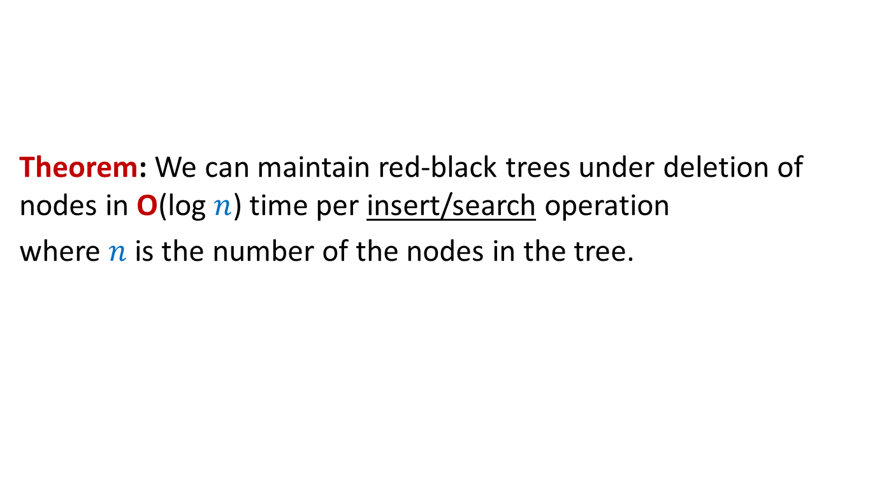
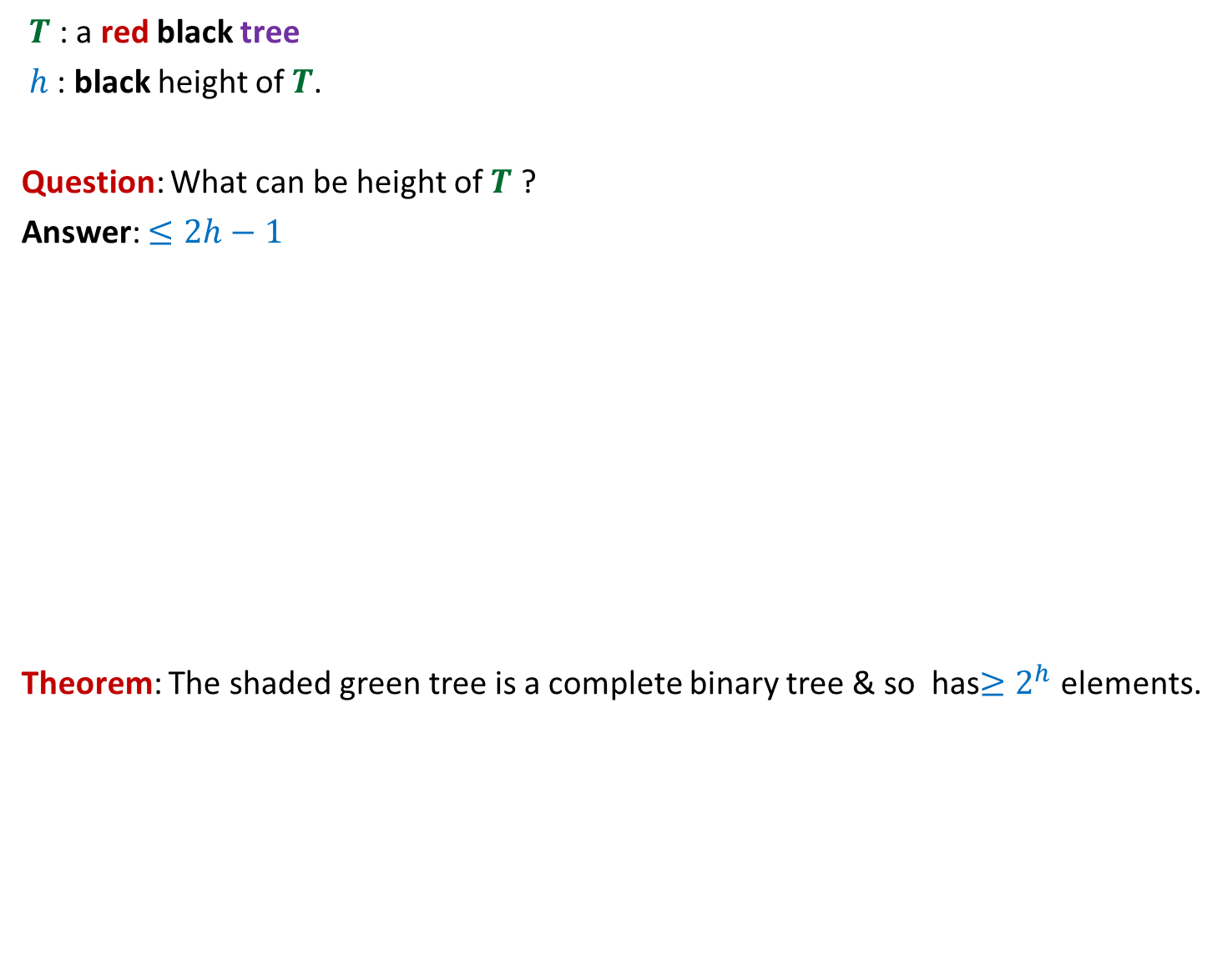


Why is a red black tree height balanced ?
$T$ : a red black tree
$h$: black height of $T$.
Question: What can be height of $T$ ?
Answer: $≤2h−1$
Theorem: The shaded green tree is a complete binary tree & so has$≥2^{h}$elements.
What is its size ?
$$T$$
$$h$$
?
$$2h−1$$
We shall prove it rigorously in the next class.

Slide 48
A practice problem
On deletion in
red-black trees

Slide 49
How to delete 9 ?
root
3
15
9
26
5
11
19
37
17
20

