Slide 1
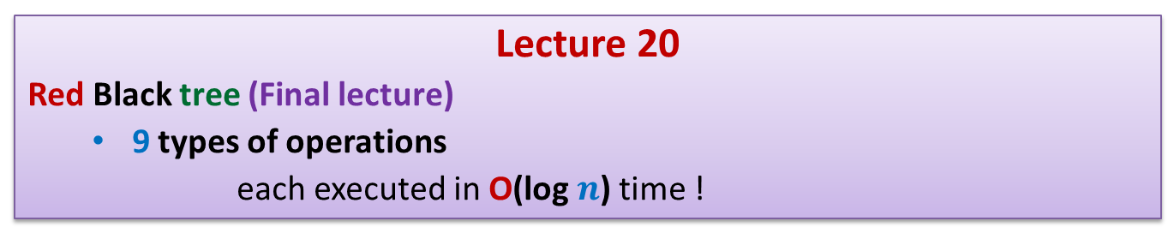
Data Structures and Algorithms (CS210A)
Lecture 20
Red Black tree (Final lecture)
9 types of operations
each executed in O(log $n$) time !

Slide 2


Red Black tree (Height Balanced BST)
Operations you already know
Search(T,$x$)
Insert(T,$x$)
Delete(T,$x$)
Min(T)
Max(T)
Every operation in O(log $n$) time.

Slide 3
Binary Search Tree
How well have you understood ?

Slide 4


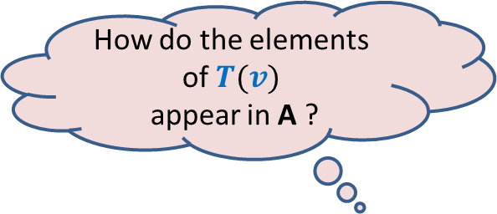


How do the elements of $T(v)$
appear in A ?
$$v$$
$$T$$
$$T(v)$$
A
Sorted
$$T(v)$$

Slide 5
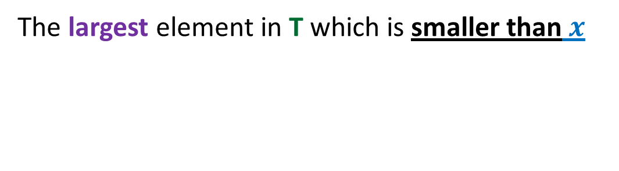

Predecessor(T,$x$)
The largest element in T which is smaller than $x$

Slide 6

Predecessor(T,$x$)
Predecessor of 25 ?
Predecessor of 28 ?
T
Predecessor of 44 ?
43
28
67
5
35
49
83
2
25
31
41
44
54
Can you figure out the algorithm for Predecessor(T,x) ?

Slide 7
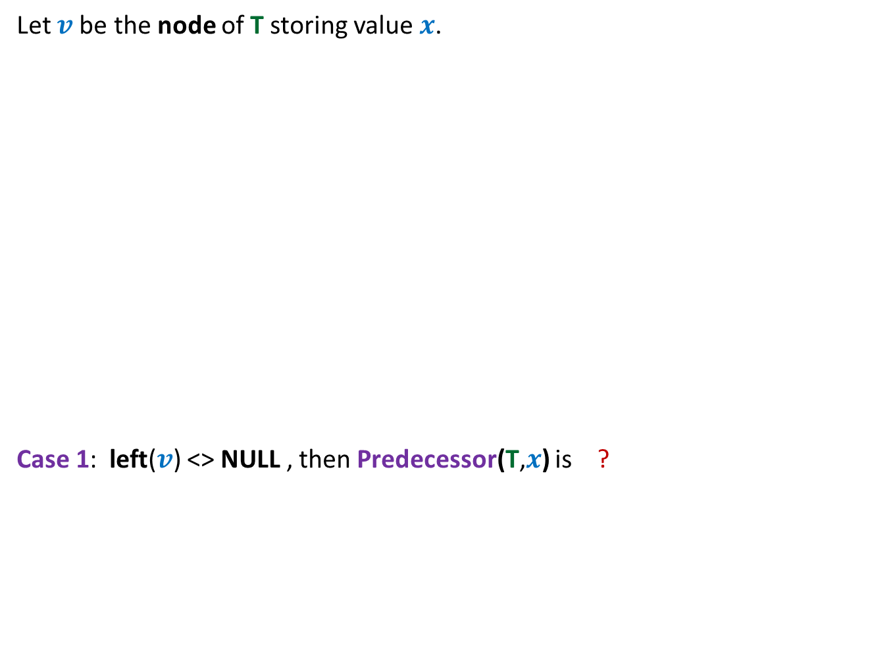



Predecessor(T,$x$)
Let $v$be the node of T storing value $x$.
Case 1: left($v$) <> NULL , then Predecessor(T,$x$) is ?
$$v$$
non-NULL
Max(left($v$))

Slide 8

Predecessor(T,$x$)
Let $v$be the node of T storing value $x$.
Case 2: left($v$) == NULL , then Predecessor(T,$x$) is ?
$$v$$

Slide 9
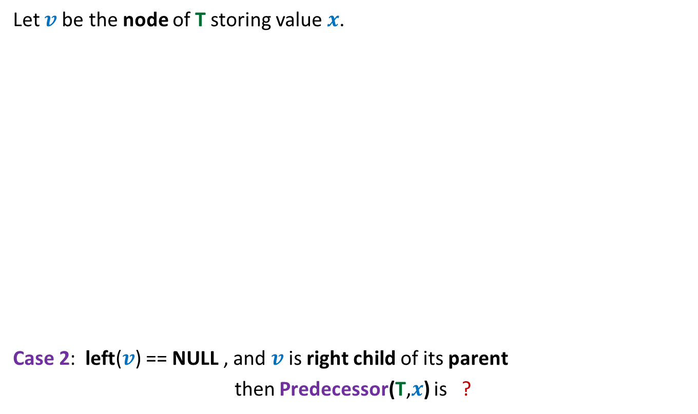

Predecessor(T,$x$)
Let $v$be the node of T storing value $x$.
Case 2: left($v$) == NULL , and $v$ is right child of its parent
then Predecessor(T,$x$) is ?
$$v$$
parent($v$)

Slide 10


Predecessor(T,$x$)
$$q$$
Let $v$be the node of T storing value $x$.
Case 3: left($v$) == NULL , and $v$ is left child of its parent
then Predecessor(T,$x$) is ?
$$v$$

Slide 11
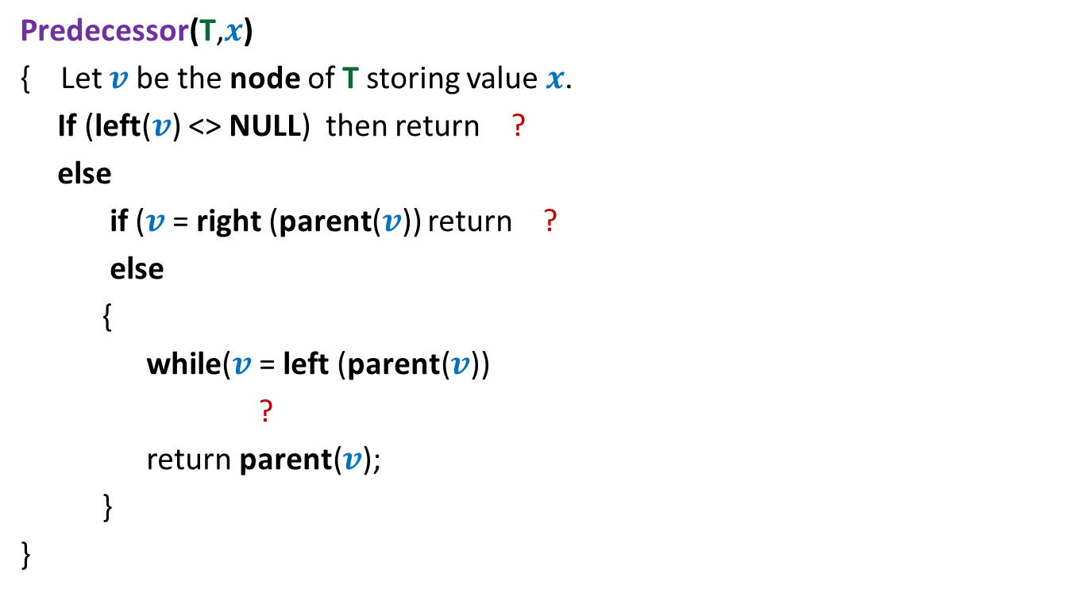



Predecessor(T,$x$)
Predecessor(T,$x$)
{ Let $v$be the node of T storing value $x$.
If (left($v$) <> NULL) then return ?
else
if ($v$= right (parent($v$)) return ?
else
{
while($v$= left (parent($v$))
?
return parent($v$);
}
}
Max(left($v$))
parent($v$)
$v$← parent($v$);

Slide 12
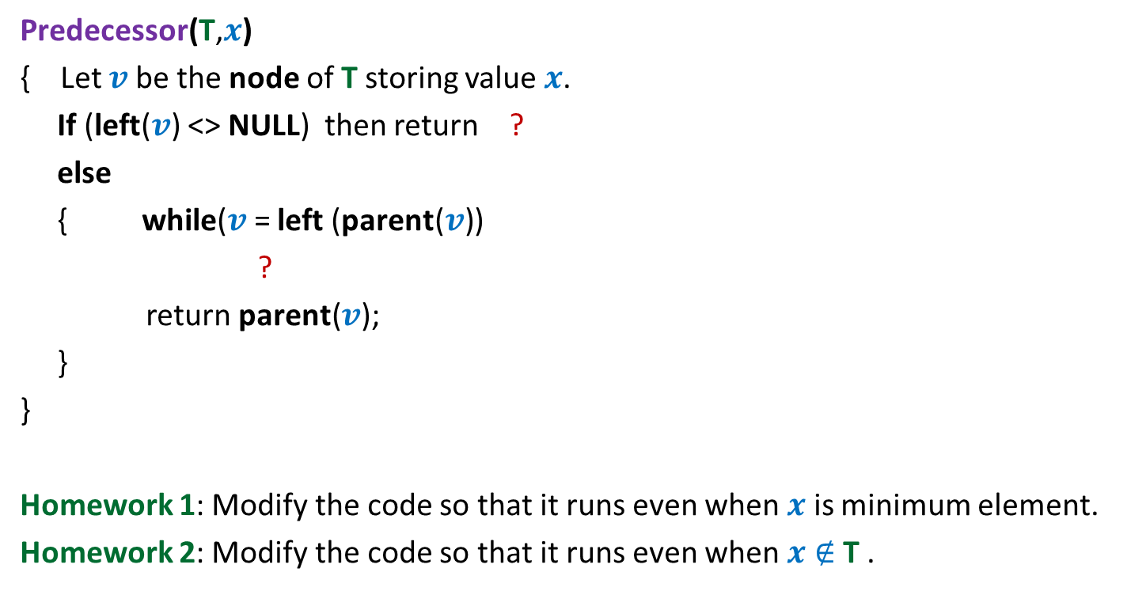

Predecessor(T,$x$)
Predecessor(T,$x$)
{ Let $v$be the node of T storing value $x$.
If (left($v$) <> NULL) then return ?
else
{ while($v$= left (parent($v$))
?
return parent($v$);
}
}
Homework 1: Modify the code so that it runs even when $x$ is minimum element.
Homework 2: Modify the code so that it runs even when $x∉$T .
Max(left($v$))
$v$← parent($v$);

Slide 13
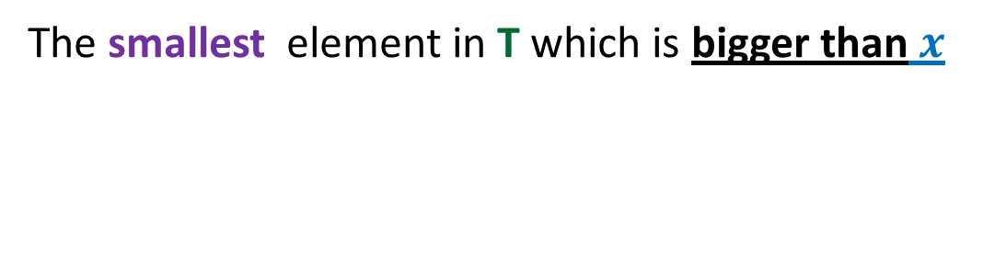

Successor(T,$x$)
The smallest element in T which is bigger than $x$

Slide 14
Red Black tree (Height Balanced BST)
Operations you already know
New operations
Search(T,x)
Insert(T,x)
Delete(T,x)
Min(T)
Max(T)
Predecessor(T,x)
Successor(T,x)
A NOTATION
T < T’ :
every element of T is smaller than every element of T’.
8. SpecialUnion(T, T’):
Given T and T’ such that T < T’,
compute T*=TUT’.
NOTE: T and T’ don’t exist after the union.
9. Split(T, x):
Split T into T’ and T’’ such that T’ < x < T’’.
Every operation in O(log n) time.

Slide 15
Red-Black Tree
How well have you understood ?

Slide 16
Insertion in a red-black tree
Can you handle it
in general as well ?
T
46
Yes
28
67
5
35
49
83
2
25
31
41
54
44
Color imbalance

Slide 17
SpecialUnion(T,T’)
Remember:
every element of T is smaller than every element of T’

Slide 18
A trivial algorithm that does not work
Time complexity: O(log n)
Height balance lost
<
T
T’

Slide 19
Towards an O(log n) time for SpecialUnion(T,T’) …
Can we solve some simple cases easily ?
Simplifying the problem
Solving the simpler version efficiently
Extending the solution to generic version

Slide 20
Simplifying the problem
Simplified problem:
Given two trees T, T’ of same black height
and a key x, such that T<x<T’,
transform them into a tree T*=TU{x}UT’
x
<
<
T
T’

Slide 21
Solving the simplified problem
Simplified problem:
Given two trees T, T’ of same black height
and a key x, such that T<x<T’,
transform them into a tree T*=TU{x}UT’
x
O (1) time
<
<
T
T’

Slide 22
Extending the algorithm to the generic problem
T
T’

Slide 23
Extending the algorithm to the generic problem
x
<
<
T
T’

Slide 24
Extending the algorithm to the generic problem
x
T
T’

Slide 25
Extending the algorithm to the generic problem
x
T
T’

Slide 26
Extending the algorithm to the generic problem
v
x
T
T’’

Slide 27
Extending the algorithm to the generic problem
v
x
T
T’’

Slide 28

Extending the algorithm to the generic problem
Algorithm for SpecialUnion(T,T’):
Let x be the node storing smallest element of T’.
Delete the node x from T’.
Let black height of T ≤ black height of T’
Keep following left pointer of T’ until we reach a node v such that
left(v) is black
The subtree T” rooted at Left(v) has black height same as that of T
left(x)← T;
right(x) ← T”;
Color(x)← red;
left(v)← x;
parent(x)← v;
If color(v) is red, remove the color imbalance
(like in the usual procedure of insertion in a red-black tree)
Total time : O(log $n$)

Slide 29
Split(T,x)

Slide 30

Achieving O(log n) time for Split(T,x)
Take a scissor
cut T into trees starting from x
Make use of SpecialUnion algorithm.
x
T

