Slide 1
Data Structures and Algorithms (CS210A)
Lecture 21
Analyzing average running time of Quick Sort

Slide 2
Overview of this lecture
Main Objective:
Analyzing average time complexity of QuickSort using recurrence.
Using mathematical induction.
Solving the recurrence exactly.
The outcome of this analysis will be quite surprising!
Extra benefits:
You will learn a standard way of using mathematical induction to bound time complexity of an algorithm. You must try to internalize it.

Slide 3
QuickSort

Slide 4

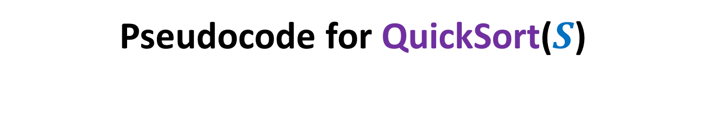
Pseudocode for QuickSort($S$)
QuickSort($S$)
{ If (|$S$|>1)
Pick and remove an element $x$from $S$;
($S_{<x}$, $S_{>x}$)← Partition($S$,$x$);
return( Concatenate(QuickSort($S_{<x}$), $x$, QuickSort($S_{>x}$))
}

Slide 5
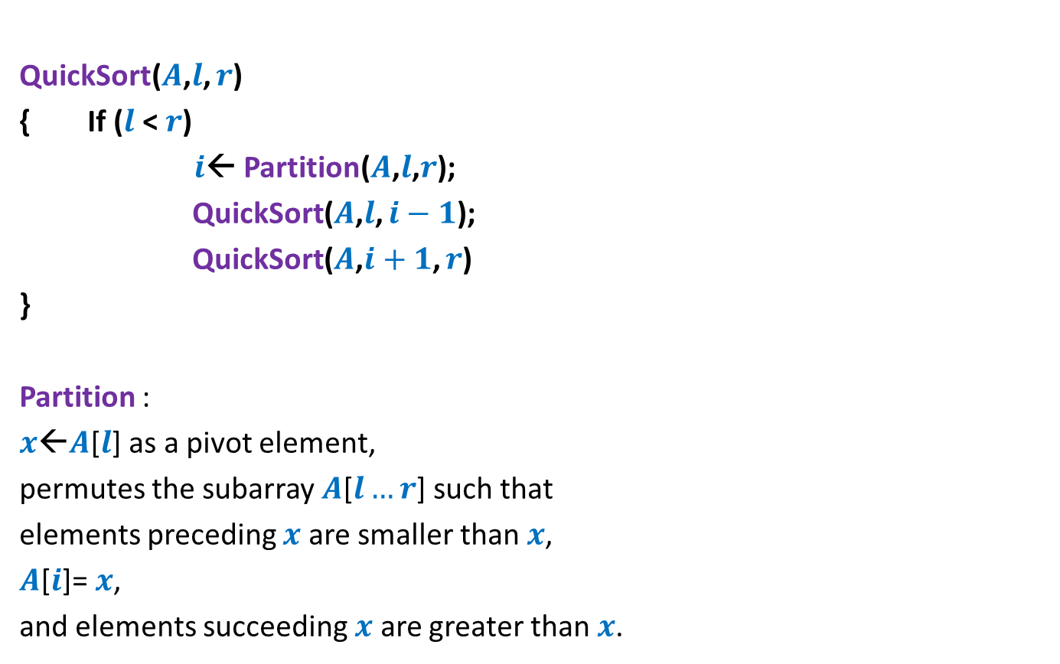
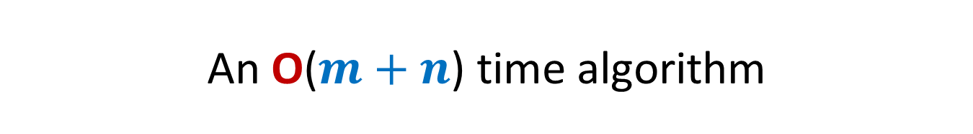
Pseudocode for QuickSort($S$) When the input $S$is stored in an array
QuickSort($A$,$l$, $r$)
{ If ($l$ < $r$)
$i$← Partition($A$,$l$,$r$);
QuickSort($A$,$l$, $i−1$);
QuickSort($A$,$i+1$, $r$)
}
Partition :
$x$←$A$[$l$] as a pivot element,
permutes the subarray $A$[$l…r$] such that
elements preceding $x$ are smaller than $x$,
$A$[$i$]= $x$,
and elements succeeding $x$ are greater than $x$.

Slide 6
Analyzing average time complexity of QuickSort
Part 1
Deriving the recurrence

Slide 7
Analyzing average time complexity of QuickSort
Assumption (just for a neat analysis):
All elements are distinct.
Each recursive call selects the first element of the subarray as the pivot element.

Slide 8

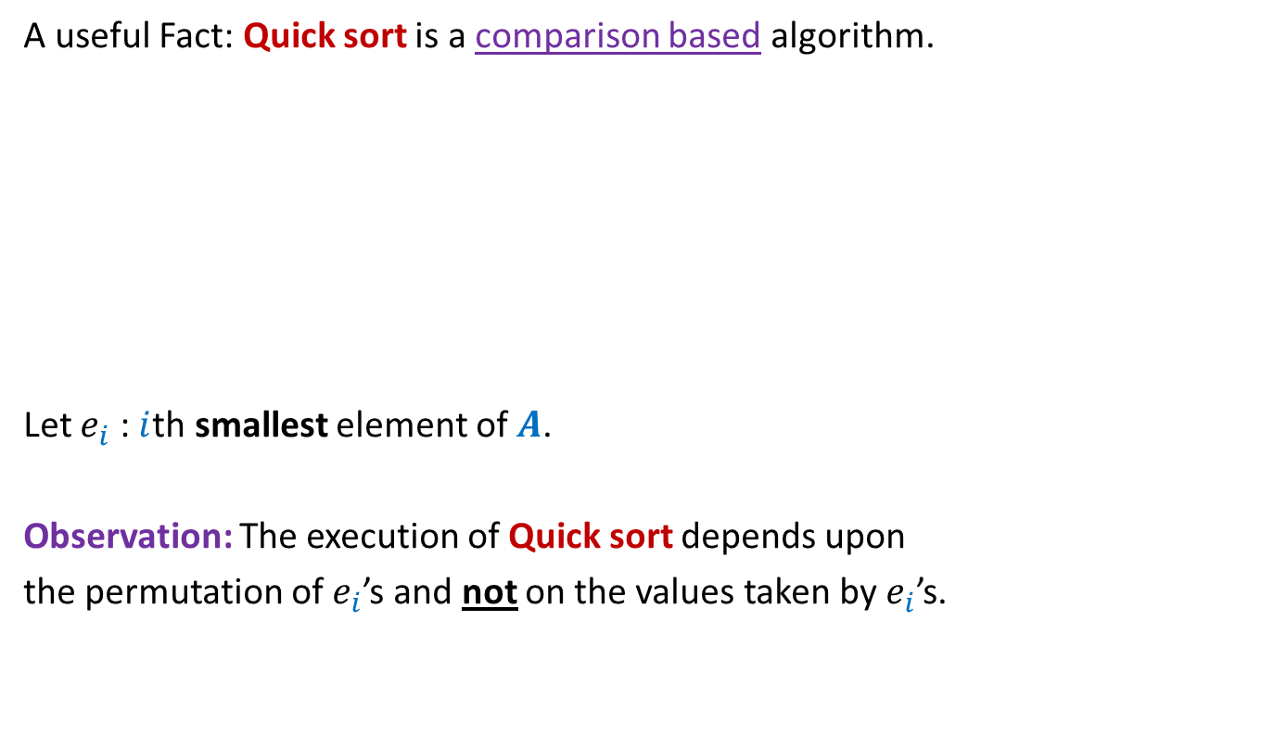

Analyzing average time complexity of QuickSort
A useful Fact: Quick sort is a comparison based algorithm.
Let $e_{i}$ : $i$th smallest element of $A$.
Observation: The execution of Quick sort depends upon
the permutation of $e_{i}$’s and not on the values taken by $e_{i}$’s.
0 1 2 3 4 5 6 7 8
0 1 2 3 4 5 6 7 8
6 11 42 37 24 5 16 27 2
15 20 49 41 29 4 23 36 3
$e_{3} e_{4} { e}_{9} e_{8 }$ $e_{6} e_{2}$ $e_{5}$ $e_{7} e_{1}$
$e_{3} e_{4} { e}_{9} e_{8 }$ $e_{6} e_{2}$ $e_{5}$ $e_{7} e_{1}$

Slide 9


Analyzing average time complexity of QuickSort
$T$($n$) : Average running time for Quick sort on input of size $n$.
(average over all possible permutations of {$e_{1}$, $e_{2}$,… ,$e_{n}$})
Hence, $T$($n$)= $\frac{1}{n!}\sum_{π }{Q(π)}$,
where $Q(π)$ is the time complexity (or no. of comparisons) when the input is permutation $π$.
Calculating $T$($n$) from definition/scratch is impractical, if not impossible.

Slide 10
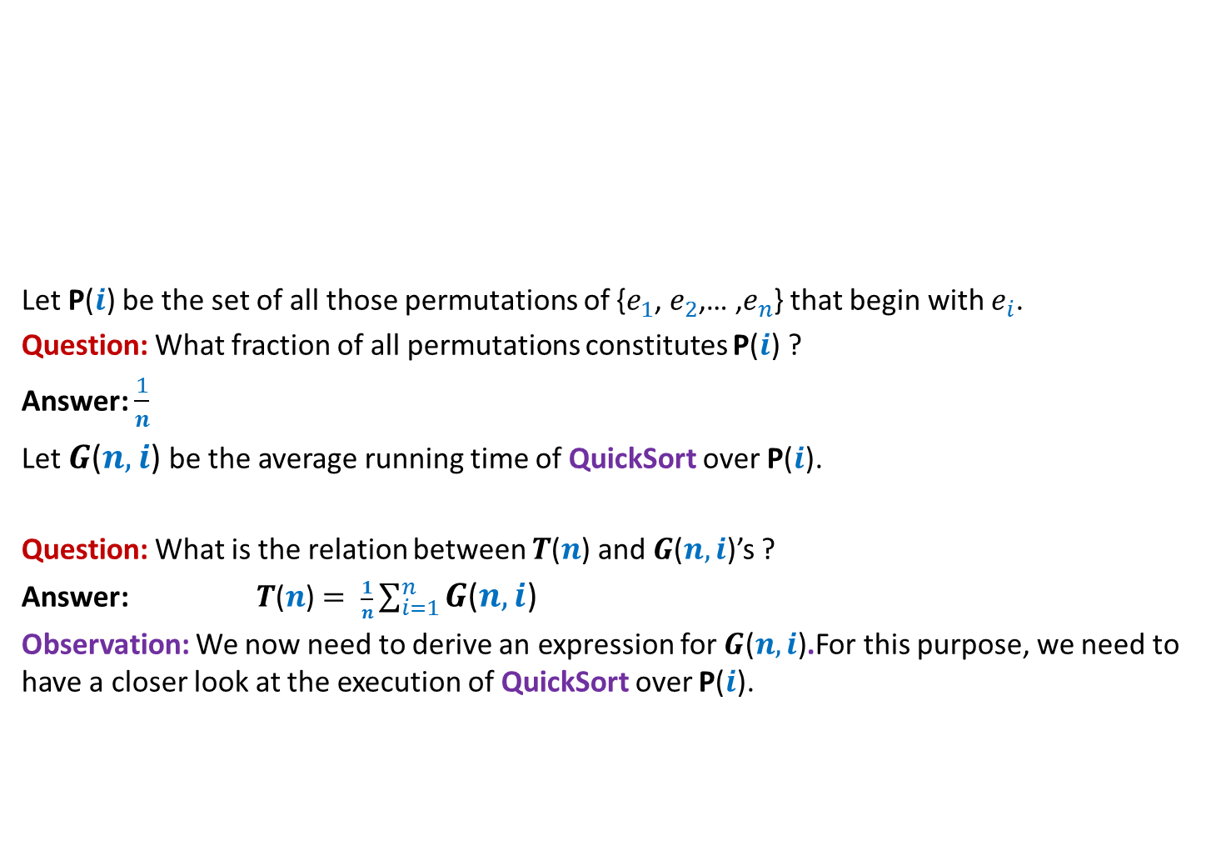




Analyzing average time complexity of QuickSort
Permutations beginning with $e_{2}$
Let P($i$) be the set of all those permutations of {$e_{1}$, $e_{2}$,… ,$e_{n}$} that begin with $e_{i}$.
Question: What fraction of all permutations constitutes P($i$) ?
Answer: $\frac{1}{n}$
Let $G$($n,i$) be the average running time of QuickSort over P($i$).
Question: What is the relation between $T$($n$) and $G$($n,i$)’s ?
Answer: $T$($n$) $= \frac{1}{n}\sum_{i=1}^{n}{G\text{(}n,i\text{)}}$
Observation: We now need to derive an expression for $G\text{(}n,i\text{)}$.For this purpose, we need to have a closer look at the execution of QuickSort over P($i$).
Permutations beginning with $e_{1}$
Permutations beginning with $e_{3}$
All $n!$permutations of {$e_{1}$, $e_{2}$,… ,$e_{n}$}

Slide 11


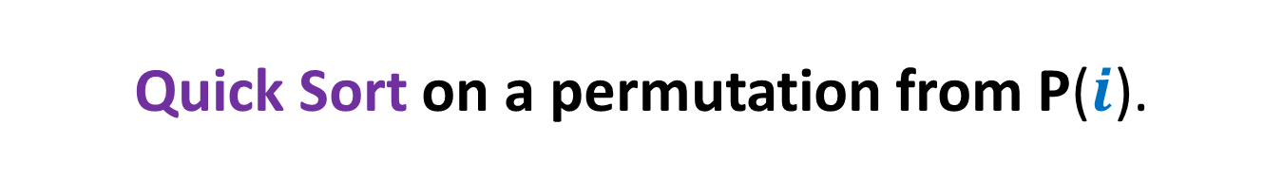
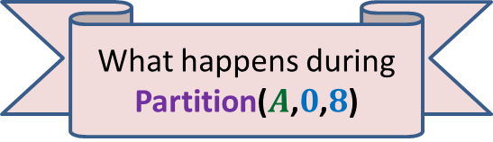


Quick Sort on a permutation from P($i$).
0 1 2 3 4 5 6 7 8
> $e_{i}$
$$A$$
< $e_{i}$
$$e_{i}$$
What happens during Partition($A$,$0$,$8$)

Slide 12



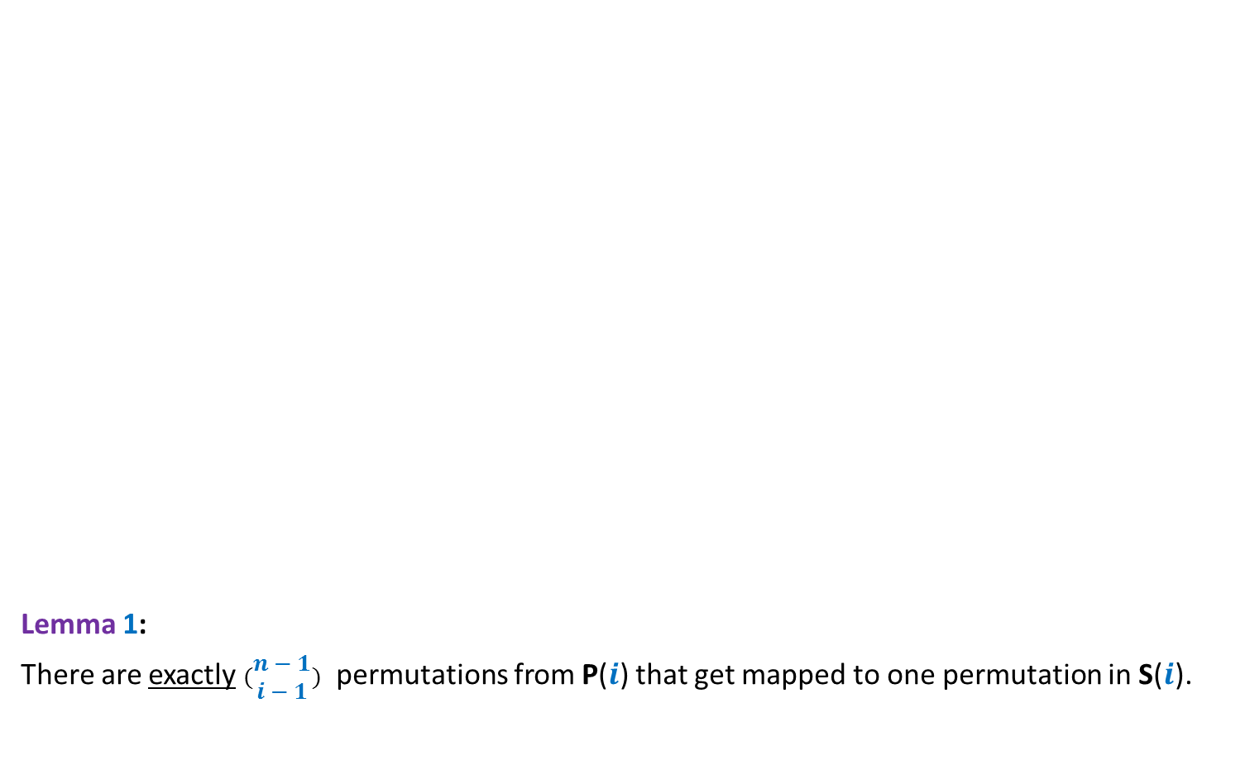







Quick Sort on a permutation from P($i$).
Lemma 1:
There are exactly $(\begin{matrix}n−1 \\ i−1\end{matrix})$ permutations from P($i$) that get mapped to one permutation in S($i$).
($n−1$)!
0 1 2 3 4 5 6 7 8
P($i$)
$$A$$
Many-to-one
mapping
$$e_{i}$$
Is it also a uniform mapping ?
Reasons:
0 1 2 3 4 5 6 7 8
Yes
- Partition() is “well-defined”
S($i$)
- Partition() just compares
pivot with other elements.
($i−1$)!⨯ ($n−i$)!
$$e_{i}$$
$e_{1}$… $e_{i−1}$
$e_{i+1}$… $e_{n}$
S($i$): Permutations resulting from Partition().
Homework: Try your best to prove Lemma 1. If you have still any doubt, please meet me.

Slide 13
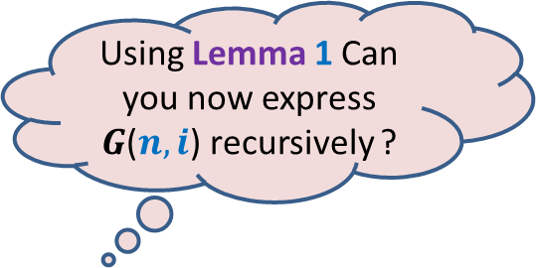
Quick Sort on a permutation from P($i$).
Lemma 1:
There are exactly $(\begin{matrix}n−1 \\ i−1\end{matrix})$ permutations from P($i$) that get mapped to one permutation in S($i$).
($n−1$)!
0 1 2 3 4 5 6 7 8
P($i$)
$$A$$
Using Lemma 1 Can you now express $G$($n,i$) recursively ?
Many-to-one
mapping
$$e_{i}$$
0 1 2 3 4 5 6 7 8
S($i$)
($i−1$)!⨯ ($n−i$)!
$$e_{i}$$
$e_{1}$… $e_{i−1}$
$e_{i+1}$… $e_{n}$

Slide 14

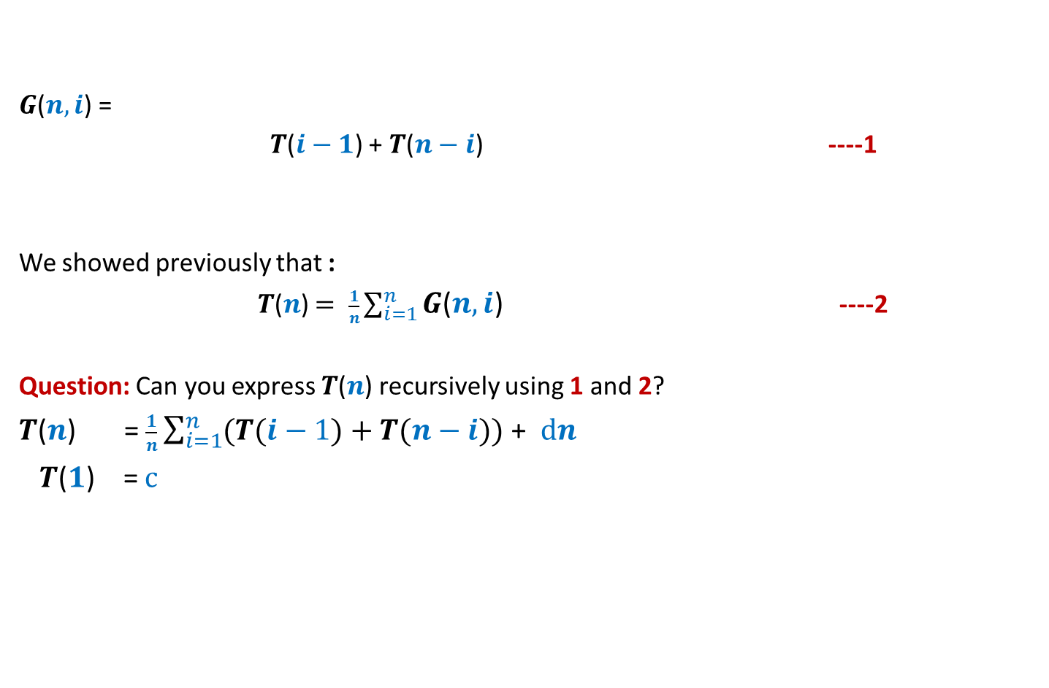
Analyzing average time complexity of QuickSort
$G$($n,i$) =
$T$($i−1$) + $T$($n−i$) ----1
We showed previously that :
$T$($n$) $= \frac{1}{n}\sum_{i=1}^{n}{G\text{(}n,i\text{)}}$ ----2
Question: Can you express $T$($n$) recursively using 1 and 2?
$T$($n$) = $\frac{1}{n}\sum_{i=1}^{n}{(T(i−1)}+T(n−i))$ + $dn$
$T$($1$) = $c$
+ $dn$

Slide 15
Analyzing average time complexity of QuickSort
Part 2
Solving the recurrence through mathematical induction

Slide 16
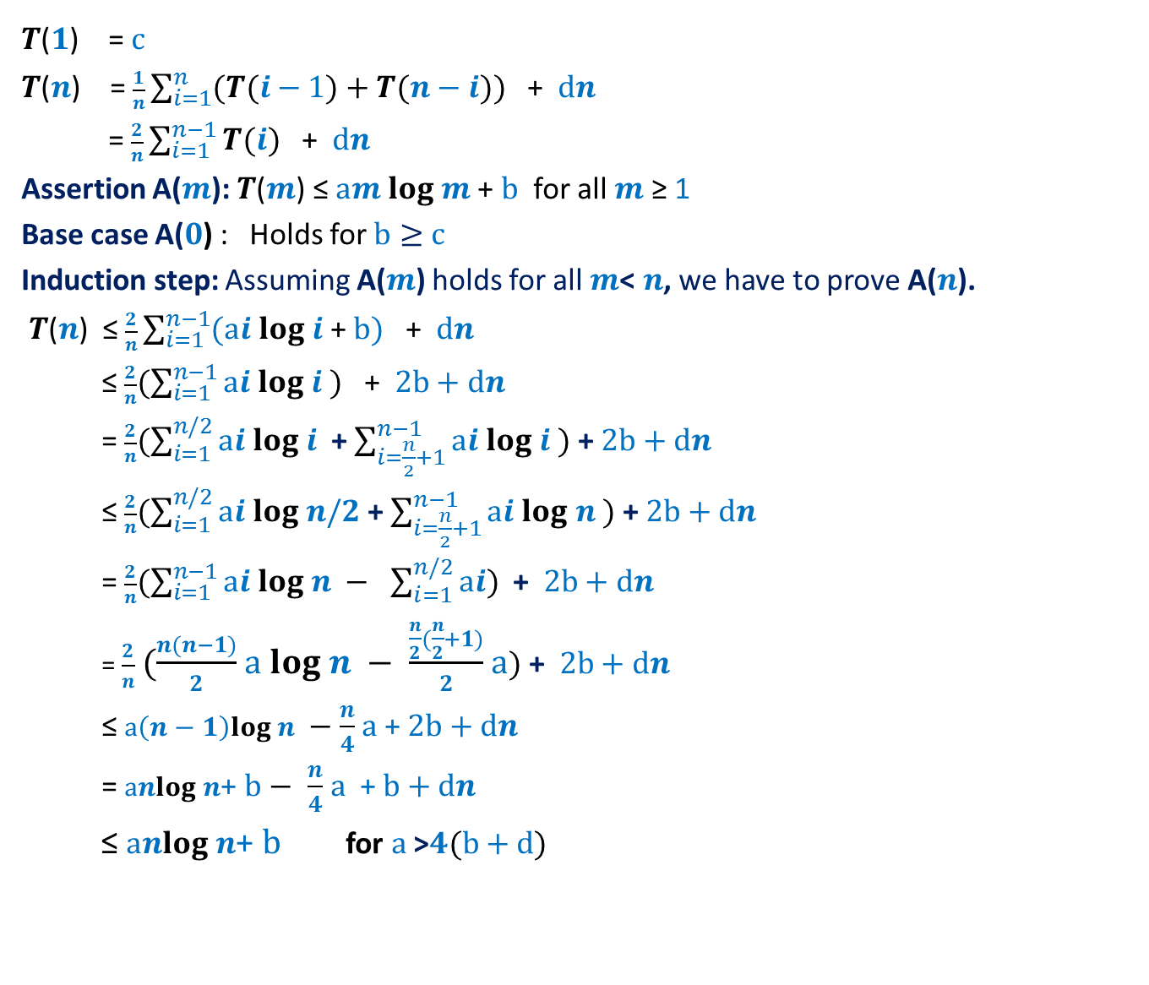
$T$($1$) = $c$
$T$($n$) = $\frac{1}{n}\sum_{i=1}^{n}{(T(i−1)}+T(n−i))$ + $dn$
= $\frac{2}{n}\sum_{i=1}^{n−1}{T(i)}$ + $dn$
Assertion A($m$): $T$($m$) ≤ $am log$ $m$ + $b$ for all $m$ ≥ 1
Base case A($0$) : Holds for $b≥$ $c$
Induction step: Assuming A($m$) holds for all $m$< $n$, we have to prove A($n$).
$T$($n$) ≤ $\frac{2}{n}\sum_{i=1}^{n−1}{(ai log i\text{ + }b)}$ + $dn$
≤ $\frac{2}{n}(\sum_{i=1}^{n−1}{ai log i })$ + $2b+dn$
= $\frac{2}{n}(\sum_{i=1}^{n/2}{ai log i }$ + $\sum_{i=\frac{n}{2}+1}^{n−1}{ai log i )}$ + $2b+dn$
≤ $\frac{2}{n}(\sum_{i=1}^{n/2}{ai log n/2}$ + $\sum_{i=\frac{n}{2}+1}^{n−1}{ai log n )}$ + $2b+dn$
= $\frac{2}{n}(\sum_{i=1}^{n−1}{ai log n − }$ $\sum_{i=1}^{n/2}{ai)}$ + $2b+dn$
= $\frac{2}{n}$ $(\frac{n(n−1)}{2}$ $a log n − \frac{\frac{n}{2}(\frac{n}{2}+1)}{2}$ $a)$ + $2b+dn$
≤ $a\left(n−1\right)log n −$ $\frac{n}{4}$ $a$ + $2b+dn$
= $anlog n\text{+ }b−$ $\frac{n}{4}$ $a$ + $b+dn$
≤ $anlog n\text{+ }b$ for $a$ >$4(b+d)$

Slide 17
Analyzing average time complexity of QuickSort
Part 3
Solving the recurrence exactly

Slide 18
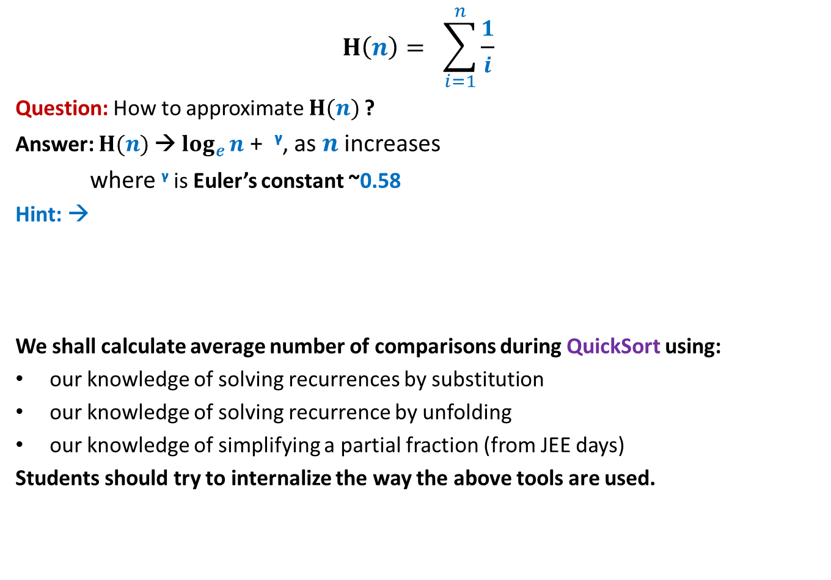
Some elementary tools
$$H\left(n\right)= \sum_{i=1}^{n}{\frac{1}{i}}$$
Question: How to approximate $H(n)$?
Answer: $H(n)$→ $\log_{e}{n}$ + ᵞ, as $n$ increases
where ᵞ is Euler’s constant ~0.58
Hint: →
We shall calculate average number of comparisons during QuickSort using:
our knowledge of solving recurrences by substitution
our knowledge of solving recurrence by unfolding
our knowledge of simplifying a partial fraction (from JEE days)
Students should try to internalize the way the above tools are used.
Look at this figure, and relate it to the curve for function f(x)= 1/x and its integration…
1
1/2
1/3
1/4
1/5
1/6

Slide 19
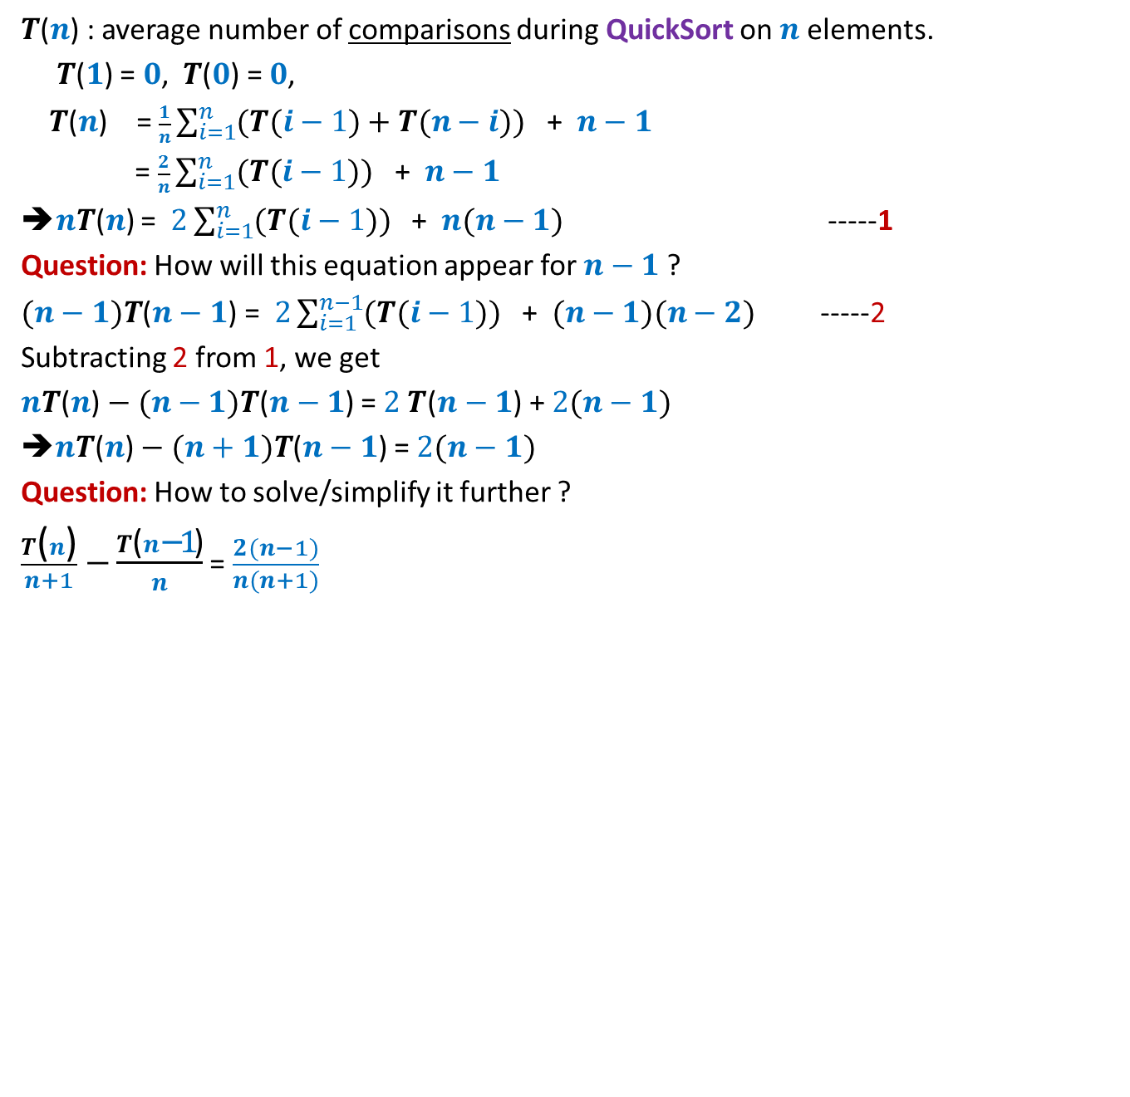
$T$($n$) : average number of comparisons during QuickSort on $n$elements.
$T$($1$) = $0$, $T$($0$) = $0$,
$T$($n$) = $\frac{1}{n}\sum_{i=1}^{n}{(T(i−1)}+T(n−i))$ + $n−1$
= $\frac{2}{n}\sum_{i=1}^{n}{(T(i−1)})$ + $n−1$
➔$nT$($n$) = $2\sum_{i=1}^{n}{(T(i−1)})$ + $n(n−1)$ -----1
Question: How will this equation appear for $n−1$ ?
$(n−1)T$($n−1$) = $2\sum_{i=1}^{n−1}{(T(i−1)})$ + $(n−1)(n−2)$ -----2
Subtracting 2 from 1, we get
$nT$($n$) $− (n−1)T$($n−1$) = $2 T$($n−1$) + $2(n−1)$
➔$nT$($n$) $− (n+1)T$($n−1$) = $2(n−1)$
Question: How to solve/simplify it further ?
$\frac{T\text{(}n\text{)}}{n+1}$ $−\frac{T\text{(}n\text{−1}\text{)}}{n}$ = $\frac{2(n−1)}{n(n+1)}$

Slide 20

$\frac{T\text{(}n\text{)}}{n+1}$ $−\frac{T\text{(}n\text{−}\text{1}\text{)}}{n}$ = $\frac{2(n−1)}{n(n+1)}$
$g(n) −g\left(n−1\right)$ = $\frac{2(n−1)}{n(n+1)}$ , where $g\left(m\right)= \frac{T\text{(}m\text{)}}{m+1}$
Question: How to simplify RHS ?
$\frac{2(n−1)}{n(n+1)}$ = $\frac{2\left(n+1\right)−4}{n(n+1)}$ =
= $\frac{2}{n}$ $−\frac{4}{n(n+1)}$
=$\frac{2}{n}$ $−\frac{4}{n}+\frac{4}{n+1}$
= $\frac{4}{n+1}$ $−\frac{2}{n}$
➔ $g(n) −g\left(n−1\right)$ = $\frac{4}{n+1}$ $−\frac{2}{n}$

Slide 21
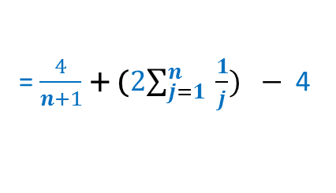
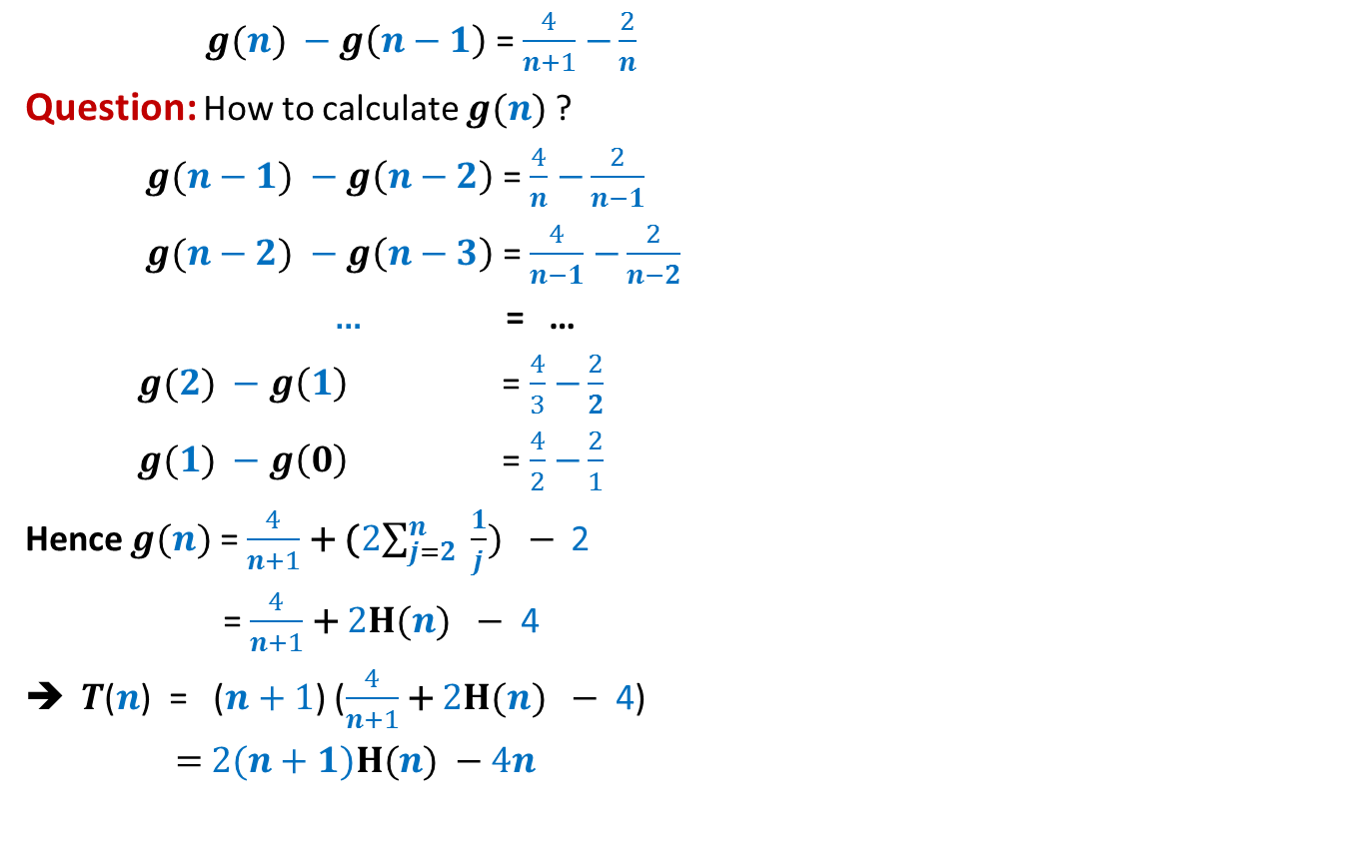
$g(n) −g\left(n−1\right)$ = $\frac{4}{n+1}$ $−\frac{2}{n}$
Question: How to calculate $g(n)$?
$g(n−1) −g\left(n−2\right)$ = $\frac{4}{n}$ $−\frac{2}{n−1}$
$g(n−2) −g\left(n−3\right)$ = $\frac{4}{n−1}$ $−\frac{2}{n−2}$
… = …
$g(2) −g\left(1\right)$ = $\frac{4}{3}$ $−\frac{2}{2}$
$g(1) −g\left(0\right)$ = $\frac{4}{2}$ $−\frac{2}{1}$
Hence $g(n)$ = $\frac{4}{n+1}$ + (2$\sum_{j=2}^{n}{ \frac{1}{j}}) −$ 2
= $\frac{4}{n+1}$ + 2$H(n) −$ 4
$T$($n$) = ($n+1$) ($\frac{4}{n+1}$ + 2$H(n) −$ 4)
= 2($n+1)H(n) −4n$
= $\frac{4}{n+1}$ + (2$\sum_{j=1}^{n}{ \frac{1}{j}}) −$ 4

Slide 22
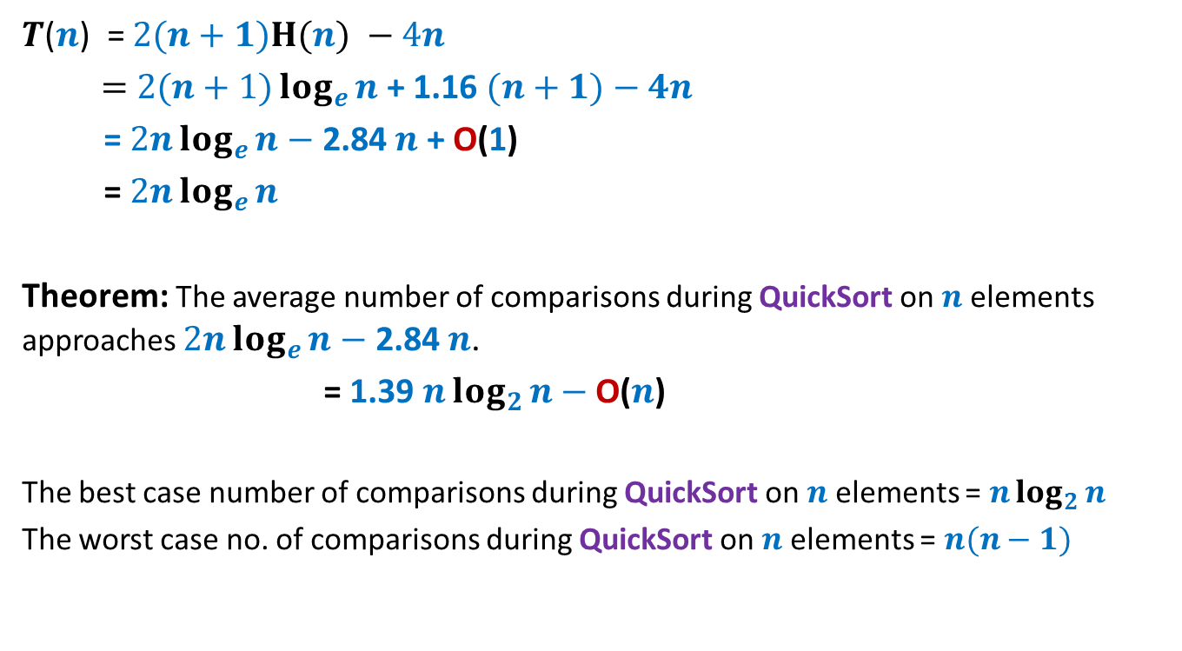
$T$($n$) = 2($n+1)H(n) −4n$
= 2$(n+1)\log_{e}{n}$+ 1.16 $(n+1)−4n$
= 2$n\log_{e}{n}−$ 2.84 $n$ + O(1)
= 2$n\log_{e}{n}$
Theorem: The average number of comparisons during QuickSort on $n$ elements approaches 2$n\log_{e}{n}−$ 2.84 $n$.
= 1.39 $n\log_{2}{n}−$ O($n$)
The best case number of comparisons during QuickSort on $n$ elements = $n\log_{2}{n}$
The worst case no. of comparisons during QuickSort on $n$ elements = $n(n−1)$

Slide 23





Quick sort versus Merge Sort
After seeing this table, no one would prefer Quick sort to Merge sort
But Quick sort is still the most preferred algorithm in practice. Why ?
No. of Comparisons | Merge Sort | Quick Sort
Average case
Best case
Worst case
$$n\log_{2}{n}$$
1.39 $n\log_{2}{n}$
$$n\log_{2}{n}$$
$$n\log_{2}{n}$$
$$n\log_{2}{n}$$
$$n(n−1)$$
You will find the answer yourself in the next programming assignment ☺

