Slide 1
Data Structures and Algorithms
(CS210A)
Lecture 22
Graphs
Notations and terminologies
Data structures for graphs
A few algorithmic problems in graphs

Slide 2
Why Graphs ??

Slide 3
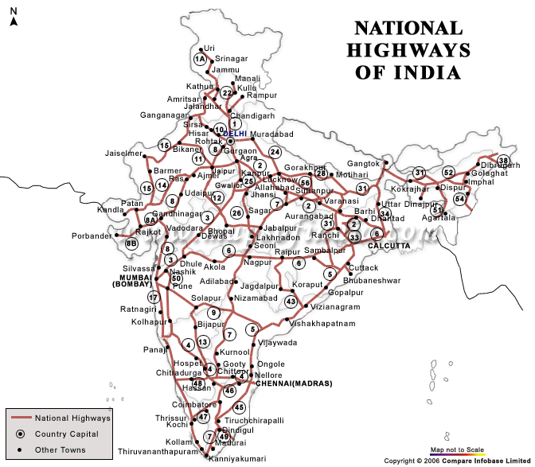
Finding shortest route between cities
Given a network of roads connecting various cities,
compute the shortest route between any two cities.
Just imagine how you would solve/approach this problem.

Slide 4
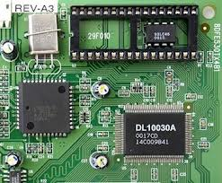
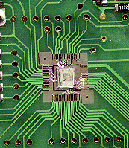
Embedding an integrated circuit on mother board
How to embed ports of various ICs on a plane
No two connections intersect each other
The total length of all the connections is minimal
and make connections among them so that

Slide 5
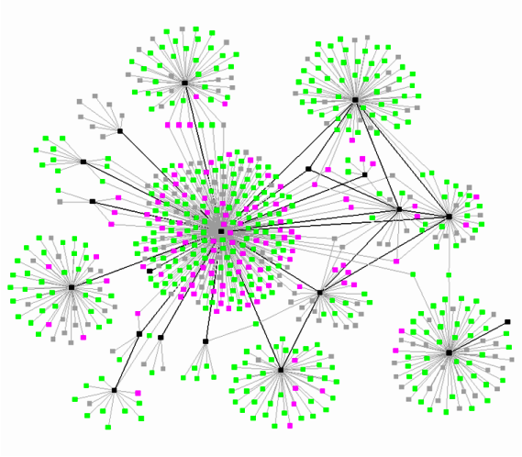
A social network or world wide web (WWW)
Can we make some useful observations about such networks ?
Do you know about the “6 degree of separation principle” of the world ?
Visit the site https://en.wikipedia.org/wiki/Six_degrees_of_separation
diameter
degree distribution

Slide 6
How will you solve these problems ?
model
II
III
I

Slide 7
Graph
Vertices
Edges

Slide 8
Graph
Definitions, notations, and terminologies

Slide 9

Graph
A graph G is defined by two sets
V : set of vertices
E : set of edges
Notation:
A graph G consisting of vertices V and edges E is denoted by
Is there any relation between E and V ?
E $⊆$ (V×V)
(V,E)

Slide 10
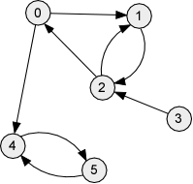
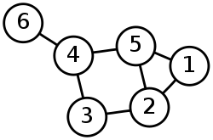
Types of graphs
Undirected Graph
Directed Graph
V= {1,2,3,4,5,6}
E= {(1,2), (1,5),
(2,5), (2,3),
(3,4),
(4,5), (4,6)}
V= {0,1,2,3,4,5}
E= { (0,1), (0,4),
(1,2),
(2,0), (2,1),
(3,2),
(4,5),
(5,4) }

Slide 11



Notations
Notations:
$n$= |V|
m = |E|
Note: For directed graphs, m ≤ ??.
For undirected graphs, m ≤ ??
$n$($n$-1)
$n$($n$-1)/2

Slide 12

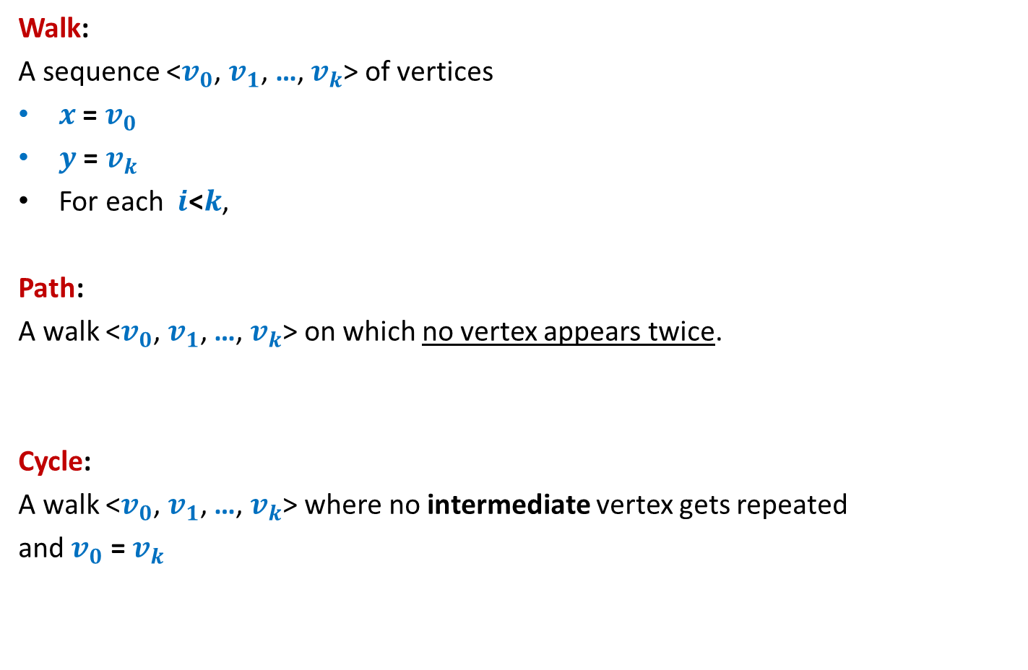

Walks, paths, and cycles
Walk:
A sequence <$v_{0}$, $v_{1}$, …, $v_{k}$> of vertices
$x$ = $v_{0}$
$y$ = $v_{k}$
For each $i\text{<}k$,
Path:
A walk <$v_{0}$, $v_{1}$, …, $v_{k}$> on which no vertex appears twice.
Cycle:
A walk <$v_{0}$, $v_{1}$, …, $v_{k}$> where no intermediate vertex gets repeated
and $v_{0}$ = $v_{k}$
is said to be a walk from $x$ to $y$
($v_{i}$, $v_{i+1}$) ϵ E

Slide 13
Examples
<1,5,4>
<1,3,2,5>
<1,2,5,2,3,4,5,4,6>
<1,2,5,4,6>
<2,3,4,5,2>
is a walk from 1 to 4.
is not a walk.
is a walk from 1 to 6.
is a path from 1 to 6.
is a cycle.

Slide 14



two vertices are said to be connected
Connected component:
A maximal subset of connected vertices
$$x$$
$$z$$
$$y$$
if there is a path between them
You can not add any more vertex to the subset and still keep it connected.

Slide 15
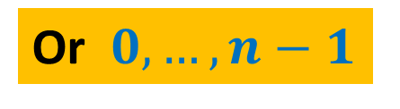
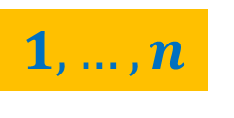
Data Structures for Graphs
Vertices are always numbered
$$1,…,n$$
Or $0,…,n−1$

Slide 16

Link based data structure for graph
Undirected Graph
Adjacency Lists
V= {1,2,3,4,5,6}
E= {(1,2), (1,5),
(2,5), (2,3),
(3,4),
(4,5), (4,6)}
1
2
5
2
1
3
5
3
2
4
4
3
5
6
5
1
2
4
6
4
Size = O($n+m$)

Slide 17
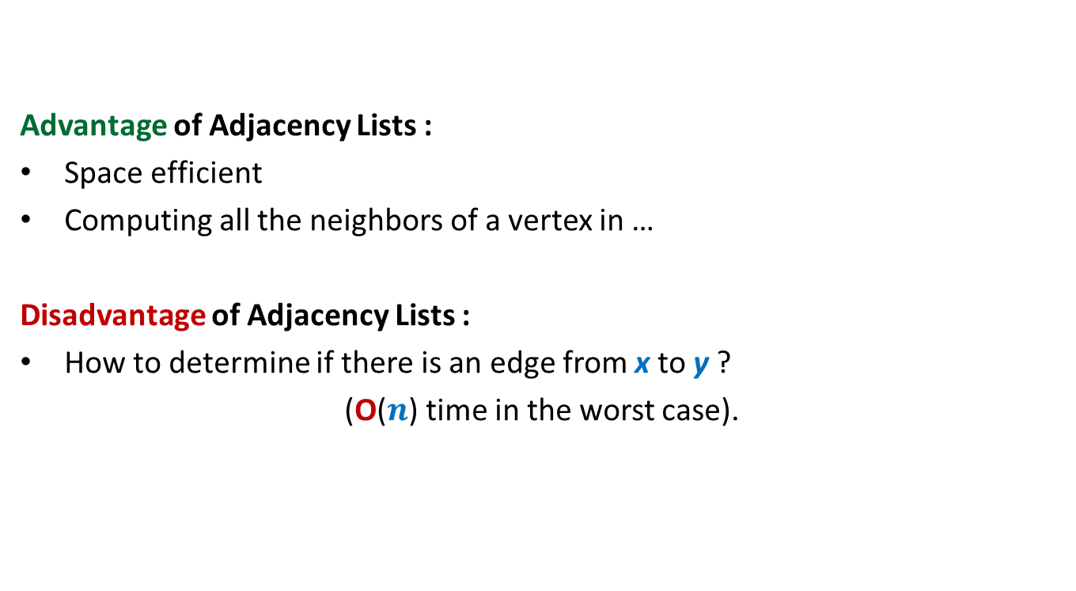
Link based data structure for graph
Advantage of Adjacency Lists :
Space efficient
Computing all the neighbors of a vertex in …
Disadvantage of Adjacency Lists :
How to determine if there is an edge from x to y ?
(O($n$) time in the worst case).
optimal time.

Slide 18

Array based data structure for graph
Undirected Graph
Adjacency Matrix
V= {1,2,3,4,5,6}
E= {(1,2), (1,5),
(2,5), (2,3),
(3,4),
(4,5), (4,6)}
1 2 3 4 5 6
1
0 1 0 0 1 0
2
1 0 1 0 1 0
3
0 1 0 1 0 0
4
0 0 1 0 1 1
5
1 1 0 1 0 0
6
0 0 0 1 0 0
Size = O($n^{2}$)

Slide 19

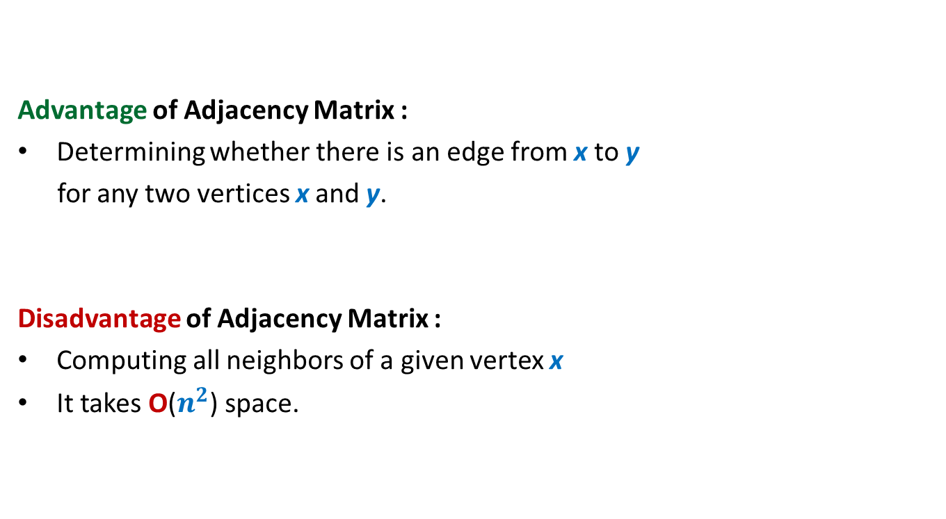
Array based data structure for graph
Advantage of Adjacency Matrix :
Determining whether there is an edge from x to y
for any two vertices x and y.
Disadvantage of Adjacency Matrix :
Computing all neighbors of a given vertex x
It takes O($n^{2}$) space.
in O(1) time
in O($n$) time

Slide 20

Which data structure is commonly used for storing graphs ?
Reasons:
Graphs in real life are sparse ($m {≪n}^{2}$).
Most algorithms require processing neighbors of each vertex.
➔Adjacency matrix will enforce O($n^{2}$) bound on time complexity for such algorithm.
Adjacency lists
But, there are a few exceptions

Slide 21

An interesting problem
(Finding a sink)
A vertex x in a given directed graph is said to be a sink if
There is no edge emanating from (leaving) x
Every other vertex has an edge into x.
Given a directed graph G=(V,E) in an adjacency matrix representation,
design an O($n$) time algorithm to determine if there is any sink in G.
Sink

Slide 22
Graph traversal
Topic for the next class

Slide 23
Graph traversal
Definition:
A vertex y is said to be reachable from x if there is a path from x to y.
Graph traversal from vertex x: Starting from a given vertex x,
the aim is to visit all vertices which are reachable from x.
x
y

Slide 24
Non-triviality of graph traversal
Avoiding loop:
How to avoid visiting a vertex multiple times ?
(keeping track of vertices already visited)
Finite number of steps :
The traversal must stop in finite number of steps.
Completeness :
We must visit all vertices reachable from the start vertex x.
Spend some time on these points and see how can you design such a traversal algorithm

Slide 25
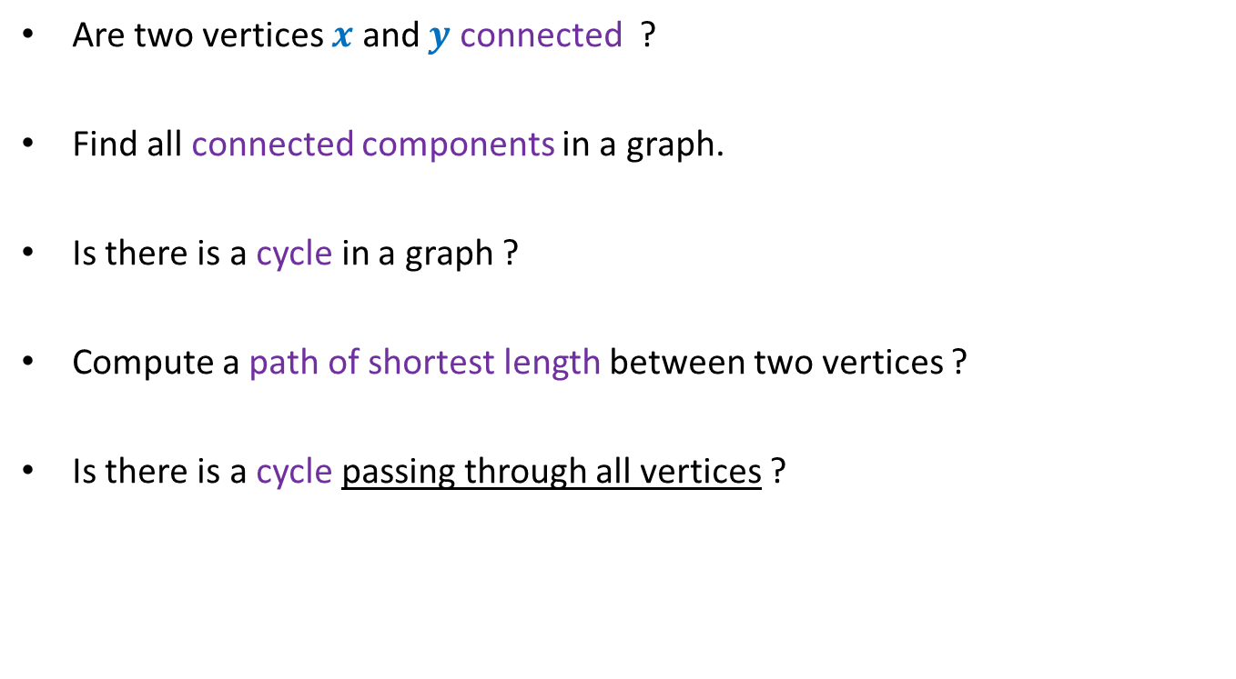
A sample of Graph algorithmic Problems
Are two vertices $x$ and $y$ connected ?
Find all connected components in a graph.
Is there is a cycle in a graph ?
Compute a path of shortest length between two vertices ?
Is there is a cycle passing through all vertices ?

