Slide 1
Data Structures and Algorithms (CS210A)
Lecture 23
Finding a sink in a directed graph
Graph Traversal
Breadth First Search Traversal and its simple applications

Slide 2
An interesting problem
(Finding a sink)
Definition: A vertex x in a given directed graph is said to be a sink if
There is no edge emanating from (leaving) x
Every other vertex has an edge into x.
sink
How many sinks can there be in G ?
At most 1.

Slide 3
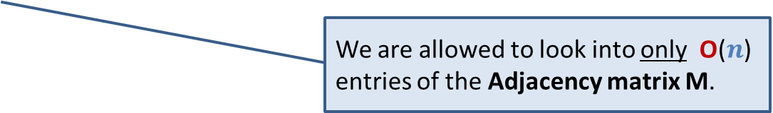
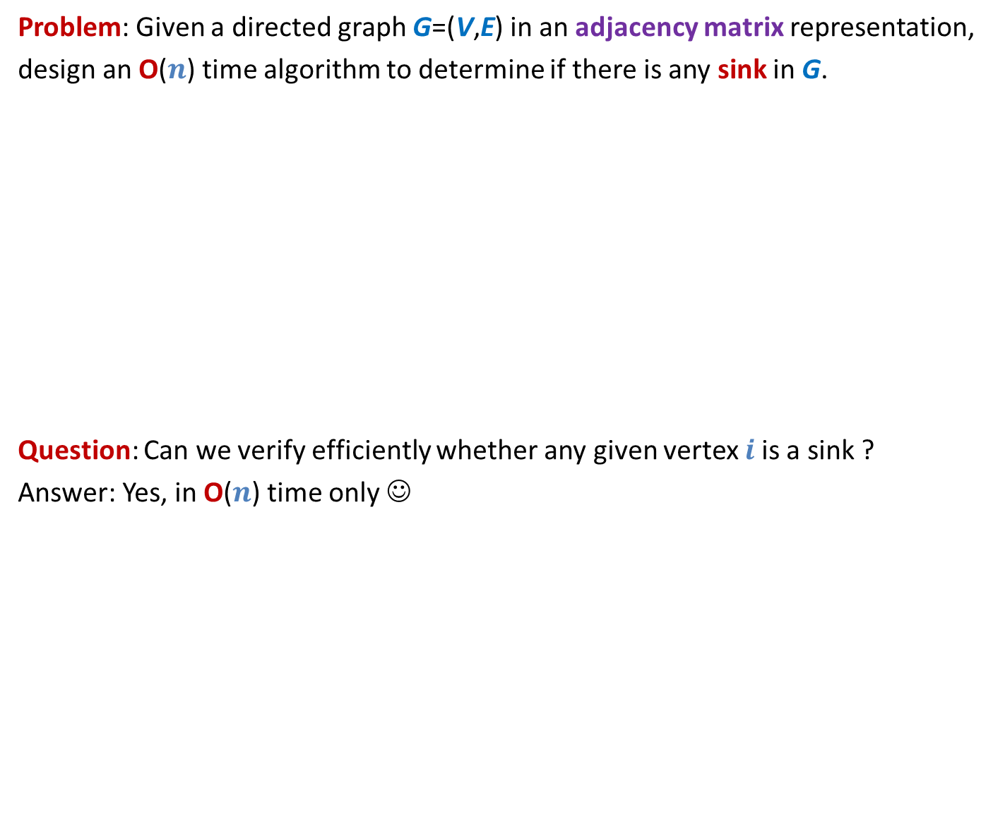

An interesting problem
(Finding a sink)
Problem: Given a directed graph G=(V,E) in an adjacency matrix representation,
design an O($n$) time algorithm to determine if there is any sink in G.
Question: Can we verify efficiently whether any given vertex $i$is a sink ?
Answer: Yes, in O($n$) time only ☺
We are allowed to look into only O($n$) entries of the Adjacency matrix M.
Sink
Look at $i$th row and $i$th column of M.

Slide 4






Key idea
If M[$i,j$] = 0, then ??
If M[$i,j$] = 1 , then ??
$$j$$
Can we eliminate $n−1$non-sink vertices in O($n$) look-up into the Adjacency Matrix M ?
M
$$i$$
$j$ can not be sink
$i$ can not be sink

Slide 5
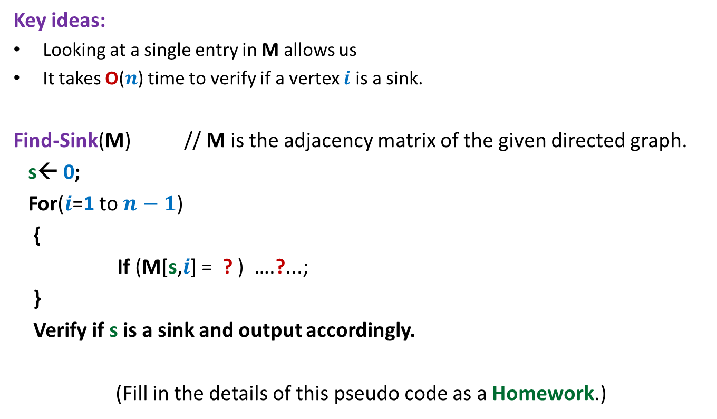
Algorithm to find a sink in a graph
Key ideas:
Looking at a single entry in M allows us
It takes O($n$) time to verify if a vertex $i$ is a sink.
Find-Sink(M) // M is the adjacency matrix of the given directed graph.
s← 0;
For($i$=1 to $n−1$)
{
If (M[s,$i$] = ? ) ….?...;
}
Verify if s is a sink and output accordingly.
(Fill in the details of this pseudo code as a Homework.)
to discard one vertex from being a sink.

Slide 6
What is Graph traversal ?

Slide 7
Graph traversal
Definition:
A vertex y is said to be reachable from x
Graph traversal from vertex x:
Starting from a given vertex x, the aim is
to visit all vertices which are reachable from x.
if there is a path from x to y.
x
y

Slide 8
Non-triviality of graph traversal
Avoiding loop:
How to avoid visiting a vertex multiple times ?
(keeping track of vertices already visited)
Finite number of steps :
The traversal must stop in finite number of steps.
Completeness :
We must visit all vertices reachable from the start vertex x.

Slide 9
Breadth First Search traversal
We shall introduce this traversal technique through an interesting problem.
computing distances from a vertex.

Slide 10
Notations and Observations
Length of a path:
the number of edges on the path.
x
y
A path of length 6 between x and y

Slide 11




Notations and Observations
Observation:
If <$x$, …,$v\text{,} y$> is a path of length $k$ from $x$ to $y$,
then what is the length of the path <$x$, …,$v$> ?
Answer: $k−1$
Question: What can be the maximum length of any path in a graph ?
Answer: $n−1$
$$k$$
x
$$v$$
y
$$k−1$$

Slide 12
Notations and Observations
Shortest Path from x to y:
Distance from x to y:
A path from x to y of least length
the length of the shortest path from x to y.
x
y

Slide 13
Shortest Paths in Undirected Graphs
Problem:
How to compute distance to all vertices reachable from x in a given undirected graph ?
x
b
w
f
u
h
v
d
g
r
y
s
c

Slide 14


Shortest Paths in Undirected Graphs
$V_{0}$ : Vertices at distance 0 from x: ??
$V_{1}$: Vertices at distance 1 from x: ??
$V_{2}$: Vertices at distance 2 from x: ??
x
b
{x}
w
f
u
{f,u,b}
h
v
d
{g,h,s,r,v,w}
g
r
y
Why ?
s
c
While reporting $V_{2}$, you have (sub)consciously used an important property of shortest paths.
Can you state this property ?

Slide 15
Shortest Paths in Undirected Graphs
$V_{0}$ : Vertices at distance 0 from x: ??
$V_{1}$: Vertices at distance 1 from x: ??
$V_{2}$: Vertices at distance 2 from x: ??
x
b
{x}
w
f
u
{f,u,b}
h
v
d
{g,h,s,r,v,w}
g
r
y
Why ?
s
c

Slide 16

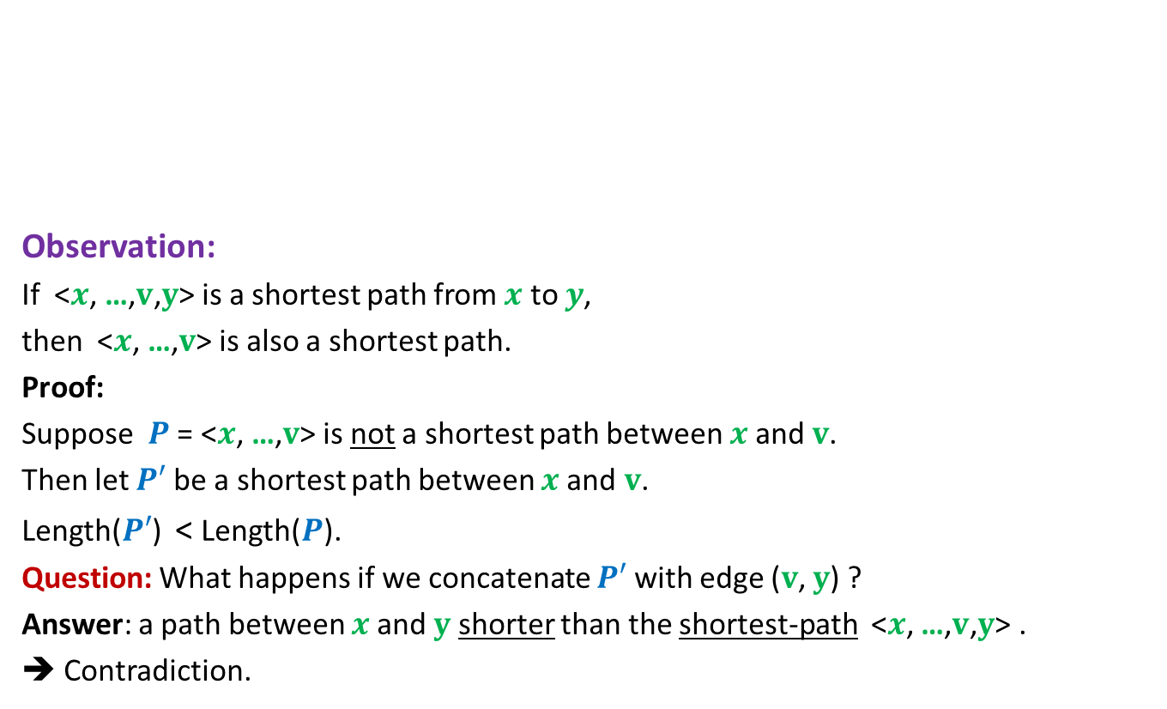


An important property of shortest paths
$$P′$$
Observation:
If <$x$, …,$v\text{,} y$> is a shortest path from $x$ to $y$,
then <$x$, …,$v$> is also a shortest path.
Proof:
Suppose $P$ = <$x$, …,$v$> is not a shortest path between $x$and $v$.
Then let $P′$ be a shortest path between $x$and $v$.
Length($P′$) < Length($P$).
Question: What happens if we concatenate $P′$ with edge ($v$, $y$) ?
Answer: a path between $x$and $y$ shorter than the shortest-path <$x$, …,$v\text{,} y$> .
➔ Contradiction.
A shortest path
between x and y
x
v
y
What can you say about $P$ ?
$$P$$

Slide 17








An important question
Question:
Let ($v$,$w$) be an edge. If Distance($x$,$v$) is $k$,
then what can be Distance($x$,$w$) ?
Answer: an element from the set {$k−1$, $k$, $k+1$} only.
$$w$$
$$w$$
$$w$$
A shortest path
between x and v
x
$$k$$
v
$$k−1$$
$$k$$
$$k+1$$

Slide 18




Relationship among vertices at different distances from x
$V_{0}$ : Vertices at distance 0 from x = {x}
$V_{1}$ : Vertices at distance 1 from x =
Neighbors of $V_{0}$
$V_{2}$ : Vertices at distance 2 from x =
Those Neighbors of $V_{1}$ which …
.
.
.
$V_{i+1}$ : Vertices at distance i+1 from x =
Those Neighbors of $V_{i}$ which …
do not belong to $V_{0}$ or $V_{1}$
do not belong to $V_{i}−1$ or $V_{i}$
How to distinguish the neighbors of $V_{i}$ which belong to $V_{i+1}$ from those which belong to $V_{j}$, $j$≤ $i$ ?

Slide 19
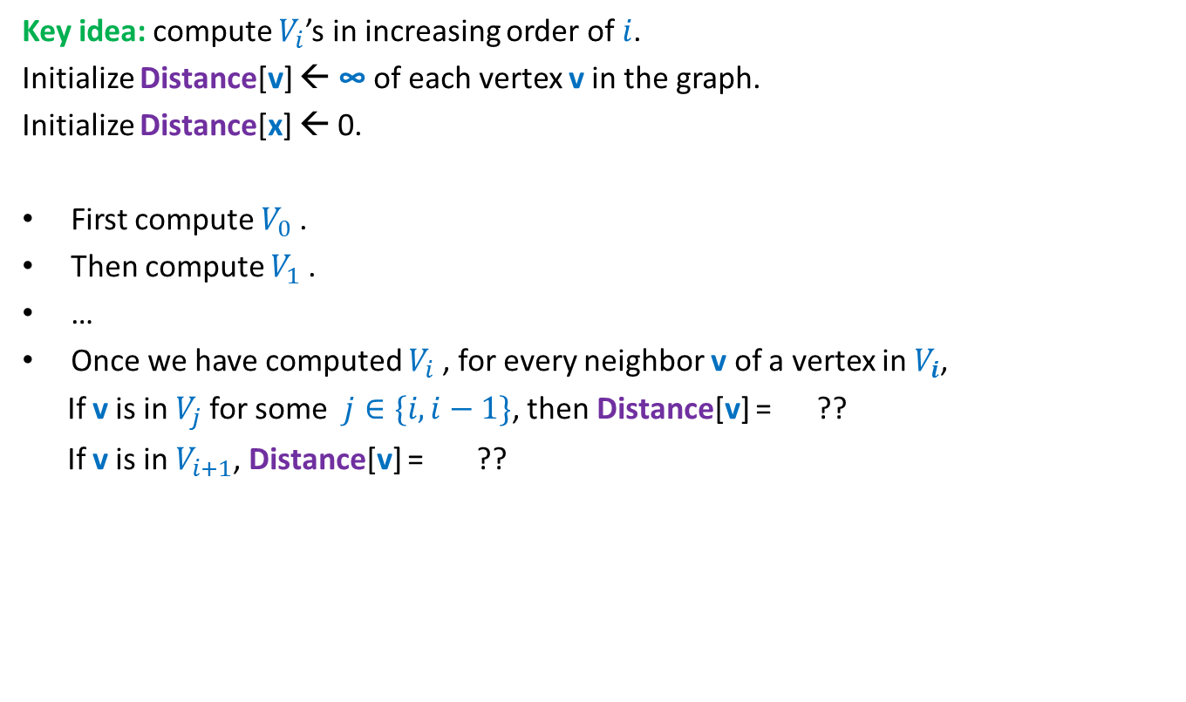

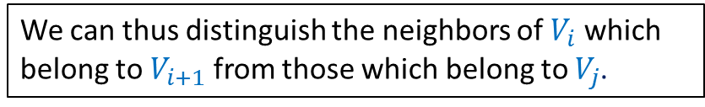

How can we compute $V_{i+1}$ ?
Key idea: compute $V_{i}$’s in increasing order of $i$.
Initialize Distance[v] ← ∞ of each vertex v in the graph.
Initialize Distance[x] ← 0.
First compute $V_{0}$.
Then compute $V_{1}$.
…
Once we have computed $V_{i}$, for every neighbor v of a vertex in $V_{i}$,
If v is in $V_{j}$for some $j∈\{i,i−1\}$, then Distance[v] = ??
If v is in $V_{i+1}$, Distance[v] = ??
a number ≤ $i$
∞
We can thus distinguish the neighbors of $V_{i}$ which belong to $V_{i+1}$ from those which belong to $V_{j}$.

Slide 20
A neat algorithm for computing distances from x
we need an algorithm which traverses/visits the vertices in
non-decreasing order of distances from x
This traversal algorithm is called BFS (breadth first search) traversal

Slide 21



Using a queue for traversing vertices in non-decreasing order of distances
Compute distance of vertices from x:
x
b
x
$$V_{0}$$
w
f
u
f u b
$$V_{1}$$
h
v
d
u b g h
g
r
y
b g h s r v w
s
c
Remove x and for each neighbor of x that was unvisited, mark it visited and put it into queue.
g h s r v w
$$V_{2}$$
Remove f and for each neighbor of f that was unvisited, mark it visited and put it into queue.
Remove u and for each neighbor of u that was unvisited, mark it visited and put it into queue.
Remove b and for each neighbor of b that was unvisited, mark it visited and put it into queue.

Slide 22
BFS traversal from a vertex
BFS(G, x)
CreateEmptyQueue(Q);
Distance(x) ← 0;
Enqueue(x,Q);
While( ?? )
{ v ←Dequeue(Q);
For each neighbor w of v
{
if (Distance(w) = ∞)
{ Distance(w) ← ?? ;
?? ;
}
}
}
Not IsEmptyQueue(Q)
Distance(v) +1
Enqueue(w, Q);

Slide 23
Running time of BFS traversal
BFS(G, x)
CreateEmptyQueue(Q);
Distance(x) ← 0;
Enqueue(x,Q);
While( ?? )
{ v ←Dequeue(Q);
For each neighbor w of v
{
if (Distance(w) = ∞)
{ Distance(w) ← ?? ;
?? ;
}
}
}
Running time of BFS(x) = no. of edges in the connected component of x.
A vertex can enter queue
at most once.
Prove this claim first.
Not IsEmptyQueue(Q)
Distance(v) +1
O(deg(v))
Enqueue(w, Q);

Slide 24
Correctness of BFS traversal
Question: What do we mean by correctness of BFS traversal from vertex x ?
Answer:
All vertices reachable from x get visited.
Vertices get visited in the
At the end of the algorithm,
Distance(v) is the distance of vertex v from x.
non-decreasing order of their distances from x.
We shall discuss this proof in the next class. Please think over it for some time before coming to the class.

Slide 25
A useful advice
An effective way to master the technique of proving correctness of an algorithm is to …
Do each home work exercise
(about proof of correctness)
that is asked in the class before attending the next class.
There is no escape. There will be question on proof of correctness in the next course. ☺

