Slide 1
Data Structures and Algorithms (CS210A)
Lecture 24
BFS traversal (proof of correctness)
BFS tree
An important application of BFS traversal

Slide 2
Breadth First Search traversal

Slide 3
BFS Traversal in Undirected Graphs
x
b
w
f
u
h
v
d
g
r
y
s
c

Slide 4

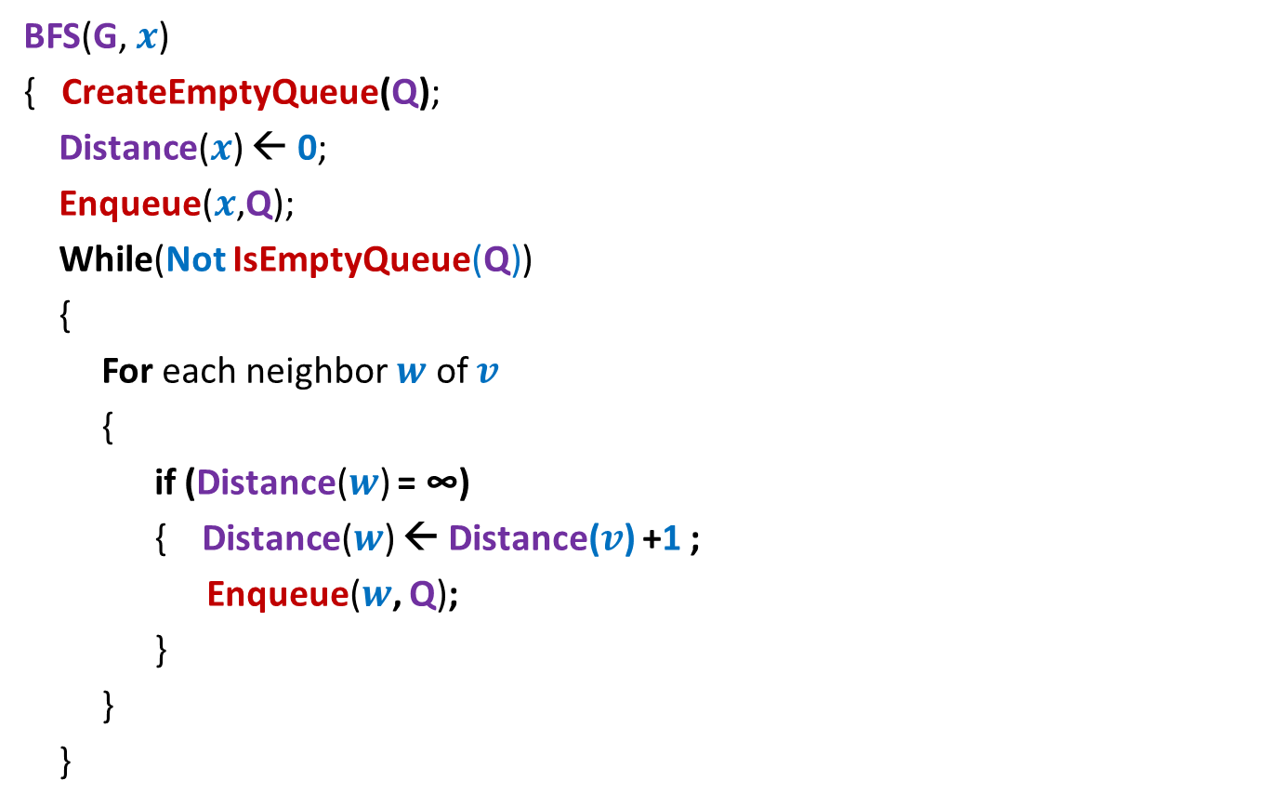





BFS traversal of G from a vertex $x$
BFS(G, $x$)
{ CreateEmptyQueue(Q);
Distance($x$) ← 0;
Enqueue($x$,Q);
While(Not IsEmptyQueue(Q))
{
For each neighbor $w$ of $v$
{
if (Distance($w$) = ∞)
{ Distance($w$) ← Distance($v$) +1 ;
Enqueue($w$, Q);
}
}
}
//Initially for each $v$, Distance($v$) ← ∞
, and Visited($v$) ← false.
Visited($x$) ← true;
$v$ ←Dequeue(Q);
Visited($w$) ← true;

Slide 5
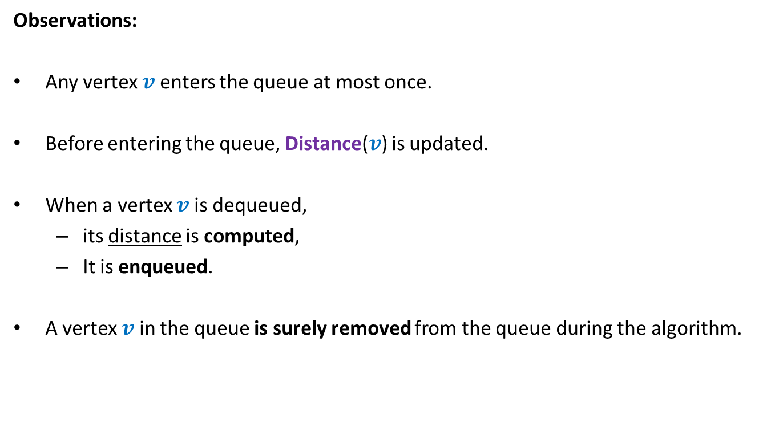


Observations about BFS($x$)
Observations:
Any vertex $v$ enters the queue at most once.
Before entering the queue, Distance($v$) is updated.
When a vertex $v$ is dequeued,
its distance is computed,
It is enqueued.
A vertex $v$ in the queue is surely removed from the queue during the algorithm.
$v$ processes all its unvisited neighbors as follows

Slide 6
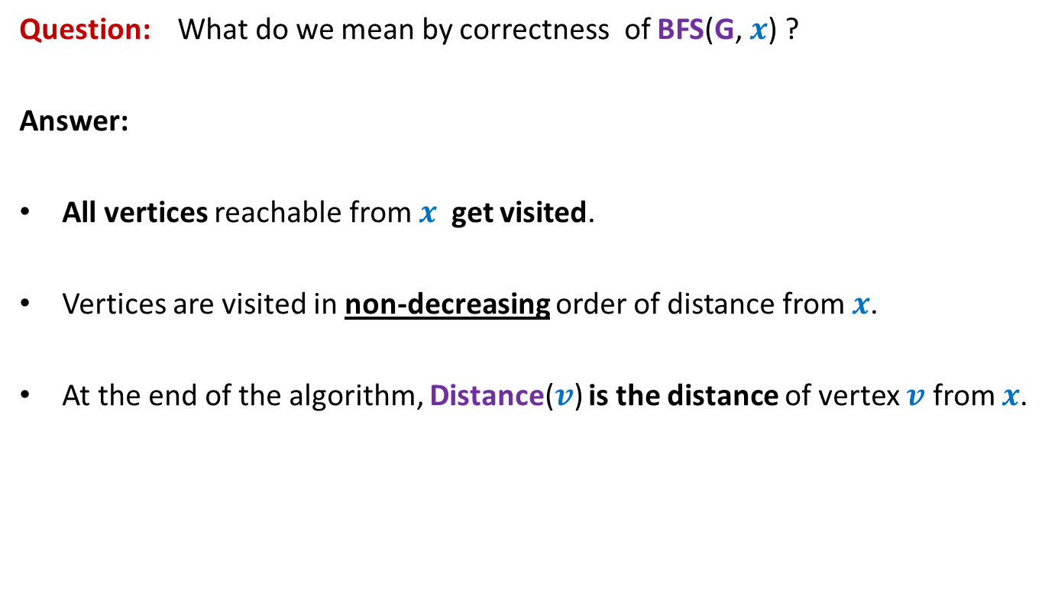
Correctness of BFS traversal
Question: What do we mean by correctness of BFS(G, $x$) ?
Answer:
All vertices reachable from $x$ get visited.
Vertices are visited in non-decreasing order of distance from $x$.
At the end of the algorithm, Distance($v$) is the distance of vertex $v$ from $x$.

Slide 7













The key idea
Partition the vertices according to their distance from $x$.
$$V_{0}$$
$$x$$
0
$$V_{1}$$
1
$$V_{2}$$
2
$w$can not have any neighbor from level $i−2$ or higher.
$$V_{i−1}$$
$$i−1$$
$$V_{i}$$
$$i$$
$$w$$
$$V_{i+1}$$
$$i+1$$

Slide 8


Correctness of BFS($x$) traversal Part 1
All vertices reachable from $x$ get visited

Slide 9

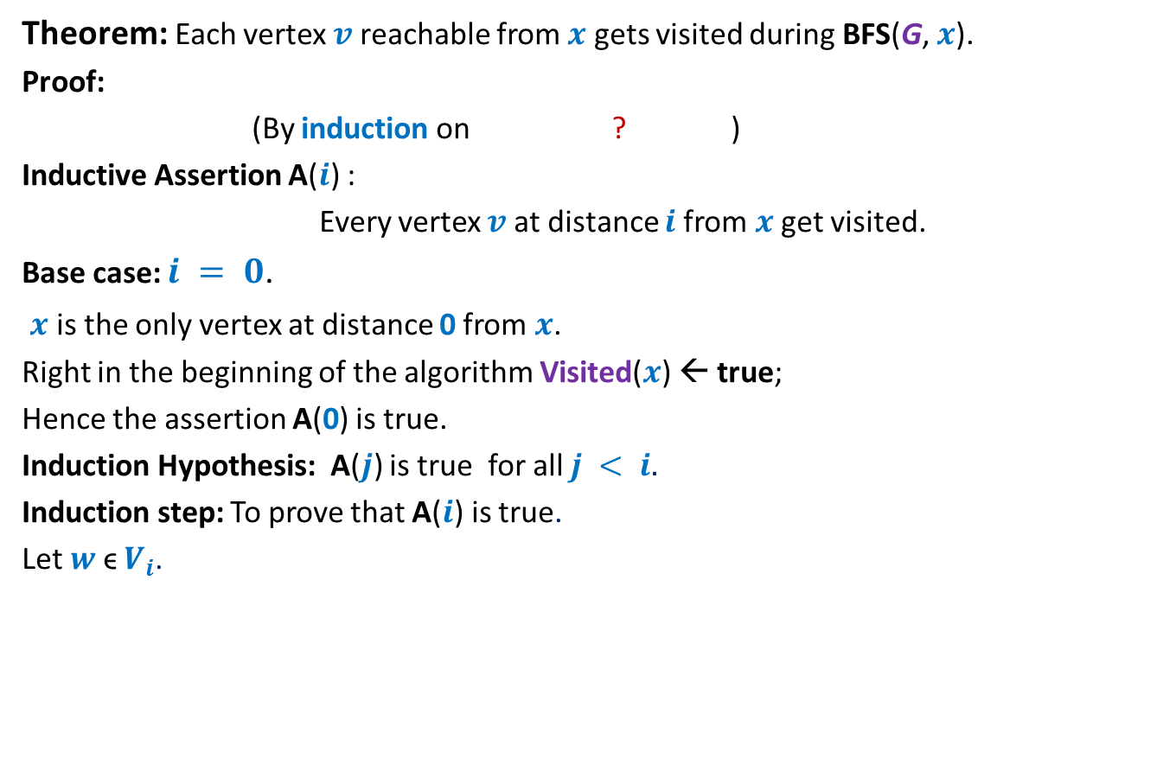
Proof of Part 1
Theorem: Each vertex $v$ reachable from $x$ gets visited during BFS(G, $x$).
Proof:
(By induction on ? )
Inductive Assertion A($i$) :
Every vertex $v$ at distance $i$from $x$ get visited.
Base case: $i = 0$.
$x$ is the only vertex at distance 0 from $x$.
Right in the beginning of the algorithm Visited($x$) ← true;
Hence the assertion A(0) is true.
Induction Hypothesis: A($j$) is true for all $j < i.$
Induction step: To prove that A($i$) is true.
Let $w$ ϵ $V_{i}$.
distance from $x$

Slide 10
BFS traversal of G from a vertex $x$
BFS(G, $x$)
{ CreateEmptyQueue(Q);
Distance($x$) ← 0;
Enqueue($x$,Q);
While(Not IsEmptyQueue(Q))
{
For each neighbor $w$ of $v$
{
if (Distance($w$) = ∞)
{ Distance($w$) ← Distance($v$) +1 ;
Enqueue($w$, Q);
}
}
}
//Initially for each $v$, Distance($v$) ← ∞
, and Visited($v$) ← false.
Visited($x$) ← true;
$v$ ←Dequeue(Q);
Visited($w$) ← true;

Slide 11
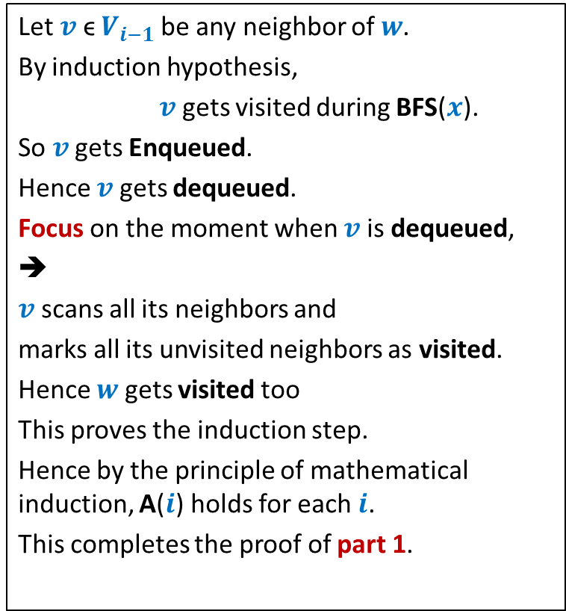

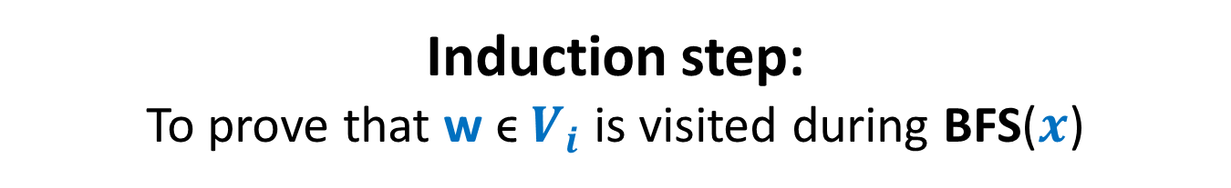


Induction step: To prove that w ϵ $V_{i}$ is visited during BFS($x$)
Let $v$ ϵ $V_{i−1}$be any neighbor of $w$.
By induction hypothesis,
$v$ gets visited during BFS($x$).
So $v$ gets Enqueued.
Hence $v$ gets dequeued.
Focus on the moment when $v$ is dequeued,
➔
$v$ scans all its neighbors and
marks all its unvisited neighbors as visited.
Hence $w$ gets visited too
This proves the induction step.
Hence by the principle of mathematical induction, A($i$) holds for each $i$.
This completes the proof of part 1.
$$x$$
0
1
2
$$v$$
if not already visited.
$$i−1$$
$$w$$
$$i$$

Slide 12
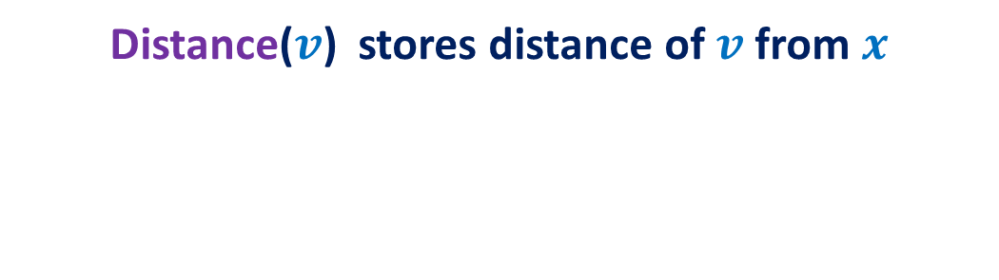

Correctness of BFS($x$) traversal Part 3
Distance($v$) stores distance of $v$ from $x$
Homework
To be discussed in the doubt clearing session

Slide 13
BFS tree

Slide 14

BFS traversal gives a tree
Perform BFS traversal from $x$.
$$V_{0}$$
$$x$$
0
$$V_{1}$$
1
$$V_{2}$$
2
$$v$$
$$V_{i−1}$$
$$i−1$$
$$V_{i}$$
$$i$$
$$w$$
$$V_{i+1}$$
$$i+1$$

Slide 15
A nontrivial application of BFS traversal
Determining
if a graph is bipartite

Slide 16
Bipartite graph
Definition: A graph G=(V,E) is said to be bipartite
if its vertices can be partitioned into two sets A and B
such that every edge in E has one endpoint in A and another in B.
Is this graph bipartite ?
A
B
YES

Slide 17
Nontriviality in determining whether a graph is bipartite
Both are same graph but drawn in different ways. Can you see it ?
Is this graph bipartite ?
A
B
B
A
A
B
A
B
bipartite
bipartite

Slide 18
Bipartite graph
Question: Is a path bipartite ?
Answer: Yes
A B A B A B A

Slide 19
Bipartite graph
Question: Is a cycle bipartite ?
B
B
A
A
A
B
B
non-bipartite
bipartite

Slide 20
Bipartite graph
Question: Is a cycle bipartite ?
B
A
B
A
B
A
Odd length cycle
A
non-bipartite
B
A
B
A
B
A
B
A
B
A
B
Even length cycle
A
A
bipartite
B
A
B
A
B

Slide 21
Subgraph
A subgraph of a graph G=(V,E)
is a graph G’=(V’,E’) such that
V’ ⊆ V
E’ ⊆ E
Question: If G has a subgraph which is an odd cycle, is G bipartite ?
Answer: No.
∩ (V’ ⨯ V’)

Slide 22
Bipartite graph
Question: Is a tree bipartite ?
Answer: Yes
Even level vertices: A
Odd level vertices: B
0
1
2
3
4

Slide 23
An algorithm for determining if a given graph is bipartite
Assumption:
the graph is a single connected component

Slide 24

Compute a BFS tree at any vertex x.
If every nontree edge goes between two consecutive levels, what can we say ?
The graph is bipartite
$$V_{0}$$
$$x$$
0
A
B
A
B
A
B
$$V_{1}$$
1
$$V_{2}$$
2
The BFS tree is bipartite. Now place the non tree edges
$$V_{i−1}$$
$$i−1$$
$$V_{i}$$
$$i$$
$$w$$
$$V_{i+1}$$
$$i+1$$

Slide 25
Observation:
If every non-tree edge goes between two consecutive levels of BFS tree,
then the graph is bipartite.
Question:
What if there is an edge with both end points at same level ?

Slide 26


What if there is an edge
with both end points at same level ?
Keep following parent pointer from $u$and $w$ simultaneously until we reach a common ancestor. What do we get ?
Can you spot an odd length cycle here ?
$$V_{0}$$
$$x$$
0
A
B
A
B
A
B
$$V_{1}$$
1
$$V_{2}$$
2
$$V_{i−1}$$
$$i−1$$
$$V_{i}$$
$$i$$
$$u$$
$$w$$
$$V_{i+1}$$
$$i+1$$

Slide 27
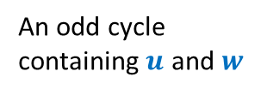
An odd cycle
containing $u$ and $w$
$$V_{0}$$
$$x$$
0
A
B
A
B
A
B
$$V_{1}$$
1
$$V_{2}$$
2
$$V_{i−1}$$
$$i−1$$
$$V_{i}$$
$$i$$
$$u$$
$$w$$
$$V_{i+1}$$
$$i+1$$

Slide 28
Observation:
If there is any non-tree edge with ?
then the graph has an odd length cycle.
Hence the graph is not bipartite.
both endpoints at the same level

Slide 29
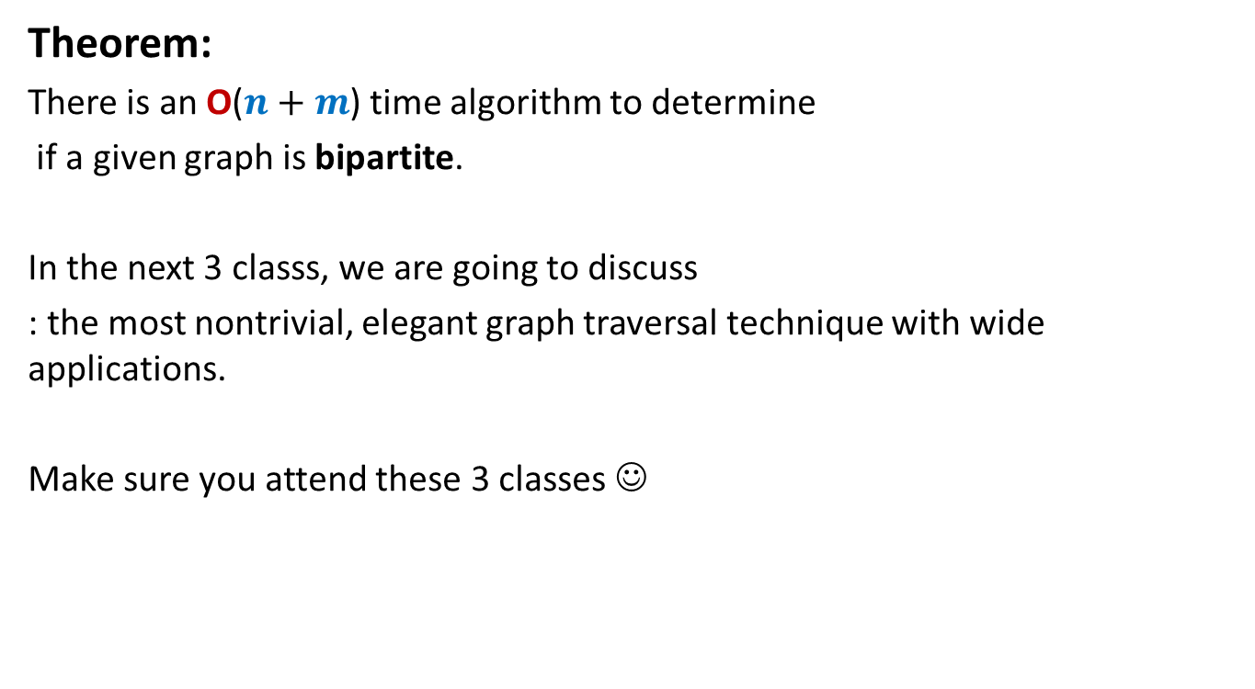
Theorem:
There is an O($n+m$) time algorithm to determine
if a given graph is bipartite.
In the next 3 classs, we are going to discuss
: the most nontrivial, elegant graph traversal technique with wide applications.
Make sure you attend these 3 classes ☺
Depth First Traversal

