Slide 1
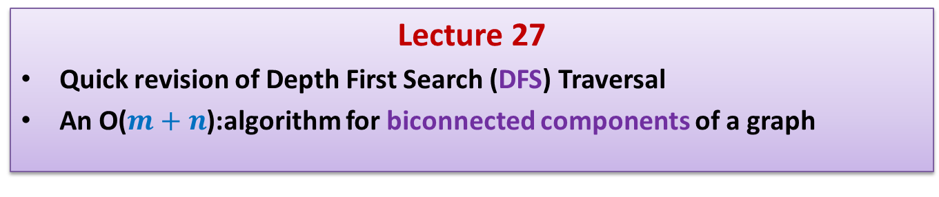
Data Structures and Algorithms (CS210A)
Lecture 27
Quick revision of Depth First Search (DFS) Traversal
An O($m+n$):algorithm for biconnected components of a graph

Slide 2
Quick revision of Depth First Search (DFS) Traversal

Slide 3
DFS traversal of G
DFS(v)
{ Visited(v) ← true;
For each neighbor w of v
{ if (Visited(w) = false)
{ DFS(w) ;
}
}
}
DFS-traversal(G)
{
For each vertex vϵ V { Visited(v)← false }
For each vertex v ϵ V { If (Visited(v ) = false) DFS(v) }
}
DFN[v] ← dfn ++;
……..;
……..;
dfn ← 0;

Slide 4
DFN number
DFN[x] :
The number at which x gets visited during DFS traversal.
y
v
1
0
10
w
f
2
3
b
4
h
12
11
d
g
u
5
r
8
z
6
9
s
7
c

Slide 5
DFS(v) computes a tree rooted at v
If x is ancestor of y then
DFN[x] ? DFN[y]
Question: Is a DFS tree unique ?
Answer: No.
Question:
Can any rooted tree be obtained through DFS ?
Answer: No.
y
v
<
w
f
b
h
d
g
u
r
z
s
c
A DFS tree rooted at v

Slide 6
Always remember this picture
non-tree edge
➔ back edge
A DFS representation
of the graph

Slide 7
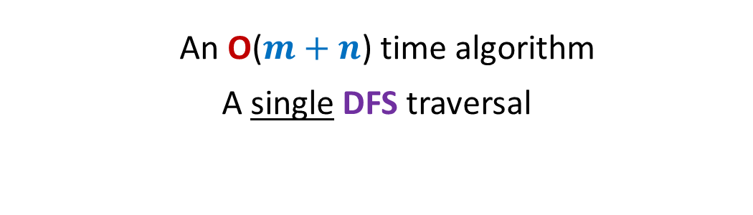
Verifying bi-connectivity of a graph
An O($m+n$) time algorithm
A single DFS traversal

Slide 8

An O($m+n$) time algorithm
A formal characterization of the problem.
(articulation points)
Exploring relationship between articulation point & DFS tree.
Using the relation cleverly to design an efficient algorithm.

Slide 9
This graph is NOT biconnected
The removal of any of {v,f,u} can destroy connectivity.
v,f,u are called the articulation points of G.
y
v
w
f
b
h
d
g
u
r
z
s
c

Slide 10
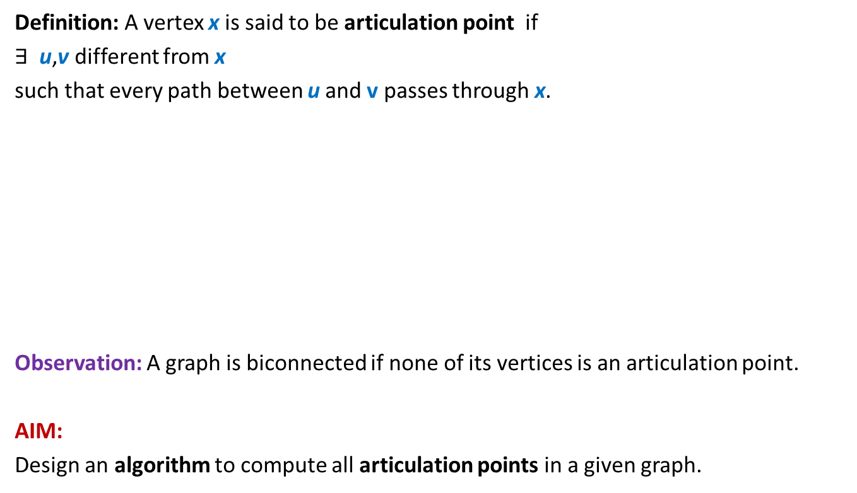
A formal definition of articulaton point
Definition: A vertex x is said to be articulation point if
$∃$ u,v different from x
such that every path between u and v passes through x.
Observation: A graph is biconnected if none of its vertices is an articulation point.
AIM:
Design an algorithm to compute all articulation points in a given graph.
u
x
v

Slide 11
Some observations
A leaf node can never be an a.p. ?
Root is an a.p. iff it has two or more children.
v
What about an internal node ?

Slide 12
Necessary and Sufficient condition for x to be articulation point
root
< 5
Theorem1:
An internal node x is articulation point iff
x has at least one child y s.t.
no back edge from subtree(y) to
➔ No back edge from subtree(y) going to a vertex “higher” than x.
z
?
ancestor of x.
x
5
How to define the notion “higher” than x ?
y
6
Use DFN numbering
9

Slide 13

Necessary and Sufficient condition for x to be articulation point
root
< 5
Theorem1:
An internal node x is articulation point iff
x has at least one child y s.t.
no back edge from subtree(y) to
High_pt(v):
DFN of the highest ancestor of v
to which there is a back edge from subtree(v).
Theorem2:
An internal node x is articulation point iff
it has a child, say y, in DFS tree such that
High_pt(y) ? DFN(x).
z
?
ancestor of x.
Invent a new function
x
5
y
6
9
$$≥$$

Slide 14
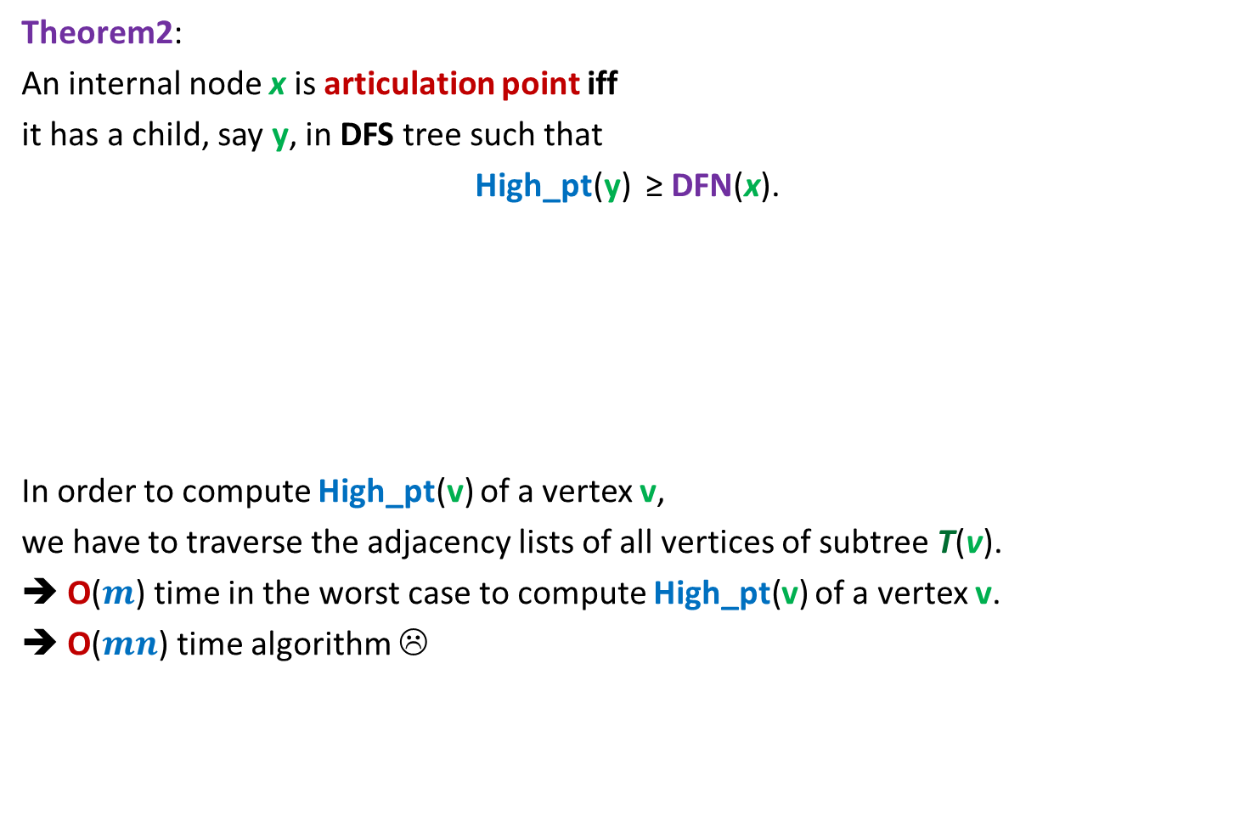
Theorem2:
An internal node x is articulation point iff
it has a child, say y, in DFS tree such that
High_pt(y) ≥ DFN(x).
In order to compute High_pt(v) of a vertex v,
we have to traverse the adjacency lists of all vertices of subtree T(v).
➔ O($m$) time in the worst case to compute High_pt(v) of a vertex v.
➔ O($mn$) time algorithm ☹
Good ☺!
But how to transform this Theorem into an efficient algorithm for articulation points ?

Slide 15
How to compute High_pt(v) efficiently ?
root
Question: Can we express High_pt(v) in terms of
its children and proper ancestors?
Exploit
recursive structure of DFS tree.
v

Slide 16
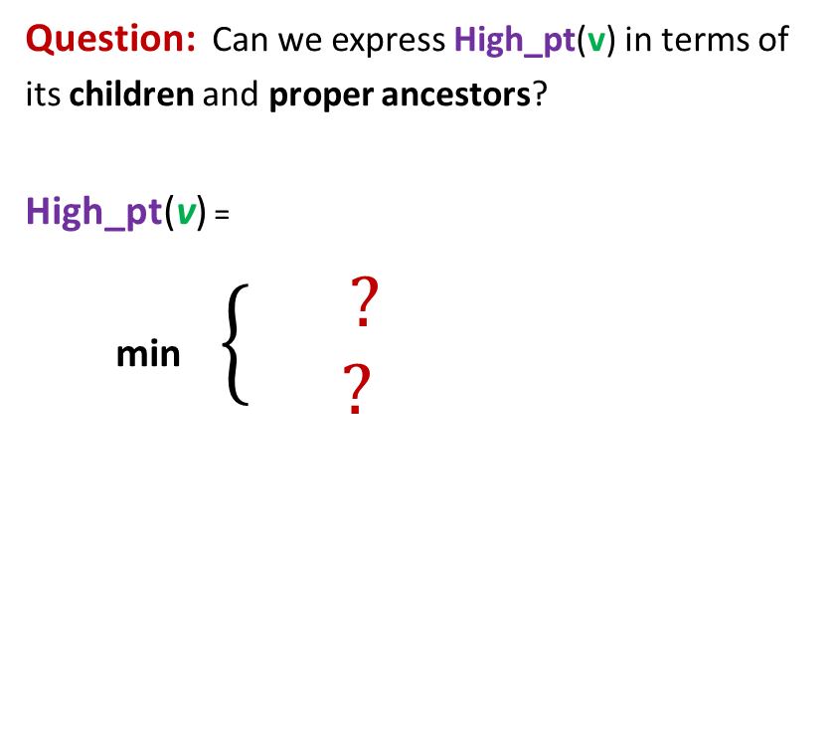
How to compute High_pt(v) efficiently ?
root
Question: Can we express High_pt(v) in terms of
its children and proper ancestors?
High_pt(v) =
min $\left\{\begin{aligned} ? \\ ?\end{aligned}\right.$
High_pt(w)
If w=child(v)
v
(v,w) ϵ E
If w = proper
ancestor of v
DFN(w)

Slide 17
The novel algorithm
Output : an array AP[] s.t.
AP[v]= true if and only if v is an articulation point.

Slide 18
Algorithm for articulation points in a graph G
DFS(v)
{ Visited(v) ← true; DFN[v] ← dfn ++;
For each neighbor w of v
{ if (Visited(w) = false)
{ DFS(w) ;
}
}
}
DFS-traversal(G)
{ dfn ← 0;
For each vertex vϵ V { Visited(v)← false; }
For each vertex v ϵ V { If (Visited(v ) = false) DFS(v) }
}
High_pt[v]←∞ ;
Parent(w) ← v;
……..;
……..;
……..;
AP[v]← false

Slide 19
Algorithm for articulation points in a graph G
DFS(v)
{ Visited(v) ← true; DFN[v] ← dfn ++;
For each neighbor w of v
{ if (Visited(w) = false)
{
}
}
}
DFS-traversal(G)
{ dfn ← 0;
For each vertex vϵ V { Visited(v)← false; }
For each vertex v ϵ V { If (Visited(v ) = false) DFS(v) }
}
High_pt[v]←∞ ;
Parent(w)← v; DFS(w);
……..;
High_pt(v) ← min( High_pt(v) , High_pt(w) );
……..;
If High_pt(w) ≥ DFN[v] AP[v] ← true
Else if ( Parent(v) ≠ w )
……..;
High_pt(v) ← min( DFN(w) , High_pt(v) )
AP[v]← false

Slide 20

Conclusion
Theorem2 : For a given graph G=(V,E), all articulation points can be computed in O($m+n$) time.

Slide 21
Data Structures
Range of
efficient functions
Lists: (arrays, linked lists)
Binary Heap
Simplicity
Binary Search Trees

Slide 22

Heap
Definition: a tree data structure where :
value stored in a node ? value stored in each of its children.
$$<$$
4
7
11
13
71
9
18
23
37
19
21
47
43

Slide 23
Operations on a heap
Query Operations
Find-min: report the smallest key stored in the heap.
Update Operations
CreateHeap(H)
Insert(x,H)
Extract-min(H)
Decrease-key(p, ∆, H)
Merge(H1,H2)
: Create an empty heap H.
: Insert a new key with value x into the heap H.
: delete the smallest key from H.
: decrease the value of the key p by amount ∆.
: Merge two heaps H1 and H2.

Slide 24
Why heaps when we can use a binary search tree ?
Compared to binary search trees, a heap is usually
-- much simpler and
-- more efficient

Slide 25
Existing heap data structures
Binary heap
Binomial heap
Fibonacci heap
Soft heap

Slide 26
Can we implement a binary tree using an array ?
Yes.
In some special cases

Slide 27
fundamental question
Question: What does the implementation of a tree data structure require ?
Answer: a mechanism to
access parent of a node
access children of a node.

Slide 28
A complete binary tree
A complete binary of 12 nodes.

Slide 29
A complete binary tree
Can you see a relationship between label of a node and labels of its children ?
Level nodes
0
0 1
1 2
1 2
3 4 5 6
2 4
7 8 9 10 11
Think over it before coming to the next class.

