Slide 1
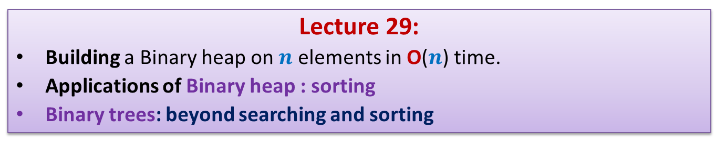
Data Structures and Algorithms (CS210A)
Lecture 29:
Building a Binary heap on $n$ elements in O($n$) time.
Applications of Binary heap : sorting
Binary trees: beyond searching and sorting

Slide 2
Recap from the last lecture

Slide 3
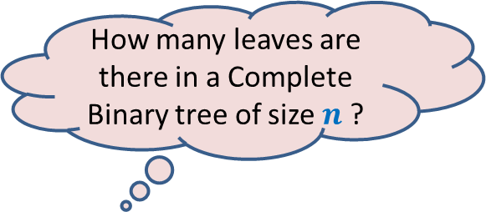
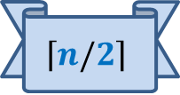
A complete binary tree
How many leaves are there in a Complete Binary tree of size $n$ ?
$$\left\lceil n/2\right\rceil$$

Slide 4
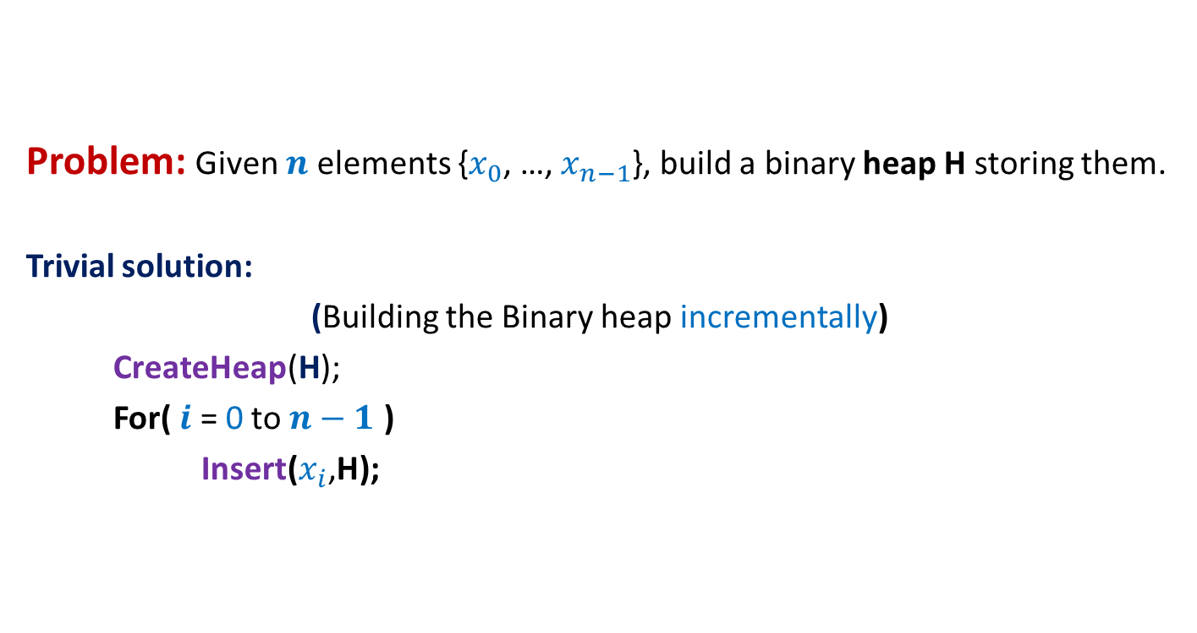
Building a Binary heap
Problem: Given $n$ elements {$x_{0}$, …, $x_{n−1}$}, build a binary heap H storing them.
Trivial solution:
(Building the Binary heap incrementally)
CreateHeap(H);
For( $i$ = 0 to $n−1$ )
Insert($x_{i}$,H);
What is the time complexity of this algorithm?

Slide 5


Building a Binary heap incrementally
The time complexity for inserting a leaf node = ?
# leaf nodes = $\left\lceil n/2\right\rceil$,
➔ Theorem: Time complexity of building a binary heap incrementally is O($n$ log $n$).
What useful inference can you draw from this Theorem ?
Top-down
approach
O(log $n$)

Slide 6

Building a Binary heap incrementally
What useful inference can you draw from this Theorem ?
Top-down
approach
The O($n$) time algorithm must take O(1) time for each of the $\left\lceil n/2\right\rceil$ leaves.

Slide 7
Building a Binary heap incrementally
Top-down
approach

Slide 8
Think of alternate approach for building a binary heap
In any complete binary tree, how many nodes satisfy heap property ?
heap property: ?
We just need to ensure this property at each node.
Does it suggest a new approach to build binary heap ?
98
14
33
all leaf nodes ☺
37
11
52
32
85
17
25
88
41
21
29
76
Bottom-up
approach
47
75
9
57
23
“Every node stores value smaller than its children”

Slide 9
Think of alternate approach for building a binary heap
heap property: ?
We just need to ensure this property at each node.
98
14
33
37
11
52
32
85
17
25
88
41
21
29
76
Bottom-up
approach
47
75
9
57
23
“Every node stores value smaller than its children”

Slide 10
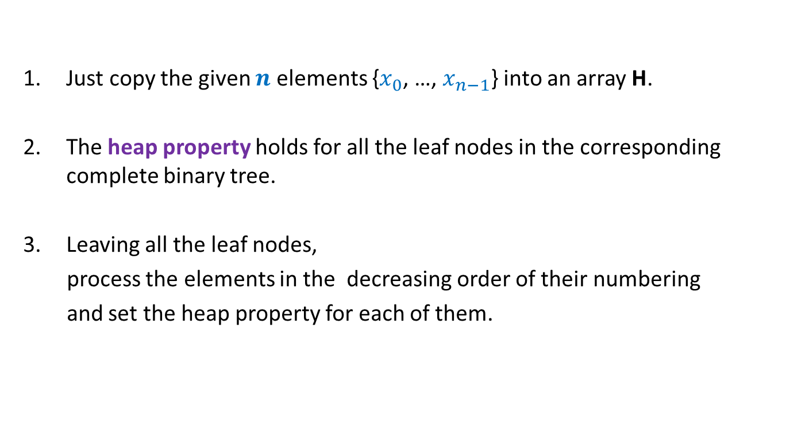
A new approach to build binary heap
Just copy the given $n$ elements {$x_{0}$, …, $x_{n−1}$} into an array H.
The heap property holds for all the leaf nodes in the corresponding complete binary tree.
Leaving all the leaf nodes,
process the elements in the decreasing order of their numbering
and set the heap property for each of them.

Slide 11
A new approach to build binary heap
98
14
33
37
11
52
32
85
17
25
88
41
21
29
76
The first node to be processed.
47
75
9
57
23
H
98 14 33 37 11 52 32 85 17 25 88 41 21 29 76 47 75 9 57 23

Slide 12
A new approach to build binary heap
98
14
33
37
11
52
32
85
17
23
88
41
21
29
76
The second node to be processed.
47
75
9
57
25
H
98 14 33 37 11 52 32 85 17 23 88 41 21 29 76 47 75 9 57 25

Slide 13
A new approach to build binary heap
98
14
33
37
11
52
32
85
9
23
88
41
21
29
76
The third node to be processed.
47
75
17
57
25
H
98 14 33 37 11 52 32 85 9 23 88 41 21 29 76 47 75 17 57 25

Slide 14
A new approach to build binary heap
98
14
33
37
11
52
32
47
9
23
88
41
21
29
76
85
75
17
57
25
H
98 14 33 37 11 52 32 47 9 23 88 41 21 29 76 85 75 17 57 25

Slide 15
A new approach to build binary heap
98
v
54
21
9
11
33
29
47
17
23
88
41
52
32
76
85
75
37
57
25
H
98 54 21 9 11 33 29 47 17 23 88 41 52 32 76 85 75 37 57 25

Slide 16
A new approach to build binary heap
98
v
9
21
54
11
33
29
47
17
23
88
41
52
32
76
85
75
37
57
25
H
98 54 21 9 11 33 29 47 17 23 88 41 52 32 76 85 75 37 57 25

Slide 17
A new approach to build binary heap
98
v
9
21
17
11
33
29
47
54
23
88
41
52
32
76
85
75
37
57
25
H
98 54 21 9 11 33 29 47 17 23 88 41 52 32 76 85 75 37 57 25

Slide 18
A new approach to build binary heap
98
v
9
21
17
11
33
29
47
37
23
88
41
52
32
76
85
75
54
57
25
H
98 54 21 9 11 33 29 47 17 23 88 41 52 32 76 85 75 37 57 25
Let v be a node corresponding to index i in H.
The process of restoring heap property at i called Heapify(i,H).

Slide 19
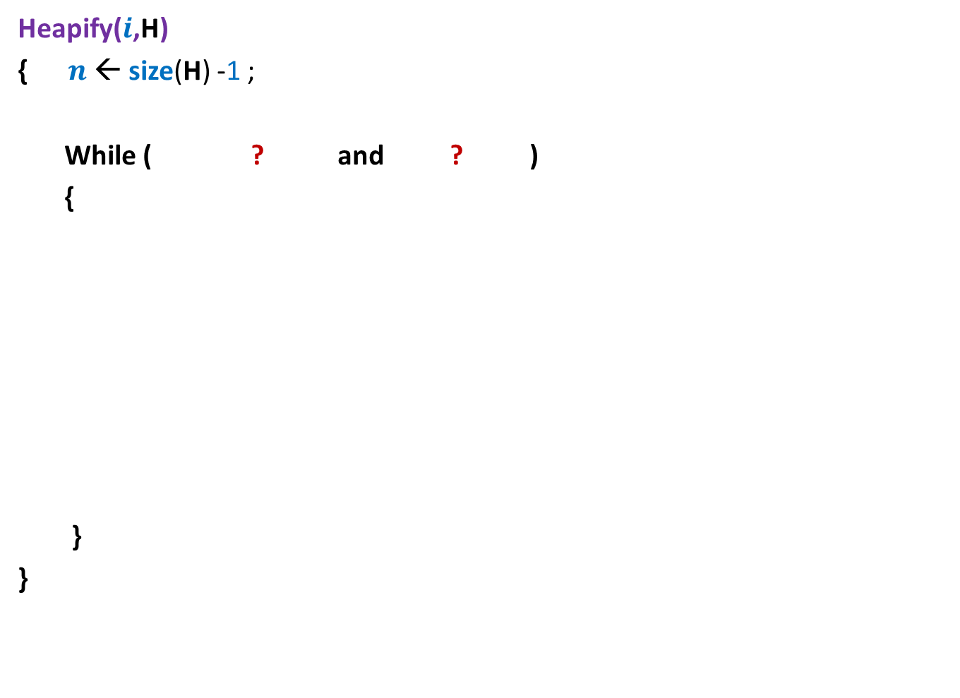

Heapify($i$,H)
Heapify($i$,H)
{ $n$← size(H) -1 ;
While ( ? and ? )
{
}
}
For node $i$, compare its value with those of its children
If it is smaller than any of its children
Swap it with smallest child
and move down …
Else stop !

Slide 20

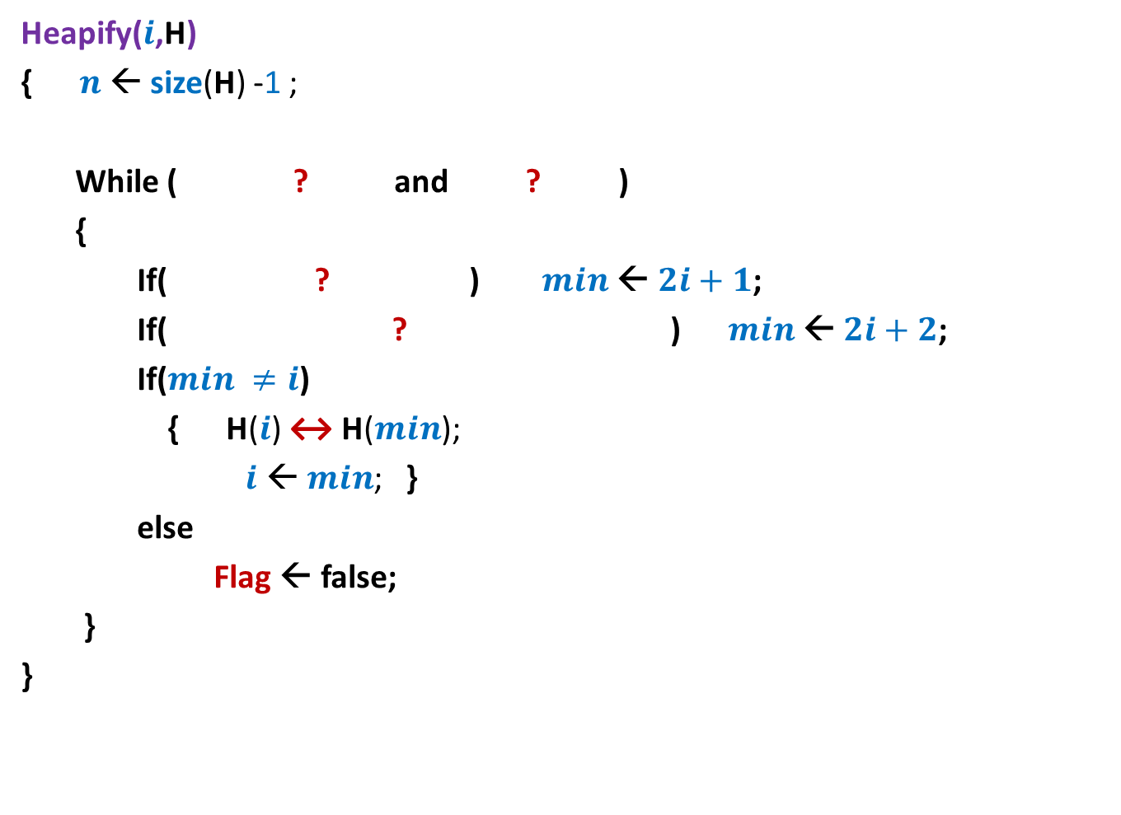



Heapify($i$,H)
Heapify($i$,H)
{ $n$← size(H) -1 ;
While ( ? and ? )
{
If( ? ) $min$← $2i+1$;
If( ? ) $min$← $2i+2$;
If($min ≠i$)
{ H($i$) ↔ H($min$);
$i$ ← $min$; }
else
Flag ← false;
}
}
Flag ← true;
$i$ ≤ $\left\lfloor (n\text{−}1)/2\right\rfloor$
Flag = true
$min$← $i$;
H[$i$]>H[$2i+1$]
$2i+2$≤ $n$ and H[$min$]>H[$2i+2$]

Slide 21


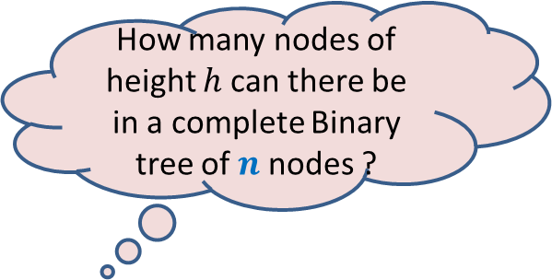
Building Binary heap in O(n) time
How many nodes of height $h$ can there be in a complete Binary tree of $n$ nodes ?
Time complexity of algorithm = ?
98
Time to heapify node v ?
v
54
21
9
11
33
29
Height(v)
47
17
23
88
41
52
32
76
85
75
37
57
25
H
98 54 21 9 11 33 29 47 17 23 88 41 52 32 76 85 75 37 57 25
$$\sum_{h}{O(h) ∙N(h)}$$
No. of nodes of height $h$

Slide 22
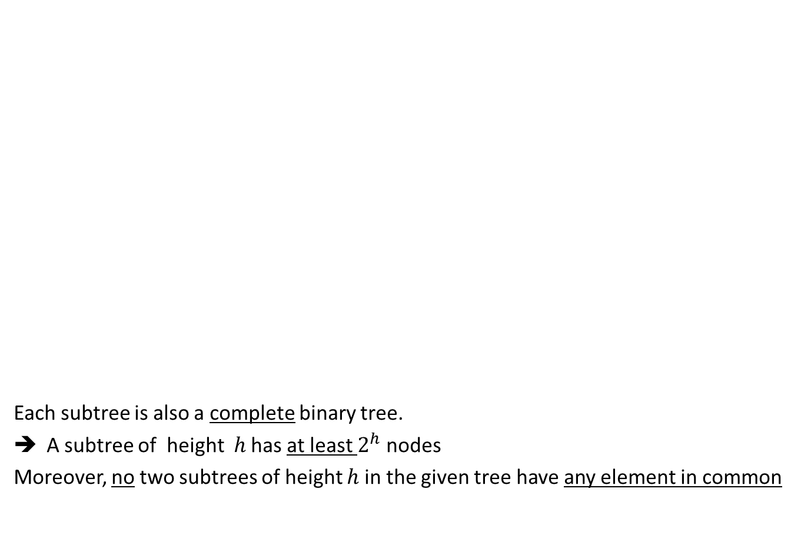
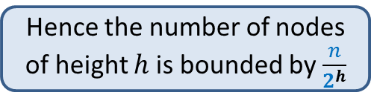
A complete binary tree
How many nodes of height $h$ can there be in a complete Binary tree of $n$ nodes ?
Hence the number of nodes of height $h$ is bounded by $\frac{n}{2^{h}}$
Each subtree is also a complete binary tree.
A subtree of height $h$ has at least $2^{h}$ nodes
Moreover, no two subtrees of height $h$ in the given tree have any element in common

Slide 23
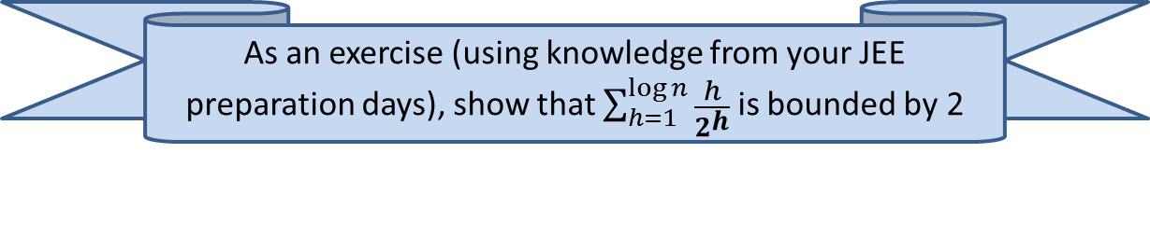

Building Binary heap in O(n) time
Lemma: the number of nodes of height $h$is bounded by $\frac{n}{2^{h}}$ .
Hence Time complexity to build the heap = $\sum_{h=1}^{\log{n}}{\frac{n}{2^{h}} O(h)}$
= $n c \sum_{i=1}^{\log{n}}{\frac{h}{2^{h}}}$
= O($n$)
As an exercise (using knowledge from your JEE preparation days), show that $\sum_{h=1}^{\log{n}}{\frac{h}{2^{h}}}$ is bounded by 2

Slide 24
Sorting using a Binary heap

Slide 25
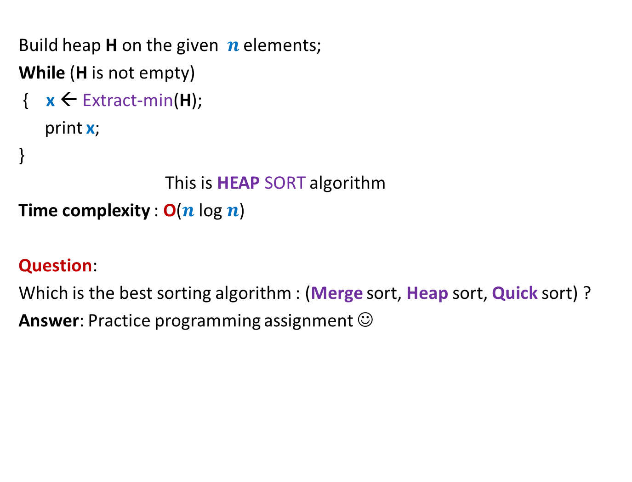
Sorting using heap
Build heap H on the given $n$ elements;
While (H is not empty)
{ x ← Extract-min(H);
print x;
}
This is HEAP SORT algorithm
Time complexity : O($n$ log $n$)
Question:
Which is the best sorting algorithm : (Merge sort, Heap sort, Quick sort) ?
Answer: Practice programming assignment ☺

Slide 26
Binary trees: beyond searching and sorting
Elegant solution for two interesting problem
An important lesson:
Lack of proper understanding of a problem is a big hurdle to solve the problem

Slide 27
Two interesting problems on sequences

Slide 28

What is a sequence ?
A sequence S = ${≺x}_{0}$, …, $x_{n−1}≻$
Can be viewed as a mapping from [0, $n$].
Order does matter.

Slide 29
Problem 1
Multi-increment

Slide 30
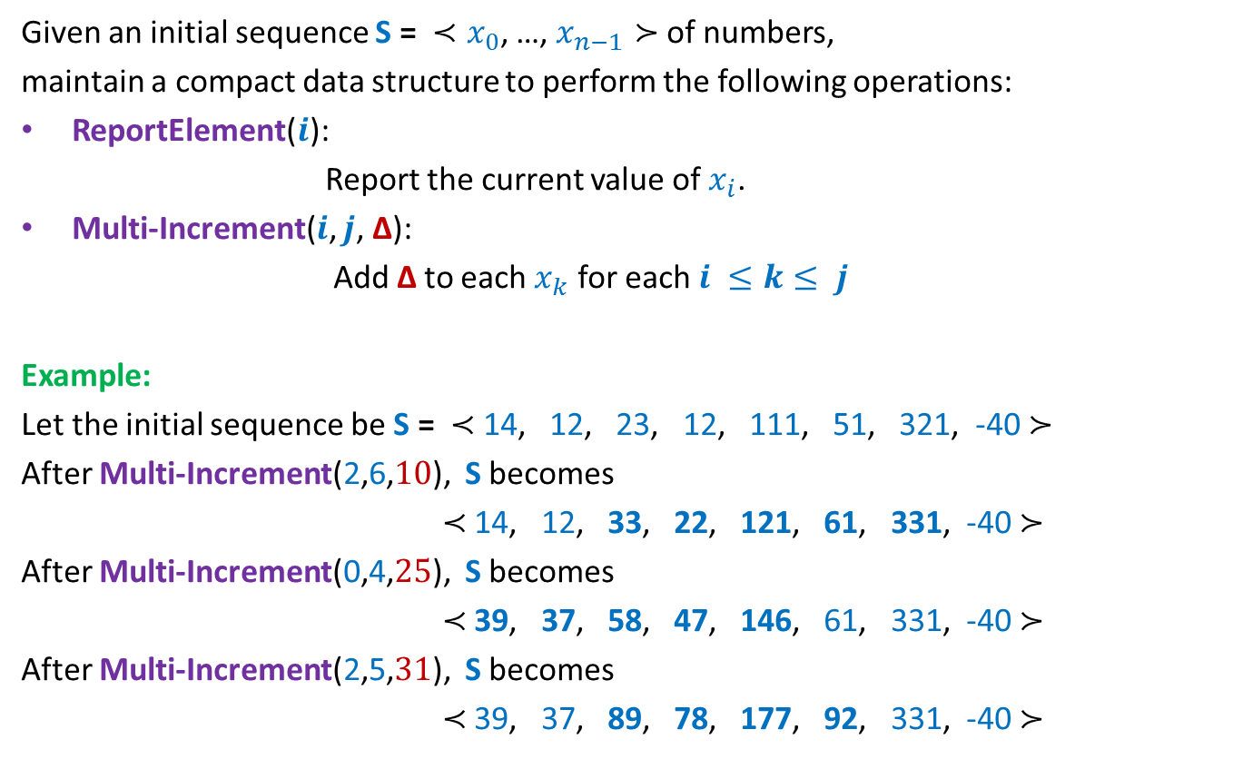
Problem 1
Given an initial sequence S = ${≺x}_{0}$, …, $x_{n−1}≻$ of numbers,
maintain a compact data structure to perform the following operations:
ReportElement($i$):
Report the current value of$x_{i}$.
Multi-Increment($i$, $j$, ∆):
Add ∆ to each $x_{k}$ for each $i ≤k≤ j$
Example:
Let the initial sequence be S = $≺$ 14, 12, 23, 12, 111, 51, 321, -40 $≻$
After Multi-Increment(2,6,$10$), S becomes
$≺$ 14, 12, 33, 22, 121, 61, 331, -40 $≻$
After Multi-Increment(0,4,$25$), S becomes
$≺$ 39, 37, 58, 47, 146, 61, 331, -40 $≻$
After Multi-Increment(2,5,$31$), S becomes
$≺$ 39, 37, 89, 78, 177, 92, 331, -40 $≻$

Slide 31

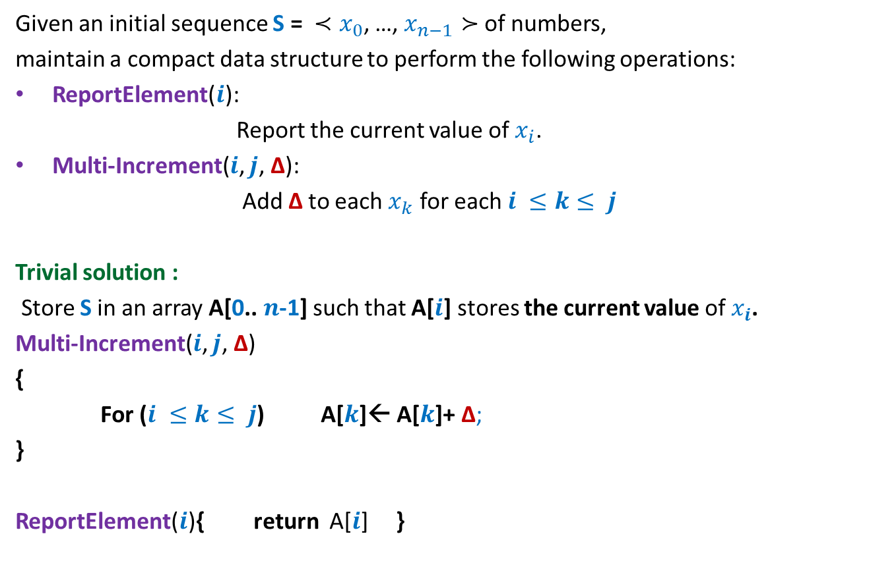

Problem 1
Given an initial sequence S = ${≺x}_{0}$, …, $x_{n−1}≻$ of numbers,
maintain a compact data structure to perform the following operations:
ReportElement($i$):
Report the current value of$x_{i}$.
Multi-Increment($i$, $j$, ∆):
Add ∆ to each $x_{k}$ for each $i ≤k≤ j$
Trivial solution :
Store S in an array A[0.. $n$-1] such that A[$i$] stores the current value of $x_{i}$.
Multi-Increment($i$, $j$, ∆)
{
For ($i ≤k≤ j$) A[$k$]← A[$k$]+ ∆;
}
ReportElement($i$){ return A[$i$] }
O($j−i$) = O($n$)
O($1$)

Slide 32
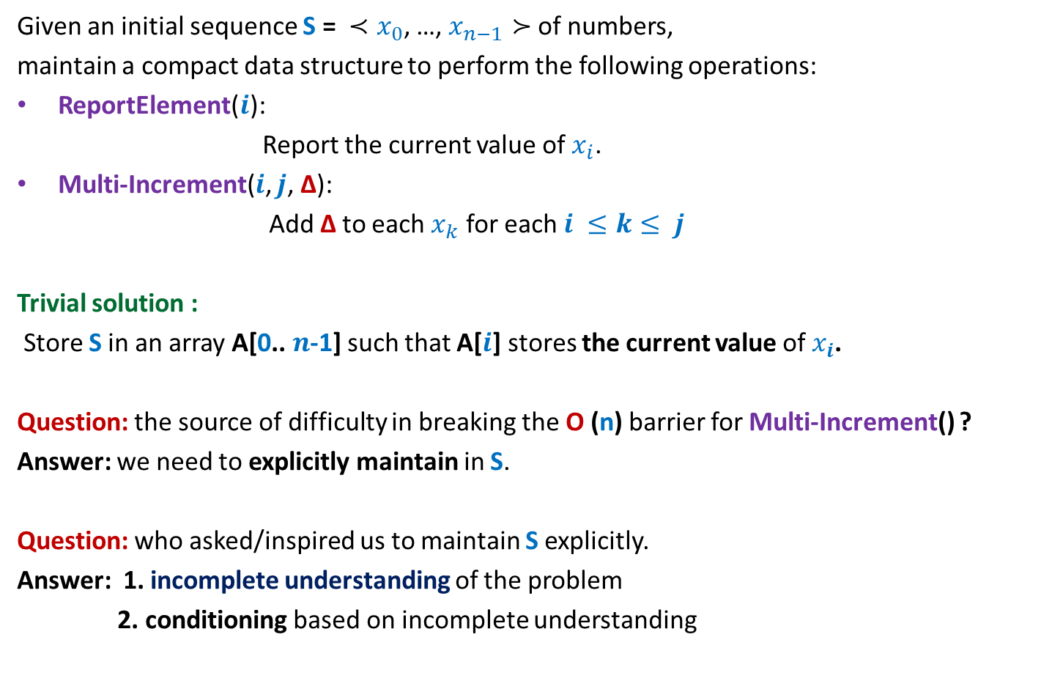
Problem 1
Given an initial sequence S = ${≺x}_{0}$, …, $x_{n−1}≻$ of numbers,
maintain a compact data structure to perform the following operations:
ReportElement($i$):
Report the current value of$x_{i}$.
Multi-Increment($i$, $j$, ∆):
Add ∆ to each $x_{k}$ for each $i ≤k≤ j$
Trivial solution :
Store S in an array A[0.. $n$-1] such that A[$i$] stores the current value of $x_{i}$.
Question: the source of difficulty in breaking the O (n) barrier for Multi-Increment() ?
Answer: we need to explicitly maintain in S.
Question: who asked/inspired us to maintain S explicitly.
Answer: 1. incomplete understanding of the problem
2. conditioning based on incomplete understanding

Slide 33
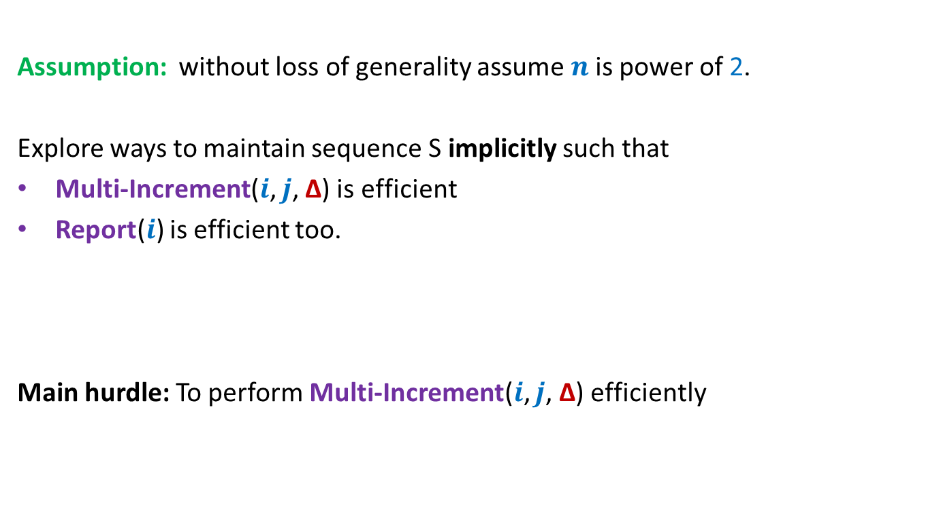
Towards efficient solution of Problem 1
Assumption: without loss of generality assume $n$is power of 2.
Explore ways to maintain sequence S implicitly such that
Multi-Increment($i$, $j$, ∆) is efficient
Report($i$) is efficient too.
Main hurdle: To perform Multi-Increment($i$, $j$, ∆) efficiently

Slide 34
Problem 2
Dynamic Range-minima

Slide 35
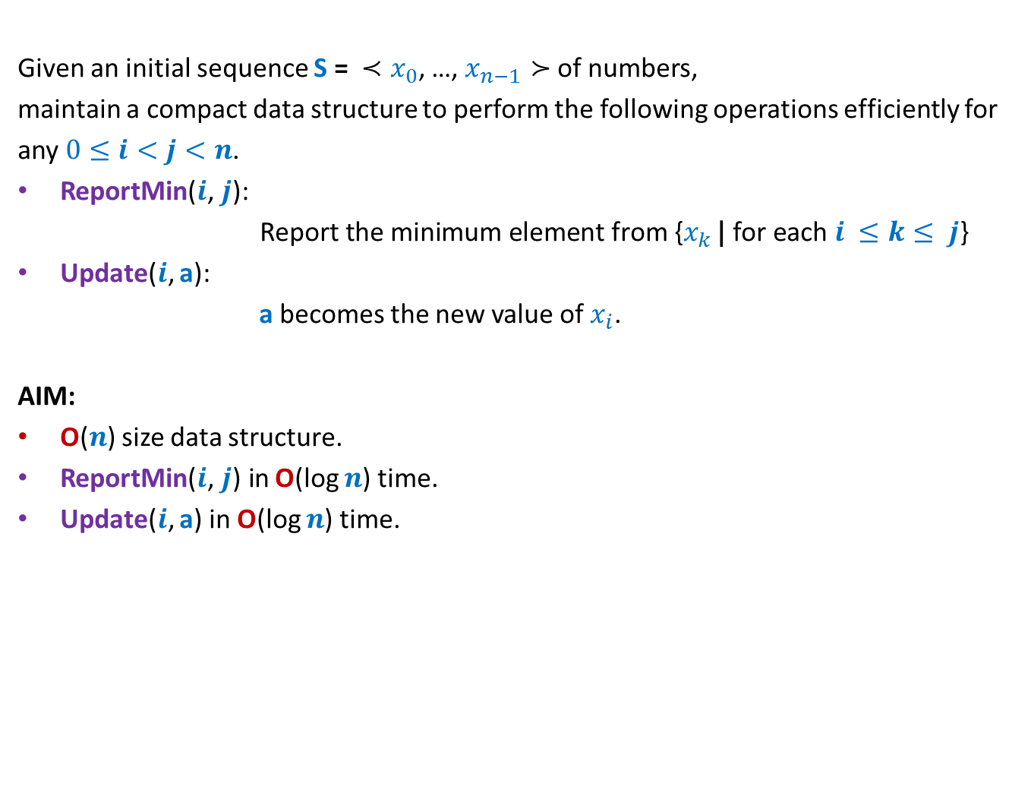
Problem 2
Given an initial sequence S = ${≺x}_{0}$, …, $x_{n−1}≻$ of numbers,
maintain a compact data structure to perform the following operations efficiently for
any $0≤i<j<n$.
ReportMin($i\text{,} j\text{): }$
$\text{Report} \text{the} \text{minimum} \text{element} \text{from} \text{\{}x_{k }\text{|} \text{for} \text{each} i ≤k≤ j$}
Update($i$, a):
a becomes the new value of $x_{i}$.
AIM:
O($n$) size data structure.
ReportMin($i\text{,} j\text{)} \text{in}$O(log $n$) time.
Update($i$, a) in O(log $n$) time.
All data structure lovers must ponder over these two problems ☺.
We shall discuss them in the next class.

