Slide 1
Data Structures and Algorithms (CS210A) Semester I – 2014-15
Lecture 30
Binary Trees
Magical applications

Slide 2
Two interesting problems on sequences

Slide 3
Problem 1
Multi-increment

Slide 4
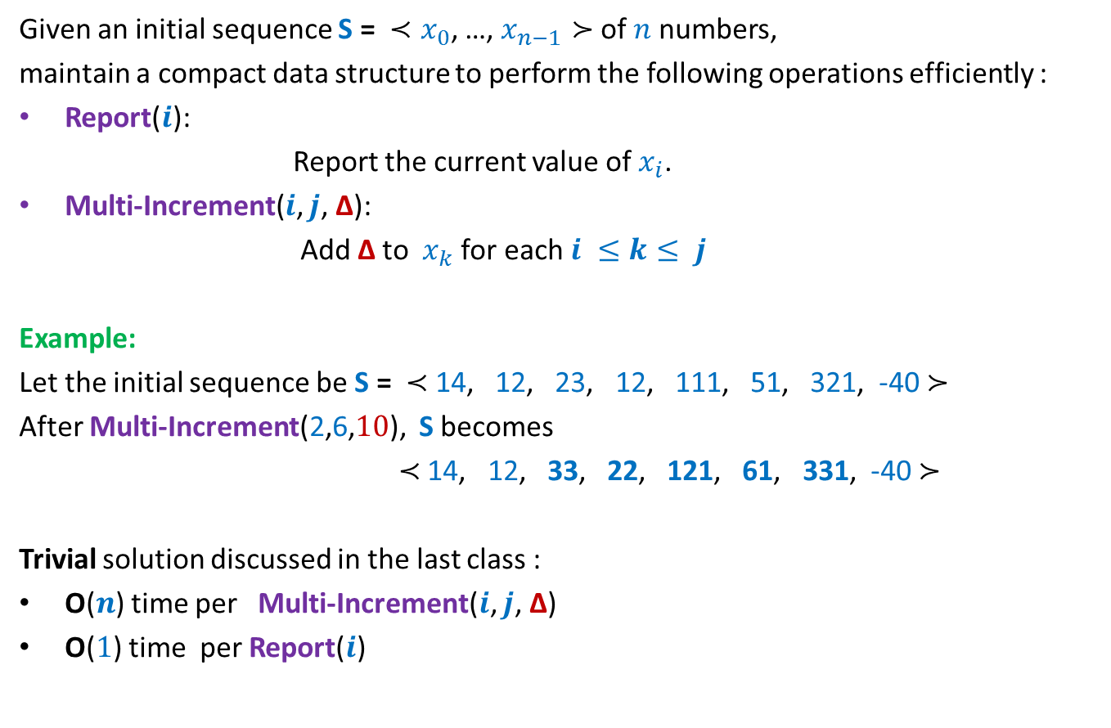
Problem 1
Given an initial sequence S = ${≺x}_{0}$, …, $x_{n−1}≻$ of $n$numbers,
maintain a compact data structure to perform the following operations efficiently :
Report($i$):
Report the current value of$x_{i}$.
Multi-Increment($i$, $j$, ∆):
Add ∆ to $x_{k}$ for each $i ≤k≤ j$
Example:
Let the initial sequence be S = $≺$ 14, 12, 23, 12, 111, 51, 321, -40 $≻$
After Multi-Increment(2,6,$10$), S becomes
$≺$ 14, 12, 33, 22, 121, 61, 331, -40 $≻$
Trivial solution discussed in the last class :
O($n$) time per Multi-Increment($i$, $j$, ∆)
O($1$) time per Report($i$)

Slide 5
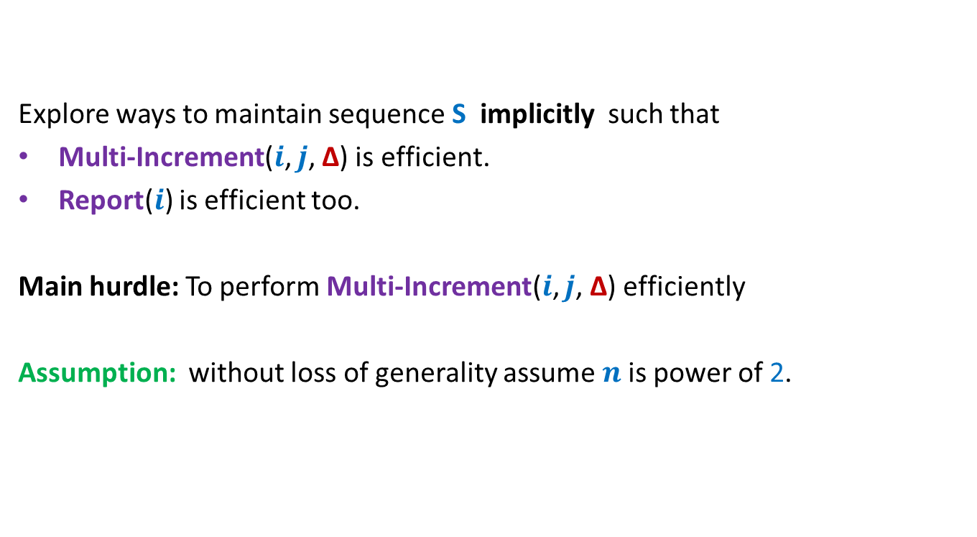
Towards efficient solution of Problem 1
Explore ways to maintain sequence S implicitly such that
Multi-Increment($i$, $j$, ∆) is efficient.
Report($i$) is efficient too.
Main hurdle: To perform Multi-Increment($i$, $j$, ∆) efficiently
Assumption: without loss of generality assume $n$is power of 2.

Slide 6
A systematic Journey to the solution

Slide 7
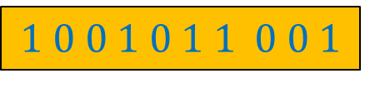

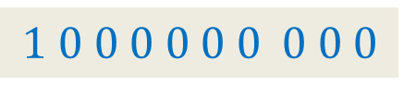

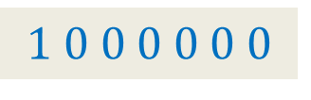
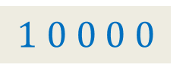

A motivating problem
S = {$1,2,3,…,2^{n}$}
Question:
Can we have a small set X$⊂$S of numbers s.t.
Every number from S can be expressed
Answer: X = {$1,2,4,8,…,2^{n}$}
|X|= $n$
as a sum
of a few numbers from X ?
$$1 0 0 0 0 0 0 0 0 0$$
If it is too trivial, try to answer the problem of next slide.☺
$$1 0 0 0 0 0 0$$
$$1 0 0 0 0$$
$$1 0 0 0$$
$$1$$
$$1 0 0 1 0 1 1 0 0 1$$

Slide 8

Extension to intervals
S = {[$i$, $j$], $0≤i≤j<n$}
Question:
Can we have a small set X$⊂$S of intervals s.t.
every interval in S can be expressed
as a union
of a few intervals from X ?
$\left[0,0\right] \left[1,1\right] \left[2,2\right] \left[3,3\right] \left[4,4\right] \left[5,5\right] \left[6,6\right] \left[7,7\right] \left[8,8\right] \left[9,9\right] …………………………………. [15,15]$
${ x}_{0}$ ${ x}_{1}{ x}_{2 }x_{3}$ $x_{4}{ x}_{5}$ ${ x}_{6}$ ${ x}_{7}{ x}_{8 }x_{9}$ $x_{10}{ x}_{11}$ ${ x}_{12}$ ${ x}_{13}{ x}_{14 }x_{15}$

Slide 9



Extension to intervals
$$[0,15]$$
$$[8,15]$$
$$[0,7]$$
Get inspiration from
the previous problem
$\left[0,3\right] [4,7]$ $\left[8,11\right] [12,15]$
$\left[0,1\right] \left[2,3\right] \left[4,5\right] \left[6,7\right] \left[8,9\right] \left[10,11\right] \left[12,13\right] [14,15]$
$\left[0,0\right] \left[1,1\right] \left[2,2\right] \left[3,3\right] \left[4,4\right] \left[5,5\right] \left[6,6\right] \left[7,7\right] \left[8,8\right] \left[9,9\right] …………………………………. [15,15]$
${ x}_{0}$ ${ x}_{1}{ x}_{2 }x_{3}$ $x_{4}{ x}_{5}$ ${ x}_{6}$ ${ x}_{7}{ x}_{8 }x_{9}$ $x_{10}{ x}_{11}$ ${ x}_{12}$ ${ x}_{13}{ x}_{14 }x_{15}$
How to express [0, 12] ?

Slide 10
Extension to intervals
$$[0,15]$$
$$[0,7]$$
$$[8,15]$$
$\left[0,3\right] [4,7]$ $\left[8,11\right] [12,15]$
$\left[0,1\right] \left[2,3\right] \left[4,5\right] \left[6,7\right] \left[8,9\right] \left[10,11\right] \left[12,13\right] [14,15]$
$\left[0,0\right] \left[1,1\right] \left[2,2\right] \left[3,3\right] \left[4,4\right] \left[5,5\right] \left[6,6\right] \left[7,7\right] \left[8,8\right] \left[9,9\right] …………………………………. [15,15]$
${ x}_{0}$ ${ x}_{1}{ x}_{2 }x_{3}$ $x_{4}{ x}_{5}$ ${ x}_{6}$ ${ x}_{7}{ x}_{8 }x_{9}$ $x_{10}{ x}_{11}$ ${ x}_{12}$ ${ x}_{13}{ x}_{14 }x_{15}$
How to express [0, 12] ?

Slide 11
Extension to intervals
$$[0,15]$$
$$[0,7]$$
$$[8,15]$$
$\left[0,3\right] [4,7]$ $\left[8,11\right] [12,15]$
c
$\left[0,1\right] \left[2,3\right] \left[4,5\right] \left[6,7\right] \left[8,9\right] \left[10,11\right] \left[12,13\right] [14,15]$
$\left[0,0\right] \left[1,1\right] \left[2,2\right] \left[3,3\right] \left[4,4\right] \left[5,5\right] \left[6,6\right] \left[7,7\right] \left[8,8\right] \left[9,9\right] …………………………………. [15,15]$
${ x}_{0}$ ${ x}_{1}{ x}_{2 }x_{3}$ $x_{4}{ x}_{5}$ ${ x}_{6}$ ${ x}_{7}{ x}_{8 }x_{9}$ $x_{10}{ x}_{11}$ ${ x}_{12}$ ${ x}_{13}{ x}_{14 }x_{15}$
How to express [0, 12] ?

Slide 12
Extension to intervals
$$[0,15]$$
$$[0,7]$$
$$[8,15]$$
$\left[0,3\right] [4,7]$ $\left[8,11\right] [12,15]$
$\left[0,1\right] \left[2,3\right] \left[4,5\right] \left[6,7\right] \left[8,9\right] \left[10,11\right] \left[12,13\right] [14,15]$
$\left[0,0\right] \left[1,1\right] \left[2,2\right] \left[3,3\right] \left[4,4\right] \left[5,5\right] \left[6,6\right] \left[7,7\right] \left[8,8\right] \left[9,9\right] …………………………………. [15,15]$
${ x}_{0}$ ${ x}_{1}{ x}_{2 }x_{3}$ $x_{4}{ x}_{5}$ ${ x}_{6}$ ${ x}_{7}{ x}_{8 }x_{9}$ $x_{10}{ x}_{11}$ ${ x}_{12}$ ${ x}_{13}{ x}_{14 }x_{15}$
How to express [3, 11] ?

Slide 13




Extension to intervals
How to use this Observation to perform
Multi-Increment($i$, $j$, ∆) efficiently?
$$[0,15]$$
Observation:
There are $2n$intervals such that
any interval [$i$, $j$] can be expressed
$$[0,7]$$
$$[8,15]$$
$\left[0,3\right] [4,7]$ $\left[8,11\right] [12,15]$
$\left[0,1\right] \left[2,3\right] \left[4,5\right] \left[6,7\right] \left[8,9\right] \left[10,11\right] \left[12,13\right] [14,15]$
$\left[0,0\right] \left[1,1\right] \left[2,2\right] \left[3,3\right] \left[4,4\right] \left[5,5\right] \left[6,6\right] \left[7,7\right] \left[8,8\right] \left[9,9\right] …………………………………. [15,15]$
${ x}_{0}$ ${ x}_{1}{ x}_{2 }x_{3}$ $x_{4}{ x}_{5}$ ${ x}_{6}$ ${ x}_{7}{ x}_{8 }x_{9}$ $x_{10}{ x}_{11}$ ${ x}_{12}$ ${ x}_{13}{ x}_{14 }x_{15}$
as union of O(log $n$) basic intervals ☺

Slide 14


Extension to intervals
How to use this Observation to perform
Multi-Increment($i$, $j$, ∆) efficiently?
$$[0,15]$$
Maintain $2n$intervals with a field increment
Multi-Increment($i$, $j$, ∆) ➔ ?
$$[0,7]$$
$$[8,15]$$
$\left[0,3\right] [4,7]$ $\left[8,11\right] [12,15]$
$\left[0,1\right] \left[2,3\right] \left[4,5\right] \left[6,7\right] \left[8,9\right] \left[10,11\right] \left[12,13\right] [14,15]$
$\left[0,0\right] \left[1,1\right] \left[2,2\right] \left[3,3\right] \left[4,4\right] \left[5,5\right] \left[6,6\right] \left[7,7\right] \left[8,8\right] \left[9,9\right] …………………………………. [15,15]$
${ x}_{0}$ ${ x}_{1}{ x}_{2 }x_{3}$ $x_{4}{ x}_{5}$ ${ x}_{6}$ ${ x}_{7}{ x}_{8 }x_{9}$ $x_{10}{ x}_{11}$ ${ x}_{12}$ ${ x}_{13}{ x}_{14 }x_{15}$
add ∆ to increment field of its O(log $n$) intervals.

Slide 15
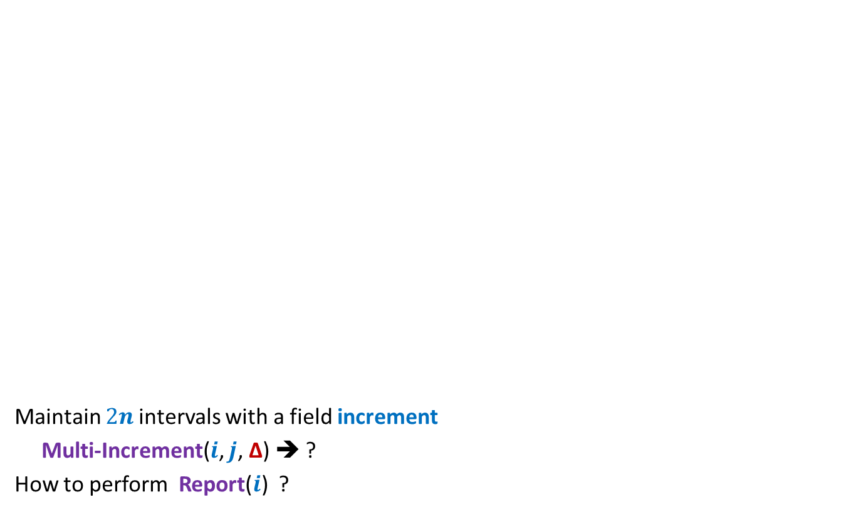
Extension to intervals
How to use this Observation to perform
Multi-Increment($i$, $j$, ∆) efficiently?
$$[0,15]$$
Maintain $2n$intervals with a field increment
Multi-Increment($i$, $j$, ∆) ➔ ?
How to perform Report($i$) ?
$$[0,7]$$
$$[8,15]$$
$\left[0,3\right] [4,7]$ $\left[8,11\right] [12,15]$
$\left[0,1\right] \left[2,3\right] \left[4,5\right] \left[6,7\right] \left[8,9\right] \left[10,11\right] \left[12,13\right] [14,15]$
$\left[0,0\right] \left[1,1\right] \left[2,2\right] \left[3,3\right] \left[4,4\right] \left[5,5\right] \left[6,6\right] \left[7,7\right] \left[8,8\right] \left[9,9\right] …………………………………. [15,15]$
${ x}_{0}$ ${ x}_{1}{ x}_{2 }x_{3}$ $x_{4}{ x}_{5}$ ${ x}_{6}$ ${ x}_{7}{ x}_{8 }x_{9}$ $x_{10}{ x}_{11}$ ${ x}_{12}$ ${ x}_{13}{ x}_{14 }x_{15}$
add ∆ to increment field of its O(log $n$) intervals.

Slide 16
Extension to intervals
How to use this Observation to perform
Multi-Increment($i$, $j$, ∆) efficiently?
$$[0,15]$$
Maintain $2n$intervals with a field increment
Multi-Increment($i$, $j$, ∆) ➔ ?
How to perform Report($i$) ?
$$[0,7]$$
$$[8,15]$$
$\left[0,3\right] [4,7]$ $\left[8,11\right] [12,15]$
$\left[0,1\right] \left[2,3\right] \left[4,5\right] \left[6,7\right] \left[8,9\right] \left[10,11\right] \left[12,13\right] [14,15]$
$\left[0,0\right] \left[1,1\right] \left[2,2\right] \left[3,3\right] \left[4,4\right] \left[5,5\right] \left[6,6\right] \left[7,7\right] \left[8,8\right] \left[9,9\right] …………………………………. [15,15]$
${ x}_{0}$ ${ x}_{1}{ x}_{2 }x_{3}$ $x_{4}{ x}_{5}$ ${ x}_{6}$ ${ x}_{7}{ x}_{8 }x_{9}$ $x_{10}{ x}_{11}$ ${ x}_{12}$ ${ x}_{13}{ x}_{14 }x_{15}$
add ∆ to increment field of its O(log $n$) intervals.

Slide 17
You might like to have another look on the last slide to answer this question.
I have reproduced it for you again in the next slide
Have another look,
think for a while …
and then only proceed.
What data structure to use ?

Slide 18
Which data structure emerges ?
$$[0,15]$$
$$[0,7]$$
$$[8,15]$$
$\left[0,3\right] [4,7]$ $\left[8,11\right] [12,15]$
$\left[0,1\right] \left[2,3\right] \left[4,5\right] \left[6,7\right] \left[8,9\right] \left[10,11\right] \left[12,13\right] [14,15]$
$\left[0,0\right] \left[1,1\right] \left[2,2\right] \left[3,3\right] \left[4,4\right] \left[5,5\right] \left[6,6\right] \left[7,7\right] \left[8,8\right] \left[9,9\right] …………………………………. [15,15]$
${ x}_{0}$ ${ x}_{1}{ x}_{2 }x_{3}$ $x_{4}{ x}_{5}$ ${ x}_{6}$ ${ x}_{7}{ x}_{8 }x_{9}$ $x_{10}{ x}_{11}$ ${ x}_{12}$ ${ x}_{13}{ x}_{14 }x_{15}$

Slide 19
Isn’t it a Binary tree that you thought ?
$$[0,15]$$
How to do Multi-Increment(3,11,10) ?
0
$$[0,7]$$
$$[8,15]$$
0 0
$\left[0,3\right] [4,7]$ $\left[8,11\right] [12,15]$
0 0 0 0
$$\left[0,1\right] \left[2,3\right] \left[4,5\right] \left[6,7\right] \left[8,9\right] \left[10,11\right] \left[12,13\right] [14,15]$$
0 0 0 0 0 0 0 0
Initial
sequence
4 14 9 17 23 21 29 91 37 25 8 33 2 67 11 44
${ x}_{0}$ ${ x}_{1}{ x}_{2 }x_{3}$ $x_{4}{ x}_{5}$ ${ x}_{6}$ ${ x}_{7}{ x}_{8 }x_{9}$ $x_{10}{ x}_{11}$ ${ x}_{12}$ ${ x}_{13}{ x}_{14 }x_{15}$
What value should you keep in leaf nodes initially ?
What value should you keep in internal nodes initially ?

Slide 20
$$[0,15]$$
How to do Multi-Increment(3,11,10) ?
0
$$[0,7]$$
$$[8,15]$$
0 0
$\left[0,3\right] [4,7]$ $\left[8,11\right] [12,15]$
0 0 0 0
$$\left[0,1\right] \left[2,3\right] \left[4,5\right] \left[6,7\right] \left[8,9\right] \left[10,11\right] \left[12,13\right] [14,15]$$
0 0 0 0 0 0 0 0
+10
4 14 9 27 23 21 29 91 37 25 8 43 2 67 11 44
${ x}_{0}$ ${ x}_{1}{ x}_{2 }x_{3}$ $x_{4}{ x}_{5}$ ${ x}_{6}$ ${ x}_{7}{ x}_{8 }x_{9}$ $x_{10}{ x}_{11}$ ${ x}_{12}$ ${ x}_{13}{ x}_{14 }x_{15}$

Slide 21
$$[0,15]$$
How to do Multi-Increment(3,11,10) ?
0
$$[0,7]$$
$$[8,15]$$
0 0
$\left[0,3\right] [4,7]$ $\left[8,11\right] [12,15]$
0 0 0 0
$$\left[0,1\right] \left[2,3\right] \left[4,5\right] \left[6,7\right] \left[8,9\right] \left[10,11\right] \left[12,13\right] [14,15]$$
0 0 0 0 0 0 0 0
+10
4 14 9 27 23 21 29 91 37 25 18 43 2 67 11 44
${ x}_{0}$ ${ x}_{1}{ x}_{2 }x_{3}$ $x_{4}{ x}_{5}$ ${ x}_{6}$ ${ x}_{7}{ x}_{8 }x_{9}$ $x_{10}{ x}_{11}$ ${ x}_{12}$ ${ x}_{13}{ x}_{14 }x_{15}$

Slide 22
$$[0,15]$$
How to do Multi-Increment(3,11,10) ?
0
$$[0,7]$$
$$[8,15]$$
0 0
$\left[0,3\right] [4,7]$ $\left[8,11\right] [12,15]$
0 0 0 0
+10
$$\left[0,1\right] \left[2,3\right] \left[4,5\right] \left[6,7\right] \left[8,9\right] \left[10,11\right] \left[12,13\right] [14,15]$$
0 0 0 0 10 0 0 0
4 14 9 27 23 21 29 91 37 25 18 43 2 67 11 44
${ x}_{0}$ ${ x}_{1}{ x}_{2 }x_{3}$ $x_{4}{ x}_{5}$ ${ x}_{6}$ ${ x}_{7}{ x}_{8 }x_{9}$ $x_{10}{ x}_{11}$ ${ x}_{12}$ ${ x}_{13}{ x}_{14 }x_{15}$

Slide 23
$$[0,15]$$
How to do Multi-Increment(3,11,10) ?
0
$$[0,7]$$
$$[8,15]$$
0 0
$\left[0,3\right] [4,7]$ $\left[8,11\right] [12,15]$
0 10 0 0
$$\left[0,1\right] \left[2,3\right] \left[4,5\right] \left[6,7\right] \left[8,9\right] \left[10,11\right] \left[12,13\right] [14,15]$$
0 0 0 0 10 0 0 0
4 14 9 27 23 21 29 91 37 25 18 43 2 67 11 44
${ x}_{0}$ ${ x}_{1}{ x}_{2 }x_{3}$ $x_{4}{ x}_{5}$ ${ x}_{6}$ ${ x}_{7}{ x}_{8 }x_{9}$ $x_{10}{ x}_{11}$ ${ x}_{12}$ ${ x}_{13}{ x}_{14 }x_{15}$

Slide 24
$$[0,15]$$
How to do Multi-Increment(3,11,10) ?
0
$$[0,7]$$
$$[8,15]$$
0 0
$\left[0,3\right] [4,7]$ $\left[8,11\right] [12,15]$
0 10 0 0
$$\left[0,1\right] \left[2,3\right] \left[4,5\right] \left[6,7\right] \left[8,9\right] \left[10,11\right] \left[12,13\right] [14,15]$$
0 0 0 0 10 0 0 0
4 14 9 27 23 21 29 91 37 25 18 43 2 67 11 44
${ x}_{0}$ ${ x}_{1}{ x}_{2 }x_{3}$ $x_{4}{ x}_{5}$ ${ x}_{6}$ ${ x}_{7}{ x}_{8 }x_{9}$ $x_{10}{ x}_{11}$ ${ x}_{12}$ ${ x}_{13}{ x}_{14 }x_{15}$
Are we done ?

Slide 25
$$[0,15]$$
How to do Multi-Increment(3,11,10) ?
0
$$[0,7]$$
$$[8,15]$$
0 0
$\left[0,3\right] [4,7]$ $\left[8,11\right] [12,15]$
0 10 0 0
$$\left[0,1\right] \left[2,3\right] \left[4,5\right] \left[6,7\right] \left[8,9\right] \left[10,11\right] \left[12,13\right] [14,15]$$
0 0 0 0 10 0 0 0
4 14 9 27 23 21 29 91 37 25 18 43 2 67 11 44
${ x}_{0}$ ${ x}_{1}{ x}_{2 }x_{3}$ $x_{4}{ x}_{5}$ ${ x}_{6}$ ${ x}_{7}{ x}_{8 }x_{9}$ $x_{10}{ x}_{11}$ ${ x}_{12}$ ${ x}_{13}{ x}_{14 }x_{15}$
Yes

Slide 26
$$[0,15]$$
How to do Multi-Increment(3,11,10) ?
0
$$[0,7]$$
$$[8,15]$$
0 0
$\left[0,3\right] [4,7]$ $\left[8,11\right] [12,15]$
0 10 0 0
$$\left[0,1\right] \left[2,3\right] \left[4,5\right] \left[6,7\right] \left[8,9\right] \left[10,11\right] \left[12,13\right] [14,15]$$
0 0 0 0 10 0 0 0
4 14 9 27 23 21 29 91 37 25 18 43 2 67 11 44
${ x}_{0}$ ${ x}_{1}{ x}_{2 }x_{3}$ $x_{4}{ x}_{5}$ ${ x}_{6}$ ${ x}_{7}{ x}_{8 }x_{9}$ $x_{10}{ x}_{11}$ ${ x}_{12}$ ${ x}_{13}{ x}_{14 }x_{15}$
What path was followed ?

Slide 27
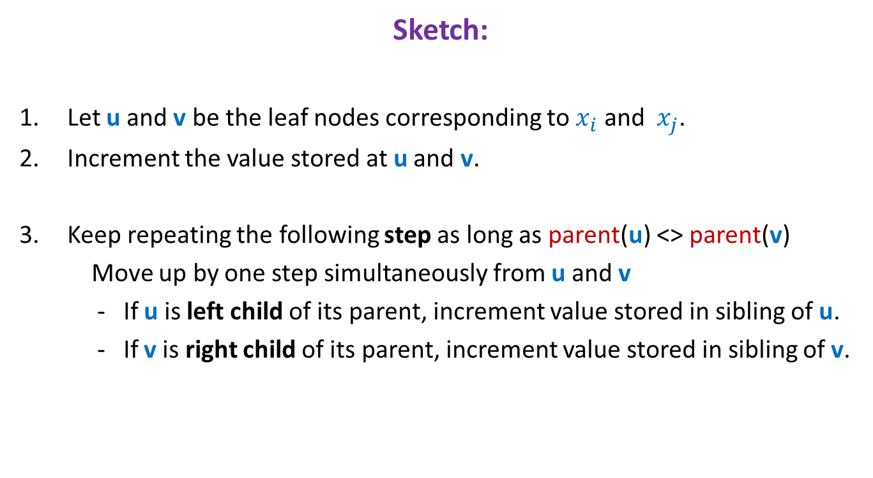

Multi-Increment($i$, $j$, ∆) efficiently
Sketch:
Let u and v be the leaf nodes corresponding to $x_{i}$ and ${ x}_{j}$.
Increment the value stored at u and v.
Keep repeating the following step as long as parent(u) <> parent(v)
Move up by one step simultaneously from u and v
- If u is left child of its parent, increment value stored in sibling of u.
- If v is right child of its parent, increment value stored in sibling of v.

Slide 28


Executing Report($i$) efficiently
Sketch:
Let u be the leaf nodes corresponding to $x_{i}$.
val ← 0;
Keep moving up from u and keep adding the value of all the nodes on the path to the root to val.
Return val.
What is an efficient implementation of the tree data structure for these two algorithms?
Realize that it was a complete binary tree.

Slide 29



Exploiting complete binary tree structure
0
Data structure: An array A of size 2n-1.
Copy the sequence S = ${≺x}_{0}$, …, $x_{n−1}≻$ into ??
Leaf node corresponding to $x_{i}$= ??
How to check if a node is
(if index of the node is odd, then the node is left child, else the node is right child)
1 2
3 4 5 6
7 8 9 10 11 12 13 14
15 16 17 18 19 20 21 22 23 24 25 26 27 28 29 30
A[$n−1$]…A[$2n−2$]
A[($n−1)+i$]
left child or right child of its parent ?

Slide 30

Exploiting complete binary tree structure
0
Data structure: An array A of size 2n-1.
Copy the sequence S = ${≺x}_{0}$, …, $x_{n−1}≻$ into ??
Leaf node corresponding to $x_{i}$= ??
How to check if a node is
1 2
3 4 5 6
7 8 9 10 11 12 13 14
15 16 17 18 19 20 21 22 23 24 25 26 27 28 29 30
A[$n−1$]…A[$2n−2$]
A[($n−1)+i$]
left child or right child of its parent ?

Slide 31

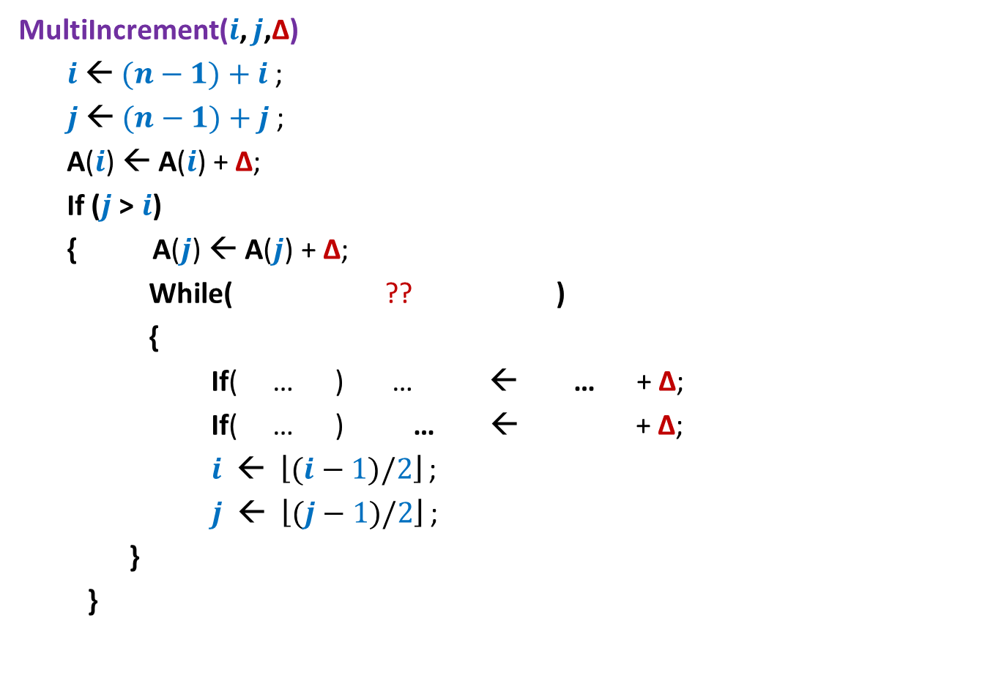







MultiIncrement($i$, $j$, ∆)
MultiIncrement($i$, $j$,∆)
$i$← $(n−1)+i$;
$j$← $(n−1)+j$;
A($i$) ← A($i$) + ∆;
If ($j$> $i$)
{ A($j$) ← A($j$) + ∆;
While( ?? )
{
If( … ) … ← … + ∆;
If( … ) … ← + ∆;
$i$ ← $\left\lfloor (i−1)/2\right\rfloor$ ;
$j$ ← $\left\lfloor (j−1)/2\right\rfloor$ ;
}
}
$\left\lfloor (i−1)/2\right\rfloor$ <> $\left\lfloor (j−1)/2\right\rfloor$
$i$%2=1
A($i+1$)
A($i+1$)
$j$%2=0
A($j−1$)
A($j−1$)

Slide 32



Report($i$)
Report($i$)
$i$← $(n−1)+i$;
val ← 0;
While( ?? )
{
val ← val + A[$i$];
$i$ ← $\left\lfloor (i−1)/2\right\rfloor$ ;
}
return val;
$i$> 0

Slide 33

The solution of Multi-Increment Problem
Theorem:
There exists a data structure of size O($n$)
for maintaining a sequence S = ${≺x}_{0}$, …, $x_{n−1}≻$ such that
each Multi-Increment() and Report() operation takes O(log $n$) time.

Slide 34
Problem 2
Dynamic Range-minima

Slide 35
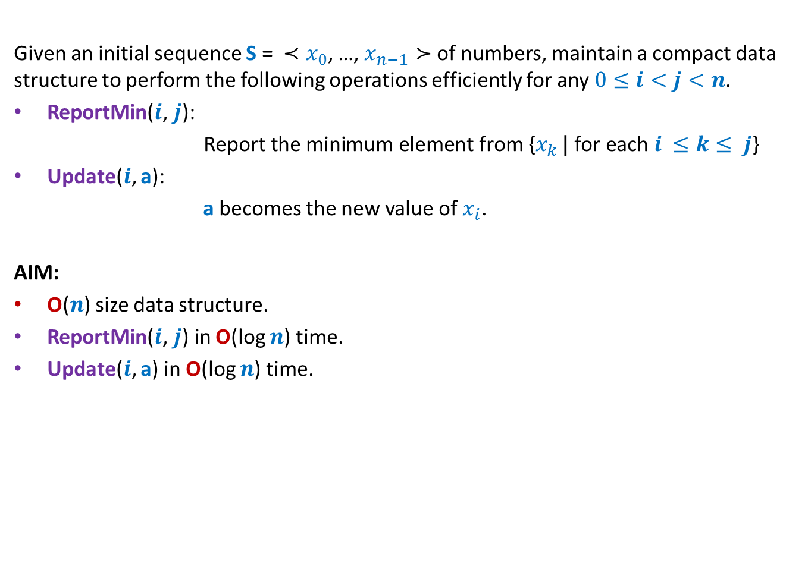
Problem 2
Given an initial sequence S = ${≺x}_{0}$, …, $x_{n−1}≻$ of numbers, maintain a compact data structure to perform the following operations efficiently for any $0≤i<j<n$.
ReportMin($i\text{,} j\text{): }$
$\text{Report} \text{the} \text{minimum} \text{element} \text{from} \text{\{}x_{k }\text{|} \text{for} \text{each} i ≤k≤ j$}
Update($i$, a):
a becomes the new value of $x_{i}$.
AIM:
O($n$) size data structure.
ReportMin($i\text{,} j\text{)} \text{in}$O(log $n$) time.
Update($i$, a) in O(log $n$) time.

Slide 36

Efficient dynamic range minima
What to store at internal nodes ?
How to perform ReportMin($i\text{,} j\text{)}$ ?
How to perform Update($i$, a) ?
Make sincere attempts to solve the problem. We shall discuss it in next class ☺
${ x}_{0}$ ${ x}_{1}{ x}_{2 }x_{3}$ $x_{4}{ x}_{5}$ ${ x}_{6}$ ${ x}_{7}{ x}_{8 }x_{9}$ $x_{10}{ x}_{11}$ ${ x}_{12}$ ${ x}_{13}{ x}_{14 }x_{15}$

