Slide 1
Data Structures and Algorithms (CS210A)
Lecture 31
Magical applications of Binary trees -II

Slide 2
Recap of Last Lecture

Slide 3
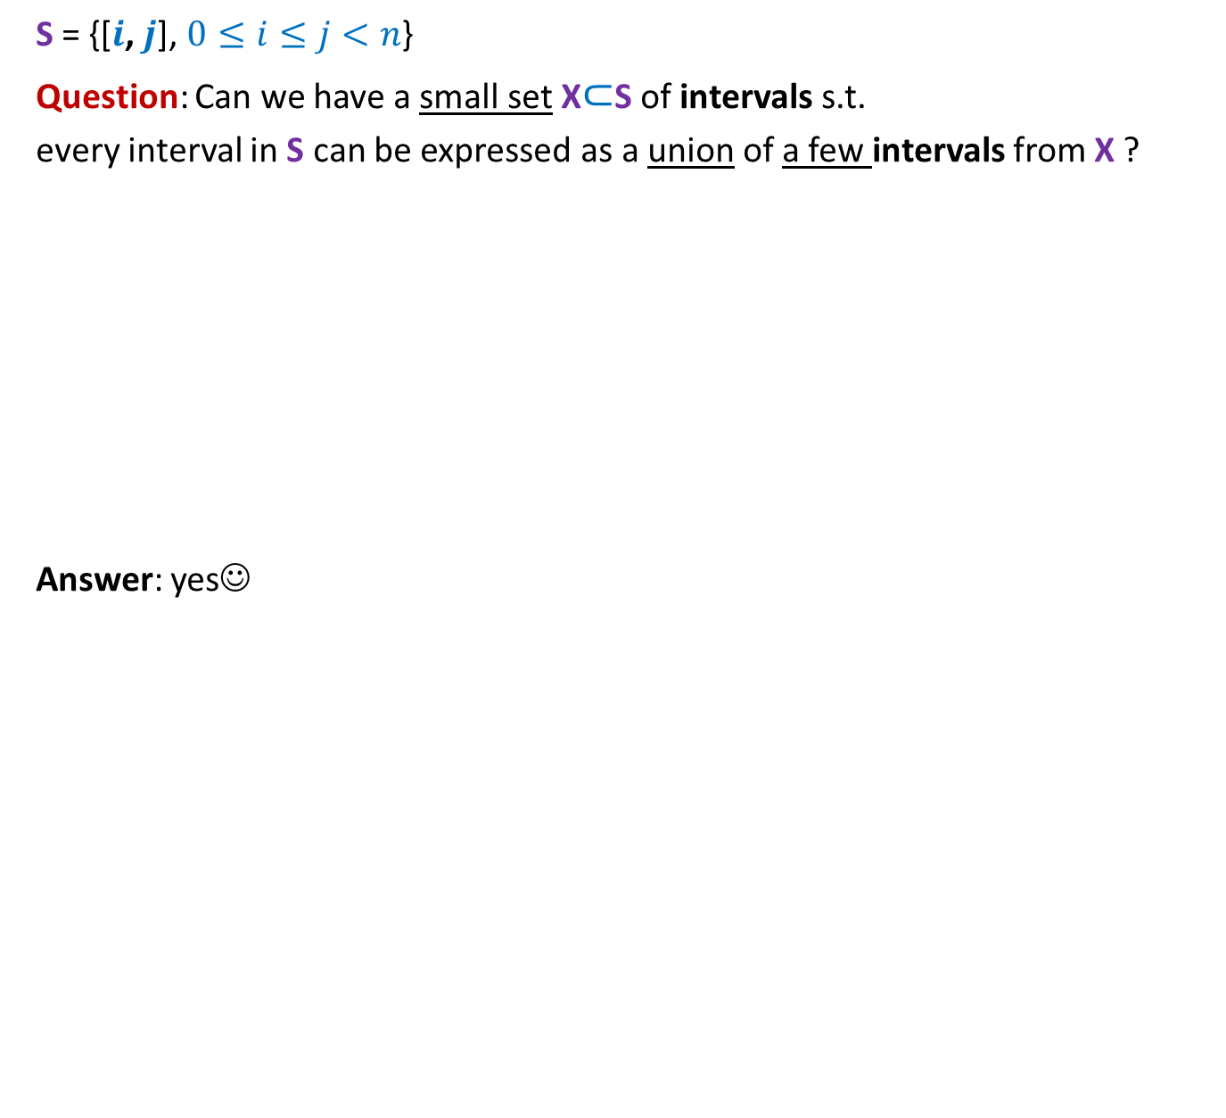
Intervals
S = {[$i$, $j$], $0≤i≤j<n$}
Question: Can we have a small set X$⊂$S of intervals s.t.
every interval in S can be expressed as a union of a few intervals from X ?
Answer: yes☺
$\left[0,0\right] \left[1,1\right] \left[2,2\right] \left[3,3\right] \left[4,4\right] \left[5,5\right] \left[6,6\right] \left[7,7\right] \left[8,8\right] \left[9,9\right] …………………………………. [15,15]$

Slide 4



Hierarchy of intervals
$$[0,15]$$
$$[0,7]$$
$$[8,15]$$
$\left[0,3\right] [4,7]$ $\left[8,11\right] [12,15]$
$\left[0,1\right] \left[2,3\right] \left[4,5\right] \left[6,7\right] \left[8,9\right] \left[10,11\right] \left[12,13\right] [14,15]$
$\left[0,0\right] \left[1,1\right] \left[2,2\right] \left[3,3\right] \left[4,4\right] \left[5,5\right] \left[6,6\right] \left[7,7\right] \left[8,8\right] \left[9,9\right] …………………………………. [15,15]$

Slide 5



Hierarchy of intervals
$$[0,15]$$
Observation: There are $2n$intervals such that
any interval [$i$, $j$] can be expressed
$$[0,7]$$
$$[8,15]$$
$\left[0,3\right] [4,7]$ $\left[8,11\right] [12,15]$
$\left[0,1\right] \left[2,3\right] \left[4,5\right] \left[6,7\right] \left[8,9\right] \left[10,11\right] \left[12,13\right] [14,15]$
$\left[0,0\right] \left[1,1\right] \left[2,2\right] \left[3,3\right] \left[4,4\right] \left[5,5\right] \left[6,6\right] \left[7,7\right] \left[8,8\right] \left[9,9\right] …………………………………. [15,15]$
as union of O(log $n$) basic intervals ☺

Slide 6
Hierarchy of intervals
$$[0,15]$$
Observation: There are $2n$intervals such that
any interval [$i$, $j$] can be expressed
$$[0,7]$$
$$[8,15]$$
$\left[0,3\right] [4,7]$ $\left[8,11\right] [12,15]$
$\left[0,1\right] \left[2,3\right] \left[4,5\right] \left[6,7\right] \left[8,9\right] \left[10,11\right] \left[12,13\right] [14,15]$
$\left[0,0\right] \left[1,1\right] \left[2,2\right] \left[3,3\right] \left[4,4\right] \left[5,5\right] \left[6,6\right] \left[7,7\right] \left[8,8\right] \left[9,9\right] …………………………………. [15,15]$
Relation to a sequence ?
as union of O(log $n$) basic intervals ☺

Slide 7
Which data structure emerges ?
$$[0,15]$$
$$[0,7]$$
$$[8,15]$$
$\left[0,3\right] [4,7]$ $\left[8,11\right] [12,15]$
$\left[0,1\right] \left[2,3\right] \left[4,5\right] \left[6,7\right] \left[8,9\right] \left[10,11\right] \left[12,13\right] [14,15]$
$\left[0,0\right] \left[1,1\right] \left[2,2\right] \left[3,3\right] \left[4,4\right] \left[5,5\right] \left[6,6\right] \left[7,7\right] \left[8,8\right] \left[9,9\right] …………………………………. [15,15]$
Sequence
${ x}_{0}$ ${ x}_{1}{ x}_{2 }x_{3}$ $x_{4}{ x}_{5}$ ${ x}_{6}$ ${ x}_{7}{ x}_{8 }x_{9}$ $x_{10}{ x}_{11}$ ${ x}_{12}$ ${ x}_{13}{ x}_{14 }x_{15}$

Slide 8
A Binary tree
$$[0,15]$$
How to perform Operation on an interval ?
$$[0,7]$$
$$[8,15]$$
$\left[0,3\right] [4,7]$ $\left[8,11\right] [12,15]$
$$\left[0,1\right] \left[2,3\right] \left[4,5\right] \left[6,7\right] \left[8,9\right] \left[10,11\right] \left[12,13\right] [14,15]$$
${ x}_{0}$ ${ x}_{1}{ x}_{2 }x_{3}$ $x_{4}{ x}_{5}$ ${ x}_{6}$ ${ x}_{7}{ x}_{8 }x_{9}$ $x_{10}{ x}_{11}$ ${ x}_{12}$ ${ x}_{13}{ x}_{14 }x_{15}$
What value should you keep in internal nodes ?

Slide 9
$$[0,15]$$
How to perform Operation on an interval ?
$$[0,7]$$
$$[8,15]$$
$\left[0,3\right] [4,7]$ $\left[8,11\right] [12,15]$
$$\left[0,1\right] \left[2,3\right] \left[4,5\right] \left[6,7\right] \left[8,9\right] \left[10,11\right] \left[12,13\right] [14,15]$$
${ x}_{0}$ ${ x}_{1}{ x}_{2 }x_{3}$ $x_{4}{ x}_{5}$ ${ x}_{6}$ ${ x}_{7}{ x}_{8 }x_{9}$ $x_{10}{ x}_{11}$ ${ x}_{12}$ ${ x}_{13}{ x}_{14 }x_{15}$

Slide 10
Problem 2
Dynamic Range-minima

Slide 11

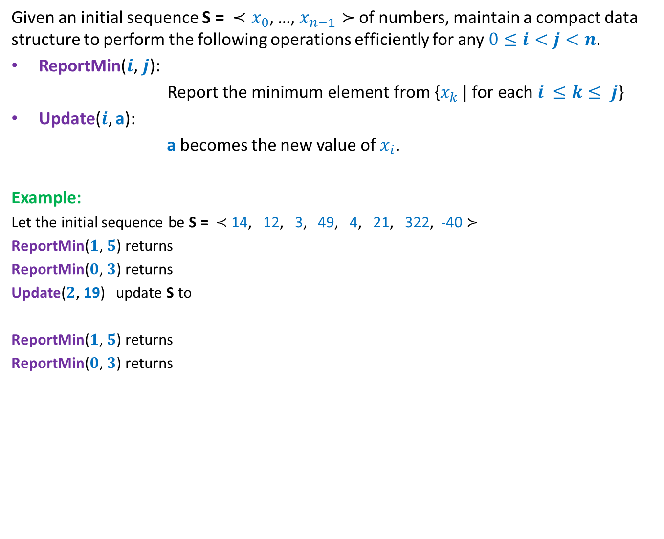
Dynamic Range Minima Problem
Given an initial sequence S = ${≺x}_{0}$, …, $x_{n−1}≻$ of numbers, maintain a compact data structure to perform the following operations efficiently for any $0≤i<j<n$.
ReportMin($i\text{,} j\text{): }$
$\text{Report} \text{the} \text{minimum} \text{element} \text{from} \text{\{}x_{k }\text{|} \text{for} \text{each} i ≤k≤ j$}
Update($i$, a):
a becomes the new value of $x_{i}$.
Example:
Let the initial sequence be S = $≺$ 14, 12, 3, 49, 4, 21, 322, -40 $≻$
ReportMin($1\text{,} 5\text{)}$ returns
ReportMin($0\text{,} 3\text{)}$ returns
Update($2$, 19) update S to
ReportMin($1\text{,} 5\text{)}$ returns
ReportMin($0\text{,} 3\text{)}$ returns
3
3
$≺$ 14, 12, 19, 49, 4, 21, 322, -40 $≻$
4
12

Slide 12
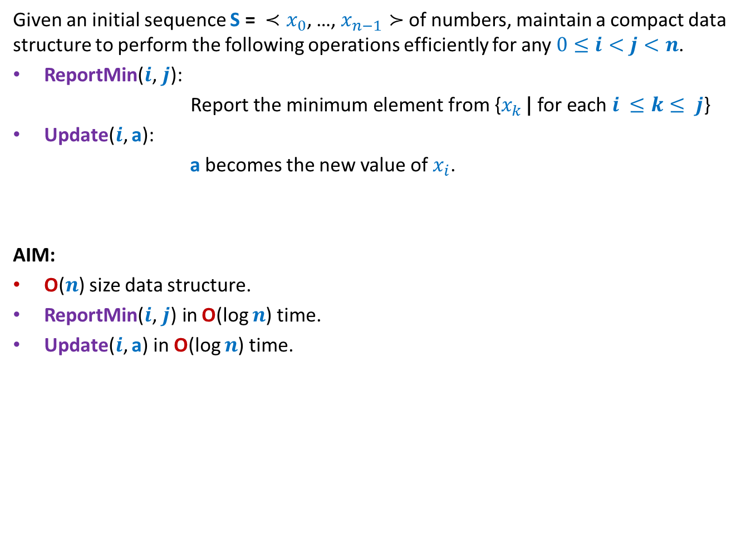
Dynamic Range Minima Problem
Given an initial sequence S = ${≺x}_{0}$, …, $x_{n−1}≻$ of numbers, maintain a compact data structure to perform the following operations efficiently for any $0≤i<j<n$.
ReportMin($i\text{,} j\text{): }$
$\text{Report} \text{the} \text{minimum} \text{element} \text{from} \text{\{}x_{k }\text{|} \text{for} \text{each} i ≤k≤ j$}
Update($i$, a):
a becomes the new value of $x_{i}$.
AIM:
O($n$) size data structure.
ReportMin($i\text{,} j\text{)} \text{in}$O(log $n$) time.
Update($i$, a) in O(log $n$) time.

Slide 13
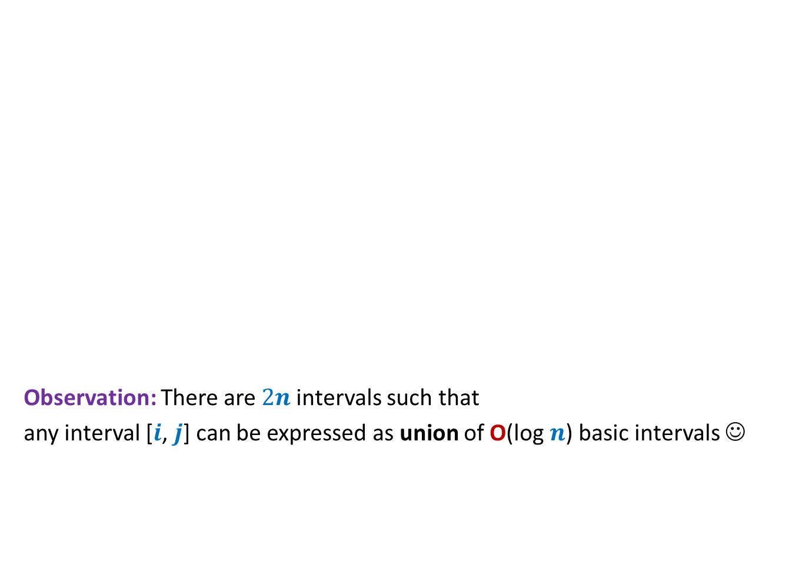
Hierarchy of intervals
$$[0,15]$$
Observation: There are $2n$intervals such that
any interval [$i$, $j$] can be expressed as union of O(log $n$) basic intervals ☺
$$[0,7]$$
$$[8,15]$$
$\left[0,3\right] [4,7]$ $\left[8,11\right] [12,15]$
$\left[0,1\right] \left[2,3\right] \left[4,5\right] \left[6,7\right] \left[8,9\right] \left[10,11\right] \left[12,13\right] [14,15]$
$\left[0,0\right] \left[1,1\right] \left[2,2\right] \left[3,3\right] \left[4,4\right] \left[5,5\right] \left[6,6\right] \left[7,7\right] \left[8,8\right] \left[9,9\right] …………………………………. [15,15]$
${ x}_{0}$ ${ x}_{1}{ x}_{2 }x_{3}$ $x_{4}{ x}_{5}$ ${ x}_{6}$ ${ x}_{7}{ x}_{8 }x_{9}$ $x_{10}{ x}_{11}$ ${ x}_{12}$ ${ x}_{13}{ x}_{14 }x_{15}$

Slide 14
Data structure for dynamic range minima
Question: What should be stored in an internal node v ?
Answer:
minimum value stored in subtree(v).
2
4
2
4
21
8
2
4
9
21
29
25
8
2
11
Initial
sequence
4 14 9 17 23 21 29 91 37 25 8 33 2 67 11 44
${ x}_{0}$ ${ x}_{1}{ x}_{2 }x_{3}$ $x_{4}{ x}_{5}$ ${ x}_{6}$ ${ x}_{7}{ x}_{8 }x_{9}$ $x_{10}{ x}_{11}$ ${ x}_{12}$ ${ x}_{13}{ x}_{14 }x_{15}$

Slide 15
Data structure for dynamic range minima
How to do Report-Min(2,10) ?
2
4
2
4
21
8
2
4
9
21
29
25
8
2
11
Initial
sequence
4 14 9 17 23 21 29 91 37 25 8 33 2 67 11 44
${ x}_{0}$ ${ x}_{1}{ x}_{2 }x_{3}$ $x_{4}{ x}_{5}$ ${ x}_{6}$ ${ x}_{7}{ x}_{8 }x_{9}$ $x_{10}{ x}_{11}$ ${ x}_{12}$ ${ x}_{13}{ x}_{14 }x_{15}$

Slide 16
Data structure for dynamic range minima
How to do Report-Min(2,10) ?
2
4
2
4
21
8
2
4
9
21
29
25
8
2
11
Initial
sequence
4 14 9 17 23 21 29 91 37 25 8 33 2 67 11 44
${ x}_{0}$ ${ x}_{1}{ x}_{2 }x_{3}$ $x_{4}{ x}_{5}$ ${ x}_{6}$ ${ x}_{7}{ x}_{8 }x_{9}$ $x_{10}{ x}_{11}$ ${ x}_{12}$ ${ x}_{13}{ x}_{14 }x_{15}$

Slide 17



Data structure for dynamic range minima
0
Data structure: An array A of size 2n-1.
Copy the sequence S = ${≺x}_{0}$, …, $x_{n−1}≻$ into ??
Leaf node corresponding to $x_{i}$= ??
How to check if a node is left child or right child of its parent ?
(if index of the node is odd, then the node is left child, else the node is right child)
2
1 2
4
2
3 4 5 6
4
21
8
2
7 8 9 10 11 12 13 14
4
9
21
29
25
8
2
11
Initial
sequence
4 14 9 17 23 21 29 91 37 25 8 33 2 67 11 44
15 16 17 18 19 20 21 22 23 24 25 26 27 28 29 30
A[$n−1$]…A[$2n−2$]
A[($n−1)+i$]

Slide 18

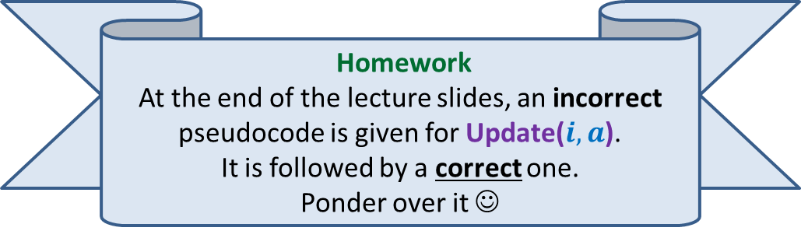
Update($i,a$)
Update($i,a$)
$i$← $(n−1)+i$;
A[$i$]← $a$;
$i$ ← $\left\lfloor (i−1)/2\right\rfloor$ ;
While( ?? )
{
}
Homework
At the end of the lecture slides, an incorrect pseudocode is given for Update($i,a$).
It is followed by a correct one.
Ponder over it ☺

Slide 19
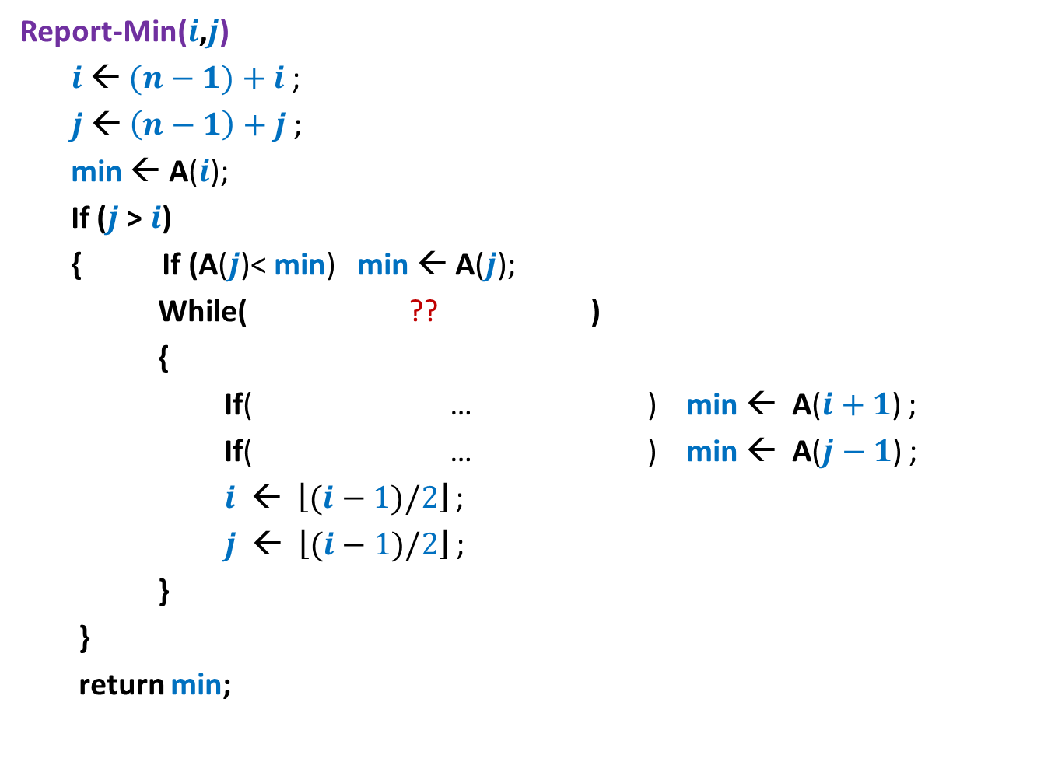




Report-Min($i$,$j$)
Report-Min($i$,$j$)
$i$← $(n−1)+i$;
$j$← $\left(n−1\right)+j$;
min ← A($i$);
If ($j$> $i$)
{ If (A($j$)< min) min ← A($j$);
While( ?? )
{
If( … ) min ← A($i+1$) ;
If( … ) min ← A($j−1$) ;
$i$ ← $\left\lfloor (i−1)/2\right\rfloor$ ;
$j$ ← $\left\lfloor (i−1)/2\right\rfloor$ ;
}
}
return min;
$\left\lfloor (i−1)/2\right\rfloor$ <> $\left\lfloor (j−1)/2\right\rfloor$
$i$%2=1 and A($i+1$)< min
$j$%2=0 and A($j−1$)< min

Slide 20
Proof of correctness
This ghost will keep haunting you in this course and next course as well.
So it is better that you face it bravely instead of running from it ☺
Let T be the tree data structure for Dynamic Range-minima problem.
Let u be any node in T.
Question:
What can we say about value(u) after a series of operations ?
After every operation:
value(u) is minimum among all values stored in the leaf nodes of subtree(u).
To prove the correctness of our datastructure/algorithm,
you need to prove that the above mentioned assertion holds after each Update() operation.
(Do it as a small exercise (4-5 sentences only)).

Slide 21
Another interesting problem on sequences

Slide 22
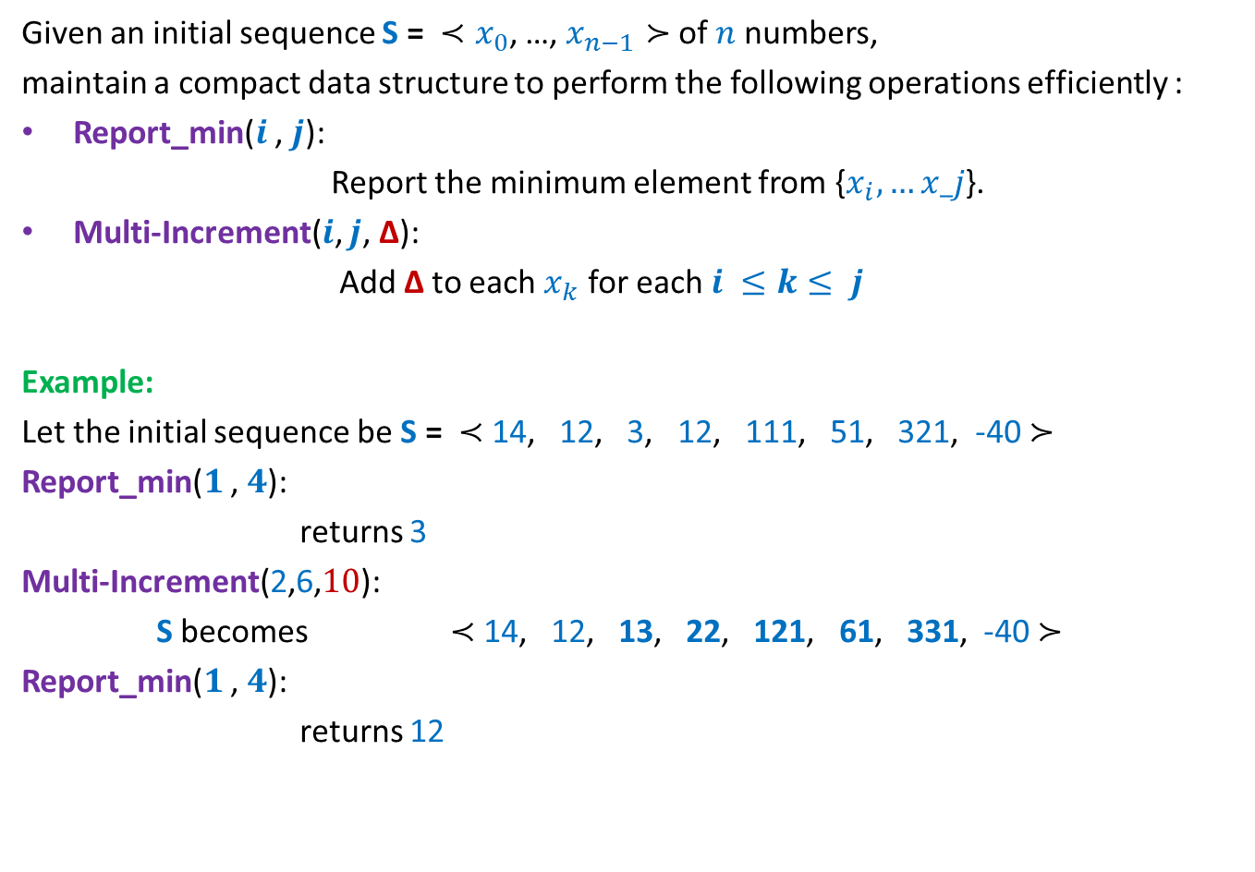
Practice Problem
Given an initial sequence S = ${≺x}_{0}$, …, $x_{n−1}≻$ of $n$numbers,
maintain a compact data structure to perform the following operations efficiently :
Report_min($i$ , $j$):
Report the minimum element from {$x_{i},…x_j$}.
Multi-Increment($i$, $j$, ∆):
Add ∆ to each $x_{k}$ for each $i ≤k≤ j$
Example:
Let the initial sequence be S = $≺$ 14, 12, 3, 12, 111, 51, 321, -40 $≻$
Report_min($1$ , $4$):
returns 3
Multi-Increment(2,6,$10$):
S becomes $≺$ 14, 12, 13, 22, 121, 61, 331, -40 $≻$
Report_min($1$ , $4$):
returns 12

Slide 23
An challenging problem on sequences
For summer vacation
(not for the exam)

Slide 24
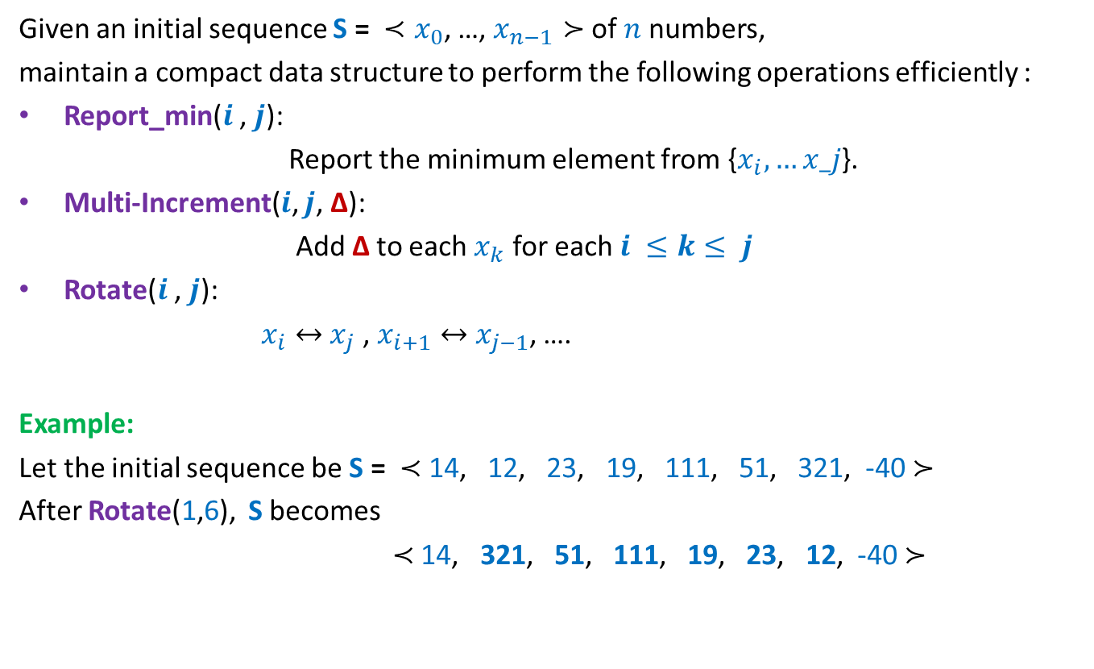

$∗$ Problem
Given an initial sequence S = ${≺x}_{0}$, …, $x_{n−1}≻$ of $n$numbers,
maintain a compact data structure to perform the following operations efficiently :
Report_min($i$ , $j$):
Report the minimum element from {$x_{i},…x_j$}.
Multi-Increment($i$, $j$, ∆):
Add ∆ to each $x_{k}$ for each $i ≤k≤ j$
Rotate($i$ , $j$):
$x_{i}↔$ $x_{j}$ , $x_{i+1}↔$ $x_{j−1}$, ….
Example:
Let the initial sequence be S = $≺$ 14, 12, 23, 19, 111, 51, 321, -40 $≻$
After Rotate(1,6), S becomes
$≺$ 14, 321, 51, 111, 19, 23, 12, -40 $≻$
The solution of this problem will require additional tools. But all these tools have already been discussed in the course. So have fun pondering over it during summer. ☺

Slide 25
Problem 4
A data structure for sets

Slide 26

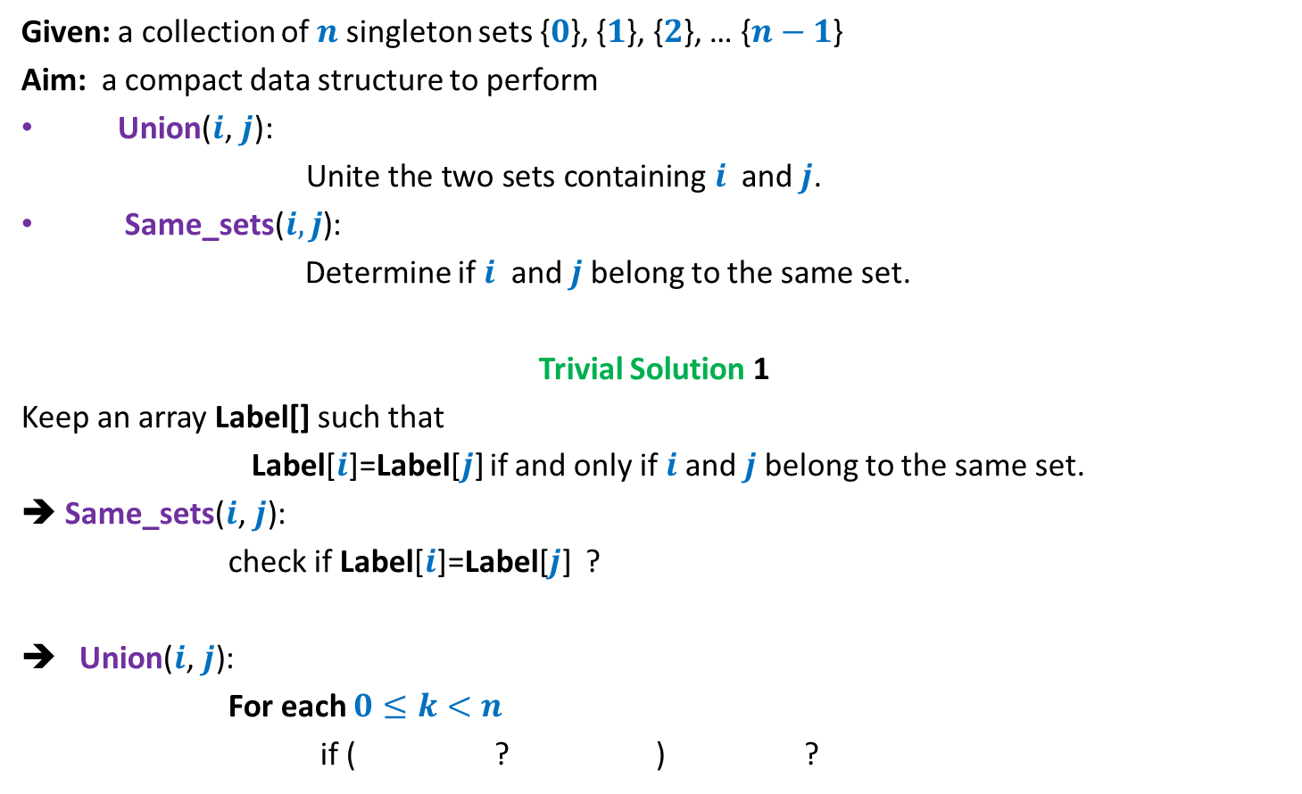


Sets under operations
Given: a collection of $n$singleton sets {$0$}, {$1$}, {$2$}, … {$n−1$}
Aim: a compact data structure to perform
Union($i\text{,} j\text{): }$
$\text{Unite} \text{the} \text{two} \text{sets} \text{containing} i$ and $j$.
Same_sets($i,j$):
Determine if $i$ and $j$belong to the same set.
Trivial Solution 1
Keep an array Label[] such that
Label[$i$]=Label[$j$] if and only if $i$and $j$belong to the same set.
➔ Same_sets($i\text{,} j\text{)}$:
check if Label[$i$]=Label[$j$] ?
Union($i\text{,} j\text{)}$:
For each $0≤k<n$
if ( ? ) ?
O(1) time
O($n$) time
Label[$k$]= Label[$i$]
Label[$k$] ← Label[$j$])

Slide 27
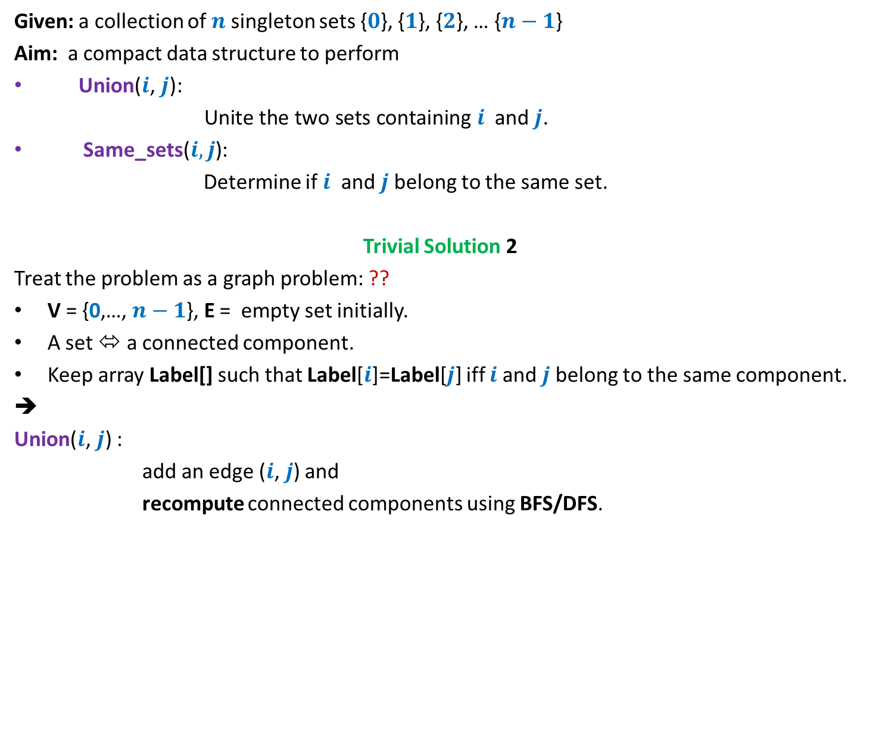
Sets under operations
Given: a collection of $n$singleton sets {$0$}, {$1$}, {$2$}, … {$n−1$}
Aim: a compact data structure to perform
Union($i\text{,} j\text{): }$
$\text{Unite} \text{the} \text{two} \text{sets} \text{containing} i$ and $j$.
Same_sets($i,j$):
Determine if $i$ and $j$belong to the same set.
Trivial Solution 2
Treat the problem as a graph problem: ??
V = {0,…, $n−1$}, E = empty set initially.
A set ⬄ a connected component.
Keep array Label[] such that Label[$i$]=Label[$j$] iff $i$and $j$belong to the same component.
➔
Union($i\text{,} j\text{)}$ :
add an edge ($i\text{,} j$) and
recompute connected components using BFS/DFS.
Connected component
O($n$) time

Slide 28
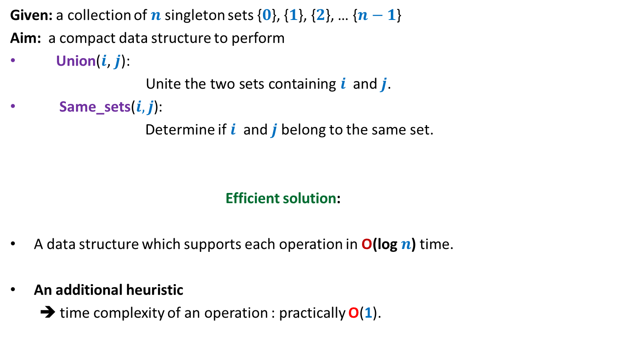
Sets under operations
Given: a collection of $n$singleton sets {$0$}, {$1$}, {$2$}, … {$n−1$}
Aim: a compact data structure to perform
Union($i\text{,} j\text{): }$
$\text{Unite} \text{the} \text{two} \text{sets} \text{containing} i$ and $j$.
Same_sets($i,j$):
Determine if $i$ and $j$belong to the same set.
Efficient solution:
A data structure which supports each operation in O(log $n$) time.
An additional heuristic
➔ time complexity of an operation : practically O(1).
We shall discuss it in the next lecture. Don’t miss it ☺.

Slide 29
Homework
For Dynamic Range-minima problem

Slide 30


Update($i,a$)
Update($i,a$)
$i$← $(n−1)+i$;
A[$i$]← $a$;
$i$ ← $\left\lfloor (i−1)/2\right\rfloor$ ;
While( ?? )
{
If($a$< A[$i$]) A[$i$]← $a$;
$i$ ← $\left\lfloor (i−1)/2\right\rfloor$ ;
}
$i$≥ 0
There is an error in the above pseudocode. Try spotting it.

Slide 31

Update($i,a$)
Update($i,a$)
$i$← $(n−1)+i$;
A[$i$]← $a$;
$i$ ← $\left\lfloor (i−1)/2\right\rfloor$ ;
While( ?? )
{
If( A[$2i+1$]< A[$2i+2$])
A[$i$]← A[$2i+1$]
else
A[$i$]← A[$2i+2$] ;
$i$ ← $\left\lfloor (i−1)/2\right\rfloor$ ;
}
$i$≥ 0
Here is the correct pseudocode.

