Slide 1
Data Structures and Algorithms (CS210A)
Lecture 35
A new algorithm design paradigm:
part II
Greedy strategy

Slide 2
Continuing Problem from last class
JOB Scheduling
Largest subset of non-overlapping job

Slide 3
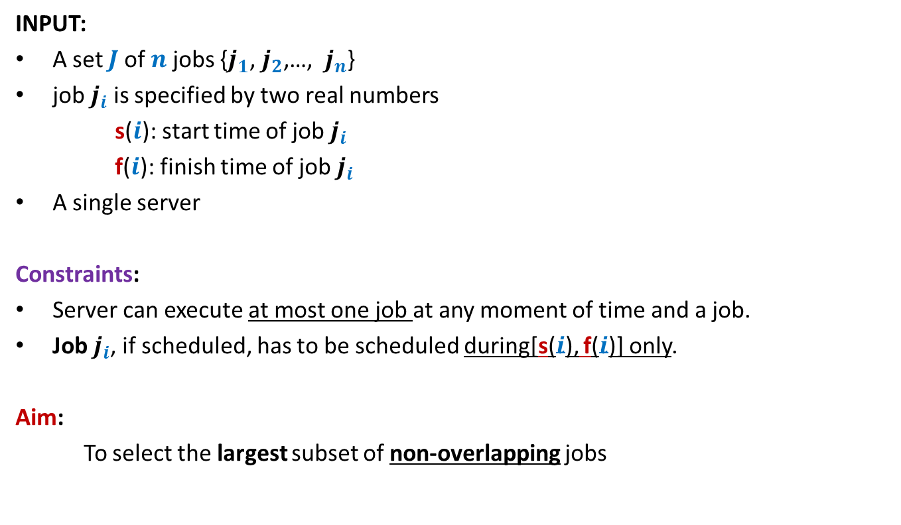
A job scheduling problem Formal Description
INPUT:
A set $J$of $n$ jobs {$j_{1}$, $j_{2}$,…, $j_{n}$}
job $j_{i}$ is specified by two real numbers
s($i$): start time of job $j_{i}$
f($i$): finish time of job $j_{i}$
A single server
Constraints:
Server can execute at most one job at any moment of time and a job.
Job $j_{i}$, if scheduled, has to be scheduled during[s($i$), f($i$)] only.
Aim:
To select the largest subset of non-overlapping jobs

Slide 4
Designing algorithm for the problem
Strategy 4: Select the job with earliest finish time
Intuition:
Selecting such a job will free the server earliest
➔ hence more no. of jobs might get scheduled.
0 1 2 3 4 5 6 7

Slide 5

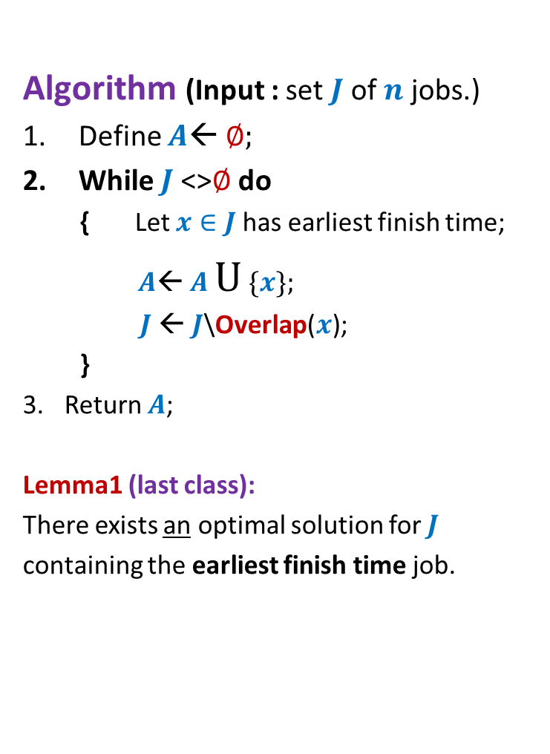


Algorithm “earliest finish time”
Proof of correctness ?
Let $x∈J$ be the job with earliest finish time.
Let $J′$ = $J\backslash$Overlap($x$)
Algorithm (Input : set $J$of $n$ jobs.)
Define $A$← ∅;
While $J$<>∅ do
{ Let $x∈J$has earliest finish time;
$A$← $A$ U {$x$};
$J$← $J$\Overlap($x$);
}
Return $A$;
Lemma1 (last class):
There exists an optimal solution for $J$
containing the earliest finish time job.
$$J$$
Greedy
step
$$J′$$
Greedy
step

Slide 6
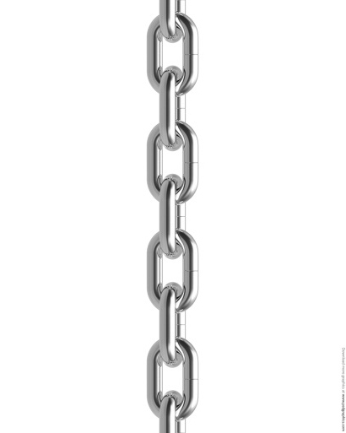


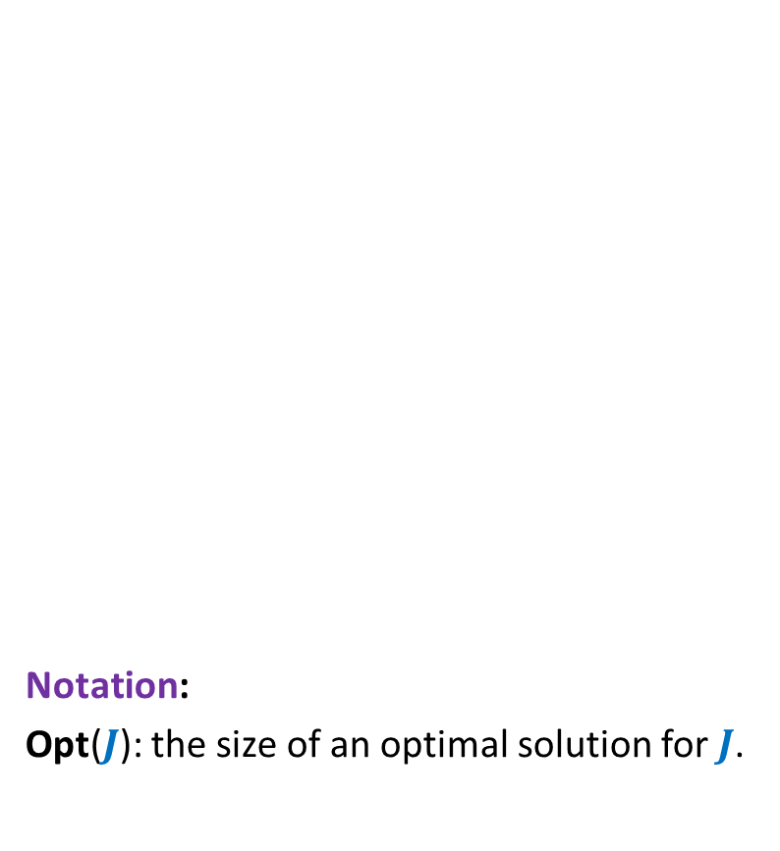

Algorithm “earliest finish time”
What will suffice as proof of correctness ?
How to prove it ?
Proof of correctness ?
Let $x∈J$ be the job with earliest finish time.
Let $J′$ = $J\backslash$Overlap($x$)
Notation:
Opt($J$): the size of an optimal solution for $J$.
Opt($J$)
$$J$$
Greedy
step
Opt($J$)= Opt($J′$) + 1
Lemma1
Opt($J′$)
$$J′$$
Greedy
step

Slide 7


Theorem: Opt($J$) = Opt($J′$) + 1.
Proof has two parts
Opt($J$) ≥ Opt($J′$) + 1
Opt($J′$) ≥ Opt($J$) – 1
Proof for each part is a proof by construction
Try to give a physical interpretation to these inequalities.

Slide 8






Algorithm “earliest finish time” Proving Opt($J$) ≥ Opt($J′$) + 1.
Observation: start time of every job in $J′$ is greater than finish time of $x$.
Let $O′$be any optimal solution for $J′$.
None of the jobs in $O′$ overlaps with $x$.
Hence $O′$ U{$x$} is a subset of non-overlapping jobs.
Therefore Opt($J$) ≥ |$O′$| + 1 = Opt($J′$) + 1.
From an optimal solution of $J′$
can you derive a solution for $J$ with one extra job?
c
$$J′$$
Overlap($x$)
$$x$$
0 1 2 3 4 5 6 7

Slide 9

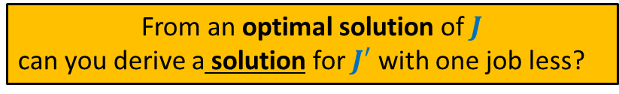

Algorithm “earliest finish time” Proving Opt($J′$) ≥ Opt($J$) - 1.
Lemma1 (last class): There exists an optimal solution for $J$in which $x$is present.
Let $O$be an optimal solution for $J$ containing $x$.
None of the jobs in $O$ overlaps with $x$.
➔ Every job from $O$ other than $x$ belongs to $J′$.
Hence $O$\{$x$} is a subset of non-overlapping jobs from $J′$.
Therefore Opt($J′$) ≥ |$O$| - 1 = Opt($J$) - 1.
From an optimal solution of $J$
can you derive a solution for $J′$ with one job less?
$$J′$$
Overlap($x$)
$$x$$
0 1 2 3 4 5 6 7

Slide 10

Theorem:
Given any set $J$of $n$jobs,
the algorithm based on “earliest finish time” approach
computes the largest subset of non-overlapping job.

Slide 11
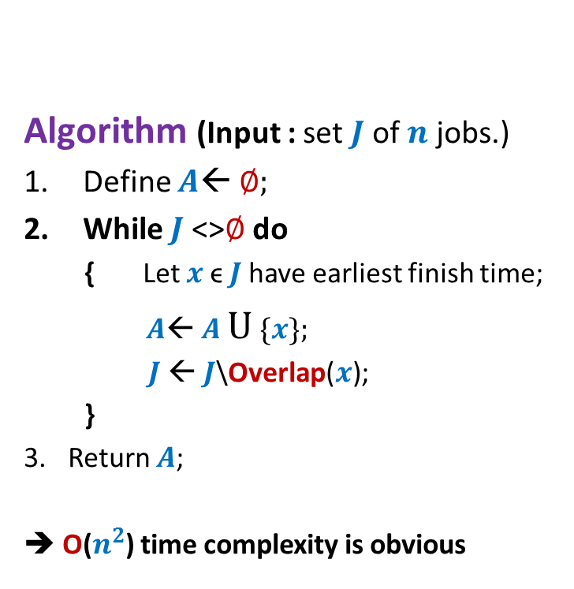

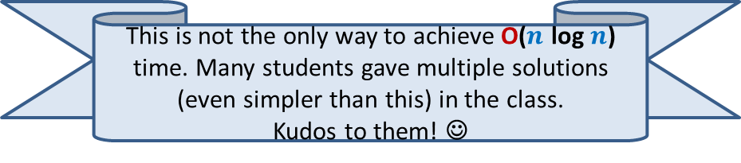
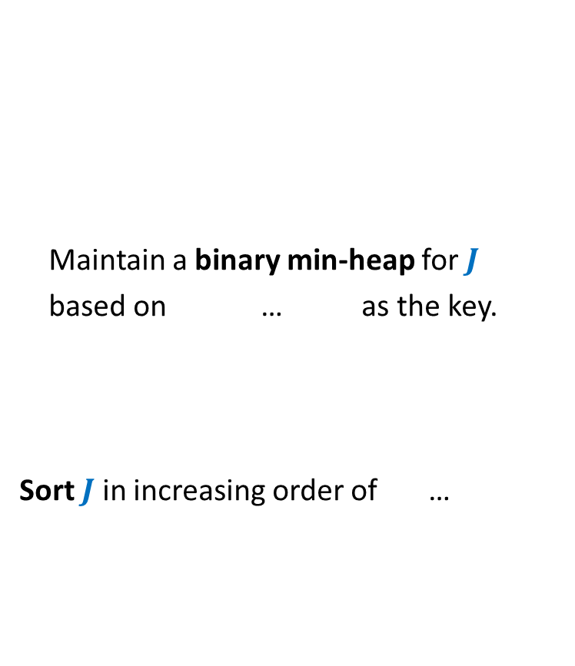
O($n$ log $n$) implementation of the Algorithm
This is not the only way to achieve O($n$ log $n$) time. Many students gave multiple solutions (even simpler than this) in the class.
Kudos to them! ☺
Algorithm (Input : set $J$of $n$ jobs.)
Define $A$← ∅;
While $J$<>∅ do
{ Let $x$ϵ $J$have earliest finish time;
$A$← $A$ U {$x$};
$J$← $J$\Overlap($x$);
}
Return $A$;
➔ O($n^{2}$) time complexity is obvious
Maintain a binary min-heap for $J$
based on … as the key.
Sort $J$ in increasing order of …
finish time
start time.

Slide 12
Problem 2
First we shall give motivation.

Slide 13
Motivation: A road or telecommunication network
Suppose there is a collection of possible links/roads that can be laid.
But laying down each possible link/road is costly.
Aim: To lay down least number of links/roads to ensure connectivity between each pair of nodes/cities.

Slide 14
Motivation
Formal description of the problem
Input: an undirected graph G=(V,E).
Aim: compute a subgraph (V,E’), E’ ⊆ E such that
Connectivity among all V is guaranteed in the subgraph.
|E’| is minimum.
How will such a subgraph look like ?

Slide 15
A road or telecommunication network

Slide 16
A road or telecommunication network
Is this subgraph meeting our requirement ?
No
Yes
No

Slide 17
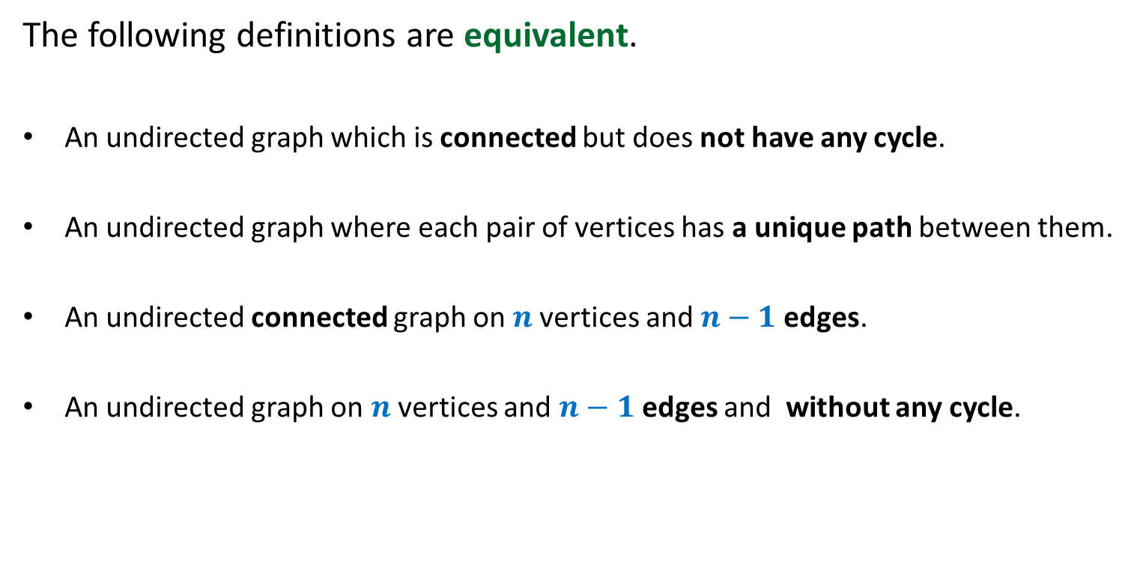
A tree
The following definitions are equivalent.
An undirected graph which is connected but does not have any cycle.
An undirected graph where each pair of vertices has a unique path between them.
An undirected connected graph on $n$vertices and $n−1$edges.
An undirected graph on $n$vertices and $n−1$edges and without any cycle.

Slide 18
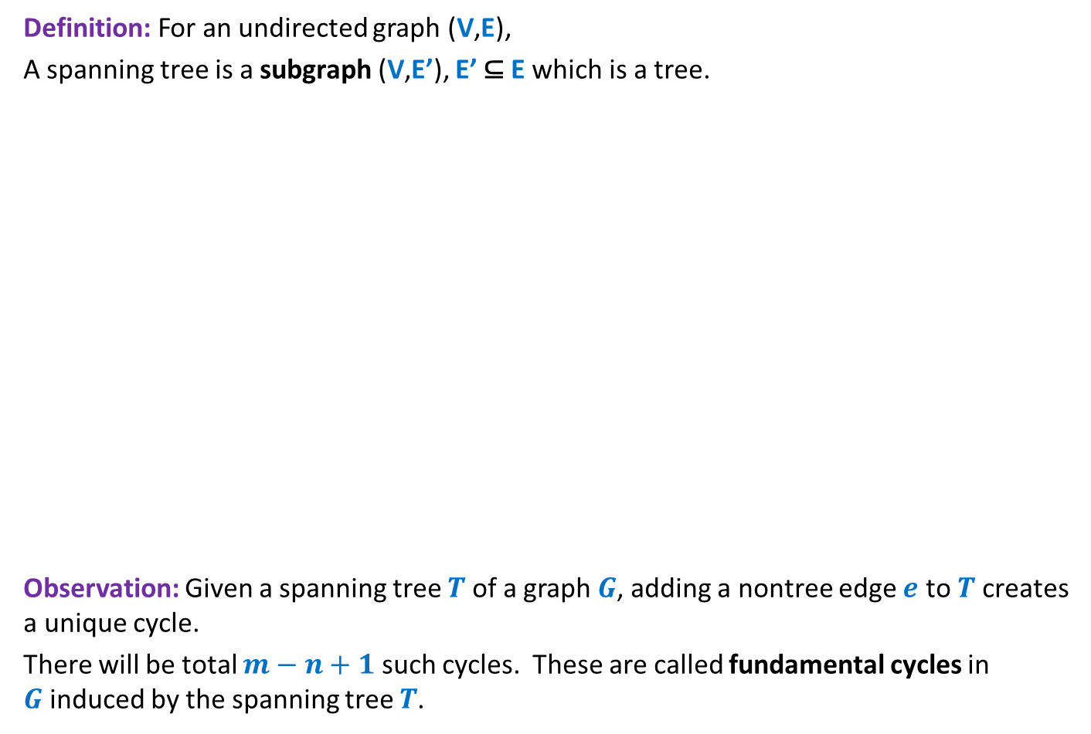
A Spanning tree
Definition: For an undirected graph (V,E),
A spanning tree is a subgraph (V,E’), E’ ⊆ E which is a tree.
Observation: Given a spanning tree $T$ of a graph $G$, adding a nontree edge $e$ to $T$creates a unique cycle.
There will be total $m−n+1$ such cycles. These are called fundamental cycles in $G$induced by the spanning tree $T$.

Slide 19
A road or telecommunication network
Assign each edge a weight/cost.
170
54
33
63
35
50
70
31
41
81
64
78
53
52
80
49
54
42
60
44
50
30
49
57
29
102
Adding more reality to the problem

Slide 20
A road or telecommunication network
Any arbitrary spanning tree (like the one shown above) will not serve our goal☹.
We need to select the spanning tree with least weight/cost.
170
54
33
63
35
50
70
31
41
81
64
78
53
52
80
49
54
42
60
44
50
30
49
57
29
102

Slide 21
Problem 2
Minimum spanning tree

Slide 22

Problem Description
Input: an undirected graph G=(V,E) with w: E → ℝ,
Aim: compute a spanning tree (V,E’), E’ ⊆ E such that
$\sum_{eϵ\text{E}\text{’}}{\text{w}(e)}$ is minimum.

Slide 23
How to compute a MST ?
The least weight edge should be in MST.
But why ?
170
54
33
63
13
50
70
31
41
81
64
78
53
52
80
49
54
42
60
44
50
30
49
57
29
102
Look at this graph carefully and with open mind.
Can you claim anything about the MST ?
Is there any edge for which you feel strongly to be present in MST ?

Slide 24



Let $e_{0}ϵ$ $\text{E}$ be the edge of least weight in the given graph.
Lemma2: There is a MST $T$containing $e_{0}$.
Proof: Consider any MST $T$. Let $e_{0}$∉ $T$.
Consider the fundamental cycle $C$defined by $e_{0}$ in $T$.
Swap $e_{0}$ with any edge $eϵ T$ present in $C$.
$$e_{0}$$
$$e$$

Slide 25

Let $e_{0}ϵ$ $\text{E}$ be the edge of least weight in the given graph.
Lemma2: There is a MST $T$containing $e_{0}$.
Proof: Consider any MST $T$. Let $e_{0}$∉ $T$.
Consider the fundamental cycle $C$defined by $e_{0}$ in $T$.
Swap $e_{0}$ with any edge $eϵ T$ present in $C$.
We get a spanning tree of weight ≤ w($T$).
$$e_{0}$$
$$e$$

Slide 26
Try to translate Lemma2 to an algorithm for MST ?
with inspiration from the job scheduling problem ☺
Next lecture class: Sunday (3rd April) at 11 AM…

