Slide 1
Data Structures and Algorithms (CS210A)
Lecture 37
A new algorithm design paradigm:
part IV
Greedy strategy

Slide 2
Problems solved till now
Job Scheduling Problem
Mobile Tower Problem
MST
Did you notice anything commons in their solutions ?
Ponder over this question before moving ahead

Slide 3
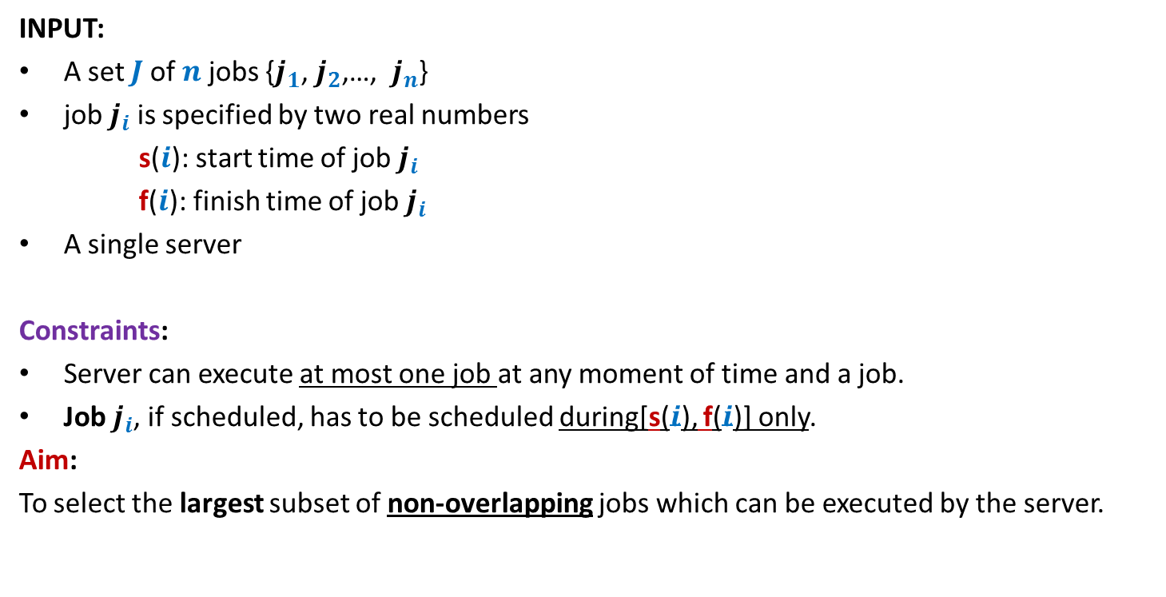
Problem 1 Job scheduling Problem
INPUT:
A set $J$of $n$ jobs {$j_{1}$, $j_{2}$,…, $j_{n}$}
job $j_{i}$ is specified by two real numbers
s($i$): start time of job $j_{i}$
f($i$): finish time of job $j_{i}$
A single server
Constraints:
Server can execute at most one job at any moment of time and a job.
Job $j_{i}$, if scheduled, has to be scheduled during[s($i$), f($i$)] only.
Aim:
To select the largest subset of non-overlapping jobs which can be executed by the server.
We could not say anything about the complete solution of this problem.

Slide 4
Problem 1 Job scheduling Problem
INPUT:
A set $J$of $n$ jobs {$j_{1}$, $j_{2}$,…, $j_{n}$}
job $j_{i}$ is specified by two real numbers
s($i$): start time of job $j_{i}$
f($i$): finish time of job $j_{i}$
A single server
Constraints:
Server can execute at most one job at any moment of time and a job.
Job $j_{i}$, if scheduled, has to be scheduled during[s($i$), f($i$)] only.
Aim:
To select the largest subset of non-overlapping jobs which can be executed by the server.

Slide 5
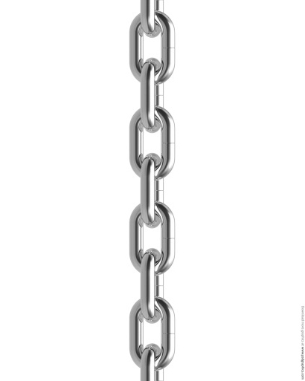

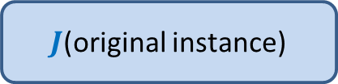

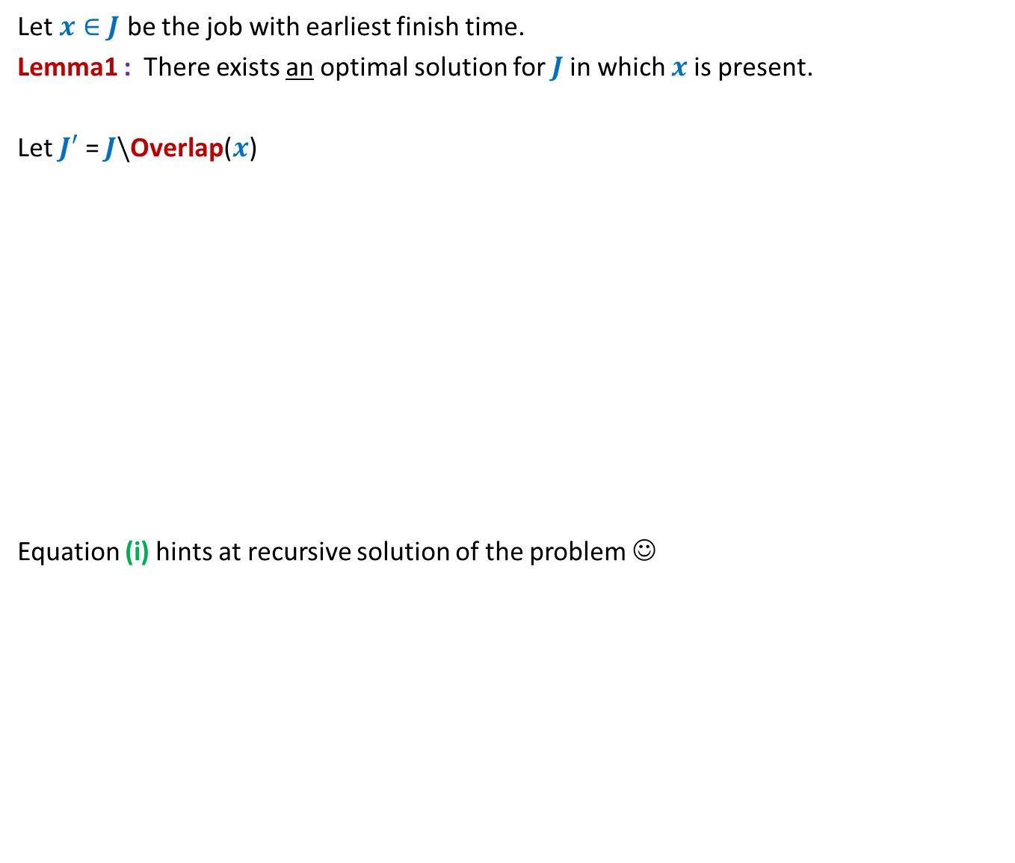

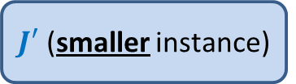
All that we could do was to make a local observation
Let $x∈J$ be the job with earliest finish time.
Lemma1 : There exists an optimal solution for $J$in which $x$is present.
Let $J′$ = $J\backslash$Overlap($x$)
Equation (i) hints at recursive solution of the problem ☺
Lemma 1 gives very small information about the optimal solution ☹
How to use it to compute this solution ?
$J$(original instance)
Opt($J$)
Greedy
step
Opt($J$)= Opt($J′$) + 1 -- (i)
Lemma1
$J′$ (smaller instance)
Opt($J′$)

Slide 6


Theorem: Opt($J$) = Opt($J′$) + 1.
Proof has two parts
Opt($J$) ≥ Opt($J′$) + 1
Opt($J′$) ≥ Opt($J$) – 1
Proof for each part is a proof by construction

Slide 7



Problem 2 Mobile Tower Problem
$$d$$
$$d$$
Problem statement:
There is a set $H$of $n$ houses located along a road.
We want to place mobile towers such that
Each house is covered by at least one mobile tower.
The number of mobile towers used is least possible.
We could not say anything about the complete solution of this problem.

Slide 8

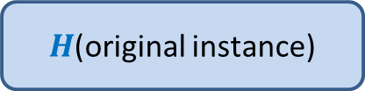



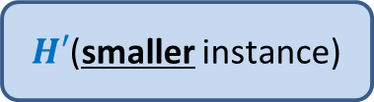
All that we could do was to make a local observation
Lemma 2: There is an optimal solution for the problem in which
the leftmost tower is placed at distance $d$ to the right of the first house.
Let $x$ be the tower located at $d$ to the right of the first house.
Let $H′$ = $H\backslash$ {all houses within distance $d$ from $x$}
Equation (i) hints at recursive solution of the problem ☺
Lemma 1 gives very small information about the optimal solution ☹
How to use it to compute this solution ?
$H$(original instance)
Opt($H$)
Opt($H$)= Opt($H′$) + 1
Greedy
step
Lemma 2
$H′$(smaller instance)
Opt($H′$)

Slide 9
What is a greedy strategy ?
A strategy that is
Based on some local approach
With the objective to optimize some function.
Note:
Recall that the divide and conquer strategy takes a global approach.

Slide 10
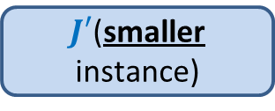
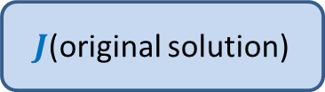
Design of a greedy algorithm
Let A be an instance of an optimization problem.
Make a local observation about the solution.
Use this observation to express optimal solution of A
in terms of
Optimal solution of a smaller instance A’
Local step
This gives a recursive solution.
Transform it into iterative one.
$J$(original solution)
Greedy
step
$J′$(smaller instance)

Slide 11
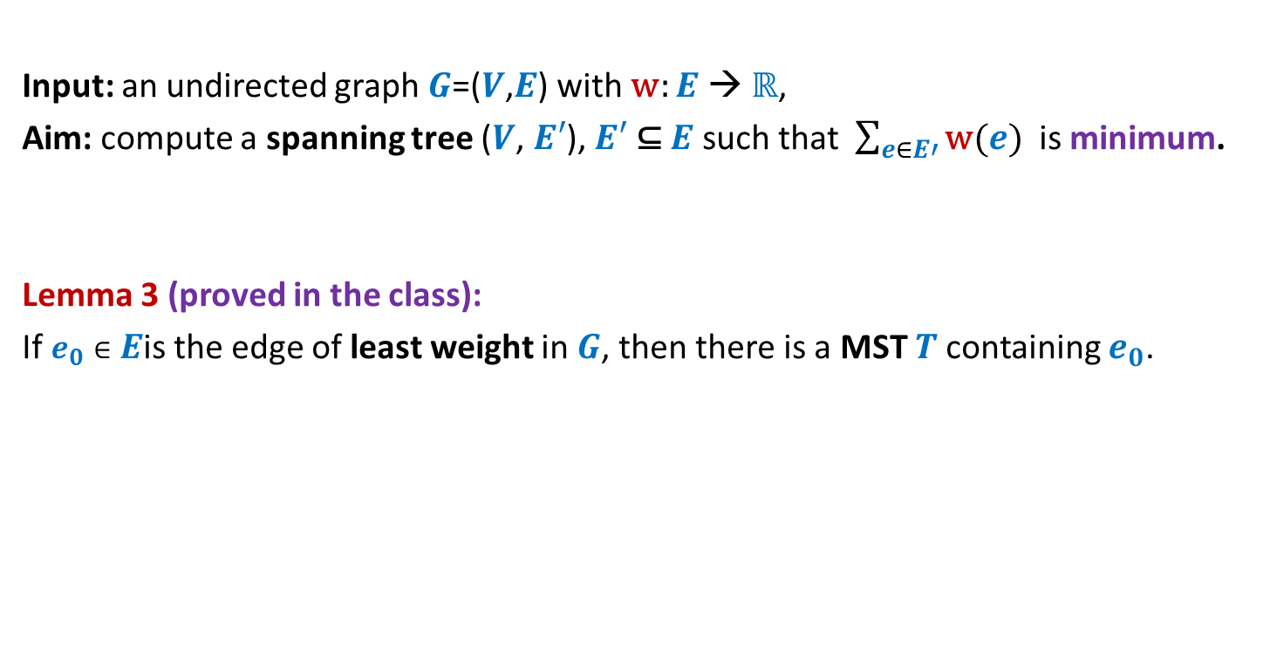
MST
Input: an undirected graph $G$=($V$,$E$) with w: $E$ → ℝ,
Aim: compute a spanning tree ($V$, $E′$), $E′$ ⊆ $E$ such that $\sum_{e∈E′}{\text{w}(e)}$ is minimum.
Lemma 3 (proved in the class):
If $e_{0}∈E$is the edge of least weight in $G$, then there is a MST $T$containing $e_{0}$.
If you have understood a generic way to design a greedy algorithm, then try to solve the MST problem.
How to use this Lemma to design an algorithm for MST ?

Slide 12
How to compute a MST ?
170
54
33
63
35
50
70
31
41
81
64
78
53
42
52
80
49
54
42
60
44
43
50
30
49
57
29
102

Slide 13
How to compute a MST ?
170
54
33
63
35
50
70
31
41
81
64
78
53
42
52
80
49
54
42
60
44
43
50
30
49
57
u
29
102
v

Slide 14
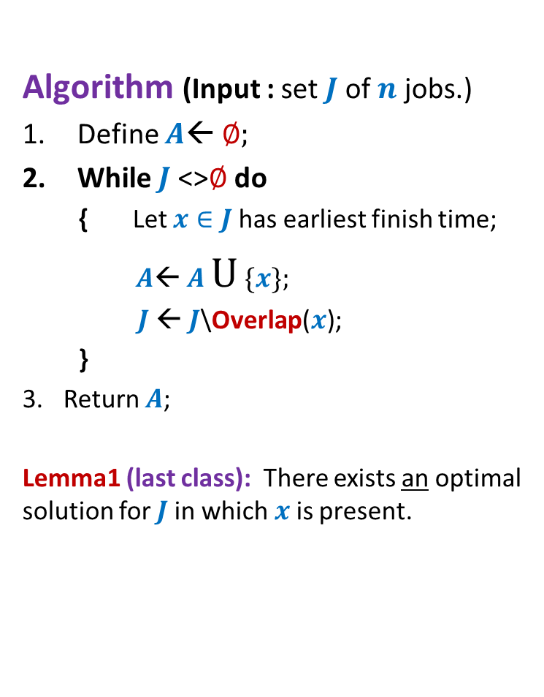
How to compute a MST ?
170
54
33
63
35
50
70
31
41
81
64
78
53
42
52
80
49
54
42
44
60
43
50
30
49
57
w
102
This is graph $G′$

Slide 15
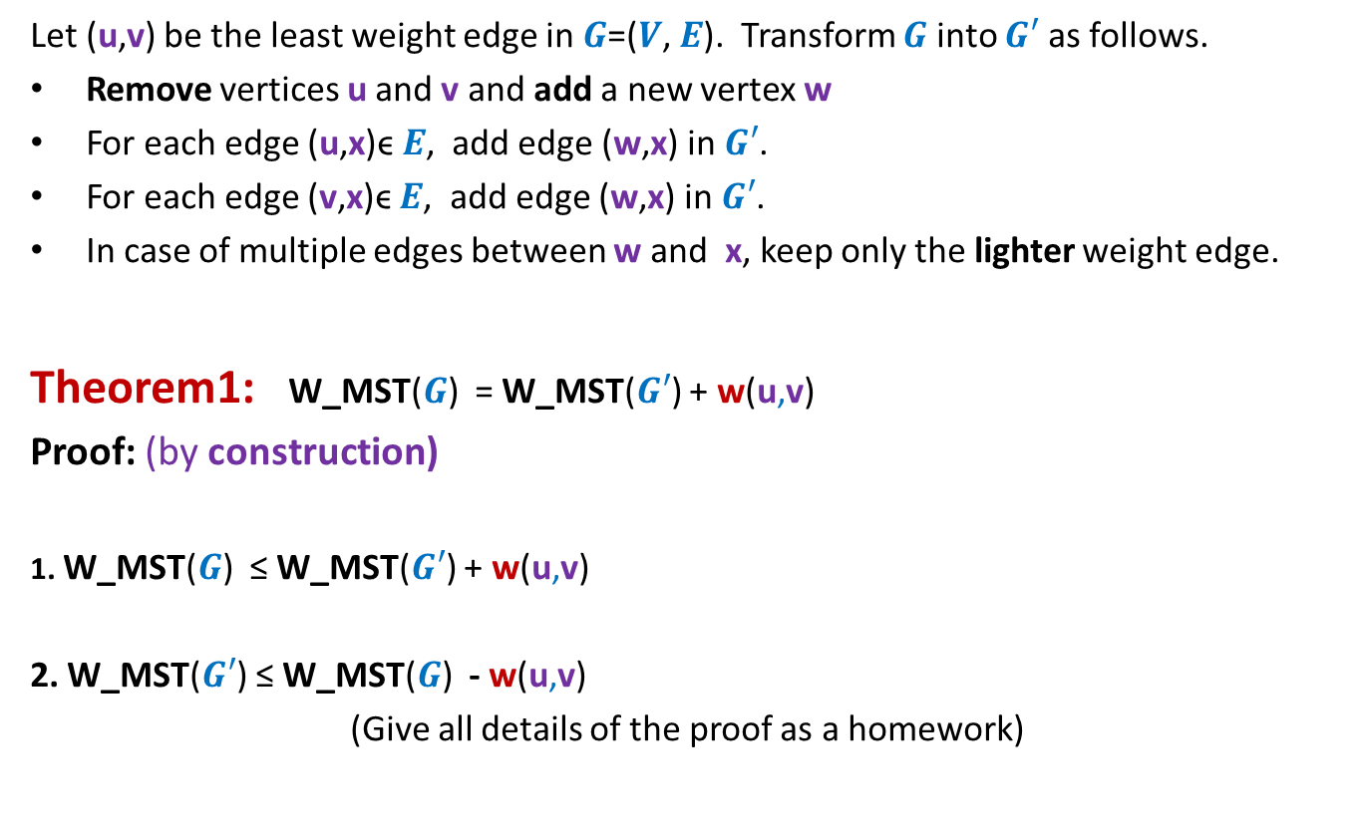
How to compute a MST ?
Let (u,v) be the least weight edge in $G$=($V$, $E$). Transform $G$ into $G′$ as follows.
Remove vertices u and v and add a new vertex w
For each edge (u,x)ϵ $E$, add edge (w,x) in $G′$.
For each edge (v,x)ϵ $E$, add edge (w,x) in $G′$.
In case of multiple edges between w and x, keep only the lighter weight edge.
Theorem1: W_MST($G$) = W_MST($G′$) + w(u,v)
Proof: (by construction)
1. W_MST($G$) ≤ W_MST($G′$) + w(u,v)
2. W_MST($G′$) ≤ W_MST($G$) - w(u,v)
(Give all details of the proof as a homework)
straightforward
Use Lemma 3

Slide 16
Problem 4 Overlapping Intervals
The aim of this problem is to make you realize that
it is sometime very nontrivial to design a greedy algorithm. In particular, it is quite challenging to design the smaller instance.
In the end semester exam of the course, no problem of this level of difficulty will be asked ☺

Slide 17
Problem 4 Overlapping Intervals

Slide 18

Overlapping Intervals
Problem statement:
Given a set A of $n$ intervals, compute smallest set B of intervals so that
for every interval I in A\B, there is some interval in B which overlaps/intersects with I.
A

Slide 19
Overlapping Intervals
Problem statement:
Given a set A of $n$ intervals, compute smallest set B of intervals so that
for every interval I in A\B, there is some interval in B which overlaps/intersects with I.
A
Not an optimal solution ☹
another optimal solution ☺
an optimal solution ☺

Slide 20
Overlapping Intervals
Strategy 1
Interval with maximum length should be there in optimal solution
Intuition:
Selecting such an interval will cover maximum no. of other intervals
There is a counter example ☹

Slide 21
Overlapping Intervals
Strategy 1
Interval with maximum length should be there in optimal solution
Intuition:
Selecting such an interval will cover maximum no. of other intervals
There is a counter example ☹

Slide 22
Overlapping Intervals
Strategy 2
Interval that overlaps maximum no. of intervals should be there in optimal solution
Intuition:
Selecting such an interval will cover maximum no. of other intervals
There is a counter example ☹

Slide 23
Overlapping Intervals
Strategy 2
Interval that overlaps maximum no. of intervals should be there in optimal solution

Slide 24
Overlapping Intervals
Strategy 2
Interval that overlaps maximum no. of intervals should be there in optimal solution
Not an optimal solution ☹

Slide 25
Overlapping Intervals
Strategy 2
Interval that overlaps maximum no. of intervals should be there in optimal solution
An optimal solution has size 2.
Think for a while :
After failure of two strategies, how to proceed to design the algorithm.

Slide 26
Overlapping Intervals
Let I* be the interval with earliest finish time.
Let I’ be the interval with maximum finish time overlapping I*.
Lemma1: There is an optimal solution for set A that contains I’.
Proof:(sketch) :
If I* is overlapped by any other interval in the optimal solution, say I^,
I’ will surely overlap all intervals that are overlapped by I^.
➔ Swapping I^ by I’ will still give an optimal solution.
I’
A
I*
Exploit the fact that I* has earliest finish time for this claim.

Slide 27
Overlapping Intervals
Question: How to obtain smaller instance A’ using Lemma 1 ?
I’
A
I*

Slide 28
Overlapping Intervals
Question: How to obtain smaller instance A’ using Lemma 1 ?
Naive approach : remove from A all intervals which overlap with I’. This is A’.
The problem is that some deleted interval (in this case I’’) could have been used for intersecting many intervals if it were not deleted. But deleting it from the instance disallows it to be selected in the solution.
There is a counter example ☹
A’
I’
A
I*
I’’

Slide 29
Homework for the summer break
How will you form the smaller instance ?
Design an algorithm for the problem.
Give a neat, concise, and formal proof of correctness of the algorithm.
If you try sincerely and don’t give up quickly,
you will surely be able to solve this problem.
We can discuss it during next semester in some doubt clearing session.
You have to bear with me for one more semester in CS345 ☺.

