Slide 1
Data Structures and Algorithms (CS210A)
Lecture 38
An interesting problem:
shortest path from a source to destination
Sorting Integers

Slide 2
Shortest pathS in a graph
A fundamental problem

Slide 3


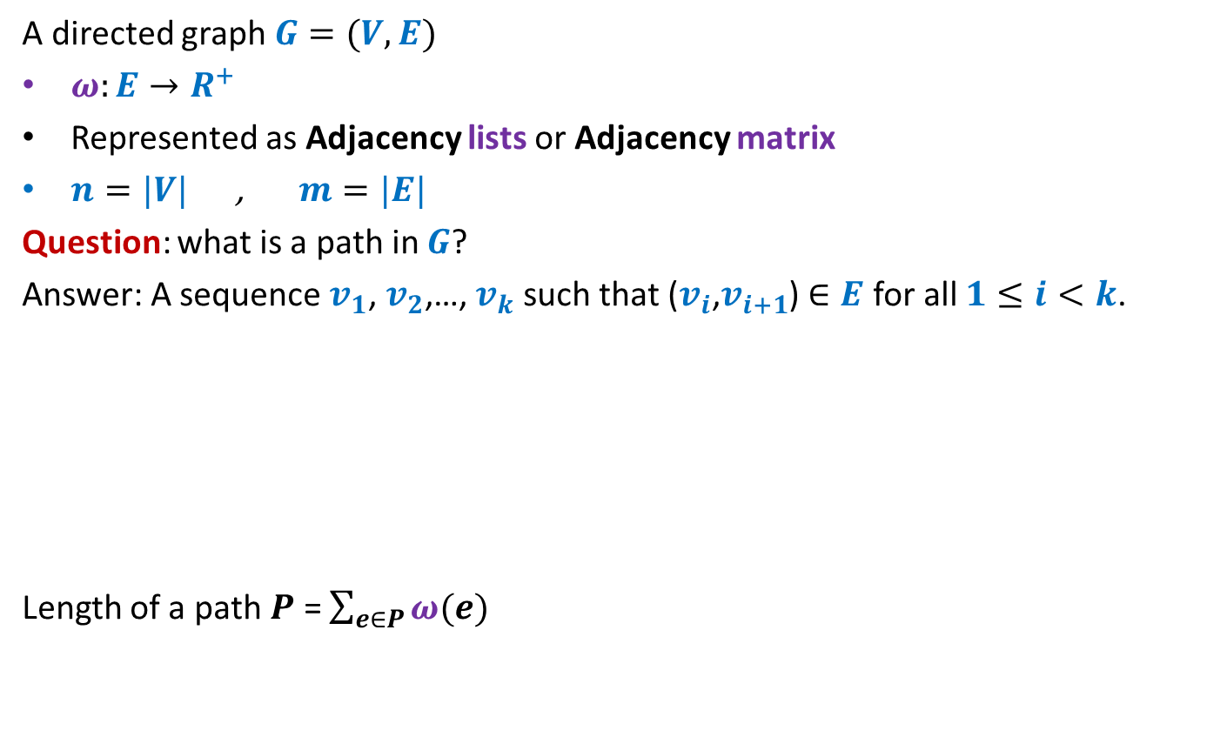



Notations and Terminologies
A directed graph $G=(V,E)$
$ω:E→R^{+}$
Represented as Adjacency lists or Adjacency matrix
$n=|V|$ , $m=|E|$
Question: what is a path in $G$?
Answer: A sequence $v_{1}$, $v_{2}$,…, $v_{k}$ such that ($v_{i}$,$v_{i+1}$) $∈E$ for all $1≤i<k$.
Length of a path $P$ = $\sum_{e∈P}{ω(e)}$
12
3
…
29
$$v_{1}$$
$$v_{2}$$
$$v_{3}$$
$$v_{k−1}$$
$$v_{k}$$

Slide 4

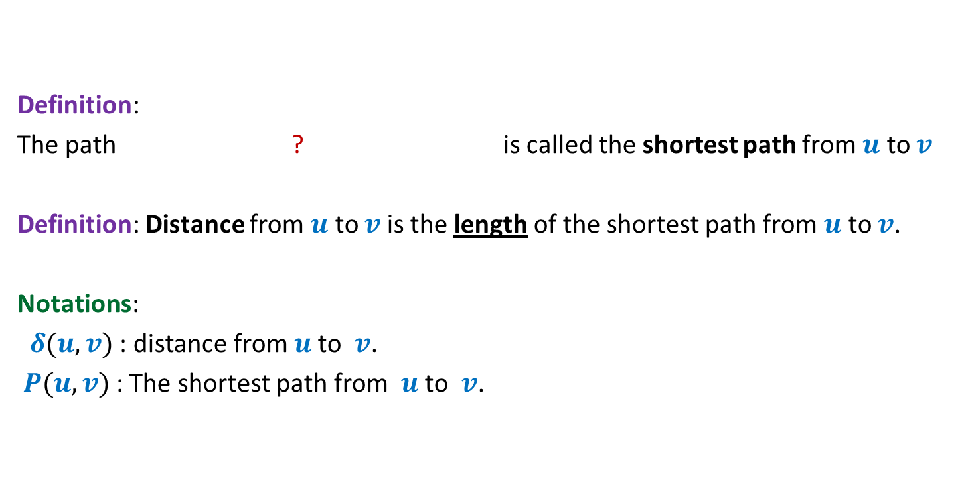
Notations and Terminologies
Definition:
The path ? is called the shortest path from $u$ to $v$
Definition: Distance from $u$ to $v$is the length of the shortest path from $u$ to $v$.
Notations:
$δ(u,v)$ : distance from $u$to $v$.
$P(u,v)$ : The shortest path from $u$to $v$.
from $u$ to $v$of minimum length

Slide 5
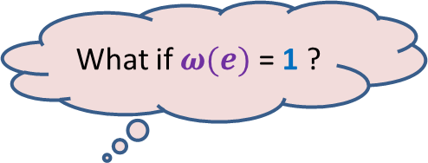


Problem Definition
Input: A directed graph $G=(V,E)$ with $ω:E→R^{+}$ and a source vertex $s∈V$
Aim:
Compute $δ(s,v)$ for all $v∈V\backslash \{s\}$
Compute $P(s,v)$ for all $v∈V\backslash \{s\}$
What if $ω(e)$ = 1 ?
Do BFS from $s$
☺

Slide 6
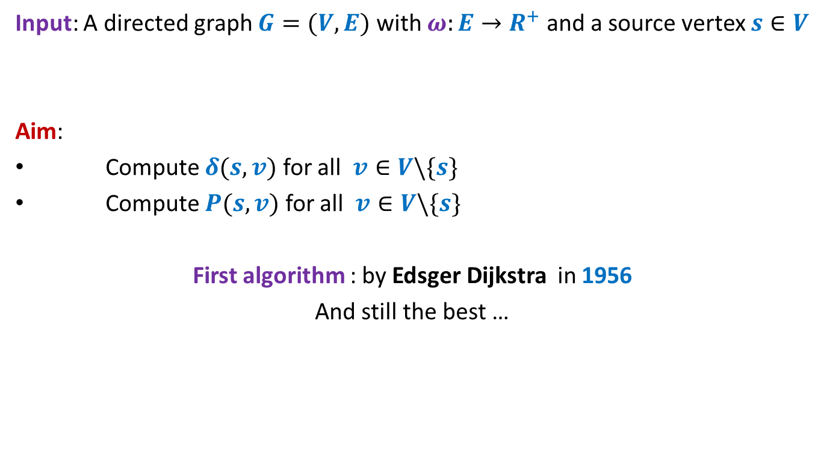
Problem Definition
Input: A directed graph $G=(V,E)$ with $ω:E→R^{+}$ and a source vertex $s∈V$
Aim:
Compute $δ(s,v)$ for all $v∈V\backslash \{s\}$
Compute $P(s,v)$ for all $v∈V\backslash \{s\}$
First algorithm : by Edsger Dijkstra in 1956
And still the best …
I am sure you will be able to re-invent it yourself if you are asked right questions ☺ So get ready !

Slide 7







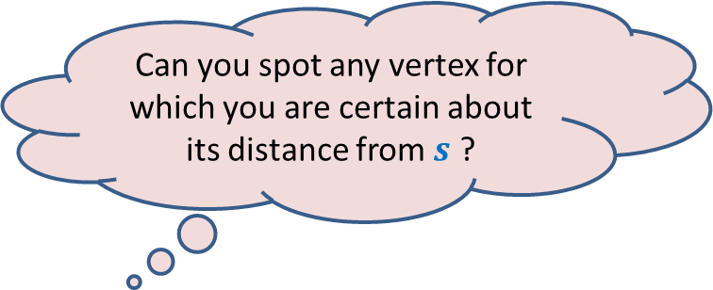
An Example
Answer: vertex $u$.
$$z$$
10
$$v$$
G
12
7
$$x$$
$$s$$
3
5
$$u$$
$$y$$
Can you spot any vertex for which you are certain about its distance from $s$ ?
Give reasons.

Slide 8

An Example
$$z$$
10
$$v$$
G
12
7
$$x$$
$$s$$
3
5
$$u$$
$$y$$
$$>0$$

Slide 9

An Example
Yes, the edge ($s$, $u$) is indeed the shortest path to $u$.
$$z$$
10
$$v$$
G
12
7
$$x$$
$$s$$
3
5
$$u$$
$$y$$
To form a smaller instance of the problem.
But how ?
Does it remind you something from recent past ? ☺
How to use it to design an algorithm for shortest paths ?
Greedy Strategy.
Right, so what should be your next step ?

Slide 10

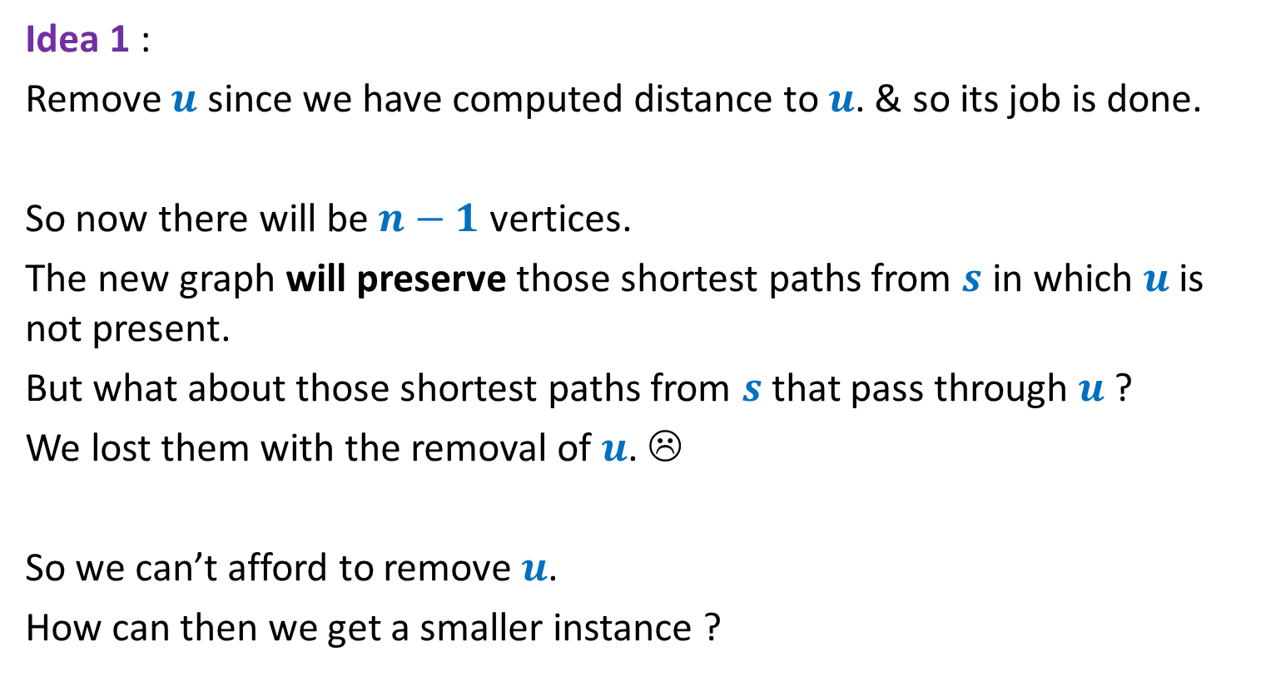
Pondering over the problem
Idea 1 :
Remove $u$ since we have computed distance to $u$. & so its job is done.
So now there will be $n−1$ vertices.
The new graph will preserve those shortest paths from $s$ in which $u$is not present.
But what about those shortest paths from $s$ that pass through $u$ ?
We lost them with the removal of $u$. ☹
So we can’t afford to remove $u$.
How can then we get a smaller instance ?
Merging $s$ and $u$☺
But how ?

Slide 11



An Example
$$z$$
10
$$v$$
G
12
7
2
$$x$$
$$s$$
21
$$t$$
3
5
$$u$$
3
8
$$y$$
$$r$$
Let us look carefully around $u$?

Slide 12

An Example
$$z$$
10
$$v$$
12
7
+3
G’
2
+3
$$x$$
21
$$t$$
$$s$$
5
+3
+3
8
3
$$y$$
$$r$$

Slide 13
An Example
$$z$$
10
$$v$$
G’
12
7
5
$$x$$
24
$$t$$
$$s$$
5
6
11
$$y$$
$$r$$

Slide 14
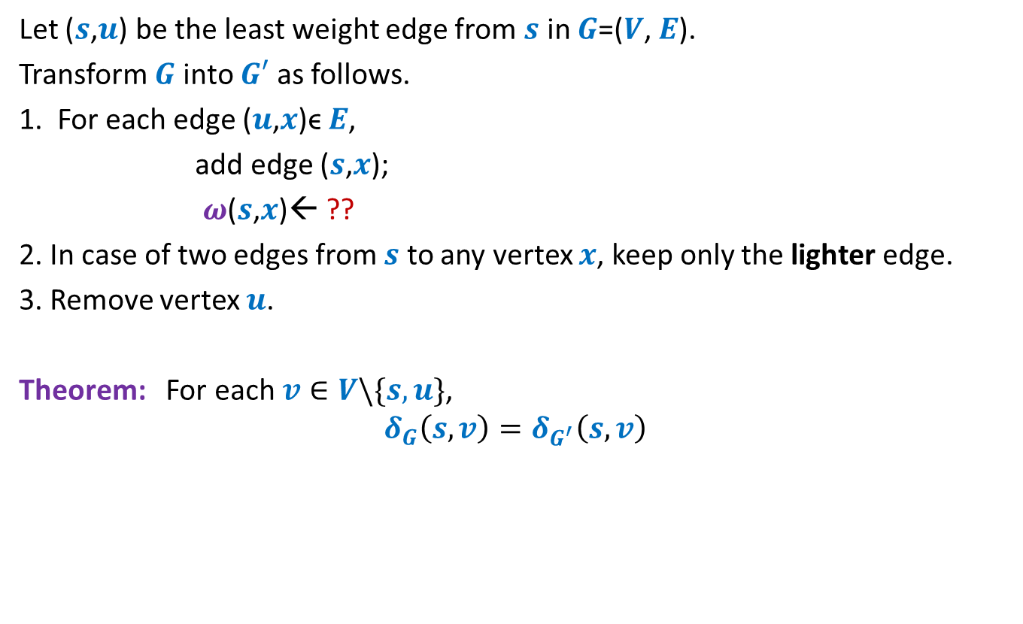


How to compute instance $G′$
Let ($s$,$u$) be the least weight edge from $s$ in $G$=($V$, $E$).
Transform $G$ into $G′$ as follows.
1. For each edge ($u$,$x$)ϵ $E$,
add edge ($s$,$x$);
$ω$($s$,$x$)← ??
2. In case of two edges from $s$ to any vertex $x$, keep only the lighter edge.
3. Remove vertex $u$.
Theorem: For each $v∈V\backslash \{s,u\}$,
$$δ_{G}\left(s,v\right)=δ_{G^{′}}\left(s,v\right)$$
$ω$($s$,$u$) + $ω$($u$,$x$);
How efficient an algorithm for shortest paths can you design ?

Slide 15



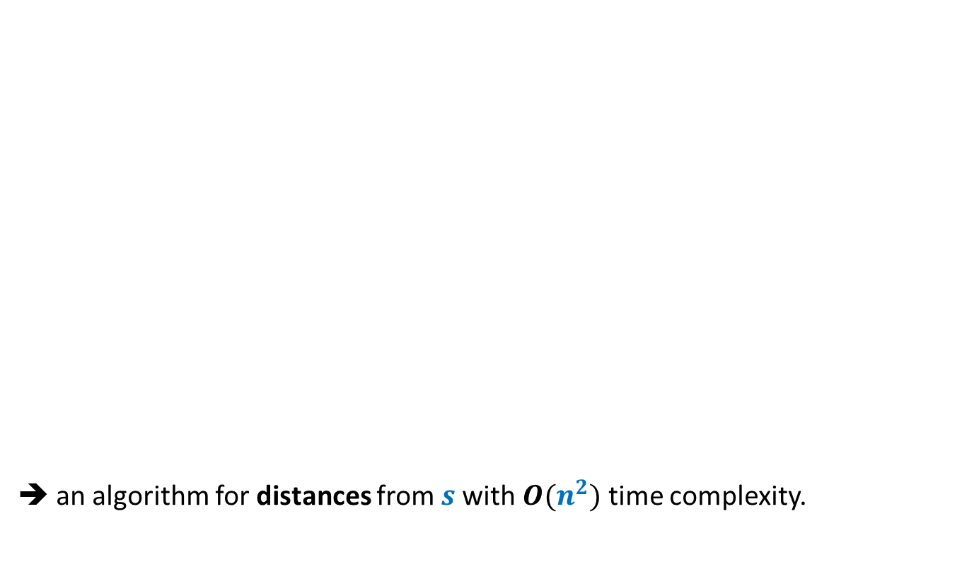



No. of vertices
➔ an algorithm for distances from $s$with $O(n^{2})$ time complexity.
($G$, $s$)
$$n$$
O($n$) time
Building
$G′$
($G′$, $s$)
$$n−1$$

Slide 16
Integer sorting

Slide 17

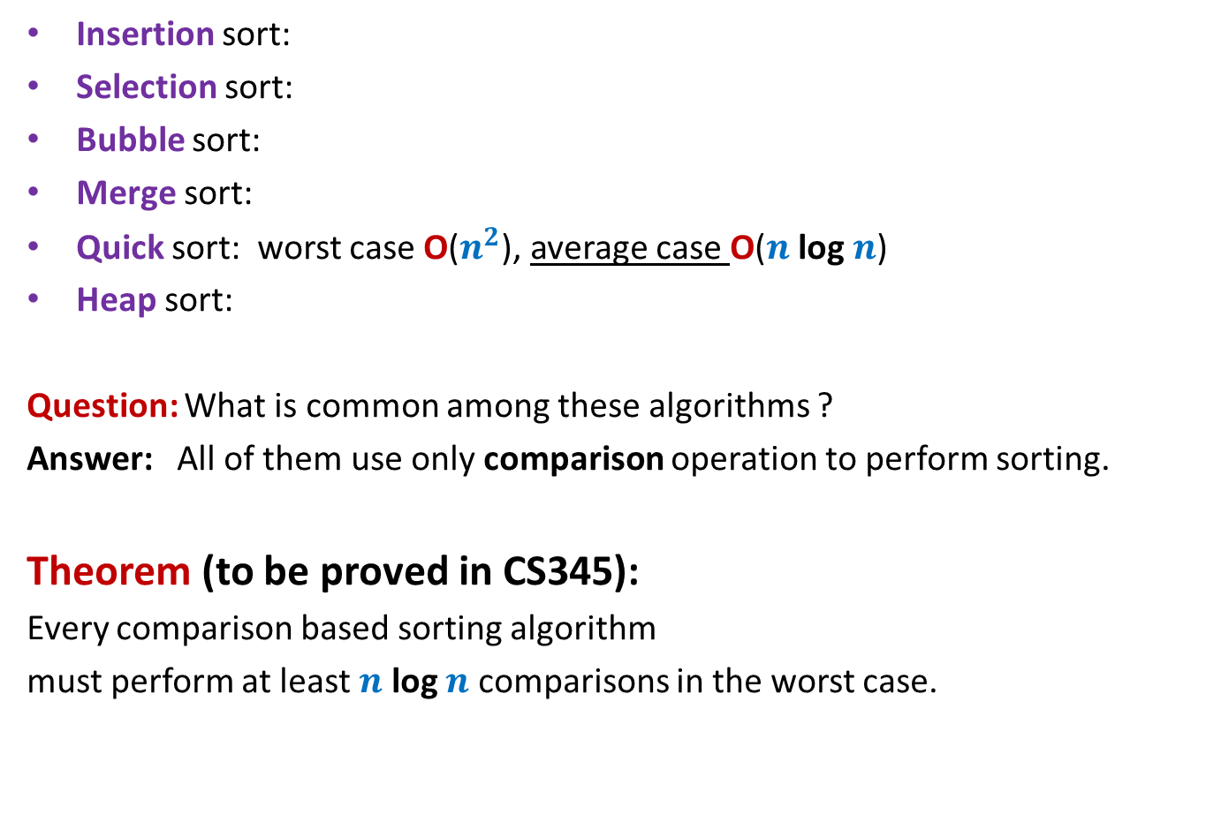





Algorithms for Sorting $n$ elements
Insertion sort:
Selection sort:
Bubble sort:
Merge sort:
Quick sort: worst case O($n^{2}$), average case O($n$ log $n$)
Heap sort:
Question: What is common among these algorithms ?
Answer: All of them use only comparison operation to perform sorting.
Theorem (to be proved in CS345):
Every comparison based sorting algorithm
must perform at least $n$ log $n$ comparisons in the worst case.
O($n^{2}$)
O($n^{2}$)
O($n^{2}$)
O($n$ log $n$)
O($n$ log $n$)

Slide 18
Question: Can we sort in O($n$) time ?
The answer depends upon
the model of computation.
the domain of input.

Slide 19
Integer sorting

Slide 20

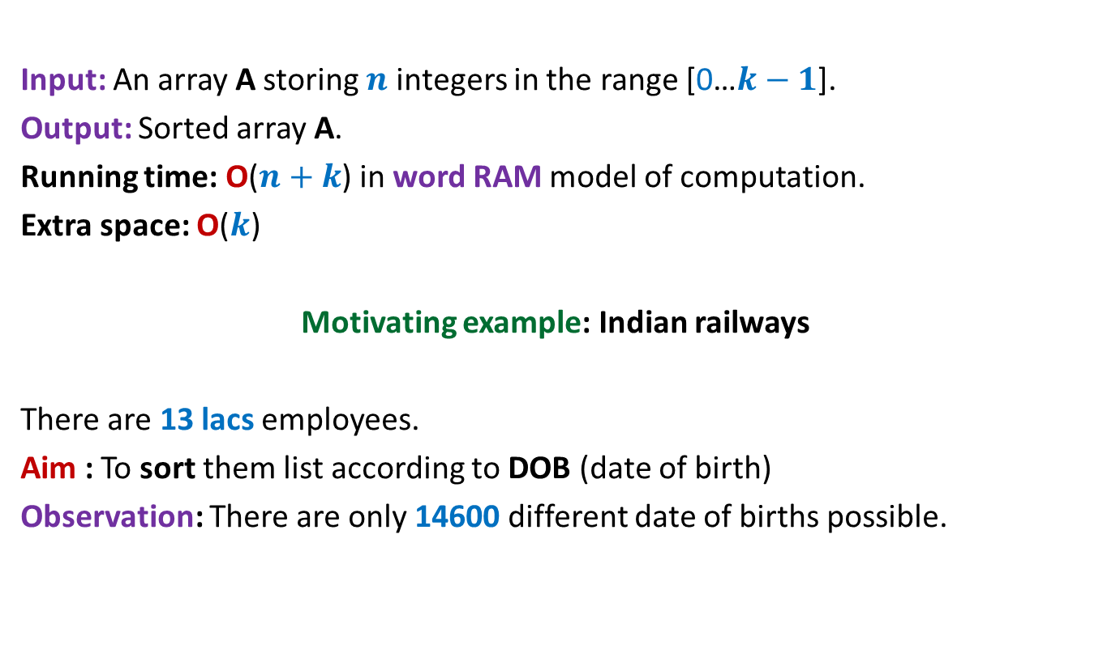
Counting sort: algorithm for sorting integers
Input: An array A storing $n$ integers in the range [0…$k−1$].
Output: Sorted array A.
Running time: O($n+k$) in word RAM model of computation.
Extra space: O($k$)
Motivating example: Indian railways
There are 13 lacs employees.
Aim : To sort them list according to DOB (date of birth)
Observation: There are only 14600 different date of births possible.
$k$= O($n$)

Slide 21
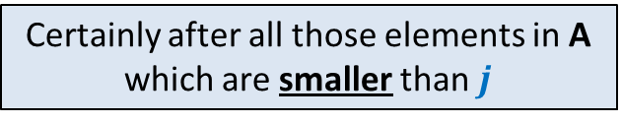

Counting sort: algorithm for sorting integers
0 1 2 3 4 5 6 7
If A[$i$]=$j$,
where should A[$i$] be placed in B ?
A
2 5 3 0 2 3 0 3
0 1 2 3 4 5
Count
2
0
2
3
0
1
Certainly after all those elements in A which are smaller than $j$
0 1 2 3 4 5
Place
2 2 4 7 7 8
0 1 2 3 4 5 6 7
B
3
Final sorted output

Slide 22
Counting sort: algorithm for sorting integers
0 1 2 3 4 5 6 7
A
2 5 3 0 2 3 0 3
0 1 2 3 4 5
Count
2
0
2
3
0
1
0 1 2 3 4 5
Place
2 2 4 6 7 8
0 1 2 3 4 5 6 7
B
0
3

Slide 23
Counting sort: algorithm for sorting integers
0 1 2 3 4 5 6 7
A
2 5 3 0 2 3 0 3
0 1 2 3 4 5
Count
2
0
2
3
0
1
0 1 2 3 4 5
Place
1 2 4 6 7 8
0 1 2 3 4 5 6 7
B
0
3
3

Slide 24

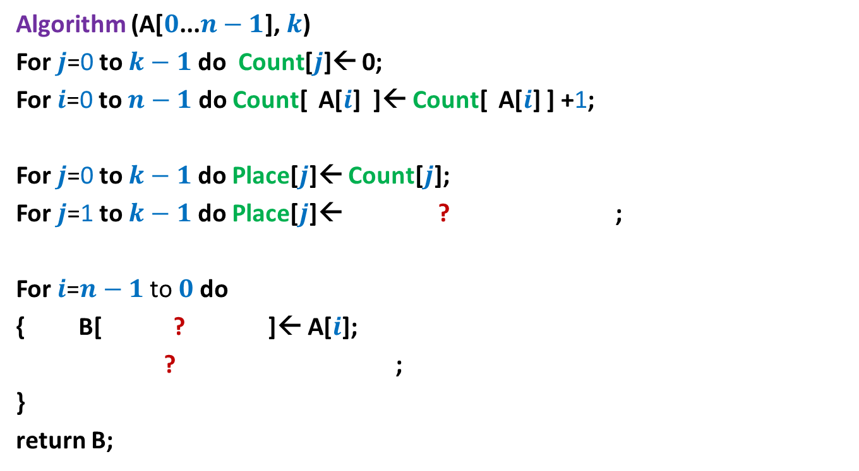


Counting sort: algorithm for sorting integers
Algorithm (A[$0$...$n−1$], $k$)
For $j$=0 to $k−1$ do Count[$j$]← 0;
For $i$=0 to $n−1$ do Count[ A[$i$] ]← Count[ A[$i$] ] +1;
For $j$=0 to $k−1$ do Place[$j$]← Count[$j$];
For $j$=1 to $k−1$ do Place[$j$]← ? ;
For $i$=$n−1$ to $0$do
{ B[ ? ]← A[$i$];
? ;
}
return B;
Place[$j−1$] + Count[$j$]
Place[A[$i$]]-1
What is the time complexity of this algorithm in word RAM model ?
Place[A[$i$]] ← Place[A[$i$]]-1;

