Slide 1
Data Structures and Algorithms (CS210A)
Lecture 41
Miscellaneous problems

Slide 2





Order notation
Definition: Let f($n$) and g($n$) be any two increasing functions of n.
f($n$) is said to be of the order of g($n$)
if there exist constants c and $n_{0}$such that
f($n$) ≤ c g($n$) for all n > $n_{0}$
f($n$) = O(g($n$))
c g($n$)
f($n$)
$$n_{0}$$

Slide 3
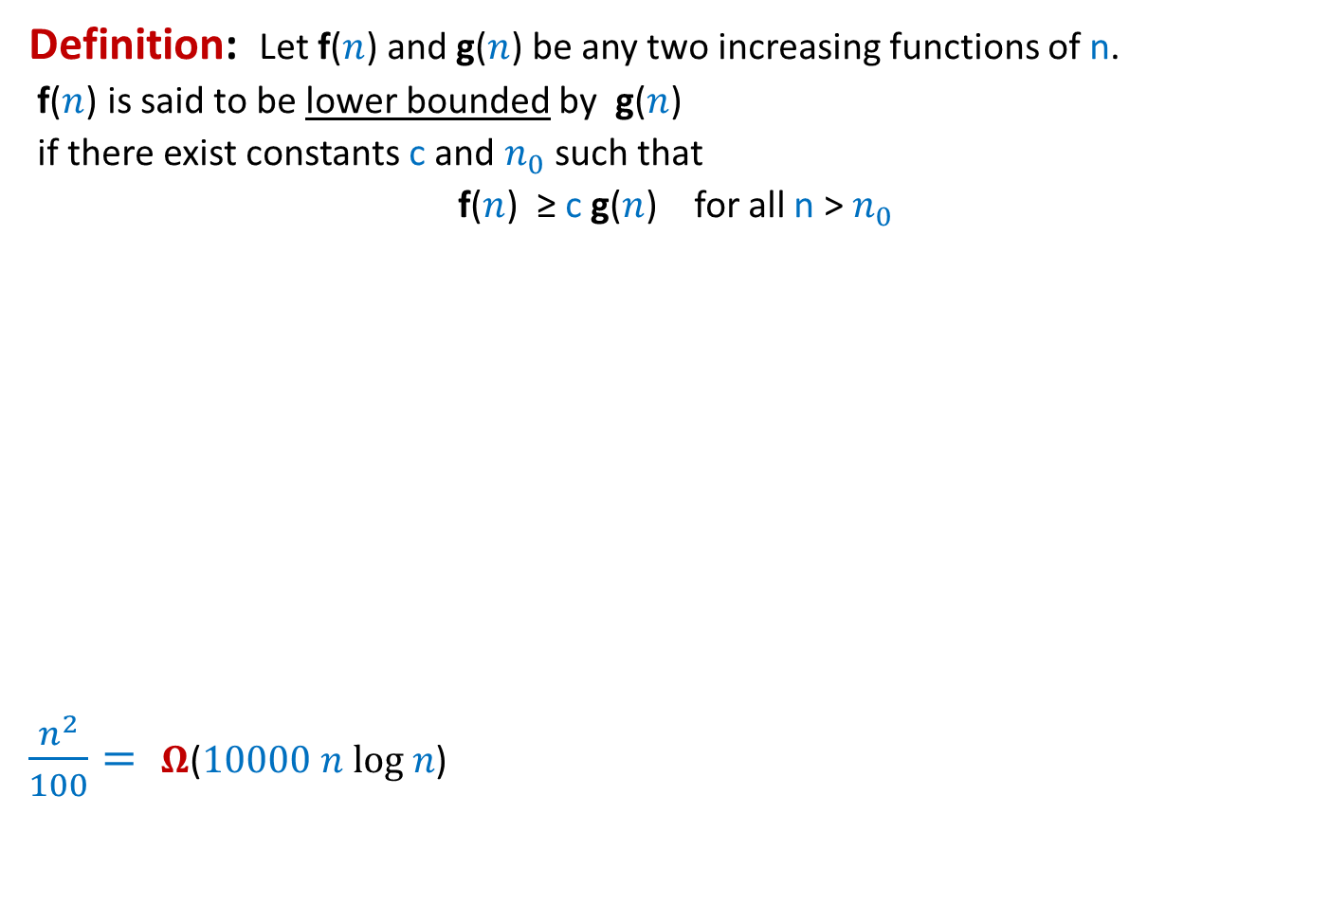



Order notation extended
Definition: Let f($n$) and g($n$) be any two increasing functions of n.
f($n$) is said to be lower bounded by g($n$)
if there exist constants c and $n_{0}$such that
f($n$) ≥ c g($n$) for all n > $n_{0}$
$\frac{n^{2}}{100}= Ω$($10000 n log n$)
f($n$) = $Ω$(g($n$))
f($n$)
c g($n$)
$$n_{0}$$

Slide 4

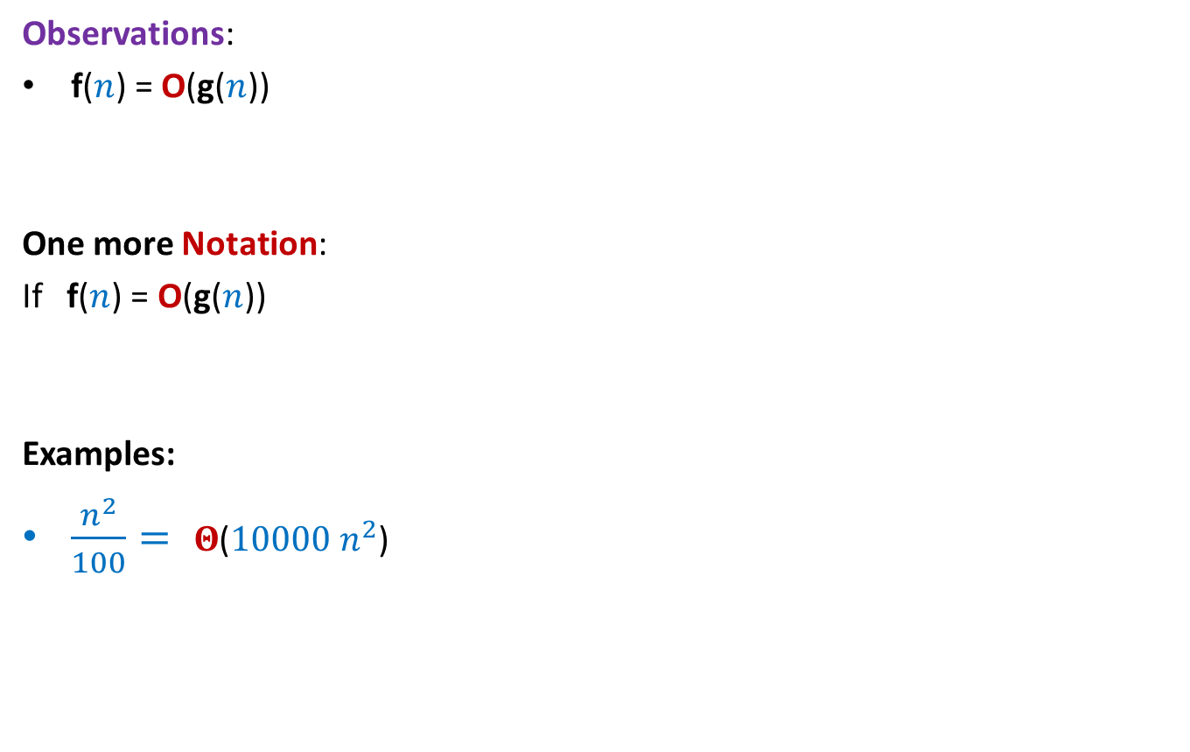


Order notation extended
Observations:
f($n$) = O(g($n$))
One more Notation:
If f($n$) = O(g($n$))
Examples:
$\frac{n^{2}}{100}= Θ$($10000 n^{2}$)
if and only if
g($n$) = $Ω$(f($n$))
and
g($n$) = $O$(f($n$))
, then
g($n$) = $Θ$(f($n$))

Slide 5


Time complexity of Quick Sort is ?
Time complexity of Merge sort is ?
$Ω$($n$ log $n$)
$Θ$($n$ log $n$)

Slide 6
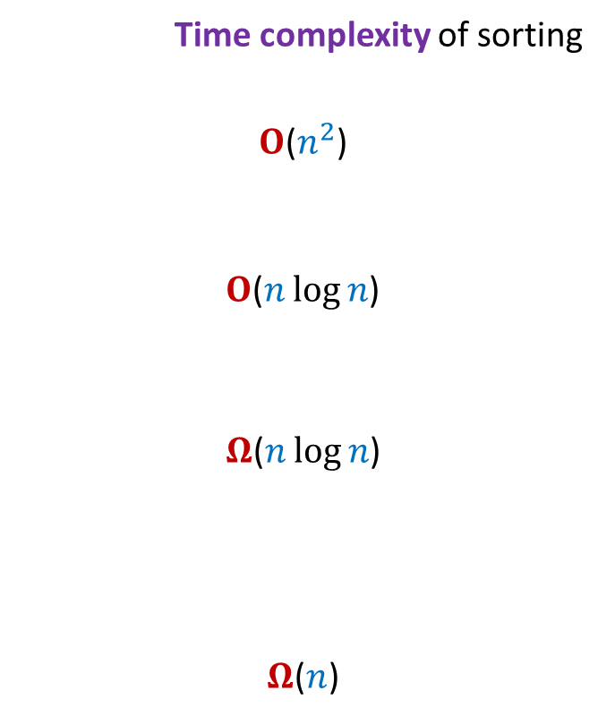
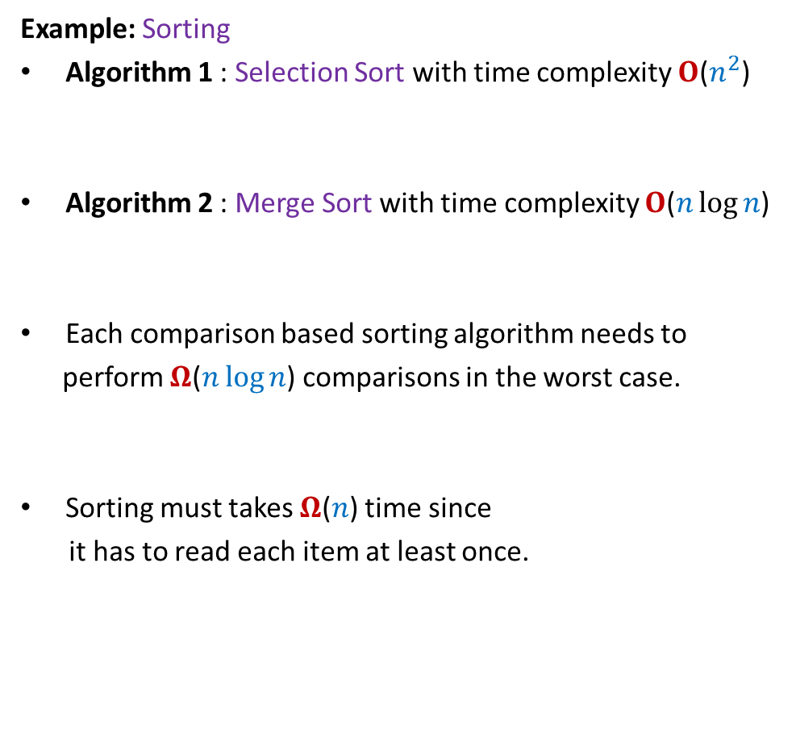
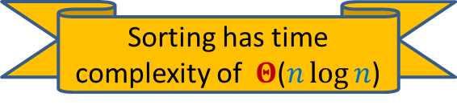
Time complexity of a problem
Time complexity of sorting
$O$($n^{2}$)
$O$($n\log{n}$)
$Ω$($n\log{n}$)
$Ω$($n$)
Example: Sorting
Algorithm 1 : Selection Sort with time complexity $O$($n^{2}$)
Algorithm 2 : Merge Sort with time complexity $O$($n\log{n}$)
Each comparison based sorting algorithm needs to
perform $Ω$($n\log{n}$) comparisons in the worst case.
Sorting must takes $Ω$($n$) time since
it has to read each item at least once.
Upper bound
Lower bound
Sorting has time complexity of $Θ$($n\log{n}$)

Slide 7

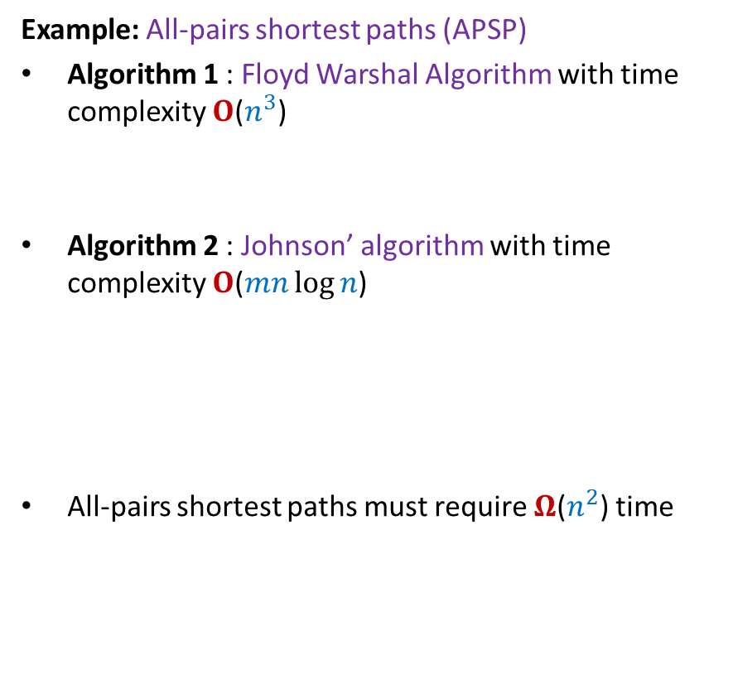
Time complexity of a problem
Time complexity of APSP
$O$($n^{3}$)
$O$($mn\log{n}$)
$Ω$($n^{2}$)
Example: All-pairs shortest paths (APSP)
Algorithm 1 : Floyd Warshal Algorithm with time complexity $O$($n^{3}$)
Algorithm 2 : Johnson’ algorithm with time complexity $O$($mn\log{n}$)
All-pairs shortest paths must require $Ω$($n^{2}$) time
Upper bound
Lower bound
There is still a gap between upper and lower bounds for APSP. ☹

Slide 8
Aim of theoretical computer science
For any given computational problem P
Get smallest possible upper bound on its time complexity
Get largest possible lower bound on its time complexity.
This requires designing better algorithm
Reduce the GAP
?

Slide 9
How to establish lower bound
Two ways:
Adversarial approach
Limitation of the model of computation
A gentle introduction today
CS345

Slide 10
Adversarial approach
Key aspects
Algorithm:
Algorithm does not have free access to the input.
To access any item in the input, algorithm has to spend some time.
The execution of an algorithm at any step is determined
only by the (partial) input it has seen till now.
Adversary
Adversary has access to all possible inputs of a problem.
The sole aim of adversary is to make an algorithm work really hard.
For this purpose, adversary discloses the input cleverly.

Slide 11


Locating 1 problem
Input: An array A[$0...n−1$] with an unknown $i$ s.t.
For all $j≠i$,
A[$i$]$=1$
Aim: To locate/search 1 in A.
Upper bound: O($n$)
Lower bound: $Ω$($n$)
A[$j$]$=0$

Slide 12








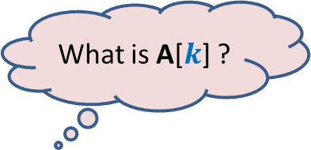

Lower bound on Locating 1 problem
What is A[$i$]?
What is A[$j$] ?
What is A[$k$] ?
Input
Algorithm
$$0$$
$$0$$
$$0$$
$$0$$
$$0$$
$$0$$
$$1$$
$$0$$
$$0$$
$$0$$
A
$$j$$
$$k$$
$$i$$
Adversary

Slide 13
Miscellaneous problems

Slide 14


Problem 1
Input: Given an array A storing $n$ numbers,
there is an $i<n$ (unknown) s.t.
A[$0$]$<$ A[$1$]$<$ …$<$ A[$i$]
Aim:
To search efficiently
Answer : O(log $n$) is possible
$>$A[$i+1$] $>$… $>$A[$n−1$]
sorted
sorted
$3 7 24 31 42 47 59 63 71 85 191 102 91 43 17$
$$i$$

Slide 15

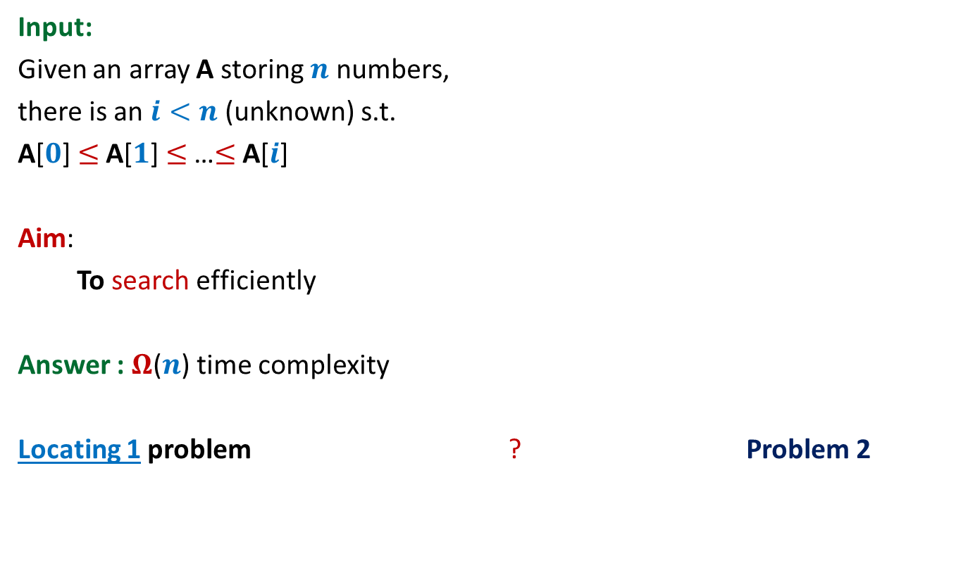
Problem 2
Input:
Given an array A storing $n$ numbers,
there is an $i<n$ (unknown) s.t.
A[$0$]$≤$ A[$1$]$≤$ …$≤$ A[$i$]
Aim:
To search efficiently
Answer : $Ω$($n$) time complexity
Locating 1 problem ? Problem 2
$≥$A[$i+1$] $≥$… $≥$A[$n−1$]
is a special case of

Slide 16

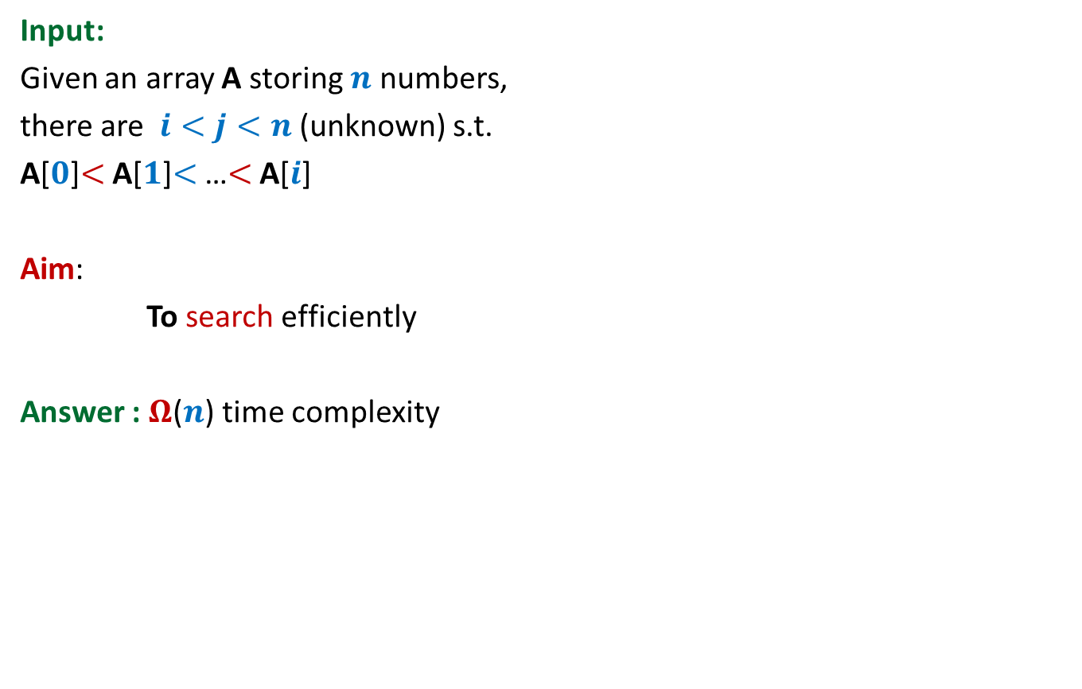

Problem 3
Input:
Given an array A storing $n$ numbers,
there are $i<j<n$ (unknown) s.t.
A[$0$]$<$ A[$1$]$<$ …$<$ A[$i$]
Aim:
To search efficiently
Answer : $Ω$($n$) time complexity
$>$A[$i+1$] $>$… $>$A[$j$]
$<$A[$j+1$] $<$… $<$A[$n−1$]

Slide 17

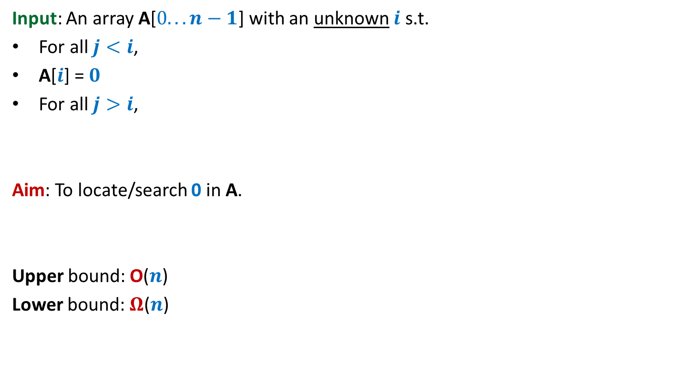



Locating 0 problem
Input: An array A[$0...n−1$] with an unknown $i$ s.t.
For all $j<i$,
A[$i$] = $0$
For all $j>i$,
Aim: To locate/search 0 in A.
Upper bound: O($n$)
Lower bound: $Ω$($n$)
A[$j$]$>0$
and
A[$j−1$] $<$A[$j$]
A[$j$]$>0$
and
A[$j$] $<$A[$j+1$]

Slide 18











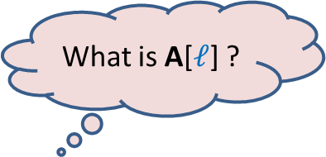




Lower bound on Locating 0 problem
What is A[$i$]?
What is A[$j$] ?
What is A[$ℓ$] ?
What is A[$k$] ?
Input
Algorithm
$$12$$
$$31$$
$$47$$
$$59$$
$$63$$
$$67$$
$$80$$
$$0$$
$$93$$
$$131$$
A
$$ℓ$$
$$j$$
$$k$$
$$i$$
Adversary

Slide 19

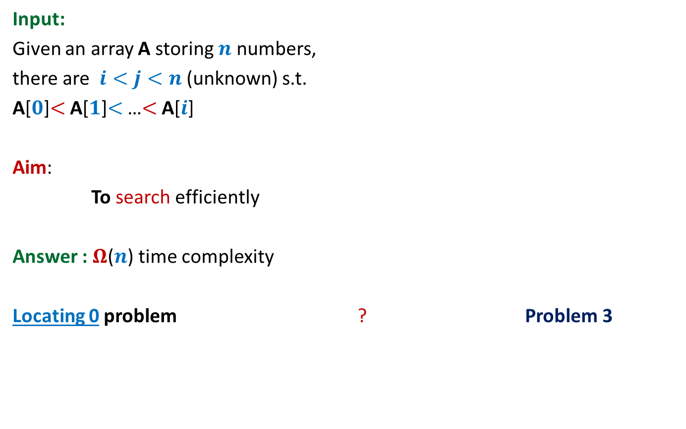
Problem 3
Input:
Given an array A storing $n$ numbers,
there are $i<j<n$ (unknown) s.t.
A[$0$]$<$ A[$1$]$<$ …$<$ A[$i$]
Aim:
To search efficiently
Answer : $Ω$($n$) time complexity
Locating 0 problem ? Problem 3
$>$A[$i+1$] $>$… $>$A[$j$]
$<$A[$j+1$] $<$… $<$A[$n−1$]
is a special case of

Slide 20
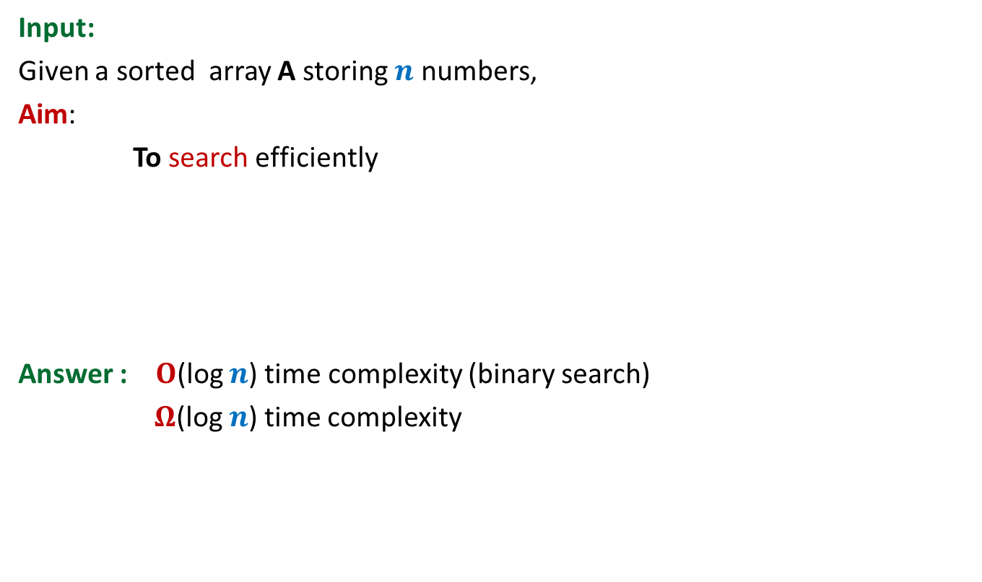
Problem 4
Input:
Given a sorted array A storing $n$ numbers,
Aim:
To search efficiently
Answer : $O$(log $n$) time complexity (binary search)
$Ω$(log $n$) time complexity

Slide 21





Lower bound on Problem 4
What is A[$i$]?
What is A[$j$] ?
A
Input
Algorithm
$$63$$
$$47$$
$$59$$
$$70$$
$$93$$
$$99$$
$$131$$
$$i$$
$$j$$
Search for $85$
Adversary

Slide 22
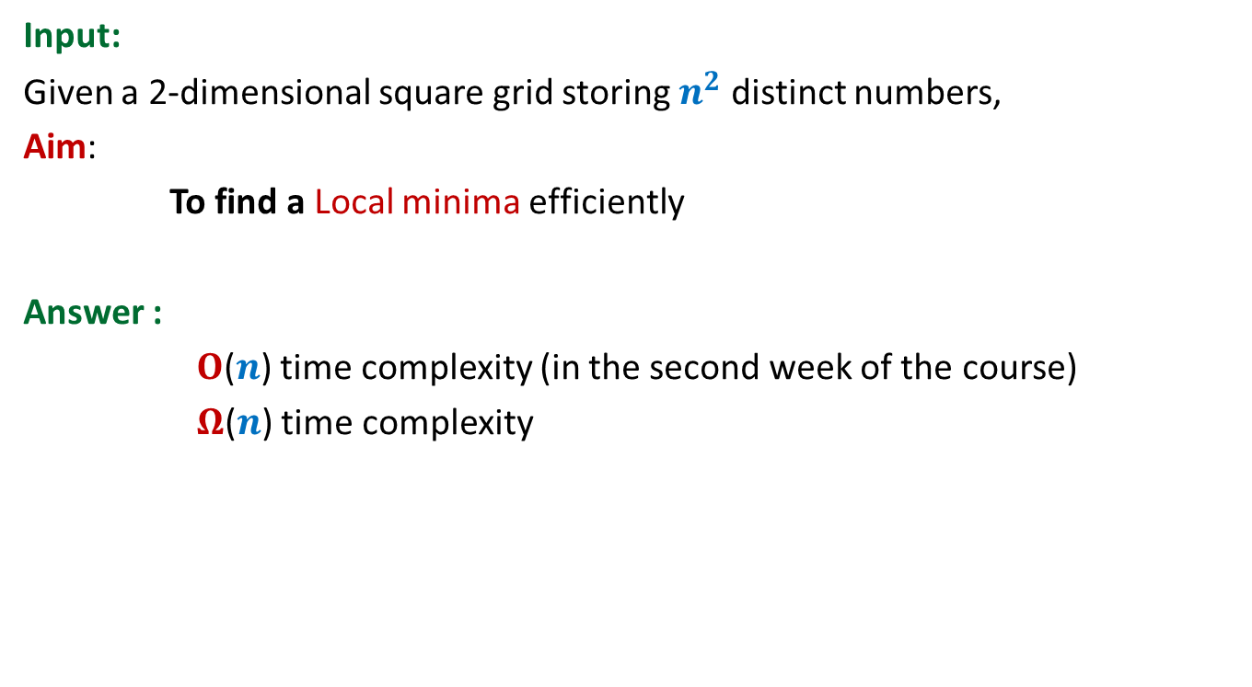
Problem 5
Input:
Given a 2-dimensional square grid storing $n^{2}$ distinct numbers,
Aim:
To find a Local minima efficiently
Answer :
$O$($n$) time complexity (in the second week of the course)
$Ω$($n$) time complexity
Prove it using Adversarial arguments during summer vacations

Slide 23
Final slide
That’s all. I hope you enjoyed this lecture.

