Slide 1
Data Structures and Algorithms (CS210A)
Lecture 7:
Data structure for Range-minima problem
Compact
and
fast

Slide 2
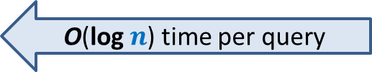
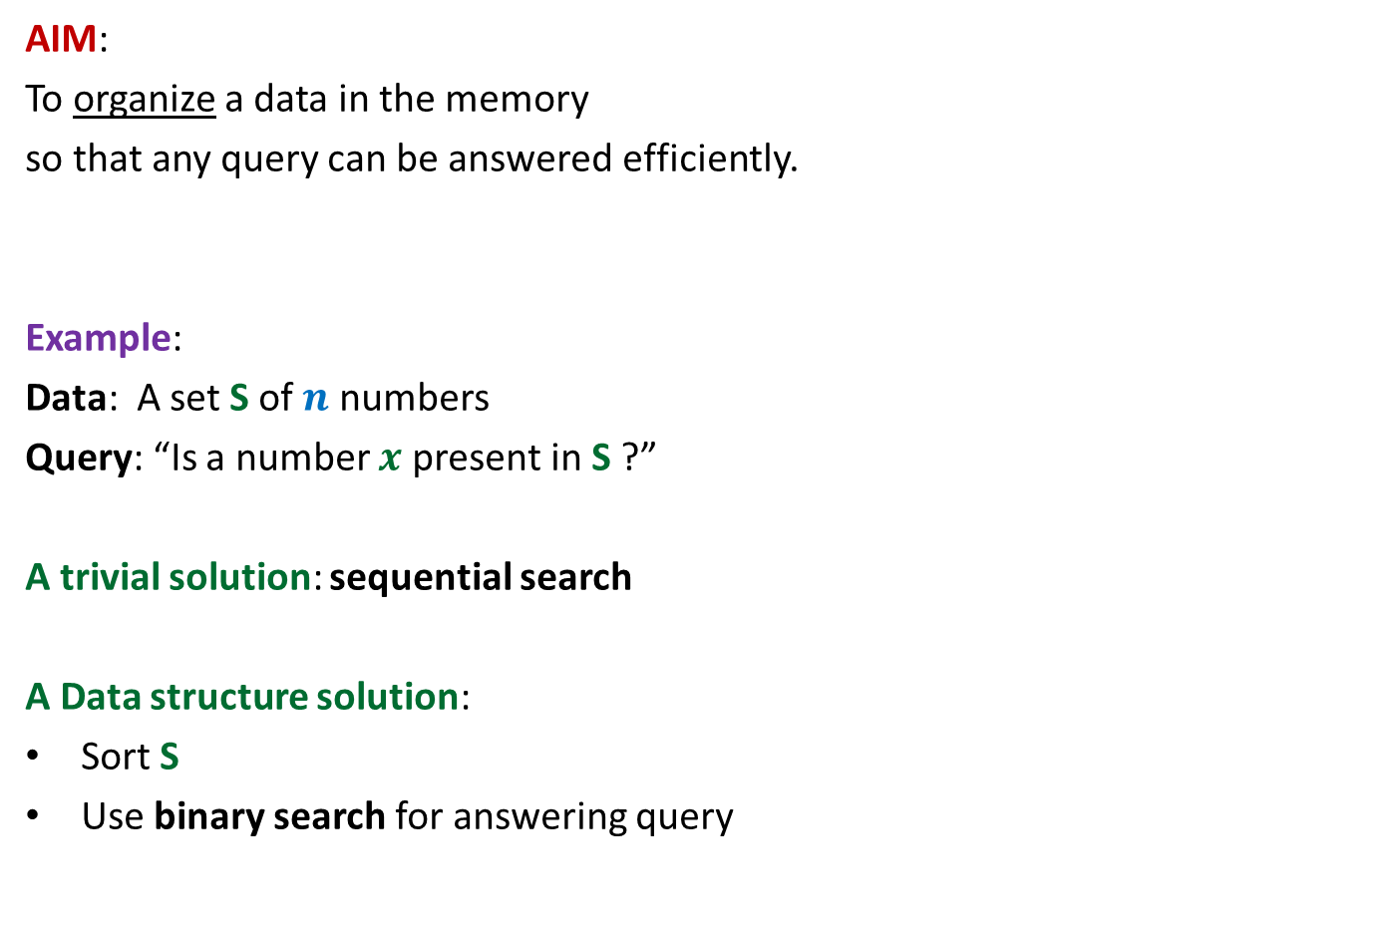


Data structures
AIM:
To organize a data in the memory
so that any query can be answered efficiently.
Example:
Data: A set S of $n$ numbers
Query: “Is a number $x$ present in S ?”
A trivial solution: sequential search
A Data structure solution:
Sort S
Use binary search for answering query
O($n$) time per query
O($n$log $n$) time to build sorted array.
O(log $n$) time per query

Slide 3
Data structures
AIM:
To organize a data in the memory
so that any query can be answered efficiently.
Important assumption:
No. of queries to be answered will be …
Parameters of Efficiency
Query time
Space
Preprocessing time
many.

Slide 4
RANGE-MINIMA Problem

Slide 5


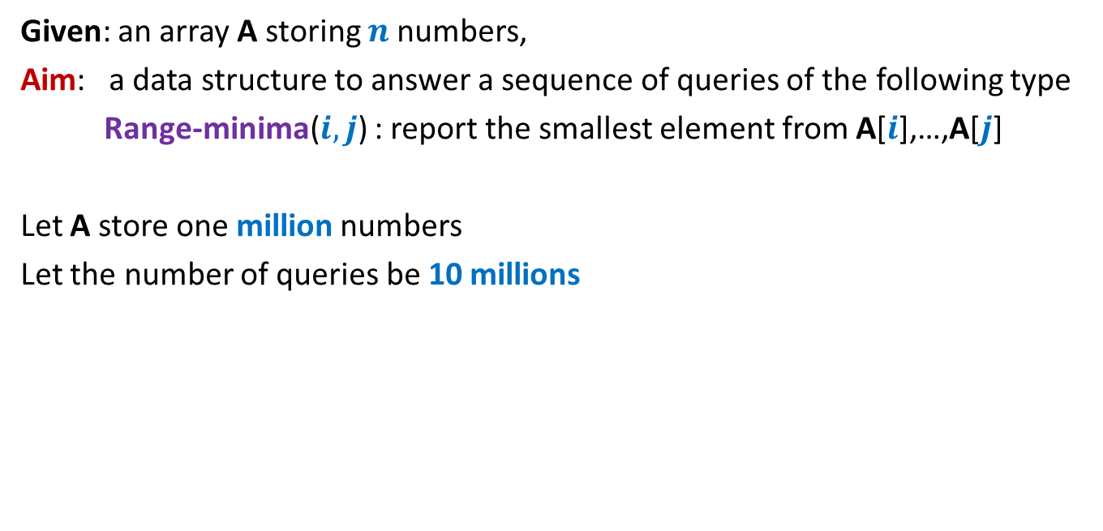

Range-Minima Problem
Given: an array A storing $n$numbers,
Aim: a data structure to answer a sequence of queries of the following type
Range-minima($i,j$) : report the smallest element from A[$i$],…,A[$j$]
Let A store one million numbers
Let the number of queries be 10 millions
Range-Minima($i,j$) = -6
A
3 5 1 8 19 0 -1 30 99 -6 10 2 40 27 44 67
$i$=4
$j$=11

Slide 6




Range-Minima Problem
Size of B is too large to be kept in RAM.
So we shall have to keep most of it in the Hard disk drive.
Hence it will take a few milliseconds per query.
Solution 1
Solution 2
(brute force)
Range-minima-trivial($i,j$)
{ temp ← $i+1$;
min ← A[$i$];
While(temp <= $j$)
{ if (min > A[temp])
min ← A[temp];
temp← temp+1;
}
return min
}
Time complexity for one query: O($n$)
(a few hours for 10 million queries)
(store all answers)
Space : O($n^{2}$)
$$j$$
$$i$$
3
B
Impractical

Slide 7





Range-Minima Problem
Query:
Report_min(A,$i,j$) : report smallest element from {A[$i$],…,A[$j$]}
Aim :
compact data structure
O($1$) Query time for any $1$ ≤ $i$< $j$ ≤ $n$.
$$1$$
$$i$$
$$j$$
$$n$$
A
29
3.1
99
781
41.5
67.4

Slide 8
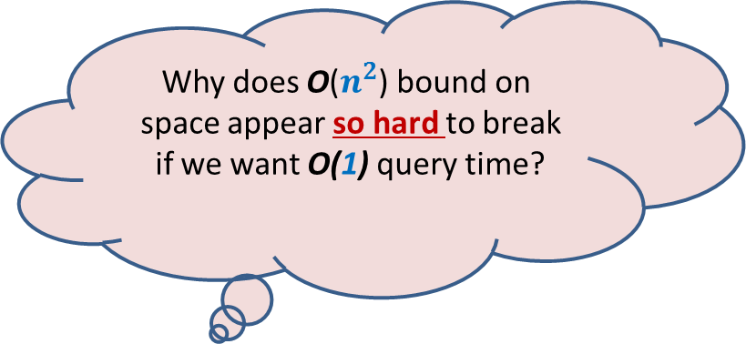
… Because of artificial hurdles
Why does O($n^{2}$) bound on
space appear so hard to break
if we want O(1) query time?

Slide 9
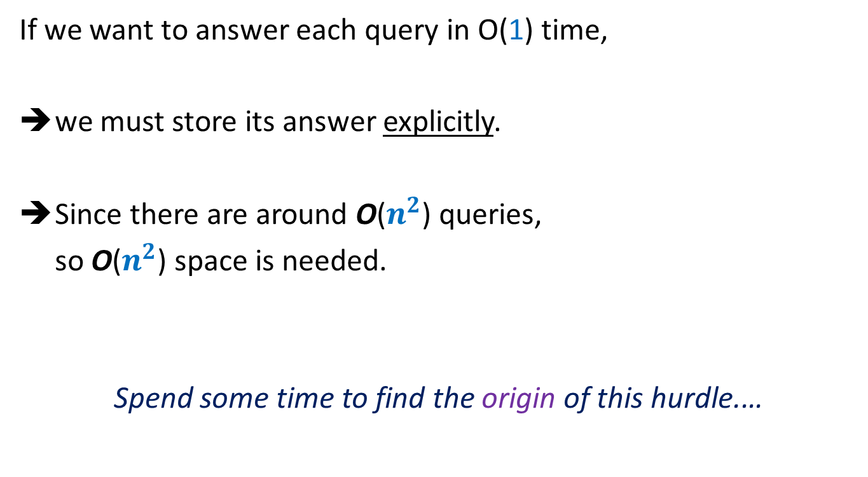
Artificial hurdle
If we want to answer each query in O(1) time,
we must store its answer explicitly.
Since there are around O($n^{2}$) queries,
so O($n^{2}$) space is needed.
Spend some time to find the origin of this hurdle.…

Slide 10



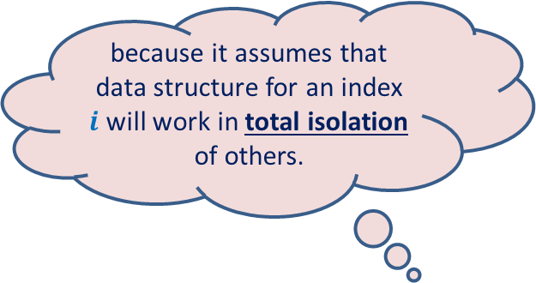
Artificial hurdle
… If we fix the first parameter $i$ for all queries, we need O($n$) space.
➔
for all $i$, we need O($n^{2}$) space.
$$i$$
$n$-1
A
29
3.1
99
781
41.5
67.4
0
True Fact
because it assumes that data structure for an index $i$will work in total isolation of others.
A wrong inference

Slide 11

Collaboration (team effort) works in real life
Why not try collaboration for the given problem ?

Slide 12
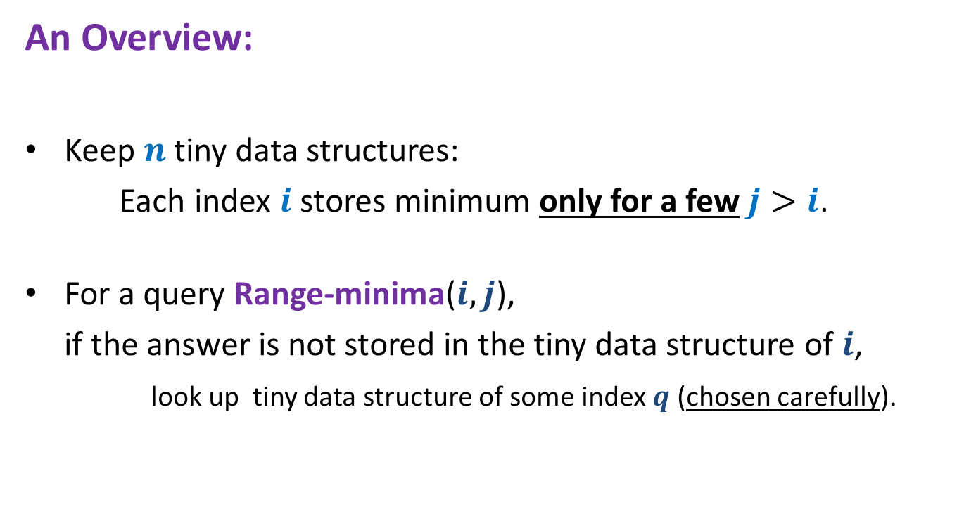

Range-minima problem: Breaking the O($n^{2}$) barrier using collaboration
An Overview:
Keep $n$ tiny data structures:
Each index $i$ stores minimum only for a few $j>i$.
For a query Range-minima($i,j$),
if the answer is not stored in the tiny data structure of $i$,
look up tiny data structure of some index $q$ (chosen carefully).

Slide 13
How does collaboration work in this problem ?

Slide 14




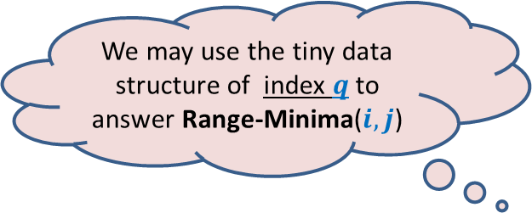




Range-minima problem: Breaking the O($n^{2}$) barrier using collaboration
We may use the tiny data structure of index $q$ to answer Range-Minima($i,j$)
$$i$$
$$j$$
A
$$1$$
$$i$$
$$q$$
$$n$$
$i$stores answers for this range
$q$stores answers for this range

Slide 15
Details of Tiny data structures

Slide 16


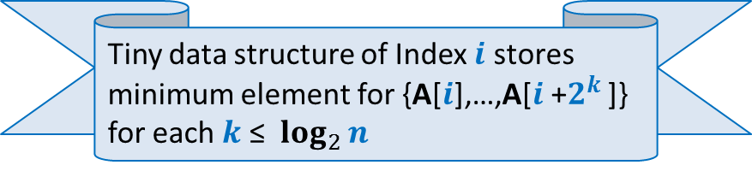


Range-minima problem : Details of tiny data structure stored at each $i$
$$2^{t}$$
8
4
2
1
A
1
$$i$$
$$n$$
Tiny data structure of Index $i$ stores
minimum element for {A[$i$],…,A[$i$+$2^{k}$ ]}
for each $k$ ≤ $\log_{2}{n}$

Slide 17


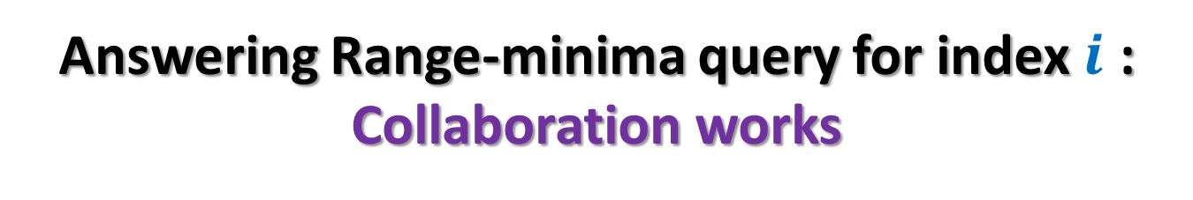


Answering Range-minima query for index $i$ : Collaboration works
$$2^{k+1}$$
$$2^{k}$$
A
1
$$i$$
$$j$$
$$n$$
$${j−2}^{k}$$

Slide 18
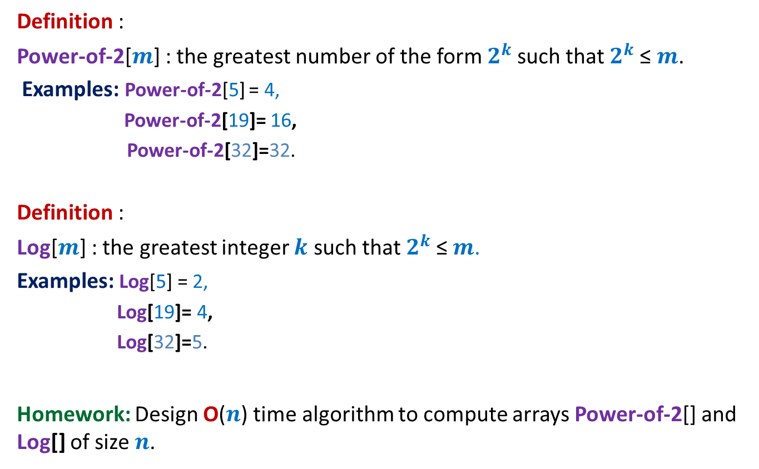
We shall use two additional arrays
Definition :
Power-of-2[$m$] : the greatest number of the form $2^{k}$such that $2^{k}$≤ $m$.
Examples: Power-of-2[5] = 4,
Power-of-2[19]= 16,
Power-of-2[32]=32.
Definition :
Log[$m$] : the greatest integer $k$ such that $2^{k}$≤ $m$.
Examples: Log[5] = 2,
Log[19]= 4,
Log[32]=5.
Homework: Design O($n$) time algorithm to compute arrays Power-of-2[] and Log[] of size $n$.

Slide 19
Final solution for Range Minima problem

Slide 20



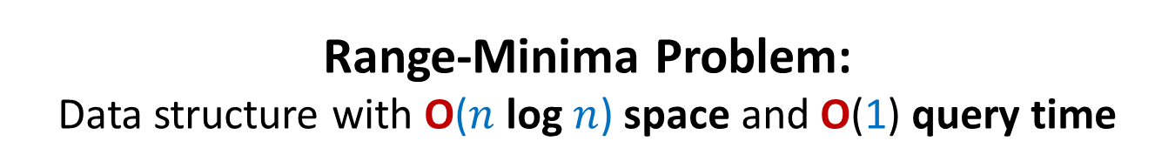




Range-Minima Problem: Data structure with O($n$ log $n$) space and O(1) query time
Data Structure:
$n$ × log $n$ matrix B where B[$i$][$k$] stores …
Array Power-of-2[]
Array Log[]
Range-minima-($i,j$)
{ L ← $j−i$;
$t$ ← Power-of-2[L];
$k$← Log[L];
If ($t$ = L) return ??;
else return min( ?? , ?? );
}
minimum of {A[$i$],A[$i$+1],…, A[$i$+$2^{k}$]}
0
1
$$log_{2} n$$
0
1
…
B
B[$i$][$k$];
B[$i$][$k$]
B[$j−t$][$k$];
$$n−1$$

Slide 21
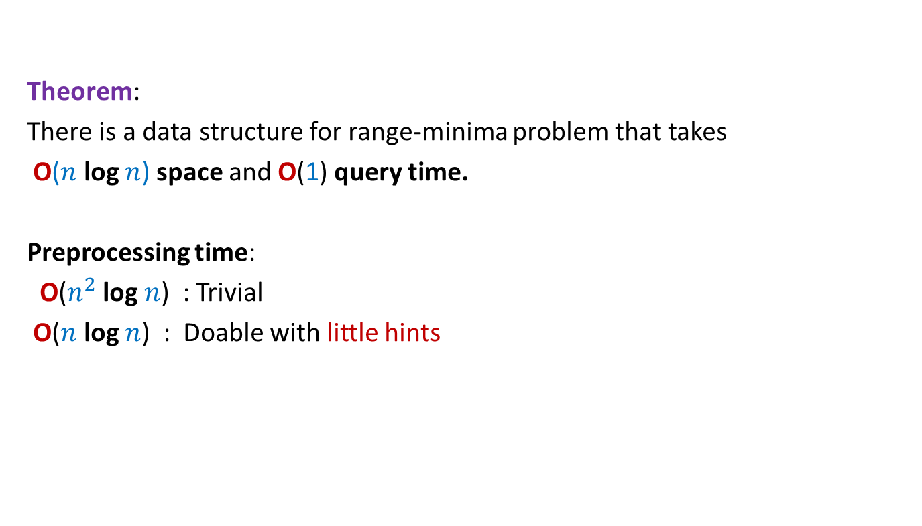
Theorem:
There is a data structure for range-minima problem that takes
O($n$ log $n$) space and O(1) query time.
Preprocessing time:
O($n^{2}$ log $n$) : Trivial
O($n$ log $n$) : Doable with little hints

Slide 22
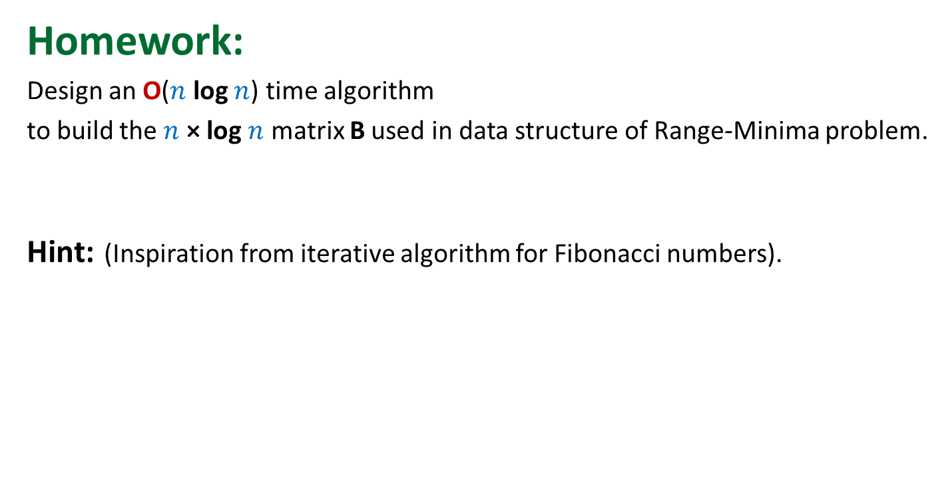
Homework:
Design an O($n$ log $n$) time algorithm
to build the $n$ × log $n$ matrix B used in data structure of Range-Minima problem.
Hint: (Inspiration from iterative algorithm for Fibonacci numbers).
Spend some time before looking at the more explicit hint below. (it is just a click away)…You can do it…
To compute B[$i$][$k$], you need to know only two entries from column **.

Slide 23
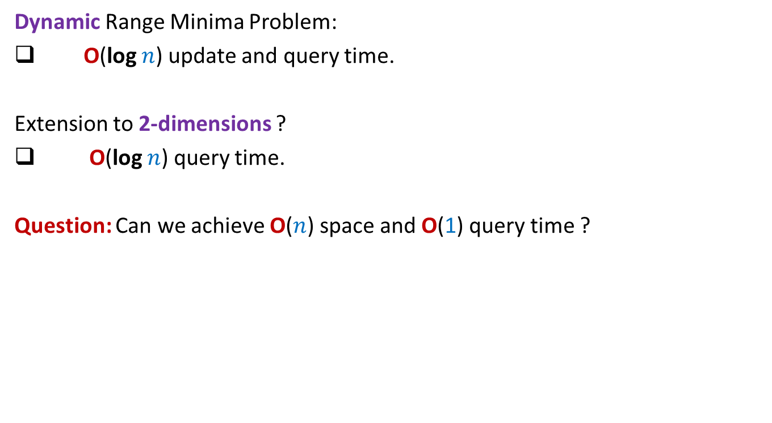
Range Minima Problem: further extensions
Dynamic Range Minima Problem:
O(log $n$) update and query time.
Extension to 2-dimensions ?
O(log $n$) query time.
Question: Can we achieve O($n$) space and O(1) query time ?
Yes.
The students whose aim is more than just a good grade should ponder over it.
I shall be happy to give them suitable hints.

Slide 24
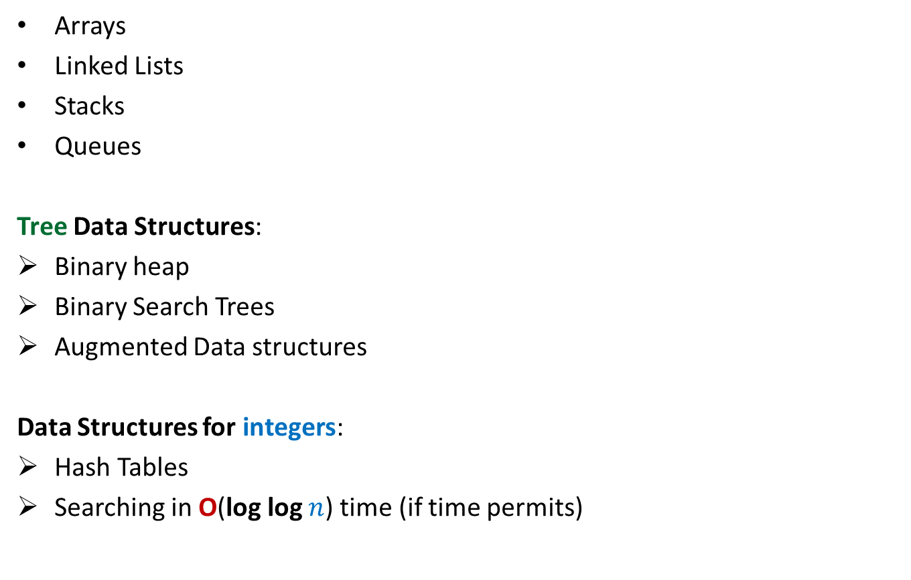
Data structures (To be discussed in the course)
Arrays
Linked Lists
Stacks
Queues
Tree Data Structures:
Binary heap
Binary Search Trees
Augmented Data structures
Data Structures for integers:
Hash Tables
Searching in O(log log $n$) time (if time permits)
Elementary

