Slide 1
Data Structures and Algorithms (CS210A)
Lecture 8:
Data structures:
Modeling versus Implementation
Abstract data type “List” and its implementation

Slide 2
Data Structure
Definition:
A collection of data elements arranged and connected in a way
that can facilitate efficient executions
of a (potentially long) sequence of operations.

Slide 3
Two steps process for designing a Data Structure
Step 1: Mathematical Modeling
A Formal description of the possible operations of a data structure.
Operations can be classified into two categories:
Query Operations: Retrieving some information from the data structure
Update operations: Making a change in the data structure
Step 2: Implementation
Explore the ways of organizing the data that facilitates
performing each operation efficiently using the existing tools available.
Outcome of Mathematical Modeling: an Abstract Data Type
Since we don’t specify here the way how each operation of the data structure will be implemented

Slide 4
Modeling of LIST
Outcome will be:
Abstract Data Type “List”

Slide 5

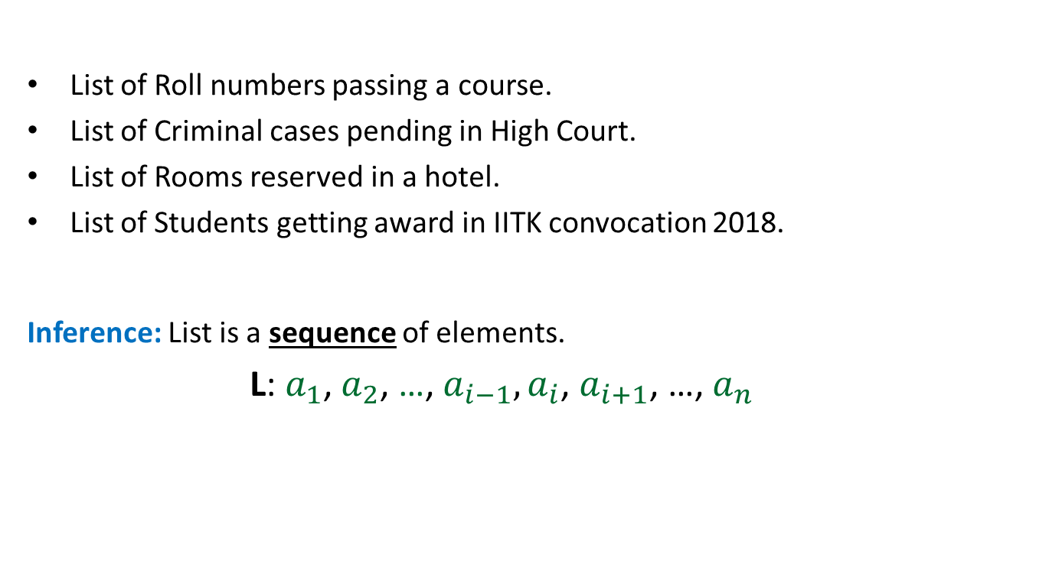
Mathematical Modeling of a List
List of Roll numbers passing a course.
List of Criminal cases pending in High Court.
List of Rooms reserved in a hotel.
List of Students getting award in IITK convocation 2018.
Inference: List is a sequence of elements.
L: $a_{1}$, $a_{2}$, …, $a_{i−1}, a_{i}$, $a_{i+1}$, …, $a_{n}$
What is common in all these examples ?
$i$th element of list L

Slide 6
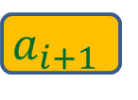
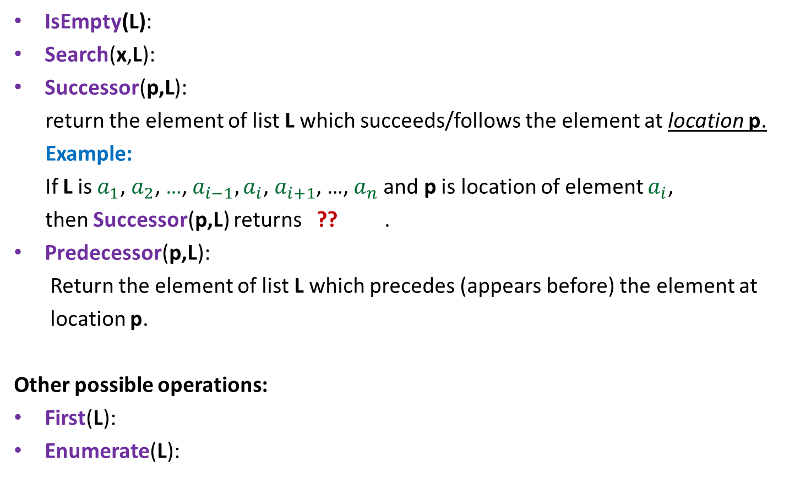
Query Operations on a List
IsEmpty(L):
Search(x,L):
Successor(p,L):
return the element of list L which succeeds/follows the element at location p.
Example:
If L is $a_{1}$, $a_{2}$, …, $a_{i−1}, a_{i}$, $a_{i+1}$, …, $a_{n}$and p is location of element $a_{i}$,
then Successor(p,L) returns ?? .
Predecessor(p,L):
Return the element of list L which precedes (appears before) the element at
location p.
Other possible operations:
First(L):
Enumerate(L):
determine if L is an empty list.
The type of this parameter
will depend on the implementation
determine if x appears in list L.
$$a_{i+1}$$
return the first element of list L.
Enumerate/print all elements of list L in the order they appear.

Slide 7

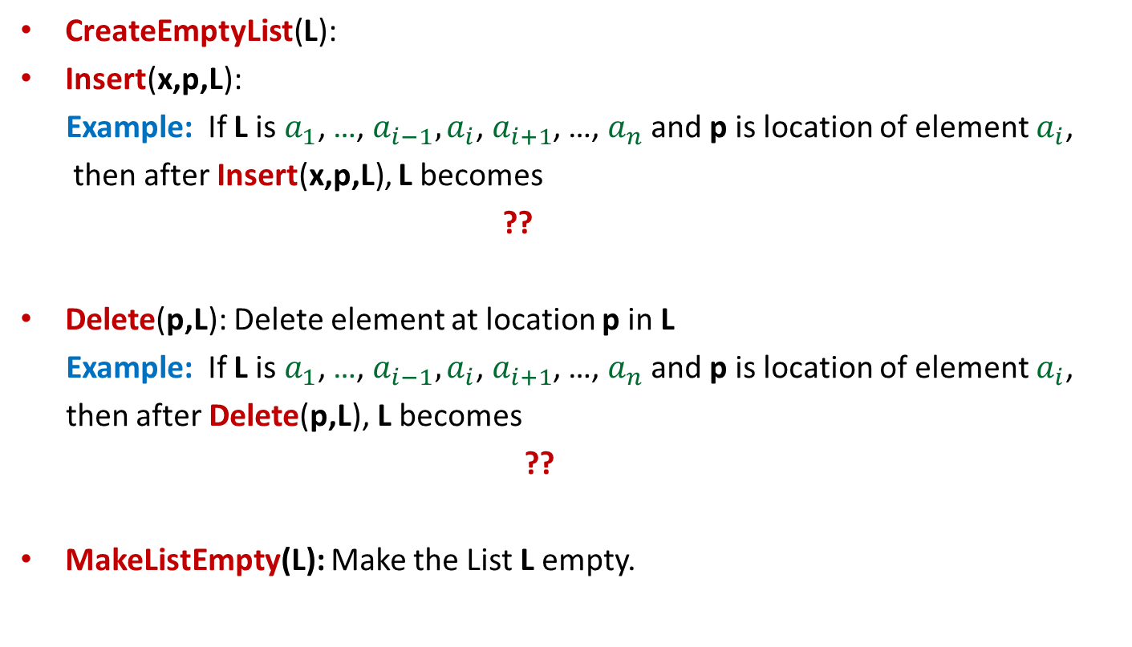

Update Operations on a List
CreateEmptyList(L):
Insert(x,p,L):
Example: If L is $a_{1}$, …, $a_{i−1}, a_{i}$, $a_{i+1}$, …, $a_{n}$and p is location of element $a_{i}$,
then after Insert(x,p,L), L becomes
??
Delete(p,L): Delete element at location p in L
Example: If L is $a_{1}$, …, $a_{i−1}, a_{i}$, $a_{i+1}$, …, $a_{n}$and p is location of element $a_{i}$,
then after Delete(p,L), L becomes
??
MakeListEmpty(L): Make the List L empty.
Create an empty list.
Insert x at a given location p in list L.
$a_{1}$, …, $a_{i−1}, {x,a}_{i}$, $a_{i+1}$ ,…, $a_{n}$
$a_{1}$, …, $a_{i−1}, a_{i+1}$ ,…, $a_{n}$

Slide 8
Implementation of
Abstract Data Type “List”

Slide 9
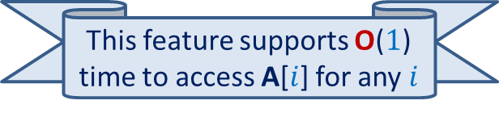

Array based Implementation
CSE students will learn about it perhaps in CS220 or some later course on Hardware.
RAM allows O($1$) time to access any memory location.
Array is a contiguous chunk of memory kept in RAM.
For an array A[] storing $n$ words,
the address of element A[$i$] =
“start address of array A” + $i$
Array A
How can we use array for implementing a list?
This feature supports O($1$) time to access A[$i$] for any $i$
RAM

Slide 10

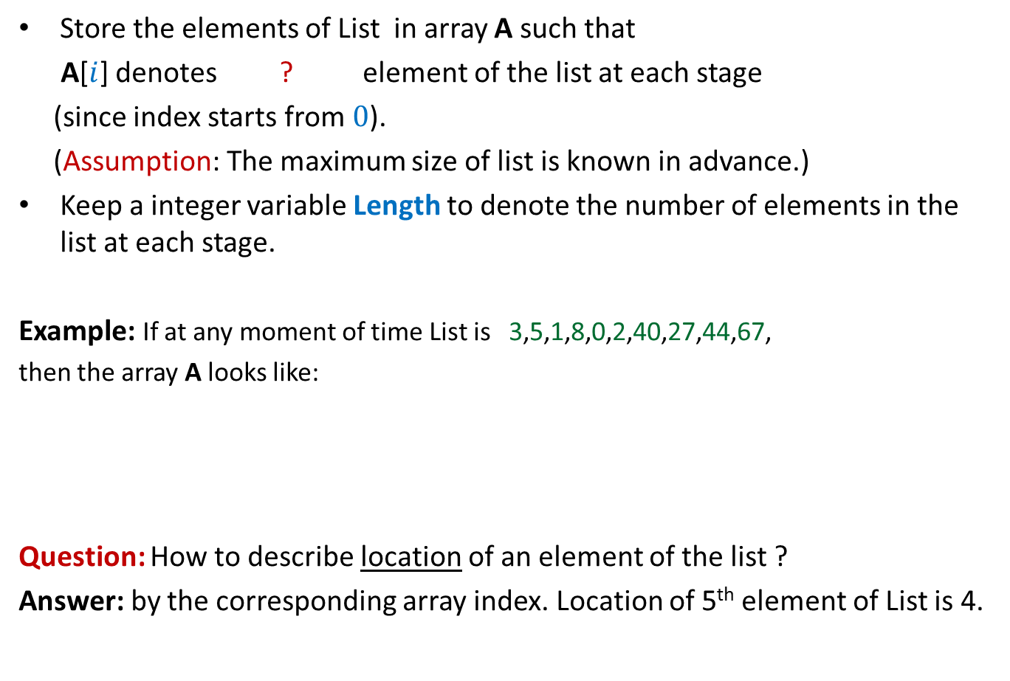
Array based Implementation
Store the elements of List in array A such that
A[$i$] denotes ? element of the list at each stage
(since index starts from $0$).
(Assumption: The maximum size of list is known in advance.)
Keep a integer variable Length to denote the number of elements in the list at each stage.
Example: If at any moment of time List is 3,5,1,8,0,2,40,27,44,67,
then the array A looks like:
Question: How to describe location of an element of the list ?
Answer: by the corresponding array index. Location of 5th element of List is 4.
($i+1$)th
A
3 5 1 8 0 2 40 27 44 67
Length = 10

Slide 11


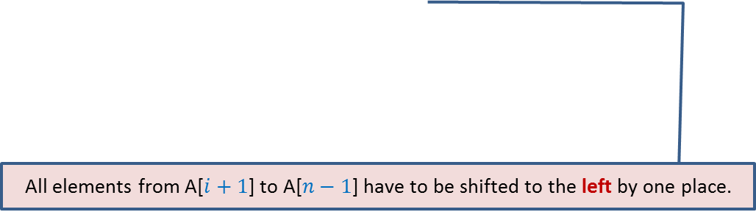
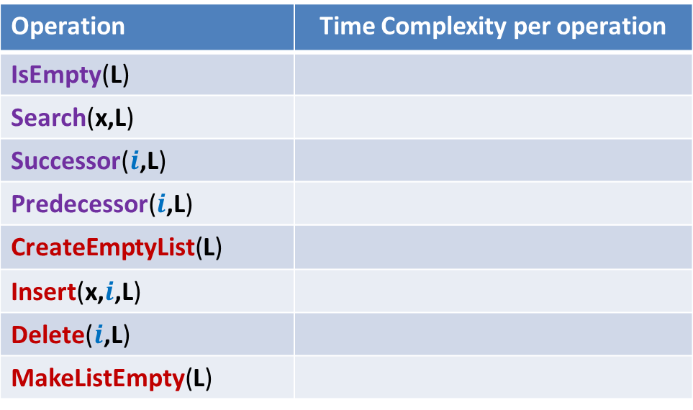
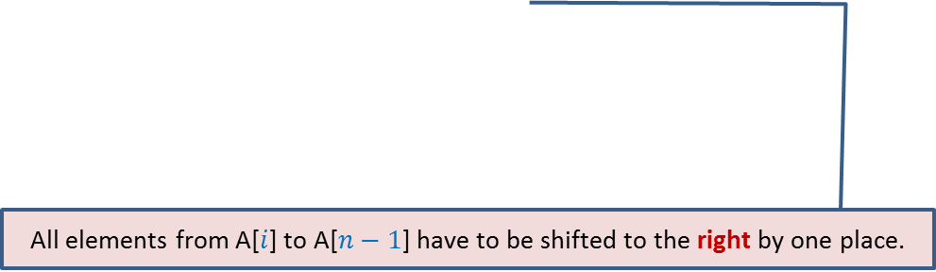


Time Complexity of each List operation using Array based implementation
Operation | Time Complexity per operation
IsEmpty(L)
Search(x,L)
Successor($i$,L)
Predecessor($i$,L)
CreateEmptyList(L)
Insert(x,$i$,L)
Delete($i$,L)
MakeListEmpty(L)
O(1)
$n$: number of elements in list at present
O($n$)
O(1)
O(1)
O(1)
Arrays are very rigid
O($n$)
O($n$)
O(1)
All elements from A[$i$] to A[$n−1$] have to be shifted to the right by one place.
Homework: Write C Function for each operation with matching complexity.
All elements from A[$i+1$] to A[$n−1$] have to be shifted to the left by one place.

Slide 12
Link based Implementation:
Address of previous (left) node
Head
node
Value
Address of next (or right) node
Doubly Linked List
Singly Linked List

Slide 13
Doubly Linked List based Implementation
Keep a doubly linked list
where elements appear in the order we follow while traversing the list.
The location of an element : ?
Example: List 3,9,1 appears as
the address of the node containing it.
Head
3
9
1

Slide 14
How to perform Insert(x,p,L) ?
Head
p
3
9
1
x
How is it done actually ?

Slide 15

How to perform Insert(x,p,L) ?
Insert(x,p,L){
q← new(node);
q.value← x;
temp← p.left;
q.right ← p;
p.left← q;
q.left ← temp;
temp.right← q;
}
Head
temp
p
3
9
1
x
q
O($1$) time
Lists are very flexible
Homework: How to perform Delete(x,p,L) ?

Slide 16
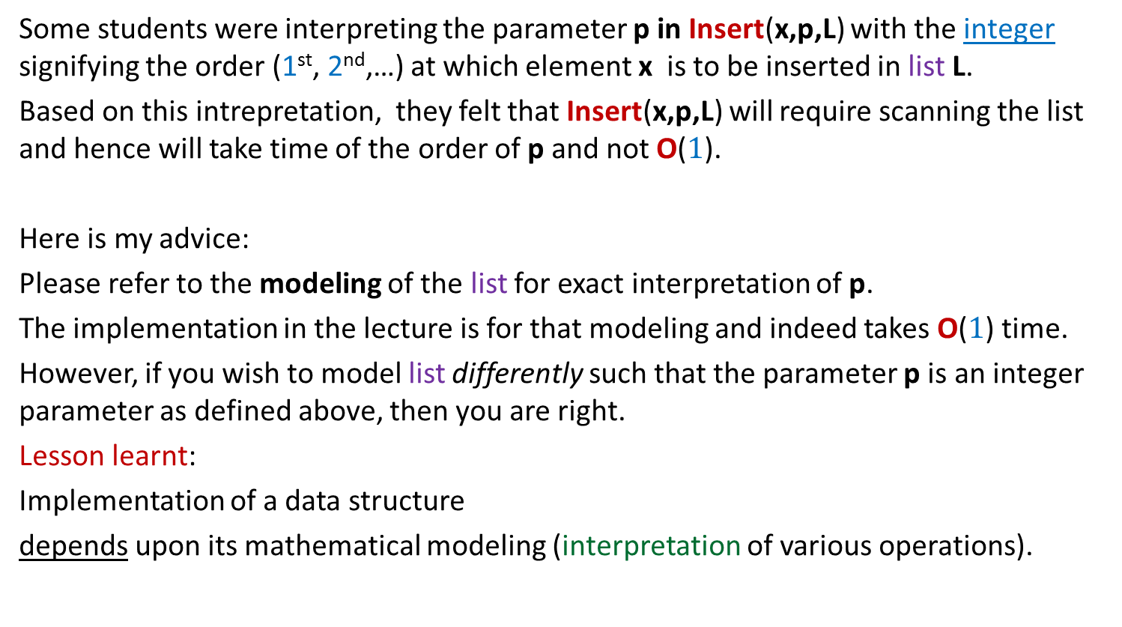
Some students were interpreting the parameter p in Insert(x,p,L) with the integer signifying the order (1st, 2nd,…) at which element x is to be inserted in list L.
Based on this intrepretation, they felt that Insert(x,p,L) will require scanning the list and hence will take time of the order of p and not O($1$).
Here is my advice:
Please refer to the modeling of the list for exact interpretation of p.
The implementation in the lecture is for that modeling and indeed takes O($1$) time.
However, if you wish to model list differently such that the parameter p is an integer parameter as defined above, then you are right.
Lesson learnt:
Implementation of a data structure
depends upon its mathematical modeling (interpretation of various operations).

Slide 17
How to perform successor(p,L) ?
Successor(p,L){
q← p.right;
return q.value;
}
Head
p
p.right
3
9
1

Slide 18

Time Complexity of each List operation using Doubly Linked List based implementation
Operation | Time Complexity per operation
IsEmpty(L)
Search(x,L)
Successor(p,L)
Predecessor(p,L)
CreateEmptyList(L)
Insert(x,p,L)
Delete(p,L)
MakeListEmpty(L)
O(1)
O($n$)
O(1)
O(1)
It takes O(1) time if we implement it by setting the head pointer of list to NULL. However, if one has to free the memory used by the list, then it will require traversal of the entire list and hence O(n) time. You might learn more about it in Operating System course.
O(1)
O(1)
O(1)
O(1)
Homework: Write C Function for each operation with matching complexity.

Slide 19
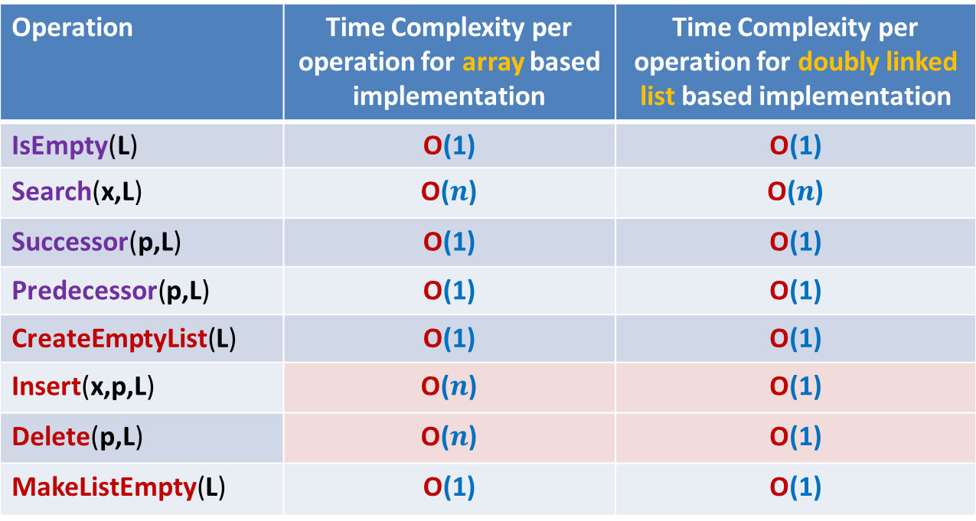
Doubly Linked List based implementation versus array based implementation of “List”
Operation | Time Complexity per operation for array based implementation | Time Complexity per operation for doubly linked list based implementation
IsEmpty(L) | O(1) | O(1)
Search(x,L) | O($n$) | O($n$)
Successor(p,L) | O(1) | O(1)
Predecessor(p,L) | O(1) | O(1)
CreateEmptyList(L) | O(1) | O(1)
Insert(x,p,L) | O($n$) | O(1)
Delete(p,L) | O($n$) | O(1)
MakeListEmpty(L) | O(1) | O(1)

Slide 20
A concrete Problem

Slide 21





Problem
Maintain a telephone directory
Operations:
Search the phone # of a person with name x
Insert a new record (name, phone #,…)
Array based solution | Linked list based solution
Log $n$
O($n$)
O($n$)
O($n$)
O($1$)
Yes. Keep the array sorted according to the names and do Binary search for x.
Can we improve it ? Think over it …
Can we achieve the best of the two data structure simultaneously ?
We shall together invent such a novel data structure in the next class

Slide 22
Important Advice
In this lecture, it was assumed that the students have a basic knowledge of records and singly linked lists from ESC101. In case, you lack this basic knowledge, you are advised to revise the basic concepts of pointers, records in C from ESC101. This will also be helpful for some programming assignment in future as well.
In case you need some assistance in these fundamentals, send email to TA Mr. Salman Khan (salman@iitk.ac.in )
Note: the address is @iitk.ac.in and not @cse.iitk.ac.in.

Slide 23
Proof of Correctness of Algorithms
All those
who are not convinced about correctness of algorithm
convinced but feel uncomfortable while proving correctness of algorithm
Are invited to the optional doubt clearing session on Friday (15th Jan) 5-6PM.

