Slide 1
Data Structures and Algorithms (CS210A)
Lecture 9:
Inventing a new Data Structure with
Flexibility of lists for updates
Efficiency of arrays for search

Slide 2
Important Notice
There are basically two ways of introducing a new/innovative solution of a problem.
One way is to just explain it without giving any clue as to how the person who invented the concept came up with this solution.
Another way is to start from scratch and take a journey of the route which the inventor might have followed to arrive at the solution.
This journey goes through various hurdles and questions,
each hinting towards a better insight into the problem
if we have patience and open mind.
Which of these two ways is better ?
I believe that the second way is better and more effective.
The current lecture is based on this way. The data structure we shall invent is called a Binary Search Tree. This is the most fundamental and versatile data structure. We shall realize this fact many times during the course …

Slide 3
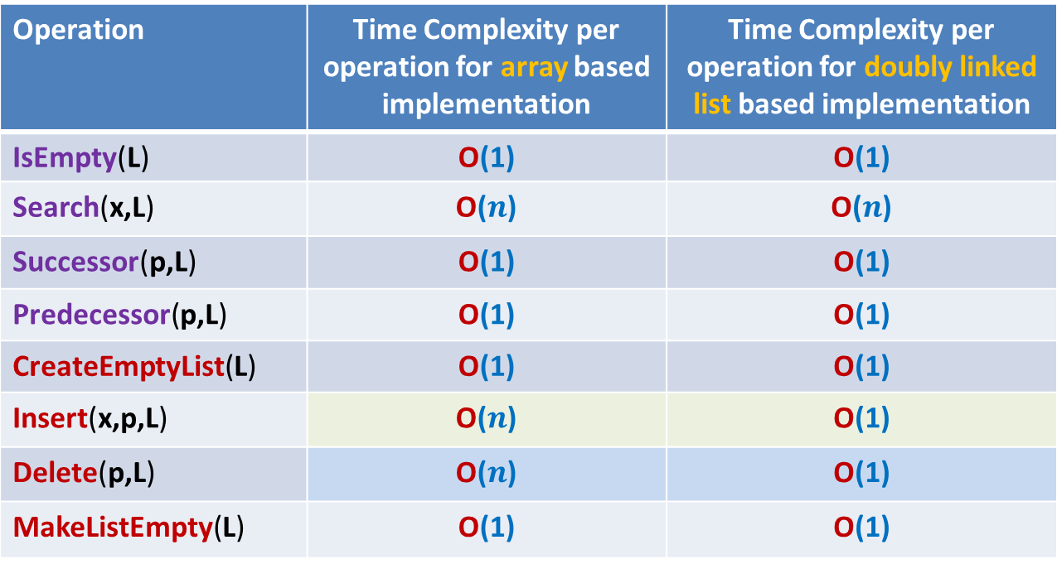
Doubly Linked List based implementation versus array based implementation of “List”
Operation | Time Complexity per operation for array based implementation | Time Complexity per operation for doubly linked list based implementation
IsEmpty(L) | O(1) | O(1)
Search(x,L) | O($n$) | O($n$)
Successor(p,L) | O(1) | O(1)
Predecessor(p,L) | O(1) | O(1)
CreateEmptyList(L) | O(1) | O(1)
Insert(x,p,L) | O($n$) | O(1)
Delete(p,L) | O($n$) | O(1)
MakeListEmpty(L) | O(1) | O(1)
Arrays are very rigid

Slide 4

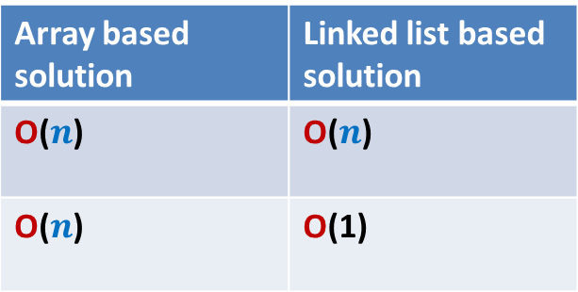
Problem
Maintain a telephone directory
Operations:
Search the phone # of a person with name x
Insert a new record (ID no., phone #,…)
Array based solution | Linked list based solution
O($n$) | O($n$)
O($n$) | O(1)
ID no.
Log $n$
Log $n$
Can we achieve the best of the two data structure simultaneously ?
We shall together invent such a novel data structure today

Slide 5
Inventing a new data structure
New Data structure
Lists are flexible, so let us try modifying the linked list structure to achieve fast search time.
Head
Too Rigid for updates
Lists
Array

Slide 6
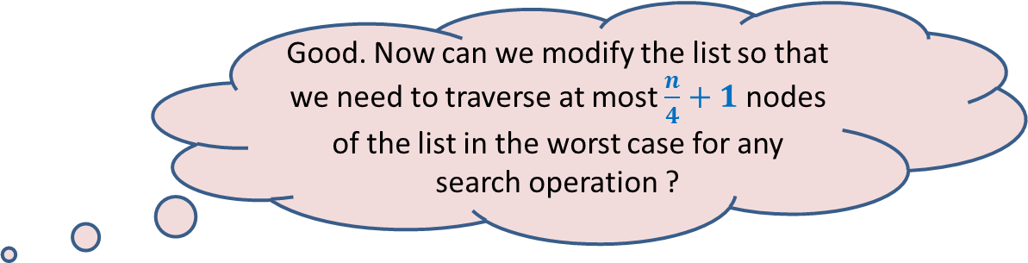
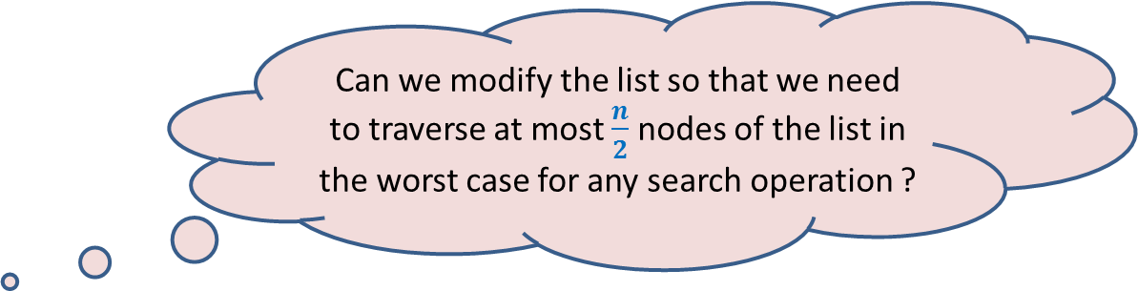
Restructuring doubly linked list
head
head
2
5
46
83
96
1
2
n/2
n-1
n
head
Since it is sorted arrangement that facilitates efficient searching in an array, so let us keep the elements of the list also sorted according to unique ID numbers of persons.
Can we modify the list so that we need to traverse at most $\frac{n}{2}$ nodes of the list in the worst case for any search operation ?
Observation:
Smaller IDs can now be searched quickly, but for larger IDs, we may have to traverse whole list. ☹
46
2
5
41
n/2
53
83
96
1
2
n/2 -1
n/2 +1
n-1
n
What structure emerges if you extend this idea further ? Imagine …
head
Good. Now can we modify the list so that we need to traverse at most $\frac{n}{4}+1$ nodes of the list in the worst case for any search operation ?
46
n/2
28
67
n/4
3n/4
2
25
31
41
53
65
73
96
1
n/4-1
n/4+1
n/2 -1
n/2 +1
3n/4-1
3n/4+1
n

Slide 7
A new data structure emerges
To analyze it mathematically, let us remove irrelevant details for some time.
head
46
28
67
5
35
49
83
2
25
31
41
48
53
73
96

Slide 8
A new data structure emerges To analyze it mathematically, remove irrlevant details
Can we relate it to something we might have seen in the real world ?
head
46
28
67
5
35
49
83
2
25
31
41
48
53
73
96
Notes:
Spend some time over this data structure to see its characteristics.
How does it look like ?…

Slide 9
A new data structure emerges
head
46
28
67
5
35
49
83
2
25
31
41
48
53
73
96
Notes:
Spend some time over this data structure to see its characteristics.
How does it look like ?…

Slide 10

Nature : a great source of inspiration
leaves
joints
root

Slide 11
Nature : a great source of inspiration

Slide 12
Nature : a great source of inspiration
root
joints
leaves

Slide 13
Nature : a great source of inspiration
root
Nodes
edges
leaves
Binary Tree

Slide 14
Binary Tree: A mathematical model
Definition: A collection of nodes is said to form a binary tree if
1. There is exactly one node with no incoming edge.
This node is called the root of the tree.
Every node other than root node has
3. Each node has … outgoing edges.
exactly one incoming edge.
at most two
Which of these are not binary trees ?

Slide 15
Binary Tree: some terminologies
If there is an edge from node u to node v,
then u is called parent of v ,and v is called child of u.
The Height of a Binary tree T is the maximum number of edges from the root to any leaf node in the tree T.
parent(y) = ??
parent(v) = ??
children(y) = ??
children(x) = ??
height(T) = ??
T
x
u
u
{r}
x
v
{y,q}
4
y
q
subtree(v)
z
r
p
subtree(y)
subtree(x)

Slide 16
Varieties of Binary trees
We call it Perfectly balanced
skewed
T
T’
u
u
x
x
v
y
y
q
p
z
w
r
w
p
For every node, the number of nodes in the subtrees of its two children differ at atmost by 1.
v
z

Slide 17





Height of a perfectly balanced Binary tree
$H(n)$ : Height of a perfectly balanced binary tree on $n$ nodes.
$H(1)$ = ?
$H(n)$ = ?
0
$$≤1+H\left(\frac{n}{2}\right)$$
$$≤\frac{n}{2}$$
$$≤\frac{n}{2}$$
$$n$$

Slide 18
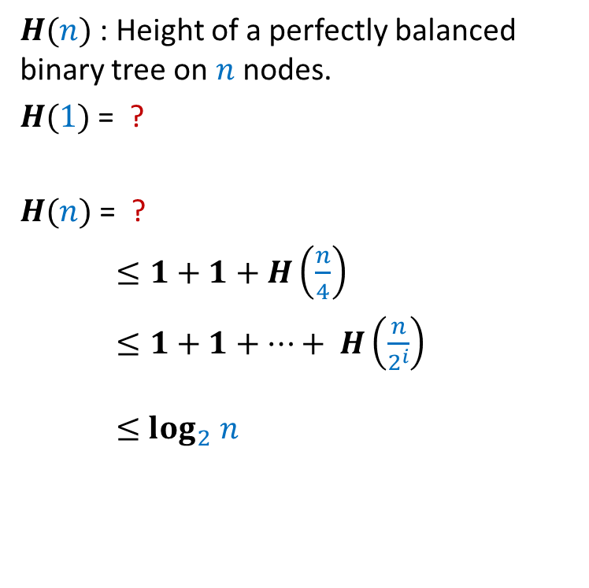


Height of a perfectly balanced Binary tree
$H(n)$ : Height of a perfectly balanced binary tree on $n$ nodes.
$H(1)$ = ?
$H(n)$ = ?
$≤1+1+H\left(\frac{n}{4}\right)$
$≤1+1+…+ H\left(\frac{n}{2^{i}}\right)$
$≤$ $\log_{2} n$
0
$$≤1+H\left(\frac{n}{2}\right)$$
$$i$$
$$≤\frac{n}{4}$$
$$n$$

Slide 19
Implementing a Binary tree
v
v
value(v)
left(v)
right(v)

Slide 20
Binary Search Tree (BST)
Definition: A Binary Tree T storing values is said to be Binary Search Tree
if for each node v in T
If left(v) <> NULL, then …
If right(v)<>NULL, then …
head
46
28
67
5
35
49
83
2
25
31
41
48
53
73
96
value(v) > value of every node in subtree(left(v)).
value(v) < value of every node in subtree(right(v)).

Slide 21
Search(T,x) Searching in a Binary Search Tree
T
Search(T,33) :
Searching for 33 in T.
46
28
67
5
35
49
83
2
25
31
41
48
53
73
96

Slide 22
Search(T,x) Searching in a Binary Search Tree
Search(T,x)
{ p← T;
Found← FALSE ;
while( ?? )
{ if(value(p) = x) ?? ;
else if (value(p) < x) ?? ;
else ?? ;
}
return p;
}
Found= FALSE & p<> NULL
Found← TRUE
p← right(p)
p← left(p)

Slide 23
Insert(T,x) Insertion in a Binary Search Tree
T
Insert(T,50) :
Inserting 50 into T.
46
28
67
5
35
49
83
2
25
31
41
48
53
73
96
50

Slide 24
A question
Time complexity of
Search(T,x) and Insert(T,x) in a Binary Search Tree T = ??
O(Height(T))

Slide 25
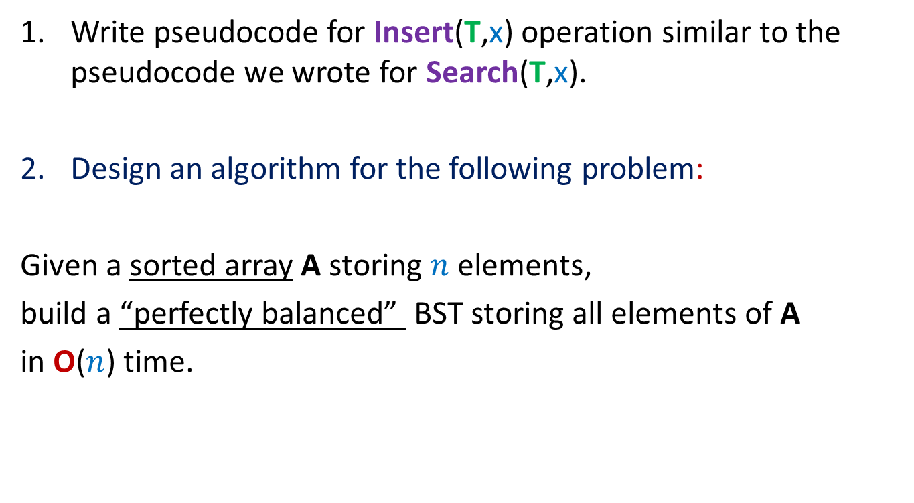
Homeworks
Write pseudocode for Insert(T,x) operation similar to the pseudocode we wrote for Search(T,x).
Design an algorithm for the following problem:
Given a sorted array A storing $n$ elements,
build a “perfectly balanced” BST storing all elements of A
in O($n$) time.

Slide 26
Homework 3
What does the following algorithm accomplish ?
Traversal(T)
{ p← T;
if(p=NULL) return;
else{ if(left(p) <> NULL) Traversal(left(p));
print(value(p));
if(right(p) <> NULL) Traversal(right(p));
}
}
Ponder over this algorithm for a few minutes to know what it is doing. You might like to try it out on some example of BST.
It prints the elements of binary search tree T in increasing order of their values. What is its time complexity ?

Slide 27


Time complexity of any search and any single insertion in a perfectly balanced Binary Search Tree on $n$ nodes
T
O( log $n$) time
46
28
67
5
35
49
83
2
25
31
41
48
53
73
96

Slide 28

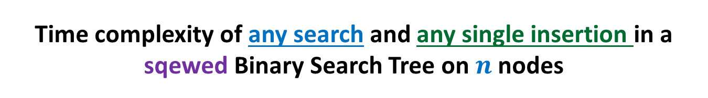
Time complexity of any search and any single insertion in a sqewed Binary Search Tree on $n$ nodes
T’
48
39
23
19
11
O($n$) time !☹
14
18

Slide 29
Our Original Problem
Maintain a telephone directory
Operations:
Search the phone # of a person with name x
Insert a new record (ID no., phone #,…)
Solution : We may keep perfectly balanced BST.
Hurdle: What if we insert records in increasing order of ID ?
BST will be skewed ☹
Though I gave a sketch of the solution for this problem in the last 5 minutes of the class,
let us discuss it from scratch in the next class ☺.
Array based solution | Linked list based solution
O($n$) | O($n$)
O($n$) | O(1)
ID no.
Log $n$
Log $n$

