Slide 1
Data Structures and Algorithms (CS210/CS210A)
Lecture 1:
An overview and motivation for the course
some concrete examples.

Slide 2
The website of the course
moodle.cse.iitk.ac.in
CSE
CS210: Data Structures and Algorithms
(guest login allowed)
This course will be taught differently.

Slide 3
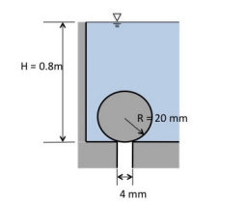
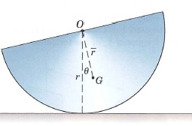
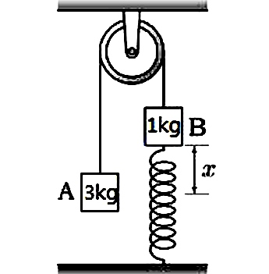
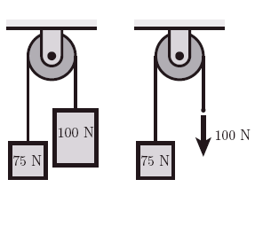
Those were the golden moments…
As an instructor, I shall try my best to make this course equally enjoyable as solving those physics problems.

Slide 4
Prerequisite of this course
A good command on Programming in C
Programs involving arrays
Recursion
Linked lists (preferred)
Fascination for solving Puzzles

Slide 5
Salient features of the course
Every concept
Solving each problem
solution will emerge naturally if we ask
right set of questions
and then try to find their answers.
… so that finally it is a concept/solution derived by you
and not a concept from some scientist/book/teacher.
We shall re-invent in the class itself.
Through discussion in the class.
Isn’t that nice ☺

Slide 6
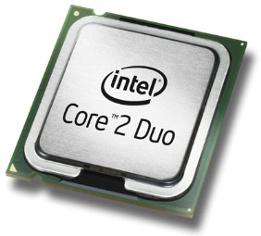
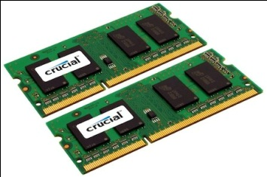
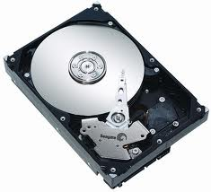
Let us open a desktop/laptop
A processor (CPU)
speed = few GHz
(a few nanoseconds to execute an instruction)
Internal memory (RAM)
size = a few GB (Stores a billion bytes/words)
speed = a few GHz( a few nanoseconds to read a byte/word)
External Memory (Hard Disk Drive)
size = a few tera bytes
speed : seek time = miliseconds
transfer rate= around billion bits per second

Slide 7
A simplifying assumption (for the rest of the lecture)
It takes around a few nanoseconds to execute an instruction.
(This assumption is well supported by the modern day computers)

Slide 8
Efficient Algorithms

Slide 9
What is an algorithm ?
Definition:
A finite sequence of well defined instructions
required to solve a given computational problem.
A prime objective of the course:
Design of efficient algorithms

Slide 10
Why should we care for Efficient Algorithms
we have Processors running at gigahertz?

Slide 11
Revisiting problems from ESC101

Slide 12
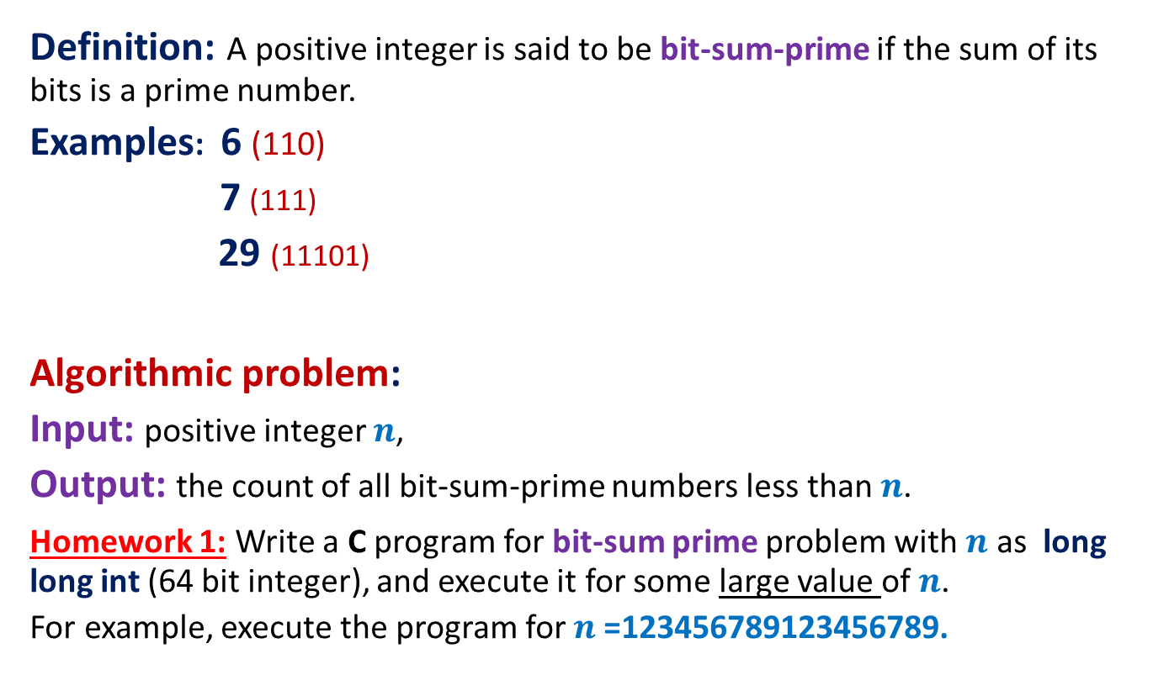
Problem 1: Bit-sum-prime numbers
Definition: A positive integer is said to be bit-sum-prime if the sum of its bits is a prime number.
Examples: 6 (110)
7 (111)
29 (11101)
Algorithmic problem:
Input: positive integer $n$,
Output: the count of all bit-sum-prime numbers less than $n$.
Homework 1: Write a C program for bit-sum prime problem with $n$ as long long int (64 bit integer), and execute it for some large value of $n$.
For example, execute the program for $n$=123456789123456789.
is bit-sum prime.
is bit-sum prime.
is not bit-sum prime.

Slide 13
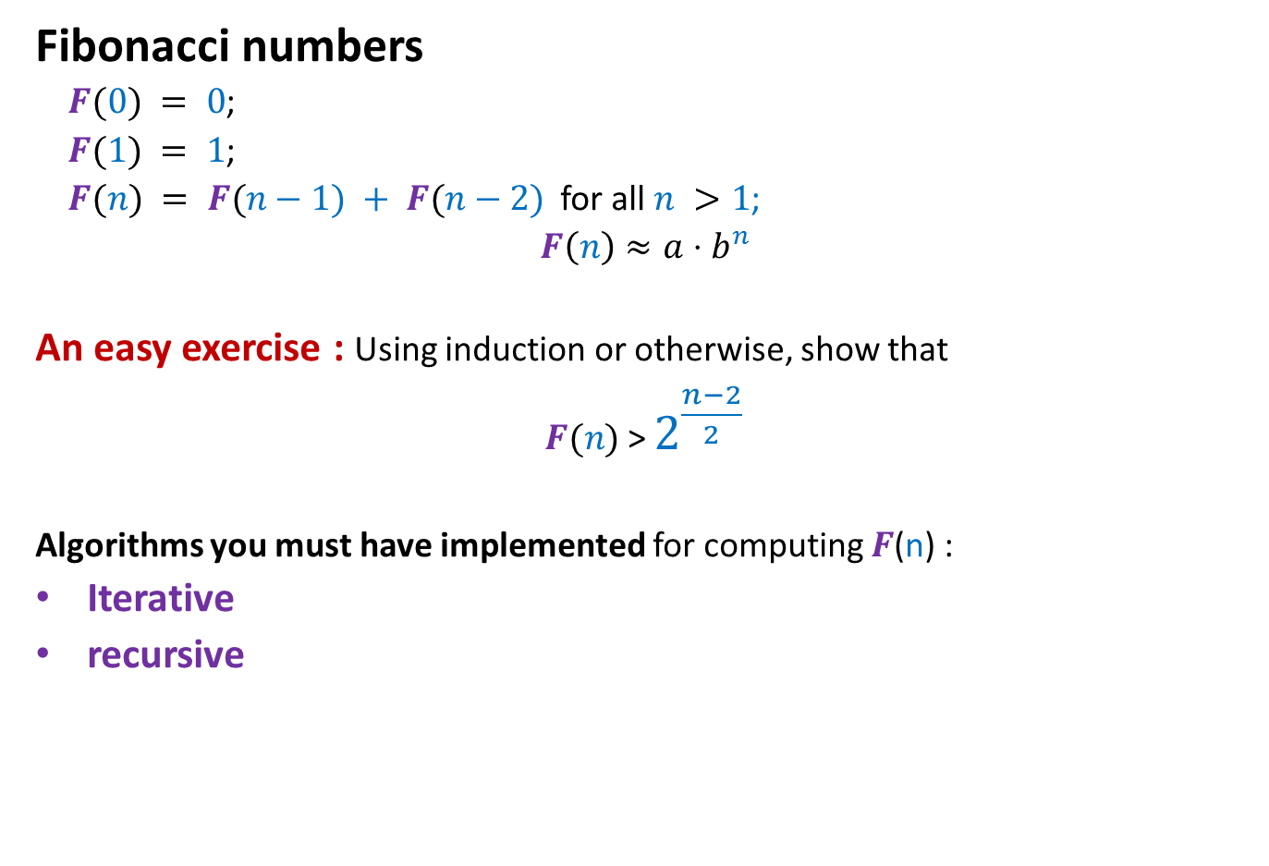
Problem 1: Fibonacci numbers
Fibonacci numbers
$F(0) = 0$;
$F(1) = 1$;
$F(n) = F(n−1) + F(n−2)$for all $n >1$;
$F\left(n\right)≈a⋅b^{n}$
An easy exercise : Using induction or otherwise, show that
$F(n)$ > $2^{\frac{n−2}{2}}$
Algorithms you must have implemented for computing $F$(n) :
Iterative
recursive

Slide 14

Iterative Algorithm for $F$($n$)
IFib(n)
if n=0 return 0;
else if n=1 return 1;
else {
a ← 0; b← 1;
For(i=2 to n) do
{ temp ← b;
b← a+b;
a← temp;
}
}
return b;

Slide 15

Recursive algorithm for $F$($n$)
Rfib(n)
{ if n=0 return 0;
else if n=1 return 1;
else return(Rfib(n-1) + Rfib(n-2))
}

Slide 16
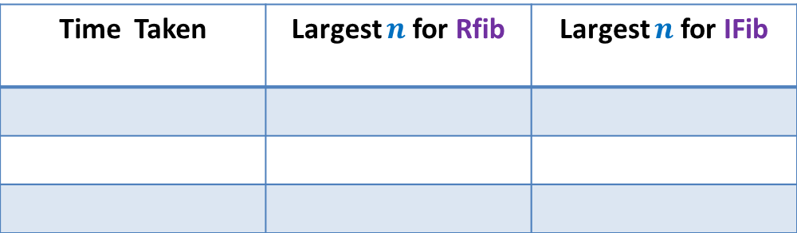

Homework 1 (compulsory)
Write a C program for the following problem:
Input: a number $n$
$n$ : long long int (64 bit integer).
Output: F($n$) mod $2014$
Time Taken | Largest $n$for Rfib | Largest $n$for IFib
1 minute
10 minutes
60 minutes

Slide 17
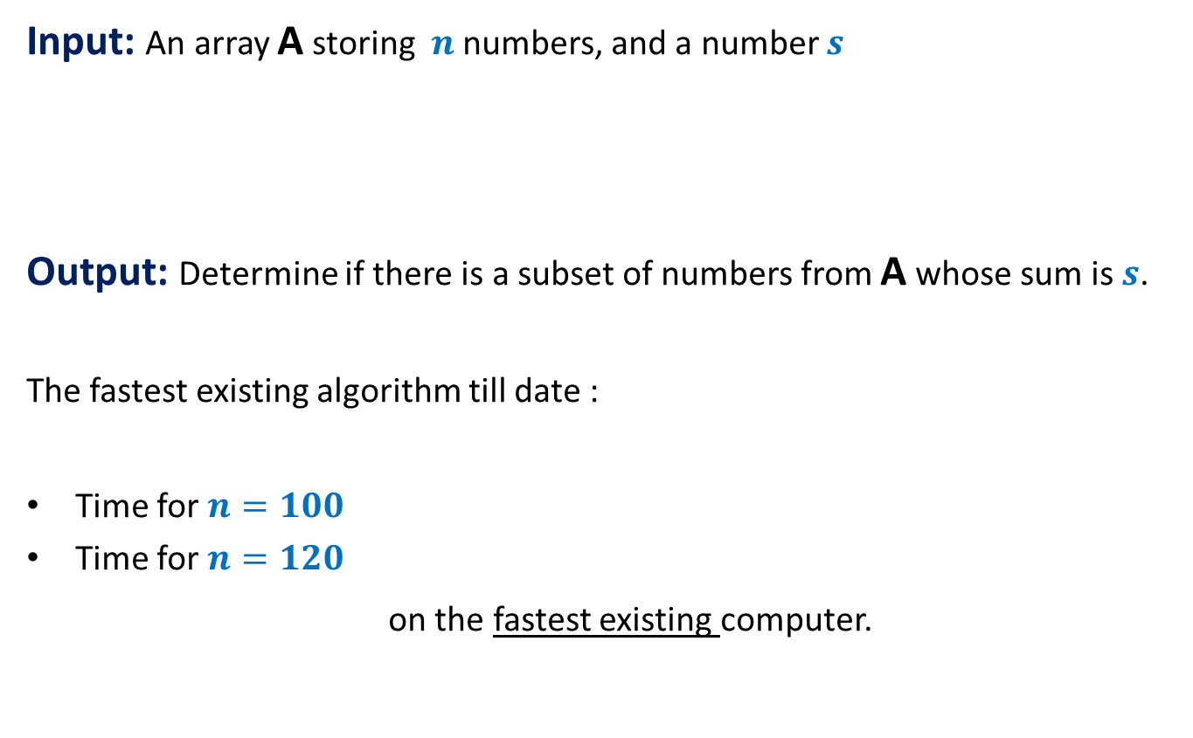



Problem 2: Subset-sum problem
Input: An array A storing $n$ numbers, and a number $s$
Output: Determine if there is a subset of numbers from A whose sum is $s$.
The fastest existing algorithm till date :
Time for $n=100$
Time for $n=120$
on the fastest existing computer.
A
$$12$$ | $$3$$ | $$46$$ | $$34$$ | $$19$$ | $$101$$ | $$208$$ | $$120$$ | 21$9$ | $$115$$
$$220$$
$$123$$
$2^{n/2}$ instructions
At least an year
At least 1000 years

Slide 18
Problem 3: Sorting
Input: An array A storing n numbers.
Output: Sorted A
A fact:
A significant fraction of the code of all the software is for sorting or searching only.
To sort 10 million numbers on the present day computers
Selection sort will take at least a few hours.
Merge sort will take only a few seconds.
Quick sort will take ??? .

Slide 19
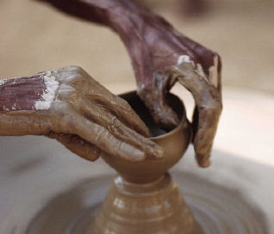
How to design efficient algorithm for a problem ?
Design of algorithms and data structures is also
an Art
Requires:
Creativity
Hard work
Practice
Perseverance (most important)

Slide 20
Summary of Algorithms
There are many practically relevant problems for which there does not exist any efficient algorithm till date ☹. (How to deal with them ?)
Efficient algorithms are important for theoretical as well as practical purposes.
Algorithm design is an art which demands a lot of creativity, intuition, and perseverance.
More and more applications in real life require efficient algorithms
Search engines like Google exploits many clever algorithms.

Slide 21
The Data Structures

Slide 22
An Example
Given: a telephone directory storing telephone no. of hundred million persons.
Aim: to answer a sequence of queries of the form
“what is the phone number of a given person ?”.
Solution 1 :
Keep the directory in an array.
do sequential search for each query.
Solution 2:
Keep the directory in an array, and sort it according to names,
do binary search for each query.
Time per query: around 1/10th of a second
Time per query: less than 100 nanoseconds

Slide 23
Aim of a data structure ?
To store/organize a given data in the memory of computer so that
each subsequent operation (query/update) can be performed quickly ?

Slide 24
Range-Minima Problem
A Motivating example
to realize the importance of data structures

Slide 25



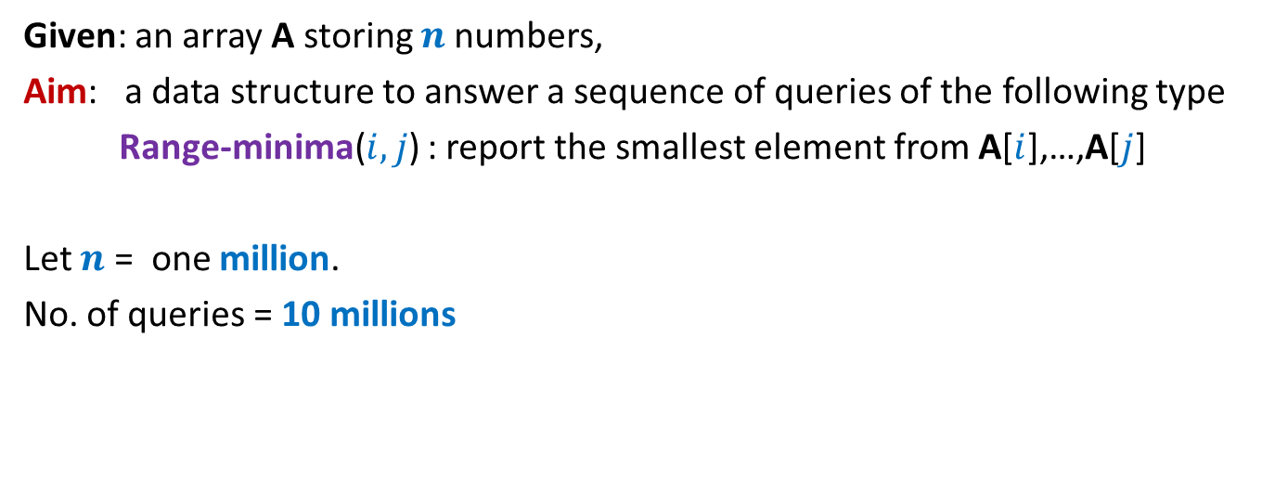
Range-Minima Problem
Given: an array A storing $n$numbers,
Aim: a data structure to answer a sequence of queries of the following type
Range-minima($i,j$) : report the smallest element from A[$i$],…,A[$j$]
Let $n$ = one million.
No. of queries = 10 millions
Range-Minima($i,j$) = -6
A
3 5 1 8 19 0 -1 30 99 -6 10 2 40 27 44 67
$$i=4$$
$$j=11$$

Slide 26
Range-Minima Problem
Applications:
Computational geometry
String matching
As an efficient subroutine in a variety of algorithms
(we shall discuss these problems sometime in this course or the next level course CS345)

Slide 27
Range-Minima Problem
Solution 1:
Answer each query in a brute force manner using A itself.
Range-minima-trivial(i,j)
{ temp ← i+1;
min ← A[i];
While(temp <= j)
{ if (min > A[temp])
min ← A[temp];
temp← temp+1;
}
return min
}
Time taken to answer a query:
Time for answering all queries:
a few hours
few milliseconds

Slide 28



Range-Minima Problem
Solution 2:
Compute and store answer for each possible query in a $n$× $n$ matrix B.
B[$i$][$j$] stores the smallest element from A[$i$],…,A[$j$]
Space : roughly $n^{2}$ words.
$$j$$
Solution 2 is
Theoretically efficient but practically impossible
$$i$$
3
Size of B is too large to be kept in RAM. So we shall have to keep most of it in the Hard disk drive. Hence it will take a few milliseconds per query.
B

Slide 29
Range-Minima Problem
Question: Does there exist a data structure for Range-minima which is
Compact
(nearly the same size as the input array A)
Can answer each query efficiently ?
(a few nanoseconds per query)
Homework 2: Ponder over the above question.
(we shall solve it soon)

Slide 30
Range-1-Query Determining if a rectangle has at least one 1 ?
Data structure: a few tables.
Query time: a few nanoseconds.
0 | 0 | 0 | 1 | 1 | 0 | 1 | 0
0 | 1 | 1 | 0 | 1 | 0 | 0 | 1
1 | 0 | 1 | 0 | 0 | 1 | 1 | 1
1 | 0 | 0 | 0 | 0 | 1 | 0 | 0
0 | 1 | 0 | 1 | 0 | 0 | 0 | 0
0 | 0 | 1 | 0 | 1 | 0 | 0 | 1
1 | 0 | 0 | 0 | 0 | 0 | 0 | 1
0 | 0 | 1 | 1 | 1 | 0 | 0 | 1
Any idea about when this result was derived ?
in a Conference in 2015

Slide 31
Data structures to be covered in this course
Elementary Data Structures
Array
List
Stack
Queue
Hierarchical Data Structures
Binary Heap
Binary Search Trees
Augmented Data Structures
Most fascinating and powerful data structures

Slide 32
Look forward to working with all of you to make this course enjoyable.
This course will be light in contents (no formulas)
But it will be very demanding too.
In case of any difficulty during the course,
just drop me an email without any delay.
I shall be happy to help ☺

