Slide 1
Data Structures and Algorithms (CS210A)
Lecture 3:
Time complexity, Big “O” notation
Designing Efficient Algorithm
Maximum sum subarray Problem

Slide 2
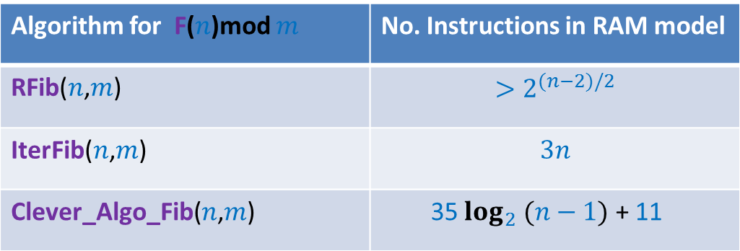
Three algorithms
Algorithm for F($n$)mod $m$ | No. Instructions in RAM model
RFib($n$,$m$) | $$>2^{(n−2)/2}$$
IterFib($n$,$m$) | $$3n$$
Clever_Algo_Fib($n$,$m$) | 35 $\log_{2} (n−1)$ + 11
Which algorithm turned out to be the best ?
Assignment 1- part 1 is over.
experimentally ?

Slide 3
Three algorithms
Algorithm for F($n$)mod $m$ | No. Instructions in RAM model
RFib($n$,$m$) | $$>2^{(n−2)/2}$$
IterFib($n$,$m$) | $$3n$$
Clever_Algo_Fib($n$,$m$) | 35 $\log_{2} (n−1)$ + 11
Which algorithm turned out to be the best turned out to be
What is the influence of variation in the times of different instructions ?
How close to reality is the RAM model of computation ?
Find it yourselves ☺
Assignment 1- part 2
?
experimentally ?

Slide 4
Lesson 1 from Assignment 1 ?
No. of instructions executed by algorithm in RAM model
?
Proportional to
Time taken by algorithm in real life
?
May be different for different input
Dependence on input

Slide 5



Time complexity of an algorithm
Definition:
the worst case number of instructions executed
as a function of the input size
Examples to illustrate input size :
Homework: What is the time complexity of Rfib, IterFib, Clever-Algo-Fib ?
(or a parameter defining the input size)
The number of bits/bytes/words
Problem | Input size
Computing F($n$)mod $m$ for any positive integers $n$and $m$
$\log_{2}n+\log_{2}{m}$ bits
Whether an array storing $j$numbers (each stored in a word) is sorted ?
$j$ words
Whether a $n×m$ matrix of numbers (each stored in a word) contains “14” ?
$nm$ words

Slide 6



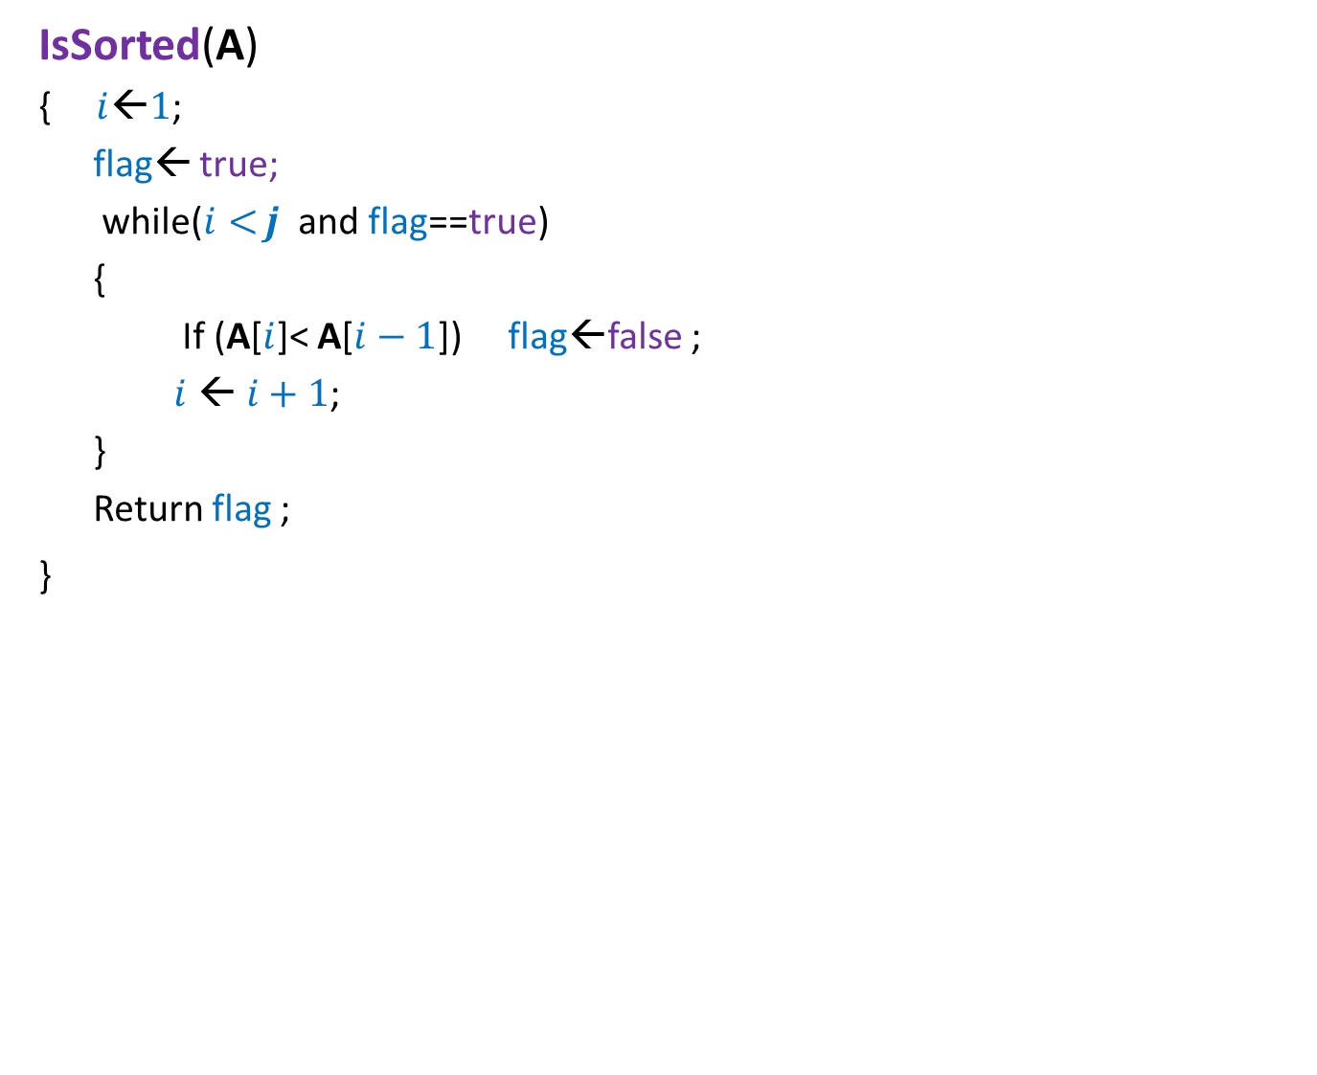


Example:
Whether an array A storing $j$numbers (each stored in a word) is sorted ?
IsSorted(A)
{ $i$←$1$;
flag← true;
while($i<$ $j$ and flag==true)
{
If (A[$i$]< A[$i−1$]) flag←false ;
$i$ ←$i+1$;
}
Return flag ;
}
$1$time
$1$time
$j−1$times in the worst case
$1$time
Time complexity = $2j+1$

Slide 7

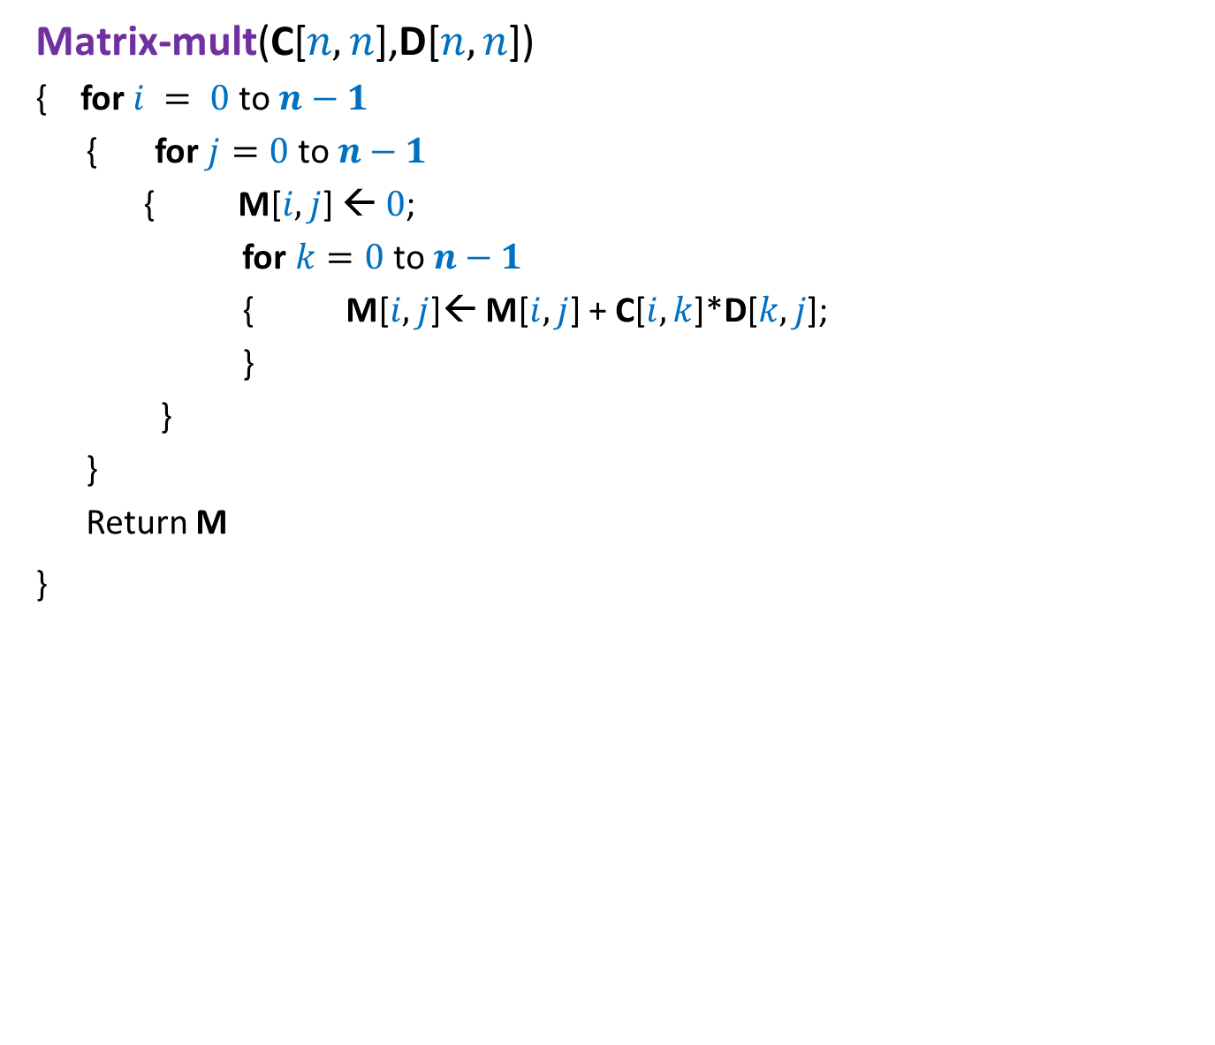



Example: Time complexity of matrix multiplication
Each element of the matrices occupies one word of RAM.
Matrix-mult(C[$n,n$],D[$n,n$])
{ for $i = 0$to $n−1$
{ for $j=0$to $n−1$
{ M[$i,j$] ← $0$;
for $k=0$ to $n−1$
{ M[$i,j$]← M[$i,j$] + C[$i,k$]*D[$k,j$];
}
}
}
Return M
}
$n$times
$n$times
$n+1$ instructions
$1$time
Time complexity = $n^{3}+n^{2}+1$

Slide 8
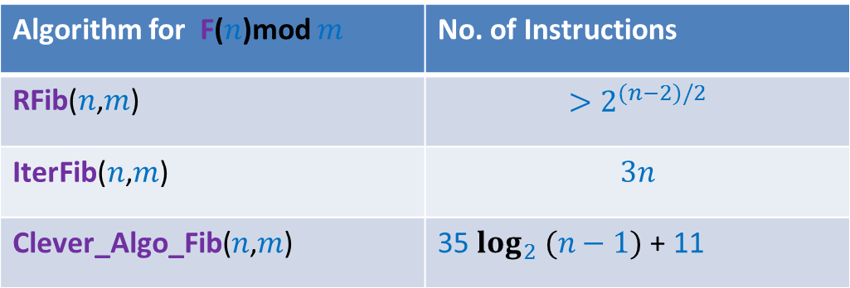


Lesson 2 learnt from Assignment 1 ?
Algorithm for F($n$)mod $m$ | No. of Instructions
RFib($n$,$m$) | $$>2^{(n−2)/2}$$
IterFib($n$,$m$) | $$3n$$
Clever_Algo_Fib($n$,$m$) | 35 $\log_{2} (n−1)$ + 11
Question: What would have been the outcome if
No. of instructions of Clever_Algo_Fib($n$,$m$) = 100 $\log_{2} (n−1)$ + 1000
Answer: Clever_Algo_Fib would still be the fastest algorithm ...
100
1000
for large value of $n$.

Slide 9
Comparing Efficiency of algorithms

Slide 10
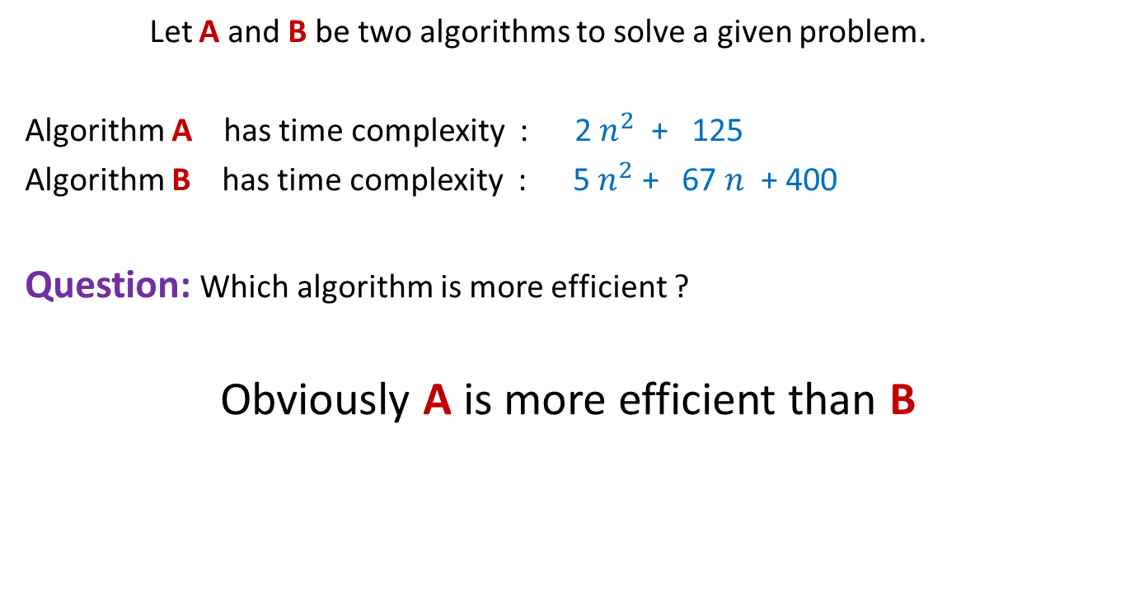
Comparing efficiency of two algorithms
Let A and B be two algorithms to solve a given problem.
Algorithm A has time complexity : 2 $n^{2}$ + 125
Algorithm B has time complexity : 5 $n^{2}$ + 67 $n$ + 400
Question: Which algorithm is more efficient ?
Obviously A is more efficient than B

Slide 11
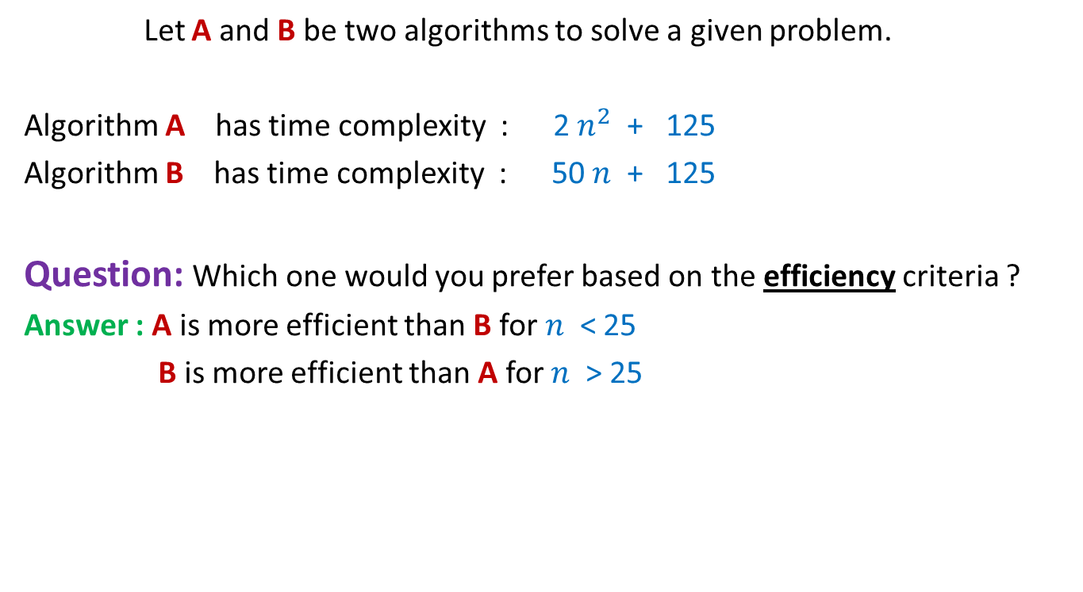
Comparing efficiency of two algorithms
Let A and B be two algorithms to solve a given problem.
Algorithm A has time complexity : 2 $n^{2}$ + 125
Algorithm B has time complexity : 50 $n$ + 125
Question: Which one would you prefer based on the efficiency criteria ?
Answer : A is more efficient than B for $n$ < 25
B is more efficient than A for $n$ > 25
Time complexity is really an issue only when the input is of large size

Slide 12
Rule 1
Compare the time complexities of two algorithms for
asymptotically large value of input size only

Slide 13

Comparing efficiency of two algorithms
Algorithm B with time complexity 50 $n$+ 125
is certainly more efficient than
Algorithm A with time complexity : $2n^{2}$ + 125

Slide 14
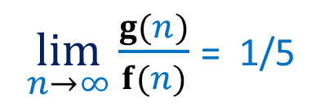

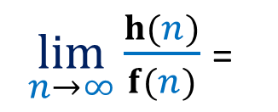
A judgment question for you !
Algorithm A has time complexity f($n$)= ${5 n}^{2}$ + $n$+ 1250
Researchers have designed two new algorithms B and C
Algorithm B has time complexity g($n$) = $n^{2}$ + 10
Algorithm C has time complexity h($n$) = ${10 n}^{1.5}$ + 20 $n$ + 2000
Which of B and C is an improvement over A in the true sense ?
$\lim_{n→∞}{\frac{g(n)}{f(n)}}$ = 1/5
$\lim_{n→∞}{\frac{h(n)}{f(n)}}$ =
?
0
C is an improvement over A in the true sense.

Slide 15
Rule 2
An algorithm X is superior to another algorithm Y if
the ratio of time complexity of X and time complexity of Y
approaches 0 for asymptotically large input size.

Slide 16
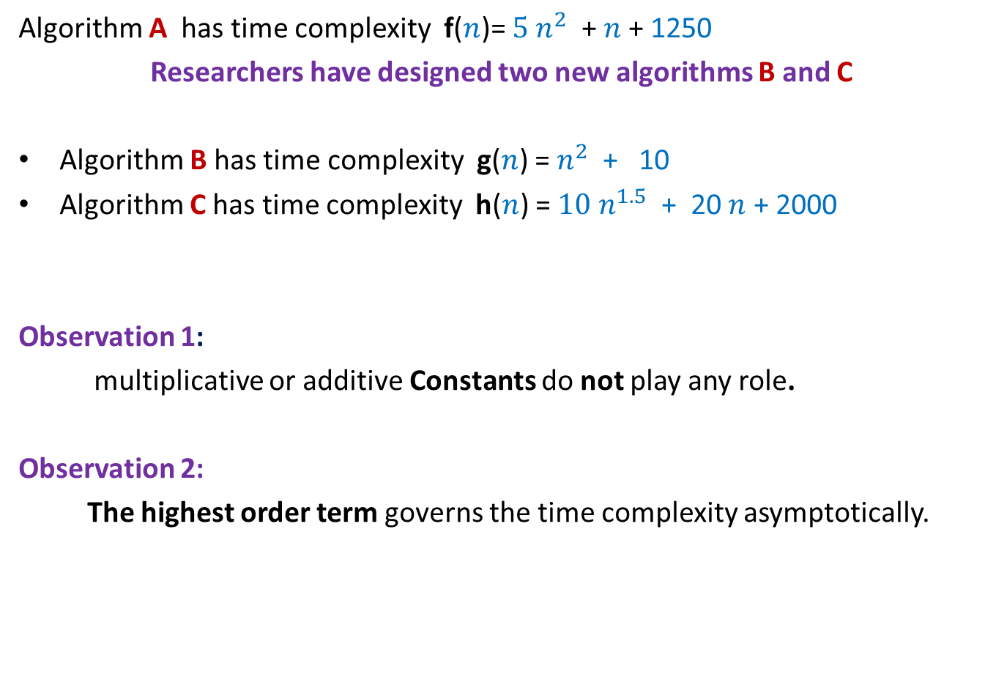
Some Observations
Algorithm A has time complexity f($n$)= ${5 n}^{2}$ + $n$+ 1250
Researchers have designed two new algorithms B and C
Algorithm B has time complexity g($n$) = $n^{2}$ + 10
Algorithm C has time complexity h($n$) = ${10 n}^{1.5}$ + 20 $n$ + 2000
Observation 1:
multiplicative or additive Constants do not play any role.
Observation 2:
The highest order term governs the time complexity asymptotically.
Algorithm C is the most efficient of all.

Slide 17
Order Notations
A mathematical way
to capture the intuitions developed till now.
(reflect upon it yourself)

Slide 18





Order notation
Definition: Let f($n$) and g($n$) be any two increasing functions of n.
f($n$) is said to be of the order of g($n$)
if there exist constants c and $n_{0}$such that
f($n$) ≤ c g($n$) for all n > $n_{0}$
c g($n$)
f($n$)
$$n_{0}$$
If f($n$) is of the order of g($n$), we write f($n$) = O(g($n$))

Slide 19

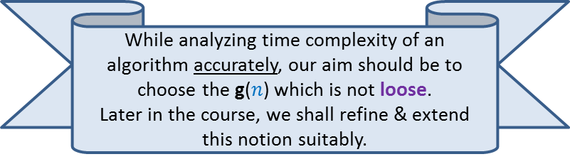
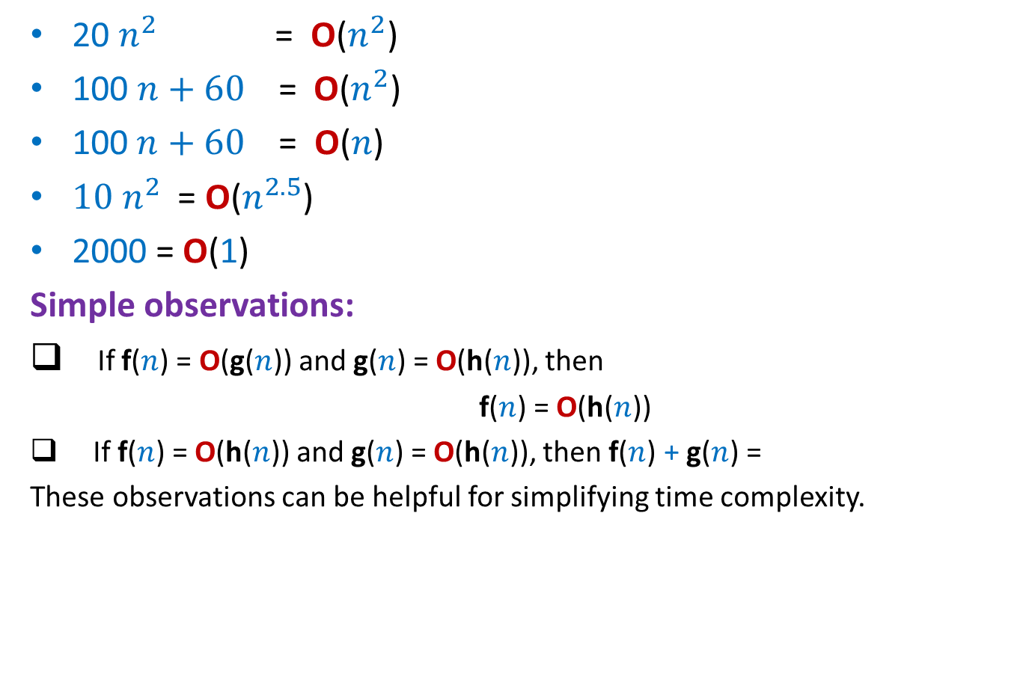



Order notation : Examples
20 $n^{2}$ = O($n^{2}$)
100 $n+60$ = O($n^{2}$)
$\text{100 }n+60\text{ = }\text{O}\text{(}n\text{)}$
${10 n}^{2}$ = O($n^{2.5}$)
2000 = O(1)
Simple observations:
If f($n$) = O(g($n$)) and g($n$) = O(h($n$)), then
f($n$) = O(h($n$))
If f($n$) = O(h($n$)) and g($n$) = O(h($n$)), then f($n$) + g($n$) =
These observations can be helpful for simplifying time complexity.
$c=$20, $n_{0}=$1
Loose
$c=$1, $n_{0}=$160
$c=$160, $n_{0}=$1
Loose
While analyzing time complexity of an algorithm accurately, our aim should be to choose the g($n$) which is not loose.
Later in the course, we shall refine & extend this notion suitably.
?
O(h($n$))
Prove these observation as Homeworks

Slide 20
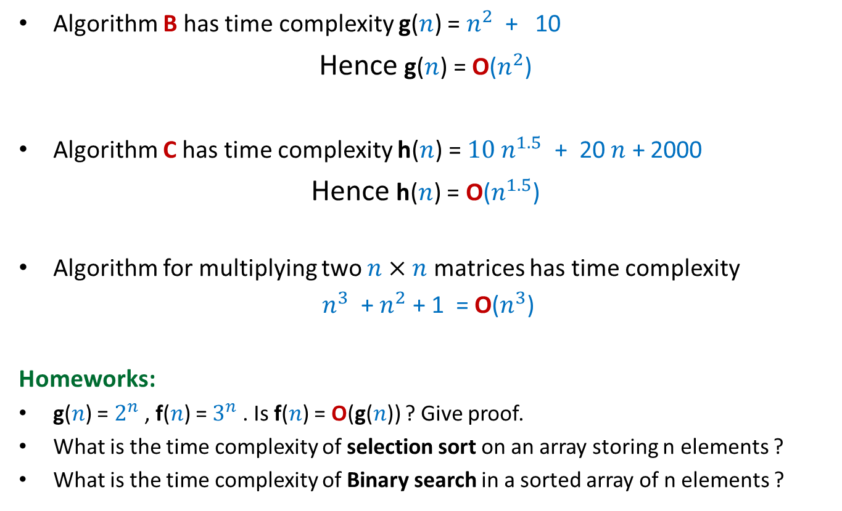
A neat description of time complexity
Algorithm B has time complexity g($n$) = $n^{2}$ + 10
Hence g($n$) = O($n^{2}$)
Algorithm C has time complexity h($n$) = ${10 n}^{1.5}$ + 20 $n$ + 2000
Hence h($n$) = O($n^{1.5}$)
Algorithm for multiplying two $n×n$ matrices has time complexity
$n^{3}$ + $n^{2}$ + 1 = O($n^{3}$)
Homeworks:
g($n$) = $2^{n}$, f($n$) = $3^{n}$. Is f($n$) = O(g($n$)) ? Give proof.
What is the time complexity of selection sort on an array storing n elements ?
What is the time complexity of Binary search in a sorted array of n elements ?

Slide 21
How to Design Efficient Algorithm ?
(This sentence captures precisely the goal of theoretical computer science)

Slide 22
Designing an efficient algorithm
Facts from the world of algorithms:
No formula for designing efficient algorithms.
Every new problem demands a fresh approach.
Designing an efficient algorithm or data structure requires
Ability to make key observations.
Ability to ask right kind of questions.
A positive attitude and …
a lot of perseverance.
We shall demonstrate the above facts during this course many times.

Slide 23
Max-sum subarray problem
Given an array A storing n numbers,
find its subarray the sum of whose elements is maximum.
4
7
A
3 -5 3 8 2 -4 9 -6 3 -2 -8 3 -5 1 7 -9
18
-2

Slide 24

Max-sum subarray problem: A trivial algorithm
A_trivial_algo(A)
{ max← A[0];
For i=0 to n-1
For j=i to n-1
{ temp ← compute_sum(A,i,j);
if max< temp then max← temp;
}
return max;
}
compute_sum(A, i,j)
{ sum←A[i];
For k=i+1 to j sum← sum+A[k];
return sum;
}
Homework: Prove that its time complexity is O($n^{3}$)

Slide 25

Max-sum subarray problem:
Question: Can we design O($n$) time algorithm for Max-sum subarray problem ?
Answer: Yes.
Think over it with a fresh mind ….
We shall design it together in the next class…☺

