Slide 1
PORTFOLIO
GEETHANJALI BM
M1043231

Slide 2

ABOUT ME
My name is Geethanjali BM, DOB(18 june,1995).
I am from Hassan, Karnataka.
We are four in a family. My father is Govt primary school teacher, my mother is Govt primary school teacher, I have sweet little sister who is a student.

Slide 3

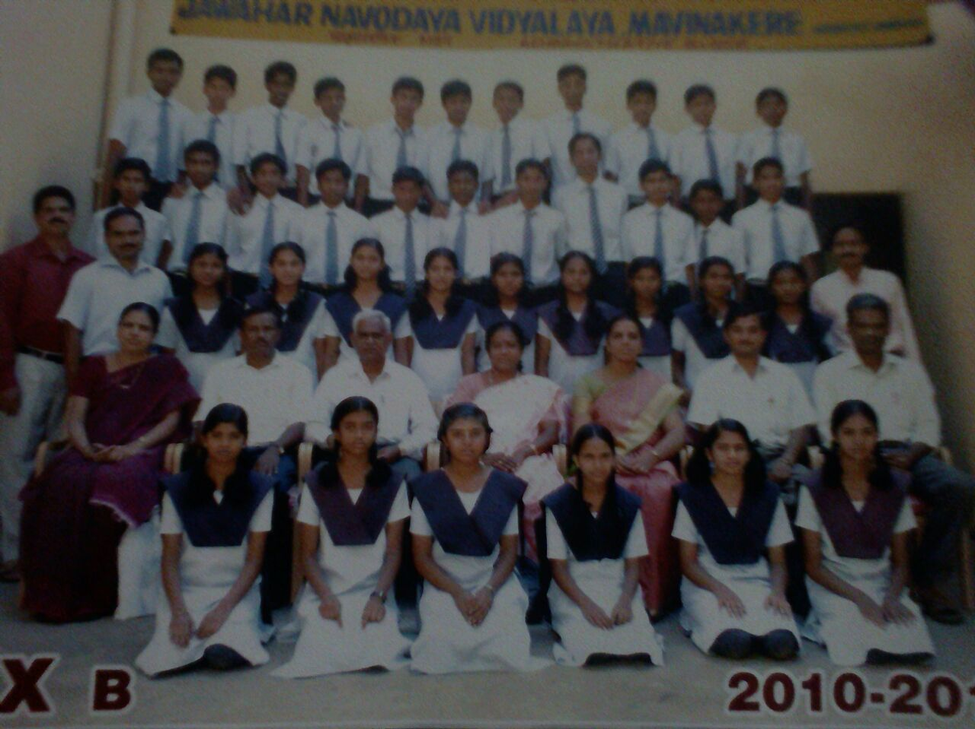
SCHOOLING
Jawahar Navodaya Vidyalaya, Mavinkere Hassan (10th) – 9.8 GP
Shri Venkateshwara PU College, Hassan (12th) – 84.67%

Slide 4
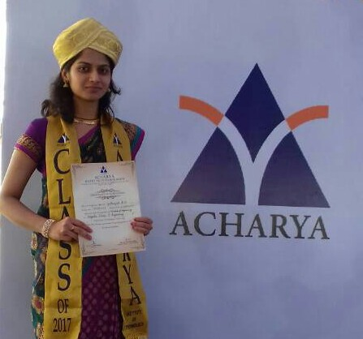
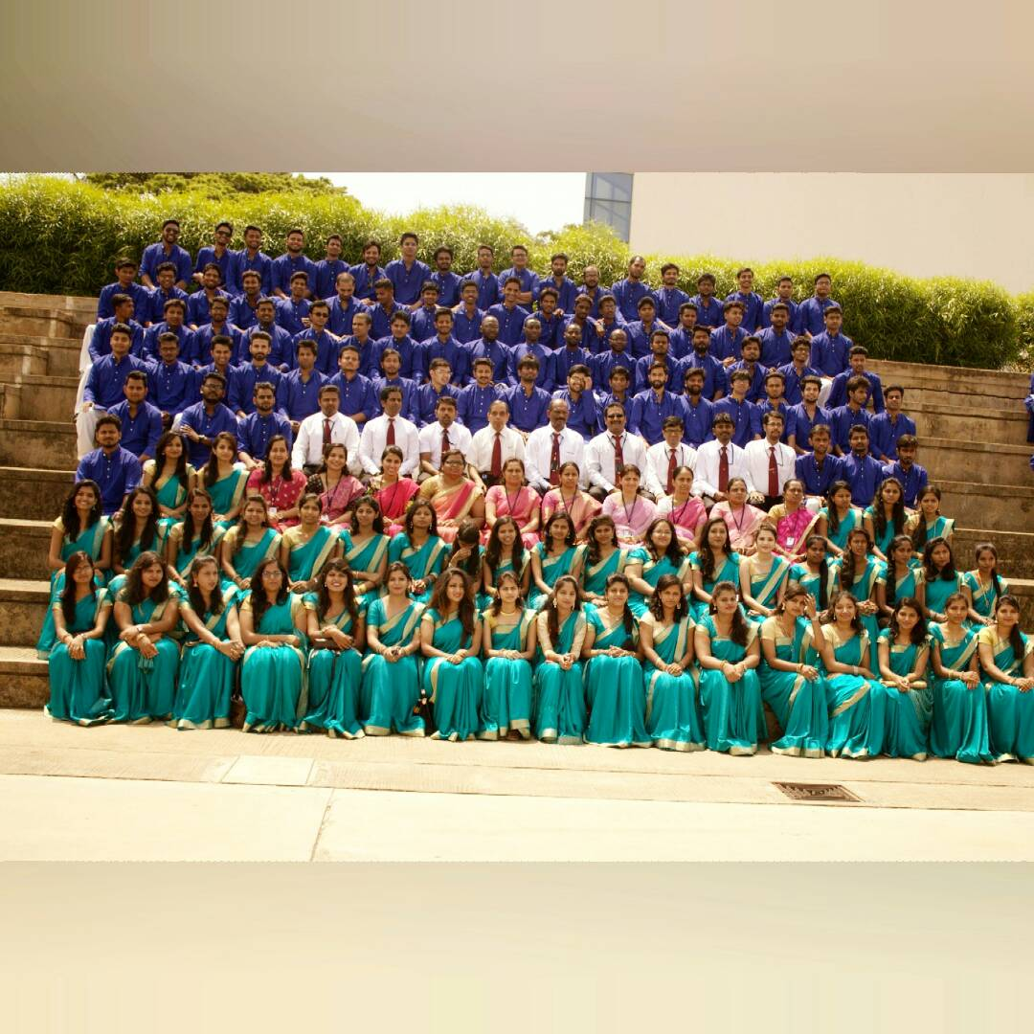
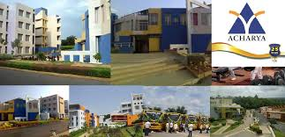
GRADUATION
From Acharya Institute of Technology, Bangalore with 70% in
Computer Science Engineering.

Slide 5



TECHNICAL SKILLS

Slide 6

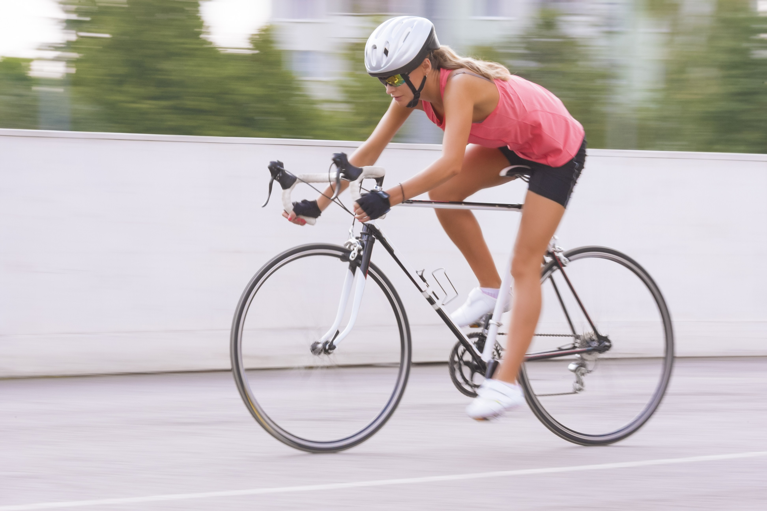
HOBBIES
Listening music
Cycling
Gardening

Slide 7
CONTACT DETAILS
Mobile No: 8197337489
Mailing Address: geethu1895@gmail.com
Outlook: Geethanjali.bm@Mindtree.com

Slide 8
THANK YOU

