Slide 1
Optimizing-User-Group-and-Role-management-with-access-control-and-workflows
SlideMake.com

Slide 2
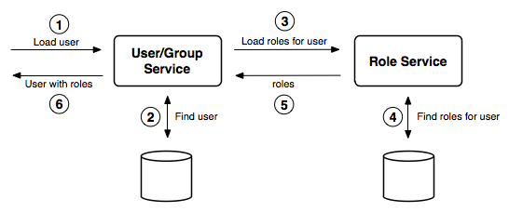
Introduction to User, Group, and Role Management
Effective user, group, and role management is essential for securing organizational data.
Proper management streamlines access control and reduces security risks.
This presentation explores strategies to optimize these processes with workflows and access controls.
Notes:
Image source: https://docs.geoserver.org

Slide 3
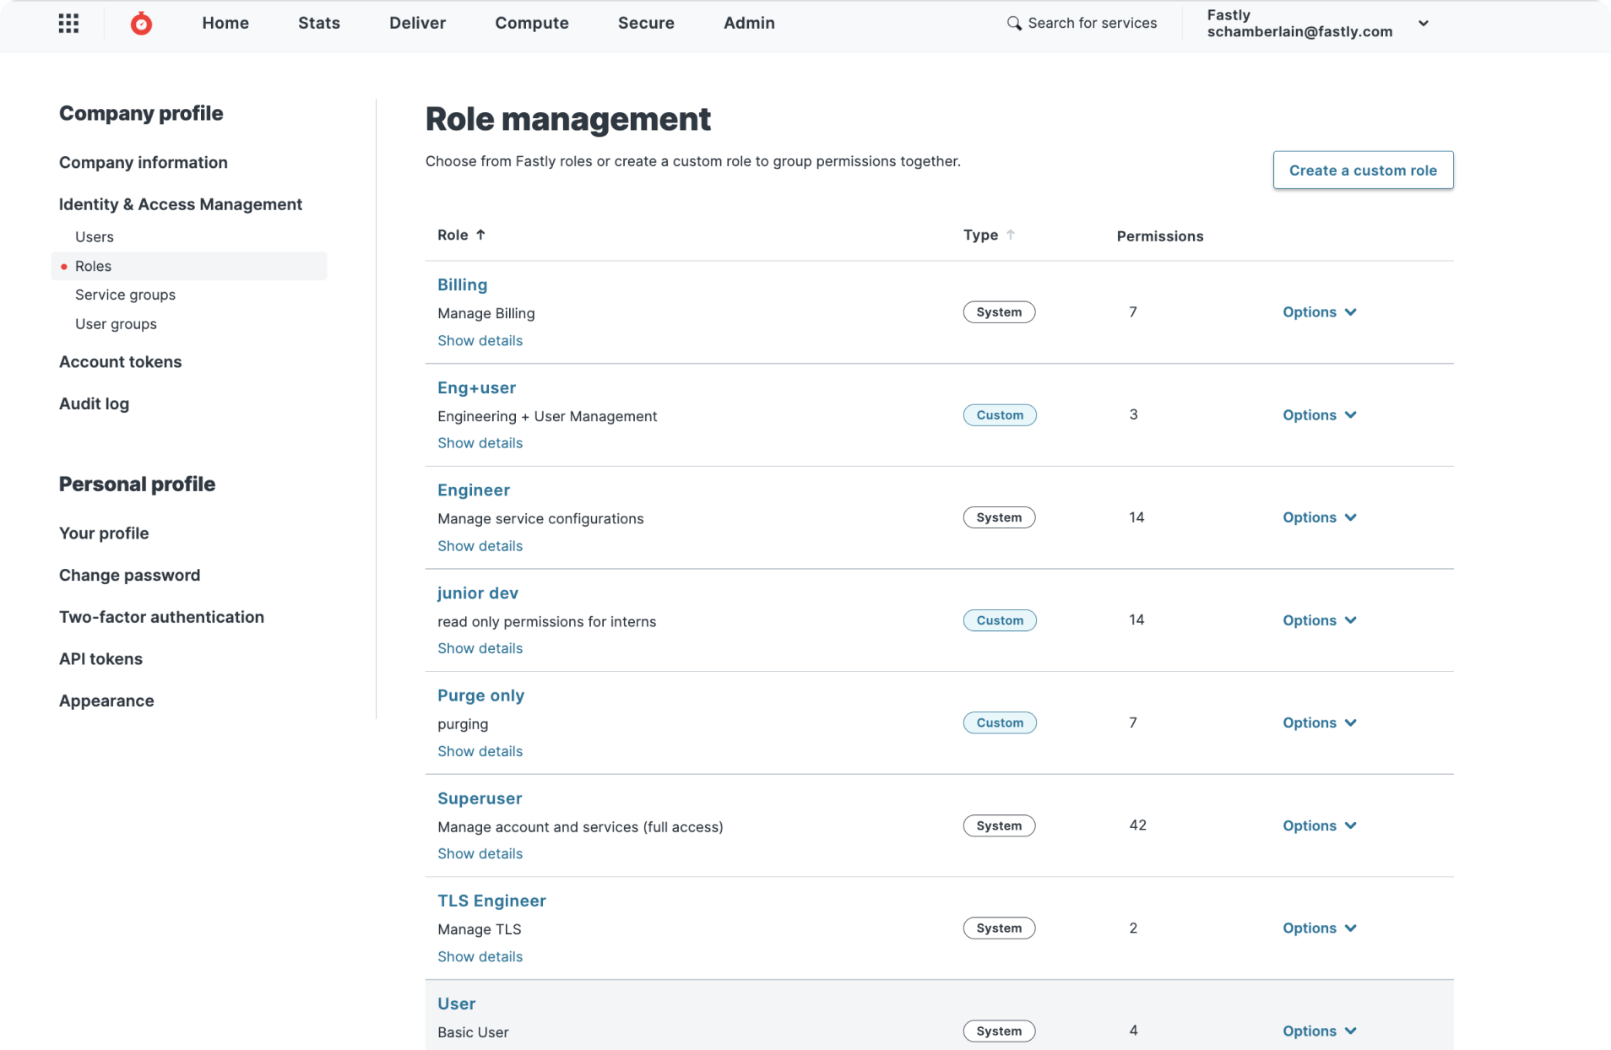
Importance of Access Control in Organizations
Access control ensures that users have appropriate permissions based on their roles.
It helps prevent unauthorized access and potential data breaches.
Implementing robust access control policies improves overall security posture.
Notes:
Image source: https://uploads-ssl.webflow.com

Slide 4

User Management Best Practices
Maintain accurate and up-to-date user information for all system users.
Enforce strong authentication methods to verify user identities.
Regularly review user privileges to ensure they align with current roles and responsibilities.
Notes:
Image source: https://www.slidemake.com

Slide 5
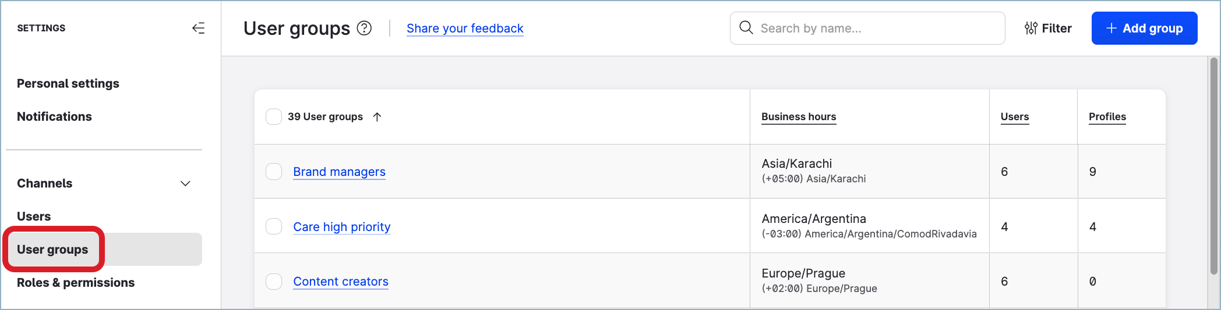
Group Management Strategies
Organize users into groups based on department, function, or project for easier management.
Assign permissions at the group level to simplify access management.
Use dynamic groups with rules to automatically update memberships as user attributes change.
Notes:
Image source: https://docs.emplifi.io

Slide 6
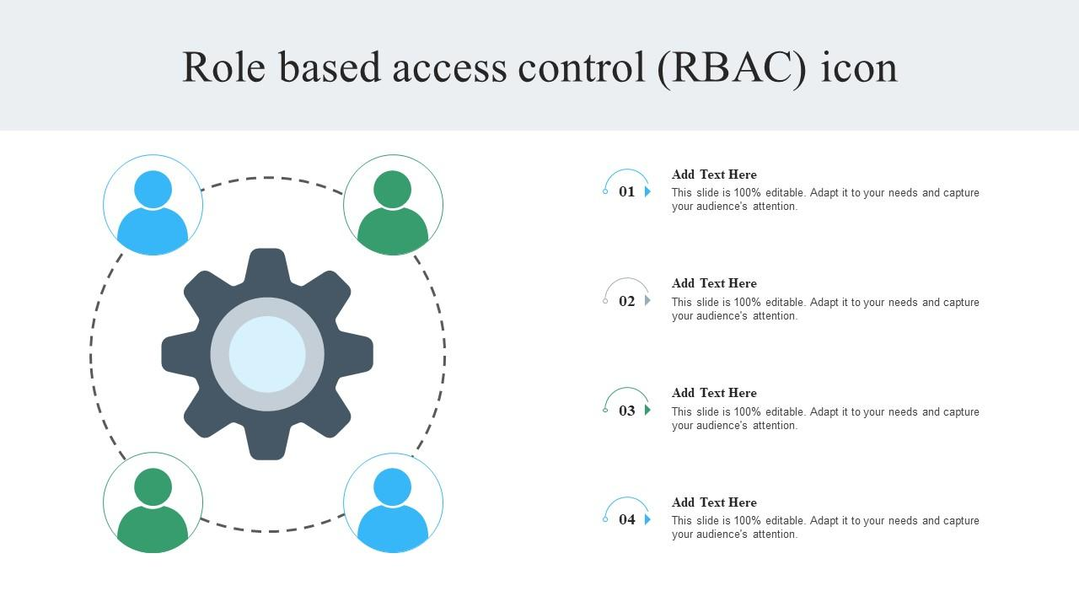
Role-Based Access Control (RBAC) Principles
RBAC assigns permissions based on predefined roles rather than individual users.
It simplifies permission management by grouping permissions into roles.
Proper role design ensures minimal privilege principles and enhances security.
Notes:
Image source: https://www.slideteam.net

Slide 7
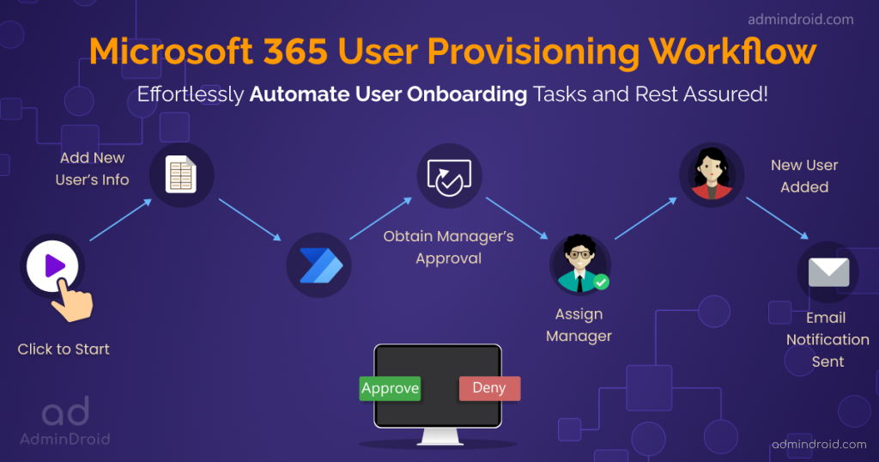
Workflow Automation in User and Role Provisioning
Automate onboarding and offboarding processes to reduce manual errors.
Use workflows to enforce approval processes for role changes and access requests.
Monitoring workflows ensures compliance and provides audit trails for security reviews.
Notes:
Image source: https://blog.admindroid.com

Slide 8

Implementing Access Control Policies
Define clear access policies aligned with organizational security requirements.
Use least privilege principles to restrict user permissions to only what is necessary.
Regular policy reviews and updates help adapt to changing security landscapes.
Notes:
Image source: https://riskhouse.co.ke

Slide 9

Tools and Technologies for Optimization
Identity and Access Management (IAM) tools streamline user, group, and role management.
Workflow automation platforms facilitate approval processes and audit tracking.
Integration of these tools with existing systems enhances efficiency and security.
Notes:
Image source: https://www.techfunnel.com

Slide 10
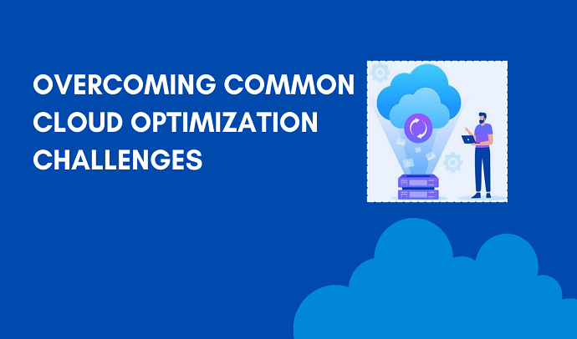
Challenges and Solutions in Management Optimization
Common challenges include managing complex permissions and maintaining compliance.
Solutions involve adopting centralized management platforms and automated workflows.
Continuous monitoring and auditing are critical for maintaining an optimal system.
Notes:
Image source: https://cloudopty.com

Slide 11
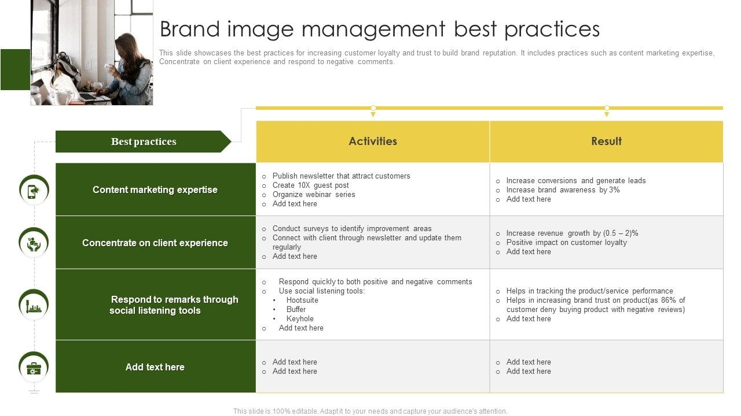
Conclusion and Best Practices Summary
Effective management requires clear policies, automation, and regular reviews.
Leveraging appropriate tools can significantly enhance security and efficiency.
Ongoing training and audits ensure that the system remains aligned with organizational goals.
Notes:
Image source: https://www.slidegeeks.com

