Slide 1

The nuclear Josephson effect & γ-ray emission
F.Barranco¹ , G.Potel¹ and E. Vigezzi²
(1)Dept. Física Aplicada III, Univ. of Seville, Spain
(2)INFN, Milano, Italy
Bienal RSEF, Sevilla julio 2026.
PID2023-146401NB-I00

Slide 2
Josephson Junctions (DC and AC): In Condensed Matter
V(t)

Slide 3
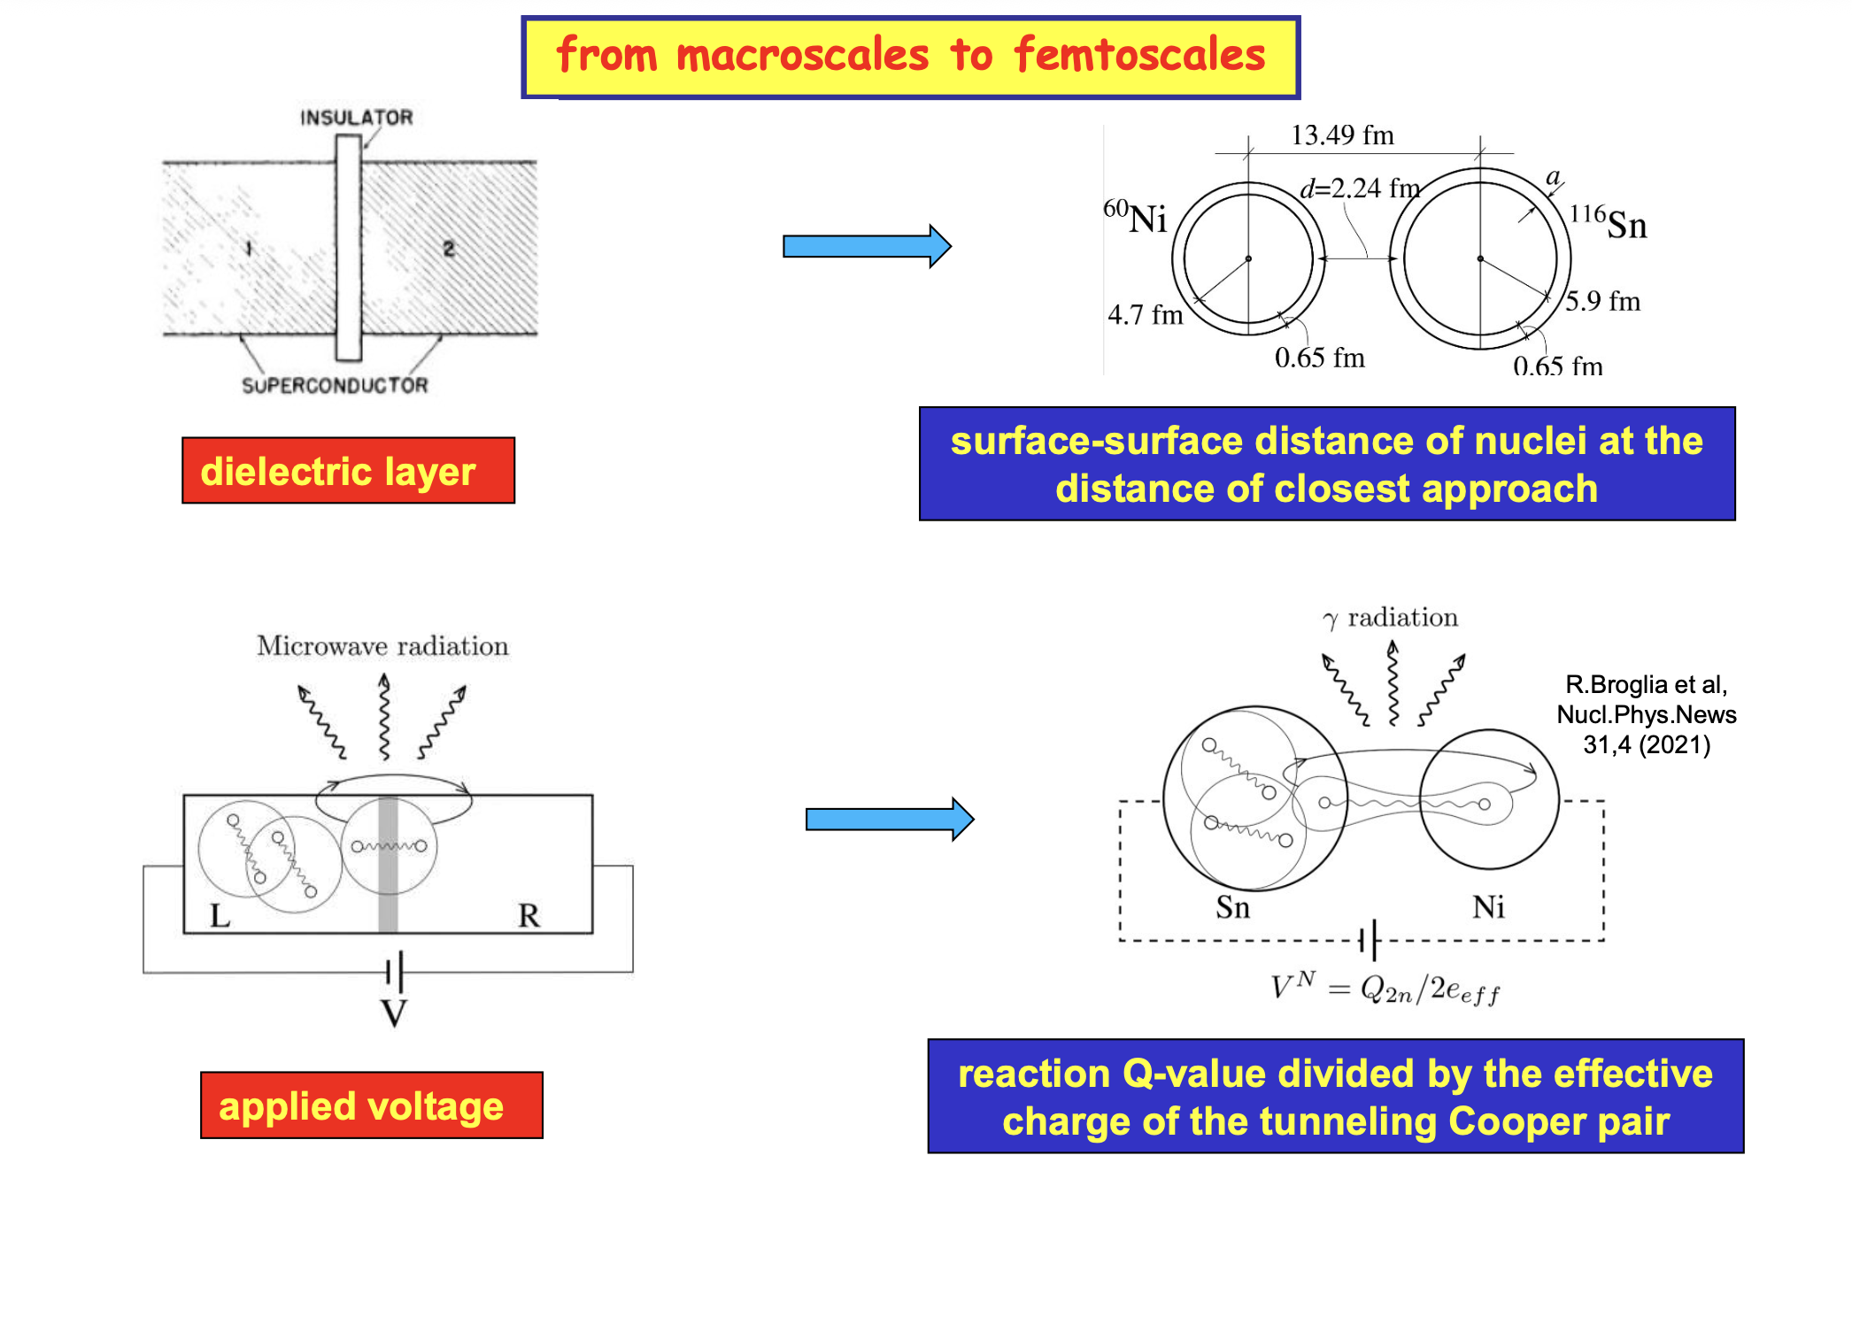

Slide 4
The Legnaro’s 116Sn+60Ni 2NT and 1NT data at different E_cm:
Note: 1n is inclusive
Semiclassical calculations in this paper

Slide 5
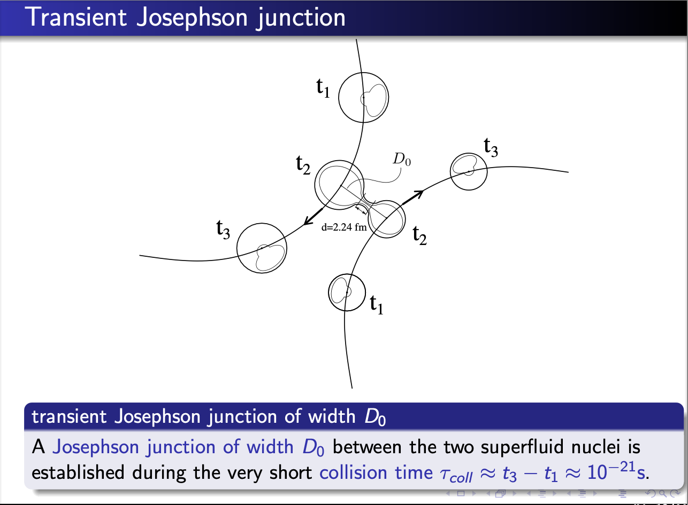
One- and two-neutron transfer probability between superfluid heavy ions as a function of the distance of closest approach
At D0 = 13.3 fm P2 = P1 !!!
D. Montanari et al, PRL 113 052501 (2014)

Slide 6
Second order DWBA: sequential transfer
Bj =

Slide 7
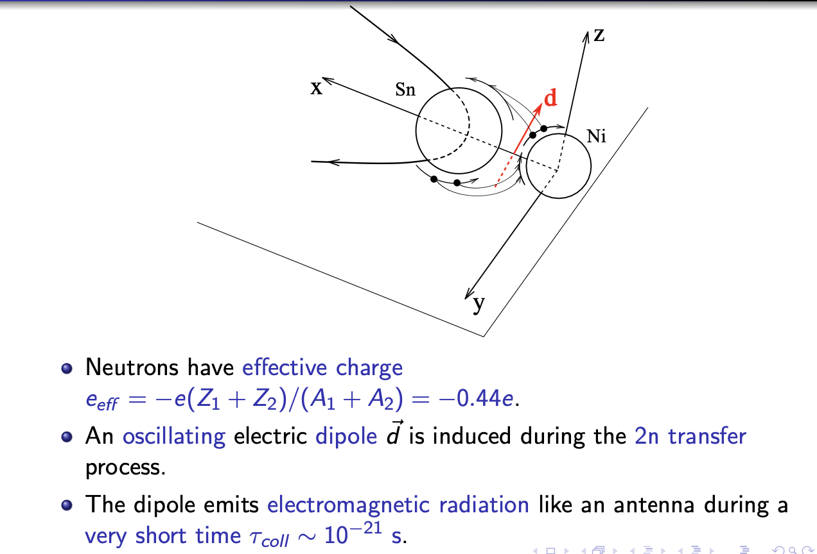

Slide 8
Gamma emission: predicted angular distribution

Slide 9
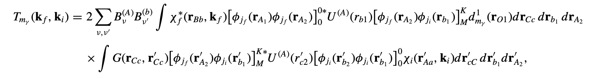
Gamma emission in 2NT channel

Slide 10
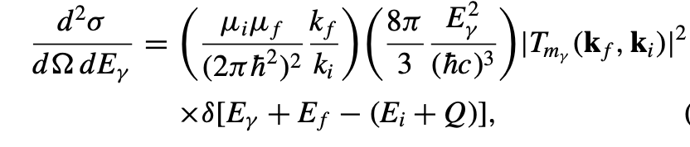
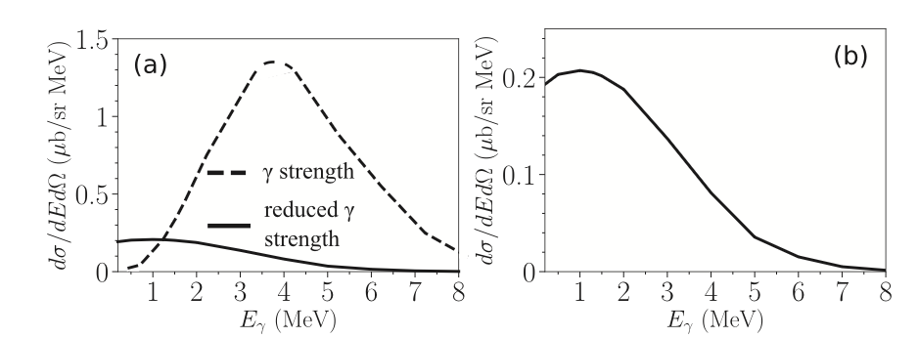
E_{𝛄}^{max} = Q_{2n}= 1.3 MeV
G.Potel et al,
PRC 103 L021601 (2021)
PRC 105 L061602 (2022)
arXiv:2206.0531

Slide 11
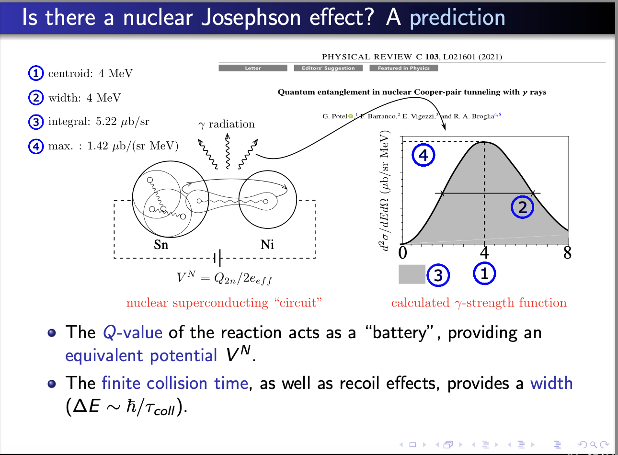

Slide 14
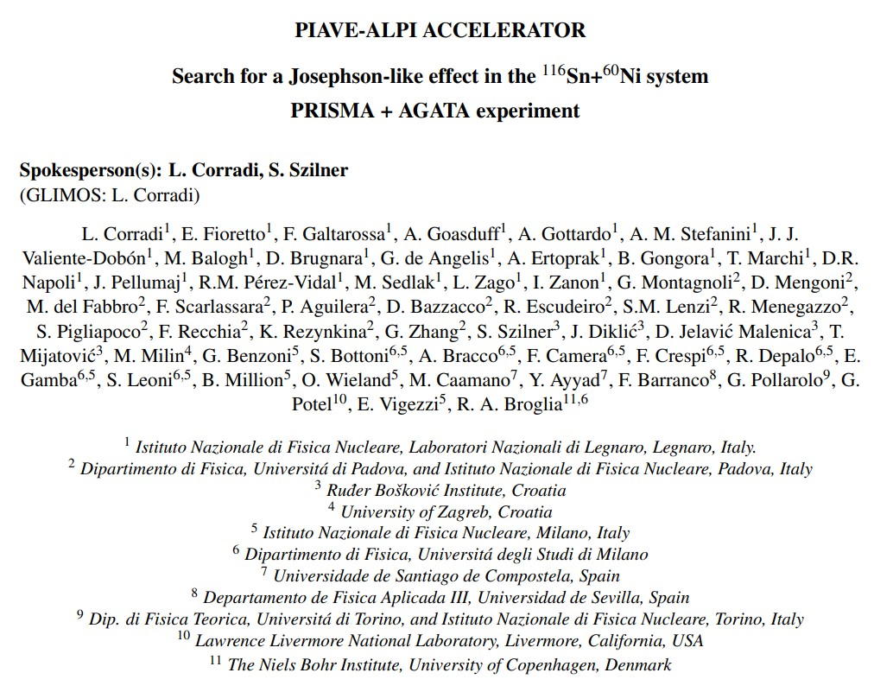
Original proposal approved by the LNL PAC → experiment performed in 2023

Slide 15
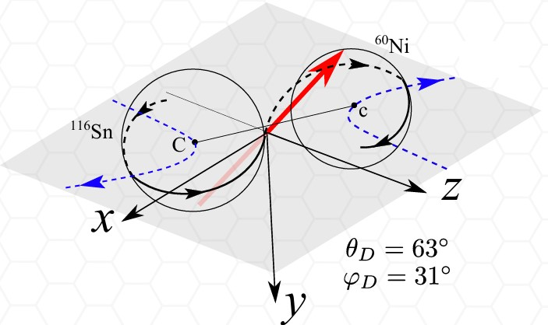
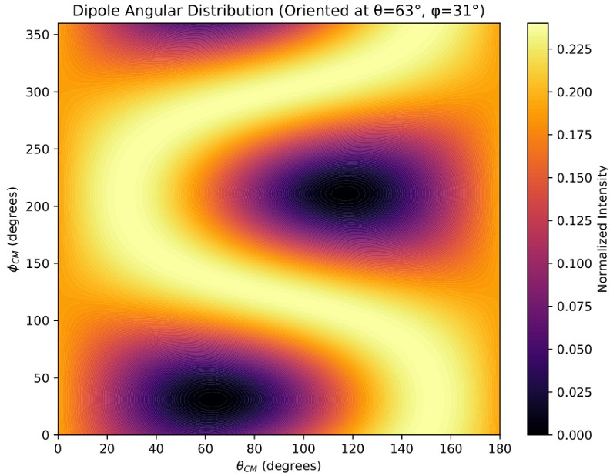
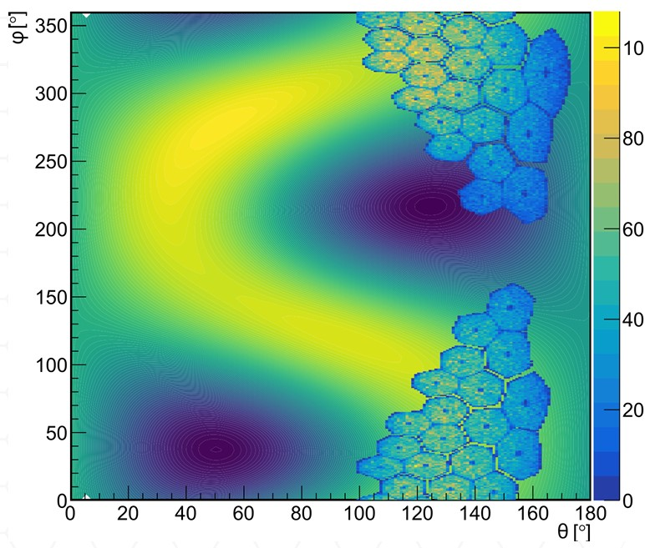
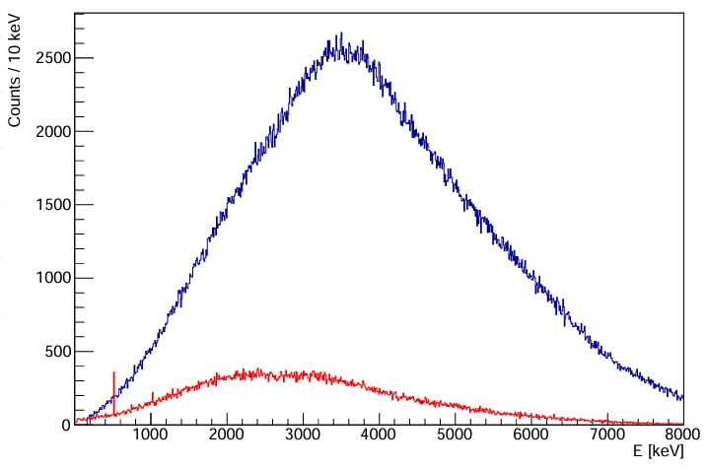
Josephson dipole gamma ray angular distributions
scheme of the reaction
theoretical predictions
overlap with AGATA geometry
simulations
input (Broglia’s theory)
output

Slide 16
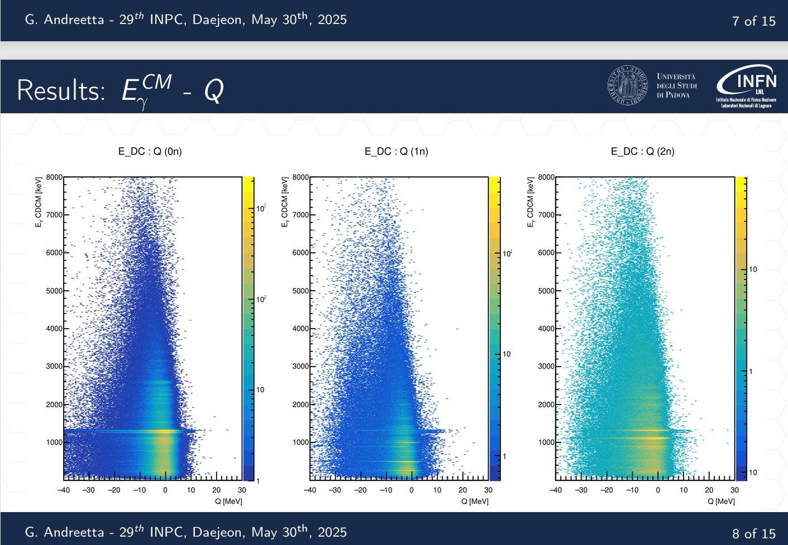

Slide 17
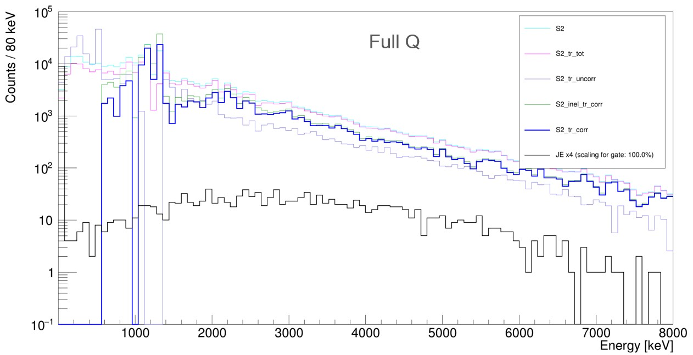
Full Q data vs. prediction

Slide 18
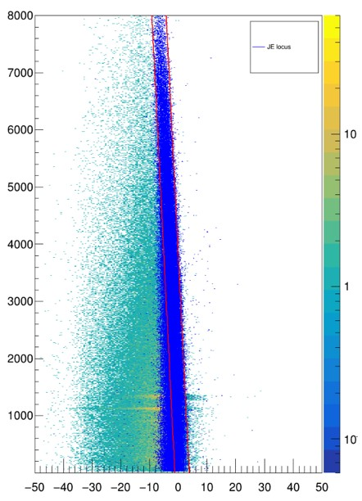
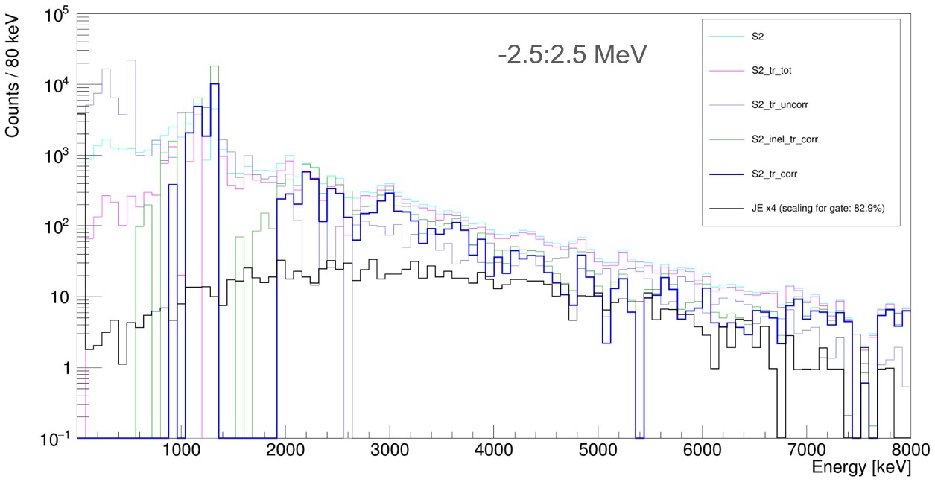
Gating on Q-Egamma matrixes
superimposed Jos simulation

Slide 19
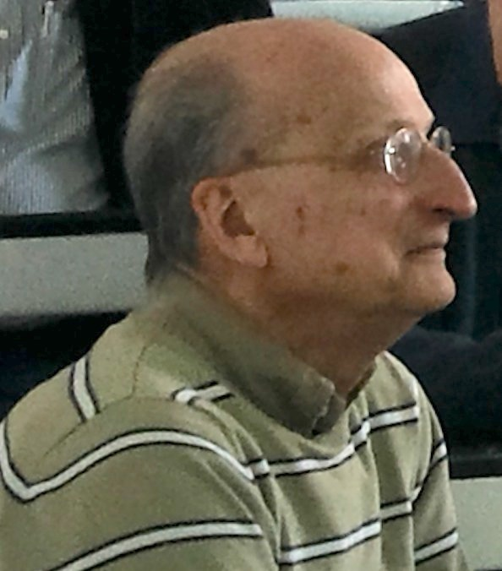

A legacy of Ricardo Broglia
Collaborators:
E. Vigezzi (Milano)
G. Potel (Sevilla)
Proc. of the International School of Physics
“Enrico Fermi” Course 213 Springer

Slide 20
Gracias por su atención!!

Slide 21
Gamma strength: 2NT versus 1NT channel
G.Potel et al., PRC 105 L061602 (2022)

Slide 22
Velocity of the Transferred Cooper and (critical) Depairing velocity .

Slide 23
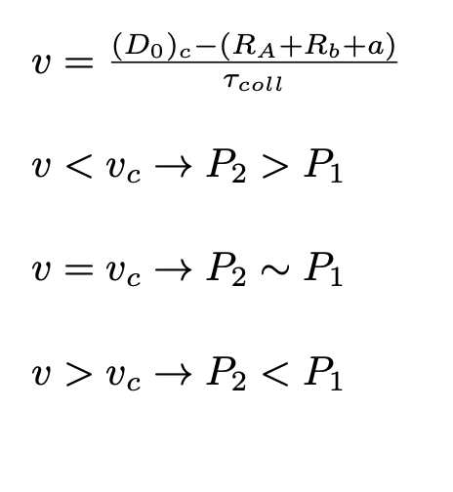

Critical depairing velocity
$$\sim$$

Slide 24
Velocity of the Transfered (nuclear) Cooper Pair.
Simulated data (DWBA calc’s) as a function of pairing interaction.
Magenta curve
ξ(fm)
Green curve
Some de-pairing velocity effect seems to be present in DWBA
G*A(MeV)

Slide 25

Critical depairing velocity
$$\sim$$
T=0.1 T_{c}
T=0.9 T_{c}

Slide 26
6. Velocity of the Transfered (nuclear) Cooper Pair larger than the critical depairing velocities leads to P2 < P1
If the Cooper-pair velocity between the nuclei is larger than v_crit
Cooper pairs breaking is most likely → P1 > P2 ……………………………… (Do > Do_crit)
Conversely if P2 > P1 Cooper pairs velocity is smaller than v_cri....(Do < Do_crit)
When P2 = P1 one can see that in fact both velocities are equal (Critical situation)
thickness of the barrier
Cooper pair velocity
Collision time
Critical Depairing velocity
Broglia et al. arXiv:2206.05351

Slide 27
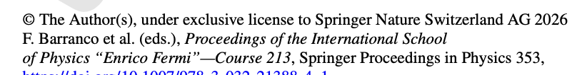

Slide 28
3. Josephson Junctions (DC and AC): In Condensed Matter
V(t)

