Slide 1
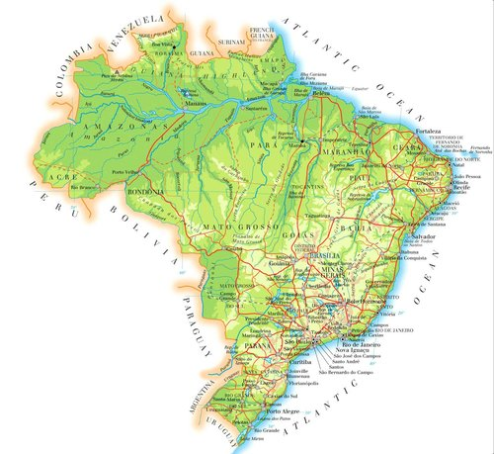

Olist Executive Review
Power BI Desktop
Olist is the largest department store in Brazilian market places. It connects small businesses from all over Brazil to channels without hassle and with a single contract. Those merchants are able to sell their products through the Olist Store and ship them directly to the customers using Olist logistics partners.
Olist experienced tremendous growth between 2017 and 2018. However, that growth rate is declining and management has decided to start an advertising campaign and needs to know where to advertise and which categories to target.
Year  | Revenue | Order Count | Customer Count
2017 | 6,057,580 | 44139 | 42803
2018 | 7,332,018 | 53473 | 52280
2018 Year over Year Revenue Change and Percent Change
RevenueChangeLastYear
RevenueChangeLastYear%
RevenueChangeLastYear
1.0M
0.82M
RevenueChangeLastYe…
699
0.60M
0.62M
0.64M
250
169
185
0.49M
0.44M
500
0.5M
0.39M
0.28M
102
79
99
51
0.0M
January
February
March
April
May
June
July
August
0
Month

Slide 2
Growth Overview
Power BI Desktop
These charts show that Olist is experiencing excellent growth, however, that growth is slowing.
Year Over Year Order Count Change Month By Month
1,000
Order Count OrderCountLY OrderDiffL OrderDiffLY%
7.2K
7.2K
6.9K
6.8K
6.4K
6.6K
6.2K
6.4K
6.1K
Order Count Changes
6K
820
4.9K
4.6K
4.5K
Percent change
3.9K
4.3K
4K
3.6K
3.2K
500
293
1.7K
2.6K
2.4K
2.3K
2.2K
2K
192
0.8K
176
89
92
58
51
0K
2018 January
2018 February
2018 March 2018 April 2018 May 2018 June 2018 July
DateYear Date Month
Order Count and Revenue by DateYear and Month
2018 August
0
8K
7.2K 7.2K
6.9K
0.88M
1.0M
Order Count
Revenue
0.94M
6.6K
6.8K
6.1K
6.2K
6.4K
6K
0.84M
0.85M
Order Counts
4.3K
3.6K
3.9K
0.5M
Revenue
4K
0.50M
3.2K
0.56M
2.6K
2.4K
0.43M
0.49M
2K
1.7K
0.36M
0.35M
0.8K
0.24M
0K
0.12M
0.0M
2017
January
2017 2017 2017 April
February March
2017 May
2017 June
2017 July
2017
August
2018
January
2018 2018 2018 April
February March
2018 May
2018 June
2018 July
2018
August
DateYear Date Month

Slide 3
Growth Overview
Power BI Desktop
We can see that sales increase are not consistent. The latter part of the year shows very small increase and even a decrease from the prior month.
Monthly Change In Revenue
RevenueLM and RevenueC…
0.99M
0.99M
RevenueLM RevenueChangeLastMonth
1.0M
0.94M
0.98M
0.84M
0.86M
0.88M
0.73M
0.50M
0.43M
0.49M
0.5M
0.36M
0.35M
0.15M
0.24M
0.21M
0.14M
0.12M
0.06M
0.07M
0.01M
0.00M
0.01M
0.0M
-0.02M
-0.07M
-0.10M
-0.13M
-0.03M
2017
January
2017 2017 2017 April 2017 May 2017 June 2017 July February March
2017
August
2018
January
2018 2018 2018 April 2018 May 2018 June 2018 July February March
2018
August
DateYear Date Month
Revenue and Revenue Change % By Month
0.94M
0.98M
100
Revenue
RevenueChangeLastMonth%
1.0M
103
0.84M
0.86M
0.88M
0.85M
RevenueChangeLastMonth%
0.99M
0.99M
Revenue
52
0.56M
0.50M
0.43M
0.49M
28
50
0.5M
0.36M
0.35M
43
15
15
17
0.24M
1
0
2
-4
-11
-13
-3
0
-14
0.0M
2017 2017 2017 April
February March
2017 May
2017 June
2017 July
2017
August
2018
January
2018 2018 2018 April 2018 May 2018 June 2018 July February March
2018
August
DateYear Date Month

Slide 4

Where To Advertise?
Power BI Desktop

Slide 5
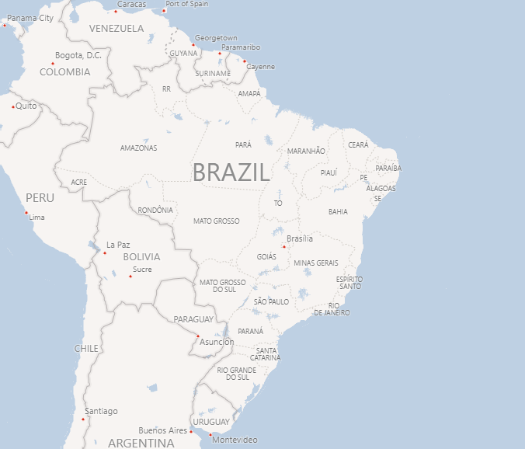



2018 Revenue By Location
Power BI Desktop
Sales are concentrated on the east coast, with the southeast having the greatest concentration.
Revenue by Location 2018
Percent of Total Sales By State 2018
Sao Paulo
Rio Grande do…
Parana
5.22%
5.17%
Santa Catarina
Bahia
3.70%
Distrito … Espirito … Goias
3.88%
40.28%
Rio de Janeiro
2.12% 2.0… 2.0…
Pernambu… Mat… Par… Ma…
1.87%
1.… … …
Maran… Al…
12.28%
Minas Gerais
Ceara
1.53%
Piaui
To…
11.59%
Para
Rio Gr…
© 2022 Miiccrrossofftt Corrporrattiion
Notes:
Sales are concentrated in the sourh east. The three largest state, Sao Paul, Rio de Janeiro and Minas Gerais account for about 62% of sales.

Slide 6
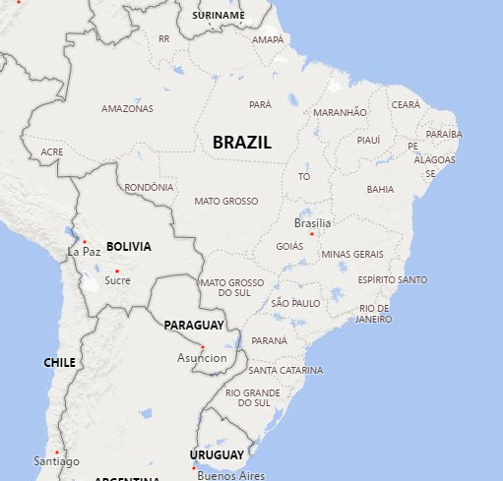
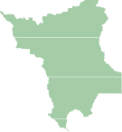
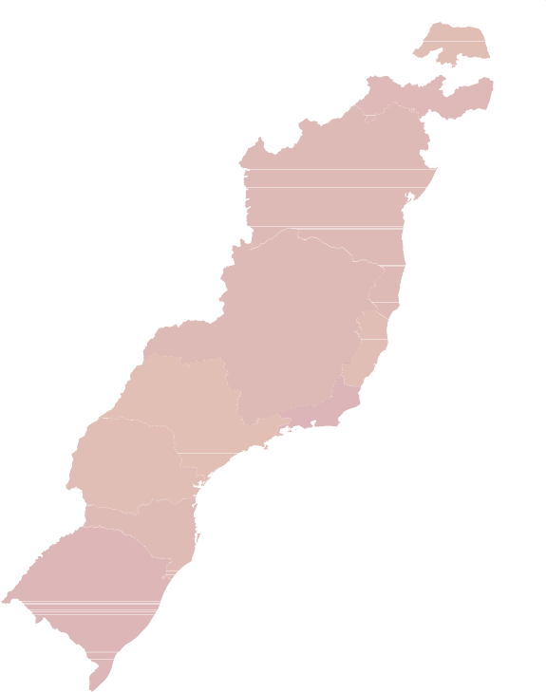
2018 Revenue Change By State
Power BI Desktop
Revenue Change by State Name
State Name RevenueLastYear Revenue
Revenue Change Change Percent

Roraima | 877.15 | 6,222 | 5,344.94 | 609.35%
Rio Grande do Norte | 15,999.68 | 46,797 | 30,796.87 | 192.48%
Distrito Federal | 56,554.59 | 155,605 | 99,050.84 | 175.14%
Sao Paulo | 1,097,005.95 | 2,952,973 | 1,855,967.15 | 169.18%
Pernambuco | 52,512.42 | 137,434 | 84,921.19 | 161.72%
Espirito Santo | 60,123.34 | 153,555 | 93,431.51 | 155.40%
Minas Gerais | 335,045.81 | 849,612 | 514,566.29 | 153.58%
Santa Catarina | 118,388.11 | 284,615 | 166,226.71 | 140.41%
Parana | 159,632.88 | 379,330 | 219,697.30 | 137.63%
Bahia | 125,977.14 | 271,575 | 145,597.38 | 115.57%
Rio Grande do Sul | 180,889.84 | 382,733 | 201,843.41 | 111.58%
Rio de Janeiro | 438,888.99 | 900,321 | 461,432.06 | 105.14%
This shows the top ten growth in both amount and percent. It shows that the states along the cost provide both. Roraima in the north has outstanding percentage growth, however, it has a very low sales amount. Olist should target any marketing campaign in the costal states.
© 2022 TomTom,, © 2022 Miiccrrossofftt Corrporrattiion,, © OpenSttrreettMap
Notes:
Roraima has the highest percent growth, however it has very low sale. These top ten all have growth rates over 100% from last year.

Slide 7
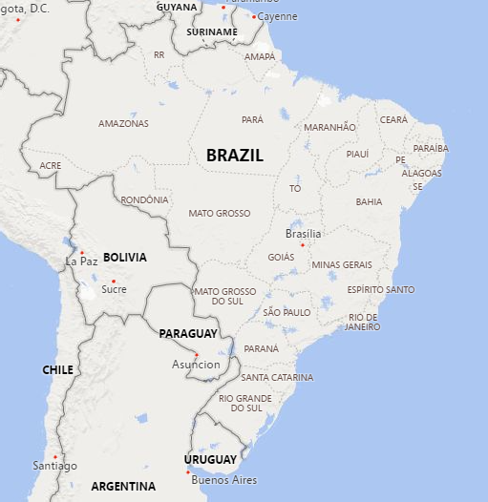
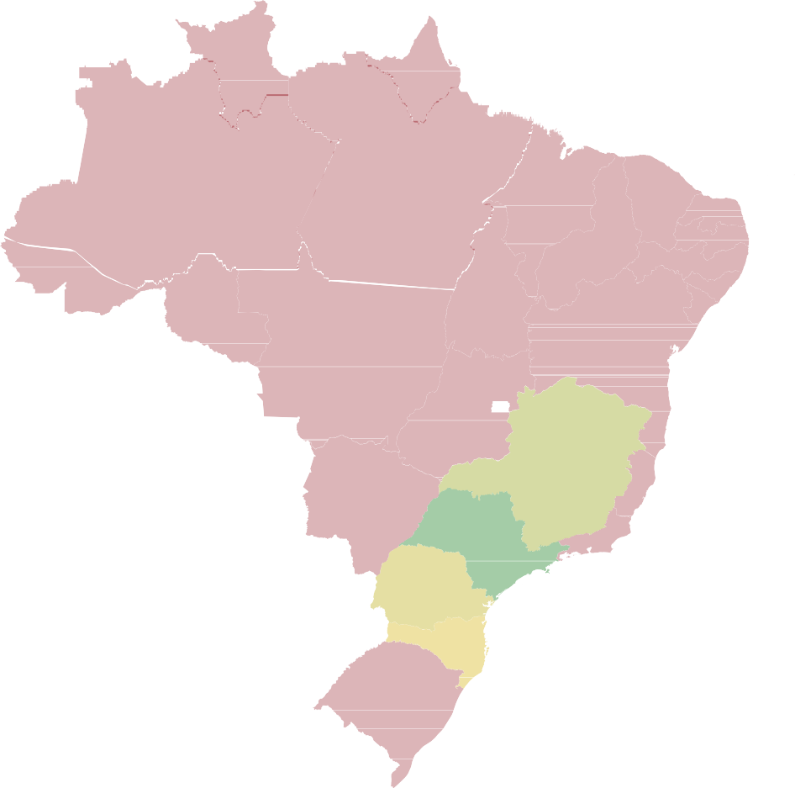
2017 - 2018 Revenue Change By State
Power BI Desktop
The top 3 states, San Paulo, Minas Gerais, and Rie de Janerio, account for ~63% of sales. Any planned marketing campaigns should focus on these areas .
Revenue Change by State Name
Revenue Change
Change Percent
2M
500%
Revenue Change
1M
Change Percent
0M
0%
Parana
Bahia
Goias
Ceara
Paraiba
Para
Piaui
Sergipe
Alagoas
Roraima
Amapa
Acre
Sao Paulo
Pernambuco
Maranhao
Tocantins
Rondonia
Amazonas
Minas Gerais
Espirito Santo
Mato Grosso
Rio de Janeiro
Santa Catarina
Distrito Federal
Rio Grande do Sul
Mato Grosso do Sul
Rio Grande do Norte
© 2022 TomTom,, © 2022 Miiccrrossofftt Corrporrattiion,, © OpenSttrreettMap
State Name

Slide 8

Which Categories?
Power BI Desktop

Slide 9

Revenue By Category 2018
Olist's products are divided into 74 categories, however, sales are concentrated in the top 5 categories.
Revenue By Category
health_beauty 10.49% | sports_leisure 7.23% | furniture_decor 5.25% | garden_tools 2.92% | telephony 2.44% |  |  | perfumery 2.41% |  |  | toys 2.31%
 |  |  | office_furniture 1.95% |  | musical_in… 1.47% | electronics 1.38% |  | small_a… 1.19% |  |  |  |  | home_a… 1.19%
 |  | auto 4.73%
 | computers_accessories 6.84%
watches_gifts 9.63%
 |  |  | stationery 1.84%
 |  |  |  |  | fashion_bags… 0.95% |  | home_co… 0.81% |  | home_a… 0.77% |  |  |  |  | agro_i… 0.59%
 |  | baby 3.49%
 |  |  |  |  | luggage_acc… 0.87%
 |  |  | pet_shop 1.75% |  |  |  | furnitur… 0.46% | fixe… 0.3… |  |  | boo… 0.3… |  |  |  |  | air_… 0.…
 | housewares 5.42%
bed_bath_table 7.33%
 |  |  |  |  |  |  | audio 0.45%
 |  |  |  |  | computers 0.87% |  |  | home… |  |  |  | …
 |  | cool_stuff 3.14%
 |  |  | construction_tools_… 1.68% |  |  |  |  | food
 |  |  |  |  |  |  | industr…
 |  |  |  |  |  |  |  |  |  |  |  | cos…
 |  |  |  |  | consoles_ga… 0.87% |  |  | drinks
 |  |  |  |  |  |  |  |  |  |  |  | fur…
 |  |  |  |  |  |  | kitchen…
 |  |  |  |  |  |  |  | signali…
Notes:
The categories below the top ten all account for less than 3% of sales.

Slide 10
Revenue By Category 2018
Power BI Desktop
Revenue By Category
5000%
Reviewing the top twenty categories in percent of sales, we see that these categories great sales growth. These categories account for 80% of sales.
10.49%
10%
9.63%
The top five categories account for ~42% of sales and the top ten ~64%.
4172.52%
Only one category, cool_stuff, did not have double digit percentage growth.
4000%
Any marketing campaign should target the top five categories to get the most return on expenditures.
7.33% _{7.23%}
Percent Of Revenue
107.31%
139.43%
6.84%
3000%
Revenue Change %
130.93%
5.42% _{5.25%}
5%
204.96%
120.05%
4.73%
173.57%
2000%
3.49%
3.14%
266.33%
2.92%
9.32%
50.20%
2.44% 2.41%
2.31%
202.99%
43.62%
42.17%
1.95%
1.84%
1.75%
1.68%
1000%
90.70%
261.31%
1.47%
1.38%
158.14%
187.85%
245.30%
241.86%
0%
212.22%
0%
health_beauty
watches_gifts
sports_leisure
housewares
auto
baby
cool_stuff
garden_tools
telephony
perfumery
toys
stationery
pet_shop
electronics
bed_bath_table
computers_accessories
furniture_decor
office_furniture
musical_instruments
construction_tools_construction
product_category_name_english
Notes:
The top twenty are included to demonstrate how quickly the percent of sales drops off. Construction tools construction has the highest percent growth. However, it has a long way to go to make it into the top ten.

Slide 11
What to Watch - Overdue Orders
Power BI Desktop
Year  | OverdueOrder | Order Count | OverduePercent
2017 | 2810 | 44139 | 6.37%
2018 | 4840 | 53473 | 9.05%
Total | 7650 | 97612 | 7.84%
The percentage of Overdue orders is increasing. Most of 2017 has an overdue percentage rate of less than 6%. There were several spikes with the high being
~14%. 2018 had huge a spike in March of nearly 21% and the average was ~9%, which is nearly a 50% increase from 2017. This could lead to customer
dissatisfaction, and lower sales.
OverdueOrder, Order Count and OverduePercent by Year and Month
OverdueOrder
Order Count
OverduePercent
8K
7.4K
20.67%
7.2K
7.2K
6.9K
6.8K
20%
6.2K
6.4K
OverdueOrder and Order Count
6K
6.6K
6.1K
13.84%
5.6K
15.61%
15%
_{4.3K} 4.5K
OverduePercent
4K
3.6K
3.9K
4.2K
9.56%
10%
8.15%
8.04%
2.6K
7.06%
3.2K
2K
1.7K
5.28%
2.4K
5.09%
5.24%
6.41%
3.63%
1.5K
4.28%
5%
2.97%
3.35%
1.0K
1.0K
5.14%
0.8K
2.83%
0.0K
3.26%
0.1K
3.24%
0.1K
0.5K
0.5K
0.5K
1.35%
0.1K
0.6K
0.1K
0.1K
0.2K
0.1K
0.1K
0.2K
0.2K
0.4K
0.3K
0K
0%
2017
January
2017
February
2017
March
2017
April
2017
May
2017 2017 July
June
2017
August
2017
Septem…
2017
October
2017
Novem…
2017
Decem…
2018
January
2018
February
2018
March
2018
April
2018
May
2018 2018 July
June
2018
August
Date Month
Notes:
This does not affect advertising, however, I felt it necessary to point out the impact that overdue orders may have. If this trend continues, it could negate any sales lift advertising could provide.

Slide 12
Review Scores
Power BI Desktop
This chart show that there was a dip in score 5 ratings as the percentage of overdue orders increased. Even though there is currently no correlation between these variables, it only stands to reason the overdue orders will make customers less satisfied.
Overdue percent and Score 5 % by Month
Review%ofMonth OverduePercent
4.1
20.67%
4.2
4.2
4.1
4.0
4.1
20%
4
3.6
4.0
3.4
15.61%
3
13.84%
3.2
15%
Review%ofMonth
2.7
2.7
2.4
OverduePercent
2.2
2.6
2
9.56%
10%
1.5
1.9
8.15%
8.04%
7.06%
1.0
5.28%
1.3
5.09%
5.24%
6.41%
1
3.63%
5.14%
4.28%
5%
2.97%
3.35%
3.26%
3.24%
0.5
0
1.35%
0%
2017
January
2017
Februa…
2017
March
2017
April
2017
May
2017
June
2017
July
2017
August
2017
Septe…
2017
October
2017
Nove…
2017
Dece…
2018
January
2018
Februa…
2018
March
2018
April
2018
May
2018
June
2018
July
2018
August
Date Month
Notes:
The top review score of 5 is increasing, however we can see that there was a dip when the overdue orders had a sharp increase.

Slide 13
CONCLUSIONS
Power BI Desktop
Any advertising campaign should focus on the southeastern states: Sao Paulo, Rio de Janeiro, Minas Gerais, Rio Grande do Sul, and Parana. These states accounted for approximately 75% of sales in 2018. Olist should also concentrate on the top five categories: health_beauty, watches_gifts, bed_bath_table, sports_leisure, and computers_accessories. These categories accounted for approximately 42% of sales. If the next five categories; housewares, furniture_decor, auto, baby, and cool_stuff were added, then approximately 60% of sales would be covered. Olist should also keep an eye on the overdue orders, as they will lead to a loss in customer satisfaction.

