Slide 1
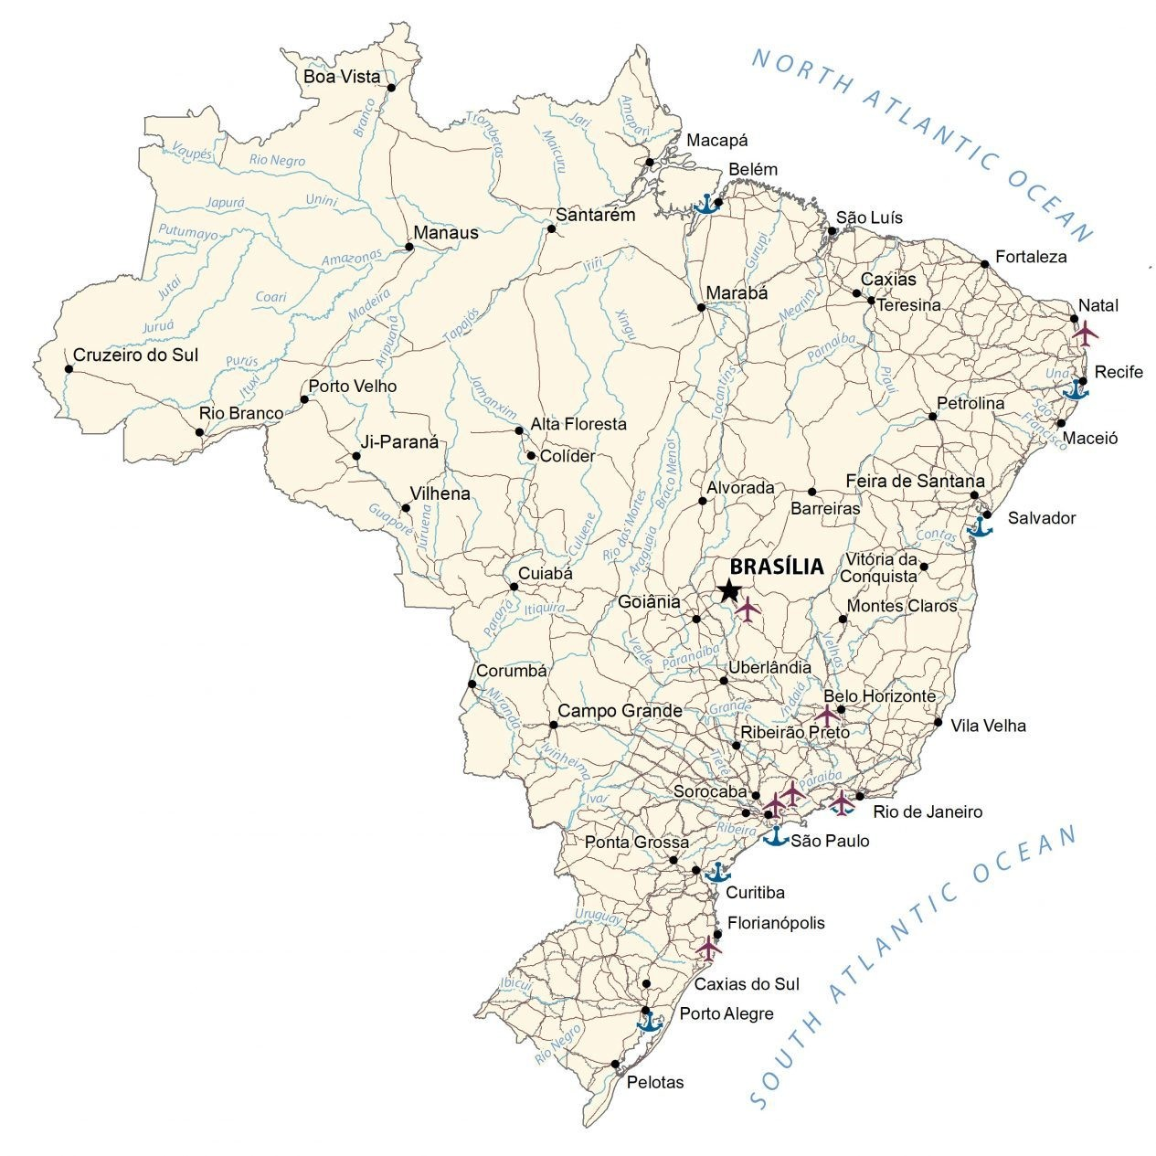

Olist Sales Insights
Power BI Desktop
Olist is the largest department store in Brazilian marketplaces.It connects small businesses from all over Brazil to channels without hassle and with a single contract. Those merchants are able to sell their products through the Olist Store and ship them directly to the customers using Olist logistics partners.

Slide 2
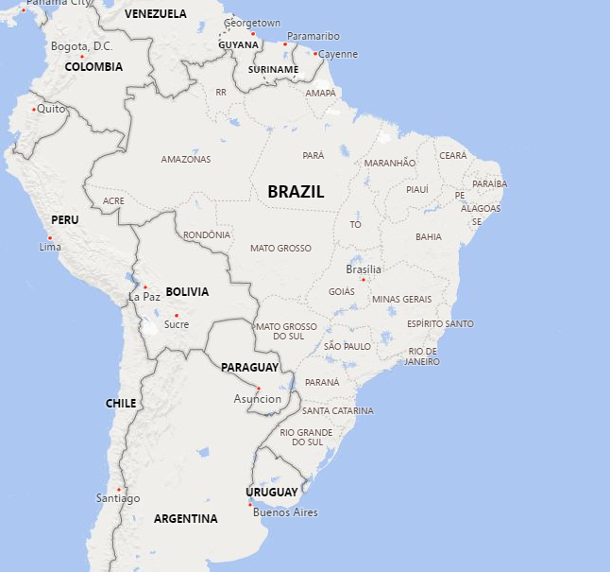
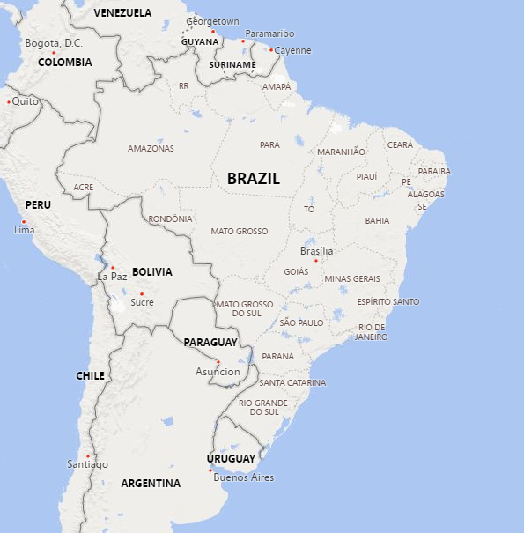
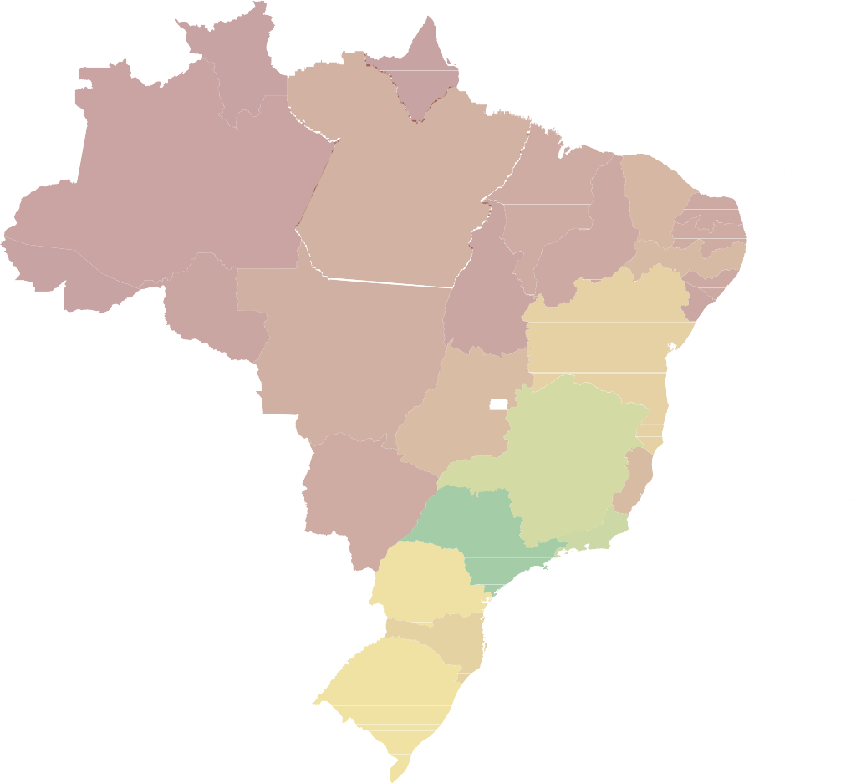

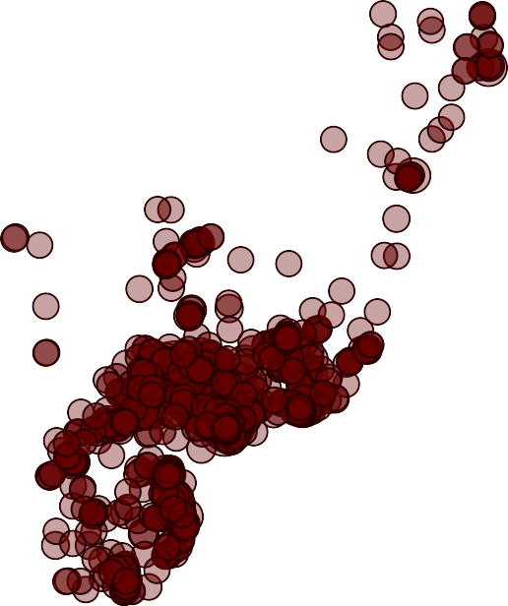

Revenue By Location
Power BI Desktop
Sales are concentrated on the east coast, with the southeast having the greatest concentration.
Revenue by State Revenue by Location 2018
© 2022 TomTom,, © 2022 Miiccrrossofftt Corrporrattiion,, © OpenSttrreettMap
© 2022 TomTom,, © 2022 Miiccrrossofftt Corrporrattiion,, © OpenSttrreettMap

Slide 3
Another Perspective on Sales Distribution
Power BI Desktop
Revenue by State and Purchase Year
2017 2018
Percent of Total Sales By State18
Purchase Year
Sao Paulo
Minas Gerais
Rio Grande d…
2.2M
Sao Paulo
3.0M
0.9M
0.9M
Rio de Janeiro
11.59%
5.22%
0.7M
Parana
Santa Catarina
Bahia
Minas Gerais
0.8M
State Name
0.4M
0.4M
Rio Grande do Sul
M
M
5.17%
3.88%
3.70%
Parana
Distrito Federal
Pernambu…
Ceara
Para
M
M
M
M
2.12%
Santa Catarina
40.28%
1.87%
1.5…
1.1…
Rio de Janeiro
Espirito Santo
Mato Gro…
Mar… Piaui Ri…
0… … …
Alag… Toca…
Bahia
2.09%
Goias
Paraiba
0M
1M
2M
Revenue
3M
12.28%
2.04%
Mato Gro…
Serg…
Ron…

Slide 4
Revenue By Category 2018
Power BI Desktop
This chart shows that Olist's sales are concentrated in ten categories. The other categories have less that 3% of sales.
Revenue By Category
auto baby
health_beauty
sports_leisure
cool_stuff
garden_tools
Percent Of Revenue
health_beauty watches_gifts
bed_bath_table sports_leisure
computers_accessories
housewares furniture_decor auto
baby
cool_stuff garden_tools
telephony perfumery toys
office_furniture stationery pet_shop
construction_tools_construction musical_instruments
electronics
small_appliances home_appliances_2
7.23%
4.73%
3.49%
3.14%
2.92%
constructio… musical_i…
computers_accessories
telephony
stationery
pet_shop
10.49%
watches_gifts
2.44%
1.84%
1.75%
1.68%
1.47%
perfumery
electronics
luggag…
compu…
consol…
home…
6.84%
housewares
1.38%
0.87%
0.87%
0.87%
0.81%
2.41%
small_applia…
home_a…
furn… audio con… ind…
0.4… 0.…
9.63%
toys
bed_bath_table
1.19%
0.77%
0.… 0.…
5.42%
small_ap…
0.64%
kitche…
furniture_decor
home_applia…
… …
2.31%
fixed_t…
office_furniture
1.19%
agro_ind…
0.59%
cos…
fashion_bags…
books…
art
construc…
air_co…
bo…
7.33%
5.25%
1.95%
0.95%

Slide 5
Revenue By Category 2018
Power BI Desktop
Revenue By Category
10.49%
Reviewing the top ten categories in percent of sales, we see that these categories great sales growth. These categories account for 64% of sales.
10%
9.63%
The top five categories account for approximately 42% of sales.
8%
7.33%
7.23%
6.84%
Percent Of Revenue
6%
5.42%
5.25%
4.73%
4%
3.49%
3.14%
2%
0%
health_beauty
watches_gifts
sports_leisure
housewares
auto
baby
cool_stuff
bed_bath_table
computers_accessories
furniture_decor
Product Category

Slide 6

Sales By Seller 2018
Power BI Desktop
Sales are disbursed over a large number of sellers. No single vendor plays a major role in sales. The top seller accounts for less than 3% of total sales.
Percent Sales By Seller
Revenue 0.00M 0.23M 0.11M
4869f7a5dfa277a7dca6462dcf3b52b2 4a3ca9315b744ce9f8e9374361493884
fa1c13f2614d7b5c4749cbc52fecda94 7c67e1448b00f6e969d365cea6b010ab 7e93a43ef30c4f03f38b393420bc753a da8622b14eb17ae2831f4ac5b9dab84a 7a67c85e85bb2ce8582c35f2203ad736 1025f0e2d44d7041d6cf58b6550e0bfa 955fee9216a65b617aa5c0531780ce60 6560211a19b47992c3666cc44a7e94c0
7d13fca15225358621be4086e1eb0964
5dceca129747e92ff8ef7a997dc4f8ca 1f50f920176fa81dab994f9023523100
cc419e0650a3c5ba77189a1882b7556a 3d871de0142ce09b7081e2b9d1733cb1 f7ba60f8c3f99e7ee4042fdef03b70c4 fe2032dab1a61af8794248c8196565c9 8581055ce74af1daba164fdbd55a40de cca3071e3e9bb7d12640c9fbe2301306 17e34d8224d27a541263c4c64b11a56b
7ddcbb64b5bc1ef36ca8c151f6ec77df 37be5a7c751166fbc5f8ccba4119e043
2.68%
2.34%
2.25%
2.20%
1.97%
1.87%
1.66%
1.62%
1.58%
seller_id
1.43%
1.33%
1.31%
1.25%
1.21%
1.10%
0.80%
0.77%
0.75%
0.74%
0.65%
0.65%
0.65%
0.0%
0.5%
1.0%
1.5%
%GT Revenue
2.0%
2.5%

Slide 7
Growth Overview
Power BI Desktop
Olist is experiencing excellent growth. Order counts and revenue are both increasing.
Order Count and Revenue by DateYear and Month
Order Count
Revenue
7.2K
7.2K
0.99M
6.9K
0.99M
6.8K
1.0M
7K
0.94M
6.6K
0.86M
6.1K
0.88M
6.2K
6.4K
6K
0.84M
0.85M
0.8M
5K
Order Counts
4.3K
0.56M
4K
3.9K
0.6M
Revenue
3.6K
3.2K
0.49M
3K
2.6K
0.36M
0.50M
2.4K
0.43M
0.4M
2K
1.7K
0.35M
0.24M
1K
0.8K
0.2M
0.12M
0K
2017
January
2017 2017 March February
2017 April
2017 May
2017 June
2017 July
2017
August
2018
January
2018 2018 March February
2018 April
2018 May
2018 June
2018 July
2018
August
DateYear Date Month

Slide 8
Year over Year Growth
Power BI Desktop
Olist had phenomenal sales growth in the beginning of the year. The percent has slowed as the monthly values have increased. However is was still 51% in August 2018.
Revenue, Last Year and Change by Month
Revenue
Last Year
Change
Revenue, Last Year and Chan…
1.0M
0.94M
0.98M
0.82M
0.84M
0.99M
0.99M
0.86M
0.88M
0.85M
0.60M
0.62M
0.64M
0.56M
0.5M
0.50M
0.43M
0.49M
0.36M
0.35M
0.49M
0.28M
0.24M
0.44M
0.39M
0.12M
0.0M
January
February
March April May June
July
August
Month
2018 Year over Year Revenue Change and Percent Change
RevenueChangeLastYear RevenueChangeLastYear%
0.82M
RevenueChangeLastYear
0.8M
600
RevenueChangeLastYear%
0.60M
0.62M
0.64M
0.6M
0.49M
400
0.44M
0.39M
0.4M
250
0.28M
185
200
0.2M
169
102
79
51
0.0M
99
0
January
February
March
April
Month
May
June
July
August

Slide 9
Review Scores
Power BI Desktop
Olist has great review ratings, the top score (5) represented about 60% for most months and another 20% were rated at 4. Usually less that 10% were rated as a 1 on a monthly basis.
Review Score Count By Month
100%
review_score
1
2
3
4
5
ReviewCount
50%
9.51%
9.21%
8.71%
0%
8.91%
2017
January
2017
February
2017
March
2017
April
2017
May
2017 2017 July
June
2017
August
2017 2017 2017 2017 2018
Septem… October Novem… Decem… January
order_date Month
Review Score % By Month
2018
February
2018
March
2018
April
2018
May
2018 2018 July
June
2018
August
61
60 | 61
20 | 19
9 | 9
3 ₇ | 2 8 | 7
review_score
1
2
3
4
5
60
58
58
59
59
60
59
56
57
Review%ofMonth
60
63
51
64 |  | 64 | 63
19 |  | 18 | 19
8 |  | 8 | 7
 | 3 | 2 ₇
56
54
40
49
18
10
19
20
20
20
20
20
20
20
21
19
14
20
12
19
19
20
10
4
9
7
9 3
9
11
16
10
3
8
9
3 9
9
3
8
9
3
9
7
8
9
2
8
9
4
4
9
3
8
7
7
4
9
4 ₈
0
3
3
2017 | 2017 | 2017 | 2017 | 2017 | 2017 | 2017 July | 2017 | 2017 | 2017 | 2017 | 2017 | 2018 | 2018 | 2018 | 2018 | 2018 | 2018 | 2018 July | 2018
January | February | March | April | May | June |  | August | Septe… | October | Novem… | Decem… | January | February | March | April | May | June |  | August
order_date Month

Slide 10

Olist Sales Insights
Power BI Desktop
Olist is an outstanding company. It has tremendous sales growth and is satisfying its customers. Its sales are concentrated near the Atlantic coast. Olist sellit products in 71 categories, however, over 60% of the sales are in the top ten categories.

