Slide 1

Olist Technical Presentation
George Fuller
15 March 2022

Slide 2
Olist insights using Python
Olist is the largest department store in Brazilian market places. It connects small businesses from all over Brazil to channels without hassle and with a single contract. Those merchants are able to sell their products through the Olist Store and ship them directly to the customers using Olist logistics partners.

Slide 3
These slides are from my juptyer lab note book

Slide 4
Initialize the environment and import packages.
import pandas as pd
import pandasql as psql
from pandasql import sqldf
import numpy as np
import calendar
import datetime
from datetime import datetime
from datetime import timedelta
from datetime import date
import matplotlib as mpl
import matplotlib.pyplot as plt
import matplotlib.ticker as ticker
import geopandas as gpd
from shapely.geometry import Point, Polygon
import seaborn as sns
sns.set_style("darkgrid")
import warnings
warnings.filterwarnings( 'ignore' )

Slide 5
These are the names of the csv files used.
File names
a olist_orders_dataset.csv
b olist_order_items_dataset.csv
c olist_customers_dataset.csv
p olist_products_dataset.csv
e product_category_name_translation.csv
l state_locations.csv
s state_names.csv
d datayear.csv
Lists used later in the code.
months_list = ['January', 'February', 'March', 'April', 'May', 'June', 'July',
'August', 'September', 'October', 'November', 'December']
short_months_list = ['Jan', 'Feb', 'Mar', 'Apr', 'May', 'Jun', 'Jul','Aug', 'Sep', 'Oct', 'Nov', 'Dec']
days_list = ["Sunday","Monday","Tuesday","Wednesday","Thursday","Friday","Saturday"]
regions_list =["North","North East","Southeast","Central-West"]x

Slide 6
Load the pandas
orders = pd.read_csv('olist_orders_dataset.csv')
items = pd.read_csv('olist_order_items_dataset.csv')
customers = pd.read_csv('olist_customers_dataset.csv')
products = pd.read_csv('olist_products_dataset.csv')
english = pd.read_csv('product_category_name_translation.csv')
state_locations = pd.read_csv('olist_state_locations.csv')
state_names = pd.read_csv('olist_state_names.csv')
date_year = pd.read_csv('olist_date_year.csv')
reviews = pd.read_csv('olist_order_reviews_dataset.csv')
Convert the Date column to a date data type
date_year = pd.read_csv('olist_date_year.csv')
date_year['Date'] = pd.to_datetime(date_year['Date'], format= '%Y-%m-%d')
#Change the data types on the time stamp columns
orders[['order_purchase_timestamp','order_approved_at','order_delivered_carrier_date','order_delivered_customer_date','order_estimated_delivery_date']]= orders[['order_purchase_timestamp','order_approved_at','order_delivered_carrier_date','order_delivered_customer_date','order_estimated_delivery_date']].apply(pd.to_datetime)

Slide 7
Convert the Date column to a date data type
date_year = pd.read_csv('olist_date_year.csv')
date_year['Date'] = pd.to_datetime(date_year['Date'], format= '%Y-%m-%d')
#Change the data types on the time stamp columns
orders[['order_purchase_timestamp','order_approved_at','order_delivered_carrier_date','order_delivered_customer_date','order_estimated_delivery_date']]= orders[['order_purchase_timestamp','order_approved_at','order_delivered_carrier_date','order_delivered_customer_date','order_estimated_delivery_date']].apply(pd.to_datetime)

Slide 8
Create new columns
order_date & set to date data type
overdue_order to get count of overdue orders
overdue_days to get severity of overdue orders
#Create date columns from time stamp columns
orders['order_date'] = orders['order_purchase_timestamp'].apply(pd.to_datetime).dt.date
orders['order_date'] = orders['order_date'].apply(pd.to_datetime)
orders['carrier_date'] = orders['order_delivered_carrier_date'].apply(pd.to_datetime).dt.date
orders['carrier_date'] = orders['carrier_date'].apply(pd.to_datetime)
orders['customer_date'] = orders['order_delivered_customer_date'].apply(pd.to_datetime).dt.date
orders['customer_date'] = orders['customer_date'].apply(pd.to_datetime)
orders['estiimated_date'] = orders['order_estimated_delivery_date'].apply(pd.to_datetime).dt.date
orders['estiimated_date'] = orders['estiimated_date'].apply(pd.to_datetime)
#Create a column to count overdue orders
orders['overdue_order'] = np.where( ( (orders['order_delivered_carrier_date'] > orders['order_estimated_delivery_date'])
| (orders['order_delivered_customer_date'] > orders['order_estimated_delivery_date']) ), 1 ,0)

Slide 9
#Create columns of days order is overdue
def get_overdue_days(row):
#print("in get_overdue_days")
#print(str(row['order_delivered_carrier_date']) + " " + str(row['order_delivered_customer_date']) + " " + str(row['order_estimated_delivery_date']) )
if row['order_delivered_carrier_date'] > row['order_estimated_delivery_date']:
date_diff = row['order_delivered_carrier_date'] - row['order_estimated_delivery_date']
return date_diff.days
elif row['order_delivered_customer_date'] > row['order_estimated_delivery_date']:
date_diff = row['order_delivered_customer_date'] - row['order_estimated_delivery_date']
return date_diff.days
else: return 0
orders['days_overdue'] = orders.apply(get_overdue_days , axis=1)
#Create column of delivery time in days.
def get_delivery_days(row):
#Set date to median
if pd.isna(row['order_delivered_carrier_date']) | pd.isna(row['order_delivered_customer_date']):
date_diff = 10
elif (row['order_delivered_carrier_date'] > row['order_delivered_customer_date']) | pd.isna(row['order_delivered_customer_date']) :
date_diff = (row['carrier_date'] - row['order_date']).days
else:
date_diff = (row['customer_date'] - row['order_date']).days
return date_diff
orders['delivery_days'] = orders.apply(get_delivery_days , axis=1)

Slide 10
#Remove the timestamp columns as they are no longer needed.
#remove unneeded columns from data frame
del orders['order_delivered_carrier_date']
del orders['order_delivered_customer_date']
del orders['order_estimated_delivery_date']
del orders['order_purchase_timestamp']
del orders['order_approved_at']
print(orders.info())
<class 'pandas.core.frame.DataFrame'>
RangeIndex: 99441 entries, 0 to 99440
Data columns (total 10 columns):
# Column Non-Null Count Dtype
--- ------ -------------- -----
0 order_id 99441 non-null object
1 customer_id 99441 non-null object
2 order_status 99441 non-null object
3 order_date 99441 non-null datetime64[ns]
4 carrier_date 97658 non-null datetime64[ns]
5 customer_date 96476 non-null datetime64[ns]
6 estiimated_date 99441 non-null datetime64[ns]
7 overdue_order 99441 non-null int32
8 days_overdue 99441 non-null int64
9 delivery_days 99441 non-null int64
dtypes: datetime64[ns](4), int32(1), int64(2), object(3)
memory usage: 7.2+ MB
None

Slide 11
Query to get the sales, customer info, and product details, dates ect
sales_query = """ select
d.dateyear as year, d.fdom,
b.order_id, e.product_category_name_english, b.product_id, c.customer_unique_id,
c.customer_zip_code_prefix, c.customer_state, c.customer_city, s.state_name,
s.region, a.order_date, d.month, d.dow_name, d.month_name, d.month_short_name,
l.Latitude as latitude, l.Longatitude as longatitude, a.overdue_order,
a.days_overdue, a.delivery_days, b.price as sales, count(distinct a.order_id) as order_count,
count(distinct b.order_id) as item_qty
from orders a
left join items b on a.order_id = b.order_id
inner join customers c on a.customer_id = c.customer_id
left join products p on b.product_id=p.product_id
left join english e on p.product_category_name=e.product_category_name
left join date_year d on a.order_date = d.date
left join state_names s on c.customer_state = s.state_code
left join state_locations l on c.customer_state = l.geolocation_state
where a.order_status in("delivered","invoiced","shipped") and dateyear in(2017,2018)
group by 1,2,3
having item_qty >0""“
sales_data = psql.sqldf(sales_query)
sales_data['order_date'] = sales_data['order_date'].apply(pd.to_datetime)

Slide 12
<class 'pandas.core.frame.DataFrame'>
RangeIndex: 97605 entries, 0 to 97604
Data columns (total 24 columns):
# Column Non-Null Count Dtype
--- ------ -------------- -----
0 year 97605 non-null int64
1 fdom 97605 non-null object
2 order_id 97605 non-null object
3 product_category_name_english 96194 non-null object
4 product_id 97605 non-null object
5 customer_unique_id 97605 non-null object
6 customer_zip_code_prefix 97605 non-null int64
7 customer_state 97605 non-null object
8 customer_city 97605 non-null object
9 state_name 97605 non-null object
10 region 97605 non-null object
11 order_date 97605 non-null datetime64[ns]
12 month 97605 non-null int64
13 dow_name 97605 non-null object
14 month_name 97605 non-null object
15 month_short_name 97605 non-null object
16 latitude 97605 non-null float64
17 longatitude 97605 non-null float64
18 overdue_order 97605 non-null int64
19 days_overdue 97605 non-null int64
20 delivery_days 97605 non-null int64
21 sales 97605 non-null float64
22 order_count 97605 non-null int64
23 item_qty 97605 non-null int64
dtypes: datetime64[ns](1), float64(3), int64(8), object(12)
memory usage: 17.9+ MB
None

Slide 13
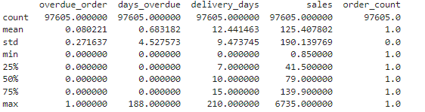
Get basic statitics from the data set.
print(sales_data.iloc[:,18:23].describe())

Slide 14
Summarize the data getting order count and sales sum by year and month
order_summary = sales_data.groupby(['year','fdom','month_name']).agg({'order_id': 'nunique', 'sales' : 'sum'}).reset_index()
#Rename the columns
order_summary.columns = ['year','fdom','month_name','Order_Count', 'Sales']
# convert the 'Date' column to datetime data type
order_summary['fdom'] = pd.to_datetime(order_summary['fdom'], format= '%Y-%m-%d')
order_summary['month'] = order_summary['fdom'].dt.month
order_summary['Sales'] = round(order_summary['Sales'],0)
print(order_summary.info())
print(order_summary.head(24))

Slide 15
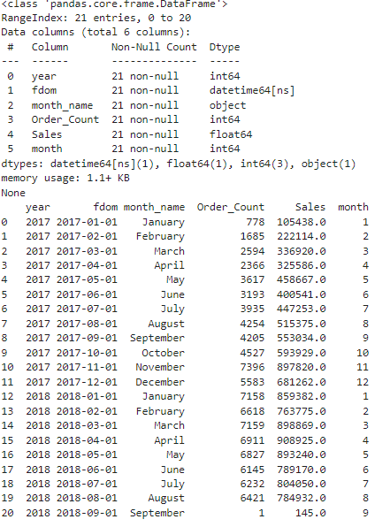

Slide 16
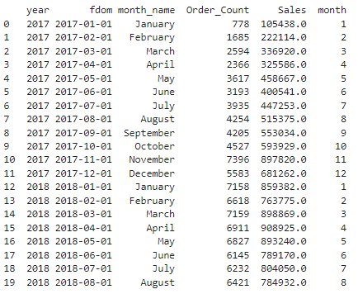
#Delete the last row since there is only 1 order
order_summary = order_summary.iloc[:20]
print(order_summary.head(24))

Slide 17
x
x

Slide 18
Summarize the data getting order count and sales sum by year and month
order_summary = sales_data.groupby(['year','fdom','month_name']).agg({'order_id': 'nunique','sales' : 'sum'}).reset_index()
#Rename the columns
order_summary.columns = ['year','fdom','month_name','Order_Count', 'Sales’]
# convert the 'Date' column to datetime data type
order_summary['fdom'] = pd.to_datetime(order_summary['fdom'], format= '%Y-%m-%d')
order_summary['month'] = order_summary['fdom'].dt.month
order_summary['Sales'] = round(order_summary['Sales'],0)
<class 'pandas.core.frame.DataFrame'>
RangeIndex: 21 entries, 0 to 20
Data columns (total 6 columns):
# Column Non-Null Count Dtype
--- ------ -------------- -----
0 year 21 non-null int64
1 fdom 21 non-null datetime64[ns]
2 month_name 21 non-null object
3 Order_Count 21 non-null int64
4 Sales 21 non-null float64
5 month 21 non-null int64
dtypes: datetime64[ns](1), float64(1), int64(3), object(1)

Slide 19
Review data
year fdom month_name Order_Count Sales month
0 2017 2017-01-01 January 778 105438.0 1
1 2017 2017-02-01 February 1685 222114.0 2
2 2017 2017-03-01 March 2594 336920.0 3
3 2017 2017-04-01 April 2366 325586.0 4
4 2017 2017-05-01 May 3617 458667.0 5
5 2017 2017-06-01 June 3193 400541.0 6
6 2017 2017-07-01 July 3935 447253.0 7
7 2017 2017-08-01 August 4254 515375.0 8
8 2017 2017-09-01 September 4205 553034.0 9
9 2017 2017-10-01 October 4527 593929.0 10
10 2017 2017-11-01 November 7396 897820.0 11
11 2017 2017-12-01 December 5583 681262.0 12
12 2018 2018-01-01 January 7158 859382.0 1
13 2018 2018-02-01 February 6618 763775.0 2
14 2018 2018-03-01 March 7159 898869.0 3
15 2018 2018-04-01 April 6911 908925.0 4
16 2018 2018-05-01 May 6827 893240.0 5
17 2018 2018-06-01 June 6145 789170.0 6
18 2018 2018-07-01 July 6232 804050.0 7
19 2018 2018-08-01 August 6421 784932.0 8
20 2018 2018-09-01 September 1 145.0 9

Slide 20
#Delete the last row since there is only 1 order
order_summary = order_summary.iloc[:20]
print(order_summary.head(24))
#order_summary.to_csv('order_summary.csv')
year fdom month_name Order_Count Sales month
2017 2017-01-01 January 778 105438.0 1
1 2017 2017-02-01 February 1685 222114.0 2
2 2017 2017-03-01 March 2594 336920.0 3
3 2017 2017-04-01 April 2366 325586.0 4
4 2017 2017-05-01 May 3617 458667.0 5
5 2017 2017-06-01 June 3193 400541.0 6
6 2017 2017-07-01 July 3935 447253.0 7
7 2017 2017-08-01 August 4254 515375.0 8
8 2017 2017-09-01 September 4205 553034.0 9
9 2017 2017-10-01 October 4527 593929.0 10
10 2017 2017-11-01 November 7396 897820.0 11
11 2017 2017-12-01 December 5583 681262.0 12
12 2018 2018-01-01 January 7158 859382.0 1
13 2018 2018-02-01 February 6618 763775.0 2
14 2018 2018-03-01 March 7159 898869.0 3
15 2018 2018-04-01 April 6911 908925.0 4
16 2018 2018-05-01 May 6827 893240.0 5
17 2018 2018-06-01 June 6145 789170.0 6
18 2018 2018-07-01 July 6232 804050.0 7
19 2018 2018-08-01 August 6421 784932.0 8

Slide 21
Since the 2018 data is only a partital year, get the total for January through August for both years, for better comparison.
comp_year = order_summary.drop(order_summary[order_summary.month >8].index).groupby(['year']).agg({'Order_Count': 'sum', 'Sales' : 'sum'}).reset_index()
#Rename the columns
comp_year.columns = ['year','order_count', 'sales']
comp_year['sales'] = round(comp_year['sales'],0)
comp_year['yoy_orders'] = comp_year['order_count'].diff().fillna(0)
comp_year['yoy_sales'] = comp_year['sales'].diff().fillna(0)
comp_year['yoy_orders_pct'] = round(comp_year['order_count'].pct_change()*100,2).fillna(0)
comp_year['yoy_sales_pct'] = round(comp_year['sales'].pct_change() * 100,2).fillna(0)

Slide 22
x
x

Slide 23
x
x

Slide 24
x
x

Slide 25
x
x

Slide 26
x
x

Slide 27
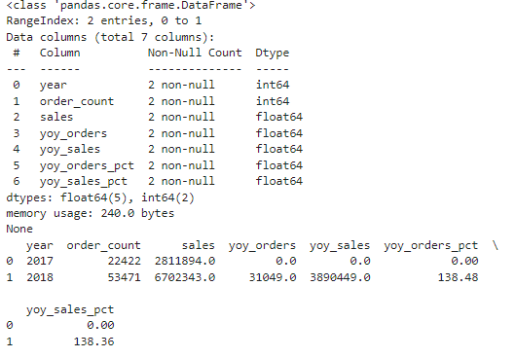
Since the 2018 data is only a partital year, get the total for January through August for both years, for better comparison.
comp_year = order_summary.drop(order_summary[order_summary.month >8].index).groupby(['year']).agg({'Order_Count': 'sum', 'Sales' : 'sum'}).reset_index()
#Rename the columns
comp_year.columns = ['year','order_count', 'sales']
comp_year['sales'] = round(comp_year['sales'],0)
comp_year['yoy_orders'] = comp_year['order_count'].diff().fillna(0)
comp_year['yoy_sales'] = comp_year['sales'].diff().fillna(0)
comp_year['yoy_orders_pct'] = round(comp_year['order_count'].pct_change()*100,2).fillna(0)
comp_year['yoy_sales_pct'] = round(comp_year['sales'].pct_change() * 100,2).fillna(0)

