Slide 1
ANSWER DARPA ASKE TA 1
Andrew Crapo
Varish Mulwad
Nurali Virani
GE Research
PI Teleconference, August 5, 2019

Slide 2

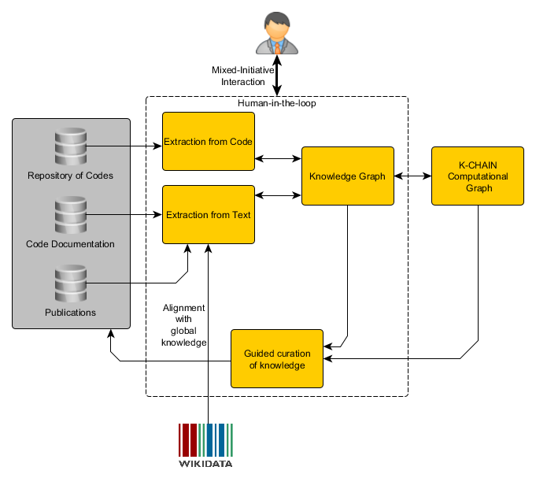




TA1 ANSWER Overview
5
2
4
3
1
Notes:
We will cover these 5 topics in this order.

Slide 3
1. Representing and capturing semantic constraints

Slide 4
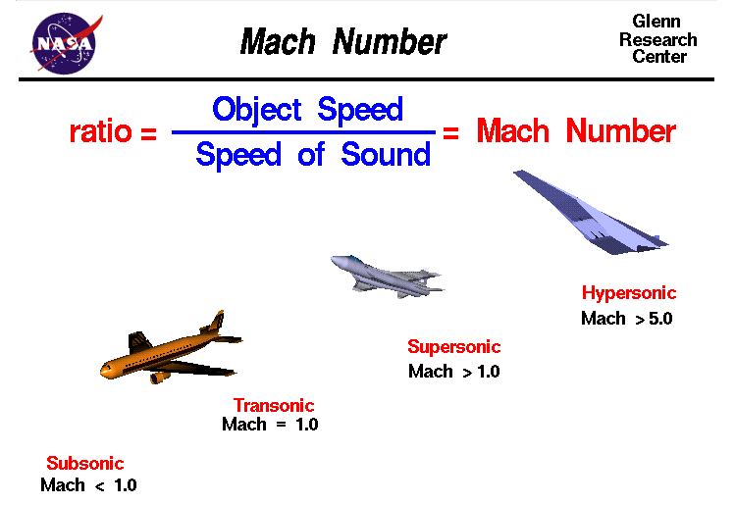
Mach Number
Notes:
Mach Number image from NASA Web Site (https://www.grc.nasa.gov/www/k-12/airplane/mach.html)

Slide 5
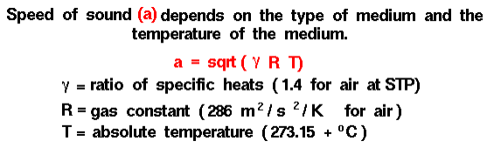
Mach Number
Notes:
Speed of sound is discussed on a different page: https://www.grc.nasa.gov/www/k-12/airplane/sound.html

Slide 6
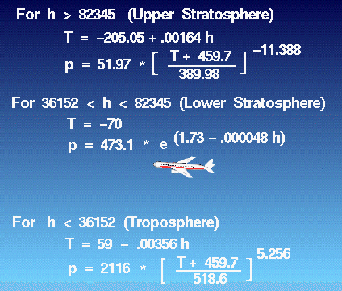

Mach Number
Notes:
The temperature T is given by the Earth Atmosphere Model: https://www.grc.nasa.gov/www/k-12/VirtualAero/BottleRocket/airplane/atmos.html
Note that T in the speed of sound equation is absolute but Kelvin is not specifically noted, and that T is the Earth Atmosphere Model is degrees F. Units must be aligned.
This example highlights data coming from different locations in text that we wish to curate and shows some of their inconsistencies in units.

Slide 7
Two Issues:
How to represent semantic and unit constraints for human-AI collaboration
Controlled English
Graphically
How to represent semantic and unit constraints in model for query, reasoning, etc.
OWL
Python
Julia
Might be the same, might be different
(might be different for different users)
Notes:
The issues of how to display semantic and unit constraints to the human collaborator and how to represent them in the computational model are independent issues other than transformation from one to the other. Also, different humans may prefer different representations.

Slide 8
Augmented Types
public double lowerStratosphereTemperature(double alt) {
return -70;
}
Equation lowerStratosphereTemperature(decimal alt
(^value of altitude of some Air and
alt > 36152 and alt <= 82345 {ft}))
returns decimal (^value of temperature of the Air {F}):
return -70.
Notes:
Take one of the temperature equations from the Earth Atmosphere Model (Lower Stratosphere) as an example. Shown is a Java method for the equation and then a controlled-English representation that captures the semantic and unit constraints specifying when the equation is valid and how inputs and outputs are related. (The input is the value of the altitude of some air in ft and the output is the value of the temperature of the same air in degrees F.)

Slide 9
Augmented Types: for human collaboration
Equation lowerStratosphereTemperature(decimal alt
(^value of altitude of some Air and
alt > 36152 and alt <= 82345 {ft}))
returns decimal (^value of temperature of the Air {F}):
return -70.
Notes:
The controlled-English representation.

Slide 10
Augmented Types: to pseudo RDF
TriplePattern (v0, rdf:type, Air)
TriplePattern (v1, rdf:type, UnittedQuantity)
TriplePattern (v0, altitude, v1)
TriplePattern (v1, value, alt)
TriplePattern(v1, unit, “ft”)
TriplePattern (v2, rdf:type, UnittedQuantity)
TriplePattern (v0, temperature, v2)
TriplePattern (v2, value, v3)
TriplePattern (v2, unit, “F”)
FunctionPattern(greaterThan, alt, 36152)
FunctionPattern(lessThanOrEqual, alt, 82345)
where v3 is the returned decimal value computed by the equation
Equation lowerStratosphereTemperature(decimal alt
(^value of altitude of some Air and
alt > 36152 and alt <= 82345 {ft}))
returns decimal (^value of temperature of the Air {F}):
return -70.
Notes:
The semantic and unit constraints in pseudo RDF representation.

Slide 11
Augmented Types: as a graph
TriplePattern (v0, rdf:type, Air)
TriplePattern (v1, rdf:type, UnittedQuantity)
TriplePattern (v0, altitude, v1)
TriplePattern (v1, value, alt)
TriplePattern(v1, unit, “ft”)
TriplePattern (v2, rdf:type, UnittedQuantity)
TriplePattern (v0, temperature, v2)
TriplePattern (v2, value, v3)
TriplePattern (v2, unit, “F”)
FunctionPattern(greaterThan, alt, 36152)
FunctionPattern(lessThanOrEqual, alt, 82345)
where v3 is the returned decimal value computed by the equation
Equation lowerStratosphereTemperature(decimal alt
(^value of altitude of some Air and
alt > 36152 and alt <= 82345 {ft}))
returns decimal (^value of temperature of the Air {F}):
return -70.
Air
UnittedQuantity
type
type
altitude
v1
type
v0
unit
alt
value
ft
temperature
greaterThan
unit
lessThanOrEqual
v2
F
36152
82345
value
v3
Notes:
The semantic and unit constraints in a graphical representation.

Slide 12
Length
Temperature
Air
type
type
altitude
v1
type
v0
unit
alt
value
ft
temperature
greaterThan
unit
lessThanOrEqual
v2
F
36152
82345
value
v3

Slide 13
2. Extraction from code

Slide 14
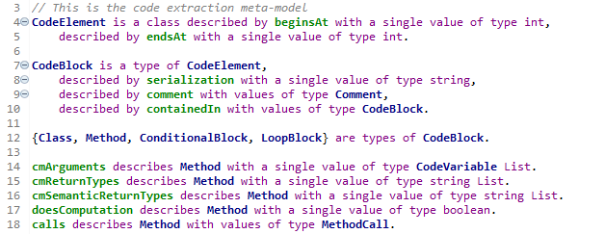
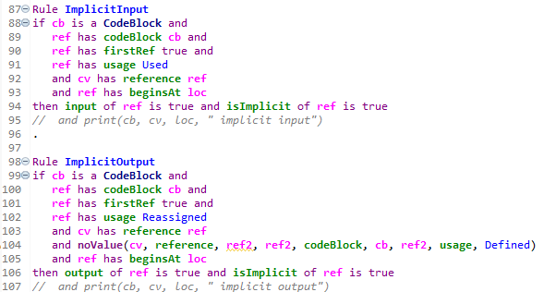
Code -> AST -> Code Model -> Inferred Code Model
Notes:
The left-hand side is a snippet of the meta-model for the code extraction from the AST. The right-hand side shows a couple of rules used to infer implicit inputs and outputs when class field variables are involved in computations. The actual code extraction is from the original serialized code using location information from the AST.

Slide 15
3. Extraction from Text

Slide 16


Text Extraction’s Goals & Objectives
(1)
(2)
(3)
Augment
Extract equations and relations between variables from text to help augment existing scientific models extracted from other sources (such as code)
Inform
Extract context associated with variables that appear in text and guide the code extraction process with information such mapping of variables to scientific concepts, associated units etc.
Extract
Extract equations and relations between variables from text to identify/build new scientific models not extracted from other sources.
Notes:
The Text extraction module is designed to help the ANSWER system and overall ASKE program to accomplish the objectives listed above by extracting equations, concepts, relations between concepts and the context associated with the equation variables.

Slide 17
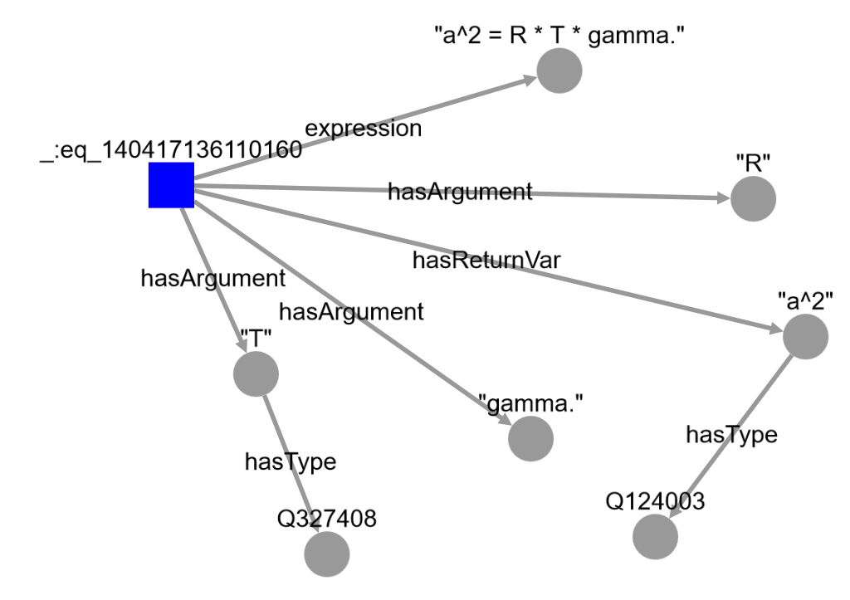
What we extract
An analysis based on conservation of mass and momentum shows that the square of the speed of sound a^2 is equal to the gas constant R times the temperature T times the ratio of specific heats gamma. The definition is a^2 = R * T * gamma.
Equations
Variable Context
Concepts
(links to external sources)
The speed of sound depends on the type of gas and the temperature of the gas
Variable Relations
Notes:
The equation visualization is one way to consume the extracted information. Understanding the visualization: https://github.com/GEGlobalResearch/DARPA-ASKE-TA1/wiki/Extraction-of-Scientific-Knowledge-from-Text#understanding-the-equation-visualizations

Slide 18

Text Extraction Pipeline
Text Equation to Python
Knowledge graph
Equations
Distant Supervision to label data
Equation and Concept Tagger
Alignment with External KBs
Domain Dictionary with initial concepts
Bi-LSTM CRF
Sequence Tagging Model
Concepts
Relation Extraction
New Document/Text
Variable Context Extraction
Evaluating AutoMATES “Text Reading” pipeline
https://github.com/GEGlobalResearch/DARPA-ASKE-TA1/tree/master/ModelsFromText
(development branch to play with latest code)
Notes:
Our focus in the coming months will be improving the variable context extraction and implementing relation extraction. For the former, we are in the process of evaluating AutoMATES "Text Reading" piepeline.

Slide 19
4. Knowledge-consistent hybrid AI networks
Notes:
Mechanism to take knowledge and create models in executable layer

Slide 20
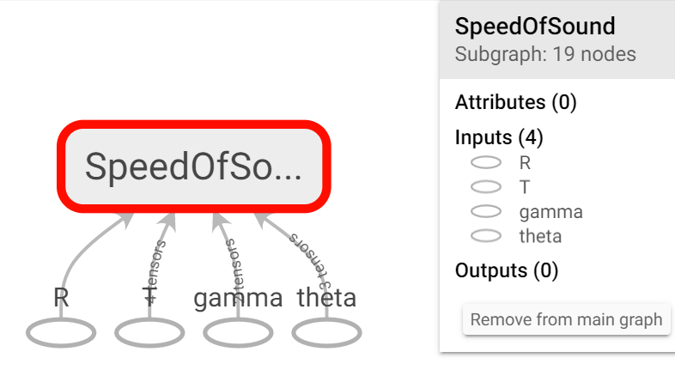
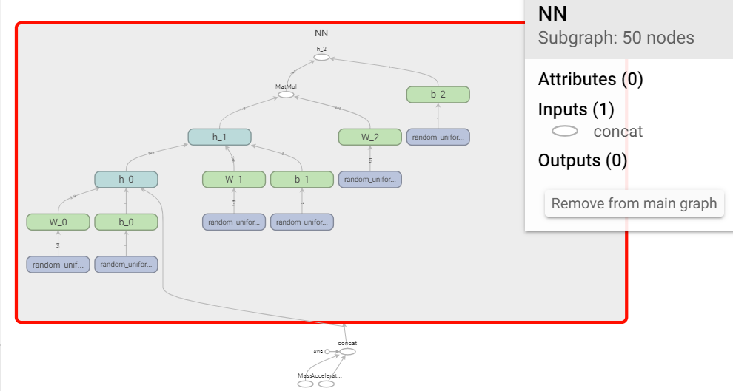
Automated creation of computational graphs for computational instantiation of knowledge
The equation extracted from text is as follows:
a^2 = R * T * {1 + (gamma - 1) / ( 1 + (gamma-1) * [(theta/T)^2 * e^(theta/T) /(e^(theta/T) -1)^2]) }.
The response from text2python service for this text equation is as follows:
a = tf.math.pow( R * T * (1 + (gamma-1)/(1 + (gamma-1) * ((theta/T) ** 2 * tf.math.exp(theta/T) / (tf.math.exp(theta/T) - 1) ** 2))), 1/2)
Build requires: Array of “inputVariables”, Array of “outputVariables”, string for “modelName”.
Optional inputs: dataLocation, equationModel
Variables have name, type, default value, and unit as inputs.
Physics-based model if equation is available during build
Data-driven model, if dataset is available in lieu of physics model
Notes:
The equation extracted from text when represented in semantic model has access to input/output variable names, type, default value, and units. If data is available for training the model or script depicting equation of model is available then build service can be used to automatically create computational graphs. If physics equation is available then computational graph can be created. If it is not available then data-driven model with those inputs and outputs can be created and trained too.

Slide 21
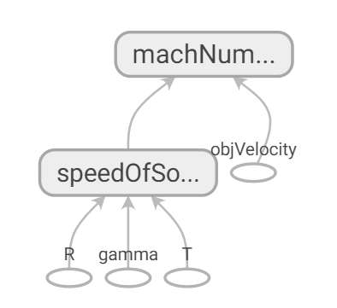
Evaluating computation with default values and inferring key missing variables
Using default values
Inferring key missing variables
Case 1: If we want to compute MachNumber, given temperature T = 300K and object velocity objVelocity = 1000m/s, then we get the following output:
output: 2.885309 default values used: {'R': 286.0, 'gamma': 1.4}
Case 2: If we want to compute MachNumber, given speed of sound speedOfSound = 350m/s and object velocity objVelocity = 1000m/s, then we get the following output:
output: 2.857143 default values used: {}
Case 3: If we want to compute MachNumber, given speed of sound speedOfSound = 350m/s, then we get the following output:
Please provide value for: objVelocity output: None default values used: {}
Case 4: If we want to compute MachNumber, given object velocity objVelocity = 1000m/s, then we get the following output:
Please provide value for: T output: None default values used: {}
Notes:
Examples of inference actions that can create mixed initiative interaction or guided-curation of more knowledge. We use computational graph given in left to compute mach number in these examples. Case 1 shows that if any default values are used in the computation, then those are reported back to curation manager (CM) to inform the user. Case 2 does not need any default values. In Case 3, the inference is not possible as values for key variables are not provided, thus we can use CM to inform the user about missing value. Case 4 shows that although we can ask user for a missing value, that variable might not be the only one that can complete the inference. Here, either T or SpeedOfSound needs to be provided for inference.

Slide 22
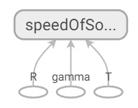
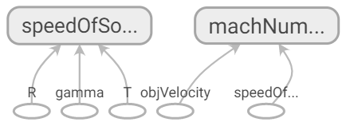
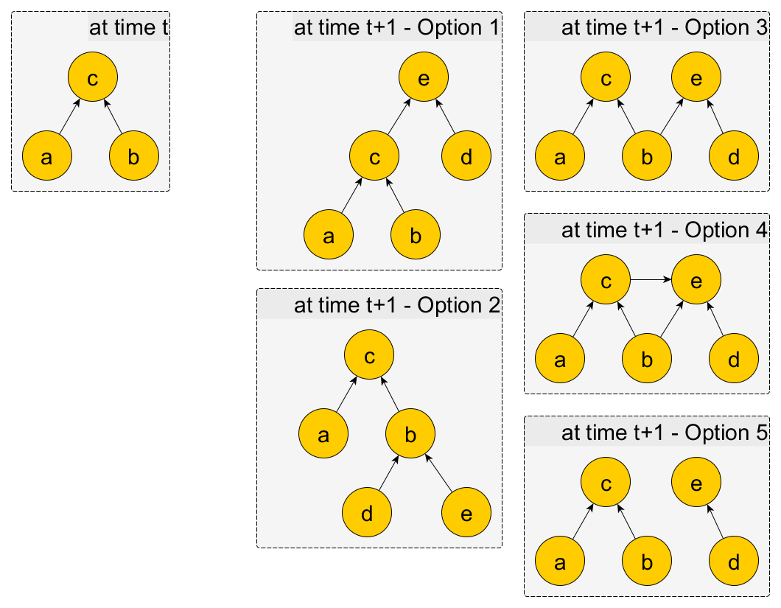
Appending computational graphs as new knowledge fragments are extracted
at time t
at time t+1
with naïve TensorFlow
with
K-CHAIN append
at time t+1
Node Dictionary Example:
'speedOfSound': {'name': 'speedOfSound',
'type': 'float',
'graphRef': <tf.Tensor 'speedOfSound/speedOfSound:0' shape=<unknown> dtype=float32>,
'subModel': 'speedOfSound’},
'objVelocity': {'name': 'objVelocity',
'type': 'float',
'graphRef': <tf.Tensor 'objVelocity:0' shape=<unknown> dtype=float32>,
'subModel': 'machNumber'},
Notes:
Figure on the left shows various options with which computational graph can evolve as more knowledge/model fragments become available after extraction from code/text. These options result in directed acyclic computational graphs. As an example of append, we start from a model with speed of sound computational model as visualized with TensorBoard. As new model for machNumber computation is extracted, using a naïve implementation in TensorFlow, we get a disjoint computational graph as speedOfSound is not identified to be the same variable. We implemented a dictionary to maintain variable metadata including the graphRef used by tensorFlow for each variable. We can inform “append” method that an existing node is exactly the same as a node needed in new computational model to connect those models.

Slide 23
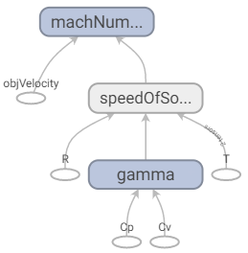
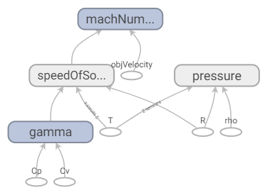
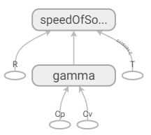
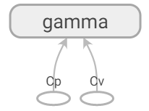
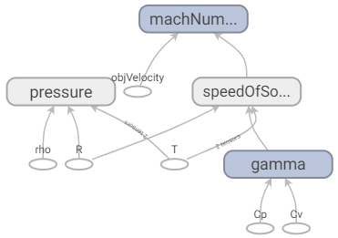
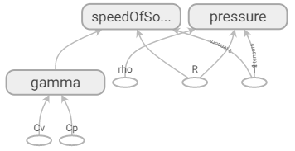
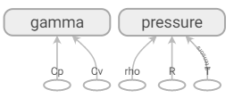
Example of Computational Graph Evolution
Example 1:
Example 2:
Notes:
Examples showing evolution of computational graphs as more knowledge fragments become available over time.

Slide 24
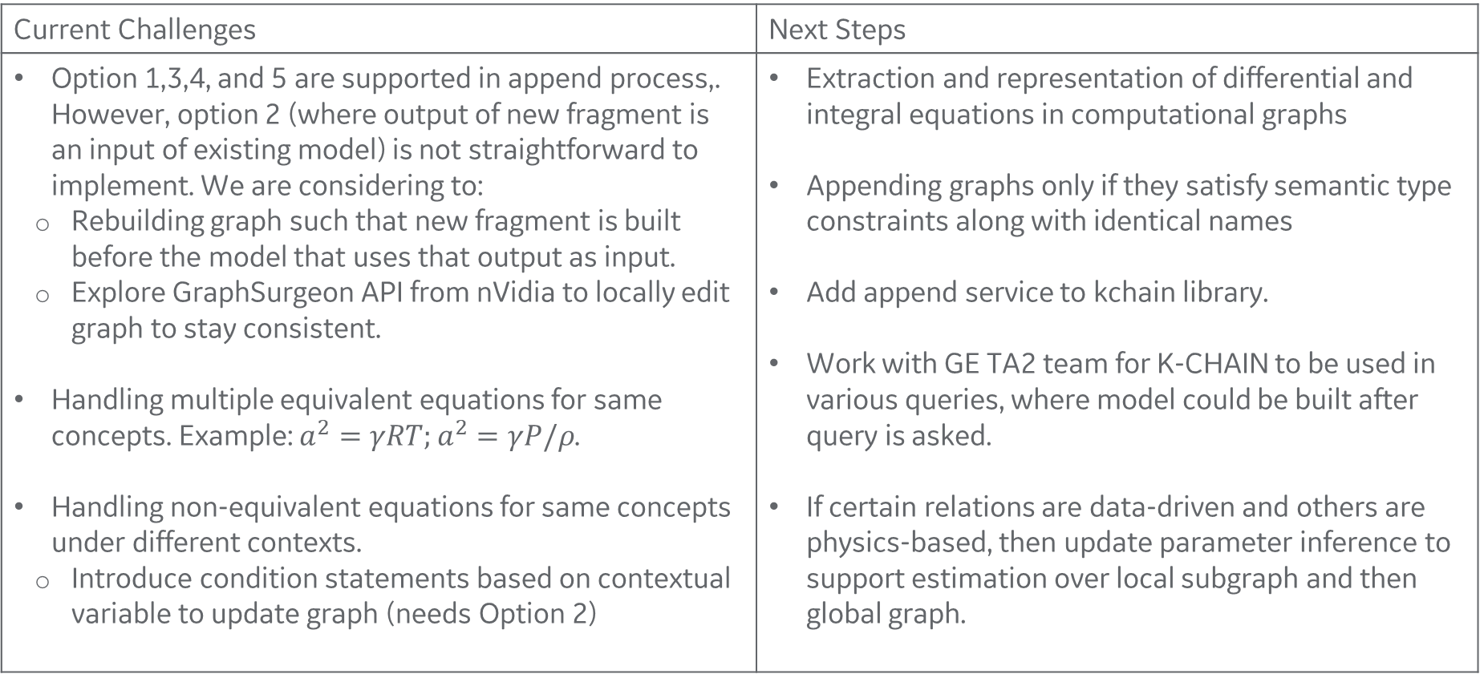
Challenges and Next Steps
Current Challenges | Next Steps
Option 1,3,4, and 5 are supported in append process,. However, option 2 (where output of new fragment is an input of existing model) is not straightforward to implement. We are considering to: Rebuilding graph such that new fragment is built before the model that uses that output as input. Explore GraphSurgeon API from nVidia to locally edit graph to stay consistent. Handling multiple equivalent equations for same concepts. Example: $a^{2}=γRT;a^{2}=γP/ρ$. Handling non-equivalent equations for same concepts under different contexts. Introduce condition statements based on contextual variable to update graph (needs Option 2) | Extraction and representation of differential and integral equations in computational graphs Appending graphs only if they satisfy semantic type constraints along with identical names Add append service to kchain library. Work with GE TA2 team for K-CHAIN to be used in various queries, where model could be built after query is asked. If certain relations are data-driven and others are physics-based, then update parameter inference to support estimation over local subgraph and then global graph.
Notes:
Current challenges and future work have been listed

Slide 25
5. Controlled–English collaborative dialog

Slide 26




UI Components
Backend Components
Code
Text
Knowledge Graph
Dialog
Editor
AnswerCurationManager¹
onChange event
JenaBasedDialogModelProcessor
Jena Java API
onChange event
last user input
DialogAnswerProvider
JenaBasedDialogInferenceProcessor
Computational Model
response, info, questions
JavaFileImportWizard, JavaImportOperation, JavaModelExtractor
REST Services
AnswerExtractionProcessor
Text to Triples
Code
JavaModelExtractor
TextProcessor
Text
Notes
AnswerCurationManager will, in the future, actively look for additional code and text sources, especially those filling identifiable gaps in the knowledge graph, while still allowing user to initiate extractions.
Notes:
The Dialog Editor and the associated DialogAnswerProvider UI component and JenaBasedDialogModelProcessor backend component provide human-configuration manager conversation for all functions from extraction to query answering to curation.

Slide 27
Dialog is a Controlled-English Extensions of SADL¹
Concepts are hyperlinked to their definitions and references
What is Acceleration?
CM: Acceleration is a type of {UnittedQuantity and Derivative}.
Derivative is a type of ScientificConcept,
described by derivedFrom with a single value of type ScientificConcept,
described by withRespectTo with a single value of type class.
¹Semantic Application Design Language, see https://github.com/crapo/sadlos2/wiki.
Notes:
This shows a snippet of Dialog above (the human asks a question and the curation manager (CM) responds). If the human asked for the definition of Derivative a model would be opened to the snippet shown below.
Many things, including the introduction of indexicals like “it” and “that”, can be added to make the conversation more natural for the human but ambiguous grammar should be avoided.

