Slide 1
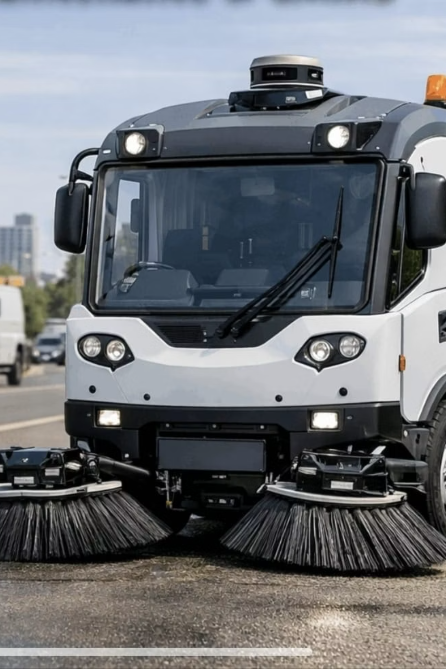
NightClean
Smart Cities Deserve Smart Cleaning
An AI-powered autonomous garbage-cleaning system that operates during night hours to keep cities spotless by morning. Combining computer vision, robotics, and citizen engagement for next-generation urban waste management.

Slide 2
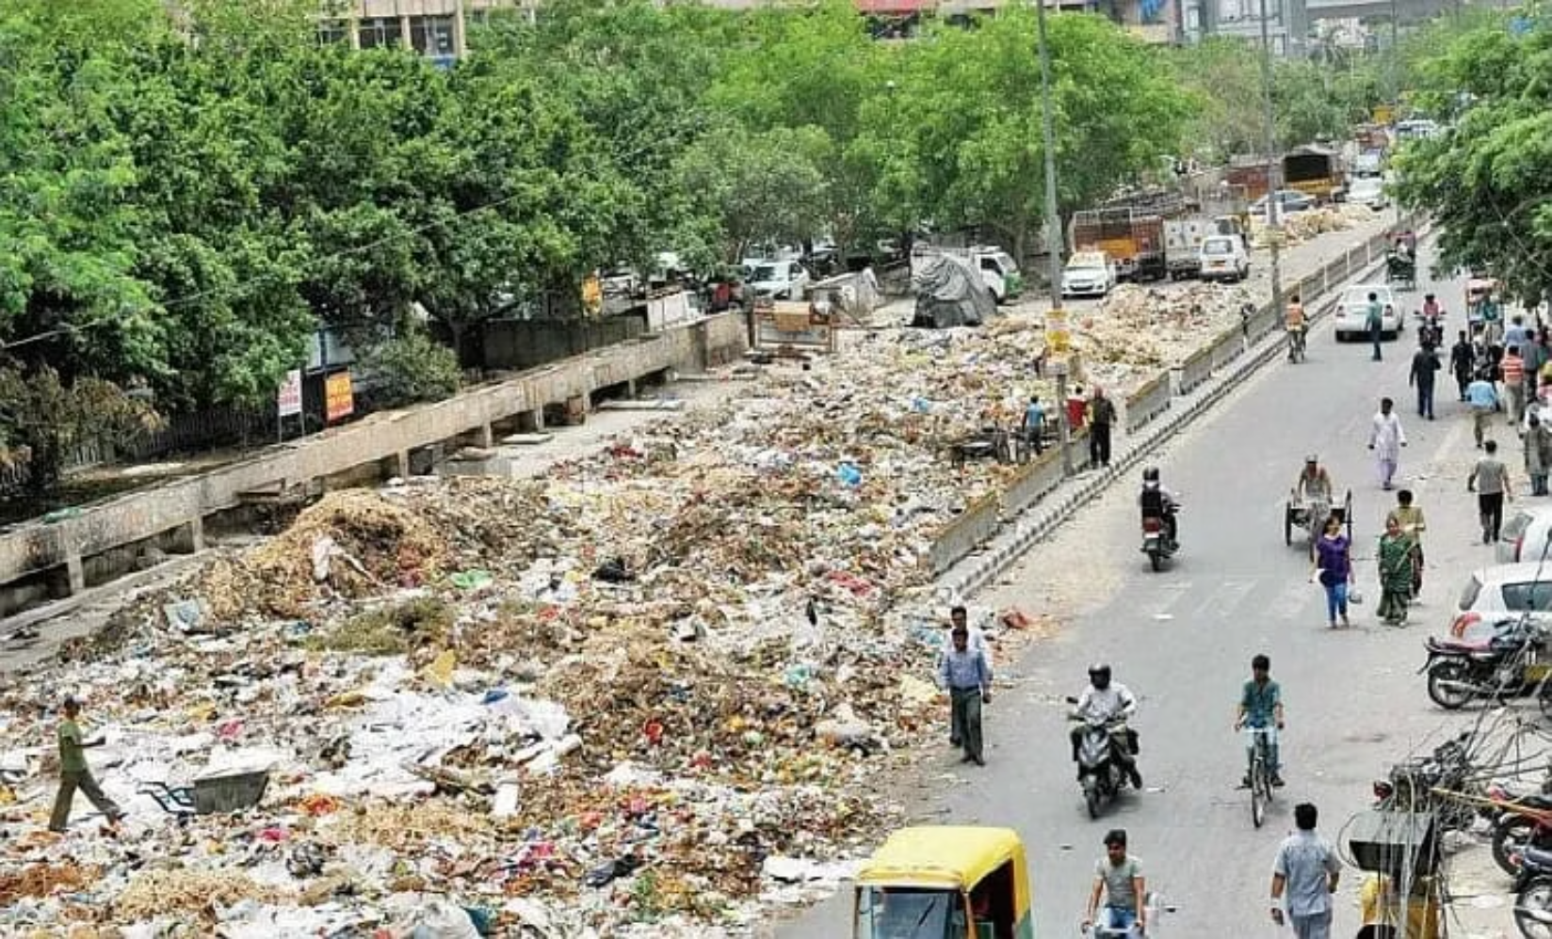
The Urban Waste Crisis
The Problem
Cities worldwide face mounting challenges with street waste management. Manual cleaning crews struggle to keep up with daily waste generation, while daytime operations create traffic congestion and road safety concerns. Without systematic monitoring and reporting mechanisms, municipalities lack visibility into problem areas.
Current waste collection systems are reactive rather than proactive, responding to complaints rather than preventing accumulation. This results in persistent dirty spots, public health hazards, and frustrated citizens.

Slide 3



Why This Matters Now
Public Health
Urban Environment
Smart City Vision
Accumulated waste harbors bacteria, attracts pests, and creates air pollution through decomposition
Litter in streets washes into drains during rain, causing blockages and water contamination
Modern cities need intelligent, automated systems to handle infrastructure maintenance efficiently
With urban populations growing rapidly, traditional waste management approaches cannot scale effectively. Cities need autonomous, data-driven solutions that optimize resource allocation and ensure consistent cleanliness across all neighborhoods.

Slide 4
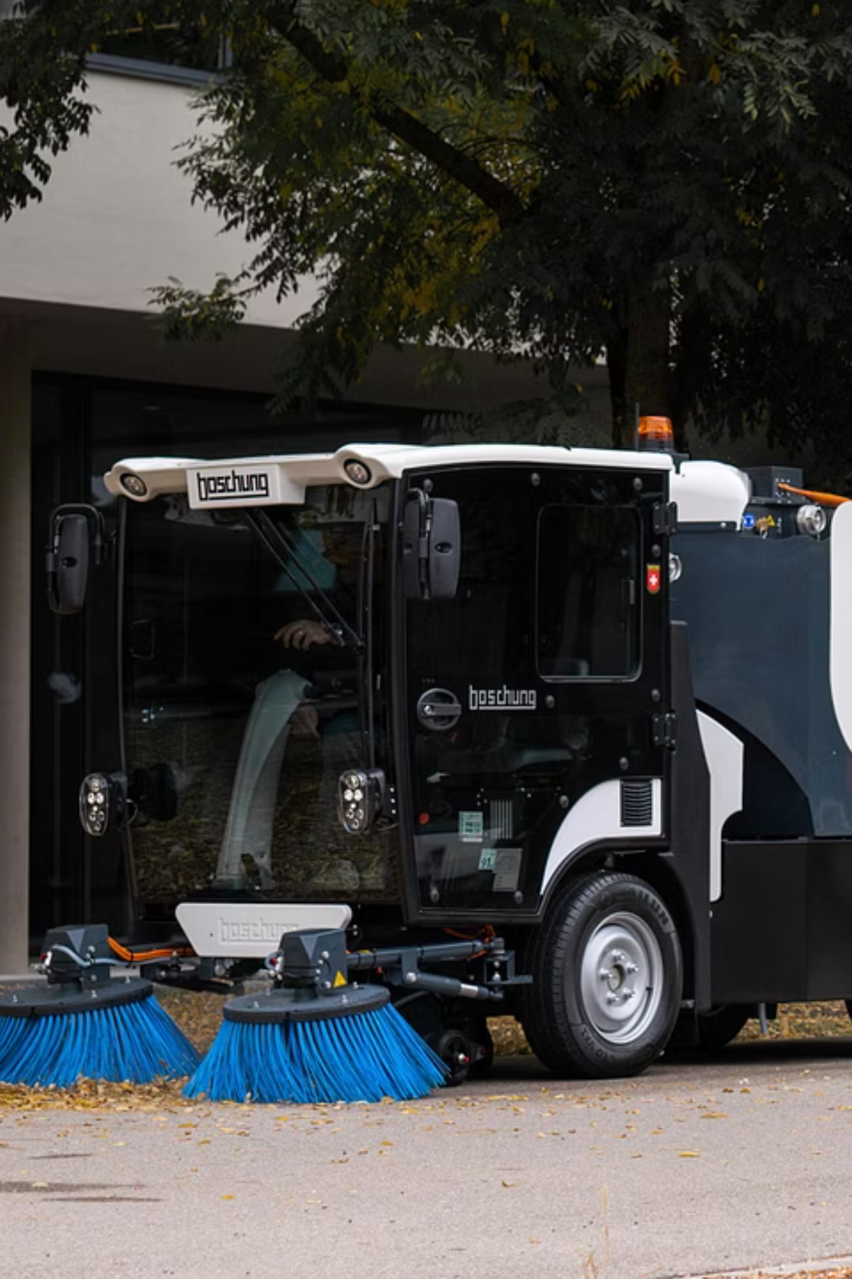



Introducing NightClean
Autonomous Night Cleaning
Self-driving trucks patrol empty roads between 12 AM–5 AM, collecting waste without disrupting daytime traffic
AI Vision Detection
Computer vision identifies garbage in real-time using trained machine learning models
Citizen Reporting
Residents upload photos of problem areas through web/mobile platform for targeted response

Slide 5
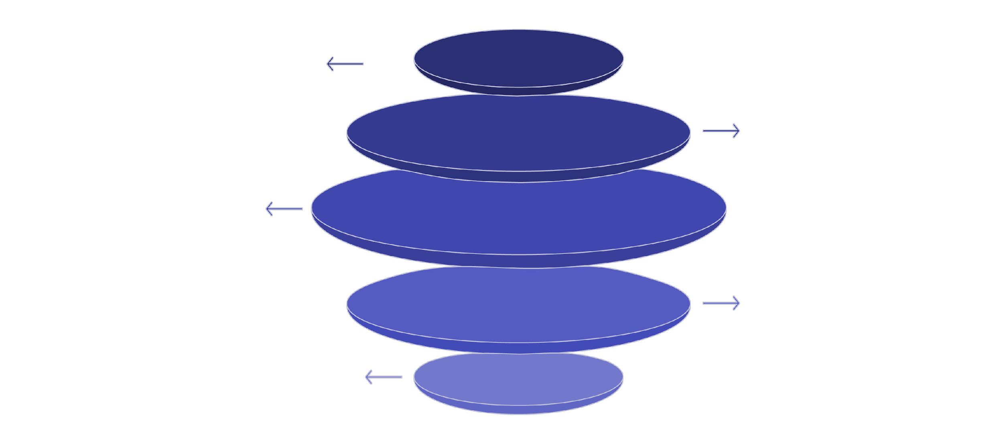
System Architecture
Data Sources
Sensors, cameras, and citizen reports collected
Cloud Ingest
Secure upload and preprocessing in cloud
AI Processing
Computer vision and analytics applied
Route Optimization
Compute optimal paths and controls
Actuation & Dashboard
Navigation updates and dashboard sync

Slide 6






Hardware Components
Processing Unit
Vision System
Raspberry Pi or ESP32 microcontroller serving as the brain, processing sensor data and executing control commands in real-time
High-resolution camera module captures street imagery continuously, feeding frames to AI detection models
Distance Sensors
GPS Module
Ultrasonic sensors detect obstacles and measure distances, ensuring safe navigation around objects
Precise location tracking enables accurate mapping of waste locations and optimized route planning
Motor Drivers
Power System
Control wheel motors for autonomous movement and robotic arm/suction system for waste collection
Rechargeable battery pack provides extended night operation, with charging stations at municipal depots

Slide 7
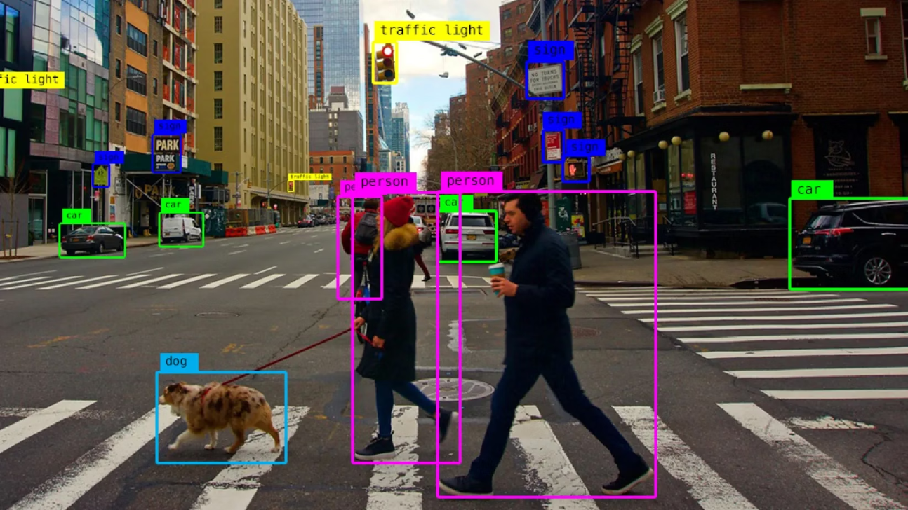
AI & Machine Learning
Computer Vision Pipeline
Our system employs a YOLO (You Only Look Once) or MobileNet architecture for real-time object detection. The model is trained on thousands of labeled images showing various types of street waste, from plastic bottles to food packaging.
During operation, the camera captures 30 frames per second, which are processed sequentially. Detected waste items are classified by type and size, with confidence scores above 85% triggering collection protocols.
Route Optimization
Citizen reports and historical data feed into a reinforcement learning algorithm that continuously improves cleaning routes. The system prioritizes high-density waste areas while minimizing travel distance and energy consumption.

Slide 8
Citizen Reporting Platform
01
02
03
Photo Capture
Location Tagging
AI Verification
Users take picture of waste location using smartphone camera
GPS automatically marks coordinates where photo was taken
System validates waste type and seriousness before accepting report
04
05
Route Integration
Status Updates
Verified reports update cleaning routes for next night's patrol
Users receive notifications when their reported area is cleaned
The web platform provides municipalities with a comprehensive heatmap dashboard showing waste concentration patterns, complaint resolution rates, and collection efficiency metrics.

Slide 9
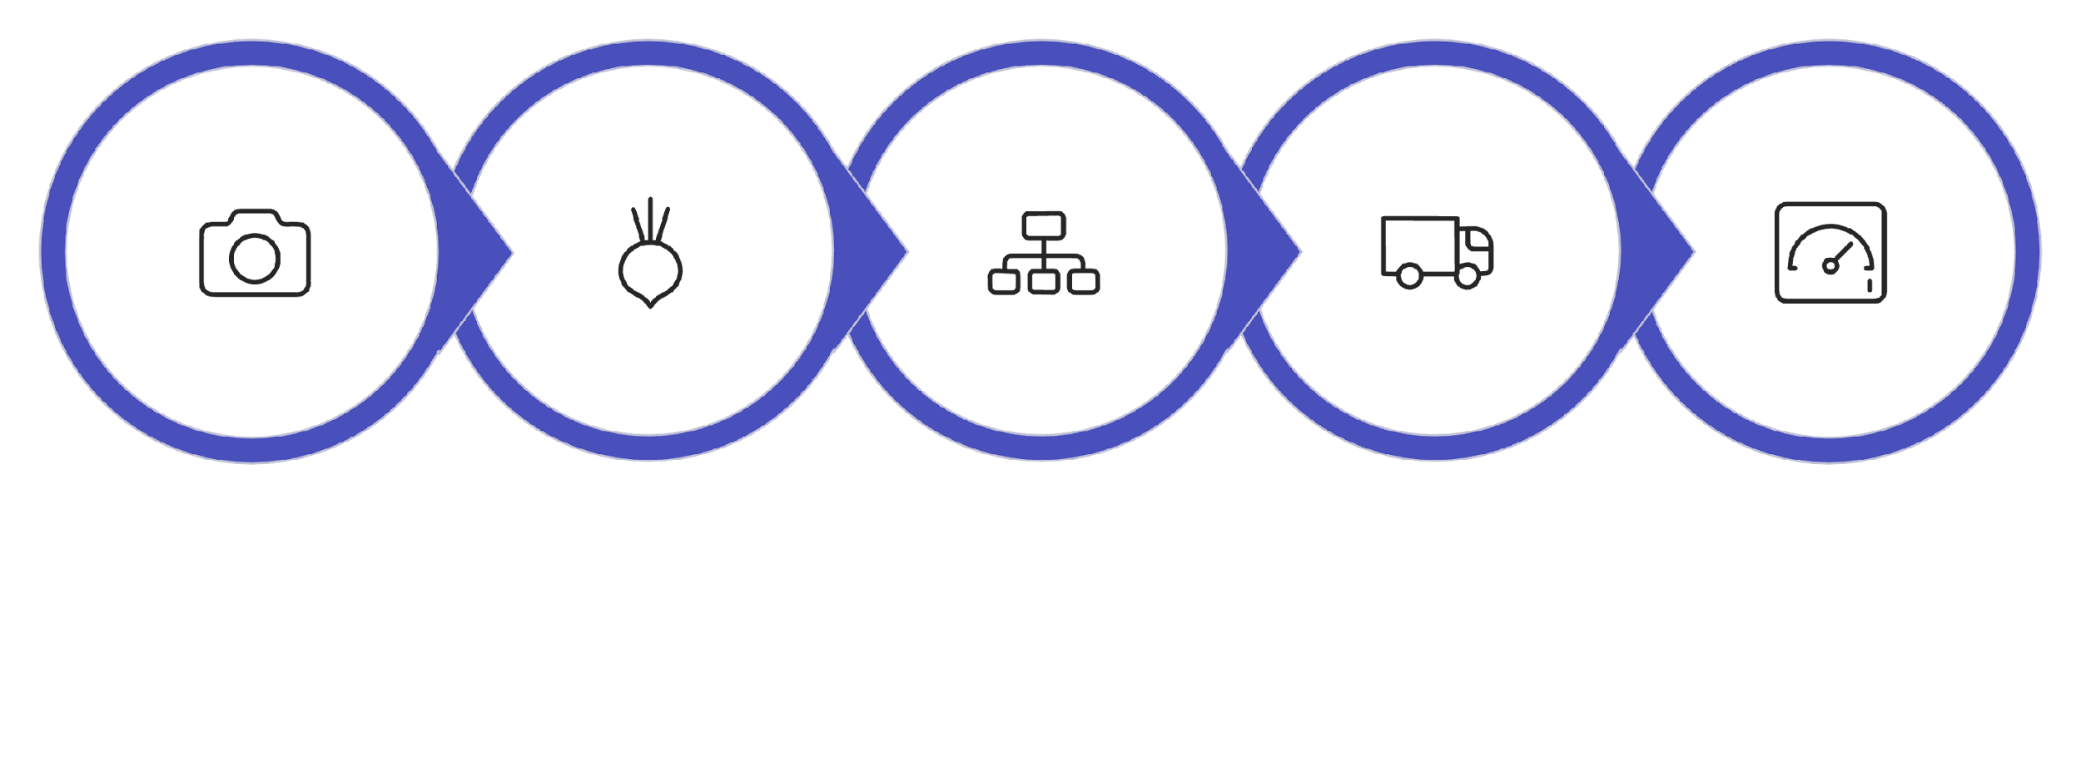





System Workflow
Upload Photo
Optimize Route
Autonomous Clean
Update Dashboard
AI Verify

Slide 10
Implementation Roadmap
Phase 1: Prototype
Phase 3: Web Platform
Build scaled-down autonomous truck with basic waste detection and collection capabilities
Launch citizen reporting app with GPS tagging and status tracking features
1
2
3
4
Phase 2: AI Training
Phase 4: Pilot Program
Collect and label dataset, train computer vision models, achieve 85%+ detection accuracy
Deploy 3 trucks in one city district for 30-day trial with municipal partnership
Expected Impact
75%
60%
4X
Reduction in street waste
Lower manpower costs
Faster response time
Based on pilot projections
Automation efficiency gains
From report to cleanup
Target deployment: Municipal corporations, smart city initiatives, and government sanitation departments. Scalable architecture supports expansion from district-level to city-wide coverage.

