Slide 1

Beginning Arduino uno

Slide 2
Workshop Overview
Introduction to Arduino
Hardware and software overview
Programming Arduino
Led examples
Sensors
Using sensors
Arduino in Proteus

Slide 3
What is Arduino ?
A tiny computer that you can program
to process input and outputs.

Slide 4
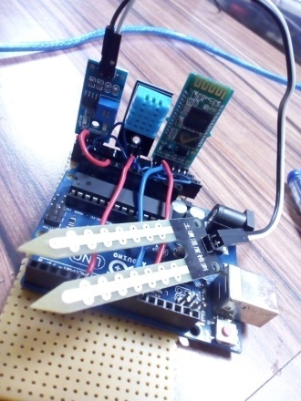
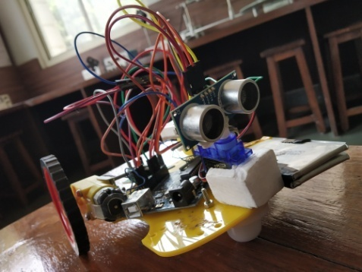
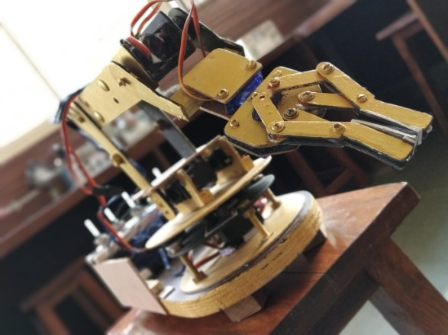
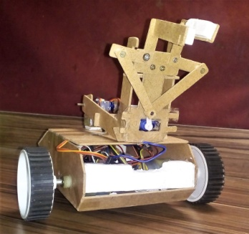
Projects we made using Arduino

Slide 5
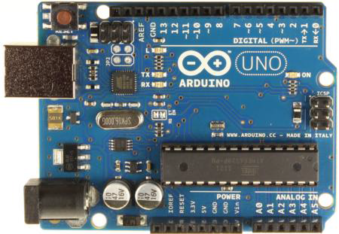
Arduino Uno R3 Hardware

Slide 6
Arduino Uno R3
Atmega 328 microcontroller
Controlling unit
Controls all the operations
Has inbuilt memory
Operates at 5V dc
Notes:
ATmega328 has three types of memory:
Flash memory: 32KB nonvolatile memory. This is used for storing application, which explains why you don't need to upload your application every time you unplug arduino from its power source.
SRAM memory: 2KB volatile memory. This is used for storing variables used by the application while it's running.
EEPROM memory: 1KB nonvolatile memory. This can be used to store data that must be available even after the board is powered down and then powered up again.

Slide 7
Arduino Uno R3
USB port
To connect arduino with PC
Used for uploading code

Slide 8
Arduino Uno R3
USB controller chip
Manages data transfer from
PC to Arduino

Slide 9
Arduino Uno R3
External power jack
Adaptor connection 6V to 12V

Slide 10
Arduino Uno R3
7805 voltage regulator
Converts 12V input to 5 volts
To power the microcontroller

Slide 11
Arduino Uno R3
voltage regulator 3 volts

Slide 12
Arduino Uno R3
voltage regulator 3 volts

Slide 13
Arduino Uno R3
Crystal oscillator
Provide clock pulses
Synchronizes all components

Slide 14
Arduino Uno R3
Transmitter and Receiver LED
Blinks when program is
Uploaded or data is send or
Received serially

Slide 15
Arduino Uno R3
Power on LED
Indicates that the Arduino
Board is ON

Slide 16
Arduino Uno R3
Reset button
Used to reset the board to
Initial condition

Slide 17
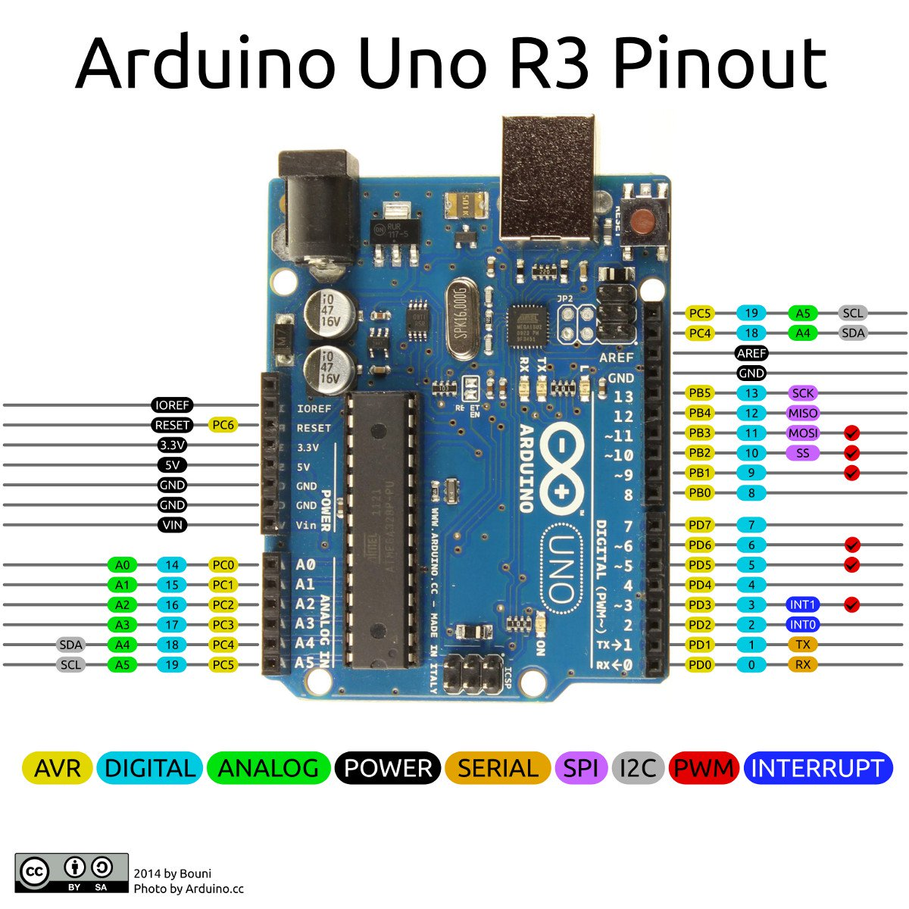
Arduino Uno R3 Pin Pout

Slide 18
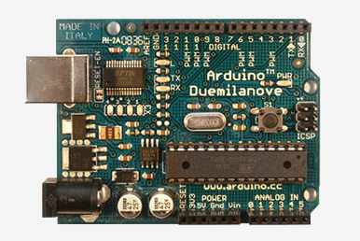
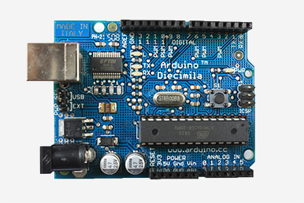
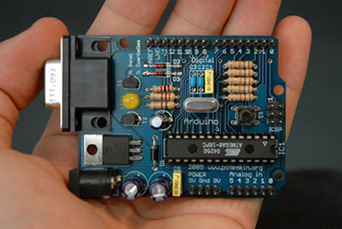
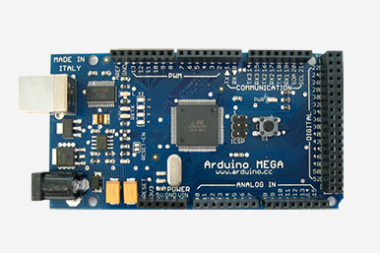
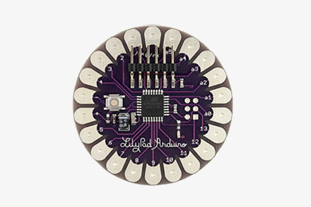
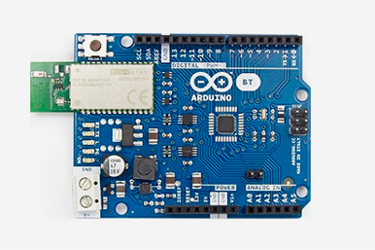
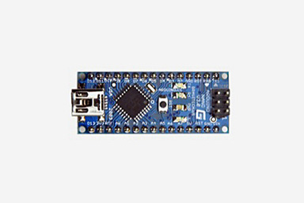
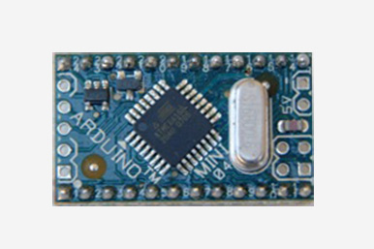
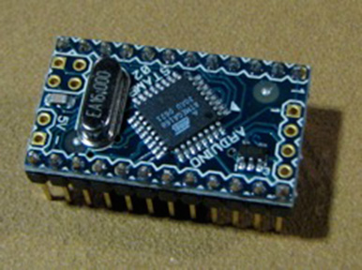
Arduino Variants

Slide 19
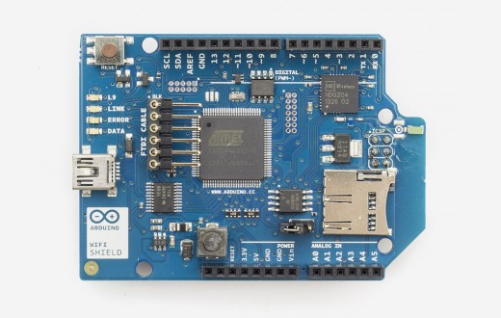
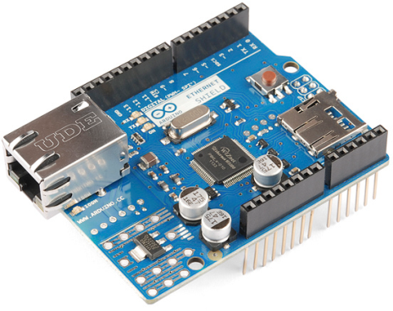
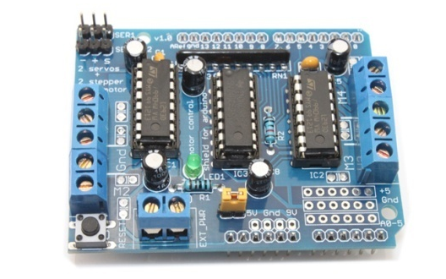
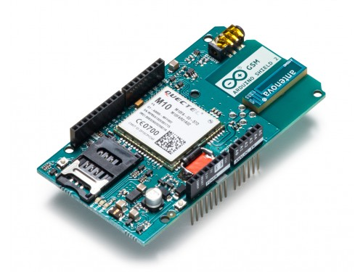
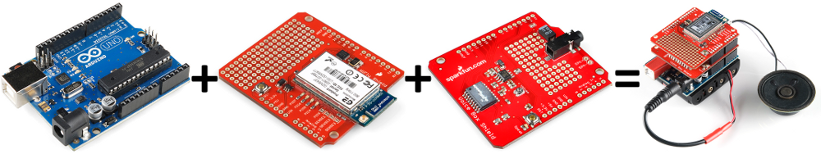
Arduino Shields
Wifi shield
Ethernet shield
Motor shield
GSM shield
Connecting Shields to arduino

Slide 20
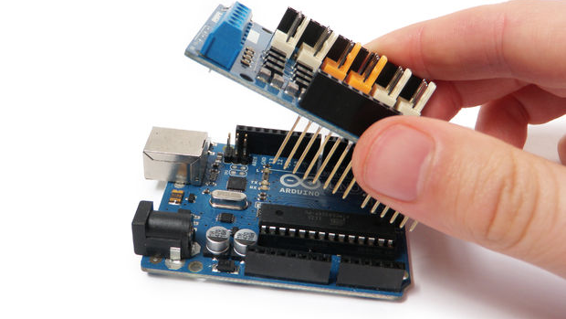
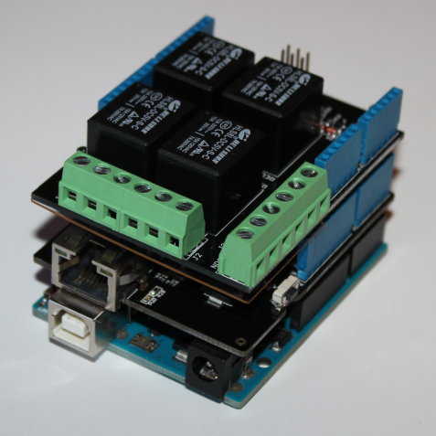
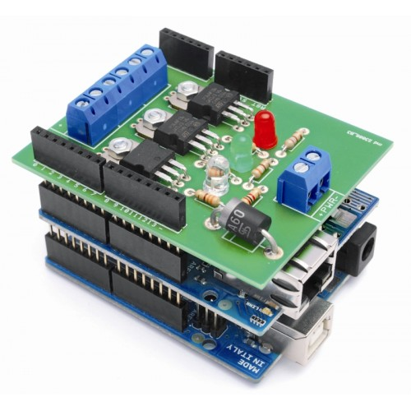
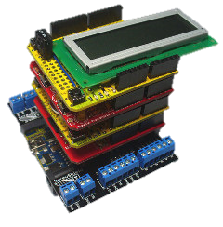
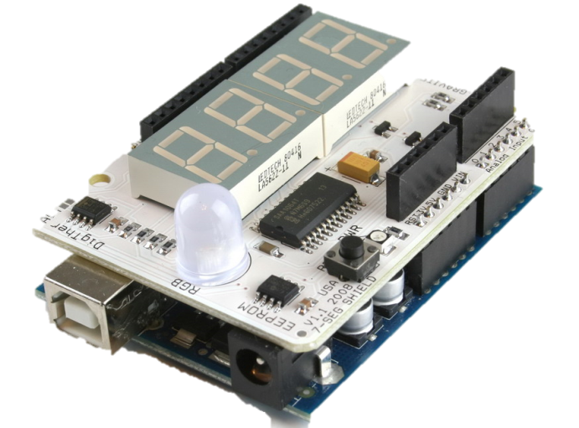
Arduino Shields

Slide 21
Want More Information about Boards and Shields
https://www.arduino.cc/en/Main/Products

Slide 22
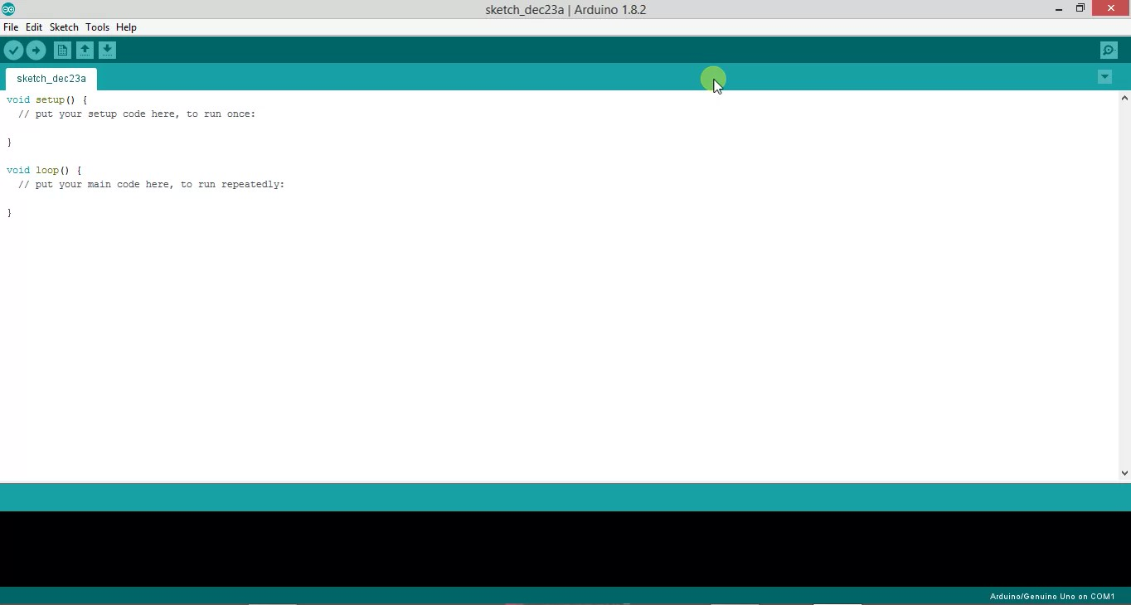
Software

Slide 23
Arduino IDE

Slide 24
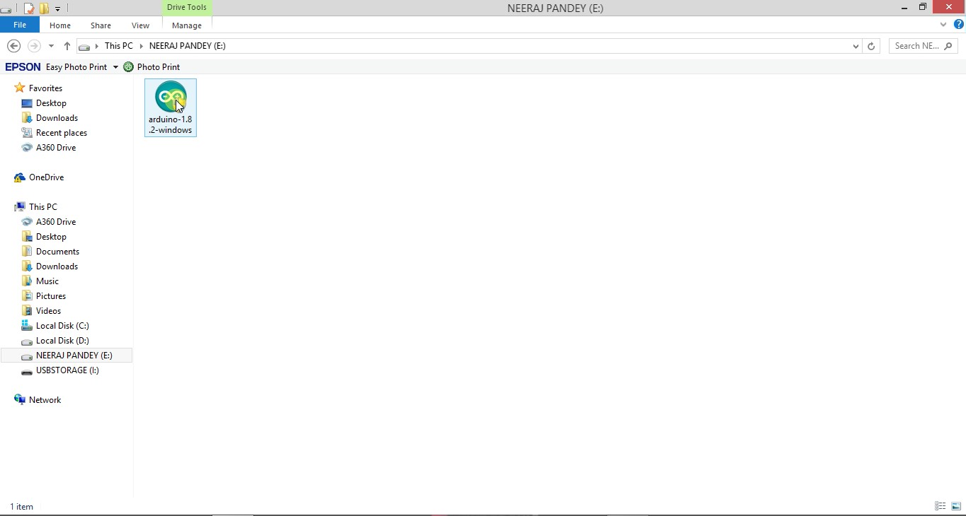

Slide 25
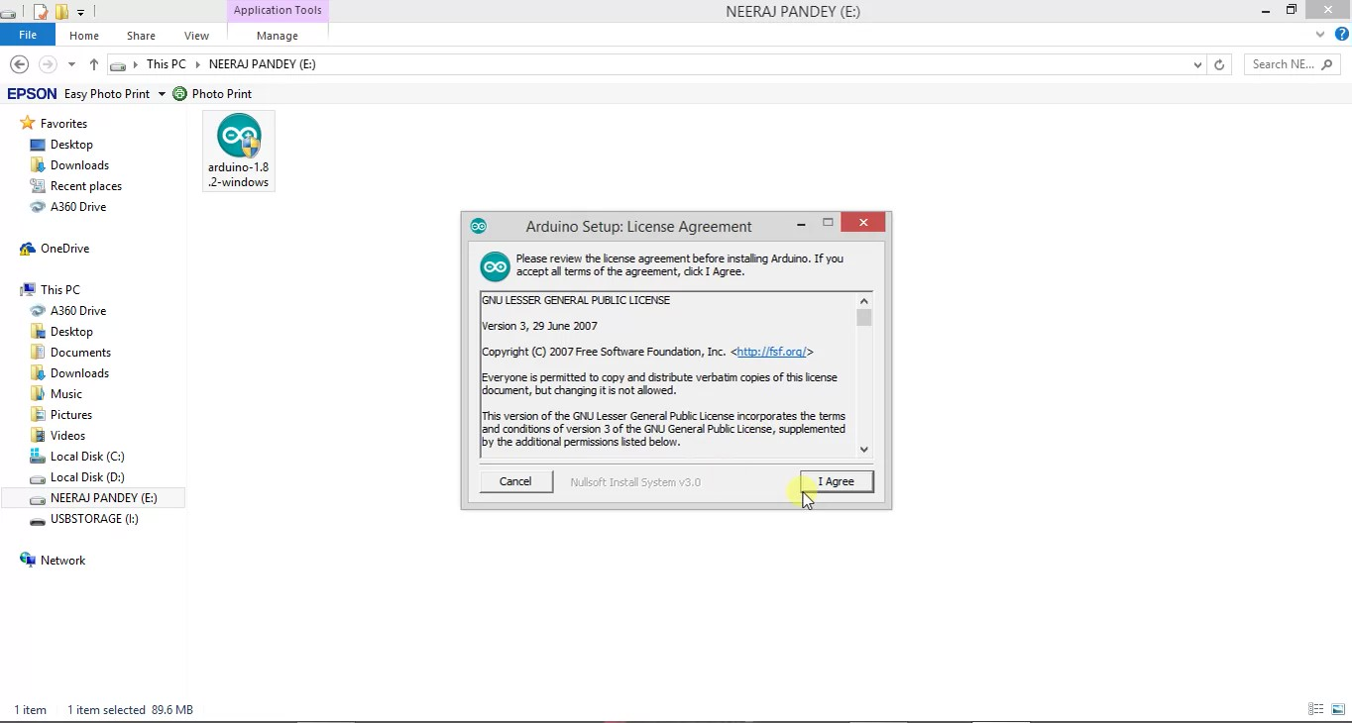

Slide 26
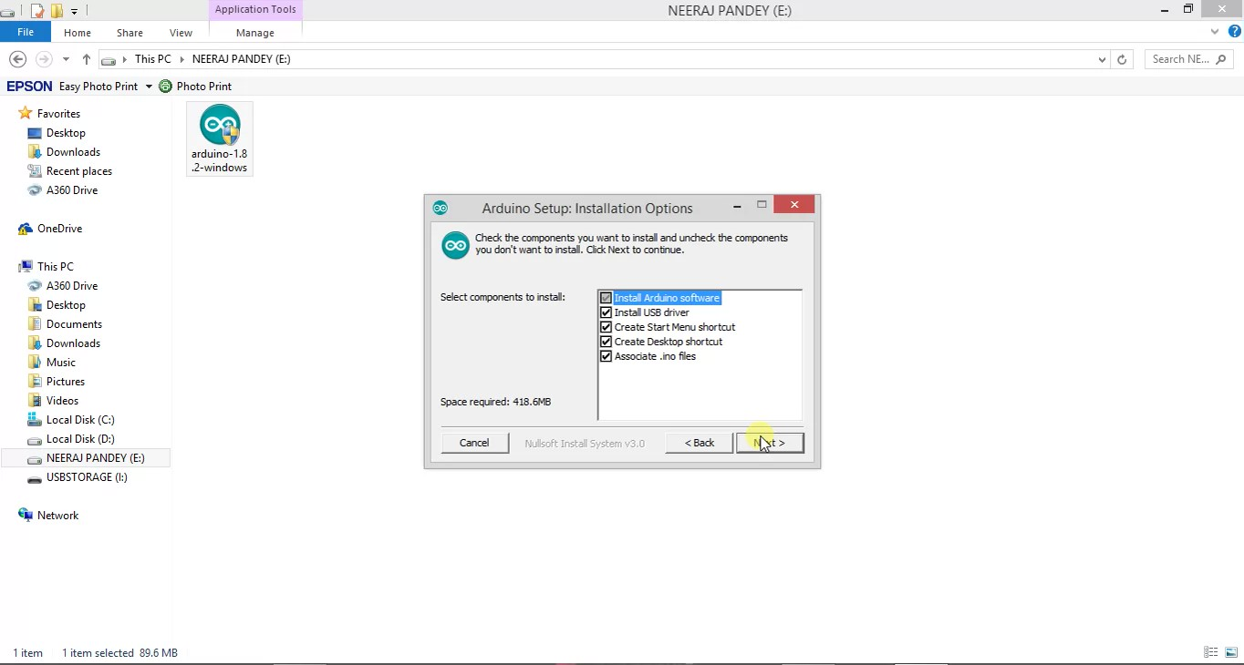

Slide 27
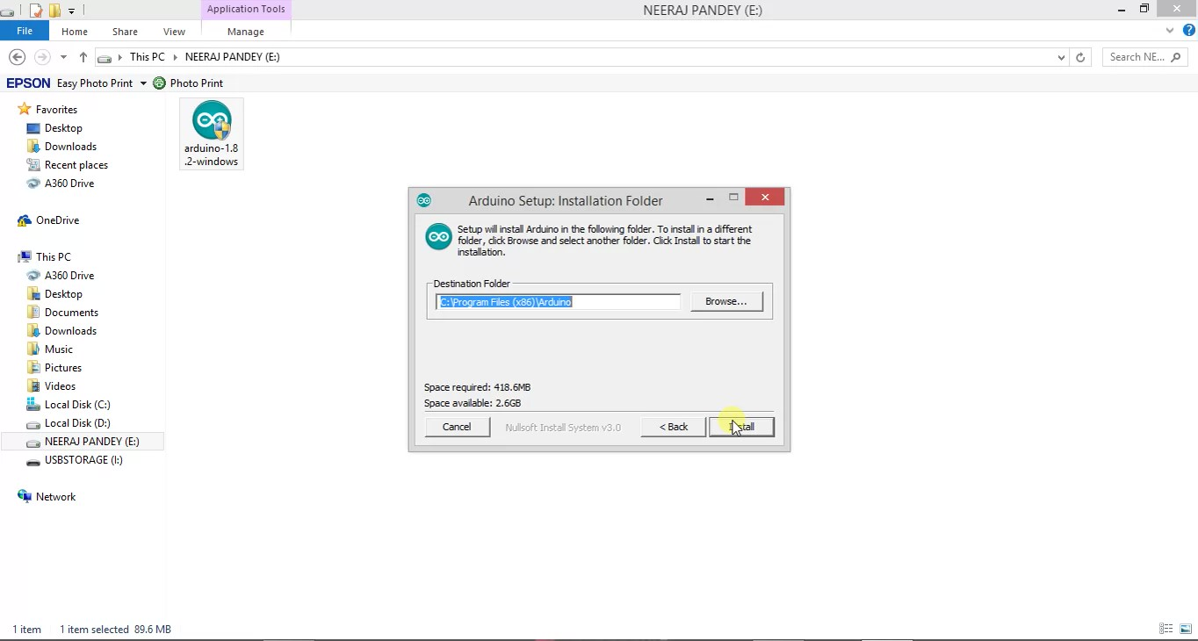

Slide 28
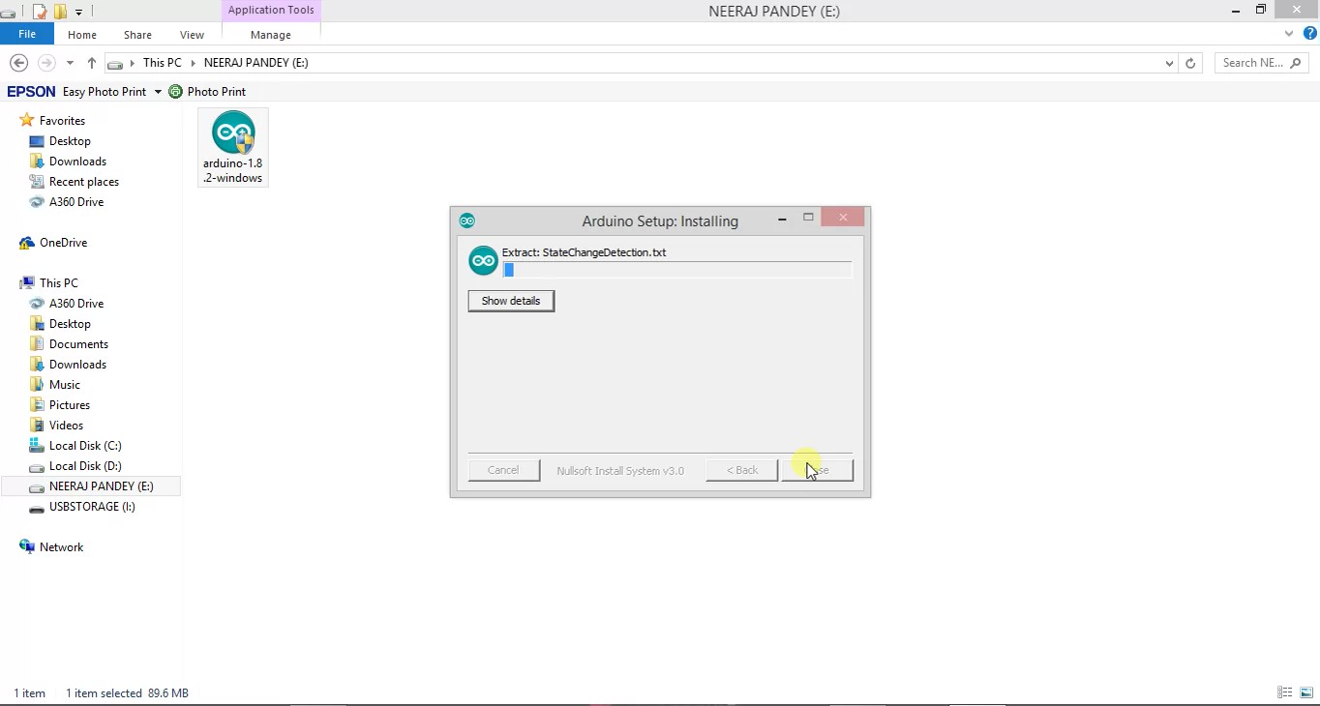

Slide 29
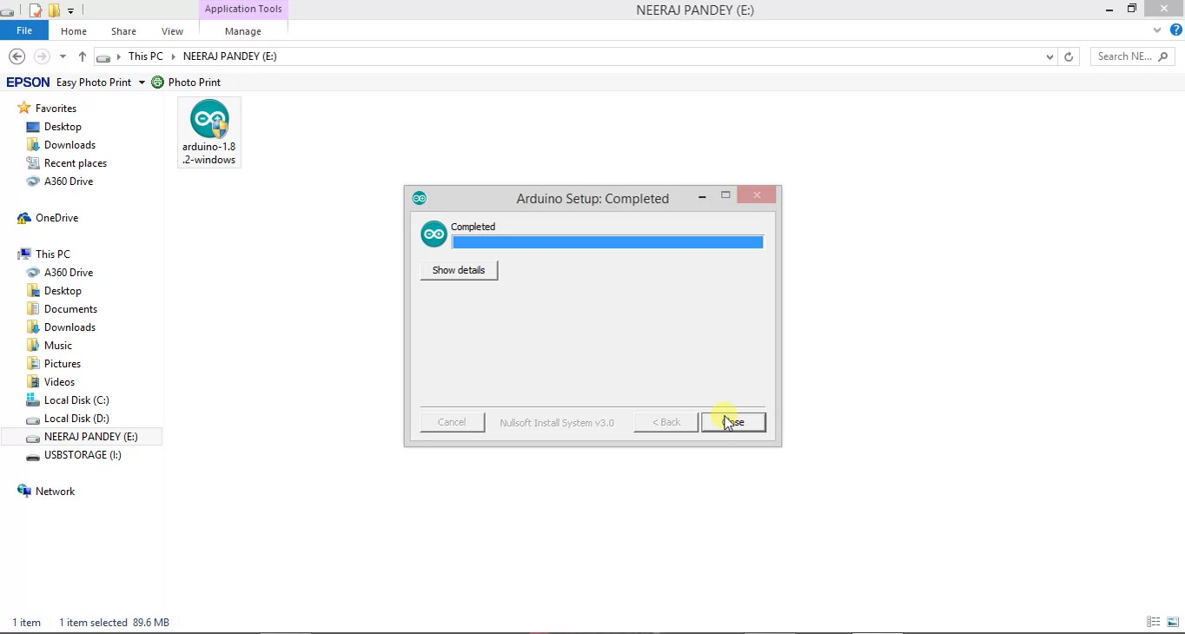

Slide 30
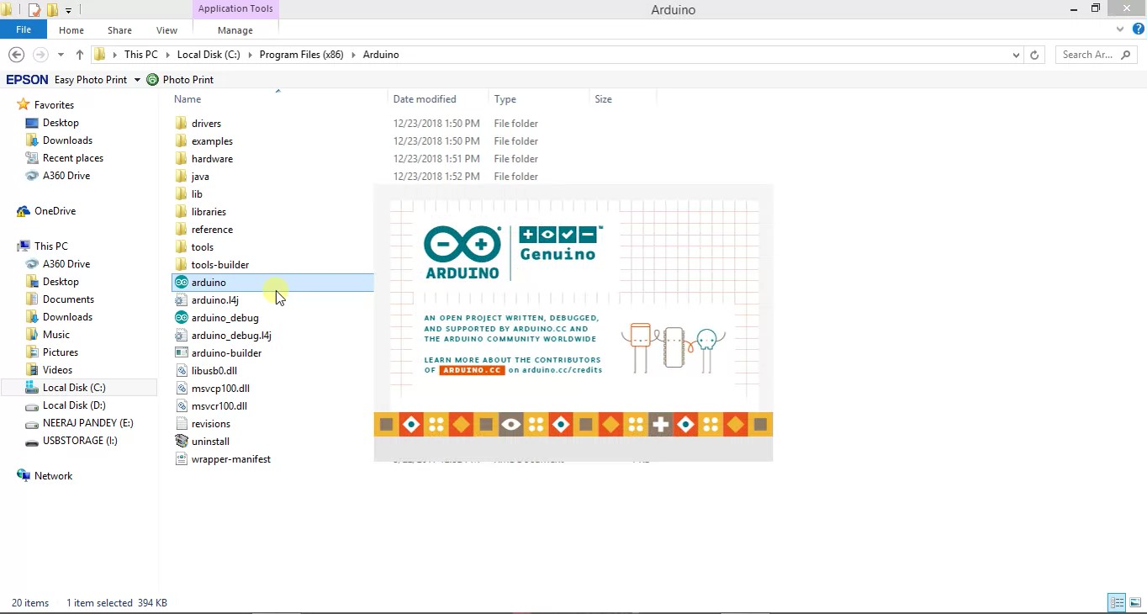

Slide 31
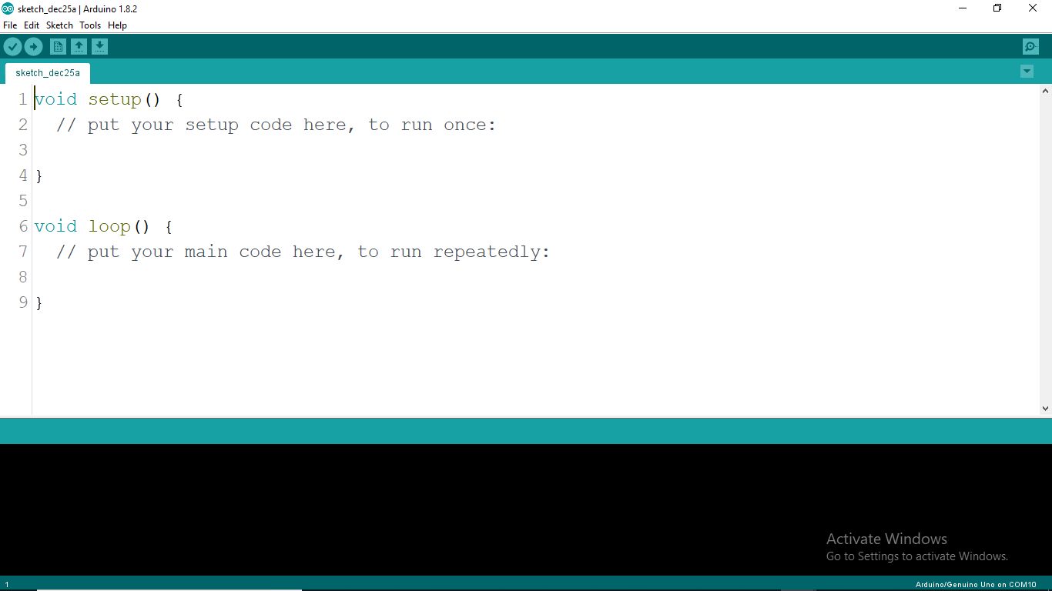

Slide 32
Menu bar

Slide 33
Button bar

Slide 34
Programming window

Slide 35
Program notification area

Slide 36
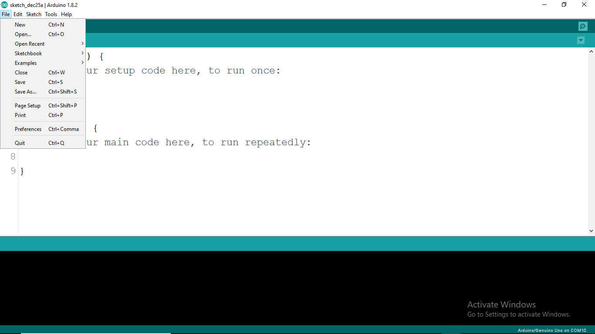
File menu

Slide 37
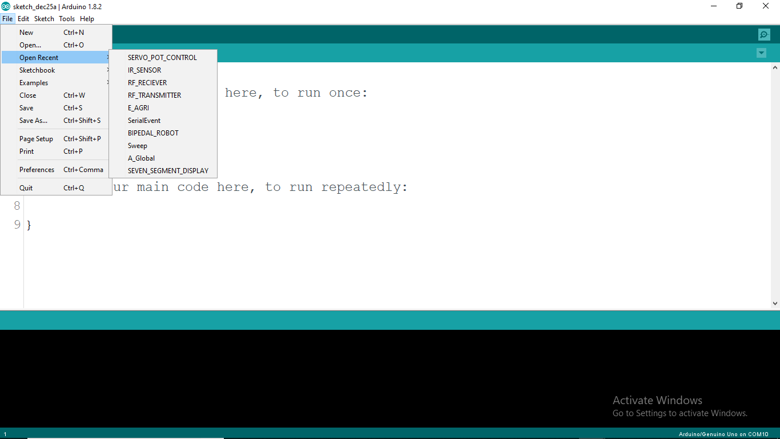
Shows recently opened files

Slide 38
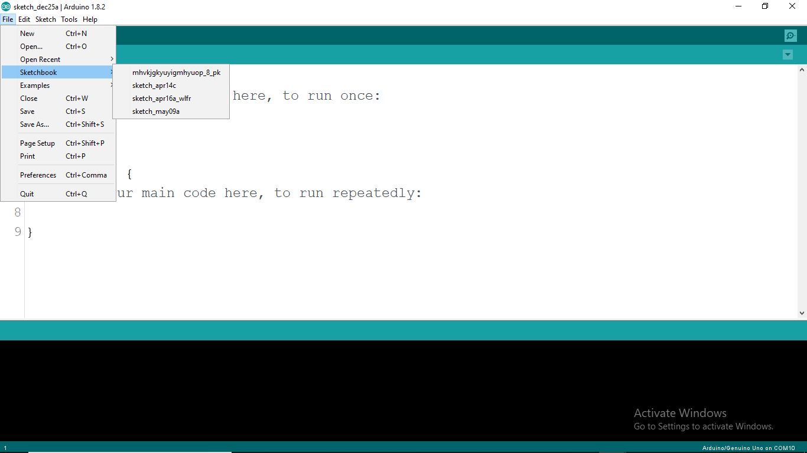
Shows the sketches which are saved in the default location

Slide 39
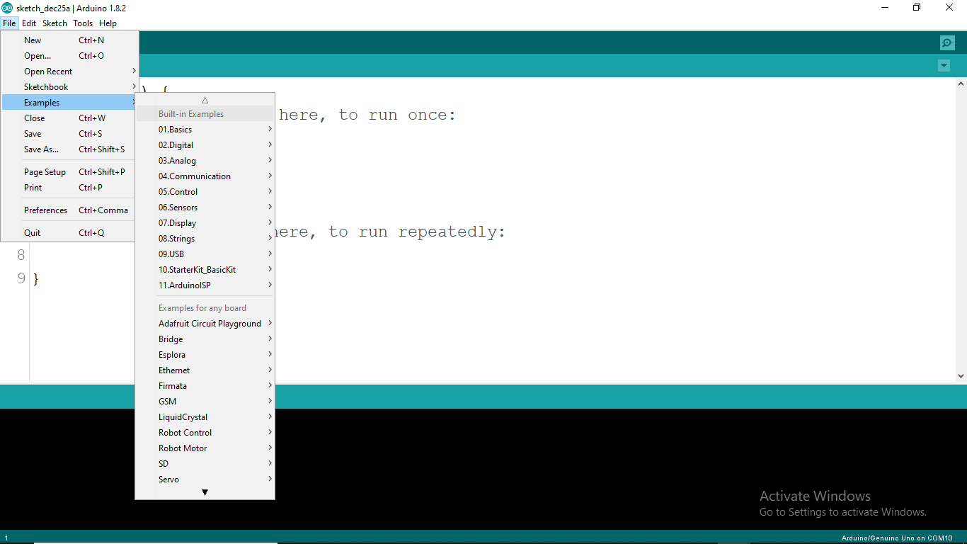
Examples

Slide 40
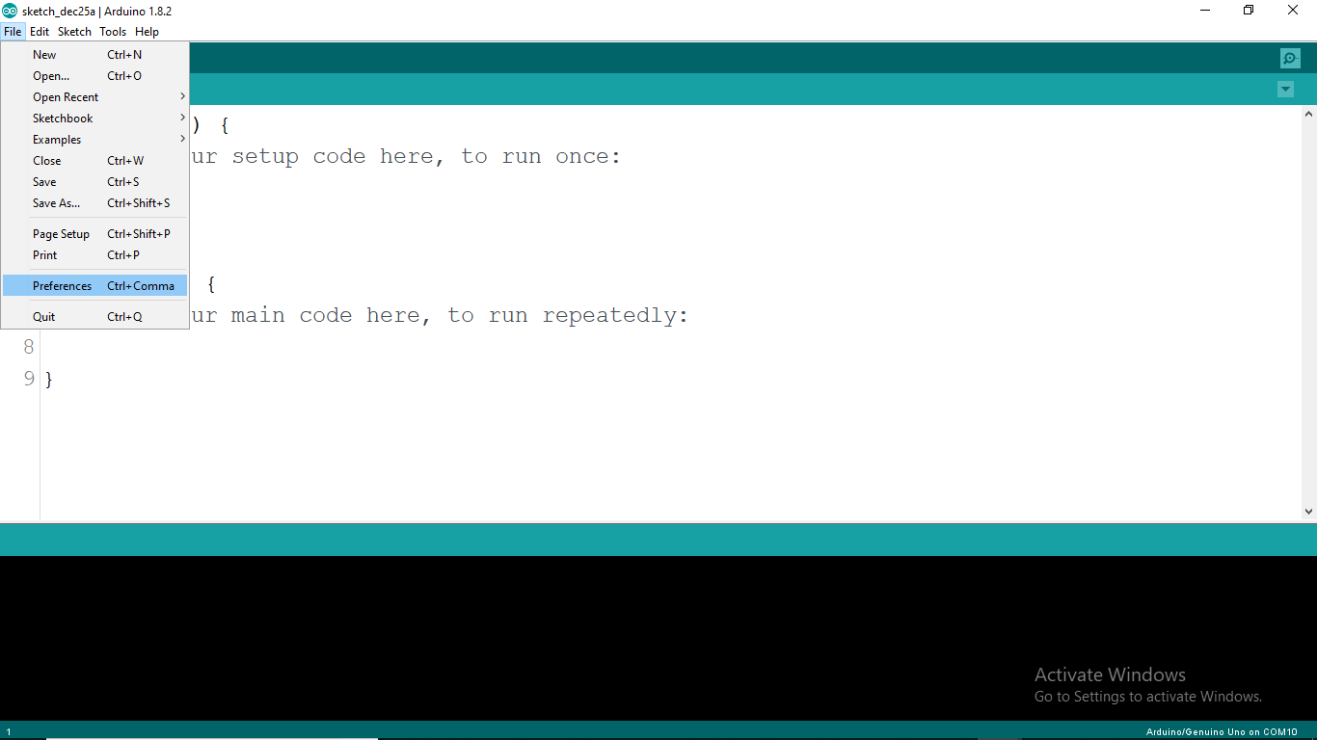
Preferences or Settings

Slide 41
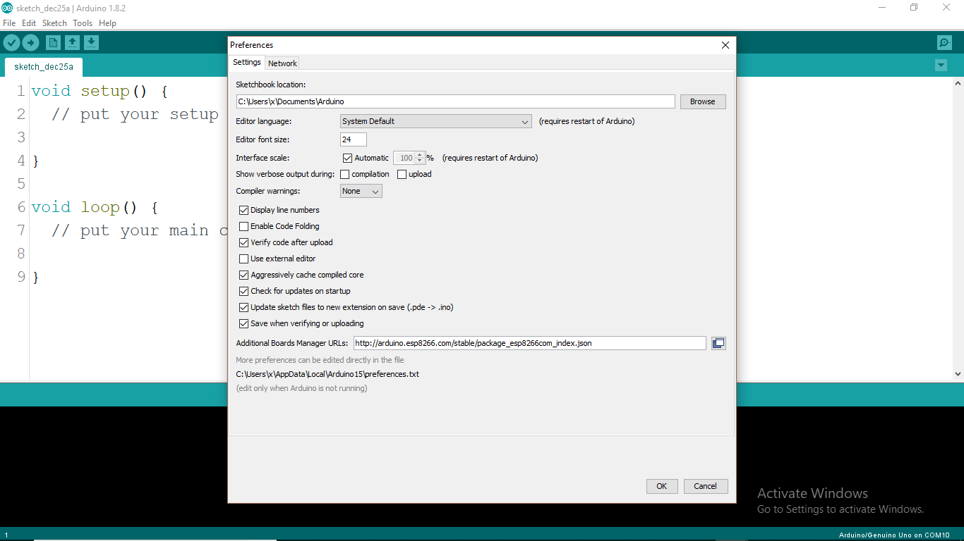

Slide 42
Change sketchbook location

Slide 43
Language and font options

Slide 44
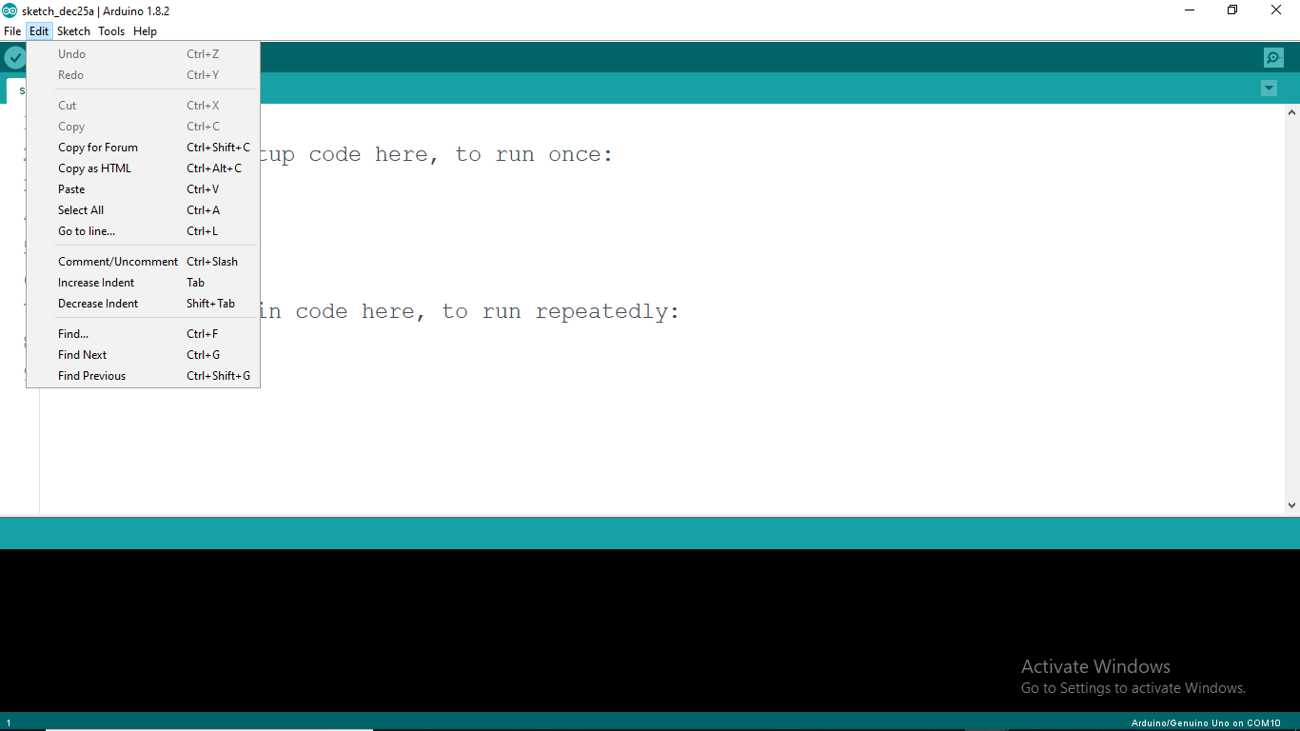
Edit menu
Options to let you to cut, copy, and paste sections of code.
You can also Find certain words within the code. The useful Undo and Redo options are used when you make a mistake. Allows you to jump to any line of your code(used in case of long codes).

Slide 45
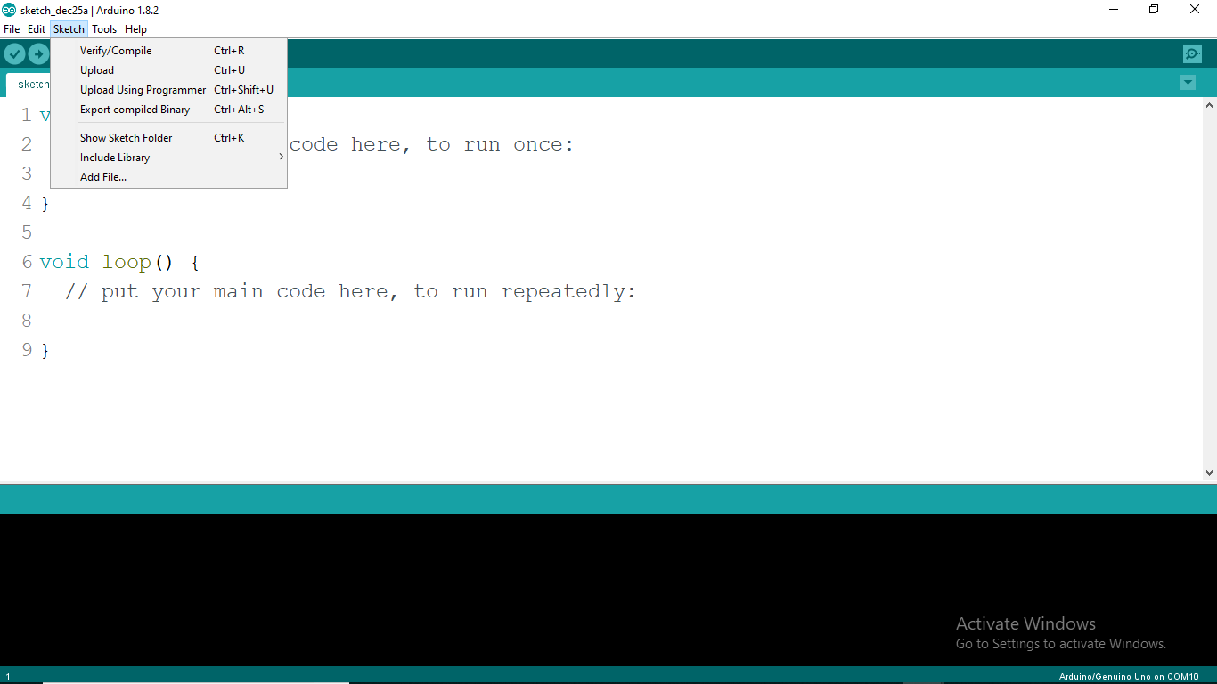
Contains the Verify/Compile functions and other useful functions including the Import Library option, which brings up a list of the available libraries stored within your libraries folder.

Slide 46
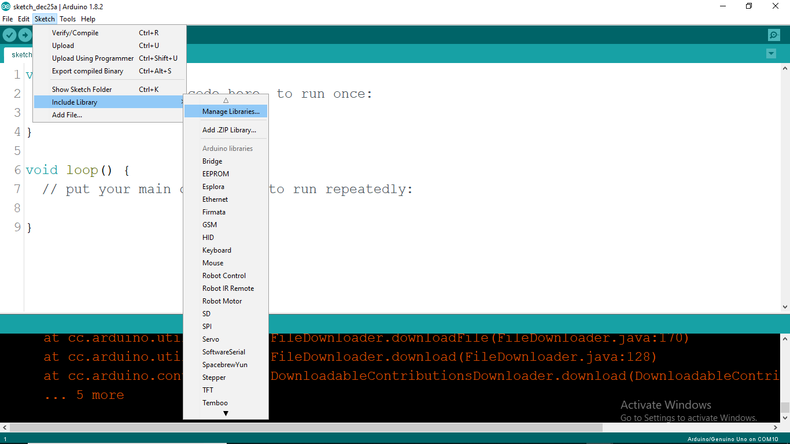
You can download additional libraries.

Slide 47
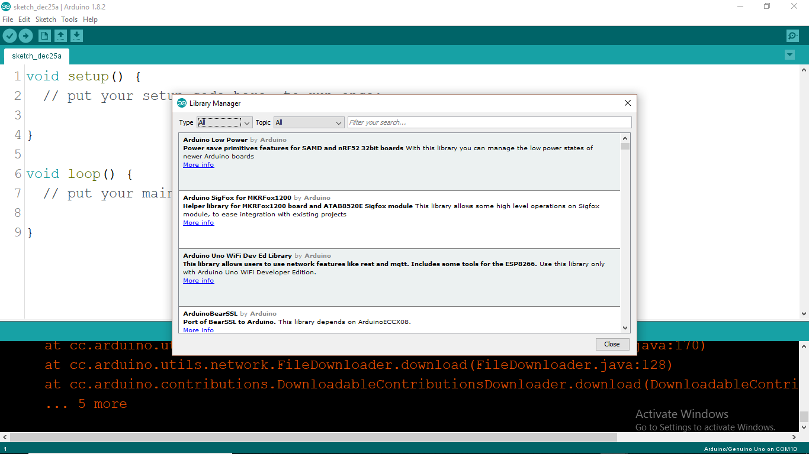

Slide 48
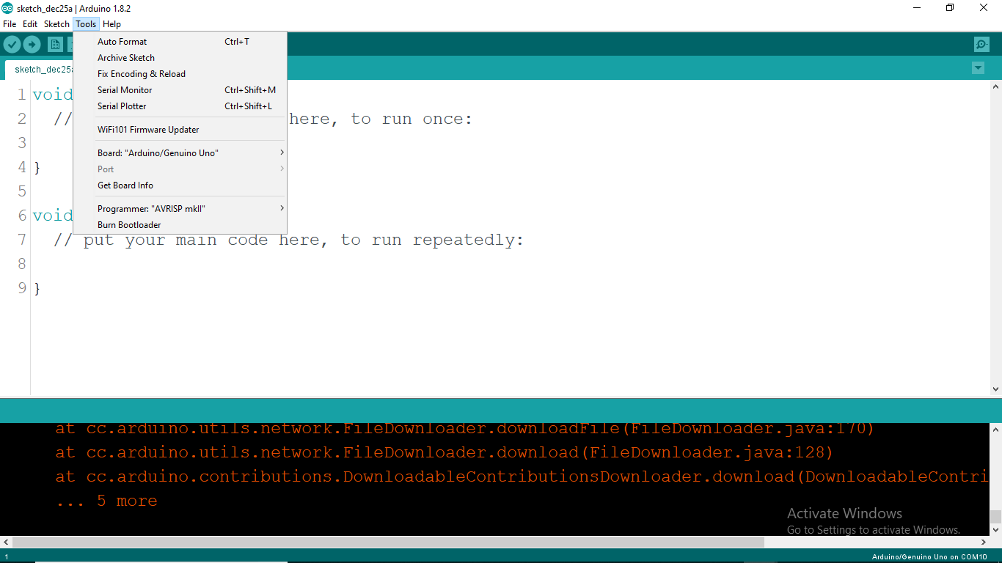
Tools menu
You can select the Board and Serial Port, when setting up the Arduino for the first time. The Auto Format function formats your code to make it look nicer. Burn bootloader option writes a piece of code on the chip to make it compatible with the Arduino IDE)

Slide 49
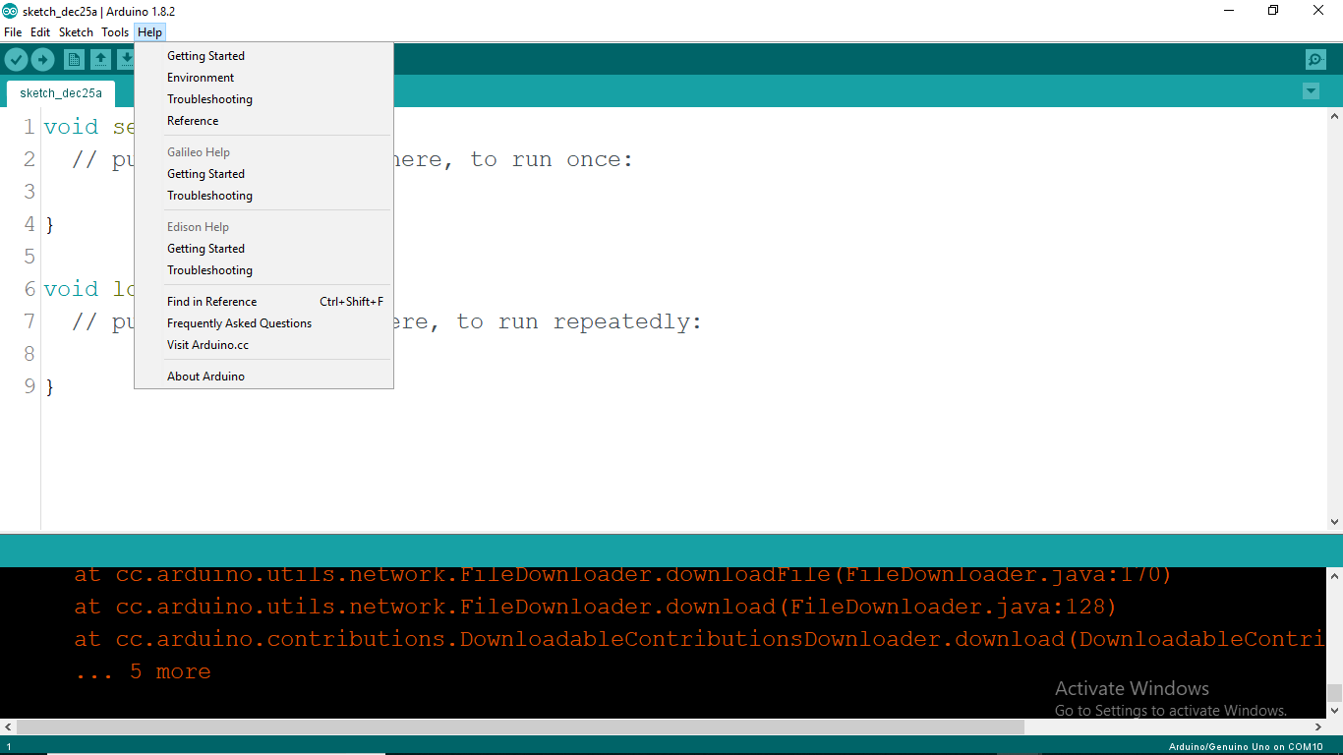
Help menu

Slide 50
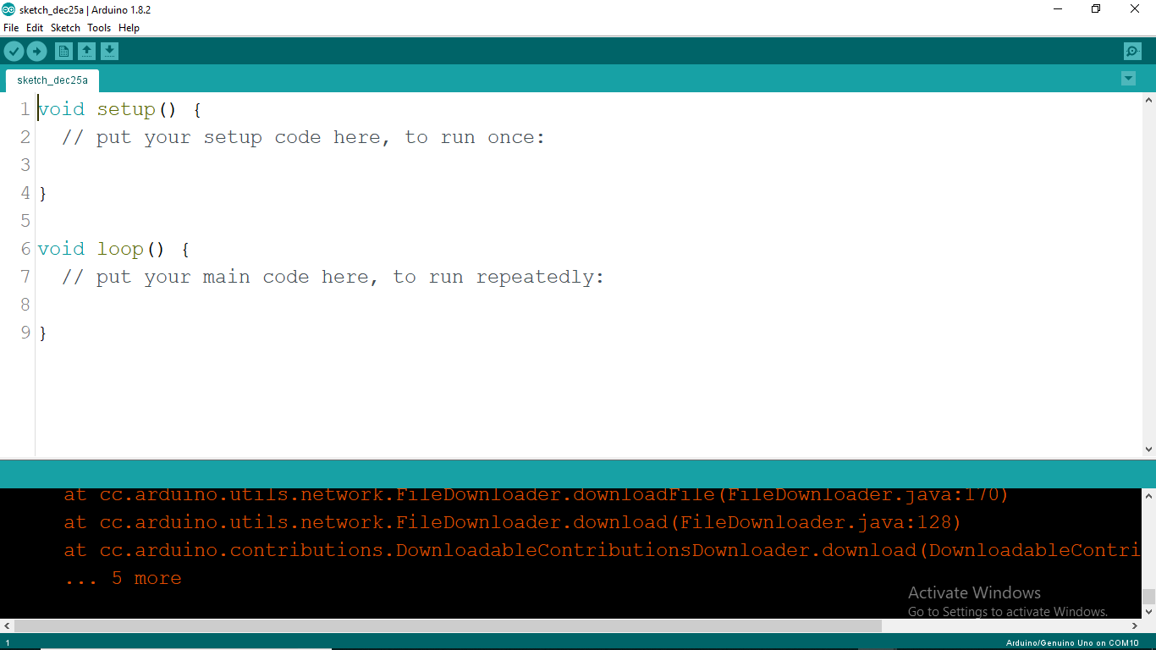
The Verify/Compile button is used to check that your code is correct and error free before you upload it to your Arduino board.

Slide 51
The Upload button uploads the code within the current sketch to Arduino.
Make sure that you have the correct board and port selected (in the Tools menu) before
Uploading the code.

Slide 52
The New button creates a new and blank sketch ready for you to enter your code into.

Slide 53
Shows a list of sketches in your Sketchbook to open

Slide 54
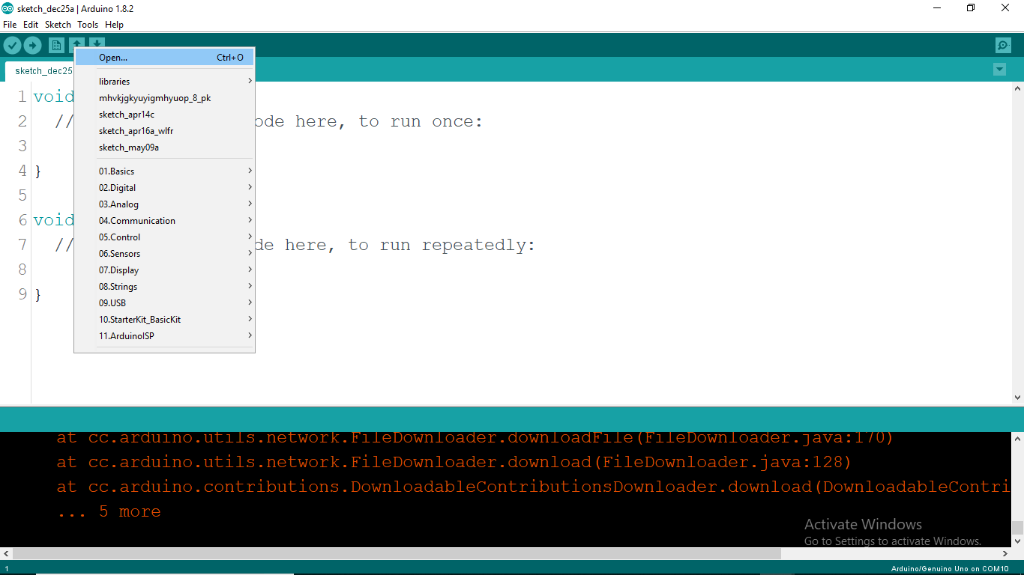

Slide 55
Saves the current Sketch to your Sketchbook

Slide 56
The serial monitor is a tool for debugging.
This feature can be extremely helpful if you are not getting the result you anticipated,
because it can show you exactly what is going on.

Slide 57
The sketch
The sketch is nothing more than a set of instructions for the Arduino to carry out. Sketches created using the Arduino IDE are saved as “.ino“ files.
To create a sketch, you need to make the three main parts:
Variable declaration.
Setup function, and
Main Loop function.

Slide 58
Variable declaration
Variable declaration means to type the names of each input or output that you want to use in your sketch.
You can rename an Arduino input/output pin number with any name and you can refer to the pin by that name throughout the sketch rather than the pin number.
You can also declare a variable for a simple value (not attached to an I/O pin) and use that name to refer to the value of that variable.
These variables can be declared as several different types, but the most common that we use is an integer (int).
Other variable types are used in later examples (i.e., float, long, unsigned int, char, byte, etc.) and are explained when used.
int my_led = 13;

Slide 59
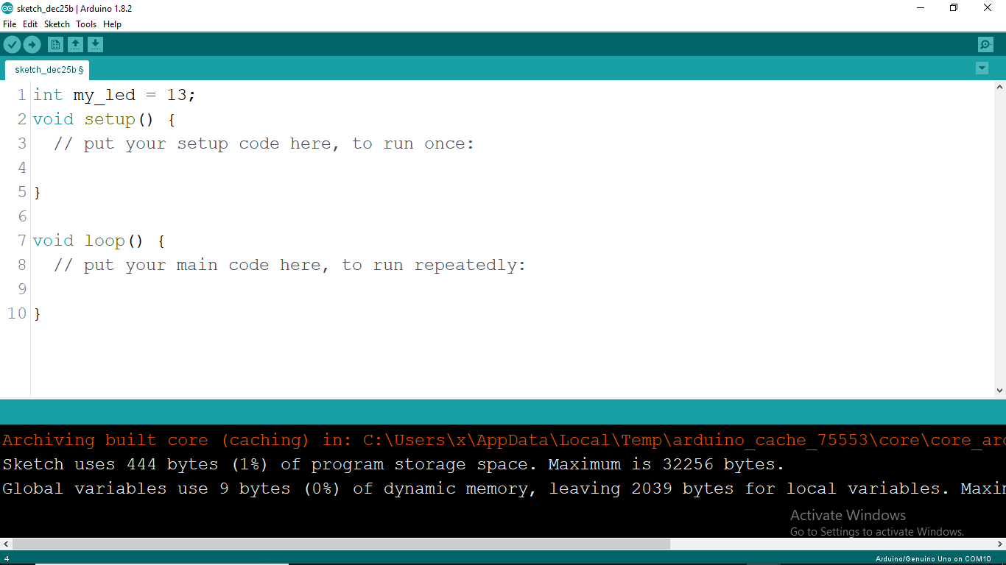
Variable declaration

Slide 60
Setup function
This function runs once, each time the Arduino is powered on.
This is usually where we determine which of the variables declared are inputs or outputs using the pinMode() command.
pinMode(my_led, OUTPUT);

Slide 61
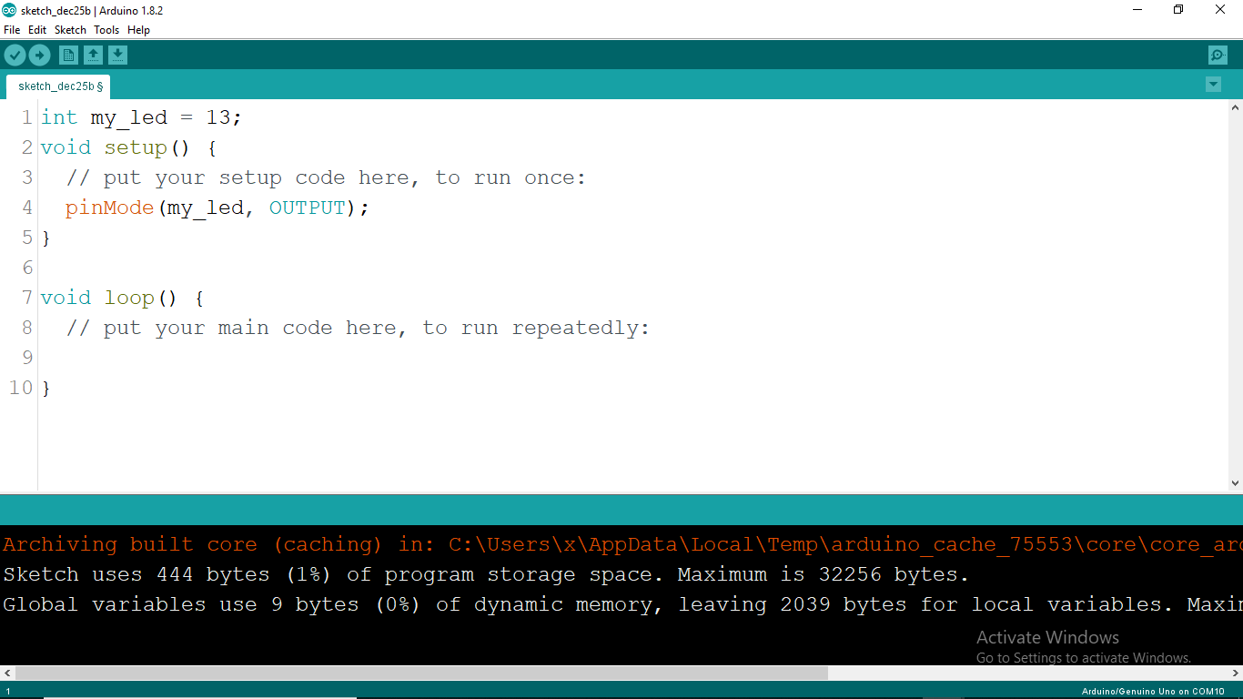
Variable input or output declaration

Slide 62
Loop function
This function is where the main code is placed and will run over and over again continuously until the Arduino is powered off.
This is where we tell the Arduino what to do in the sketch.
Example of LED blinking
The loop function simply blinks the LED on and off by using the delay(ms) function.
Changing the first delay(1000) effects how long the LED stays on, whereas changing the second delay(1000) effects how long the LED stays off.
digitalWrite(my_led, HIGH); // turn LED On
delay(1000); // wait 1 second
digitalWrite(my_led, LOW); // turn LED Off
delay(1000); // wait 1 second

Slide 63
digitalWrite(my_led, HIGH);
this writes a HIGH value to the pin within the statement
delay(1000);
this statement simply tells the Arduino to wait for 1000 milliseconds before carrying out the next statement
digitalWrite(my_led, LOW);
this writes a LOW value to the pin within the statement
delay(1000); wait 1 second

Slide 64

Code written in loop function

Slide 66

Save and Compile the code

Slide 67

Code is compiled and has no errors

Slide 68

Components required

Slide 69


Breadboard connections
LED

Slide 70

Attach LED to the Breadboard
+ -

Slide 71

Connect one end of resistance to positive terminal of LED
+ -

Slide 72

13
+ -
Connect other end of resistance to pin 13

Slide 73

13
GND
+ -
Connect negative terminal of LED to Ground(GND) pin

Slide 74

Plug in USB
Green led indicates board is on

Slide 75

Select COM port

Slide 76

Select board

Slide 77

Upload the code to Arduino Board

Slide 78

Upload done, Tx and Rx LED’s on the board flashes

Slide 79
Now lets make it…

Slide 80


Traffic light
Make connections

Slide 81
// Variable declearation
int ledDelay = 10000; // delay in between changes
int redPin = 10;
int yellowPin = 9;
int greenPin = 8;

Slide 82


Slide 83
// Setup function
void setup() {
pinMode(redPin, OUTPUT);
pinMode(yellowPin, OUTPUT);
pinMode(greenPin, OUTPUT);
}

Slide 84


Slide 85
//Loop function
void loop() {
digitalWrite(greenPin, LOW); // turn green off
digitalWrite(redPin, HIGH); // turn red on
digitalWrite(yellowPin, LOW); // turn yellow off
delay(ledDelay); // wait 10 seconds
digitalWrite(greenPin, LOW); // turn green off
digitalWrite(redPin, LOW); // turn red off
digitalWrite(yellowPin, HIGH); // turn yellow on
delay(ledDelay); // wait 10 seconds
digitalWrite(greenPin, HIGH); // turn green on
digitalWrite(redPin, LOW); // turn red off
digitalWrite(yellowPin, LOW); // turn yellow off
delay(ledDelay); // wait 10 seconds
// now our loop repeats
}

Slide 86

Save and compile the code

Slide 87


Slide 88


Slide 89


Slide 90


Slide 91


Slide 92


Slide 93


Slide 94


Slide 95


Slide 96
Now lets make it…

Slide 97


LED chase effect
Connections

Slide 98
// Variable declearation
byte ledPin[] = {4, 5, 6, 7, 8, 9, 10, 11, 12, 13}; // Create array for LED pins
int ledDelay(65); // delay between changes
int direction = 1;
int currentLED = 0;
unsigned long changeTime;
An array is a collection of variables that are accessed using an index number
byte ledPin[] = {4, 5, 6, 7, 8, 9, 10, 11, 12, 13};
It has 10 values (Digital Pins 4 through to 13)

Slide 99


Slide 100
// Setup function
void setup() {
for (int x=0; x<10; x++)
{ pinMode(ledPin[x], OUTPUT); // set all pins to output
}
changeTime = millis();
}
An array is a collection of variables that are accessed using an index number
byte ledPin[] = {4, 5, 6, 7, 8, 9, 10, 11, 12, 13};
It has 10 values (Digital Pins 4 through to 13)

Slide 101


Slide 102
// Loop function
void loop() {
if ((millis() - changeTime) > ledDelay) { // if it has been ledDelay ms since
last change
changeLED();
changeTime = millis();
}
}
void changeLED() {
for (int x=0; x<10; x++) { // turn off all LED's
digitalWrite(ledPin[x], LOW);
}
digitalWrite(ledPin[currentLED], HIGH); // turn on the current LED
currentLED += direction; // increment by the direction value
// change direction if we reach the end
if (currentLED == 9) {direction = -1;}
if (currentLED == 0) {direction = 1;}
}

Slide 103


Slide 104

Save and compile the code

Slide 105
HARDWARE IMAGES

Slide 106
Now lets make it…

Slide 107
LED Dimming Effect
Connections

