Slide 1
Genomics Assembly and Analysis Training Module

Slide 2
Genomics Assembly and Analysis Training Module
Objectives
Introduce the process of genome assembly and analysis, using Mate et. al. “Molecular Evidence of Sexual Transmission of Ebola Virus” as an example analysis.
Starting with raw sequencing data, understand the steps for assembling a complete genome sequence.
Compare multiple genome sequences.
Use the output of the above analyses to draw conclusions about the biology of the samples.

Slide 3
Genomics Assembly and Analysis Training Module
Outline
Brief review of Mate et. al. and Next Generation Sequencing.
Step by step instructions for analyzing sequencing data using a Jupyter notebook.
Glossary, FAQ, and complete breakdowns of all computational steps are provided at the end of this presentation.

Slide 4

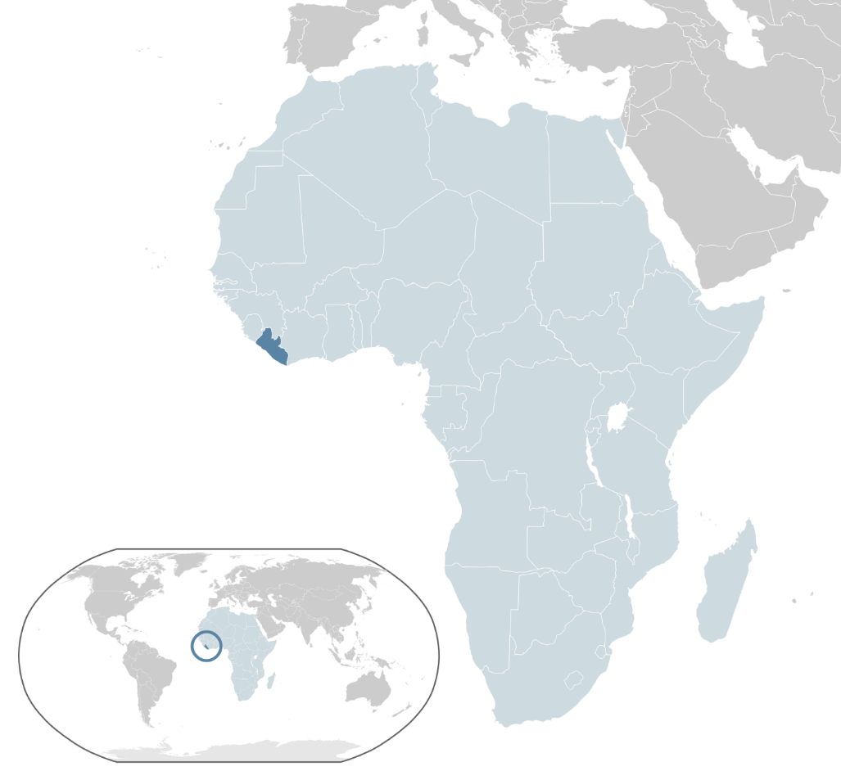
In Liberia, the partner of an Ebola survivor became sick.
Did the partner contract Ebola through sexual transmission? Or through some other means?
How can we tell?
These questions can be answered by sequencing.

Slide 5
To answer these questions, we can:
Isolate virus from the survivor and their partner.
Sequence the virus to discover the complete, accurate genome of each sample.
Compare these sequences to each other and to other virus samples from this outbreak.
Is the partner sample more similar to the survivor sequence? Or to the other samples from this outbreak?

Slide 6
We can answer these questions by following this outline:
Isolate RNA samples from subjects
Amplify virus-specific sequences.
Sequence on the Illumina Miseq instrument
Assemble the viral genome.
Compare sample genomes to other, known genomes.
What can we conclude about sexual transmission of Ebola?

Slide 7
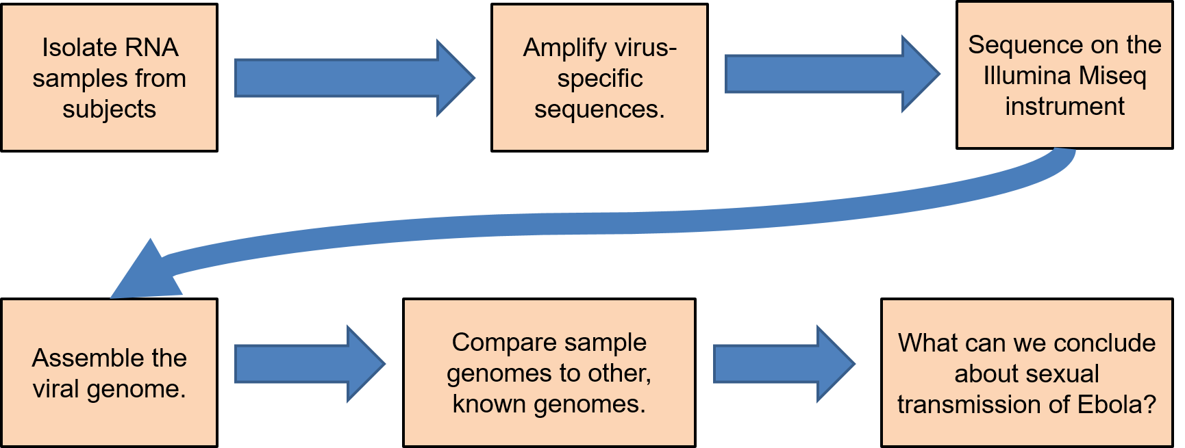
This module focuses on the final three steps: analyzing the raw sequencing data.
But it is important to first understand how the raw data is generated.

Slide 8
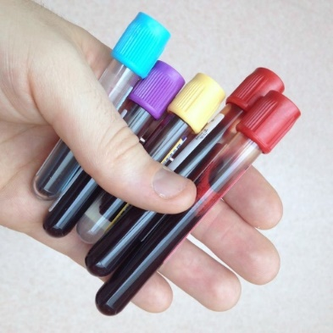
Isolate RNA samples from subjects
Blood cells
Ebola virus
*
*
Collect samples
*
Extract RNA, convert to DNA. It will be fragmented, and mostly from the host.
The samples contain mostly host cells.

Slide 9

Amplify virus-specific sequences.
Since most of the DNA will be from the host, we need to increase the proportion of viral DNA.
Find a previously sequenced Ebola genome (a “reference” sequence).
Make primers-short fragments of DNA-that match the reference genome.
The primers bind to the similar Ebola virus sequence found in our sample.
Primer-bound DNA is amplified, producing lots of viral DNA fragments.

Slide 10
Sequence on the Illumina Miseq instrument
Illumina adapter
Original viral sequence
Add adapters to both ends of the DNA fragment to be sequenced.
These are DNA sequences necessary for sequencing on the Illumina Miseq.
The pool of DNA to be sequenced is known as a “library.”
primer
Illumina adapter

Slide 11
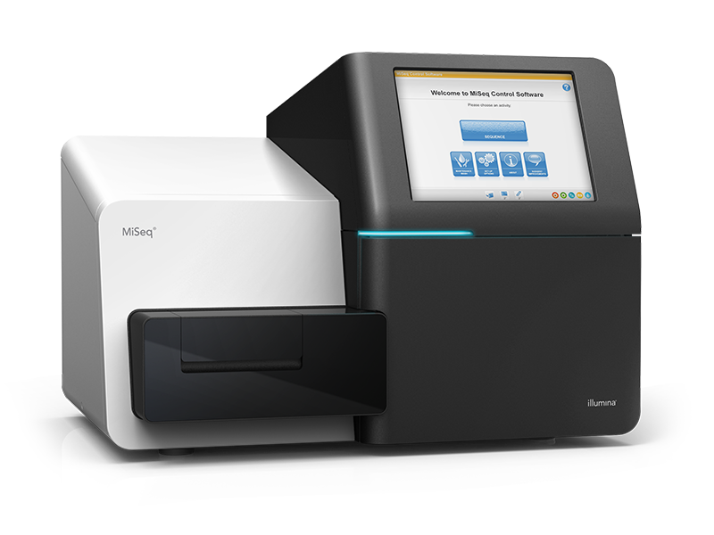
Sequence on the Illumina Miseq instrument
Illumina adapter
Original viral sequence
Read 1
Read 2
primer
Illumina adapter
Each piece of DNA is sequenced twice, starting from either end (Paired end sequencing). The products of a sequencing run are called “reads.” The sequence and quality information are stored in .fastq files.
Raw data, in .fastq format.
Library-DNA fragments ready to be sequenced
Illumina MiSeq

Slide 12
Now we can assemble the raw data produced by the Miseq.

Slide 13
Assembly: Broad Overview of the Computational Steps
Remove adapters and poor quality sequence.
Raw data, in .fastq format.
…CACGTTGGC…
…CACGTTG
TTGGC..
Map reads to a reference genome
Preliminary Assembled Genome.
Raw data consists of sequences containing fragments of the Ebola genome. Ultimately, we need to take these fragments and assemble them into the complete genome.

Slide 14

Prepare for assembly: Open a virtual machine, which contains all of the data and programs you need to complete the module.
Click on the Oracle VM VirtualBox icon

Slide 15
Open the Jupyter notebook.
Run through each step of the Jupyter notebook, examining any slides embedded in the step.
Steps that advance the pipeline will be accompanied by an explanation slide, which is detailed next.

Slide 16
Assembly pipeline: How we get from raw data to the final assembled genome.
Raw data
Corrected
Data
Reference Guided Assembly
Preliminary Assembled Genome
Polish errors
Read QC
Pass
Read trimming/
quality filtering
Try different parameters
Draft QC
Pass
Final Assembled Genome
Fail
Fail
Stop

Slide 17
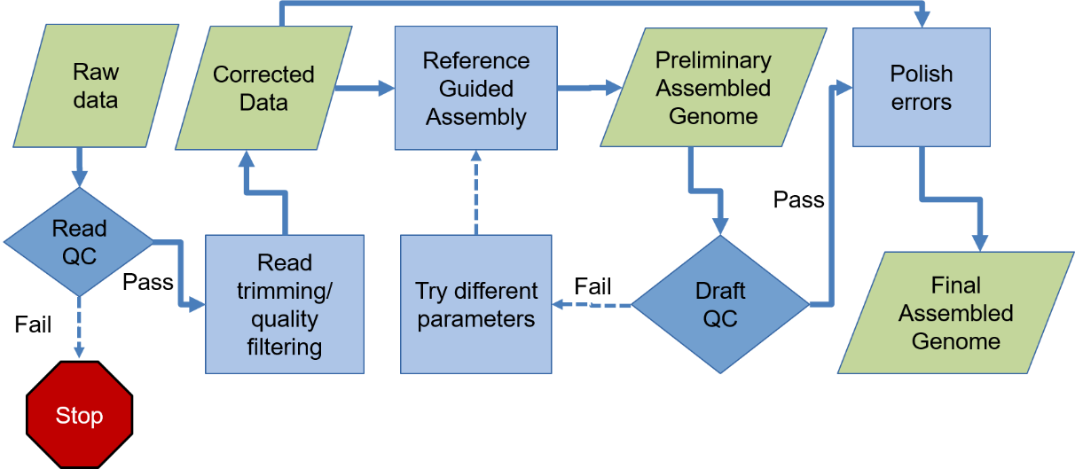
Location in the overall pipeline
Start with raw sequencing data, in fastq format and zipped.
Remember, there are two reads for each DNA fragment. The first read of each fragment is stored in one file, and the second read of each fragment is stored in another.
Run Fastqc, a program that summarizes the quality of reads. Also outputs a number of useful metrics.
Plain English description of the steps in the pipeline.
Read1.fastq.gz
Read2.fastq.gz
Fastqc
Click on one of the .html files to view the reports
Inputs and outputs for the current step of the pipeline.

Slide 18
Fastqc
Start with raw sequencing data, in fastq format and zipped.
Remember, there are two reads for each DNA fragment. The first read of each fragment is stored in one file, and the second read of each fragment is stored in another.
Run Fastqc, a program that summarizes the quality of reads. Also outputs a number of useful metrics.
Read1.fastq.gz
Read2.fastq.gz
Fastqc
Click on one of the .html files to view the reports

Slide 19
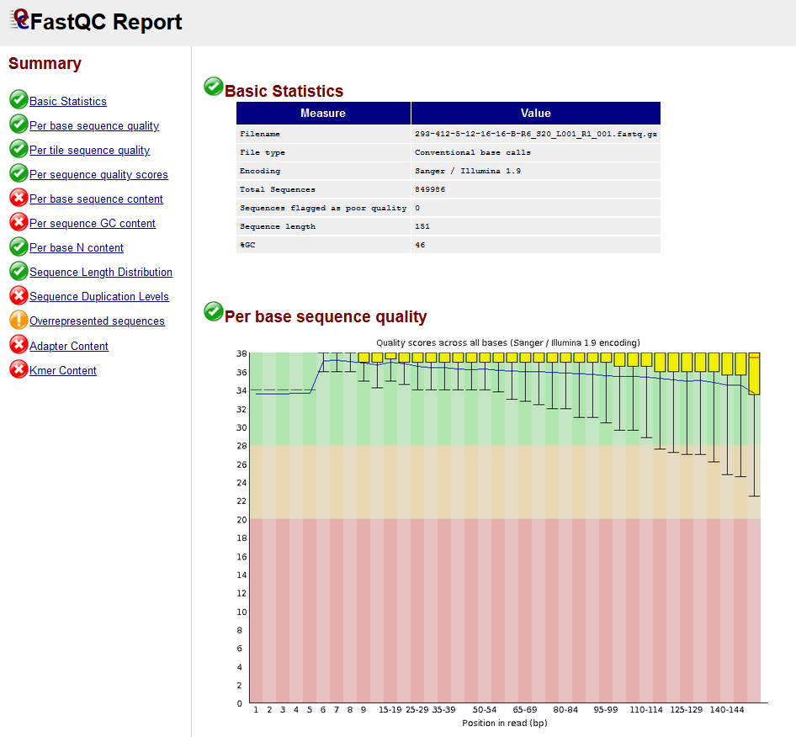
Fastqc Report
FASTQC Report
Preliminary information, number of sequences in file, average sequence length, etc.
Across all sequences, at each base position, what is the average quality score?
Quality>30 is good for most purposes.
The quality scores are high at each position of the read. We can proceed with the analysis.
Links to other reports

Slide 20
Illumina adapter
Original viral sequence
Add adapters to both ends of the DNA fragment to be sequenced.
These are DNA sequences necessary for sequencing on the Illumina Miseq.
The pool of DNA to be sequenced is known as a “library.”
primer
Illumina adapter
Remember that sequences were added during sample and library preparations that are not part of the original viral sequence.
We need to remove those sequences now.

Slide 21
Read trimming/quality filtering
Read trimming/quality filtering: Trimmomatic
Primer
X
Raw reads
X
X
X
Output high quality reads that only contain viral sequence.
?
?
X
X
Adapter
Low-quality sequence
Find and remove adapters, primers and any low quality sequence

Slide 22
Read Trimming and Quality Control
Take raw reads and a list of sequences added during library prep.
Remove those sequences, and any sequence of low quality
Read1.fastq.gz
Read2.fastq.gz
Read1_
trimmed.fastq.gz
Read2_
trimmed.fastq.gz
Trimmomatic
adapters_primers.fasta

Slide 23
We can now align the viral reads to a known reference sequence.
Sequence of the reference strain (already known).
Quality Viral Reads, from the previous step.
Use the “bwa” program to map the viral reads to the known reference assembly.

Slide 24
Reference Guided Assembly, pt. 1
Start with quality reads and a reference genome.
The reference genome is the known sequence from the same species.
Reads are mapped to the reference genome, creating a preliminary alignment
Read1_
trimmed.fastq.gz
Read2_
trimmed.fastq.gz
bwa mem
Preliminary Alignment
Reference genome

Slide 25
Reference Guided Assembly, pt. 2
Starting with the preliminary alignment, run the velveth and velvetg programs.
These programs compare the aligned reads to the reference genome and output a preliminary assembled genome.
This preliminary assembly is now our best guess of the genome sequence of the virus isolated from our sample.
Preliminary Alignment
velvet
Preliminary Assembled Genome

Slide 26
Quality Control of the Preliminary Assembled Genome
Quast compares the preliminary assembly to a known genome from the same species.
Also, identifies functional sequences, like genes and RNAs.
Reference genome
Preliminary Assembled
Genome
Quast
Click on the .html file to open up the quast output.
List of genes, and other features

Slide 27
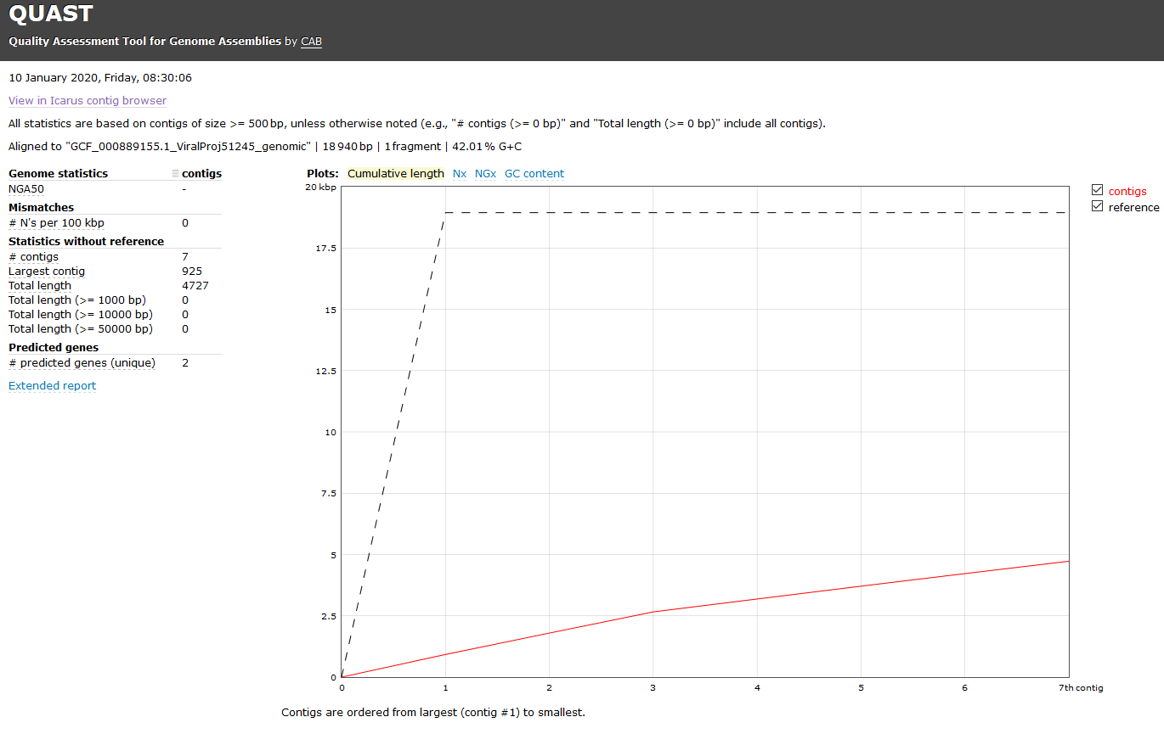
Assessing genome quality with QUAST. FIX
Compare the length of the reference to the cumulative length of the contigs.
Could the preliminary assembly contain a complete genome?
Basic information about the assembly

Slide 28
We now have a preliminary assembly
Preliminary Assembly

Slide 29
Improve the quality of the assembly: Polishing
Preliminary Assembly
Reads
We can map the quality filtered reads to this preliminary assembly.
This is similar to the initial read mapping to the reference genome done previously.

Slide 30
Improve the quality of the assembly: Polishing
Preliminary Assembly
A
G
T
A
T
A
Variants
T
A
T
A
A
A
T
T
Reads
T
T
The read sequences may disagree with the assembly sequence at certain positions. The divergent sequences are known as “variants.”
Identifying these differences will enable us to correct small-scale errors, yielding a more accurate final assembly.

Slide 31
Improve the quality of the assembly: Polishing
Preliminary Assembly
A
G
T
A
T
A
T
A
T
A
A
A
T
T
Final Assembly
Reads
T
T
Consensus
T
A
A final assembly is generated with the consensus sequences, which are generally the most common sequence at the position.

Slide 32
Polishing the Genome
“Polish” out errors in the assembly by mapping the reads back to the assembly.
Identify positions where the read sequences differ from the draft genome.
Correct the draft sequence at those positions, producing a higher quality final assembled genome.
Read1_
trimmed.fastq.gz
Read2_
trimmed.fastq.gz
Final Assembled Genome
Run polishing pipeline
Preliminary Assembled Genome

Slide 33
Multiple Genome Alignment
Take the final assembled genome, along with a diversity of other Ebola genomes.
Align the genomes to each other, allowing us to quantify how different the genomes from each patient are from each other, and from other Ebola sequences.
Final Assembled Genome
Alignment file
mafft
Other Ebola Genomes (from Mate et. al., and other sources)

Slide 34
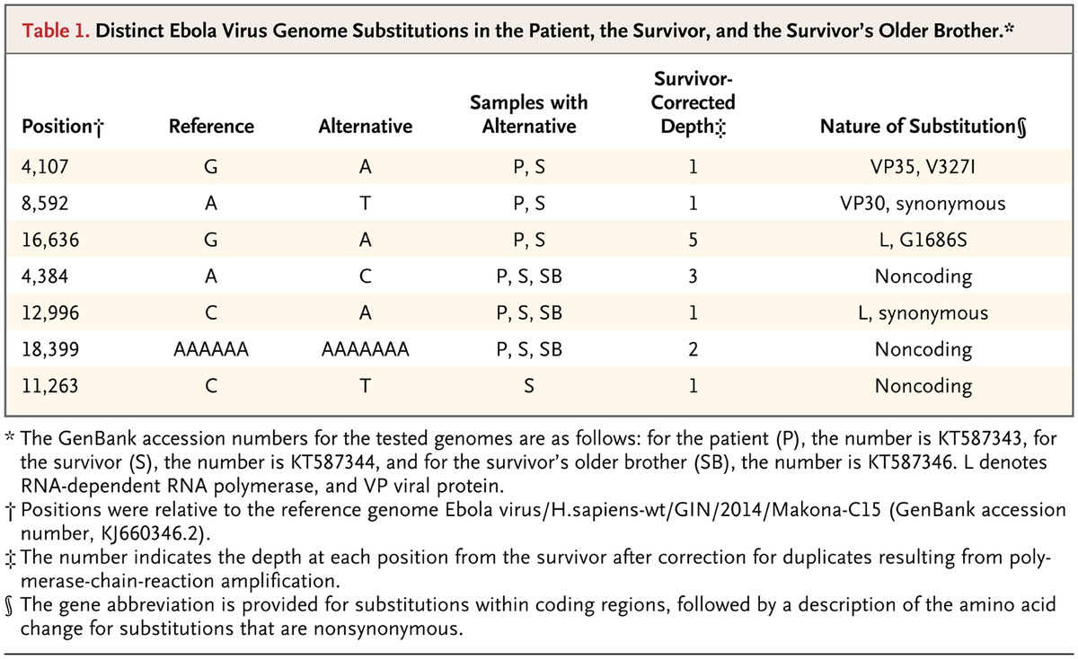
Summary of the alignment.
List the differences between the Mate et al. samples and a reference genome in a chart.
There are three positions where the Survivor and Survivor’s Partner differ from the reference, but not from each other (lines 1-3).
There are three positions where the Survivor, Survivor’s partner and Survivor’s brother differ from the reference (lines 4-6).
There is one position where only the Survivor differs from the reference (line 7).

Slide 35
Show Alignment File

Slide 36
Haplotype Network Analysis
Start with the alignment file made in the previous step.
Arrange the genomes in a haplotype network: where each genome is connected by a line to the genomes it is most similar to.
This allows us to visually depict the differences between several genomes.
Alignment file
Run haplonetwork_analysis.Rscript
Haplotype Network

Slide 37
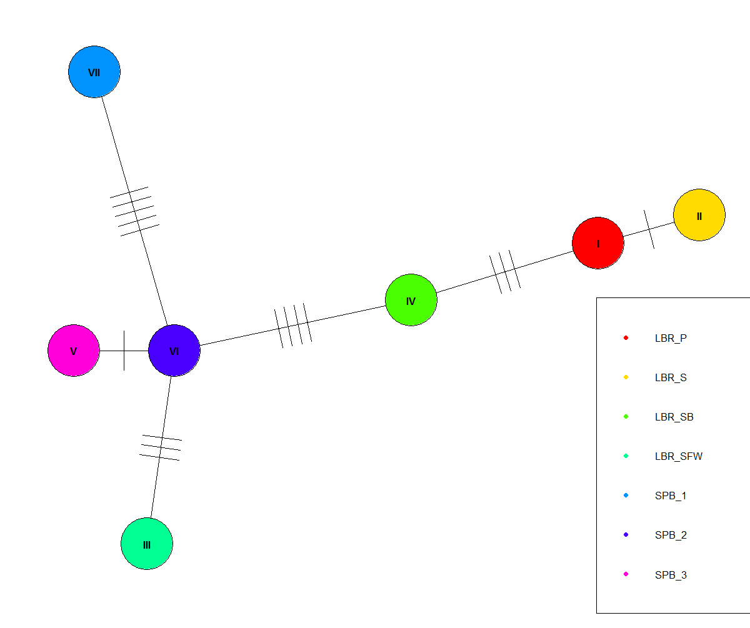
Compare the genomes in the study and other Ebola genomes using a haplotype network
Survivor
Survivor’s partner
A haplotype is a region of DNA inherited from the parent.
NOTE: for viruses, the haplotype is the full genome.
Each circle (node) represents a genome sequence.
Hash marks on the lines show the number of differences between the genomes connected by the lines.
Remember our original question: Is the partner sample more similar to the survivor sequence? Or to the other samples from this outbreak?
Other Ebola genomes from the outbreak.
Survivor’s brother

Slide 38
Compare the genomes in the study and other Ebola genomes using a haplotype network
Survivor
Survivor’s partner
The Survivor and Survivor’s Partner have one difference between them.
There are at least three differences between the Survivor’s Partner and the next most similar genome.
Other Ebola genomes from the outbreak.
Survivor’s brother

Slide 39
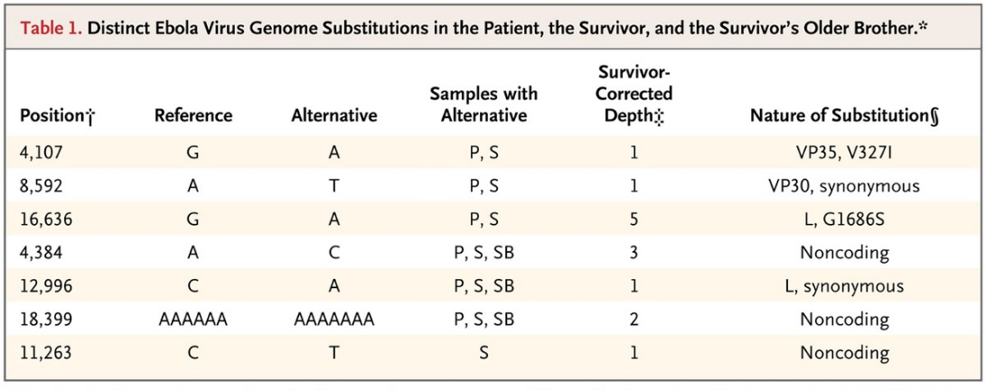
What can we conclude about sexual transmission of Ebola?
Survivor
Survivor’s partner
We see a similar pattern from the chart we previously produced.
There is one position unique to the Survivor.
There are three positions shared by the Survivor and Survivor’s partner, but different in the Survivor’s brother.
This data is consistent with sexual transmission from the Survivor to the Survivor’s Partner.
Other Ebola genomes from the outbreak.
Survivor’s brother

Slide 40
Assembly through the command line.
The following details how to run the analysis through the command line.
The underlying analysis is the same, but we go into greater detail, breaking down each command that ran behind the scenes in the previous tutorial.

Slide 41
The Shell
A Shell is a program that provides a text only user interface for interacting with the computer.
The shell consists of a command prompt, showing the user name and location, and the command line, where commands are entered.
Command Prompt
Command Line
[user_name@computer_name folder_name]$ _

Slide 42
The Command Prompt
The command prompt shows basic information.
Name of logged in user.
Name of computer or server where the user is logged in.
[user_name@computer_name folder_name]$_
Current location in the computer’s file structure.

Slide 43
The Command Line
Run programs and navigate files by typing commands into the command line, next to the command prompt.
Program
[user_name@computer_name folder_name]$ fastqc --help
Option

Slide 44
--help
Note that for most programs that run on the command line, the manual can be accessed by typing the name of the program, followed by a space and “-h” or “--help” as in the example below.
Program
[user_name@computer_name folder_name]$ fastqc --help
Option

Slide 45
Command line caveats
Commands are case sensitive. Enter commands exactly as written!
Spacing and ordering of arguments are important, and can change the output of the command, so enter the commands exactly as written!
Pressing enter runs the command as it appears in the command line. There is no warning or confirmation!
Shells are text only interfaces. You cannot click on a space in the command line with the mouse. Use the arrow keys to navigate.

Slide 46
Benefits of using the command line.
Finer control of program parameters.
Can string together multiple programs into analysis pipelines.
Record of exactly what commands and parameters have been run.
Increased portability and reproducibility.

Slide 47
The files necessary to complete this step
Plain English summary of what the command does
file1
file2
Start with file1 and file2.
Run command_name
End up with file3.
Breakdown of commands.
Name of files to process
Save output to this file.
Option
What to enter on the command line
command_name --option file1 file2 > file3
Files and reports generated, and the next steps in the analysis.
file3
Next

Slide 48
Read1.fastq.gz
Read2.fastq.gz
Start with raw sequencing data, in fastq format and zipped.
Remember, there are two reads for each DNA fragment. The first read of each fragment is stored in one file, and the second read of each fragment is stored in another.
Run Fastqc, a program that summarizes the quality of reads. Also outputs a number of useful metrics.
Where to save output
Name of files to process
fastqc -o output_folder Read1.fastq.gz Read2.fastq.gz
Fastqc Report, in the output folder
Read Quality check

Slide 49
Warning! The next command is lengthy and contains many options.
It is written on several lines for ease of viewing.
Read1.fastq.gz
Read2.fastq.gz
adapters_primers.fasta
Take raw reads and list of sequences added during library prep.
Remove those sequences, and any sequence of low quality
java program to run
Paired-end mode
Save log file.
Raw read files
Indicates the line below is a continuation of this line, and not a new command.
java –jar trimmomatic-0.33.jar PE–trimlog trim.log Read1.fastq.gz Read2.fastq.gz \
trimmedR1_paired.fastq trimmedR1_unpaired.fastq trimmedR2_paired.fastq trimmedR2_unpaired.fastq \
ILLUMINACLIP:adapters_primers.fasta:2:30:10 LEADING:3 TRAILING:3 SLIDINGWINDOW:4:15 MINLEN:30
Remove these sequences from reads
Trim reads based on quality
Output files
trimmedR1_paired.fastq
trimmedR2_paired.fastq
Reference Based Assembly
trimmedR1_unpaired.fastq
trimmedR2_unpaired.fastq
Discard for this analysis

Slide 50
Read1.fastq.gz
Read2.fastq.gz
adapters_primers.fasta
Take raw reads and list of sequences added during library prep.
Remove those sequences, and any sequence of low quality
java program to run
Paired-end mode
Save log file.
Raw read files
Indicates the line below is a continuation of this line, and not a new command.
java –jar trimmomatic-0.33.jar PE–trimlog trim.log Read1.fastq.gz Read2.fastq.gz \
trimmedR1_paired.fastq trimmedR1_unpaired.fastq trimmedR2_paired.fastq trimmedR2_unpaired.fastq \
ILLUMINACLIP:adapters_primers.fasta:2:30:10 LEADING:3 TRAILING:3 SLIDINGWINDOW:4:15 MINLEN:30
Remove these sequences from reads
Trim reads based on quality
Output files
trimmedR1_paired.fastq
trimmedR2_paired.fastq
Reference Based Assembly
trimmedR1_unpaired.fastq
trimmedR2_unpaired.fastq
Discard for this analysis

Slide 51
Note that this command requires outputting 4 files, but we will only use two in the subsequent steps.
Read1.fastq.gz
Read2.fastq.gz
adapters_primers.fasta
Take raw reads and list of sequences added during library prep.
Remove those sequences, and any sequence of low quality
java program to run
Paired-end mode
Save log file.
Raw read files
Indicates the line below is a continuation of this line, and not a new command.
java –jar trimmomatic-0.33.jar PE–trimlog trim.log Read1.fastq.gz Read2.fastq.gz \
trimmedR1_paired.fastq trimmedR1_unpaired.fastq trimmedR2_paired.fastq trimmedR2_unpaired.fastq \
ILLUMINACLIP:adapters_primers.fasta:2:30:10 LEADING:3 TRAILING:3 SLIDINGWINDOW:4:15 MINLEN:30
Remove these sequences from reads
Trim reads based on quality
Output files
trimmedR1_paired.fastq
trimmedR2_paired.fastq
Reference Based Assembly
trimmedR1_unpaired.fastq
trimmedR2_unpaired.fastq
Discard for this analysis

Slide 52
trimmedR1_paired.fastq
trimmedR2_paired.fastq
Reference genome, indexed for use with bwa
Start with quality reads and a reference genome.
Use bwa mem to align the reads to the reference.
Save the output in a .sam file, which links the read to a location in the reference genome where the read aligns.
Mapping algorithm
Name of reference.
Name of files to process
bwa mem ebola_ref trimmedR1_paired.fastq trimmedR2_paired.fastq \
> Prelim_alignment.sam
Save output in a .sam file.
Prelim_alignment.sam
Continue Reference Based Assembly

Slide 53
Prelim_alignment.sam
Sort the alignment file (.sam) by location in the reference genome, and save as a bam.
This makes the data easier to process by downstream programs.
Sort the .sam by reference location.
Save the output in .bam format
The input file
samtools sort -O BAM Prelim_alignment.sam > Prelim_alignment.bam
Save the output in a .bam file.
Prelim_alignment.bam
Continue Reference Based Assembly

Slide 54
Prelim_alignment.bam
Run velveth on the preliminary alignment file.
Makes folder containing intermediate files necessary for reference based assembly.
K-mer setting (ignore for now).
Name of folder containing output files.
Input is in .bam format.
velveth AssemRef 27 -bam -longPaired Prelim_alignment.bam
Paired read setting.
Name of output file.
Continue Reference Based Assembly
Folder containing necessary files for assembly

Slide 55
Folder containing necessary files for assembly
Run the assembly program, velvetg.
Reads the alignment file, in the folder containing intermediate files, and generates the preliminary assembly.
Name of folder containing output files.
Make a file for QC purposes
Save a log file.
velvetg AssemRef -amos_file yes > logfile_assemref_27.txt 2>&1 &
Save any error messages, and run this command in the background.
Preliminary assembly
Assembly Quality Check

Slide 56
Quast compares the preliminary assembly to a known genome from the same species.
Also, identifies functional sequences, like genes and RNAs.
Preliminary Assembled Genome
Reference genome
List of genes, and other features
Preliminary assembly
The reference .fasta file.
quast.py prelim_assembly.fasta –R ebola_ref.fasta \
–G ebola_ref_genes.gff –o output_folder –glimmer
List of genes in the reference.
Output folder containing results
Provide list of gene locations in the preliminary assembly.

Slide 57
Preliminary assembly
“Polish” out errors in the assembly by mapping the reads back to the assembly.
This will take several steps.
Map the quality filtered reads to the preliminary assembly.
The index can then be used by the mapping program, bwa mem, in the next step.
“index” the assembly for use in downstream programs.
The algorithm to use.
The preliminary assembly to index.
bwa index -a bwtsw prelim_assembly.fasta
bwa index of the Preliminary Assembled Genome
Continue with the “polish errors” section

Slide 58
Preliminary Assembled Genome
trimmedR1_paired.fastq
trimmedR2_paired.fastq
Map the quality filtered reads to the preliminary assembly.
Save output as an alignment (.sam) file. This indicates where, and how well, the reads map to the assembly.
Specify mapping algorithm.
Trimmed, quality filtered reads
Preliminary assembly
bwa mem prelim_assembly.fasta trimmedR1_paired.fastq \ trimmedR2_paired.fastq > alignment.sam
Trimmed, quality filtered reads, cont.
Save the output as a .sam file.
alignment.sam
Continue with the “polish errors” section

Slide 59
Use Samtools to sort and convert alignment.sam to a sorted .bam file. This file is smaller and will be processed more quickly in future programs
alignment.sam
Run the Samtools sort tool.
Save the output as a sorted bam file.
Name of tool to run
Alignment file
samtools view –bS alignment.sam | samtools sort - > alignment_sorted.bam
“-” means use the output (.bam) file from the previous command as an argument here.
Read in a .sam file, and output a .bam file (compressed sam file).
“|” indicates to use the output of the previous command as the input to the following command.
Alignment_sorted.bam
Continue with the “polish errors” section

Slide 60
Preliminary Assembled Genome
Make an index of the preliminary assembled genome.
This is necessary to use the assembly in the next step.
Make a samtools compatible index.
Preliminary assembled genome
samtools faidx prelim_assembly.fasta
Preliminary Assembled Genome Index
Continue with the “polish errors” section

Slide 61
Samtools mpileup estimates the probability that each base in the preliminary assembly is correct, given the reads that map to it.
bcftools call determines if the reads provide support for a different base at any given position in the assembly, based on these probabilities.
The output is a list of positions in the preliminary assembly that should be changed, in the “variant call format (.vcf).”
Preliminary Assembly, indexed
trimmedR1_paired.fastq
trimmedR2_paired.fastq
Output uncompressed, bcf format
Tool for genotype estimation, based on alignment.
Output only positions that differ, in a compressed format.
The input reference file
The alignment file
samtools mpileup -u -g -f prelim_assembly.fasta alignment_sorted.bam | bcftools call -v -m -O z -o mpileup.vcf.gz > logfile.txt
Save the output as mpileup.vcf.gz, and keep logfile.txt, a record of the steps run by each program.
Identifies bases in assembly not supported by reads.

Slide 62
mpileup.vcf.gz
Make an index of the .vcf file, which will make processing the file easier in the next step.
.vcf file containing the base positions that should be changed in the assembly.
Make a bcftools compatible index.
bcftools index mpileup.vcf.gz
Indexed .vcf file.
Continue with the “polish errors” section

Slide 63
Read in the preliminary assembly.
Use “bcftools consensus” to make a new fasta with the corrected sequences.
alignment.sam
Read in the preliminary assembly
Make a new fasta containing the corrected sequences
The .vcf file containing list of changes to make.
Save the new assembly
cat prelim_assembly.fasta | bcftools consensus mpileup.vcf.gz > final_assembly.fasta
Assemble the viral genome.
SNP-analysis, phylogenetics

Slide 64
Align the final assembly to the reference genome.
This alignment will be used as input for the phylogenetic analysis.
Final assembly
Reference genome
Read in the preliminary assembly
Run another aligner: mafft
Reference Genome
Save the alignment file.
cat final_assembly.fasta | mafft ebola_ref.fasta > Final_alignment.out
Final_alignment.out
SNP-analysis, phylogenetics

Slide 65
Final alignment
Run the haplonetwork_analysis.Rscript file, which contains instructions for running the haplotype network analysis in the R environment.
Final assembly
A script (code) that runs the phylogenetic analysis.
The final alignment file.
Rscript haplonetwork_analysis.Rscript Final_alignment.out
SNP-analysis, phylogenetics
What can we conclude about sexual transmission of Ebola?

Slide 66
De Novo Assembly
Remove adapters and poor quality sequence.
Raw data, in .fastq format.
Build contigs
Overlap reads
Build assembly, a preliminary approximation of the viral genome.
Raw data consists of sequences containing fragments of the Ebola genome. Ultimately, we need to take these fragments and assemble them into the complete genome.

Slide 67
File types
.gz | Appended to files that are compressed
.fasta | Simple format for storing sequence information.
.fastq | Stores sequence and quality information
.gff | General Feature Format: a list of genes and other genomic features, and their location in a particular genome.
.sam | Sequence Alignment/Map format. Links sequences (as from reads) to a position in a reference genome.
.bam | The compressed version of a .sam file.
.vcf | Variant Call Format; stores information about variation between sequences, as between reads and a reference genome.

