Slide 1
Genomics Training Module

Slide 2
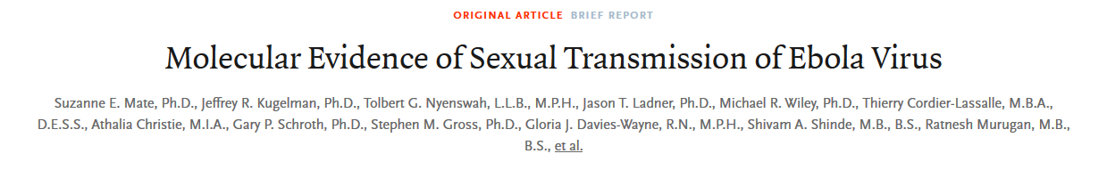

In Liberia, the partner of an Ebola survivor became sick.
Did the partner contract Ebola through sexual transmission? Or through some other means?
How can we tell?
These questions can be answered by sequencing.

Slide 3
Isolate virus from the survivor and their partner.
Sequence the virus to discover the complete, accurate genome of each sample.
Compare these sequences to each other and to other virus samples from this outbreak.
Is the partner sample more similar to the survivor sequence? Or to the other samples from this outbreak?

Slide 4
Study overview
Isolate RNA samples from subjects
Amplify virus-specific sequences.
Sequence on the Illumina Miseq
Assemble the viral genome.
SNP-analysis, phylogenetics
What can we conclude about sexual transmission of Ebola?

Slide 5
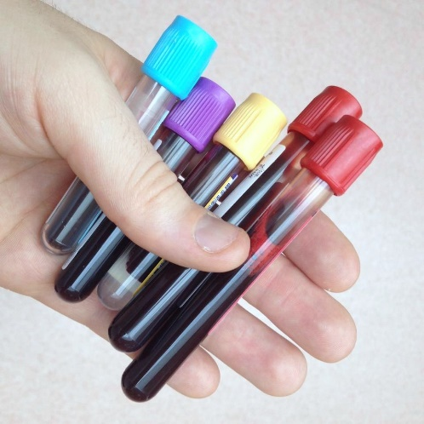

Sequencing Library Prep
Make primers that span known filoviruses (including Ebola)
Extract RNA, convert to DNA.
Most will be from the host.
Amplify viral DNA, using primers specific to the CHIKV genome.
Collect blood sample

Slide 6
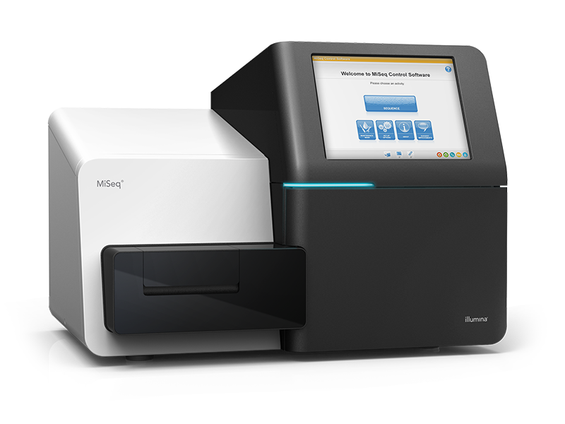
Library Preparation
Illumina adapter and barcode (p5)
Original sequence
CHIKV primer
Illumina adapter and barcode (p7)
Each piece of DNA is sequenced, starting from either end (Paired end sequencing). The products of a sequencing run are called “reads.”

Slide 7
Assembly overview
Fastq files: store sequence and quality in 4 lines
Name of sequence
Indicates beginning of sequence record
Separates sequence from quality
@SEQ1_NAME
ACCCTTGGAGTCATC
+
!359><<%%+=>>21
For paired end sequencing, the insert (original sequence from the sample), is sequenced twice, starting from either end.
This results in two files for each sample called: read1 and read2.
These are in .fastq format.
Compressed with GNU zip to save space (.gz).
Quality score for each base
Bases detected

Slide 8
File types
.gz | Appended to files that are compressed
.fasta | Simple format for storing sequence information.
.fastq | Stores sequence and quality information

Slide 9
The Shell
A Shell is a program that provides a text only user interface for interacting with the computer.
The shell consists of a command prompt, showing the user name and location, and the command line, where commands are entered.
Command Prompt
Command Line
[user_name@computer_name folder_name]$ _

Slide 10
The Command Line
The command prompt shows basic information.
Name of logged in user.
Name of computer or server where the user is logged in.
[user_name@computer_name folder_name]$_
Current location in the computer’s file structure.

Slide 11
The Command Line
Run programs and navigate files by typing commands into the command line, next to the command prompt.
Program
[user_name@computer_name folder_name]$ fastqc --help
Option

Slide 12
Command line caveats
Commands are case sensitive. Enter commands exactly as written!
Spacing and ordering of arguments are important, and can change the output of the command, so enter the commands exactly as written!
Pressing enter runs the command as it’s written. There is no warning/confirmation!
Shells are text only interfaces. You cannot click on a space in the command with the mouse. Use the arrow keys to navigate.

Slide 13
Benefits of using the command line.
Finer control of program parameters.
Can string together multiple programs into analysis pipelines.
Record of exactly what commands have been run.

Slide 14
Assembly overview
Assemble the viral genome based on sequences
Raw data
Corrected Data
De novo assembly
Preliminary Assembled Genome
Polish errors
Read Quality Check
Assembly Quality Check
Read trimming
Try different parameters
Pass
Fail
Pass
Final Assembled Genome
Fail
Stop

Slide 15
The files necessary to complete this step
Plain English summary of what the command does
file1
file2
Input:
Start with file1 and file2.
Run command_name
End up with file3.
Breakdown of commands.
Option
Name of files to process
Save output to this file.
Command Line:
command_name --option file1 file2 > file3
What to enter on the command line
Files and reports generated, and the next steps in the analysis.
file3
Next
Output:

Slide 16
Read1.fastq.gz
Read2.fastq.gz
Raw data from the sequencing machine, in fastq format and zipped.
Input:
Where to save output
Name of files to process
Start with raw sequencing data, in fastq format and zipped.
Run Fastqc, a program that summarizes the quality of reads. Also outputs a number of useful metrics.
Command Line:
fastqc -o output folder Read1.fastq.gz Read2.fastq.gz
Fastqc Report
Read Quality check
Generates an html report.
Are the reads of sufficient quality to proceed?
Output:

Slide 17
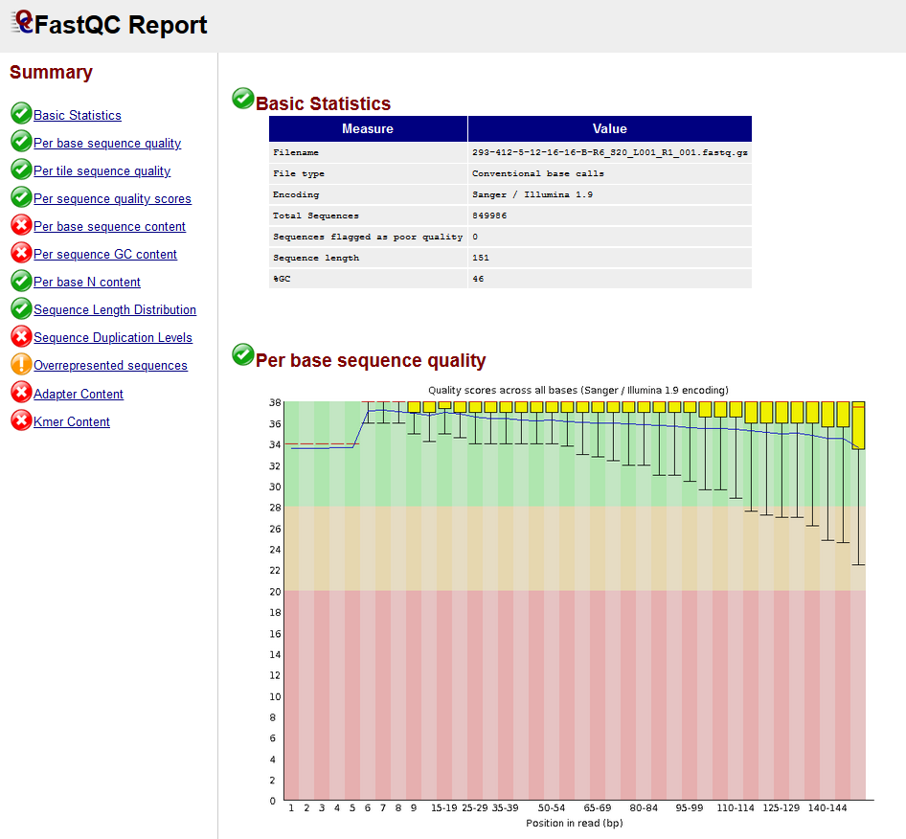
Fastqc Report
FASTQC Report
Preliminary information, number of sequences in file, average sequence length, etc.
Across all sequences, at each base position, what is the average quality score?
Quality>30 is good for most purposes.
Links to other reports

Slide 18
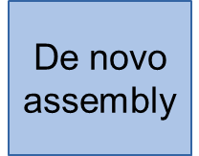
Read1.fastq.gz
Read2.fastq.gz
adapters_primers.fasta
Take raw reads and list of sequences added during library prep.
Remove sequences
Input:
java program to run
Paired-end mode
Indicates the line below is a continuation of this line, and not a new command.
Save log file.
Raw read files
java –jar trimmomatic-0.33.jar PE -threads 10 –trimlog trim.log Read1.fastq.gz Read2.fastq.gz \
trimmedR1_paired.fastq trimmedR1_unpaired.fastq trimmedR2_paired.fastq trimmedR2_unpaired.fastq \
ILLUMINACLIP:adapters_primers.fasta:2:30:10 LEADING:3 TRAILING:3 SLIDINGWINDOW:4:15 MINLEN:30
Command Line:
Output files
Remove these sequences from reads
Trim reads based on quality
trimmedR1_paired.fastq
trimmedR2_paired.fastq
High quality reads, containing only viral sequence.
Ready for de novo assembly.
Output:

Slide 19
Read1.fastq.gz
Read2.fastq.gz
adapters_primers.fasta
Raw read files. List of sequences added during the library
Input:
java program to run
Paired-end mode
Save log file.
Raw read files
java –jar trimmomatic-0.33.jar PE -threads 10 –trimlog trim.log Read1.fastq.gz Read2.fastq.gz \
trimmedR1_paired.fastq trimmedR1_unpaired.fastq trimmedR2_paired.fastq trimmedR2_unpaired.fastq \
ILLUMINACLIP:adapters_primers.fasta:2:30:10 LEADING:3 TRAILING:3 SLIDINGWINDOW:4:15 MINLEN:30
Command Line:
Output files
Remove these sequences from reads
Trim reads based on quality
trimmedR1_paired.fastq
trimmedR2_paired.fastq
High quality reads, containing only viral sequence.
Ready for de novo assembly.
Output:

Slide 20
Read1.fastq.gz
Read2.fastq.gz
adapters_primers.fasta
Raw read files. List of sequences added during the library
Input:
java program to run
Paired-end mode
Save log file.
Raw read files
java –jar trimmomatic-0.33.jar PE -threads 10 –trimlog trim.log Read1.fastq.gz Read2.fastq.gz \
trimmedR1_paired.fastq trimmedR1_unpaired.fastq trimmedR2_paired.fastq trimmedR2_unpaired.fastq \
ILLUMINACLIP:adapters_primers.fasta:2:30:10 LEADING:3 TRAILING:3 SLIDINGWINDOW:4:15 MINLEN:30
Command Line:
Output files
Remove these sequences from reads
Trim reads based on quality
trimmedR1_paired.fastq
trimmedR2_paired.fastq
High quality reads, containing only viral sequence.
Ready for de novo assembly.
Output:
trimmedR1_unpaired.fastq
trimmedR2_unpaired.fastq
Discard for this analysis

Slide 21
trimmedR1_paired.fastq
trimmedR2_paired.fastq
Inputs: High quality, trimmed and paired reads.
Input:
“Kmer” setting (ignore, for now)
Folder to save output files
Using short, paired reads.
Read 1 and Read 2 are in separate files
Input files
Command Line:
velveth Assem 31 -shortPaired2 -fastq -separate trimmedR1_paired.fastq trimmedR2_paired.fastq
Input is in fastq format
Folder with preliminary assembly files.
Outputs: Folder with intermediate files for de novo assembly.
Now ready for de novo assembly.
Output:

Slide 22
Inputs: Folder with intermediate files for de novo assembly.
Input:
Folder with preliminary assembly files.
Save QC output
Use paired end read info to join together contigs
Folder with preliminary files. Also contains the output assembly.
velvetg -amos_file yes -scaffolding yes -alignments yes Assem/
Command Line:
Make alignments to reference
Assembly Quality Check
Outputs: The preliminary assembly.
Is the assembly complete?
Preliminary Assembled Genome
Output:

Slide 23

Quast compares the de novo assembly to a known sequence from the same species.
Also, identifies functional sequences, like genes and RNAs.
Input:
Preliminary Assembled Genome
Reference genome
List of gene, and other features
Preliminary assembly
The reference genome
List of genes in the reference.
Where to save the reports
quast.py [prelim_assembly.fasta] –R [Reference.fasta] –G [Reference_genes.gff] –o [output_folder] –glimmer
Command Line:
Annotate the reference genes that appear in the assembly.
Assembly Quality Check
Genome quality reports
Output:
Outputs: The preliminary assembly.
Is the assembly complete?

Slide 24
Assessing genome quality.

Slide 25
Start with the preliminary assembled genome, in .fasta
Input:
Preliminary Assembled Genome
Use the index tool of the bwa program
The algorithm to use
Make an index from this file.
Make an index, which is a file more easily input into downstream programs.
Command Line:
bwa index -a bwtsw prelim_assembly.fasta
file3
Next
Outputs: files and reports generated, and the next steps in the analysis.
Output:

Slide 26
Preliminary de novo assembly.
[host_removed_R1.fastq]
[host_removed_R2.fastq]
“Polish” de novo assembly. Map reads to the de novo assembled contigs.
Use the reads to correct any errors in the de novo assembly.
Input:
bwa index -a bwtsw [prelim_assembly.fasta]
bwa mem -t 30 [prelim_assembly.fasta] [host_removed_R1.fastq]
[host_removed_R2.fastq] > [alignment.sam]
-Make an index of the de novo assembly
-align reads to the de novo assembly. Save output as .sam.
Process:
Where reads map to the de novo assembly
[alignment.sam]
Convert the .sam to .bam and sort.
Output:

Slide 27
Where reads map to the de novo assembly
[alignment.sam]
“Polish” de novo assembly. Map reads to the de novo assembled contigs.
Use the reads to correct any errors in the de novo assembly.
Input:
samtools view –bS [alignment.sam] > [alignment.bam]
samtools sort -O [alignment.bam] > [alignment_sorted.bam]
samtools faidx [prelim_assembly.fasta]
-Convert to .sam to .bam
-Sort the .bam file.
-Index the de novo assembly for use with samtools
Process:
[alignment_sorted.bam]
Index files for [prelim_assembly.fasta]
Now ready to identify where the read sequence varies from the de novo assembly.
Output:

Slide 28
[alignment_sorted.bam]
[prelim_assembly.fasta]
“Polish” de novo assembly. Map reads to the de novo assembled contigs.
Use the reads to correct any errors in the de novo assembly.
Input:
samtools mpileup -u -g -f [prelim_assembly.fasta] \
[alignment_sorted.bam] | bcftools call -v -m -O z -o [mpileup.vcf.gz] \
> [logfile.txt] 2>&1 &
-mpileup lines up reads from [alignment_sorted.bam] with [prelim_assembly.fasta].
-call identifies where there is a disagreement between the read sequences and the assembly. Output as .vcf.
Process:
[mpileup.vcf.gz]
Now we can make a new [assembly.fasta]
Output:

Slide 29
[mpileup.vcf.gz]
[prelim_assembly.fasta]
“Polish” de novo assembly. Map reads to the de novo assembled contigs.
Use the reads to correct any errors in the de novo assembly.
Input:
bcftools index [mpileup.vcf.gz]
cat [prelim_assembly.fasta] | bcftools consensus [mpileup.vcf.gz] \
> [final_assembly.fasta]
-make index of the .vcf file
-Make a new fasta that incorporates changes based on the .vcf file.
Process:
[final_assembly.fasta]
We now have a final assembly, our best estimate of what the actual sequence of the original sample.
Output:

