Slide 1

Use of MinION and Illumina Reads for Bacterial Assembly
Global Emerging Infections Surveillance MinION User Group
Subject Matter Expert and POC for this tutorial is Dr. Joshua Richardson joshua.b.richardson2.ctr@mail.mil

Slide 2
Introduction
The purpose of this tutorial is to provide a complete tool and guide for assembling bacterial genomes from MINion Illumina data.
This powerpoint deck will step you through the analysis, from downloading the software to the actual assembly with sample data.

Slide 3
Introduction
MinION data can be extremely useful for finishing the assembly of difficult genomes.
The data set provided in the tutorial illustrates this in Francisella tularensis.
The following slides give background on this data, then steps through how to perform the assembly.

Slide 4
Bacteria can be difficult to assemble, even with long reads: Francisella tularensis
Highly pathogenic, gram-negative bacteria
Despite small, 1.9Mb genome, can be problematic to sequence:
GC: 32%
Slow growing (difficult to get large amounts of DNA)
Numerous mobile elements/insertion sequences.
Strains can have 1-2 35kb pathogenicity islands.

Slide 5
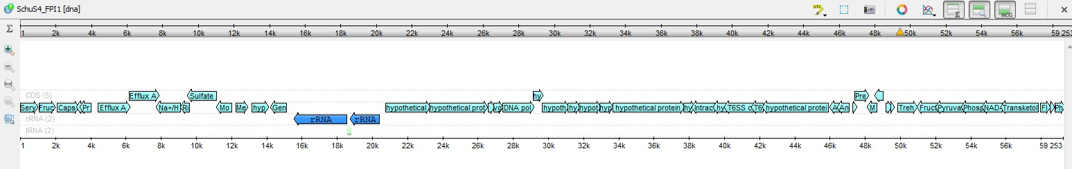
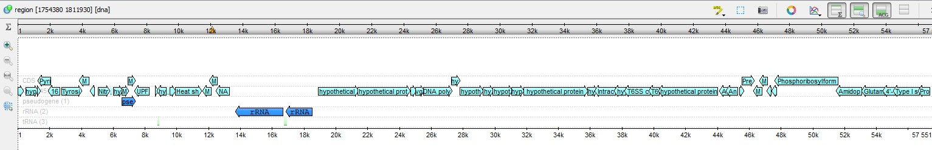
Francisella tularensis reference strain SchuS4 has two ~35kb pathogenicity islands.
Islands are nearly identical.
Difficult to acquire reads that overlap the islands and their junctions.

Slide 6
Case Study: FRAN258
A version of the reference strain SchuS4.
Contains one, 1.9Mb chromosome, no plasmids and two copies of the large pathogenicity islands.
Assembly with PacBio reads fails to completely circularize the genome.

Slide 7
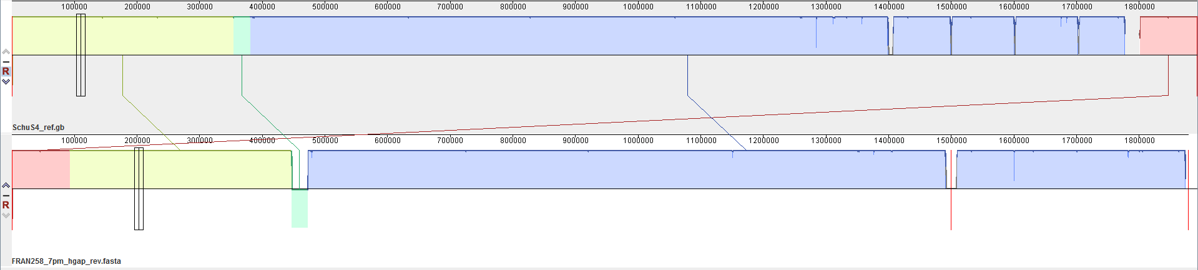
PacBio reads fail to completely assemble the genome
Deleted in assembly
SchuS4 published genome
FRAN258 PB
Contig 1
Contig 2
The colored blocks indicates highly similar sequence.
Used PacBio’s HGAP, min qual=0.7, Aggressive mode=On.
Generates 2 contigs, with ends mapping to the pathogenicity islands.

Slide 8
Example: FRAN258
We sequenced the strain again with Illumina and MinION technology.
Sequence Tech: | Raw Reads: | Longest Read Length: | Qual:
MinION | 222635 | 299455 | (Phred) 23
MinION 10k* | 10000 | 250313 | (Phred) 23
Illumina | 1654192 | 251 | (Phred) 38
*For this tutorial, we are only providing 10000 MinION reads (it will be enough!)

Slide 9
Objectives
Assemble the chromosome of Francisella tularensis FRAN258, a USAMRIID lab strain of SchuS4 into one circular contig.
Mapping reads should produce even coverage across the assembly. No peaks or valleys exceeding 2x the average.
No need for manual correction. Pipeline generates finished sequence automatically.
Should be high enough quality to identify SNPs and small indels between strains, in addition to large structural variants. ~100x read depth with no systemic biases in error rates.

Slide 10
Assembly Outline, General
Polishing, Error Correction
Raw Reads
Filtering Assembly
Check assembly

Slide 11
Assembly outline: MinION + Illumina
Filtlong: Correct MinION reads with Illumina reads.
Hybrid assembly and error correction: Unicycler
Raw MinION Reads
Raw Illumina Reads
Trimmomatic: Correct Illumina Reads
Hybrid assembly and error correction: Spades
Downstream:
Annotate,
compare to other strains: PATRIC
Check assembly statistics: CHECKM, QUAST
Check assembly: Read mapping with Minimap.
Refine draft assemblies: Flye, Pilon (part of Unicycler).

Slide 12

We will be using Docker

Slide 13
Docker
This tutorial requires docker.
Docker requires:
Windows 10
4 Gb ram
Internet connection
For Windows Pro: https://docs.docker.com/docker- for-windows/install/
For Windows Home: https://docs.docker.com/docker-for- windows/install-windows-home/

Slide 14
Docker
Docker is a program that downloads and runs “containers” which can be thought of as self-contained computing environments.
The Docker container for this tutorial contains all the Linux- based assembly tools necessary to assemble bacterial genomes from raw MINion and Illumina reads.
Docker is not hard to install and use, but does require use of terminals, and running programs as administrator.
Once Docker is installed, we will use PowerShell to activate and run the container.

Slide 15
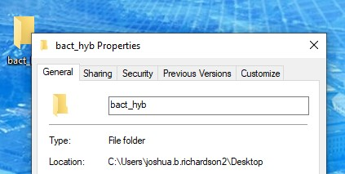
Prepare
Make a working directory.
Note the location.
All of the tutorial files are included in the Docker container. In a real use case, you would put your raw data here.
Notes:
Presenter
2020-12-17 16:18:52
--------------------------------------------
Show docker when you start to run. Also show what happens when you type “ls”

Slide 16
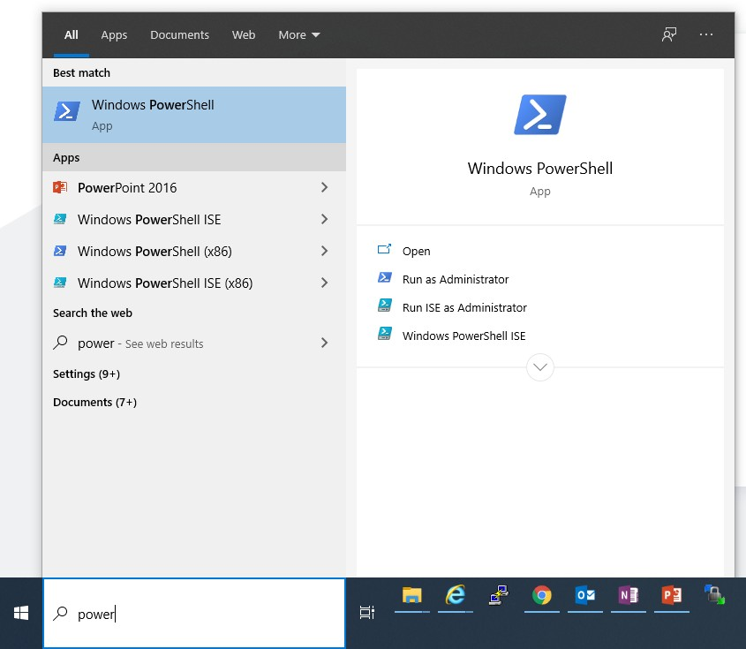
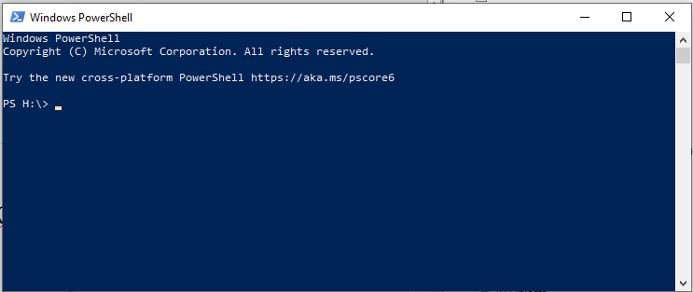
Open Powershell, run as administrator

Slide 17
A note about this tutorial
The following slides contain the commands to process the data. Simply copy and paste the white text in gray boxes into the powershell terminal to complete the tutorial
A breakdown of what each part of the command does, and a description of what to expect from the output is included.
After working through the tutorial, you can use the same commands to analyze your data. They are included in the docker container’s home directory in “Bact_hyb_assembly.sh”

Slide 18
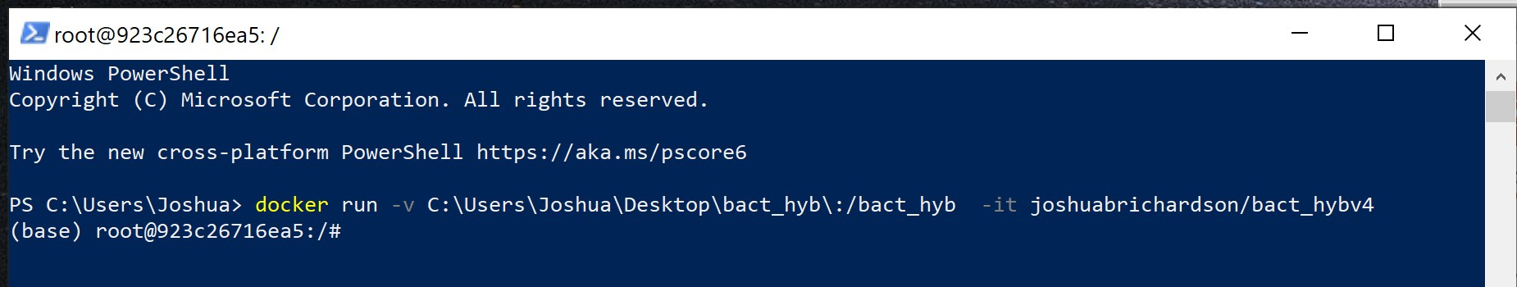
Docker
Command (Copy and paste into powershell):
docker run -v C:\Users\Joshua\Desktop\bact_hyb\:/bact_hyb -it joshuabrichardson/bact_hybv4
Explanation:
> docker run
-v C:\Users\Joshua\Desktop\bact_hyb\
:/bact_hyb
-it joshuabrichardson/bact_hybv4
# Run a docker container.
# This argument matches your folder to the container. # This is where the folder appears in the container.
# Run this container interactively. It will also download # the latest version, if necessary.
Output:
Notes:
Presenter
2020-12-17 16:18:53
--------------------------------------------
Add a screenshot of the docker starting.

Slide 19
Running Docker
You are now running Docker.
This is a command line, virtual environment.
Files are not saved unless written to the directory specified with the “-v” command above. That is the link to the virtual environment.
Files saved to the working folder are saved permanently when Docker is closed. Likewise, moving files in to this folder makes them accessible to the Docker container.
Important: Type the following to copy the latest version of this power point to the working folder.
cp /Minion_assembly_tutorial_latest.pptx /bact_hyb/

Slide 20
Running Docker
Commands:
cp FRAN258_* /bact_hyb/ ILL_R1=FRAN258_R1_raw_ill.fastq.gz ILL_R2=FRAN258_R2_raw_ill.fastq.gz MIN_RAW=FRAN258_min_10k.fastq.gz STRAIN=FRAN258
Explanation:
cp FRAN258_* /bact_hyb/ # Copy files beginning with FRAN258_ to the working folder ILL_R1=FRAN258_R1_raw_ill.fastq.gz # Assign a variable to the raw Illumina read1 file.
ILL_R2=FRAN258_R2_raw_ill.fastq.gz # Assign a variable to the raw Illumina read2 file. MIN_RAW=FRAN258_min_10k.fastq # Assign a variable to the raw MinION reads.
STRAIN=FRAN258 # Assign a variable for your strain (useful for naming files.)
Note: These are preliminary steps make the downstream analysis easier.
Notes:
Presenter
2020-12-17 16:18:53
--------------------------------------------
Add a screenshot of the docker starting.

Slide 21
FastQC
Commands:
cd /bact_hyb mkdir fastqc
fastqc *ill.fastq* --outdir=fastqc --noextract
Explanation:
cd /bact_hyb mkdir fastqc
fastqc *ill.fastq* --outdir=fastqc --noextract
# Change to the working directory.
# Make a directory to hold the fastqc output.
# Run fastqc on files containing “ill.fastq” in the # name.
Check out the output:
Navigate to the “fastqc” folder, in the working directory. Open the .html files.
Notes:
Presenter
2020-12-17 16:18:54
--------------------------------------------
Add a screenshot of the docker starting.

Slide 22
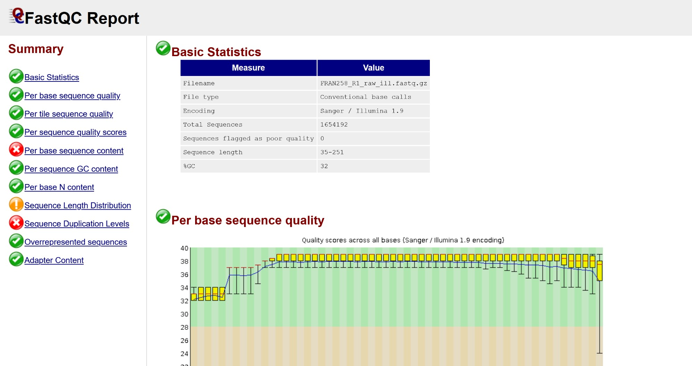
FastQC Output
Gives basic information about the sequence files and their quality.
Note the extreme GC content.

Slide 23
Trimmomatic
Commands:
trimmomatic PE $ILL_R1 $ILL_R2 -baseout trimmo.fastq ILLUMINACLIP:/Ill_adapters.fasta:2:30:10 SLIDINGWINDOW:10:30 MINLEN:50
Explanation:
trimmomatic PE
$ILL_R1
$ILL_R2
-baseout trimmo.fastq ILLUMINACLIP:/Ill_adapters.fasta:2:30:10 SLIDINGWINDOW:10:30
MINLEN:50
# Run Trimmomatic, paired end mode # Read 1 name
# Read 2 name
# The prefix for the output files
# Trim adapters listed in this fasta file
# Sliding window mode: cut if Q<30 in 10bp window # Eliminate any reads less than 50 bp in length.
Output:
# ILLUMINACLIP: Using 0 prefix pairs, 3 forward/reverse sequences, 0 forward only sequences, 0 reverse only sequences
# Quality encoding detected as phred33
# Input Read Pairs: 1654192 Both Surviving: 1294254 (78.24%) Forward Only Surviving: 227947
(13.78%) Reverse Only Surviving: 24487 (1.48%) Dropped: 107504 (6.50%) # TrimmomaticPE: Completed successfully
Notes:
Presenter
2020-12-17 16:18:54
--------------------------------------------
Test the illumina clip part.

Slide 24
Filter long reads: Filtlong
1. Takes high-quality reference sequences, such as, Illumina reads. Hash all 16-mers
AACCTGAGCTTATGAACCTTTTAAATGGCGGATCTCAGTC
AACCTGAGCTTATGAA
ACCTGAGCTTATGAAC
Filters reads based on any minimum length or quality requirements.
Score reads based on presence/absence in 16-mers.
Keep either the best X%, or a target number of bases.

Slide 25
Filtlong
Commands:
filtlong --min_length 2000 -1 trimmo_1P.fastq -2 trimmo_2P.fastq $MIN_RAW --target_bases 200000000 >
${STRAIN}_long_filt.fastq
Explanation:
filtlong
--min_length 2000
-1 trimmo_1P.fastq
-2 trimmo_2P.fastq
$MIN_RAW
--target_bases 200000000
> ${STRAIN}_long_filt.fastq
# Run Filtlong
# Eliminate reads less than 2000 bp in length # Read 1 name
# Read 2 name
# MINion raw reads
# Aim for ~100x coverage
# Save the filtered reads to a new file
Output:
# Filtering long reads
# target: 200000000 bp # keeping 200009183 bp
# Outputting passed long reads
Notes:
Presenter
2020-12-17 16:18:55
--------------------------------------------
Test the illumina clip part.

Slide 26
Unicycler
Complete hybrid assembly pipeline.
Input short and long reads (as accurate as possible).
De novo assemble with Spades; estimate contig copy number from assembly graph.
Use long reads to bridge gaps between contigs.
Only use long reads to determine contig order; sequence comes from Spades assembly.
Merge contigs, circularize (if possible), and shift so that dnaA is the first CDS on the forward strand.
Use Bowtie2 and Pilon to correct fine scale errors, at the single base level.

Slide 27
Unicycler
Commands:
unicycler -1 trimmo_1P.fastq -2 trimmo_2P.fastq -l FRAN258_long_filt.fastq -o Unicycler_hybrid --no_miniasm -- samtools_path /bin/samtools
cp /bact_hyb/Unicycler_hybrid/assembly.fasta /bact_hyb/Unic_hyb.fasta
Explanation:
unicycler
-1 trimmo_1P.fastq
-2 trimmo_2P.fastq
-l FRAN258_long_filt.fastq
-o Unicycler_hybrid
--no_miniasm
--samtools_path /bin/samtools
cp …/assembly.fasta …/Unic_hyb.fasta
# Run unicycler
# Corrected Illumina Read 1 name # Corrected Illumina Read 2 name # Corrected long reads
# The output folder name # Don’t use miniasm tool
# Path where samtools is located.
# Copy the draft assembly to the main working directory
Important Note: The previous steps should have happened fairly quickly (a few minutes per slide, roughly). This step will take several hours. Unicycler is the core tool of this pipeline. It is also very “verbose” in that it provides detailed descriptions of each step. It is worth looking through it, at least once or twice. The key output to watch for is shown on the next slide.
Notes:
Presenter
2020-12-17 16:18:55
--------------------------------------------
Test the illumina clip part.

Slide 28
Unicycler
Commands:
unicycler -1 trimmo_1P.fastq -2 trimmo_2P.fastq -l FRAN258_long_filt.fastq -o Unicycler_hybrid --no_miniasm -- samtools_path /bin/samtools
cp /bact_hyb/Unicycler_hybrid/assembly.fasta /bact_hyb/Unic_hyb.fasta
Unicycler
Key outputs:
After Assembly:
Bridged assembly graph (2020-11-04 17:09:02)--------------------------------------------
The assembly is now mostly finished and no
more structural changes will be made. Ideally the assembly graph should now have one contig per replicon and no erroneous contigs (i.e a complete assembly). If there are more contigs, then the assembly is not complete.
Component Segments Links Length N50 Longest segment Status
Single, circular contig
1 1 1 1,892,774 1,892,774 1,892,774 complete
After circularization and error correction:
Rotating completed replicons (2020-11-04 17:48:32)-------------------------------------------------- Any completed circular contigs (i.e. single contigs which have one link connecting end to start) can have their start position changed with altering the sequence. For consistency, Unicycler now searches for a starting gene (dnaA or repA) in each such contig, and if one is found, the contig is rotated to start with that gene on the forward strand.
Segment Length Depth Starting gene
Position Strand Identity Coverage
279,570 reverse 92.1% 100.0%
Identified dnaA and shifted.
1 1,892,775 1.00x UniRef90_B0TWF7

Slide 29
The Assembly is essentially finished!
Unicycler produced a single, circularized contig, and automatically shifted DnaA to the beginning.
The assembly is in the working folder: Unic_hyb.fasta
It has also performed a Pilon error correction step (“polishing” any fine-scale errors).
I include two additional steps: another hybrid assembly step, and a step that reconciles each assembly.
This comes in handy when the genomes refuse to assemble…

Slide 30
Spades
Commands:
spades.py --nanopore FRAN258_long_filt.fastq -1 trimmo_1P.fastq -2trimmo_2P.fastq -o FRAN258_Spades_hyb cp FRAN258_Spades_hyb/contigs.fasta /bact_hyb/Spades_hyb.fasta
Explanation:
spades.py # Run Spades
--nanopore FRAN258_long_filt.fastq # Corrected long reads
-1 trimmo_1P.fastq # Corrected Illumina Read 1 name
-2 trimmo_2P.fastq # Corrected Illumina Read 2 name
-o FRAN258_Spades_hyb # The output folder name
cp …/contigs.fasta …/Spades_hyb.fasta # Copy the draft assembly to the main working directory
Output:
# Component Segments Links Length | N50 | Longest segment | Status
# 1 1 1 1,892,775 | 1,892,775 | 1,892,775 | complete
Note the length and size. It also assembled the genome!
Notes:
Presenter
2020-12-17 16:18:56
--------------------------------------------
Test the illumina clip part.

Slide 31
Flye
Commands:
flye --subassemblies Spades_hyb.fasta Unic_hyb.fasta --genome-size 2000000 --out-dir FRAN258_flye_sub cp /bact_hyb/FRAN258_flye_sub/assembly.fasta /bact_hyb/Flye_sub.fasta
Explanation:
flye --subassemblies Spades_hyb.fasta Unic_hyb.fasta
--genome-size 2000000
--out-dir FRAN258_flye_sub
cp …/assembly.fasta …/Flye_sub.fasta
# Run Flye, in subassemblies mode # Name of one draft assembly
# Name of another draft assembly # Estimated genome size
# Directory to save output
# Copy new assembly to the main directory.
Output:
# [2020-12-10 08:22:39] INFO: >>>STAGE: finalize
# [2020-12-10 08:22:40] INFO: Assembly statistics:
# Total length: 1892775 # Fragments: 1
# Fragments N50: 1892775 # Largest frg: 1892775
# Scaffolds: 0
# Mean coverage: 1
Notes:
Presenter
2020-12-17 16:18:56
--------------------------------------------
Test the illumina clip part.

Slide 32
Check the assemblies
The output from each tool indicates a complete assembly is formed.
But is a good idea to check by other means.
We will map both the long and short reads back to the new assembly to make sure they all map evenly.

Slide 33
Minimap2
Commands:
minimap2 -ax sr Unic_hyb.fasta trimmo_1P.fastq trimmo_2P.fastq > FRAN258_ill_Unic_aln.sam
Explanation:
minimap2
-ax sr Unic_hyb.fasta
trimmo_1P.fastq trimmo_2P.fastq
> FRAN258_ill_Unic_aln.sam
# Run Minimap2
# Use the short read settings
# Name of the file to use as the template # The corrected Illumina short reads
# Save the output as a SAM file.
Note: the .SAM file created in this step is huge; one line per read. It describes how each read aligns to the reference file. Read more
Notes:
Presenter
2020-12-17 16:18:57
--------------------------------------------
Test the illumina clip part.

Slide 34
Samtools
Commands:
/bin/samtools view -b FRAN258_ill_Unic_aln.sam | /bin/samtools sort - -o FRAN258_ill_aln_sorted.bam
/bin/samtools index FRAN258_ill_aln_sorted.bam -b FRAN258_ill_aln_sorted.bam.bai
/bin/samtools depth -a FRAN258_ill_aln_sorted.bam > /bact_hyb/ill_aln_depth.csv
Explanation:
/bin/samtools view -b FRAN258_ill_Unic_aln.sam
| /bin/samtools sort - -o FRAN258_ill_aln_sorted.bam
/bin/samtools index FRAN258_ill_aln_sorted.bam
-b FRAN258_ill_aln_sorted.bam.bai
/bin/samtools depth -a FRAN258_ill_aln_sorted.bam
> /bact_hyb/ill_aln_depth.csv
# Run Samtools, convert to bam # Sort the bam file
# Index the bam file
# Save the bam file index
# Calculate the depth at each position # Save the depth calculations
Note: These steps compress the .sam file and generate an index file. These are common steps when working with
.sam files and required for many downstream genomics tools.
Notes:
Presenter
2020-12-17 16:18:57
--------------------------------------------
Test the illumina clip part.

Slide 35
Minimap2
Commands:
minimap2 -ax map-ont Unic_hyb.fasta FRAN258_long_filt.fastq > FRAN258_np_Unic_aln.sam
Explanation:
minimap2
-ax map-ont Unic_hyb.fasta FRAN258_long_filt.fastq
> FRAN258_np_Unic_aln.sam
# Run Minimap2
# Use the nanopore settings
# Name of the file to use as the template # The corrected Nanopore short reads
# Save the output as a SAM file.
Repeat the mapping with the long reads.
Notes:
Presenter
2020-12-17 16:18:57
--------------------------------------------
Test the illumina clip part.

Slide 36
Samtools
Commands:
/bin/samtools view -b FRAN258_np_Unic_aln.sam | /bin/samtools sort - -o FRAN258_np_Unic_aln_sorted.bam
/bin/samtools index FRAN258_np_Unic_aln_sorted.bam -b FRAN258_ill_aln_sorted.bam.bai
/bin/samtools depth -a FRAN258_np_Unic_aln_sorted.bam > /bact_hyb/np_aln_depth.csv
Explanation:
/bin/samtools view -b FRAN258_np_Unic_aln.sam # Run Samtools, convert to bam
| /bin/samtools sort - -o FRAN258_np_Unic_aln_sorted.bam # Sort the bam file
/bin/samtools index FRAN258_np_Unic_aln_sorted.bam # Index the bam file
-b FRAN258_ill_aln_sorted.bam.bai # Save the bam file index
/bin/samtools depth -a FRAN258_np_Unic_aln_sorted.bam # Calculate the depth at each position
> /bact_hyb/ np_aln_depth.csv # Save the depth calculations
Note: we ran the samtools depth command, which gives a depth position across the assembly. Now we can plot this data using R to generate coverage plots. We can see if there are any regions of uneven coverage.
Notes:
Presenter
2020-12-17 16:18:58
--------------------------------------------
Test the illumina clip part.

Slide 37
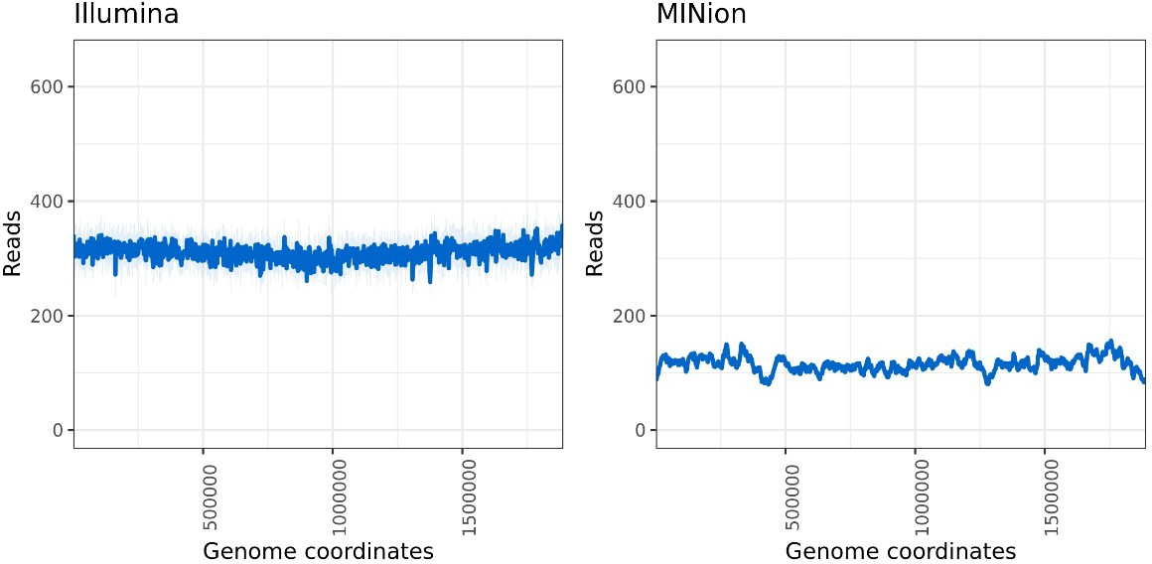
R
Commands:
Rscript /cov_plots.r /depthfiles.txt
Explanation:
Rscript
/cov_plots.r
/depthfiles.txt
# Run Rscript, executing a script in R. # The R script to run
# Required argument of the script
Output:
In the work folder, open the “cov_plot.jpeg” file.
MinION
Notes:
Presenter
2020-12-17 16:18:58
--------------------------------------------
Test the illumina clip part.

Slide 38
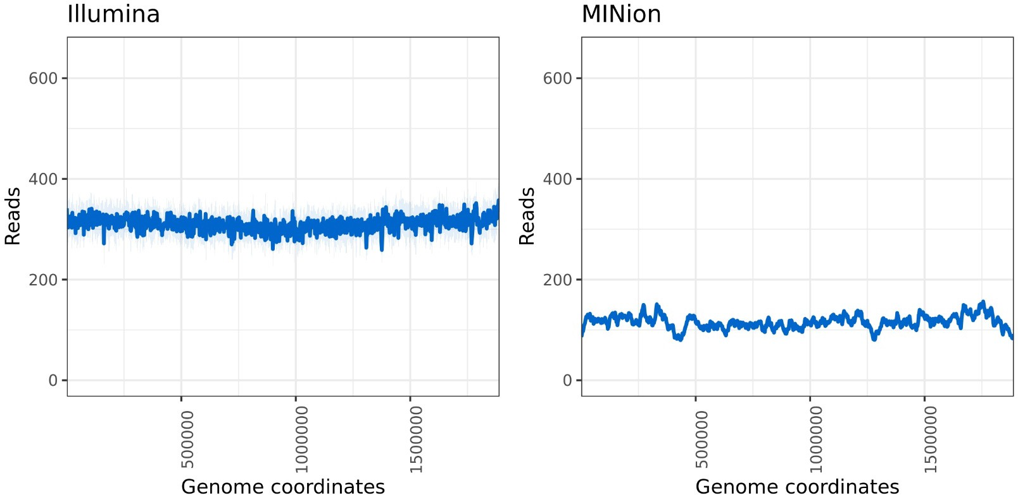
The Genome is assembled!
The reads have been assembled into a complete chromosome and appear to be consistent with the reads.
There are no extreme peaks (indicating the sequence occurs more frequently in the reads than the assembly) or valleys (indicating the sequence occurs too frequently in the assembly).
MinION

Slide 39
Downstream
Now the genome can be annotated, further assessed for quality and compared to other genomes.
I recommend looking into PATRIC, especially the Comprehensive Genome Analysis tool.
Quast is also commonly used.
The next few slides take a closer look at the assembly just produced.

Slide 40
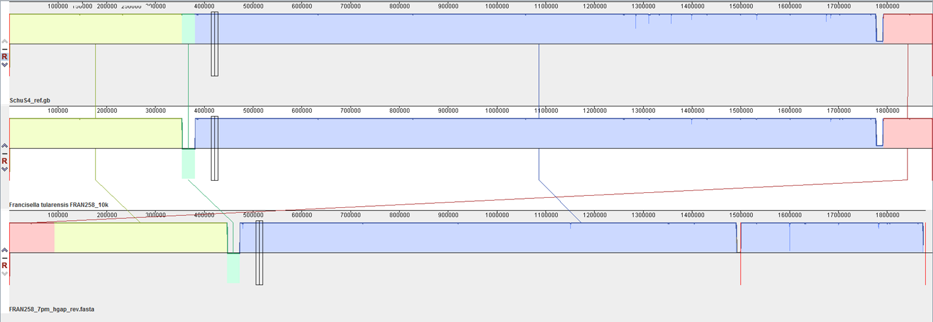
Alignment of reference, MinION plus Illumina
assembly, and PacBio assembly.
SchuS4 published sequence
FRAN258
FRAN258 PacBio Assembly
Contig 1
Contig 2
Both de novo assemblies generally resemble the SchuS4 reference genome.
The PacBio assembly breaks at the pathogenicity islands, while the MinION and Illumina assembly generates a complete contig.

Slide 41
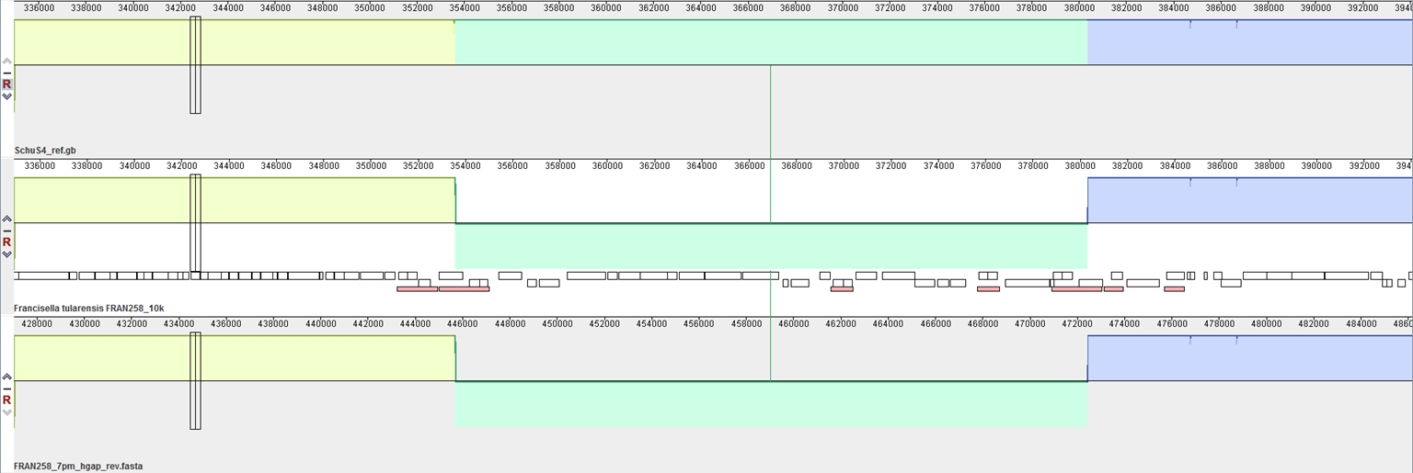
Close up of 25 kb inverted region
SchuS4 published sequence
FRAN258
FRAN258 PacBio Assembly
Mobile Elements
Both assemblies identify the inversion correctly.
Note the orientation of mobile elements. Reads that extend into the region from only one side are not informative.
Some MinION reads completely overlap the circled regions completely.

Slide 42
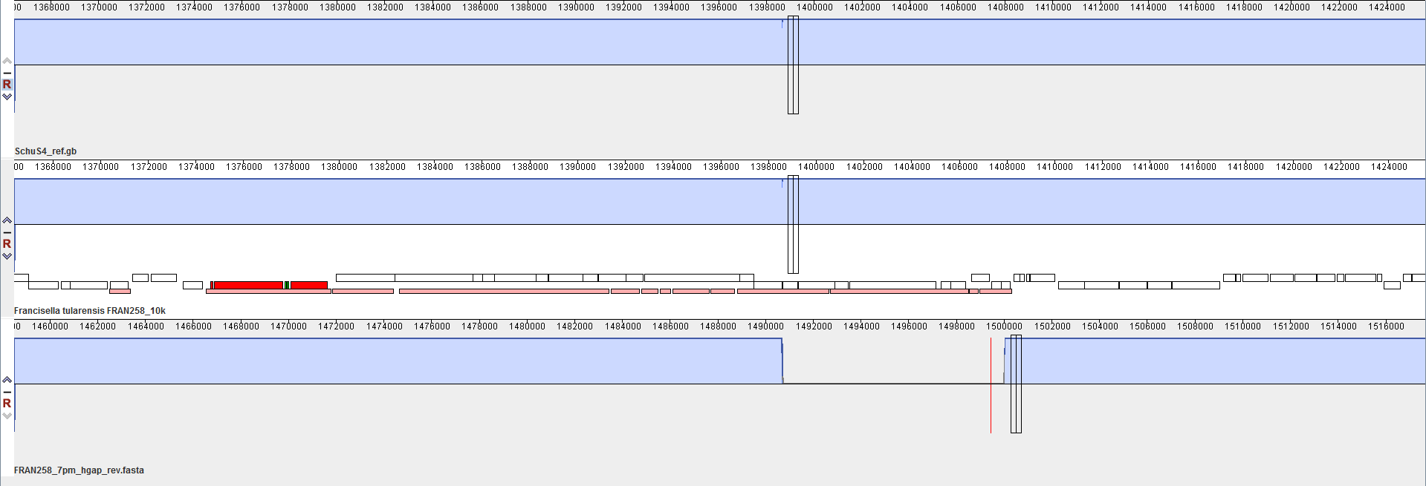
Close up of Francisella Pathogenicity Island 1
SchuS4 published sequence
FRAN258
Contig 1
Contig 2
FRAN258 PacBio Assembly
The PacBio assembly breaks within FPI1.
5’ end of Contig 2 overlaps with 3’ of Contig 1 of the PacBio assembly.

Slide 43
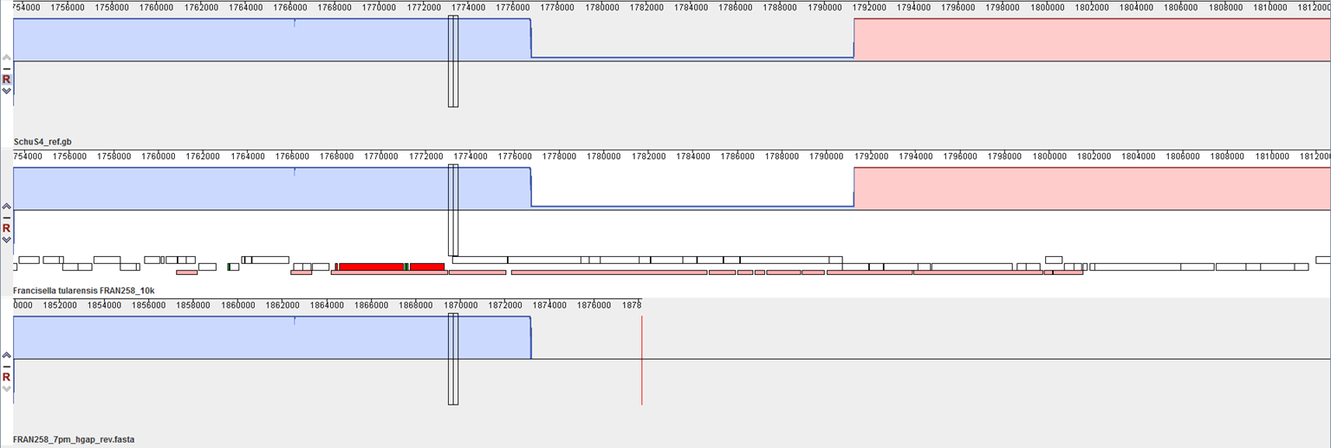
Close up of Francisella Pathogenicity Island 2
SchuS4 published sequence
FRAN258
FRAN258 PacBio Assembly
Contig 2
Contig 2 does not assemble past FPI 2.

Slide 44
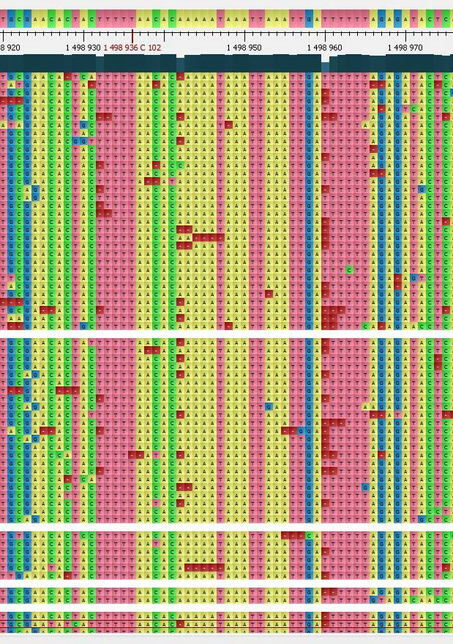
MinION reads not suitable for SNP-calling
MinION reads mapped to FRAN258 assembly

Slide 45
MinION reads not suitable for SNP-calling,
but Illumina reads are.
MinION reads mapped to FRAN258 assembly
Illumina reads mapped to FRAN258 assembly

