Slide 1
Preliminary work on a domain decomposition method for Poisson’s equation (2D)
Scott Aiton
Donna Calhoun
Grady Wright

Slide 2
Problem
(Non-homogeneous also possible with the code)

Slide 3
Decompose the domain
(Non-homogeneous also possible with the code)
Solve:

Slide 4
Discretize the domain
(Non-homogeneous also possible with the code)
Solve:

Slide 5
Discretize the domains
(Non-homogeneous also possible with the code)
Solve:

Slide 6
Discretize the domains
(Non-homogeneous also possible with the code)
Solve:

Slide 7
Linear system

Slide 8
Schur Complement

Slide 9
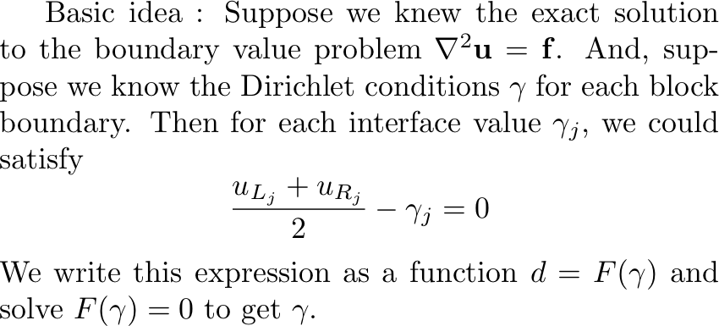
Solving the Schur complement system

Slide 10
% Construct Schur complement system
g = zeros(number_of_interface_values,1);
b = F(g); % Inhomogeneous part
for j = 1:number_of_interface_values
g(j) = 1;
S(:,j) = F(g) - b;
g(j) = 0;
end
g = -S\b % Solve Sg + b = 0
function d = F(g) % F(g) = Sg + b
for k = 1:number_of_blocks
Solve Au_k = f_k + b_k g
end
% Get difference
for j = 1:number_of_interface_values
d(j) = (u_left(j) + u_right(j))/2 - g(j)
end
end

Slide 11
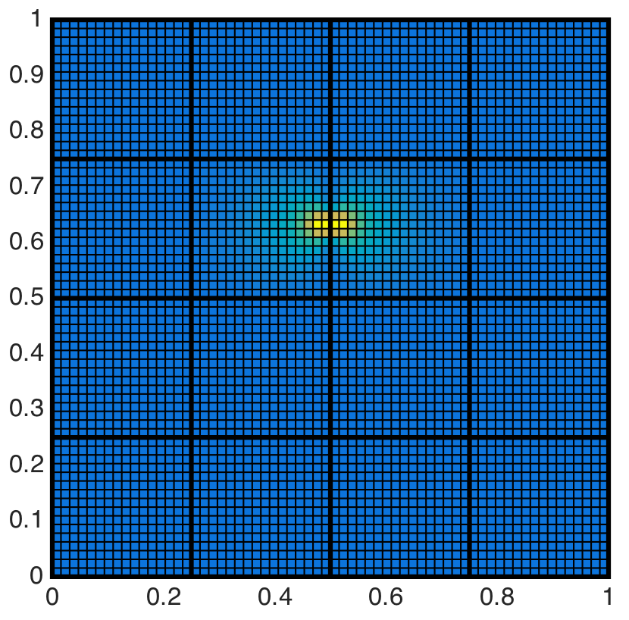
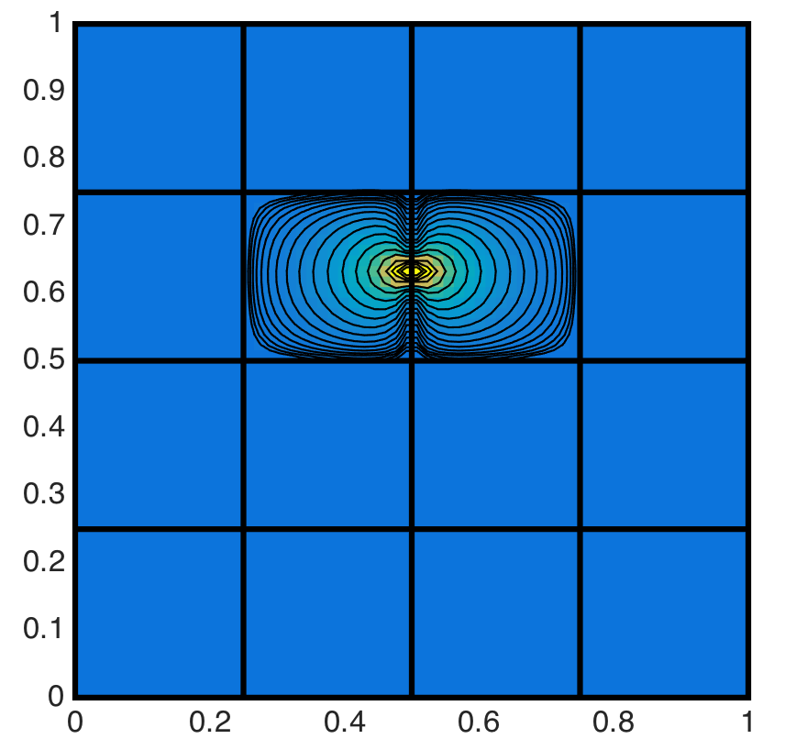
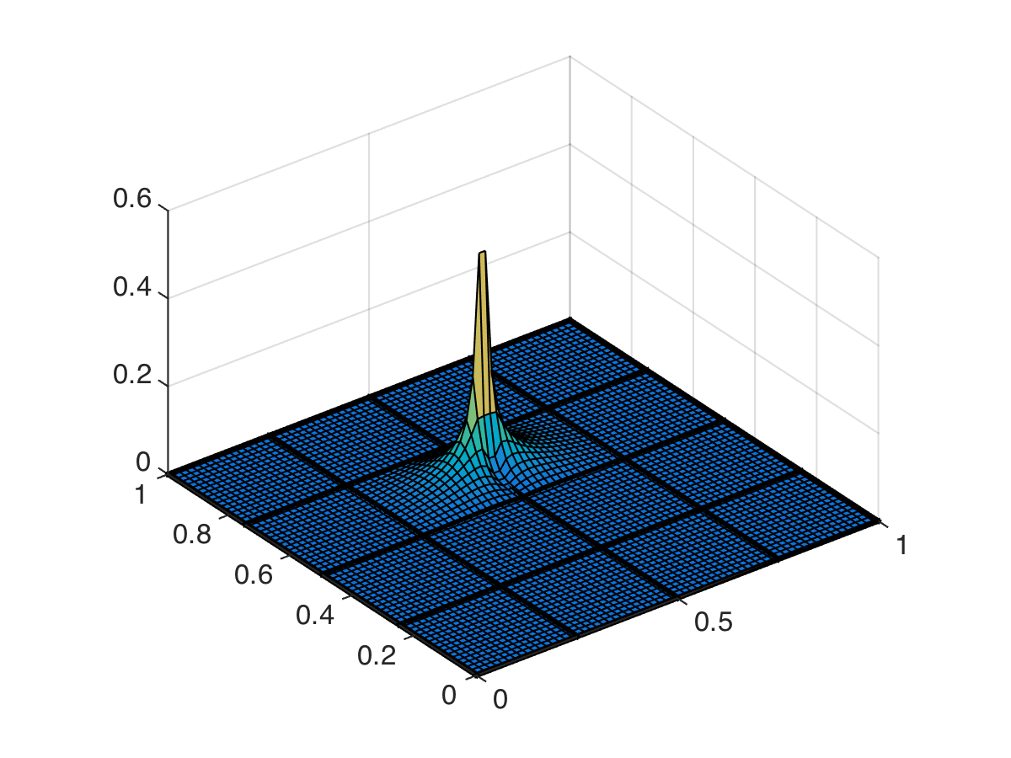

Slide 12
Software Used
Serial version:
Eigen - for matrix and vector classes, and iterative solvers
fftw – for fast direct solve on each subdomain
boost - for the graph coloring algorithm
Parallel version:
Epetra from Trilinos, matrix and vector data structures
Belos2 from Trilinos, iterative solvers (PCG specifically)
fftw – for fast direct solve on each subdomain

Slide 13
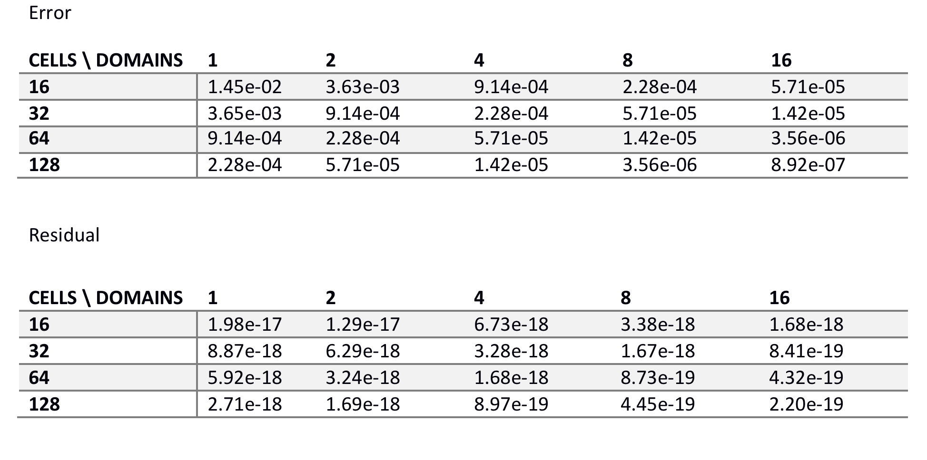
Numerical results

Slide 14
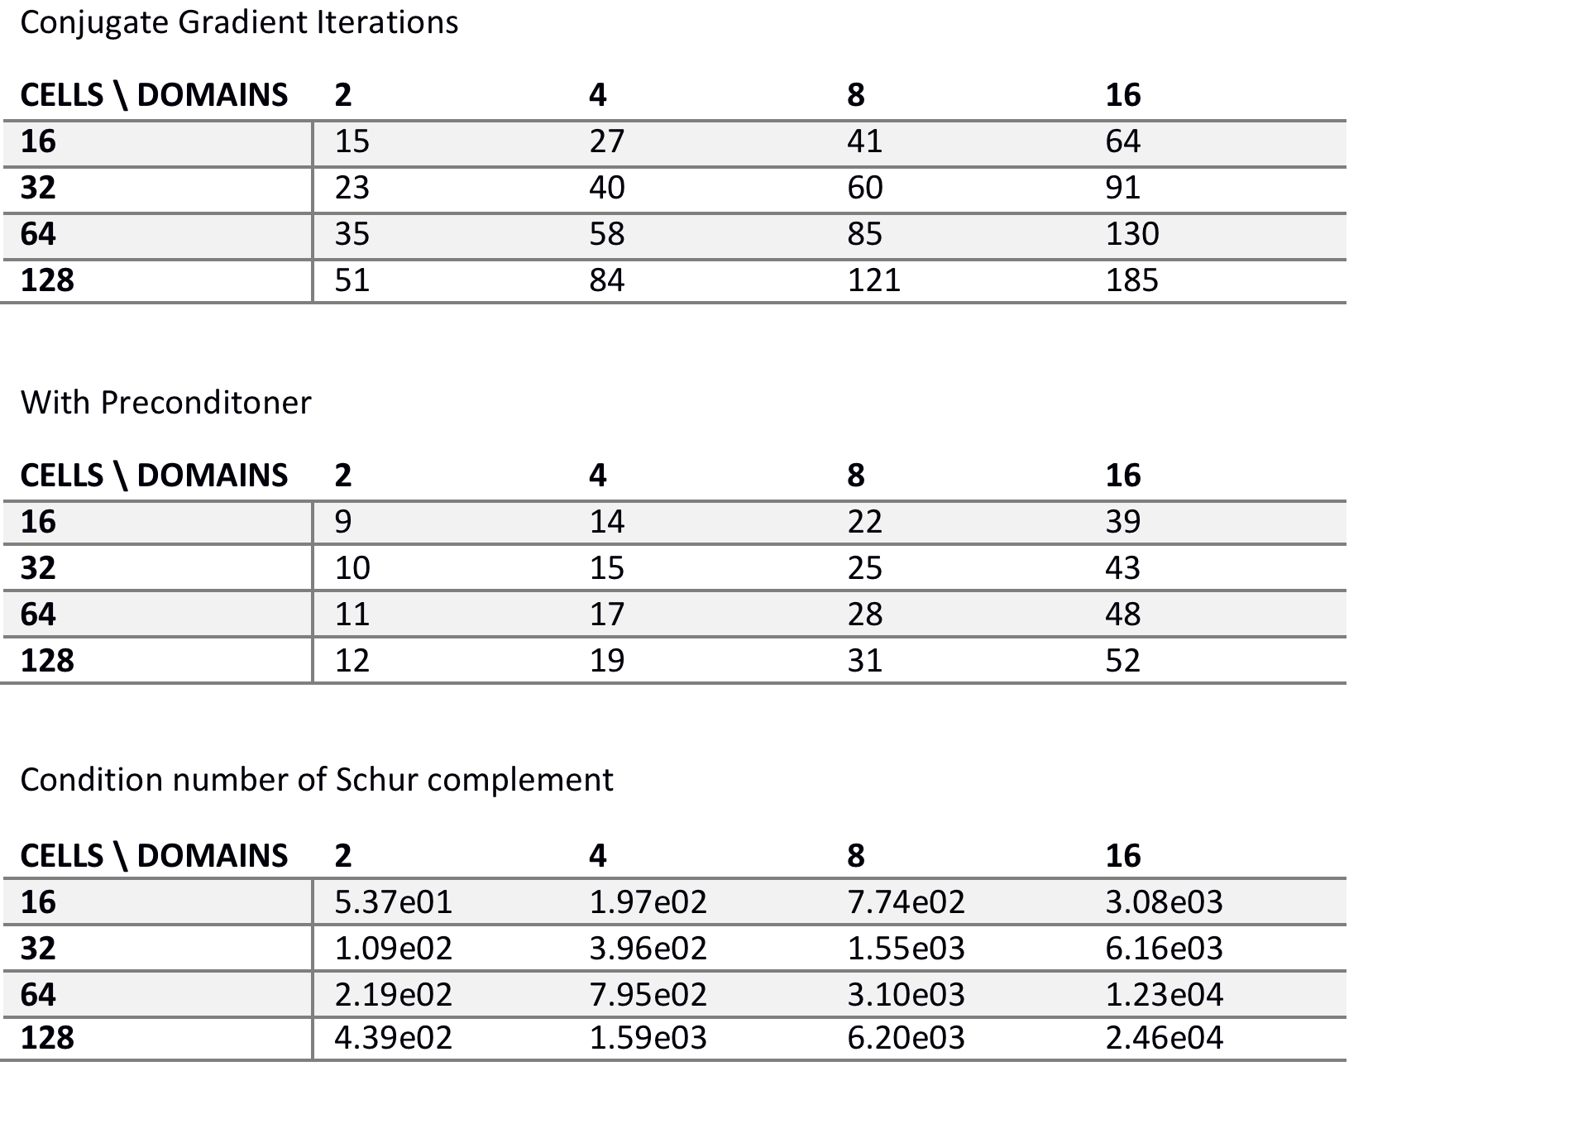
Numerical results

Slide 15
What’s next?
Neumann boundary conditions
Non-rectangular domains (still polygonal->rectilinear curves)
Adaptively refined mesh
Parallel performance on Kestrel
How do we solve the Schur complement system in Parallel
Look at a better preconditioner and different iterative solvers
Extend to 3D
Cut cell domains?

