Slide 1
SPE EUROPE ENERGY GEOHACKATHON 2026 | EXPRESS EDITION
3 x 3,500 m
Three doublets at 3,500 m, direct heating and brine-driven cooling
doublets, depth
COP 17
heat + cooling per unit of electricity
An AI agent designed it. The GEMINI digital twin verified every step.
0 unmet
Ramdhan Ari Wibawa
ramdhan@zanskar.us | 4 November 2026
365 days, every limit passed
GEMINI Agentic Geothermal Design Hackathon 2026 | R. A. Wibawa
1

Slide 2
A district needs heat and cooling. The reservoir on offer is too cold.
30 + 10 MW
2,500 m
87 C
heating at 100 C, cooling at 20 C
reservoir in the brief
brine: 13 C short of the network
We gave the problem to an AI agent with the GEMINI digital twin: design it, prove it, explain it.
GEMINI Agentic Geothermal Design Hackathon 2026 | R. A. Wibawa
2

Slide 3
The agent works like an engineer: propose, test on the twin, fix, repeat
Propose
Evaluate
Diagnose
Repair
GEMINI supplies the well, pump, corrosion and erosion physics.
We built the heat exchanger, heat pump, chillers and dispatcher that GEMINI did not have.
Every move is logged with its reasoning and its token count. A rule-based mode gives the same design with no LLM.
GEMINI Agentic Geothermal Design Hackathon 2026 | R. A. Wibawa
3

Slide 4
The answer: drill deeper. Hot brine feeds the network directly and drives the chiller.
30 + 10 MW
94 %
64 EUR
delivered on the peak day
of the energy from the ground
per MWh delivered (indicative)
3 doublets at 3,500 m | direct plate heat exchange | 10 MW absorption chiller on the brine | 2.5 MW heat pump for cold spells
One decision, depth, removes almost all the electricity the shallow design needed.
GEMINI Agentic Geothermal Design Hackathon 2026 | R. A. Wibawa
4

Slide 5
Every alternative was tried and rejected with a number: cost in EUR per MWh
The two-doublet shortcut looks cheapest and fails 16 peak days. The agent kept three.
GEMINI Agentic Geothermal Design Hackathon 2026 | R. A. Wibawa
5

Slide 6
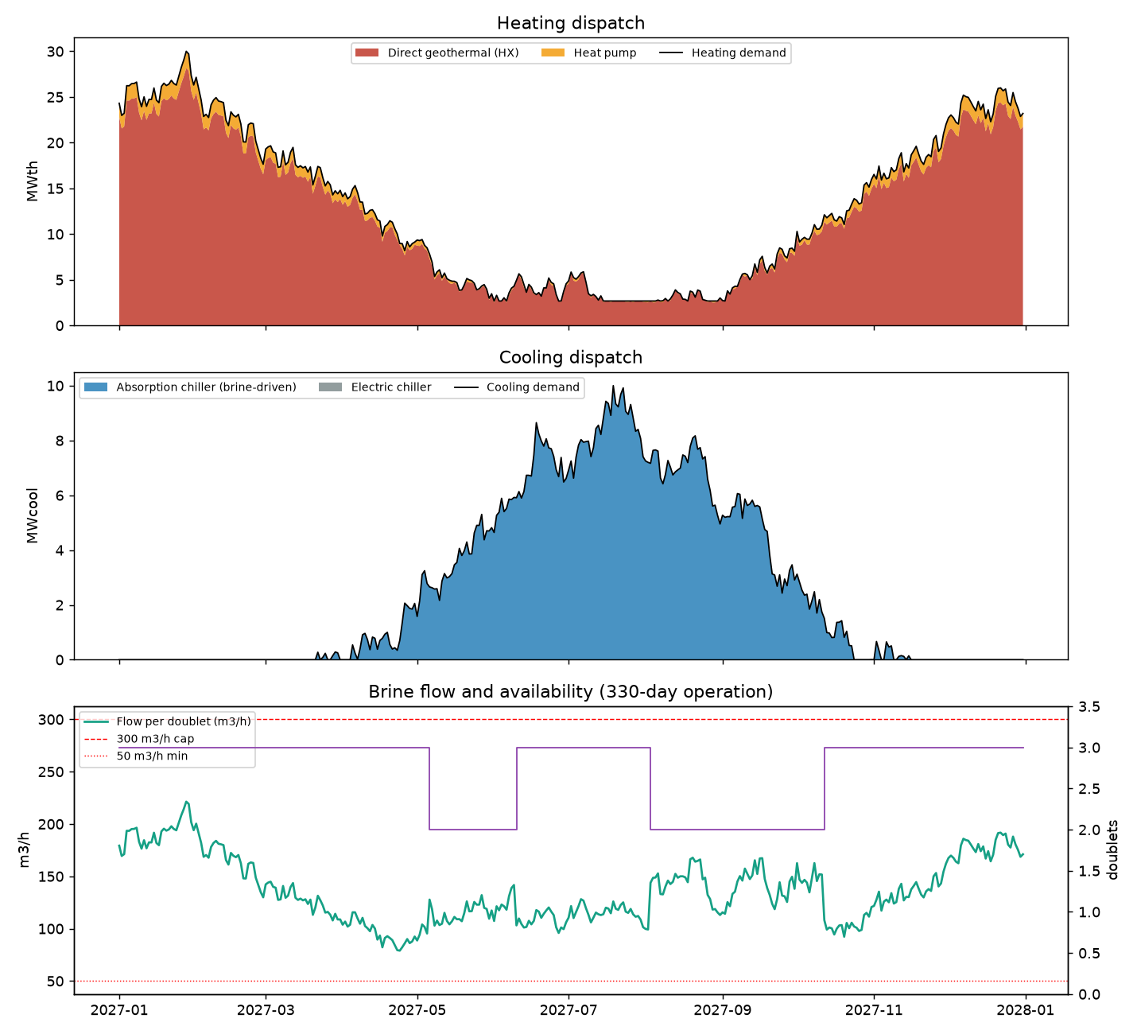
Proven on all 365 days: every limit in the brief passes
8 of 8
challenge limits pass every day
+3
engineering guards we added: gas, erosion, injection
GEMINI Agentic Geothermal Design Hackathon 2026 | R. A. Wibawa
6

Slide 7
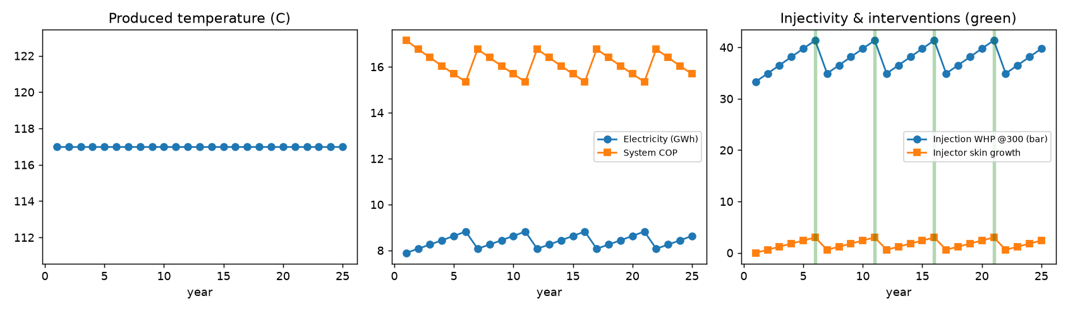
Beyond the brief: the design is tested against uncertain geology and 25 years of operation
Uncertainty
Re-run over a range of permeability and gradient. We found a cliff at 3,250 m; our design keeps 250 m of margin.
Operations
A yearly controller re-runs the twin with reservoir cooling and pump wear and books acid jobs and workovers.
GEMINI Agentic Geothermal Design Hackathon 2026 | R. A. Wibawa
7

Slide 8
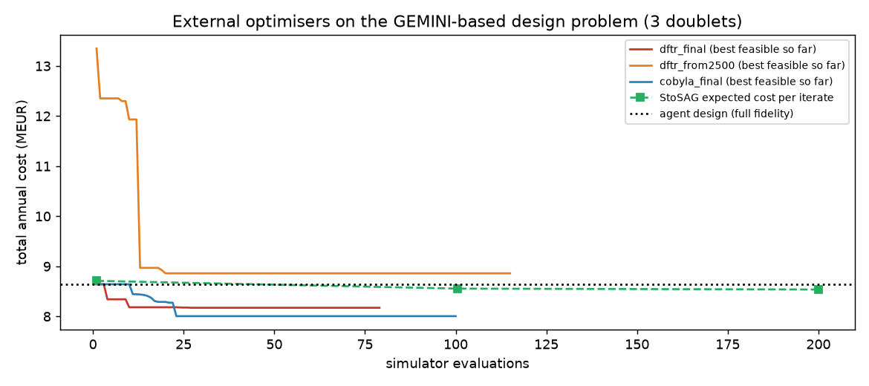
Three external optimisers agree with the agent and trim the cost by 5 %
Same structure: three doublets, direct heating, absorption cooling.
Sweet spot 150 m shallower, just deep enough for 100 C.
Started from the brief's 2,500 m, the optimiser lands in a worse design. The agent's reasoning is the right starting point.
GEMINI Agentic Geothermal Design Hackathon 2026 | R. A. Wibawa
8

Slide 9
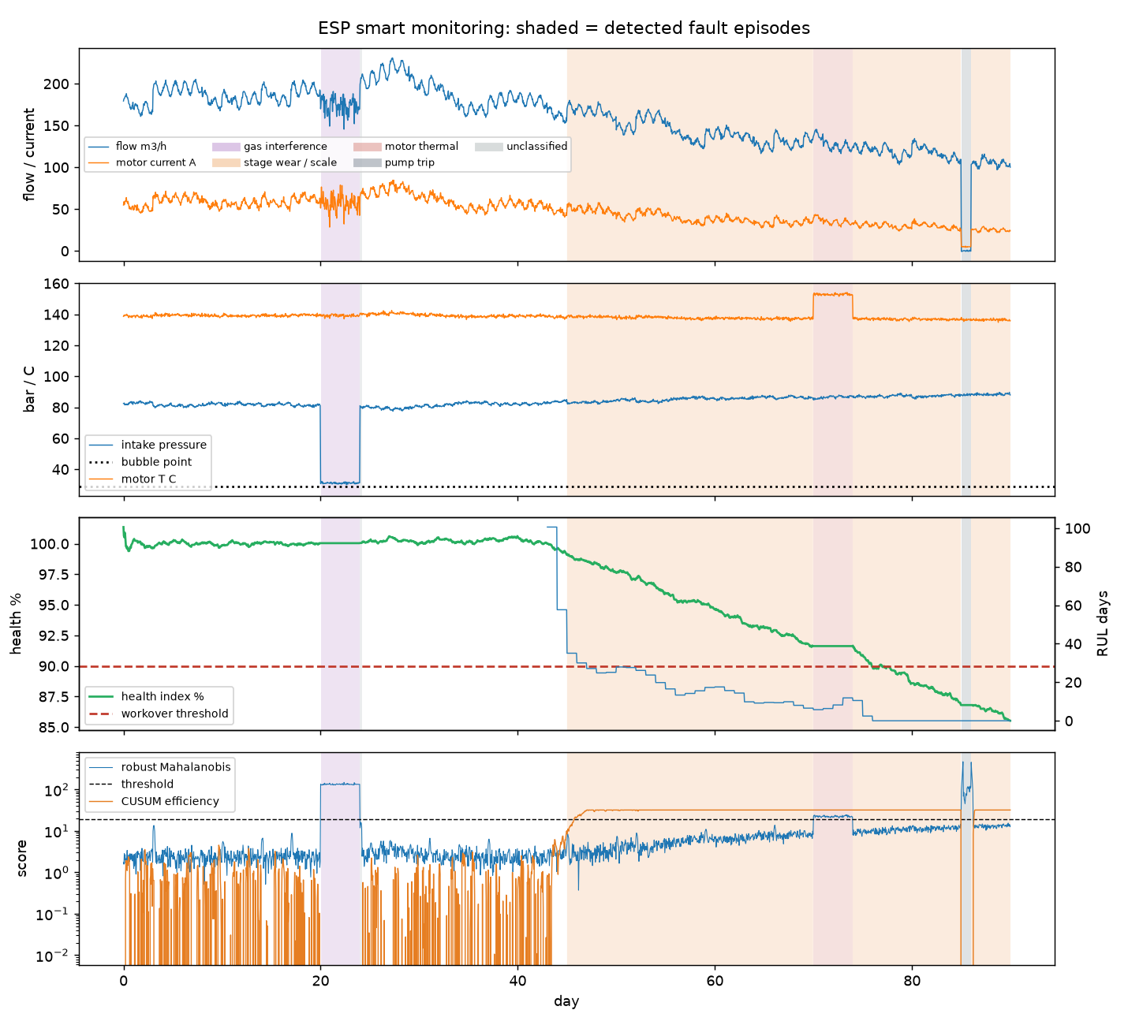
Live pump monitoring closes the loop: faults are caught from telemetry and fed back into the plan
91 %
of fault hours detected
< 1 %
false alarms
4 of 4
faults correctly named
GEMINI Agentic Geothermal Design Hackathon 2026 | R. A. Wibawa
9

Slide 10
The agent knows its limits
Incomplete data: it lists what is missing and asks before running.
Out-of-scope request: it declines.
Contradictory inputs: it refuses to size the plant until they are resolved.
Open source. Runs offline in five minutes. Pushed to the GEMINI repository.
Dashboard: https://claude.ai/artifact/NsWjVJL11z7fZCAK5Fe4my
Thank you.
GEMINI Agentic Geothermal Design Hackathon 2026 | R. A. Wibawa
10

