Slide 1
SPE EUROPE ENERGY GEOHACKATHON 2026 | EXPRESS EDITION
3 x 3,500 m
Three doublets at 3,500 m, direct heating and brine-driven cooling: an AI-designed, twin-verified district energy system
doublets and reservoir depth selected
COP 17.3
heat + cooling per unit of electricity
Propose - evaluate - diagnose - repair on the GEMINI twin, then closed-loop management, robust optimisation and real-time ESP monitoring.
0 MWh
unmet demand over 365 days
Ramdhan Ari Wibawa
ramdhan@zanskar.us | 4 November 2026 | dashboard: https://claude.ai/artifact/NsWjVJL11z7fZCAK5Fe4my
GEMINI Agentic Geothermal Design Hackathon 2026 | R. A. Wibawa
1

Slide 2
The challenge, and what the agent delivered
A 2,500 m, 87 C reservoir must serve 30 MW of heating at 100 C and 10 MW of cooling at 20 C, inside eight hard caps
Hard caps from the brief
3
117 C
112 + 24
• 1-3 doublets, 50-300 m3/h each
• Brine cooled at most 40 C
• 330 operating days per doublet
• Pump efficiency 70 %, volumes balanced
• 100 C heating and 20 C cooling supply
doublets, 6 wells, 3,500 m TVD
reservoir, 114 C at the wellhead
GWh heat + cooling, nothing unmet
7.8 GWh
63.8
67 MEUR
electricity per year, 94 % geothermal
EUR per MWh delivered (indicative)
capex, of which wells dominate
Not fixed, and not needed
• Depth: 'for a different depth use hydrostatic pressure and the 30 C/km gradient'
• Surface plant: GEMINI has no heating or cooling models; they are ours
• Thermal storage: not added. The heat-pump top-up runs through 144- and 110-day cold stretches that a daily buffer cannot shift, and at 94 % geothermal share seasonal storage has nothing to displace
Selected system
• Direct plate heat exchange carries 105 of 112 GWh of heat; a 2.5 MW high-temperature heat pump tops up cold spells
• 10 MW single-effect absorption chiller driven by the brine covers all cooling; no electric chiller
• ESP at 1,000 m, 26 stages, VSD 30-65 Hz, intake 70 bar against a 29 bar bubble point; inhibitor + lined tubing against 8 mm/yr CO2 corrosion
GEMINI Agentic Geothermal Design Hackathon 2026 | R. A. Wibawa
2

Slide 3
Agentic workflow: the twin pushes back on every proposal
Two orchestrators drive one toolbox; the loop ends when the simulator has nothing left to object to
Propose
Evaluate
Diagnose
Repair
Explore + trim
Rank + explain
archetype or
modification
365-day dispatch
on the GEMINI twin
worst violation ->
engineering cause
deeper, more doublets,
bigger HP, new ESP...
16 archetypes,
right-size capacities
cost, COP, share,
rationale per step
repeat until feasible, at most 2 repeats per action
Orchestrator 1: Claude
Orchestrator 2: rule-based
Reasoning, memory, gates
• Claude Fable 5.1 drives the toolbox (claude_session.py): chooses each move, states the hypothesis before the run, reads the twin's verdict after
• Commercial model, documented; API key is a placeholder in the committed code
• 8 turns, 7 evaluations, ~2 min; ~33k tokens (770 output + 32k context re-read), per-turn table in INTERACTION_EVIDENCE.md
• Same tools, deterministic engineering heuristics, zero LLM tokens, fully offline and reproducible
• Explores 16 archetypes, 38 evaluations, ~5 min
• Both orchestrators converge on the same design
• Intake gate: missing inputs, out-of-scope asks and contradictory data are returned to the user before any run
• Memory: evaluation cache keyed on design signature, repeat guard, session state on disk
• Repairs are explicit rules with a stated cause, so every step is auditable
GEMINI Agentic Geothermal Design Hackathon 2026 | R. A. Wibawa
3

Slide 4
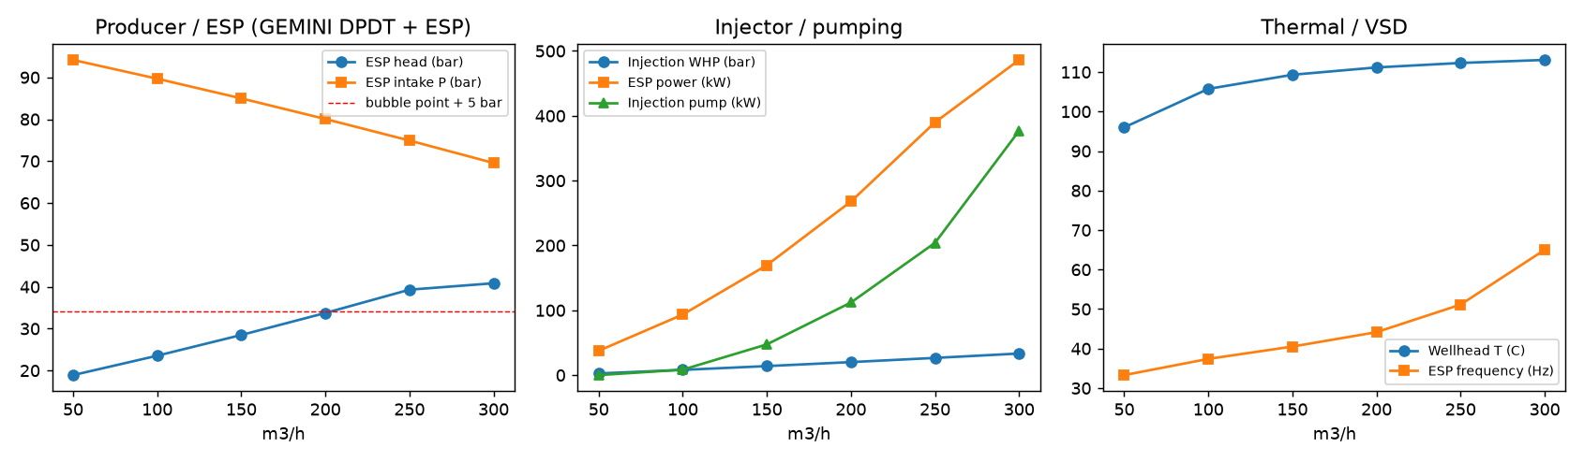
GEMINI gives the physics; plant, dispatcher and agent are ours
Python, gemini_model called directly; numpy, pandas, scipy, matplotlib, scikit-learn, py-trsqp, petlab, anthropic SDK
GEMINI model (gemini_model) | Used for
bottomhole_skin_dp + IPR | productivity / injectivity, drawdown vs flow
DPDT wellbore P and T + PVT | wellhead T and P, marched 100 m with the gradient
ESP stage curve (HC27000) | stages, VSD frequency, pump power; affinity-scaled frame
CO2Corrosion (de Waard-Milliams) | 8 mm/yr un-mitigated -> material decision
ErosionModel (API RP14E) | erosional velocity -> casing ID check
Built for this challenge | Model
Plate heat exchanger | 3 C approach, 95 % effectiveness
HT heat pump | COP = 0.5 x Carnot, 85 C max lift
Absorption chiller | LiBr single effect, off < 72 C, COP 0.72 at >= 95 C
Electric chiller, gas handling | COP 5.5; CH4/CO2 at GLR 0.8, bubble point
Daily dispatcher | min brine flow, parallel heating/cooling split
Cost model, closed loop, monitor | ranking only; 25-year controller; ESP anomaly detection
Well performance from the twin
ESP head and power across the 50-300 m3/h band; intake pressure stays 40 bar above the 29 bar bubble point, which is why the pump sits at 1,000 m.
Tubing velocity 2.3 m/s at 300 m3/h, below the API erosional limit in 9-5/8" casing.
Why these models
Single-effect LiBr is the standard chiller for 90-100 C driving heat; 0.5 x Carnot matches published HT heat-pump COPs; 3 C approach is plate-HX practice. Simple enough to run 365 days in seconds, so the agent can iterate.
GEMINI Agentic Geothermal Design Hackathon 2026 | R. A. Wibawa
4

Slide 5
How the agent got there: a number and a reason for every move
Claude-orchestrated run, levelised cost per step; the twin rejected the two-doublet shortcut
Why the design is what it is
• One doublet is infeasible: the 330-day rule leaves 35 days without supply
• The 40 C cap, not temperature, sets heat per doublet (~13.4 MW at 300 m3/h): 30 MW needs three
• 2,500 m brine is 85 C: all heat lifted by a 31 MW heat pump, 36 GWh/yr electricity
• 3,000 m is the worst of both: deep wells and still a heat pump
• 3,500 m clears the 103 C direct-supply threshold; electricity falls to 7.8 GWh/yr
• 4,000 m adds well cost for no extra cap-limited heat
• Two doublets + 15 MW heat pump fail 16 peak days: at the 40 C cap there is no source left for the heat pump
• Absorption cooling saves 4.3 GWh/yr versus electric chillers
GEMINI Agentic Geothermal Design Hackathon 2026 | R. A. Wibawa
5

Slide 6
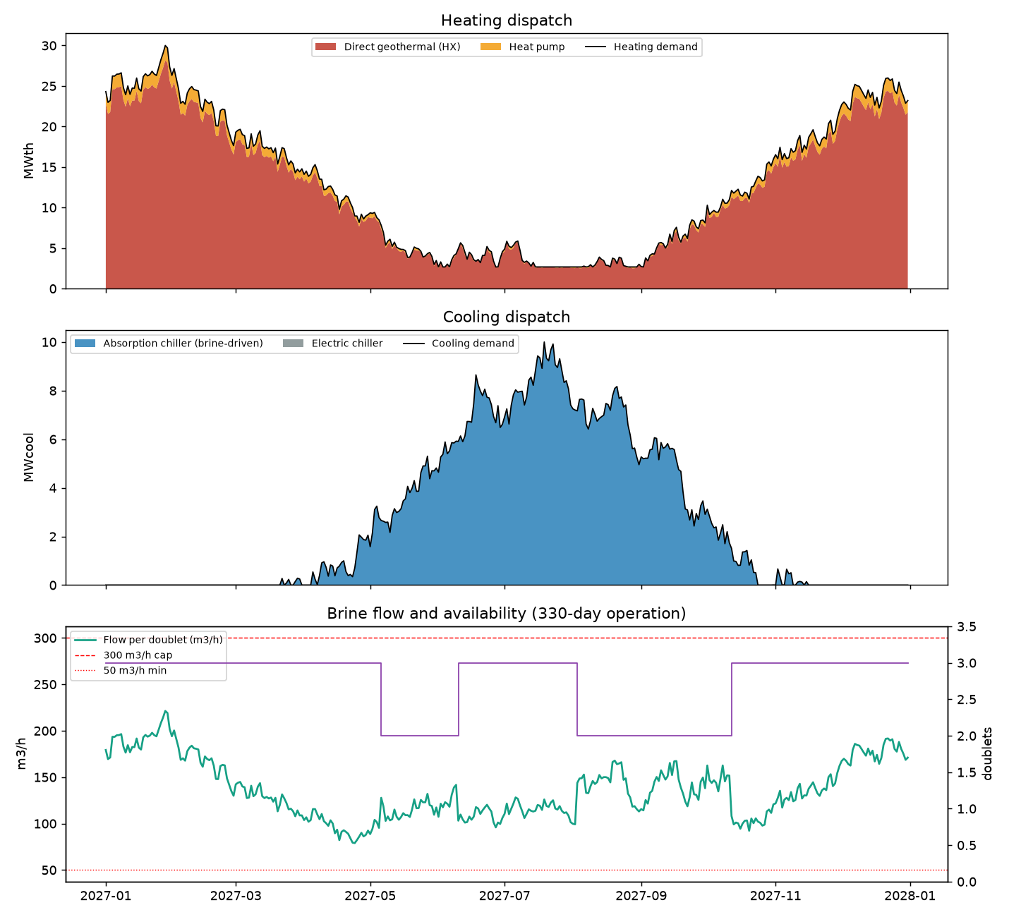
Validated on all 365 days: every cap and every engineering guard
Annual dispatch of the selected design; one doublet at a time is out for its 35-day window in the low-load season
Check | Value | Limit
Flow per doublet | 221 peak / 136 mean | 50-300 m3/h | pass
Brine cooling | 40.0 C max | 40 C | pass
Operating days per doublet | 330 | 330 | pass
Unmet heat / cooling | 0 / 0 GWh | 0 | pass
ESP intake vs bubble point | 70 vs 29 bar | > + 5 bar | pass
Tubing velocity | 2.3 m/s | < 4.8 m/s | pass
Injection wellhead pressure | 33 bar | < 60 bar | pass
ESP power | 486 kW | < 1,500 kW | pass
Realized capacities and energy balance, year 1
Heating 30.0 MW delivered on the peak day (28.2 MW direct HX + 1.8 MW heat pump; installed 3 x 13.7 MW HX + 2.5 MW HP). Cooling 10.0 MW delivered (10 MW absorption installed).
Heat 111.7 GWh (direct 105.1, heat pump 6.5); cooling 23.7 GWh, all absorption.
Electricity 7.8 GWh: ESP 3.6, injection 0.9, heat pump 1.4, chillers 1.9. System COP 17.3, geothermal share 94 %.
Associated gas 2.59 MNm3/yr (80 % CH4): a 1 MW gas engine on the CH4 yields 7.8 GWh/yr, the plant's whole electricity; CO2 balance 5,100 t/yr versus 7,500 t flaring with grid power at 0.3 kg/kWh.
GEMINI Agentic Geothermal Design Hackathon 2026 | R. A. Wibawa
6

Slide 7
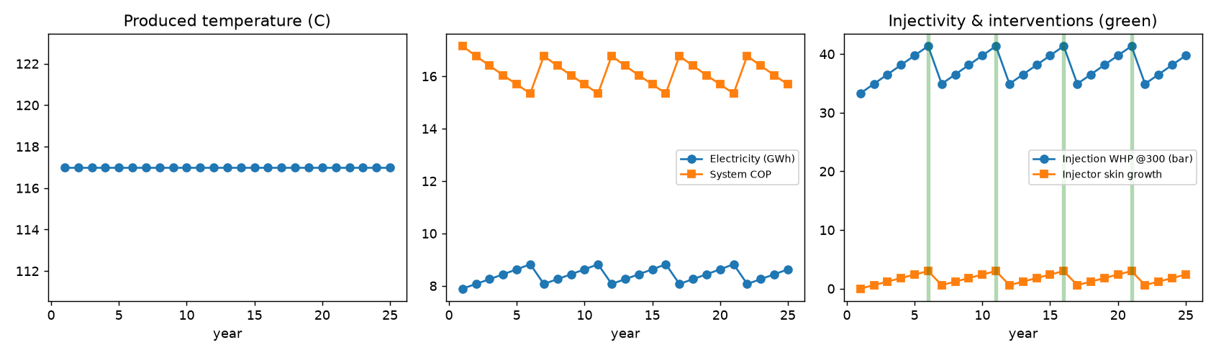
Beyond the brief 1: 25-year closed loop under uncertainty
The twin is re-run every year with reservoir cooling, injector skin growth and ESP wear; the controller books the interventions
Controller actions
• Acid stimulation when injector skin reaches +3 or WHP hits 85 % of its limit
• ESP workover at 90 % efficiency (about every 5 years)
• Heat-pump or chiller retrofit if produced temperature falls
• Spacing: breakthrough after 20 yr at 600 m, 36 yr at 800 m, > project life at 1,500 m
Uncertainty: a six-member geological ensemble
What is still assumed
• Permeability lognormal around 200 mD (140-220 mD), gradient 30 +/- 1.5 C/km, injector skin varied; every candidate is re-scored on all members
• Finding: the design space has a cliff at ~3,250 m. A design sitting on it is cheapest on paper and collapses when the gradient is 1 C/km lower (worst case +30 % cost)
• The 3,500 m design keeps 250 m of margin; the recommendation is conditional on a temperature log confirming the gradient
• Permeability independent of depth
• Lumped Gringarten-Sauty breakthrough
• Degradation rates (0.6 skin/yr, 2 % ESP/yr) until field data replaces them
GEMINI Agentic Geothermal Design Hackathon 2026 | R. A. Wibawa
7

Slide 8
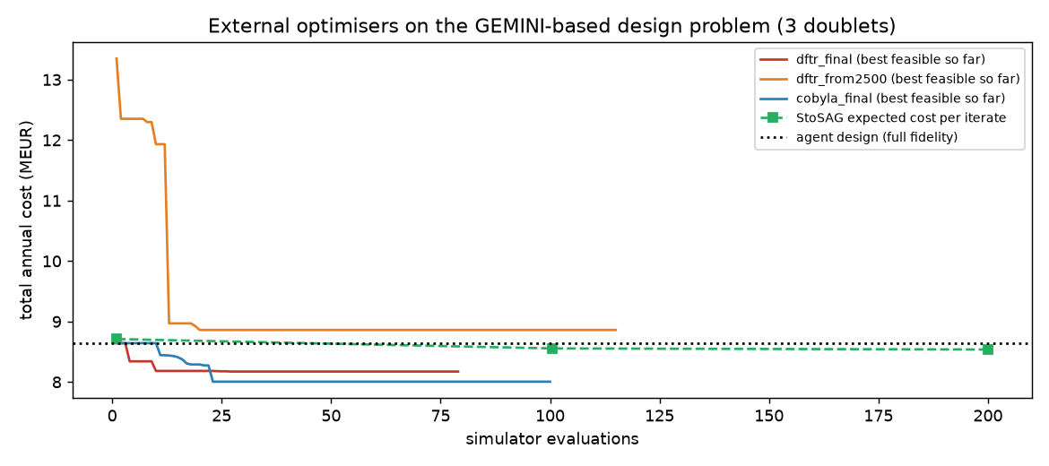
Beyond the brief 2: optimisers confirm the agent, shave 5 %
DFTR-Filter (py-trsqp), COBYLA and StoSAG robust optimisation via petlab's backend interface; every candidate re-run at full fidelity
Candidate | Depth | HP | MEUR/yr | Worst
Agent design | 3,500 | 2.5 | 8.63 | 8.86
DFTR from agent | 3,344 | 0 | 8.17 | 8.65
StoSAG robust | 3,335 | 1.9 | 8.42 | 8.88
COBYLA | 3,250 | 0 | 8.28 | 10.63
DFTR from 2,500 m | 3,938 | 0 | 8.86 | 9.02
Depth in m, heat pump in MW, worst = highest cost over the ensemble
What the optimisers taught us
• They agree with the agent's structure (3 doublets, direct heating, absorption cooling) and find the sweet spot 150 m shallower: just deep enough for 100 C, no heat pump
• COBYLA sat on the 3,250 m cliff; DFTR kept 100 m of margin and stays cheapest in every realisation; StoSAG, optimising the ensemble mean, keeps a 1.9 MW heat pump as hedge
• Starting DFTR from the specified 2,500 m lands in a worse local optimum (deep wells, electric cooling): the agent's reasoning is the right starting point for a black-box optimiser
GEMINI Agentic Geothermal Design Hackathon 2026 | R. A. Wibawa
8

Slide 9
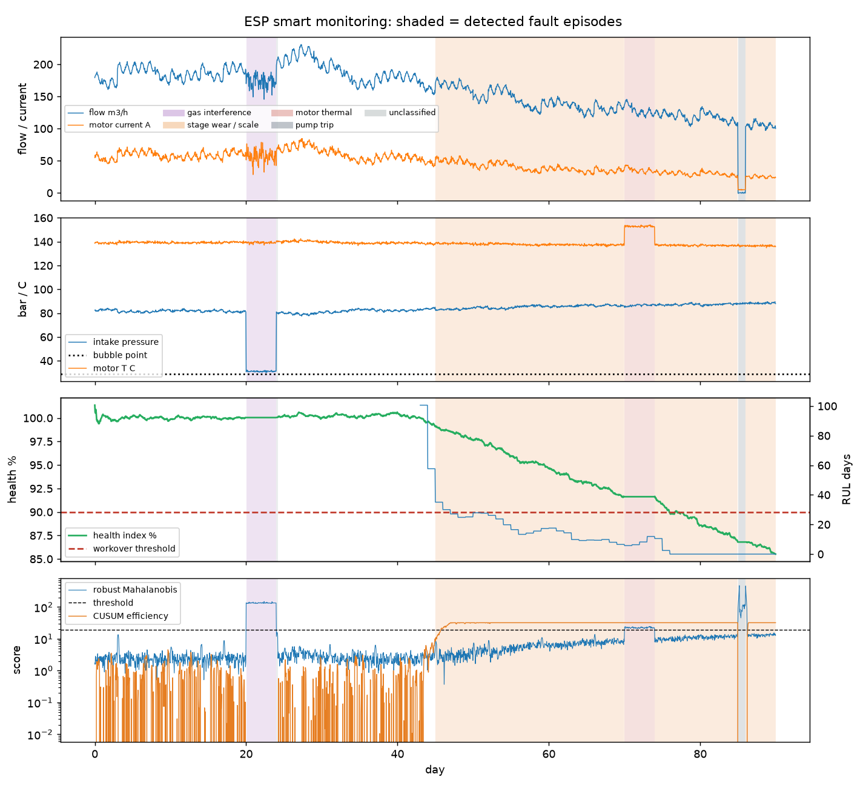
Beyond the brief 3: real-time ESP monitoring closes the loop
Hourly telemetry against the same twin; anomaly detection, fault naming, health index and remaining useful life
How it works
• Twin residuals: measured head, intake pressure and power minus the GEMINI expectation at the measured frequency and flow
• Detectors: robust Mahalanobis distance (MCD), Isolation Forest, CUSUM on hydraulic efficiency for slow drift; trained on 14 healthy days, no labels
• Signature classifier: gas interference, stage wear / scale, motor thermal, trip; each with a recommended action for the dispatcher or controller
91 %
0.7 %
100 %
recall on fault hours
false alarms on healthy hours
faults correctly named
Synthetic telemetry (no field data in the challenge) with four injected faults the detector was not told about. The health index replaces the assumed ESP wear rate in the 25-year loop and the RUL brings the workover forward; a trip or gas slug is re-balanced across doublets by the dispatcher.
GEMINI Agentic Geothermal Design Hackathon 2026 | R. A. Wibawa
9

Slide 10
Evidence, deliverables and what we would do next
Everything runs offline from the command line in about five minutes; 13 unit tests pass
Agent interaction evidence
Deliverables
Limits and next steps
• Heating file without cooling file: the agent lists the three missing inputs and asks whether to proceed on heating only
• 'Design a 50 MWe ORC power plant': declined, direct use only
• 'Which stock should I buy': declined, not an engineering question
• 'The reservoir is 140 C at 2,500 m': flagged as contradicting the 30 C/km gradient (87 C); refuses to size until resolved, because the design flips on it
• Full exchanges in INTERACTION_EVIDENCE.md; design reasoning in orchestration_log.md
• This deck (10 slides) and the 5-minute pitch
• Code pushed to the GEMINI repository: gemini_design_agent (spec, demand, components, subsurface, system, agent, closed_loop, intake, esp_monitoring, optimize_ext, report, cli, tests)
• Generated reports: DESIGN_REPORT (both modes), OPTIMIZATION_REPORT, ESP_MONITORING_REPORT
• Interactive dashboard with 14 data sources: https://claude.ai/artifact/NsWjVJL11z7fZCAK5Fe4my
• Zip with all outputs as a fallback attachment
• Costs are indicative planning figures used to rank, not to budget
• Claude is a commercial model; the rule-based mode gives the same design with zero tokens
• Monitoring telemetry is synthetic; the classifier is signature-based until field events exist
• Next: assimilate produced temperature and injection pressure each year to update the ensemble (EnKF), then re-run StoSAG on the updated ensemble: the model-updating half of closed-loop reservoir management
• Next: contribute the chiller, heat-pump and monitor models back to GEMINI
GEMINI Agentic Geothermal Design Hackathon 2026 | R. A. Wibawa
10

