Slide 1

DS-3002: Data Systems
Data Lakehouses & Streaming Data
Prof. Jon Tupitza – Spring 2022

Slide 2

Modern Data Platform: Solution Scenarios
Big (Unstructured and/or Poly-Schematic) Data Integration and Advanced Analytics
“We want to integrate all our data into our data warehouse”
“We’re trying to predict which of our customers will churn”
“We’re trying to get insights from our devices in real-time”
Modern Data Warehousing
Advanced Analytics
Real-Time Analytics

Slide 3

Delta Lake: A New Standard for Data Lakes
Open Format Based on Parquet
Optimized for Cloud Storage
Built to Handle Scalable Metadata
Transactional Support
Apache Spark API’s

Slide 4


Databricks: Data Lakehouse Architecture
Addresses the Shortcomings and Dysfunctions of Data Lakes and Data Warehouses
Data Lake
Data Warehouse
Lakehouse
One Platform to Unify All Your Data, Analytics and AI Workloads

Slide 5



Data Lakes: Data Reliability Challenges
Failed production jobs leave data in corrupt state requiring tedious recovery
✗
Lack of schema enforcement creates inconsistent and low quality data
Lack of consistency makes it almost impossible to mix appends and reads, batch and streaming

Slide 6
Delta Lake: Ensures Data Reliability
Batch
Parquet Files
High Quality & Reliable Data always ready for analytics
Streaming
Updates/Deletes
Transactional Log
ACID Transactions
Schema Enforcement
Unified Batch & Streaming
Time Travel/Data Snapshots
Key Features

Slide 7


Data Lakes: Performance Challenges
Too many small or very big files - more time opening & closing files rather than reading contents (worse with streaming).
Partitioning aka “poor man’s indexing”- breaks down if you picked the wrong fields or when data has many dimensions, high cardinality columns.
No caching - cloud storage throughput is low (cloud object storage is 20-50MB/s/core vs 300MB/s/core for local SSDs).

Slide 8

Delta Lake: Optimizes Performance
Databricks optimized engine
Highly Performant
queries at scale
Parquet Files
Transactional Log
Indexing
Compaction
Data skipping
Caching
Key Features

Slide 9
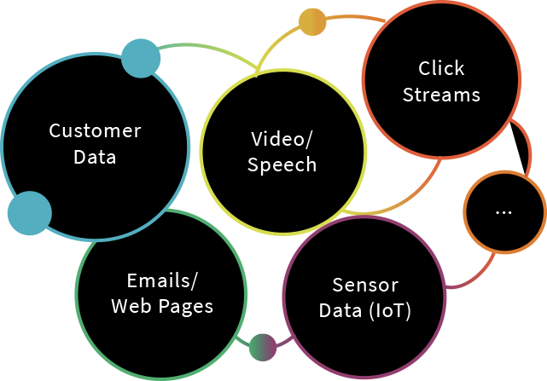
Delta Lakes: Makes Data Ready for Analytics
Data Science & ML
Reliability
Performance
Recommendation Engines
Risk, Fraud Detection
IoT & Predictive Maintenance
Genomics & DNA Sequencing

Slide 10
Databricks: Why Use It?
Make Data Engineers More Effective
Single, open, consistent way to do ETL and streaming
BYO IDEs and tools
Reliable APIs, CLIs, and other interfaces
DevOps Integration
Comprehensive library management
Make Data Scientists More Effective
Collaborative Data Science Workspace
ML Runtime with pre-installed, optimized libraries
Open, Consistent tracking and deployment with MLFlow
HyperOpt, AutoML
Make Compute More Effective
30%-500% faster than OSS Spark
Always the latest, greatest Spark
Query-load-based autoscaling
Ephemeral jobs clusters
Unparalleled Expertise

Slide 11
Data Integration
How to Approach Populating a Data Warehouse

Slide 12
Data Processing: Batch vs. Stream Processing
Challenges and Components Encountered When Integrating Real-Time & Historic Data
Data Motion:
At-Rest Data: Data that has settled
In-Motion Data: Data where new events arrive at some continuous interval
Datasets:
Bounded Datasets: Data of a known & finite size; having a start point and endpoint
Unbounded Datasets: Data wherein events are continuously added to the dataset
Data Processing Engines:
Batch Processing Engines: Only capable of processing data after it has settled
Streaming Processing Engines: Capable of processing data in-motion as it’s arriving

Slide 13
Data Processing Paradigms: Latency Requirements
Latency & Response: The speed at which clients require new insights determines the frequency at which new data must be processed
1. Batch
2. Continuous/Streaming
3. Real-time
10 ms
100 ms
1 sec
1 min
1 hour
1 day
Low-Latency Real-Time
Spark-less, highly-available prediction server
Real-Time
Prediction server with Spark
Micro-Batch
Structured Streaming
Batch
Spark batch processing

Slide 14
Data Processing Paradigms: Lambda Architecture
All Data Flows Through One of Two Paths: Hot or Cold
Hot Path
Speed Layer
Real-Time Views
Analytics Client
Unified Log
(Event Data)
Incremental Updates
Cold Path: Accumulates Data in its Raw Form then Processes it Later
Batch Layer
Master Data
Serving Layer
Batch Views

Slide 15
Data Processing Paradigms: Kappa Architecture
All Data Flows Through One of Two Paths: Hot or Cold
Speed Layer
Real-Time Views
Analytics Client
Unified Log
(Event Data)
Recompute Log Events From Storage If Needed
Mirror Events to Long-Term Storage
Long-Term Store
Master Data

Slide 16
Databricks: Spark Structured Streaming
Implements Incremental Processing to Provide Near Real-Time Analytic Insights
Designed for Distributed Computing:
Enables the incremental loading of new data files, each of which represent mini-batches or micro-batches, from streaming inputs.
Enables reasoning over potentially very large, continuously changing, sources.
Prefix-integrity Guarantee:
Ensures Spark SQL can be used to query a table while a streaming query is continuously writing data transactionally such that concurrent interactive query processing always sees a consistent view of the latest data
Joins with Static Data:
Structured Streaming data can be joined with static [reference] data

Slide 17
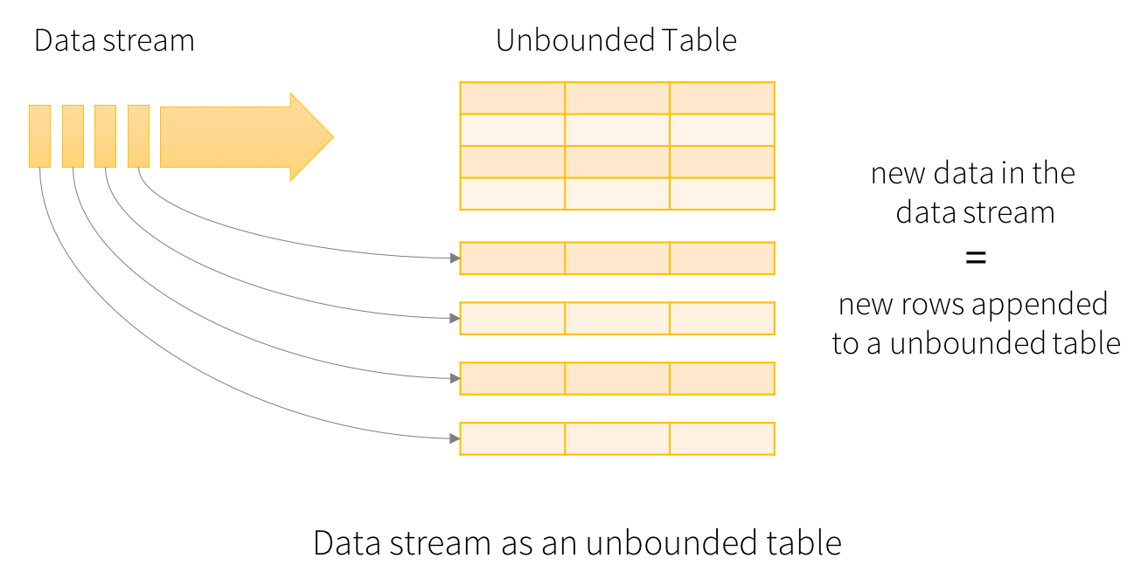
Databricks: Spark Structured Streaming
Enables Interaction with Unbounded Data Sources As If They Were SQL Database Tables
A Data Stream describes any data source that grows over time:
JSON log files landing in cloud storage
Database updates captured in a CDC feed
Events queued in a messaging queue feed
CSV files of sales closed the previous day

Slide 18
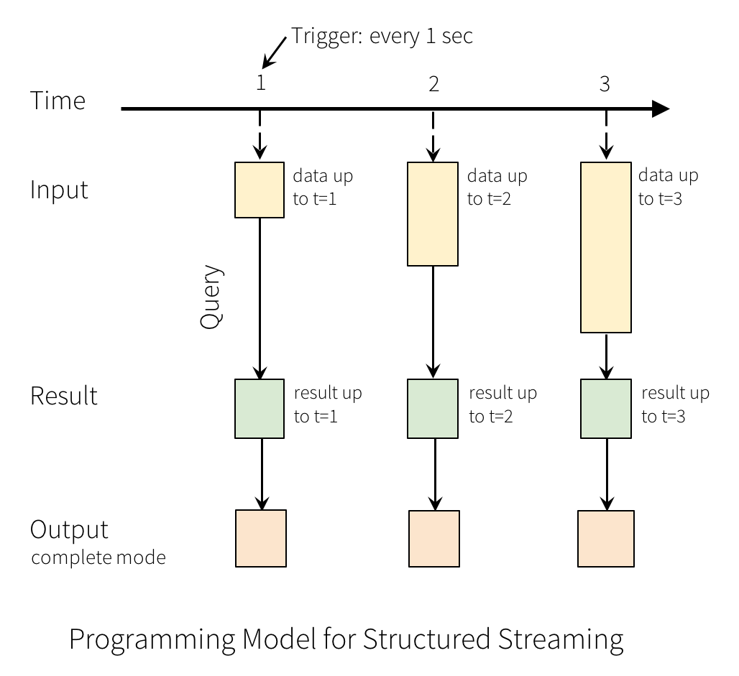
Databricks: Spark Structured Streaming
The Spark Structured Streaming Programming Model
The developer defines an input table by configuring a streaming read against a source. The syntax for doing this is similar to working with static data.
A query is defined against the input table. Both the DataFrames API and Spark SQL can be used to easily define transformations and actions against the input table.
This logical query on the input table generates the results table. The results table contains the incremental state information of the stream.
The output of a streaming pipeline will persist updates to the results table by writing to an external sink. A sink will be a durable system such as files or a pub/sub messaging bus.
New rows are appended to the input table for each trigger interval. These new rows are analogous to micro-batch transactions, and they will be automatically propagated through the results table to the sink.

Slide 19
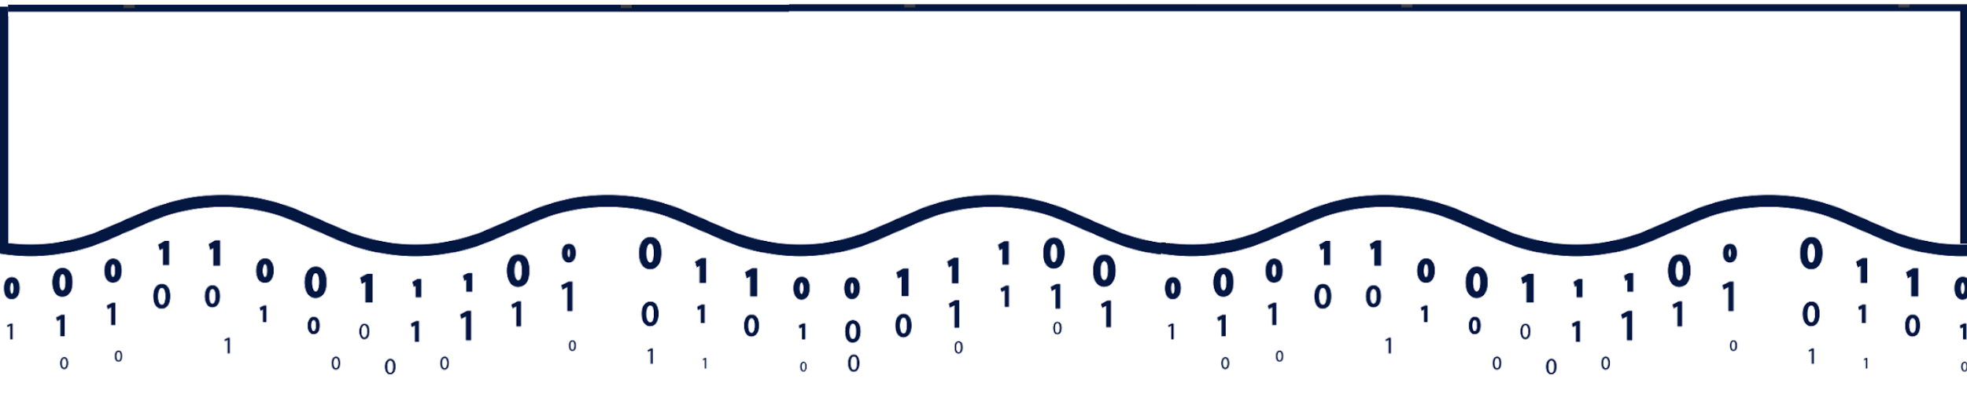







Modern Data Lakehouse Architecture
Building a Modern Data Lakehouse using Best-in-Class Open-Standard Components
Big Data Engineering
Streaming
Data Science and Machine Learning
SQL Analytics
and BI
Reporting and dashboards
Curated Data
ADLS G2
Raw Data
Structured
Semi-Structured
Unstructured Data

Slide 20
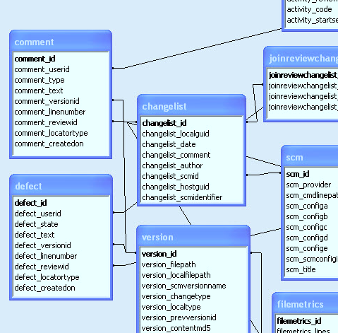


Paradigms: Data Storage and Retrieval
Schema on Write versus Schema on Read
Schema on Write: Stores data in an organized structure (schema)
Client or Process
Writes Data to
Schema
Client or Process
Reads Data from
Schema
RDBMS
Schema on Read: Applies schema only when read, data stored in its original format
Client or Process
Writes Data
To Storage
Client or Process
Reads Data into Schema
From Storage
Data Lake

Slide 21




Modern Data Platform: Data Services Pipeline
INGEST
STORE
PREPARE
SERVE
PREDICT
Data Orchestration & Monitoring
Unstructured Data Storage
Data Cleansing, Transformation & Streaming
Data Modeling, Serving & Storing
Reporting, BI, Predictive Analytics & AI
Data Integration
Data Lake Storage
Databricks
Data Warehouse
Machine Learning
DELIVER
MLOps Integration: CI/CD Pipelines, Version Control, Monitoring, Test Automation, Infrastructure as Code, Containers, Microservices
DevOps

Slide 22




Data Engineering… for Data Science
Ingest
Store
Prep & Train
Model & Serve
Logs, files and media
(unstructured)
Ad-hoc analysis
Azure Data Factory
Azure Data Lake Storage
Azure Databricks
(Spark, Delta Lake)
Power BI
Optimized Connector
Business/custom apps
(Structured)
Azure Machine Learning
PolyBase
Azure Synapse (DW)

Slide 23
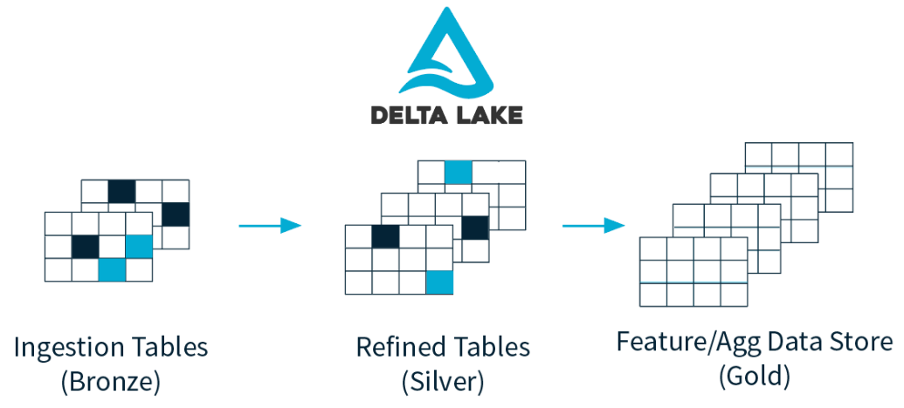
Databricks: Delta Lake at Scale
ACID Transaction Guarantees
Atomic, Consistent, Isolated, Durable
Versioned Parquet Files
Delta transaction log keeps track of all operations
Efficient Upserts
MERGE, DELETE, UPDATE
Time Travel
Audit history, pipeline debugging, data reproducibility
Small file compaction with no interrupt to availability
OPTIMIZE and VACUUM
Z-Order partitioning with up to 100x perf
New multidimensional partitioning enables data skipping

Slide 24




Design Pattern: Modern Data Warehousing
Step 1
Load raw data to Azure Data Lake Storage
Step 2
Use Azure Databricks to:
Combine streaming & batch
Save data as Delta format
Step 3
Use Azure Databricks to
1. Join, enrich, clean, transform data
2. Develop, train, and score ML models with Azure ML + MLFlow
Step 4
Load data into serving layers like
1. Azure Synapse Data Warehouse for enterprise BI scenarios.
2. Cosmos DB for real-time Apps
Sensors and IoT
(unstructured)
Cosmos DB
Apps
+
Logs (unstructured)
Azure Event Hub
Azure IoT Hub
Kafka
Polybase
Azure Data Factory
Raw Format
Delta Format
(Bronze Table)
Delta Format
(Silver Table)
Delta Format
(Gold Table)
Azure Synapse Data Warehouse
Power BI
Azure Data Lake Storage

Slide 25
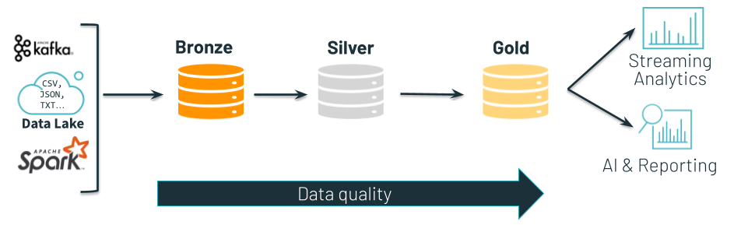
Data Lakehouse: Multi-Stage Architecture
Bronze Layer: Replaces the “Data Swamp” with Some Organization
Typically just a copy of the “raw” data that’s being ingested
Replaces the traditional Data Lake
Provides efficient storage and querying of full, unprocessed history of data

Slide 26
Data Lakehouse: Multi-Stage Architecture
Silver Layer: Validated Single Source of Truth Data
Reduces data storage complexity, latency and redundancy
Optimizes ETL throughput and analytic query performance
Preserves the grain of original data while enforcing the Production schema
Eliminates duplicate records, checks data quality & quarantines corrupt data

Slide 27
Data Lakehouse: Multi-Stage Architecture
Gold Layer: Customer-Ready Insights, Not Just Data
Powers applications, reporting, dashboards, and ad hoc analytics
Refined views of the data, typically including aggregations
Reduces strain on production systems
Optimizes query performance for business-critical data

Slide 28
Q & A
A Survey of Data Management Systems

