Slide 1
Electricity Price Forecasting using
Multilayer Perceptron
By :
Abhishek Kamal (16IT202)
Bhavya Bordia (16IT213)
Bharat Sharma (16IT210

Slide 2

Introduction
What is Electricity Price Forecasting ?
Branch of Energy Forecasting which focuses on predicting the spot and forward prices.
Helps producers and consumers in decision- making mechanism

Slide 3
Tools And Models
TensorFlow Library
Keras Library
Numpy
Pandas
Sklearn
Basic Model Used is Multilayer perceptron using backpropagation with different topologies.

Slide 4
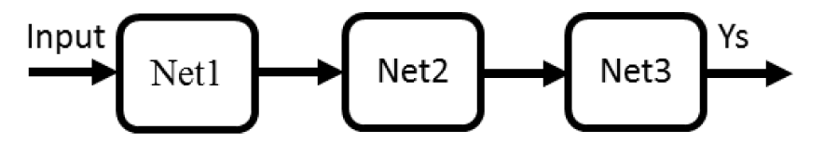
System Description
Neural Network connected in many Configuration known as “Topology”.
Cascade Topology - Interconnected in feed forward connection where output of first is used as input of another
Net1 = 6 Neurons
Net2 = 7 Neurons
Net3 = 8 Neurons

Slide 5
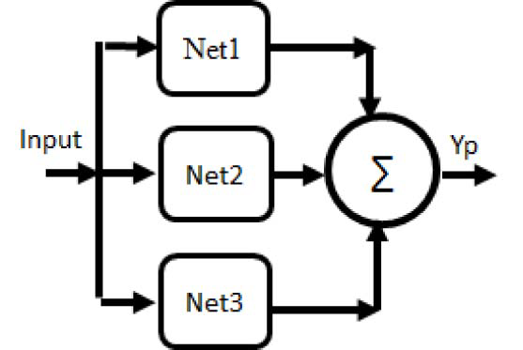
Parallel Topology
In the parallel topology one starts using the same input applied to all networks and then the output of all the networks is aggregated into to a single output neuron

Slide 6
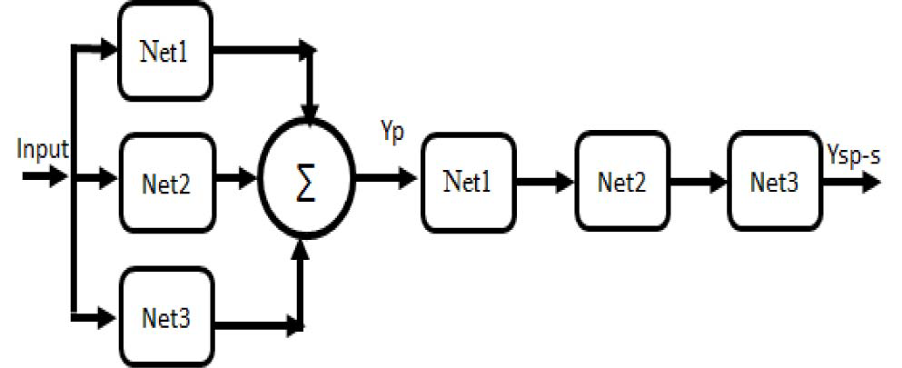
Parallel-cascade-in-cascade Topology
In this, one starts with the same input applied to all network in parallel and then output of all network is aggregated into a single output neuron which is then feeded into cascade topology where output of first is considered as input of second.

Slide 7
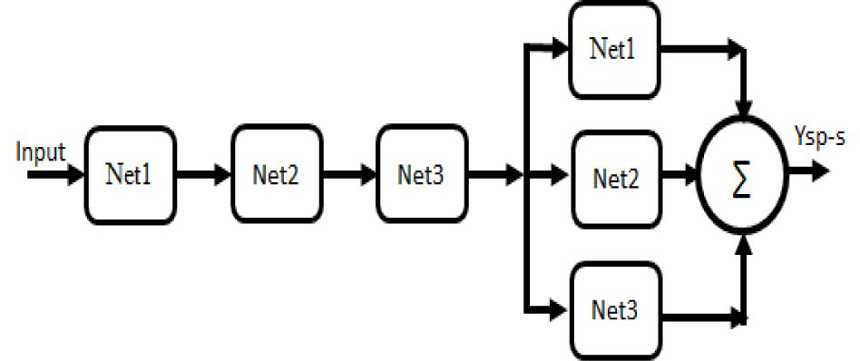
Cascade-parallel-in-cascade Topology
Networks are interconnected in feedforward connection where the output of the first network is used as input for the second network.Then the final output of the this is feed into a parallel system where one starts using the same input applied to all networks and then the output of all the networks is aggregated into to a single output neuron.

Slide 8
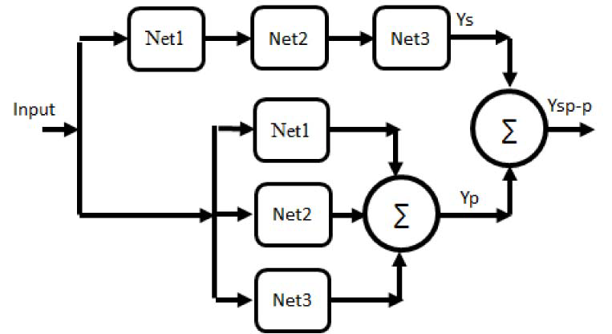
Cascade-parallel-in-parallel Topology
There is cascade topology and parallel topology of network and both are connected in parallel. So, a single input is feed into both parallel and cascade one and then final output is the combined one.

Slide 9
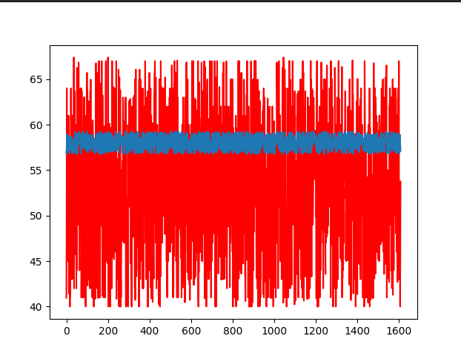
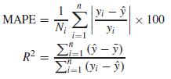
Results
Cascade Model Results :
MAPE : 15.57364420851%
R^2 : 0.9999412395585447
yi ,ˆy = actual and predicted prices
Ni = number of predicted data
R2 = coefficient of determination, ¯y = average of data

Slide 10
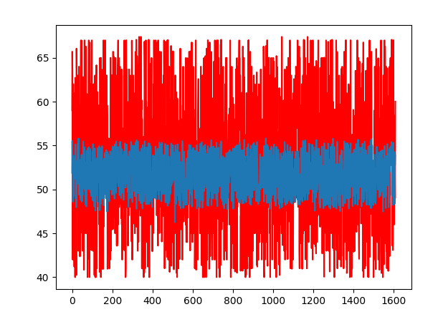
Parallel Model
MAPE: 12.293347768 %
R^2: 1.000019412958 %

Slide 11
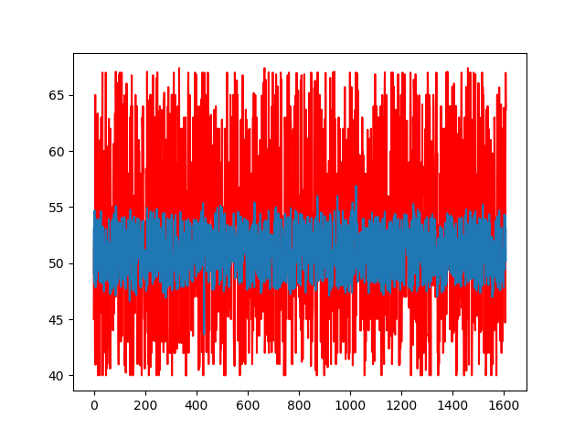
Cascade-Parallel-In-Parallel
R^2: 1.0000269535570292
MAPE: 12.180791973566283

Slide 12
Cascade-Parallel-In-Cascade
R^2: 1.0000262804778046
MAPE: 12.146127750373704

Slide 13
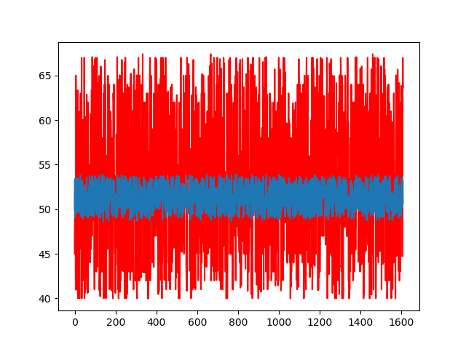
Parallel-Cascade-In-Cascade
R^2: 1.0000235698168043
MAPE: 12.21540831724789

Slide 14
Conclusion
Parallel Topology performance is superior than Cascade Topology.
Cascade–parallel-in-cascade topology performance is superior than Cascade–parallel in parallel.
No difference in accuracy between a Parallel–cascade-in-cascade connection and parallel–cascade-in-parallel topology.
Overall Cascade–parallel-in-cascade topology is superior to all different all mentioned topologies.
Parallel topology, which averages the output errors, improves the performance of the systems
Cascade topology accumulates the error from each training stage, improves the overall performance in the systems .

Slide 15
References
https://ieeexplore.ieee.org/document/7778265
https://en.wikipedia.org/wiki/Multilayer_perceptron
https://ieeexplore.ieee.org/document/6725869
N. Amjady and A. Daraeepour, “Mixed price and load forecasting of electricity markets by a new iterative prediction method,” Electr. PowerSyst. Res., vol. 79, no. 9, pp. 1329–1336, 2009.
Github Link :
https://github.com/GENU05/Electric-Price-Forcasting

Slide 16
Thank You

